Slide 1
Unclonable Secret Sharing
Prabhanjan Ananth, Vipul Goyal, Jiahui Liu, Qipeng Liu

Slide 2
No-Cloning Theorem
$$|ψ⟩$$
$$|ψ⟩$$
Cloning Machine
unknown quantum state
$$|ψ⟩$$

Slide 3
Classically Impossible Primitives
QKD [BB’84]
Quantum Money [Wiesner’69, AC’12, Zhandry’19…]
Quantum Copy-Protection [Aaronson’09, CLLZ’21 …]
Signature Token [BS’16, AGKZ’20, CLLZ’21]
Unclonable Encryption, Decryption [Gottesman’02, BL’19, GZ’20, CLLZ’21]
…

Slide 4
Unclonable version of secret sharing?
Never considered in literatures
Important applications
prevent cloud servers from copying your data
Classical solution (traceable secret sharing) only deters, does not prevent

Slide 5
Unclonable version of secret sharing?
Never considered in literatures
Important applications
prevent cloud servers from copying your data
Classical solution (traceable secret sharing) only deters, does not prevent
We propose the following question
Can we define and achieve unclonable secret sharing?

Slide 6
Talk Outlines
Definition of unclonable secret sharing (USS)
Implication to unclonable encryption and position verification
Negative and Positive Results

Slide 7
Unclonable Secret Sharing (2-party example): Correctness
Secret $s$
Share$\left(s\right)→ρ_{1}, ρ_{2}$
Share $ρ_{1}$
Share $ρ_{2}$
$$ρ_{\begin{aligned}1 \\ \end{aligned}}$$
$$ρ_{\begin{aligned}2 \\ \end{aligned}}$$
R$econstruct\left(ρ_{1}, ρ_{2}\right)→s$
$$s$$
$$s$$
Notes:
We have two algorithms: Share and Reconstruct

Slide 8
Unclonable Secret Sharing (2-party example): Unclonable Security
Secret $s$
Share $ρ_{1}$
Share $ρ_{2}$
$$σ_{\begin{aligned}1,2 \\ \end{aligned}}$$
$$σ_{\begin{aligned}2,1 \\ \end{aligned}}$$
$$σ_{\begin{aligned}1,1 \\ \end{aligned}}$$
$$σ_{\begin{aligned}2,1 \\ \end{aligned}}$$
$$s$$
$$s$$

Slide 9
Unclonable Secret Sharing ($k$-party): Unclonable Security
Secret $s$
$$ρ_{1}$$
$$ρ_{3}$$
$$ρ_{2}$$
Focus on 2->3
But can handle any bounded
$$s$$
$$s$$
$$Enc(pk, m;r_{1})$$

Slide 10
More General USS: $t$-out-of-$k$ collusion
Secret $s$
$$ρ_{1}$$
$$ρ_{2}$$
$$ρ_{3}$$
Focus on 2->3
But can handle any bounded
$$s$$
$$s$$
$$Enc(pk, m;r_{1})$$
Notes:
We also consider a more general setting of USS: where some subset of parties can collude and communicate.

Slide 11
USS: Additional Properties
Regular Secret-Sharing Soundness:
No $(n−1)$-size subset of parties can recover one-copy of secret
Unclonable Security: Computational vs. Information-theoretic
We consider both computational and IT unclonable security in our paper

Slide 12
USS: allow entanglement between parties
$$pk$$
Secret $s$
$$ρ_{1}$$
$$ρ_{2}$$
$$ρ_{3}$$
$$| ⟩$$
No communication
But entangled!
$$| ⟩$$
$$Enc(pk, m;r_{0})$$
Focus on 2->3
But can handle any bounded
$$Enc(pk, m;r_{2})$$
$$s$$
$$s$$
$$Enc(pk, m;r_{1})$$
Notes:
A natural factor to take into account is that the parties can share entanglement in their attack, even in the setting where we do not allow collusion.

Slide 13
USS: different entanglement between parties
Entanglement graph:
divide parties into disjoint
connected components
depending on entanglement
$$pk$$
Secret $s$
$USS_{k}: k$ disjoint components,
Inside component:
mutually entangled
$$ρ_{1}$$
$$ρ_{2}$$
$$ρ_{3}$$
$$| ⟩$$
$$| ⟩$$
$$Enc(pk, m;r_{0})$$
Focus on 2->3
But can handle any bounded
$$Enc(pk, m;r_{2})$$
$$s$$
$$s$$
$$Enc(pk, m;r_{1})$$
Notes:
for this talk, we will focus on the entanglement resources and how different entanglement between parties will lead to different levels of challenges in achieving unclonable security.

Slide 14
USS: allow entanglement between parties
Different entanglement graphs: the fewer components, the more secure the USS protocol is, but more difficult to prove
$USS_{k}$: easier to achieve when $k$ gets larger (more unentangled components)
$USS_{1}$: most challenging (all entangled)
Trivial implication: $USS_{1}→USS_{2}⋯→USS_{k}$

Slide 15
Application 1: Unclonable Encryption
Secret $s$
$$|Enc(m)⟩$$
Alice
$$ρ_{1}$$
$$ρ_{2}$$
$$Enc(pk, m;r_{1})$$
Bob
Charlie
$$Enc(pk, m;r_{0})$$
$$m$$
$$m$$
Notes:
Unclonable encryption is an important notion in unclonable cryptography:
The scheme encodes a message in

Slide 16
Application 1: Unclonable Encryption
UE implies 2-out-of-2 $USS_{2}$
Two parties; no entanglement, information-theoretic
$USS_{1}$ implies UE:
with entanglement, information-theoretic
Reverse direction does NOT hold in IT setting
2-out-of-2

Slide 17
Application 2: Quantum Position Verification
I am at 0.5.
$$|x^{θ}⟩$$
$$θ$$
$$x$$
$$x$$
$USS_{1}$ implies Position verification (against entangled adversaries)
Notes:
Another application is position verification using quantum information.
It is a useful primitive where verifiers can verify if a prover is at a location it claims to be at.

Slide 18
Negative Result 1: Fully-IT $USS_{1}$ impossible
If all parties have unbounded entanglement & computation & memory resources: $USS_{1}$ is impossible!
General Attack using:
Port-based teleportation + Standard teleportation
Require entanglement/computation/memory all be exponentially large

Slide 19
Positive Result 1: $USS_{ω(logλ)}$ , IT-secure
Share($m$):
Classically share $m$ into $(k−1)$ classical shares, $k= ω(log λ)$
Encode each share into BB84 states (conjugate coding) with random basis
The $k$-th share is the basis information
Reconstruct:
Recover all classical shares by measuring the first $(k−1)$ shares under basis given in $k$-th share
Recover $m$ from classical shares
Notes:
In correspondence to our 1 st negative, we present a positive result where the parties are unentangled and we can achieve IT-security.

Slide 20
Positive Result 1: $USS_{ω(logλ)}$ , IT-secure
Share($m$):
Classically share $m$ into $(k−1)$classical shares, $k= ω(log λ)$
Encode each share into BB84 states (conjugate coding) with random basis
The $k$-th share is the basis information
Reconstruct:
Recover all classical shares by measuring the first $(k−1)$ shares under basis given in $k$-th share
Recover $m$ from classical shares (XOR-ing them)
Proof: (New) XOR repetition lemma of cloning BB84 states
Has to XOR all classical secrets in each state together to learn $m$
Notes:
To prove the security of the scheme, we give a new XOR repetition lemma for cloning BB84 states.
By sharing the secret in k-1 BB84 states such that one has to XOR all classical secrets in each state together to learn anything about m , we ensure that the adversary’s advantage is negligible.

Slide 21
Negative Result 2: Low-T count Reconstruct $USS_{1}$ impossible
T gate is one of the gate in the universal quantum gate set
Essential for achieving universal quantum computation
A quantum circuit without T gates can be classically simulated
A key quantum resource
If honest Reconstruct algorithm has only $Ο(log λ)$ T-gates:
$USS_{1}$ (fully entangled, efficient adversaries) is impossible!
Gate teleportation tricks

Slide 22
Positive Result 2: $USS_{1}$ in QROM
Unclonable encryption + Quantum Random Oracle Model $→$ $USS_{1}$
(k-party, fully entangled, query-bounded adversaries)
High-level Idea:
Reconstruct requires using random oracle
Random functions are “high T-depth” and computationally-hard to evaluate in teleportation attacks
Reprogram random oracle “before” adversaries can access this information
Notes:
Complementing our 2nd negative result, we present another positive result where if we use a high-T gate circuit in the Reconstruct algorithm, we can avoid the previous attack.

Slide 23
Thank you!

Slide 24
Outline (for Jiahui Qipeng only)
Classically impossible primitives
No study on secret sharing
Propose the question – unclonable secret sharing
Also, secret sharing can be viewed as weaken unclonable encryption (which is hard to build), may provide some insights

Slide 25
Application 2: Position verification
$USS_{1}$ implies Position verification (against entangled adversaries):

Slide 26
Outline (for Jiahui Qipeng only)
Formal definition of unclonable secret sharing
Distinguish how much entangled is shared between parties
Positive: Theorem 1.1, USS IT secure against polynomial amount of entanglement implies UE
Negative: Theorem 1.2, Unbounded entanglement/time/communication is impossible
Thus, we give the formal definition, characterized by entanglement (connected-component-based) USS_d

Slide 27
Outline (for Jiahui Qipeng only)
Our work part 1, bridge UE with USS
Theorem 1.2, USS_2 is implied by UE
USS_{omega(log lambda)} exists unconditionally
Construction
Proof (an XOR lemma for BB84 states against unentangled strategies)
Conclude by the Figure 1 in the paper
Mention the connections with PV, and a final conclusion maybe .. (TBD)

Slide 28
Previous Results (standard model only)
 | Unclonable Decryption | Copy-Protection PRF | Unclonable Signing Key
Subspace States | VBB [GZ’20] | Not known | Not known
Coset States | iO + OWF [CLLZ’21] | iO + OWF [CLLZ’21] | Not known
Not Collusion-Resistant!

Slide 29
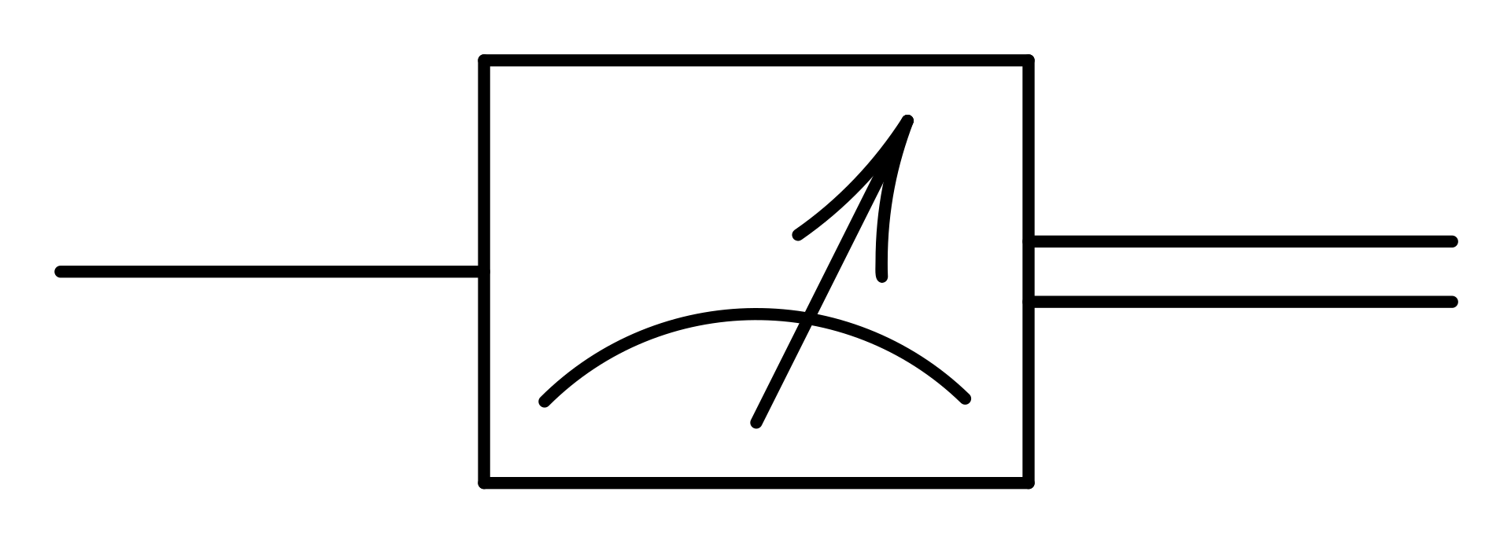
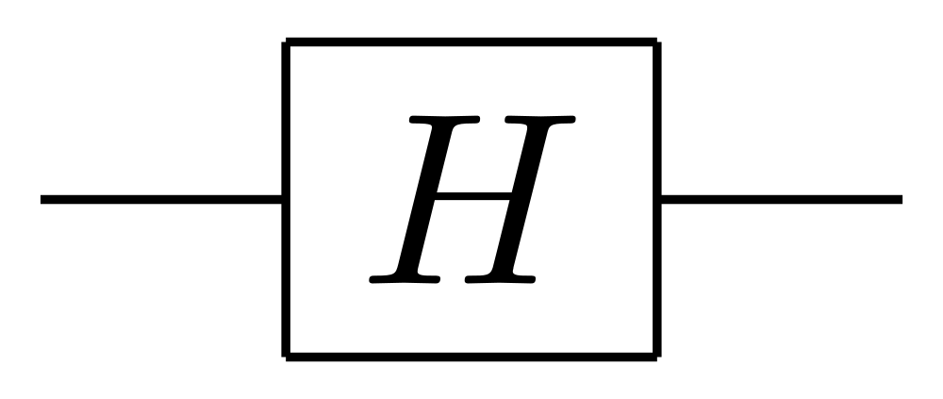
Subspace States [Aaronson-Christiano’12]
$$|A⟩$$
Hidden subspace state for some unknown space $A$
Let $P_{A}$, $P_{A^{⊥}}$ be the membership checking programs for $A$ and $A^{⊥}$
Definition: $\left|A\right\rangle ∝\sum_{a∈A}{|a⟩}$
$$|A⟩$$
$$v∈A$$
$$|A⟩$$
$$u∈A^{⊥}$$
$$\dim\left(A\right)=\dim\left(A^{⊥}\right)=λ/2$$

Slide 30
$$m_{0},m_{1}$$
filling
to

Slide 31
Coset States
Direct-Product Hardness [This Work]:
No (query-bounded) quantum algorithm :
Subspace states:
$P_{A+s},P_{A^{⊥}+s′}$
$$|A_{s,s′}⟩$$
$$u, v∈\left(A+s\right)×{(A}^{⊥}+s′)$$
$P_{A},P_{A^{⊥}}$
$$|A⟩$$
$$u, v∈A\backslash \{0\}×A^{⊥}\backslash \{0\}$$
Notes:
Coset states satisfy the direct product hardness property.
It says for any query bounded quantum algorithm, given a single copy of a coset state,
even it gets oracle access to both membership checking oracles,
It can not find two vectors in both cosets.
[NEXT]
For subspace states, we do not allow an algorithm to find 0 vectors. We do not have such a requirement for coset states.
Because you can think of 0 vectors are now replaced with s and s’, which are now also secret.
Thus, finding s or s’ is also hard in our case and direct-product hardness still holds if we do not put such a constraint.
[NEXT]
So, the direct-product hardness of coset states naturally gives a construction of signature tokens, but still relative to classical oracles.

Slide 32
Computational Direct-Product Hardness
No QPT algorithm :
$$|A_{s,s′}⟩$$
$$,iO\left(P_{A+s}\right), iO\left(P_{A^{⊥}+s′}\right)$$
$$u, v∈\left(A+s\right)×{(A}^{⊥}+s′)$$
Notes:
Next, we show that by replacing VBB obfuscation or classical oracles with iO, we can achieve the direct-product hardness in the plain model.
It then naturally gives the construction of signature tokens in the plain model.
[NEXT]
Formally, we want to prove the following security:
There is not efficient quantum algorithm that given a coset state and two iO of membership checking programs, can produce vectors in both cosets.

