Slide 1
Improved Quantum Lifting
by Coherent Measure-and-Reprogram
Alexandru Cojocaru Juan Garay Qipeng Liu Fang Song
University of Edinburgh
Texas A&M University
UC San Diego
Portland State University
Asiacrypt 2024

Slide 2
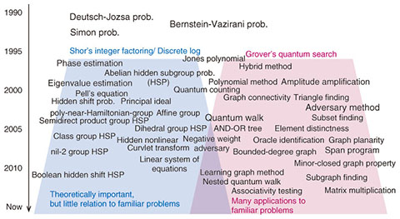
Quantum Query Algorithms
Quantum Algorithms
Numerous known algorithms are query algorithms;
Quantum and Post-Quantum Cryptography
Study query complexity of certain problems implies (post-)quantum security of cryptosystems
Allows lower bounds on # resources required solve problem

Slide 3
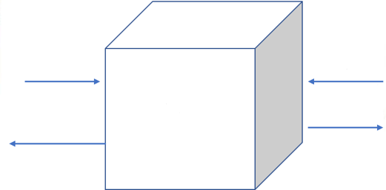
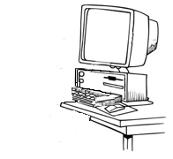
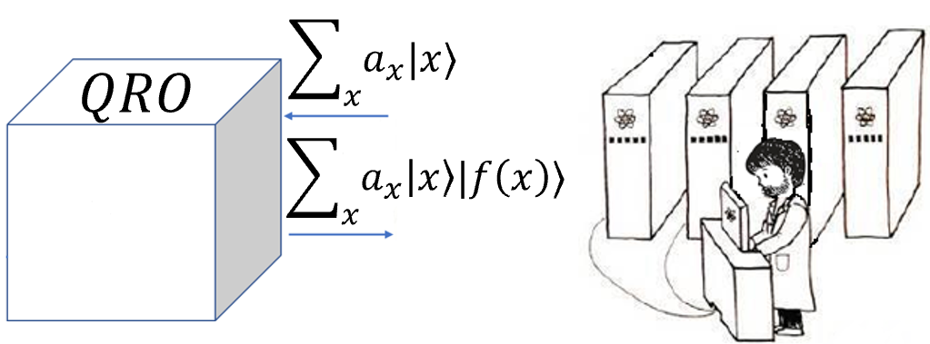
Query Model
Query Model - elegant abstraction adopted Cryptography & Complexity Theory
Random Oracle Model (ROM)
Numerous cryptosystems designed & analyzed in ROM
Query algorithm solves problem querying $f$
Complexity of Algorithm = # queries to $f$;
$$RO$$
$$x$$
$$y$$
Random
black-box
function $f$
$$f(x)$$
$$f(y)$$
Quantum computing: new query model $→$ Quantum Random Oracle:
Superposition Queries to $f$ permitted
Equips quantum parties and quantum algorithms with new capabilities;
Random
black-box
function $f$
Notes:
today we are going to work in this query model, which is

Slide 4
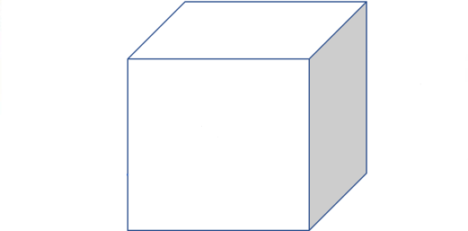
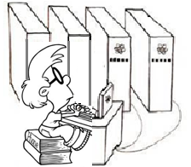
Lifting Theorem in QROM
Focus on Lifting Theorems for Security (Search) Games in Quantum Random Oracle Model
Search Game
$$f$$
$q$ quantum queries
$k$ classical queries
$$Adversary A$$
$Challenger$ $C$
$$Accept or Reject$$
Notes:
Our main results focus on Lifting Theorems in QROM that allow us to stufdu the securitry of general search game. More precisely,

Slide 5
Lifting Theorem in QROM
$$f$$
$q$ quantum queries
$k$ classical queries
Introduced by Yamaka and Zhandry [Eurocrypt’21], as a tool to lift security from ROM to QROM
Informally: If a search game with a challenger performing a constant number of queries to the random oracle is hard against a classical adversary,
then it is also hard against a quantum adversary (in QROM).
Specifically, if $C$makes 𝑘 queries and
$A$makes 𝑞 quantum queries and wins Game with probability 𝜖,
then exists classical algorithm $B$ performing only 𝑘 classical queries
winning with probability $ε/{\left(2q + 1\right)}^{2k}$.
$$Adversary A$$
$Challenger$ $C$
$$Accept or Reject$$

Slide 6
Lifting Theorem in QROM
$$f$$
$q$ classical queries
$k$ classical queries
$Adversary$ $A$
$Challenger$ $C$
$$Accept or Reject$$
Main Result: Quantum Lifting Theorem. Let $k$number of $C$’s classical queries.
Then for any QPT $A$making $q$ quantum queries, there exists a QPT $B$ making $k$ quantum queries s.t.:
$\operatorname{Pr}\left[<A, C> →Accept\right]≤2^{2k}{\left({q+k \atop k}\right)}^{2}\operatorname{Pr}\left[<B,C> →Accept\right]$

Slide 7
Main Result
Generalize and improve tool for lifting security from ROM to QROM of Yamakawa-Zhandry (YZ).
Our Lifting Thms applicable to Search Games defined as:
$A$ receives challenge from $C$;
$A$ respond with 𝑘-tuple {$z_{1}$, …, $z_{k}$}
If 𝑘-tuple satisfies some relation 𝑅 specified by Game, we say $A$ wins.
Example Function Inversion: adversary aims to find a preimage of 0 for a RO $H$, with $C$ querying RO to verify $A$’s answer
Recall, (Quantum) Lifting Theorem. Let $k$number of $C$’s (classical) queries.
Then for any QPT $A$making $q$ quantum queries, there exists a QPT $B$ making $k$ quantum queries s.t.:
Ours: $\operatorname{Pr}\left[<A, C> →Accept\right]≤2^{2k}{\left({q+k \atop k}\right)}^{2} \operatorname{Pr}\left[<B, C> →Accept\right]$
YZ: $\operatorname{Pr}\left[<A, C> →Accept\right] ≤$ ${\left(2q + 1\right)}^{2k} \operatorname{Pr}\left[<B, C> →Accept\right]$
Our improved lifting theorem reduces loss by factor of ${\left(k!\right)}^{2}$
Enables exploring tighter/new results, e.g. non-uniform security, multi-instance security and Direct Product Thms

Slide 8
Example: Function Inversion
Problem 1: Adversary finds a preimage of 0 in the random oracle 𝐻 : [𝑀] → [𝑁]
while, Challenger queries RO to verify $A$’s answer.
For Function Inversion, 𝑘 = 1 and $\frac{ε}{{\left(2q+1\right)}^{2}}≤\frac{1}{N}$
$⇒ ε ≤ {\left(2q + 1\right)}^{2}/N$ -- tight bound for Grover’s search
Problem 2. For 𝑘-Function Inversion: find 𝑘 distinct inputs $x_{1}, …, x_{k}$ s.t. $H\left(x_{1}\right)= …=H\left(x_{k}\right)=0$
YZ bound is $O{\left({\left(kT\right)}^{2}/N\right)}^{k}$ for any quantum algorithm with 𝑞 = 𝑘𝑇 queries,
which has a large $k^{2k}$ factor gap from tight bound $Θ{\left(T^{2}/N\right)}^{k}$
Our Bound is Tight:
$$\frac{ε}{2^{2k}{\left({kT+k \atop k}\right)}^{2}}≤\frac{1}{N^{k}} ⇒ ε≤O{\left(\frac{T^{2}}{N}\right)}^{k}$$
YZ Lifting: If $C$makes 𝑘 queries and $A$makes 𝑞 quantum queries and wins Game with probability 𝜖,
then exists classical algorithm $B$ performing only 𝑘 classical queries
winning with probability $ε/{\left(2q + 1\right)}^{2k}$.
Our Lifting: If $C$makes 𝑘 queries and $A$makes 𝑞 quantum queries and wins Game with probability 𝜖,
then exists quantum algorithm $B$ performing only 𝑘 quantum queries
winning with probability $ε/2^{2k}{\left({kT+k \atop k}\right)}^{2}$.
Notes:
as using single query one finds pre-image of 0 with probability 1/𝑁

Slide 9
Quantum Security and Complexity by Classical Reasoning
Relying on Lifting Thm prove quantum security and complexity results by pure classical reasoning
Show for an Alg $B$ makes exactly 𝑘 quantum queries, success probability of $B$ is upper bounded by 𝑝(𝑅), 𝑅 is winning relation specified by game:
$$p\left(R\right)=\operatorname{Pr}\left[exists a permutation π \right| \left(y_{π\left(1\right)},y_{π\left(2\right)},…y_{π\left(k\right)}\right)∈R :\left(y_{1},…, y_{k}\right) unif sampled]$$
𝑝(𝑅) depends solely on game - can be calculated with only classical reasoning
Quantum Lifting Theorem with Classical Reasoning. For any q. algorithm $A$ with 𝑞 quantum queries $A$`s success probabilities in game $G$ is at most:
$$\operatorname{Pr}\left[A wins G\right]≤2^{2k}{\left({q+k \atop k}\right)}^{2}⋅p(R)$$
Notes:
Min 10

Slide 10
Applications
Advantage: reduces to solely classical reasoning by calculating combinatorial quantity p(R).
Cryptographic and Complexity-Th Applications:
The quantum security of cryptographic tasks:
multiple-instance function inversion or collision-resistance,
salted security
non-uniform security
First Direct Product Theorems (DPT) in average case (in QROM), in quantum setting
Previously, only worst-case quantum DPTs were known.

Slide 11
Applications: DPT, Non-Uniform Security, Salting
Direct Product Thm establish hardness of solving 𝑔 independent instances (each with independent oracle) of game $G$ given total of 𝑔 · 𝑞 quantum queries
Direct Product Thm. For any quantum algorithm $A$ equipped with 𝑔 · 𝑞 quantum queries,
$A$’s success probability to solve the Direct Product game $G^{⊗g}$ given by $G$ with relation $R$:
$\operatorname{Pr}\left[A wins G^{⊗g}\right]≤{\left(2^{2k}{\left({q+k \atop k}\right)}^{2}p\left(R\right)\right)}^{g}$
DPT directly imply non-uniform security of salting:
Non-uniform: parties do heavy computation offline to use it to attack protocols.
Salting: method prevents non-uniform attacks against hash functions.
Salting Defeats Quantum Preprocessing: Any non-uniform quantum alg $A$ with 𝑞 quantum queries and 𝑆-bit of classical advice,
$A$’s success probability to solve salted game $G$:
$$\operatorname{Pr}\left[A wins salted G\right]≤\frac{4S}{K} +{\left(O\left(\frac{q^{2}}{k^{2}}+\frac{c}{k}\right)\right)}^{k}p(R)$$

Slide 12
Applications: Multi-Image Inversion,
Multi-Collision Finding, Multi-Search, 3SUM
Lifting Thm can be applied to derive quantum security of cryptographic tasks:
Example 1: Hardness of Multi-Image Inversion: invert 𝑘 different images of RO 𝐻 : [𝑀] → [𝑁]
tight bound (already known, but shown in a much simpler way)
For any distinct $y = (y_{1}, …, y_{k}) ∈{\left[N\right]}^{k}$ and for any 𝑞-quantum query algorithm $A$ invert all images in $y$ :
$$\underset{H}{Pr}\left[A\left(y\right)→ x = \left(x_{1}, …, x_{k}\right): H\left(x_{i}\right)= y_{i} ∀i ∈ \left[k\right]\right]≤ 2^{2k}{\left({q+k \atop k}\right)}^{2}⋅\frac{k!}{N^{k}}$$
Example 2: Multi-Collision Finding : find 𝑘 inputs that map to same image of RO $H : [M ] → [N]$
For any 𝑞-quantum query algorithm $A$, the probability of solving 𝑘-multi-collision:
$$\underset{H}{Pr}[A() → x = (x_{1}, …, x_{k}) : H(x_{1}) = … = H(x_{k})] ≤\frac{1}{N^{k −1}}{\left[\frac{2e\left(q+k\right)}{k}\right]}^{2k}$$

Slide 13
Applications: Multi-Image Inversion,
Multi-Collision Finding, Multi-Search, 3SUM
Lifting Thm can be applied to derive quantum security of cryptographic tasks:
Example 3: Multi-Search tight bound for finding 𝑘 distinct inputs all map to 0 (useful in proofs-of-work)
For any 𝑞-quantum query algorithm $A$:
$$\underset{H}{Pr}\left[A() → x = \left(x_{1}, …, x_{k}\right): H\left(x_{i}\right)= 0 ∀i ∈ \left[k\right]\right]≤{\left[\frac{4e^{2}{\left(q+k\right)}^{2}}{Nk^{2}}\right]}^{k}$$
Lifting Thm can be applied for quantum hardness of problems in computational complexity theory:
Example 4: Hardness of 3SUM: Algorithm finds 3 inputs mapped by a RO $H : [M] → \{−N, …, 0, …, N\}$ to 3 images sum up to 0
For any 𝑞-quantum query algorithm $A$, success probability of $A$ to solve the 3SUM problem :
$$\underset{H}{Pr} [A()→ x = (x_{1}, x_{2}, x_{3}) : H(x_{1}) + H(x_{2}) + H(x_{3}) = 0] ≤ O\left({\left(q^{2}+c\right)}^{3}⋅\frac{1}{N}\right)$$
Notes:
Finished at minute 17

Slide 14
Coherent Reprogramming
Coherent Reprogramming - Novel Measure-and-Reprogram technique
Improves adaptive reprogramming QRO on multiple points by Don et al. [DFM20, DFMS22] (DFMS)
Yields tighter reprogramming bounds
DFMS: when carefully measuring 𝑘 out of 𝑞 quantum queries of a quantum algorithm
these 𝑘 measurement outcomes will correspond to the final output of the algorithm
with a multiplicative loss ${\left(2q + 1\right)}^{k}$
Our Approach: Instead of directly measuring the algorithms queries one by one,
put them into a separate register, a.k.a., measure the queries coherently.
With the help of a “controlled reprogrammed oracle query”,
can progressively reprogram oracle and run algorithm with updated oracle.
Gain: Since we only measure all reprogrammed inputs as an unordered set at the end,
rather than measuring their order (as DFMS)
we achieve a reduction in loss by a factor of ${\left(k!\right)}^{2}$.
The ability to coherently measure and reprogram is key to all improvements.
Notes:
At a high level, our simulator resembles DFMS;
Intuitively,

Slide 15
Coherent Reprogramming: Background
Reprogrammed Oracle. Reprogram oracle $H$ to output $y$ on input $x$, results in the new oracle, defined as:
$H_{x, y}\left(z\right)=\left\{\begin{aligned}y \text{, } \text{if} z=x \\ H\left(z\right) \text{, }\text{otherwise}\text{.}\end{aligned}\right.$
Similarly define a multi-input reprogram oracle $H_{\vec{x},\vec{y}}$ for$\vec{x}∈X^{k}$ without duplicates and $\vec{y} ∈Y^{k}$:
$H_{\vec{x},\vec{y}} \left(z\right)=\left\{\begin{aligned}y_{i}\text{, }\text{if} z=x_{i} \\ H\left(z\right), \text{otherwise}\text{.}\end{aligned}\right.$
Controlled Reprogrammed Oracle Query: an oracle query will be reprogrammed by a list of input and output pairs in a control register.
For every $a, b$and any $\vec{x} ,\vec{y}$, controlled reprogrammed oracle $O_{H}^{ctrl}$ acts as:
$$O_{H}^{ctrl} |a⟩ |b⟩ |\vec{x},\vec{y}⟩ =(O_{H_{\vec{x},\vec{y}}}|a⟩ |b⟩) |\vec{x},\vec{y}⟩$$

Slide 16
Coherent Reprogramming
Coherent Reprogramming Theorem
$H, G$ be two random oracles
$A$ be any $q$-quantum query algorithm to oracle $H$
$\vec{x_{o}}= \left(x_{1}, …, x_{k}\right)∈ X^{k}$ be any $k$-vector of inputs and $\vec{y_{o}}= (y_{1}, …, y_{k}) = (G(x_{1}), …, G(x_{k}))$.
Then $∃$ simulator $Sim$ that given oracle access to $H, G$ and $A$, simulates output of $A$ having oracle access to $H_{\vec{x_{o}},\vec{y_{o}}}$ with probability:
$$\underset{H, G}{Pr} [Sim outputs correct solution]$$
$≥\frac{1}{2^{2k }{\left({q+k \atop k}\right)}^{2}} ⋅\underset{H, G}{Pr} [A^{H_{\vec{x_{o}},\vec{y_{o}}}} outputs correct solution]$
where correct is defined wrt predicate that can depend on reprogrammed oracle $H_{\vec{x_{o}},\vec{y_{o}}}$.
Similarly to the comparison between our lifting theorem and YZ lifting, Coherent Reprogramming improves DFMS by a factor of ${\left(k!\right)}^{2}$.

Slide 17
Coherent Measure-and-Reprogram Experiment
Let $A$ $q$-quantum query algorithm.
Coherent Measure-and-Reprogram $Sim^{H, G}$:
Pick uniformly random subset$\vec{v}$of $[q+k]$ of length $k$. ---- which queries should be reprogrammed
Pick$\vec{b}∈ \{0,1\}^{k}$ uniformly at random. ---- reprogram before or after the query
Run $A$ with an additional control register $R$. Consider operation $U$ updates control register: for $x∉L$, $U \left|x\right\rangle {\left|L\right\rangle }_{R}→\left|x\right\rangle {\left|L∪\left(x, G\left(x\right)\right)\right\rangle }_{R}$
When $A$ makes its $i$-th query:
If $i = v_{j}$ for some $j∈ [k]$, do either of the following:
If $b_{j}=0$, first update $R$ and then make $i$-th query to $H$ (controlled by $R$)
If $b_{j}=1$, first make $i$-th query to $H$ and then update $R$
Else answer $A$'s $i$-th query;
Let $(\vec{x},\vec{y})$ be $A$'s output;
Measure $R$ register to obtain $L = (\vec{x′},\vec{y′})$.
Output $(\vec{x},\vec{y})$ if$\vec{x′}≡\vec{x}$; otherwise, abort.
---- instead of measuring $A$'s queries, put it into separate register
---- Controlled reprogrammed oracle query
---- allows progressively reprogram oracle and
---- run algorithm with updated oracle

Slide 18
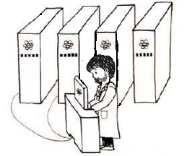
Summary & Future Directions
In a follow-up work we showed these results also extend in the NISQ hybrid setting, i.e. algorithms/adversaries equipped with classical and quantum queries;
- Extend to other NISQ setting;
2. Tighter Lifting Thms for other optimal security and complexity results;
3. Extend results to general interactive search games;
Thank You!
Notes:
26 minutes / 25 mins / 23 mins

Slide 19
Relation between $A$and $Sim$:
Decompose $A$’s final state
Decompose $A$after making 1st query to $H_{\vec{x},\vec{y}}$ s.t. each component corresponds to one of the cases in $Sim$:
$O_{H_{\vec{x},\vec{y}}}U_{1} |0⟩$ $=O_{H_{\vec{x},\vec{y}}} I U_{1}|0⟩$
$=O_{H_{\vec{x},\vec{y}}}\left(I − \sum_{x_{j}}{\left|x_{j}\right\rangle \left\langle x_{j}\right|}+\sum_{x_{j}}{\left|x_{j}\right\rangle \left\langle x_{j}\right|}\right) U_{1}|0⟩$
$=O_{H_{\vec{x},\vec{y}}} \left(I − \sum_{x_{j}}{\left|x_{j}\right\rangle \left\langle x_{j}\right|}\right) U_{1}\left|0\right\rangle +O_{H_{\vec{x},\vec{y}}} \left(\sum_{x_{j}}{\left|x_{j}\right\rangle \left\langle x_{j}\right|}\right) U_{1}|0⟩$
${= O}_{H}\left(I − \sum_{x_{j}}{\left|x_{j}\right\rangle \left\langle x_{j}\right|}\right)U_{1}\left|0\right\rangle +\sum_{x_{j}}{ O_{H_{x_{j}, y_{j}}} \left|x_{j}\right\rangle \left\langle x_{j}\right| U_{1}|0⟩}$
$= \underset{1}{\underbrace{O_{H} U_{1}|0⟩}} −\sum_{x_{j}}{\underset{2}{\underbrace{O_{H}\left|x_{j}\right\rangle \left\langle x_{j}\right|U_{1}|0⟩}}} +\sum_{x_{j}}{\underset{3}{\underbrace{O_{H_{x_{j}, y_{j}}}\left|x_{j}\right\rangle \left\langle x_{j}\right|U_{1}|0⟩}}}$
(1) $O_{H} U_{1}|0⟩$ corresponds: no measurement happens for 1st query
(2) $O_{H}\left|x_{j}\right\rangle \left\langle x_{j}\right|U_{1}|0⟩$ corresponds: measurement is made at 1st query and query input is $x_{j}.$ Also, oracle is not reprogrammed immediately. This is the case $(v_{1}, b_{1}) = (1, 1)$ in $Sim$
(3) $O_{H_{x_{j}, y_{j}}}\left|x_{j}\right\rangle \left\langle x_{j}\right|U_{1}|0⟩$ corresponds: measurement is made at 1st query and query input is $x_{j}$; Also, oracle is reprogrammed immediately and used for 1st query. This is the case $(v_{1}, b_{1}) = \left(1, 0\right)$in $Sim$
If query input is not in $\vec{x}$, $H_{\vec{x},\vec{y}}$ is functionally equivalent to $H$
If query input is $x_{j}$, $H_{\vec{x},\vec{y}}$is functionally equivalent to $H_{x_{j}, y_{j}}$

Slide 20
Coherent Measure-and-Reprogram Experiment
$A$ $q+k$-quantum query algorithm outputs $\vec{x}∈X^{k} and \vec{y}∈ Y^{k}$. Assume$\vec{ y}$is computed as $H(\vec{x})$ using last $k$ queries.
Coherent Measure-and-Reprogram $Sim^{H, G}$:
Pick a uniformly random subset$\vec{v}$of $[q+k]$ of length $k$. ---- which queries should be reprogrammed
Pick$\vec{b}∈ \{0,1\}^{k}$ uniformly at random. ---- reprogram before or after the query
Run $A$ with an additional control register $R$, initialized as $∅$. Define operation $U$ updating control register: for $x∉L$, $U \left|x\right\rangle {\left|L\right\rangle }_{R}→\left|x\right\rangle {\left|L∪\left(x, G\left(x\right)\right)\right\rangle }_{R}$ $L$ is set of input-output pairs. As only work with basis states $\left|x\right\rangle |L⟩$ whose $x∉L$, $U$ clearly can be implemented by a unitary
When $A$ makes its $i$-th query:
If $i = v_{j}$ for some $j∈ [k]$, do either of the following:
If $b_{j}=0$, update $R$ using the input register and $G$, and make the $i$-th query to $H$ controlled by $R$ -- using $O_{H}^{ctrl}$;
If $b_{j} =1$, make the $i$-th query to $H$ controlled by $R$ and update $R$ using the input register and $G$.
Before updating the control register, it checks coherently that the input register is not contained in the control register; otherwise, it aborts.
Else, answer $A$'s $i$-th query controlled by $R$;
Let $(\vec{x},\vec{y})$ be $A$'s output;
Measure $R$ register to obtain $L = (\vec{x′},\vec{y′})$.
Output $(\vec{x},\vec{y})$ if$\vec{x′}≡\vec{x}$; otherwise, abort.

Slide 21
Coherent Measure-and-Reprogram: Analysis of Simulator
Compared to DFMS: instead of measuring $A$'s queries, we put it into a separate register
a.k.a., measure queries coherently
Using controlled reprogrammed oracle query - are still able to progressively reprogram oracle and
run algorithm with updated oracle
High-Level Analysis:
Decompose $A$’s final state after performing all queries, based on: (i) when measurements take place and (ii) whether queries are made before or after measure-and-reprogram operations;
Take into account final $k$ classical queries that will be performed by $A$ to generate output $(x, H(x))$;
Apply Verification Projectors on each of these states results in a decomposition where we can fix inputs appearing in the measure-and-reprogram of quantum queries;
Express each terms in this decomposition to a behaviour of $Sim$ in Coherent Measure-and-Reprogram.

