Slide 1
On the Complexity of Cryptographic Groups and Generic Group Models
Keyu Ji^{1,2} Cong Zhang^{1,2} Taiyu Wang^{1,2} Bingsheng Zhang^{1,2}
Hong-Sheng Zhou³ Xin Wang⁴ Kui Ren^{1,2}
¹ Zhejiang University
² Hangzhou High-Tech Zone (Binjiang) Blockchain and Data Security Research Institute
³ Virginia Commonwealth University
⁴ Ant Group
Notes:
Hi everyone. This is Keyu Ji, a phd student from Zhejiang University. Today I’d like to present our work titled On the Complexity of Cryptographic Groups and Generic Group Models. This is a joint work with Cong Zhang, Taiyu Wang, Bingsheng Zhang, Hong-Sheng Zhou, Xin Wang, and Kui Ren.

Slide 2
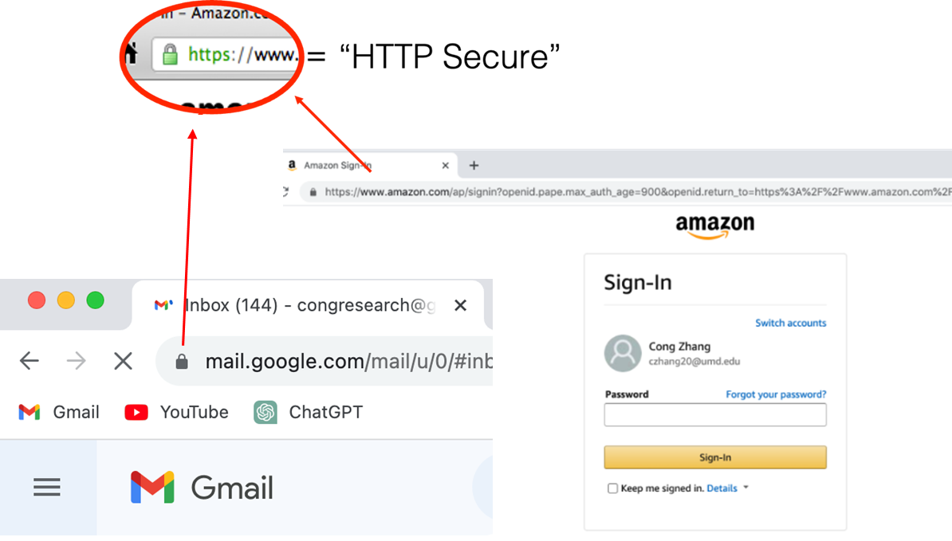
Where do we use cryptography technology in our daily life?
Cryptography is everywhere!
Http Secure
Hash and Signature
End to End Encryption
Notes:
Let’s begin with three questions. The first question is where do we use crypto in daily life.
Of course, we use cryptography everywhere.

Slide 3
How could we implement these cryptographic tools?
Typically, cryptographic groups
Hmm.., show some examples
Diffie-Hellman key exchange
in TLS 1.3
DHIES/ECIES encryption scheme
Cryptographic
Group
Schnorr signature
for blockchain
Pedersen Commitment
For ZK
Notes:
The next question is how we implement these crypto tools.
Typically, we implement them by cryptographic groups. For example, Diffie-Hellman key exchange, Schnorr signature and so on.

Slide 4
How to justify the security of group-based cryptosystems?
Usually, the black-box reduction
Prove: If X holds, then Y(X) is secure
Group-based cryptosystem
Cryptographic group
Cryptographic groups are typically treated as an collection
e.g. Encryption
Signature
Zero-knowledge
MPC
…
e.g. Dlog
CDH
DDH
…
Some inherent properties of cryptographic groups might be overlooked
Complex Y
Primitive X
Notes:
This is the last question, how do we justify the security of group-based cryptosystems.
We usually use black-box reduction. It likes a bridge between the cryptographic group and the group-based cryptosystem.
We note that, when using the cryptographic group in such black-box manner, some inherent properties might be overlooked.
In this work, we focus on an inherent property, the encoding length, of the cryptographic group.

Slide 5
Diving In
Notes:
In this work, we focus on an inherent property, the encoding length, of the cryptographic group.

Slide 6
Outline
Motivation
Longer encodings shorter encodings for groups
Longer encodings shorter encodings in GGM
Conclusion
Notes:
Firstly, I will talk about our motivation. (2 page)

Slide 7
Outline
Motivation
Longer encodings shorter encodings for groups
Longer encodings shorter encodings in GGM
Conclusion

Slide 8
Observation
$$pk=g^{x}$$
El Gamal Encryption
$$g^{r},{pk}^{r}⋅m$$
$$sk=x$$
Notes:
Let’s see the ElGamal encryption.

Slide 9
Observation
$$pk=g^{x}$$
El Gamal Encryption
$$g^{r},{pk}^{r}⋅m$$
$$sk=x$$
black-box
In the literature
Any group in which
DDH assumption holds
IND-CPA for
El Gamal encryption
Notes:
In the literature, it is CPA secure with respect to any DDH-secure group. The bit-length of a group element is not considered

Slide 10
Observation
$$pk=g^{x}$$
El Gamal Encryption
$$g^{r},{pk}^{r}⋅m$$
$$sk=x$$
black-box
In the literature
Any group in which
DDH assumption holds
IND-CPA for
El Gamal encryption
For 128-bit security
In practice
$ℤ_{p}^{∗}$ for prime $p$: the typical bit-length of a group element is 3072
Curve 25519: the typical bit-length of a group element is 255
Notes:
However, in practice, for better efficiency, we typically prefer concrete groups with shorter element encodings, like curve.
Hereby, we ask a question: Does the length of the group encoding matter when using it in a black-box manner? Our study of this question will bring the research community a better understanding of the cryptographic groups, from the perspective of the black-box reduction/separation.

Slide 11
Length Matter for Groups
Cryptographic Groups
Does the length of the group encoding matter when using it in a black-box manner
Groups with longer encodings
Groups with shorter encodings
Notes:
Hereby, we ask a question: Does the length of the group encoding matter when using it in a black-box manner?
It’s like Collision Resistant Hash Function is black-box separated from the CPA secure PKE;

Slide 12
Length Matter for Groups
Cryptographic Groups
Does the length of the group encoding matter when using it in a black-box manner
Groups with longer encodings
Groups with shorter encodings
Public Key Encryption
CRHFs are black-box separated from the IND-CPA secure PKE
Collision Resistant
Hash Function
[Asharov-Segev, FOCS’ 15]
Notes:
It’s like Collision Resistant Hash Function is black-box separated from the CPA secure PKE;
But it can be black-box reduced to homomorphic encryption.

Slide 13
Length Matter for Groups
Cryptographic Groups
Does the length of the group encoding matter when using it in a black-box manner
Groups with longer encodings
Groups with shorter encodings
Public Key Encryption
CRHFs are black-box separated from the IND-CPA secure PKE
Homomorphic Encryption
Collision Resistant
Hash Function
[Asharov-Segev, FOCS’ 15]
CRHFs can be black-box reduced to Homomorphic Encryption
[Ishai et al., TCC’ 05]
Notes:
But it can be black-box reduced to homomorphic encryption.

Slide 14
Length Matter for Groups
Cryptographic Groups
Does the length of the group encoding matter when using it in a black-box manner
Groups with longer encodings
Groups with shorter encodings
Intuitively,
What about
If TRUE, the length of the group encoding does not matter.
If FALSE, “the length matters” should be reinterpret !!!
Notes:
Come back to our question. Intuitively, it is easy to build a longer group from a shorter group by padding. However, what about building a shorter group from a longer group? If we can do it, the length of the group encoding does not matter. We will be super happy to see that. If it is impossible, “the length matters” should be reinterpret. Unfortunately, we prove the impossibility.

Slide 15
Our Main Result
Theorem: Given any arbitrary longer group, it is impossible to generically shorten the group encoding and obtain a shorter group within the same group order.
[Ji-Zhang-Wang et al. Asiacrypt’ 24]
Groups with longer encodings
Groups with shorter encodings
Notes:
This is the informal description of our main result. Given any arbitrary longer group, it is impossible to generically shorten the group encoding and obtain a shorter group within the same group order.

Slide 16
Moving on...
Notes:
Now, I will talk about some details.

Slide 17
Outline
Motivation
Longer encodings shorter encodings for groups
Longer encodings shorter encodings in GGM
Conclusion
Notes:
Longer encodings cannot build shorter encodings for groups.

Slide 18
Primitive and Black-box Reduction
Functionality：
finite cycle groups with longer/shorter encodings
Primitive
Security：
DDH
CDH
Dlog
Notes:
A primitive consists of two components: the functionality and the security. For a primitive of cryptographic group, its functionality means the finite cycle groups with longer/shorter encodings., and the security is some computational assumptions, like DDH, CDH and Dlog, from strong assumption to weak.
Of course, the relationship between dlog secure groups is most interesting.
However, due to the technical challenge, we study the relationship between the longer groups and the shorter groups in which the CDH is assumed to be hard. I will talk about the challenge of dlog later.

Slide 19
Primitive and Black-box Reduction
Functionality：
finite cycle groups with longer/shorter encodings
Primitive
Security：
DDH
CDH
Dlog
The shorter CDH-secure groups are black-box separated from the longer CDH-secure groups
There is no black-box reduction from the shorter CDH-secure groups to the longer CDH-secure groups
Notes:
In this paper, we show the shorter CDH-secure groups are black-box separated from the longer CDH-secure groups. Equivalently, there is no black-box reduction from the shorter CDH-secure groups to the longer CDH-secure groups.

Slide 20
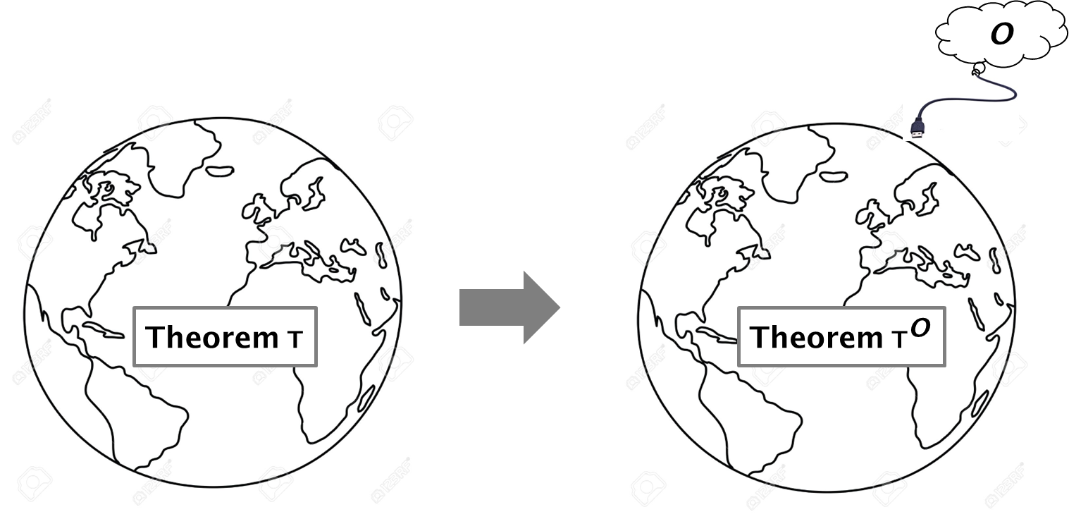
Primitive and Black-box Reduction
Theorem T：
There exists a black-box reduction from the primitive P to the primitive Q
Notes:
To establish the black-box separation, we use a common technique, namely, the relativizing separation. Roughly speaking, given a theorem T: There exists a black-box reduction from the primitive P to the primitive Q. If the theorem T is true, it must be true under any oracle O. Thus, if primitive P exists in O, but Q does not, we have that Theorem T is false.

Slide 21
Our Strategy
Find a proper
Longer CDH-secure groups exist relative to
Shorter CDH-secure groups do not exist relative to
Notes:
In this way, we prove our result following these three steps: First, find a proper oracle. Second, prove that Longer CDH-secure groups exist relative to this oracle. Third, prove that Shorter CDH-secure groups do not exist relative to the oracle.

Slide 22
Idealized Models
Random Oracle Model (ROM)
The random oracle model is an idealized model of a truly random publicly accessible hash function H：${\left\{0,1\right\}}^{∗}→{\left\{0,1\right\}}^{n}$.
Utility: OAEP, Fiat-Shamir transform, Fujisaki-Okamoto transform
ROM
$$x_{1}$$
$$x_{1}$$ | $$str_{1}$$
$$x_{2}$$ | $$str_{2}$$
$$x_{3}$$ | $$str_{3}$$
… | …
$$str_{1}$$
Notes:
For the first step, we will naturally consider the random oracle model. It is an overwhelmingly popular idealized model in cryptosystem. A random oracle responds to every unique query with a (truly) random response.

Slide 23
Our Strategy
Find a proper
Longer CDH-secure groups exist relative to
Shorter CDH-secure groups do not exist relative to
[IR89]:
There exists a separation between ROM and CDH-secure groups
Notes:
Unfortunately, the random oracle does not serve our purpose,
because Impagliazzo and Rudich proved that there exists a separation between random oracle model and CDH-secure groups. Hereby, we need to find a stronger oracle than RO.

Slide 24
Idealized Models
Generic Group Model (GGM)
The generic group model is an idealized model of a random group encoding from $ℤ_{p}$to some set $S={\left\{0,1\right\}}^{n}.$ It consists of two interfaces: group labeling and group addition.
Utility: Justify tons of assumptions e.g. Dlog, CDH, DDH
$$2$$
$$1$$ | $$str_{1}$$
$$2$$ | $$str_{2}$$
$$3$$ | $$str_{3}$$
… | …
$$str_{2}$$
Notes:
Our idea is to use the generic group model. It is an idealized model of a random group encoding from Zp to some set S, and consists of group labeling interface like this

Slide 25
Idealized Models
Generic Group Model (GGM)
The generic group model is an idealized model of a random group encoding from $ℤ_{p}$to some set $S={\left\{0,1\right\}}^{n}.$ It consists of two interfaces: group labeling and group addition.
Utility: Justify tons of assumptions e.g. Dlog, CDH, DDH
$str_{1}$, $str_{2}$
$$1$$ | $$str_{1}$$
$$2$$ | $$str_{2}$$
$$3$$ | $$str_{3}$$
… | …
$$str_{3}$$
Fine-grained GGM：the GGM with longer encoding
Notes:
and addition interface lite this. At the first glance, this is also impossible, because GGM implies CDH trivially!
Fortunately, the GGMs varying in length of group encodings might also yield different levels of complexity, it is our second result, I will talk about it later.
and thus we set this oracle to be a fine-grained GGM with longer encoding

Slide 26
Our Strategy
Find a proper
Longer CDH-secure groups exist relative to
Shorter CDH-secure groups do not exist relative to
Notes:
The second step is trivial. I will focus on how to prove the last statement. Shorter CDH-secure groups do not exist relative to the longer GGM.
Intuitively, we need to construct an adversary that breaks the CDH game for any construction of shorter group relative to the longer GGM.
However, due to technical difficulties, we switch to an alternative path: find a primitive who is implied by the shorter CDH-secure group, but is separated from longer GGM.

Slide 27
Our Strategy
Find a proper
Longer CDH-secure groups exist relative to
Shorter CDH-secure groups do not exist relative to
(NIKE) does not exist relative to Random Oracle Model (ROM)
Non-Interactive Key Exchange
[Impagliazzo-Rudich, 1989]
Notes:
We pin down the non-interactive key exchange as such primitive. The shorter CDH-secure group implying NIKE is straightforward. But what about the separation from the longer GGM?
Before presenting our proof, I will first provide a brief explanation of the separation between NIKE and the random oracle. It is from impagliazzo and rudich. Later, I will demonstrate how we incorporate their ideas into our analysis.
Consider a NIKE with perfect completeness. It consists of a public key generation algorithm KG and a shared key generation algorithm SHK.

Slide 28
NIKE does not exist in ROM
ROM
Step 1:
Sample $sk_{A}$
Compute $pk_{A}←KG(sk_{A})$
Step 1:
Sample $sk_{B}$
Compute $pk_{B}←KG(sk_{B})$
$$pk_{A}$$
$$pk_{B}$$
Step 2:
Compute $k=SHK(sk_{A},pk_{B})$
Step 2:
Compute $k=SHK(sk_{B},pk_{A})$
Notes:
Consider a NIKE with perfect completeness. It consists of a public key generation algorithm KG and a shared key generation algorithm SHK.
This is an execution of NIKE between Alice and Bob. In the first step, Alice and Bob respectively sample their secret key, and compute the public keys. Then they exchange their public keys. In the second step, Alice compute the shared key using her secret key skA and bob’s public key pkB; similarly for Bob.

Slide 29
NIKE does not exist in ROM
ROM
Step 1:
Sample $sk_{A}$
Compute $pk_{A}←KG(sk_{A})$
Step 1:
Sample $sk_{B}$
Compute $pk_{B}←KG(sk_{B})$
$$pk_{A}$$
$$pk_{B}$$
Step 2:
Compute $k=SHK(sk_{A},pk_{B})$
Step 2:
Compute $k=SHK(sk_{B},pk_{A})$
Computationally Unbounded
Recover $k =SHK\left(sk_{A},pk_{B}\right)$
$=SHK(sk_{B},pk_{A})$
Query Efficient to ROM
Notes:
To prove NIKE does not exist in ROM, we need a computationally unbounded but query efficient adversary. Given the transcript between Alice and Bob, that is pkA and pkB, the adversary can recover the correct shared key k.
This is the definition of the adversary in random oracle model. Given two public keys, the adversary runs polynomial round iterations for attack

Slide 30
Adversary in ROM
$$(pk_{A},pk_{B})$$
Multi-round Iterations (Poly)
guessing shared key ${\tilde{k}}_{i}$
Simulation Phase
Update Phase
output the majority of the keys
Notes:
This is the definition of the adversary in random oracle model. Given two public keys, the adversary runs polynomial round iterations for attack. An iteration includes a simulation phase and an update phase. And in each iteration, the adversary will guess a shared key. Finally, adversary outputs the majority of keys. Now, let’s see some details of each iteration.
In the simulation phase, the adversary makes no query to the random oracle.

Slide 31
Adversary in ROM
Simulation Phase
Simulate ${\tilde{sk}}_{A}$ and such that
$$KG({\tilde{sk}}_{A})$$
$$pk_{A}$$
$$x_{1}$$ | $$\tilde{str_{1}}$$
$$x_{2}$$ | $$\tilde{str_{2}}$$
… | …
$$x_{q}$$ | $$\tilde{str_{q}}$$
query
response
$$SHK({\tilde{sk}}_{A},pk_{B})$$
$$\tilde{k}$$
Notes:
In the simulation phase, the adversary makes no query to the random oracle. It locally searches a proper view of Alice. That is a proper secret key tilde skA and a simulated RO. After that, it computes and records a shared key tilde k under the simulated RO.
Assume q be the polynomial upper bound of queries make by Alice and Bob. The adversary simulated at most q query/response pairs.

Slide 32
Adversary in ROM
Update Phase
query
response
$$x_{1}$$ | $$\tilde{str_{1}}$$
$$x_{2}$$ | $$\tilde{str_{2}}$$
… | …
$$x_{q}$$ | $$\tilde{str_{q}}$$
$$x_{1}$$ | $$str_{1}$$
$$x_{2}$$ | $$str_{2}$$
… | …
$$x_{q}$$ | $$str_{q}$$
update
Notes:
In the update phase, the adversary makes all queries it simulated to the real random oracle, and correct the response.
For the next iteration, the adversary’s simulation should be consistent with all the real query/response pairs it made before.

Slide 33
Adversary in ROM
Simulation Phase
Simulate ${\tilde{sk}}_{A}$ and such that
$$x_{1}$$ | $$str_{1}$$
… | …
$$x_{q}$$ | $$str_{q}$$
$$KG({\tilde{sk}}_{A})$$
$$pk_{A}$$
query
response
$$x_{q+1}$$ | $$str_{q+1}$$
$$x_{q+2}$$ | $$str_{q+2}$$
… | …
$$SHK({\tilde{sk}}_{A},pk_{B})$$
$$\tilde{k}$$
Notes:
For the next iteration, the adversary’s simulation should be consistent with all the real query/response pairs it made before.
Next, I explain why Adversary wins.

Slide 34
Why the Adversary Wins
query
response
$$KG({\tilde{sk}}_{A})$$
$$pk_{A}$$
$$SHK({\tilde{sk}}_{A},pk_{B})$$
$$\tilde{k}$$
Notes:
Next, I explain why Adversary wins. The adversary computes the shared key tilde k using the guessed view of Alice, including the simulated secret key and the simulated random oracle.
For the honest party Bob, he computes the pkB and the shared key k under the real random oracle.

Slide 35
Why the Adversary Wins
query
response
query
response
$$KG({\tilde{sk}}_{A})$$
$$pk_{A}$$
$$KG(sk_{B})$$
$$pk_{B}$$
$$SHK({\tilde{sk}}_{A},pk_{B})$$
$$\tilde{k}$$
$$SHK(sk_{B},pk_{A})$$
$$k$$
Notes:
For the honest party Bob, he computes the pkB and the shared key k under the real random oracle.
Consider this case, the query set simulated by adversary is disjoint from Bob.

Slide 36
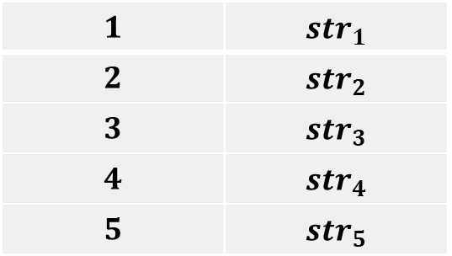
Why the Adversary Wins
$$1$$ | $$str_{1}$$
$$2$$ | $$str_{2}$$
$$3$$ | $$str_{3}$$
$$4$$ | $$str_{4}$$
$$5$$ | $$str_{5}$$
$$6$$ | $$str_{6}$$
$$7$$ | $$str_{7}$$
$$8$$ | $$str_{8}$$
$$9$$ | $$str_{9}$$
$$10$$ | $$str_{10}$$
query
response
query
response
$$KG({\tilde{sk}}_{A})$$
$$pk_{A}$$
$$KG(sk_{B})$$
$$pk_{B}$$
$$SHK({\tilde{sk}}_{A},pk_{B})$$
$$\tilde{k}$$
$$SHK(sk_{B},pk_{A})$$
$$k$$
Notes:
Consider this case, the query set simulated by adversary is disjoint from Bob.
Thin this case, there is a valid random oracle consistent with the simulated view of Alice and the real view of Bob. Due to the perfect complexity of NIKE, the tilde k computed by the adversary is equal to the real shared key k computed by Bob.

Slide 37
Why the Adversary Wins
$$1$$ | $$str_{1}$$
$$2$$ | $$str_{2}$$
$$3$$ | $$str_{3}$$
$$4$$ | $$str_{4}$$
$$5$$ | $$str_{5}$$
$$6$$ | $$str_{6}$$
$$7$$ | $$str_{7}$$
$$8$$ | $$str_{8}$$
$$9$$ | $$str_{9}$$
$$10$$ | $$str_{10}$$
query
response
query
response
$$KG({\tilde{sk}}_{A})$$
$$pk_{A}$$
$$KG(sk_{B})$$
$$pk_{B}$$
$$SHK({\tilde{sk}}_{A},pk_{B})$$
$$\tilde{k}=k$$
$$SHK(sk_{B},pk_{A})$$
$$k$$
Notes:
Thin this case, there is a valid random oracle consistent with the simulated view of Alice and the real view of Bob. Due to the perfect completeness of NIKE, the tilde k computed by the adversary is equal to the real shared key k computed by Bob.
On the other hand, if the query set simulated by adversary intersects with Bob, bad event could happen. Let’s see this table.

Slide 38
Why the Adversary Wins
$$6$$ | $$str_{6}$$
$$2$$ | $$str_{7}$$
$$3$$ | $$str_{3}$$
$$4$$ | $$str_{4}$$
$$10$$ | $$str_{5}$$
$$6$$ | $$str_{6}$$
$$7$$ | $$str_{7}$$
$$8$$ | $$str_{8}$$
$$9$$ | $$str_{9}$$
$$10$$ | $$str_{10}$$
query
response
query
response
$$KG({\tilde{sk}}_{A})$$
$$pk_{A}$$
$$KG(sk_{B})$$
$$pk_{B}$$
$$SHK({\tilde{sk}}_{A},pk_{B})$$
$$\tilde{k}$$
$$SHK(sk_{B},pk_{A})$$
$$k$$
Notes:
On the other hand, if the query set simulated by adversary intersects with Bob, bad event could happen. Let’s see this table.
The first line of Adversary is from the update phase. Obviously, it is okay.

Slide 39
Why the Adversary Wins
$$6$$ | $$str_{6}$$
$$2$$ | $$str_{7}$$
$$3$$ | $$str_{3}$$
$$4$$ | $$str_{4}$$
$$10$$ | $$str_{5}$$
$$6$$ | $$str_{6}$$
$$7$$ | $$str_{7}$$
$$8$$ | $$str_{8}$$
$$9$$ | $$str_{9}$$
$$10$$ | $$str_{10}$$
query
response
query
response
$$KG({\tilde{sk}}_{A})$$
$$pk_{A}$$
$$KG(sk_{B})$$
$$pk_{B}$$
$$SHK({\tilde{sk}}_{A},pk_{B})$$
$$\tilde{k}$$
$$SHK(sk_{B},pk_{A})$$
$$k$$
Notes:
The first line of Adversary is from the update phase. Obviously, it is okay.
In the second line, Adversary and Bob have different queries, but the responses are identical. Since a valid random oracle tolerate collision, it doesn’t matter.

Slide 40
Why the Adversary Wins
$$6$$ | $$str_{6}$$
$$2$$ | $$str_{7}$$
$$3$$ | $$str_{3}$$
$$4$$ | $$str_{4}$$
$$10$$ | $$str_{5}$$
$$6$$ | $$str_{6}$$
$$7$$ | $$str_{7}$$
$$8$$ | $$str_{8}$$
$$9$$ | $$str_{9}$$
$$10$$ | $$str_{10}$$
query
response
query
response
$$KG({\tilde{sk}}_{A})$$
$$pk_{A}$$
$$KG(sk_{B})$$
$$pk_{B}$$
$$SHK({\tilde{sk}}_{A},pk_{B})$$
$$\tilde{k}$$
$$SHK(sk_{B},pk_{A})$$
$$k$$
Notes:
In the second line, Adversary and Bob have different queries, but the responses are identical. Since a valid random oracle tolerate collision, it doesn’t matter.
The next two lines are not in the intersection set. They also can appear in a valid RO.

Slide 41
Why the Adversary Wins
$$6$$ | $$str_{6}$$
$$2$$ | $$str_{7}$$
$$3$$ | $$str_{3}$$
$$4$$ | $$str_{4}$$
$$10$$ | $$str_{5}$$
$$6$$ | $$str_{6}$$
$$7$$ | $$str_{7}$$
$$8$$ | $$str_{8}$$
$$9$$ | $$str_{9}$$
$$10$$ | $$str_{10}$$
query
response
query
response
$$KG({\tilde{sk}}_{A})$$
$$pk_{A}$$
$$KG(sk_{B})$$
$$pk_{B}$$
$$SHK({\tilde{sk}}_{A},pk_{B})$$
$$\tilde{k}$$
$$SHK(sk_{B},pk_{A})$$
$$k$$
Notes:
The next two lines are not in the intersection set. They also can appear in a valid RO.
The bad event happens in the last line.

Slide 42
Why the Adversary Wins
$$6$$ | $$str_{6}$$
$$2$$ | $$str_{7}$$
$$3$$ | $$str_{3}$$
$$4$$ | $$str_{4}$$
$$10$$ | $$str_{5}$$
$$6$$ | $$str_{6}$$
$$7$$ | $$str_{7}$$
$$8$$ | $$str_{8}$$
$$9$$ | $$str_{9}$$
$$10$$ | $$str_{10}$$
update
query
response
query
response
$$KG({\tilde{sk}}_{A})$$
$$pk_{A}$$
$$KG(sk_{B})$$
$$pk_{B}$$
$$SHK({\tilde{sk}}_{A},pk_{B})$$
$$\tilde{k}$$
$$SHK(sk_{B},pk_{A})$$
$$k$$
Notes:
The bad event happens in the last line. Adversary and Bob have same query ten, but the responses are different. In a valid RO, every query should map to a single response. Fortunately, this bad pair could be corrected in the update phase! Recall that, we assume Bob makes at most q queries. So, this bad event happens up to q times. After q iteration, the adversary always computes a correct shared key. Therefore, the adversary can win in the random oracle model.
Now, come back to our purpose!

Slide 43
Back to Our Purpose
$$6$$ | $$str_{6}$$
$$2$$ | $$str_{7}$$
$$3$$ | $$str_{3}$$
$$4$$ | $$str_{4}$$
$$10$$ | $$str_{5}$$
Bad Event
$$6$$ | $$str_{6}$$
$$7$$ | $$str_{7}$$
$$8$$ | $$str_{8}$$
$$9$$ | $$str_{9}$$
$$10$$ | $$str_{10}$$
query
response
query
response
$$KG({\tilde{sk}}_{A})$$
$$pk_{A}$$
$$KG(sk_{B})$$
$$pk_{B}$$
$$SHK({\tilde{sk}}_{A},pk_{B})$$
$$\tilde{k}$$
$$SHK(sk_{B},pk_{A})$$
$$k$$
Notes:
Now, come back to our purpose! Under the GGM, we need to deal with another bad event.
Let see the second line. Unlike RO, a valid GGM does not tolerate collision. Unfortunately, this bad event cannot be corrected in the update phase.

Slide 44
Further Analysis
$$x_{1}$$ | $st$r
Bad Event
$$x_{2}$$ | $st$r
$$KG({\tilde{sk}}_{A})$$
$$pk_{A}$$
$$KG(sk_{B})$$
$$pk_{B}$$
$$SHK({\tilde{sk}}_{A},pk_{B})$$
$$\tilde{k}$$
$$SHK(sk_{B},pk_{A})$$
$$k$$
Why bad event happens?
It's just a coincidence
—— negligible
Notes:
Let’s go to further analysis. Why this bad event happens? It might be just a coincidence.
We will be very happy to see that, because the probability of sampling a valid group encoding is negligible!

Slide 45
Further Analysis
$$x_{1}$$ | $st$r
Bad Event
$$x_{2}$$ | $st$r
$$KG({\tilde{sk}}_{A})$$
$$pk_{A}$$
$$KG(sk_{B})$$
$$pk_{B}$$
$$SHK({\tilde{sk}}_{A},pk_{B})$$
$$\tilde{k}$$
$$SHK(sk_{B},pk_{A})$$
$$k$$
Why bad event happens?
It's just a coincidence
—— negligible
$str$ can be extracted from $pk_{A}$ and $pk_{B}$
Notes:
However, the pkA, pkB are related to GGM. So the adversary may be able to extract the group encoding from them.

Slide 46
Our Strategy
$$pk_{A}←KG(sk_{A})$$
group encoding
$$pk_{B}←KG(sk_{B})$$
group encoding
Notes:
More specifically, assume pkA is related to the green encodings in the real GGM, pkB is related to the blue encoding.

Slide 47
Our Strategy
$$pk_{A}←KG(sk_{A})$$
group encoding
$$pk_{B}←KG(sk_{B})$$
group encoding
Notes:
More specifically, assume pkA is related to the green encodings in the real GGM, pkB is related to the blue encoding.
The extracted encoding is in the union of green and blue. For clarity, I set the intersection of the green set and blue set as yellow. Now, there are two cases for the extracted encoding.

Slide 48
Our Strategy
$$pk_{A}←KG(sk_{A})$$
group encoding
$$pk_{B}←KG(sk_{B})$$
group encoding
$str$ is independent of $pk_{B}$
Notes:
First, it is outside the intersection. For example, it is in the green area. It means that this string is independent of pkB. The adversary can only obtain string’s information from pkA.
Here I introduce our length tool. Recall that, we want to prove the separation from the longer GGM to the NIKE.

Slide 49
Our Strategy
$$pk_{A}←KG(sk_{A})$$
Longer
GGM
group encoding
$$pk_{B}←KG(sk_{B})$$
Longer
GGM
group encoding
$str$ is independent of $pk_{B}$
Length matter
It is impossible to extract a valid group encoding from a single public key
Notes:
Here I introduce our length tool. Recall that, we want to prove the separation from the longer GGM to the NIKE. Intuitively, if the length of the public key is much shorter than the group encoding, then a single public key would not carry enough information to recover the group encodings. In our paper, we take four pages to formally prove it.

Slide 50
Our Strategy
$$pk_{A}←KG(sk_{A})$$
Longer
GGM
group encoding
$$pk_{B}←KG(sk_{B})$$
Longer
GGM
group encoding
$pk_{A}$ and $pk_{B}$ might carry enough information of $str$
Frequent query
Trivial, sampling $sk_{1},…,sk_{q}$ and run $KG(sk_{i})$
Gathering the generated group encodings
Notes:
On the other hand, the extracted encoding may be in the intersection. In this case, two public keys might carry enough information. Fortunately, since the secret keys skA and skB are independent, with high probability all queries in the intersection are frequent. To avoid this bad case, we can sample enough random secret key to run KG algorithm, and gather the generated group encodings to collect the whole frequent queries.

Slide 51
Separation
Find a proper
Longer CDH-secure groups exist relative to
Shorter CDH-secure groups do not exist relative to
NIKE with shorter public-key does not exist relative to
Combining together, we establish the separation
Notes:
Now, we successfully deal with all the bad events!
We have proven that the NIKE with shorter public-key does not exist relative to the longer GGM.
Combining them together, we establish the separation from longer CDH-secure groups to shorter CDH-secure groups!

Slide 52
Outline
Motivation
Longer encodings shorter encodings for groups
Longer encodings shorter encodings in GGM
Conclusion
Notes:
In addition to our main result, I will talk about our second result as mentioned before.

Slide 53
Hierarchy of GGMs
Theorem: The shorter GGM is strictly stronger than the longer GGM, even in the presence of computationally bounded adversaries. Specifically,
shorter GGM statistically implies the longer one;
longer GGM does not computationally imply the shorter one.
[Ji-Zhang-Wang et al. Asiacrypt’ 24]
Notes:
This is the hierarchy of GGMs. Informally, the shorter GGM is strictly stronger than the longer GGM, even in the presence of computationally bounded adversaries. Specifically, shorter GGM statistically implies the longer one; longer GGM does not computationally imply the shorter one. Please see our paper for this proof.

Slide 54
Outline
Motivation
Longer encodings shorter encodings for groups
Longer encodings shorter encodings in GGM
Conclusion
Notes:
Finally, I will conclude our results.

Slide 55
Conclusion
Identity-based Encryption
Registration-based Encryption
Notes:
In literature, GGM is often used to show the impossibility of group-based cryptosystems. For example, the separations from GGM to IBE or RBE.

Slide 56
Conclusion
Identity-based Encryption
Registration-based Encryption
Shorter CDH-secure Groups
Study the “length” in fundamental primitives, e.g. PKE
Notes:
Our results shows the first evidence that the GGM can also be used to show the impossibility of constructing plain cryptographic groups, varying in distinct length of group encodings. I believe that, our result would motivate the community to study the “lengths” in fundamental primitives (e.g., PKE).

Slide 57
Limitation
Separation of cryptographic groups within the same group order
same group order
the order of $𝔾_{2}$ is a factor of $𝔾_{1}$
$$𝔾_{1}$$
$$𝔾_{2}$$
Notes:
However, I stress that our separation results have a limitation. It is only for the same order groups. Nevertheless, our results are interesting and important. Because when it comes to the problem that building a cryptographic group G two from another one G one, it is natural to think about the cases that they have the same order, or the order of G two is a factor of G one. Our analysis can be generalized to capture such the second case.

Slide 58
Limitation
Separation of cryptographic groups within the same group order
same group order
the order of $𝔾_{2}$ is a factor of $𝔾_{1}$
the group orders are distinct and co-prime
$$𝔾_{1}$$
$$𝔾_{2}$$
Notes:
For another case, the group orders are distinct and co-prime.
To the best of our knowledge, no technique can generically build G two from G one in this case. So our separations do capture the natural settings.

Slide 59
Limitation
Separation of cryptographic groups within the same group order
same group order
the order of $𝔾_{2}$ is a factor of $𝔾_{1}$
the group orders are distinct and co-prime
$$𝔾_{1}$$
$$𝔾_{2}$$
DDH
CDH
Dlog
Open question:
Does this separation still hold for Dlog-secure cryptographic groups？
Notes:
The other limitation is that our analysis cannot support the separation between dlog-secure groups. This is because our technology relies on the primitive NIKE. And it is unclear whether dlog implies key agreement or not yet.
Now, we leave it as an open problem: Does this separation still hold for Dlog-secure cryptographic groups？

Slide 60
Thanks
Notes:
That’s all. Thank you for listening.

