Slide 1
Dishonest Majority Multiparty Computation over Matrix Rings
Hongqing Liu, Chaoping Xing, Chen Yuan, Taoxu Zou
Shanghai Jiao Tong University
Dec 10th,ASIACRYPT 2024
Notes:
Hello, everyone, I am Hongqing Liu from Shanghai Jiao Tong University. Today, I am honored to introduce our new work, “Dishonest Majority Multiparty Computation over Matrix Rings.” This is a joint work with Chaoping Xing, Chen Yuan, and Taoxu Zou.

Slide 2
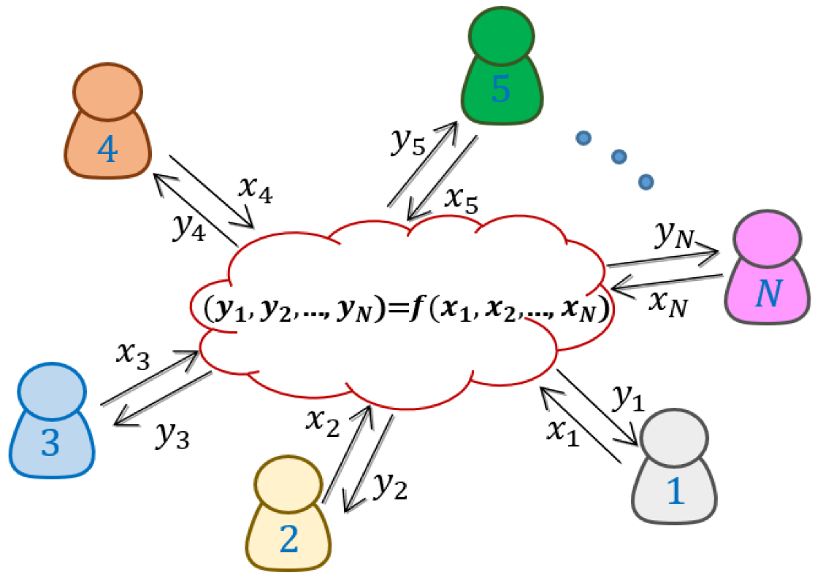
Multiparty Computation
Ring | Honest majority | Dishonest Majority
Large field | DN07,ATLAS,… | BDOZ,SPDZ
Binary field | CCXY18,GS21,… | MiniMAC,…
Integer ring $ℤ_{2^{k}}$ | ACD+19,CRX21,… | SPDZ2k,EXY22
Non-commutative ring | ES21 | ❓
Question: Can we design an efficient MPC protocol for some non-commutative rings in the dishonest majority setting against a malicious adversary?
Answer: Yes for matrix rings $ℳ_{m×m}(𝔽)$!
Notes:
Multiparty computation (MPC) allows several distrustful parties to compute a public function without leaking their private information. According to the number of corrupted parties, we classify MPC into honest majority and dishonest majority protocols. Here we focus on malicious adversary, where the corrupted parties can arbitrarily deviate the protocol.
In the beginning, MPC protocols are restricted to large fields. Recently, a series of MPC protocols have been designed for binary fields and integer rings Z2k. We can even construct an MPC protocol over non-commutative rings in the honest majority setting!
Naturally, we want to ask a question: Can we design an efficient MPC protocol for some non-commutative rings in the dishonest majority setting against a malicious adversary?
In this work, we answer this question affirmatively. We design an MPC protocol for matrix rings, which contain m times m matrices over a finite field F.

Slide 3
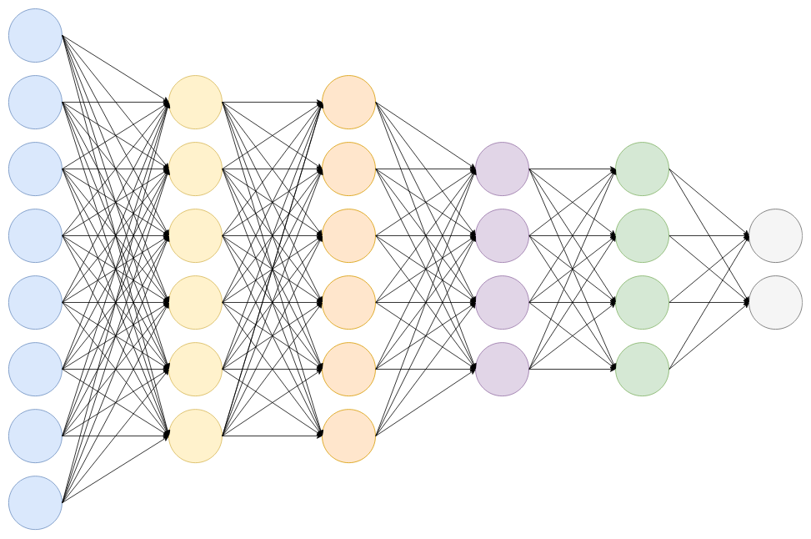
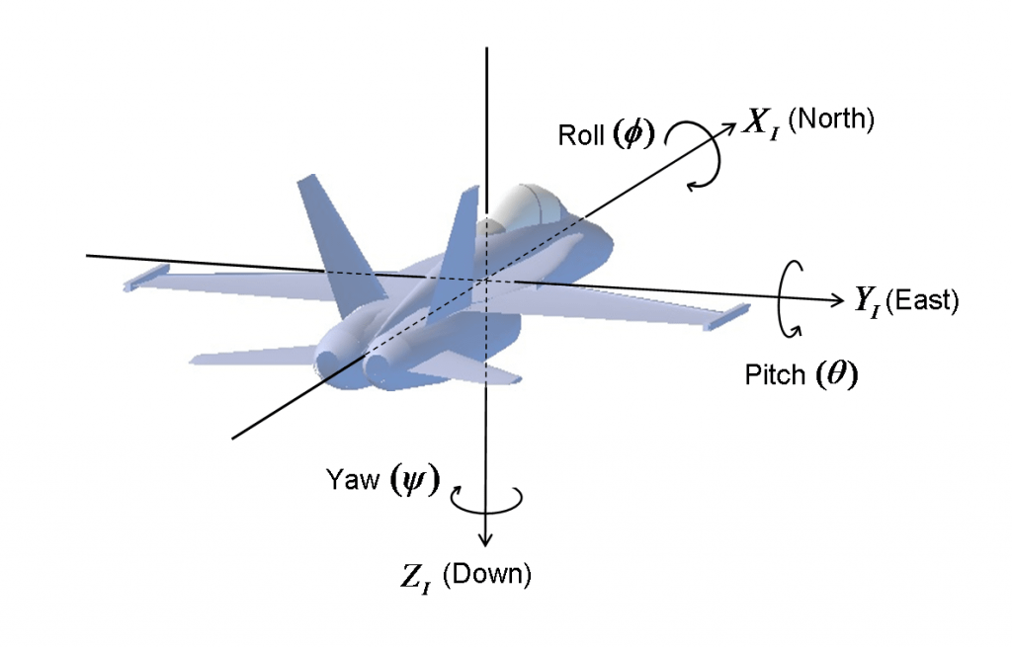
Why Matrix Rings?
Matrix rings: privacy preserving machine learning
Quaternion rings: computer graphics, aerospace
Notes:
So why do we choose matrix rings? On the one hand, the matrix plays an important role in privacy protection machine learning. The linear layers of machine learning, such as fully connected and convolution layers, involve numerous matrix operations.
On the other hand, many applicable non-commutative rings can be represented as a matrix. For example, quaternion rings can describe rotations in 3-D spaces, thus they are applied in computer graphics and aerospace.
We observe that any element of a quaternion ring can be written as a 4 times 4 matrix.

Slide 4
Why Matrix Rings?
Matrix rings: privacy preserving machine learning
Quaternion rings: computer graphics, aerospace
Can be represented in the form of matrices!
$$a+bi+cj+dk⟹\left[\begin{matrix}a & d & −c & b \\ −d & a & −b & −c \\ c & b & a & −d \\ −b & c & d & a\end{matrix}\right]$$
Notes:
So why do we choose matrix rings? On the one hand, the matrix plays an important role in privacy protection machine learning. The linear layers of machine learning, such as fully connected and convolution layers, involve numerous matrix operations.
On the other hand, many applicable non-commutative rings can be represented as a matrix. For example, quaternion rings can describe rotations in 3-D spaces, thus they are applied in computer graphics and aerospace.
We observe that any element of a quaternion ring can be written as a 4 times 4 matrix.

Slide 5
Recap: SPDZ protocol [DPSZ12]
SPDZ: authenticated sharing = additive sharing + MAC
$$P_{1}$$
$$P_{n}$$
secret
$$x ={ x}_{1} + ⋯ + x_{n}$$
global key
$$α ={ α}_{1} + ⋯ + α_{n}$$
$$\left[\left[x\right]\right]=(\left[x\right],\left[α\right], \left[αx\right])$$
MAC
$$α⋅x= m_{1}\left(x\right) + ⋯ + m_{n}(x)$$
Local computation
Multiplication
Addition $\left[\left[x+y\right]\right]=(\left[x]+[y\right], \left[α\right], [αx]+[αy])$
Preprocessing
$$(\left[\left[a\right]\right],\left[\left[b\right]\right],\left[\left[c\right]\right])$$
$$c=a⋅b$$
open $d←\left[\left[x\right]\right]−\left[\left[a\right]\right], e←\left[\left[y\right]\right]−[\left[b\right]]$
Scalar Mult $\left[\left[rx\right]\right]=(r\left[x\right], \left[α\right], r[αx])$
Online
compute $\left[\left[z\right]\right]=\left[\left[c\right]\right]+d\left[\left[b\right]\right]+e\left[\left[a\right]\right]+d⋅e$
Notes:
Let’s start with the classical SPDZ protocol, which is an efficient dishonest majority MPC protocol. To tolerate n-1 parties corrupted by a malicious adversary, SPDZ protocol applies an authenticated secret sharing scheme. The core idea is to append a message authenticated code (MAC) for additive sharing. We can detect the additive errors introduced by the adversary with the help of MAC.
Assume there are n parties P1 to Pn. In the initialization step, each party Pi obtains the key share \alpha_i of the global key \alpha. Then for each additive sharing of x, all parties need to generate the additive sharing of \alpha x as the corresponding MAC.
Obviously, we can locally compute addition and scalar multiplication for authenticated secret sharing.
To multiply two authenticated sharings [[x]] and [[y]], we need to prepare an authenticated Beaver triple [[a]], [[b]], [[c]] in the preprocessing phase, where a and b are uniformly sampled from the field and c is the product of a and b. In the online phase, we only need to open two values d=x-a and e=y-b. These two openings leak no information about x and y since a and b act as random masks. Then we can locally compute the authenticated sharing of z, the product of x and y.

Slide 6
SPDZ protocol + matrix rings [CKR+21]
secret
key
MAC
$$X$$
$$αX$$
$$\left[\left[X\right]\right]=(\left[X\right],\left[α\right], \left[αX\right])$$
$$α$$
Local computation
Multiplication
Addition $\left[\left[X+Y\right]\right]=(\left[X]+[Y\right], \left[α\right], [αX]+[αY])$
Preprocessing
$$(\left[\left[A\right]\right],\left[\left[B\right]\right],\left[\left[C\right]\right])$$
$$C=AB$$
Left linearity $\left[\left[AX\right]\right]=(A\left[X\right], \left[α\right], A[αX])$
open $D←\left[\left[X\right]\right]−\left[\left[A\right]\right], E←\left[\left[Y\right]\right]−[\left[B\right]]$
Online
Right linearity $\left[\left[XA\right]\right]=(\left[X\right]A, \left[α\right], \left[αX\right]A)$
compute $\left[\left[Z\right]\right]=\left[\left[C\right]\right]+D\left[\left[B\right]\right]+\left[\left[A\right]\right]E+DE$
Notes:
SPDZ protocol works for a single element of a field; now, we turn to the matrix ring over this field. Without modifying the global key, we only need to extend the secret and MAC to matrices. Compared to the traditional SPDZ protocol, this new protocol makes full use of the structure of matrices and avoids redundant communication.
Similar to the original SPDZ protocol, this protocol also supports some local computation, including addition and multiplication with a public matrix on both the left and right sides. This is because the global key can be regarded as a scalar matrix, which lies in the center of matrix rings.
For the multiplication, we only need to extend authenticated Beaver triples to matrices. In the final equality, note that the computation of DB and AE requires left and right linearity respectively.

Slide 7
Our authenticated sharing
Share size:
$$2m^{2}→m^{2}+m$$
Reduce around 50%!
secret
key
MAC
$$X$$
$$v$$
$$Xv$$
$$⟨X⟩=(\left[X\right],\left[v\right], \left[Xv\right])$$
Local computation
Multiplication
Addition $⟨X+Y⟩=(\left[X]+[Y\right], \left[v\right], [Xv]+[Yv])$
Preprocessing
$$(\left\langle A\right\rangle , \left\langle B\right\rangle ,⟨C⟩)$$
$$C=AB$$
Left linearity $⟨AX⟩=(A\left[X\right], [v], A[Xv])$
open $D←\left\langle X\right\rangle −\left\langle A\right\rangle , E←\left\langle Y\right\rangle −⟨B⟩$
Online
Right linearity ❌
compute $⟨Z⟩=⟨C⟩+D⟨B⟩+⟨AE⟩+DE$
How to compute?
Notes:
The previous two protocols use an element of field as the global key. We observe that if we replace the global key with a column vector, then MAC is compressed from a matrix to a vector. In this way, the size of authenticated secret sharing is reduced from 2m^2 to m^2+m, which is only half when m is large enough.
However, this improvement brings a problem: The new secret sharing scheme can only locally compute addition and left multiplication with a public matrix. The right linearity does not hold anymore.
This change affects our multiplication protocol. We cannot locally compute the term AE in the final equality without right linearity.

Slide 8
Our multiplication protocol
Question: How to achieve the right linearity for our authenticated sharing scheme?
Answer: Make of use the transpose of matrices!
double sharing
Preprocessing
$$(\left\langle A\right\rangle , \left\langle A^{T}\right\rangle ,\left\langle B\right\rangle ,\left\langle C\right\rangle , \left\langle R\right\rangle ,⟨R^{T}⟩)$$
$$C=AB$$
Multiplication sextuple = Beaver triple + double sharing
open $D←\left\langle X\right\rangle −\left\langle A\right\rangle , E←\left\langle Y\right\rangle −⟨B⟩$
Drawback: Additional round
Online
open $F←E^{T}\left\langle A^{T}\right\rangle −⟨R^{T}⟩$
compute $\left\langle Z\right\rangle =\left\langle C\right\rangle +D\left\langle B\right\rangle +\left\langle R\right\rangle +F^{T}+DE$
Solution: Function-dependent preprocessing
Notes:
To solve this problem, we need to achieve the right linearity for our authenticated secret sharing.
Here, we resort to the transpose of matrices. In this case, we need to prepare a new type of correlated randomness double sharing, which is a pair authenticated sharing of a random matrix and its transpose.
For each multiplication gate, we prepare a multiplication sextuple. …… A multiplication sextuple is the combination of a Beaver triple and two double sharings.
In the online phase, we first follow the original protocol to open two matrices D and E; then we open F by using the transpose of A, R and public matrix E. This opening still leaks nothing due to the mask of R^T.
We realize the right linearity with the cost of an extra opening and consumption of two double sharings. Note that this new multiplication protocol requires an additional round, which can be eliminated by using function-dependent preprocessing. In the function dependent preprocessing phase, all parties know the the circuit but have no idea of the input. They can make use of the knowledge of circuit structure to reduce the communication round and complexity in the online phase.

Slide 9
Vector Oblivious Linear Evaluation
Expand
$$u∈𝔽^{m}, x∈ 𝔽$$
$$u$$
$$x$$
VOLE
$$v$$
$$w$$
Alice
Bob
$v,w←𝔽^{m}$ s.t. $v+w=x⋅u$
$n$-party VOLE = $n^{2}$ invocations of 2-party VOLE
Application: VOLE could be used to generate the MAC shares.
Notes:
From now on, we will focus on the preprocessing phase. The main task is to prepare a multiplication sextuple for each multiplication gate. First of all, let’s consider how to generate an authenticated secret sharing. We resort to a two-party primitive vector oblivious linear evaluation (VOLE).
In a VOLE instance, Alice inputs a vector u of length m, and Bob inputs a scalar x. Then Alice and Bob receive two vectors of length m, v and w, respectively. The sum of v and w is the product between vector u and scalar x.
We can obtain n-party VOLE with n^2 invocations of 2-party VOLE between each pair of parties.
Since the global key remains unchanged during the whole protocol, we can apply VOLE to generate the MAC shares by setting the input of Bob as the key share.

Slide 10
Random VOLE [BCGI18]
$$Expand: S→𝔽^{m}$$
$$u=Expand(s)$$
$$u$$
Expand
$$s ∈S, x∈ 𝔽$$
$$s$$
$$x$$
RVOLE
$$v$$
$$w$$
Alice
Bob
$v,w←𝔽^{m}$ s.t. $v+w=x⋅u$
From VOLE to RVOLE: Communication cost sublinear in the vector length $m$
Fundamental primitives of RVOLE: Base VOLE + OT
NEW!
VOPE
Subfield VOLE
Notes:
Now, we proceed to random VOLE, RVOLE. The pseudorandom correlation generator (PCG) technique is used to reduce the communication cost. Here we introduce a function “expand” that generates a random vector u with the input of a seed s, which can be regarded as a PRG. Compared to VOLE, Alice only needs to input a seed s instead of a whole vector u.
The communication cost of RVOLE is only sublinear in the vector length m. In contrast, the communication cost of VOLE scales linearly in the vector length m.
It is not easy to clarify the detailed construction of RVOLE in such a short time, therefore I will omit this part. We only need to know that RVOLE needs to invoke two fundamental primitives: base VOLE and OT, oblivious transfer.
We will discuss two variants of RVOLE, subfield VOLE and our VOPE, which optimize OT and base VOLE respectively.

Slide 11
Subfield VOLE [BCG+19]
$$Expand: S→𝔽^{m_{1}}$$
$$u=Expand(s)$$
$$u$$
Expand
Expand
$$s ∈S, x∈ 𝔽^{m_{2}}$$
$$s$$
$$x$$
SVOLE
$$V$$
$$W$$
Alice
Bob
$$⊗:𝔽^{m_{1}}×𝔽^{m_{2}}→ℳ_{m_{1}×m_{2}}(𝔽)$$
$${\left(u⊗x\right)}_{i,j}=u_{i}⋅x_{j}$$
$V,W←ℳ_{m_{1}×m_{2}}(𝔽)$ s.t. $V+W=u⊗x$
From RVOLE to SVOLE: Reuse the seed to reduce the number of OT instances
Notes:
This is the first variant of RVOLE, subfield VOLE. In the classical subfield VOLE, the vector chosen by Alice is defined over a subfield. Here we take an equivalent view to fit our setting.
In a subfield VOLE instance, Alice still inputs a seed s that can be expanded to a random vector u of length m1 like RVOLE. The difference is that Bob inputs a vector of length m2 instead of a scalar.
The subfield VOLE returns two m1 times m2 matrices V and W to Alice and Bob respectively. The sum of V and W is the outer product between two vectors, u and x. We can regard a subfield VOLE instance as m2 instances of RVOLE with the same seed and different scalars. These scalars form the input vector chosen by Bob.
Subfield VOLE can reuse the seed to reduce the number of OT instances.

Slide 12
Vector Oblivious Product Evaluation
$$Expand: S→𝔽^{m_{1}}$$
$$u=Expand(s)$$
$$Expand′: S′→𝔽^{m_{2}}$$
$$x=Expand′(s′)$$
$$u$$
$$x$$
Expand
$$Expand′$$
Expand
$$s ∈S, s′∈S′$$
$$s$$
$$s′$$
VOPE
$$V$$
$$W$$
Alice
Bob
$$⊗:𝔽^{m_{1}}×𝔽^{m_{2}}→ℳ_{m_{1}×m_{2}}(𝔽)$$
$${\left(u⊗x\right)}_{i,j}=u_{i}⋅x_{j}$$
$V,W←ℳ_{m_{1}×m_{2}}(𝔽)$ s.t. $V+W=u⊗x$
From SVOLE to VOPE: Transform base VOLE instances into random VOLE instances
Notes:
Based on the subfield VOLE, we propose vector oblivious product evaluation, VOPE. VOPE is used to obtain the additive sharing of the outer product between two long random vectors.
We observe that when m2 is also large, we can introduce a new expand function to generate a random vector of length m2. In this case, both Alice and Bob only need to input a seed. What is the benefit of replacing the input of Bob from a vector to a seed?
Recall that all variants of RVOLE have to invoke base VOLE as a building block. Compared to subfield VOLE, our VOPE protocol transforms these base VOLE instances into random VOLE instances. This modification allows us to make use of the advantage of PCG technique again, which reduces the communication and computation complexity further.

Slide 13
Random Matrix Multiplication
$$A∈M_{m_{1}×m_{2}}(𝔽)$$
$$B∈M_{m_{1}×m_{2}}(𝔽)$$
$$C∈M_{m_{1}×m_{3}}(𝔽)$$
$$C=AB$$
$$A∈M_{m_{1}×m_{2}}(𝔽)$$
$$B∈M_{m_{1}×m_{2}}(𝔽)$$
$$C∈M_{m_{1}×m_{3}}(𝔽)$$
$$i∈\left[m_{1}\right], j∈[m_{3}]$$
$$C_{i,j}$$
$$a_{i}$$
$$C_{i,j}=a_{i}⋅b_{j}$$
$$b_{j}$$
inner product
Notes:
Finally, we show how to compute matrix multiplication C between two random matrices A and B, which corresponds to a Beaver triple. This is the bottleneck of our preprocessing phase.
Previously, most works were based on homomorphic encryption. These works encrypt each row of matrix A and each column of matrix B respectively. Then the matrix multiplication is decomposed into several inner products.

Slide 14
Random Matrix Multiplication via VOPE
$$A∈M_{m_{1}×m_{2}}(𝔽)$$
$$B∈M_{m_{1}×m_{2}}(𝔽)$$
$$C∈M_{m_{1}×m_{3}}(𝔽)$$
$$C=AB=\sum_{i=1}^{m_{2}}{a_{i}⊗b_{i}}$$
$$b_{i}$$
$$a_{i}$$
outer product
$Expand: S→𝔽^{m_{1}}$ $a_{i}=Expand(s_{i})$
$Expand′: S→𝔽^{m_{3}}$ $b_{i}=Expand′(s_{i}^{′})$
$$a_{i}$$
$$b_{i}$$
Expand
$$Expand′$$
Expand
$$s_{i} ∈S, s_{i}′∈S′$$
$V_{i},W_{i}←ℳ_{m_{1}×m_{3}}(𝔽)$
s.t.
$$s_{i}$$
$$s_{i}′$$
$$V_{i}+W_{i}=a_{i}⊗b_{i}$$
VOPE
$$V_{i}$$
$$W_{i}$$
Alice
Bob
Notes:
In our work, we take a different view of matrix multiplication: We regard matrix multiplication as the sum of outer products.
For each outer product, we can apply our VOPE protocol. Alice and Bob randomly choose m2 seeds from the seed space respectively. Then Alice uses each seed to generate a column of matrix A, and Bob applies each seed to obtain a row of matrix B. In each VOPE instance, Alice and Bob only need to input the corresponding seeds.
Previous works rely on the inner product of vectors, while our protocol resorts to the outer product of vectors. Our protocol provides a new method to compute random matrix multiplication.

Slide 15
Performance: Online Phase
Theoretic analysis
Protocol | Communication | Share size | # multiplication
SPDZ | $$4m^{3}\left(n−1\right)\log{q}$$ | $$2m^{2}\log{q}$$ | $$6m^{3}$$
SPDZ + matrix | $$4m^{2}\left(n−1\right)\log{q}$$ | $$2m^{2}\log{q}$$ | $$5m^{3}+m^{2}$$
This work (FI*) | $$6m^{2}\left(n−1\right)\log{q}$$ | $$m\left(m+1\right)\log{q}$$ | $$3m^{3}+3m^{2}$$
This work (FD*) | $$4m^{2}\left(n−1\right)\log{q}$$ | $$m\left(m+1\right)\log{q}$$ | $$3m^{3}+3m^{2}$$
* FI / FD: Function-Independent / Dependent Preprocessing
Reduce 40% computation!
Experiment result
$$m$$ | SPDZ | SPDZ + matrix | This work
128 | 1.3 sec | 96 ms | 52 ms
256 | 9.5 sec | 559 ms | 329 ms
512 | 77.9 sec | 5.0 sec | 3.2 sec
1024 | 633 sec | 42.5 sec | 30.9 sec
1.38x-1.85x
speedup!
Notes:
Let’s consider the performance. This is the theoretic analysis of the online phase. Compared to traditional SPDZ protocol, both our protocol and SPDZ + matrix reduce the communication complexity of each multiplication gate from O(m^3) to O(m^2). The advantage of our protocol is the share size and computation cost, which reduce around 50% share size and 40% number of multiplications compared to SPDZ + matrix when m is large enough.
We also implement the online phase of all three protocols. The experimental result shows that our protocol achieves a 1.38 to 1.85 times speedup compared to SPDZ + matrix, which roughly matches our theoretical analysis.

Slide 16
Performance: Preprocessing Phase
Theoretic analysis of communication
$$m$$ | Random VOLE | Subfield VOLE | This work | HE [CKR+21]
128 | 83.5 MB | 34.8 MB | 19.0 MB | 12.5 MB
256 | 362 MB | 138 MB | 60 MB | 50 MB
512 | 1453 MB | 518 MB | 198 MB | 199 MB
1024 | 6000 MB | 2004 MB | 739 MB | 797 MB
Experiment result: benchmark
$$m$$ | Random VOLE | Subfield VOLE | This work | HE [CKR+21]
128 | 3.6 sec | 2.9 sec | 4.1 sec | 5.9 sec
256 | 13.9 sec | 10.1 sec | 8.2 sec | 25.5 sec
512 | 56.4 sec | 38.2 sec | 16.8 sec | 2.3 min
1024 | 4.1 min | 2.5 min | 36.0 sec | 14.5 min
1.44x-24.17x
speedup!
Notes:
In the preprocessing phase, we first analyze the communication cost of random VOLE, subfield VOLE and our VOPE. We also display the communication cost of homomorphic encryption for a full comparison. From random VOLE, subfield VOLE to our VOPE, we observe that communication complexity is reduced step by step. The communication complexity of our VOPE is even comparable to homomorphic encryption.
We calculate the number of base VOLE and OT instances and benchmark to estimate the runtime of VOLE-based protocols. Note that homomorphic encryption also argues with a benchmark.
In the aspect of the experimental result, our VOPE protocol achieves a 1.44 to 24.17 times speedup compared to HE! This speedup is prominent when matrix size m is large. Although VOLE-based protocols are believed to be applicable in random matrix multiplication, we are the first to analyze the concrete efficiency and our VOPE protocol makes a large improvement compared to random VOLE and subfield VOLE.

Slide 17
Summary
DPSZ12
CKR+21
This work
online
communication
share size
$$50\%$$
$$1/m$$
computation
$$60\%$$
HE
CKR+21
preprocessing
RVOLE
[BCGI18]
SVOLE
[BCG+19]
VOPE
This work
VOLE
OT $↓$
base VOLE $↓$
Notes:
At the end of the speech, we make a brief summary of this talk. In the online phase, we apply a new authenticated secret sharing by replacing the global key and MAC with vectors. To deal with the non-commutative property of matrix rings, we apply the transpose of matrices to design a multiplication sextuple as correlated randomness for each multiplication gate. Previous work CKR+21 only requires 1/m communication cost compared to traditional SPDZ protocol, while our protocol optimizes the share size and computation complexity.
In the preprocessing phase, almost all previous works for matrix multiplication are based on homomorphic encryption. Here we list CKR+21 as a representative work against a malicious adversary. We follow the technical line of VOLE and design a new protocol VOPE specialized for matrix multiplication. Our work has shown the potential of VOLE-based protocols in matrix multiplication, and we hope our work can attract the interest of VOLE in matrix multiplication and more applications.

Slide 18
References
[DPSZ12] Ivan Damgard, Valerio Pastro, Nigel Smart, and Sarah Zakarias: Multiparty computation from somewhat homomorphic encryption. In: CRYPTO 2012.
[BGIN18] Elette Boyle, Geoffroy Couteau, Niv Gilboa, and Yuval Ishai: Compressing vector OLE. In: ACM CCS 2018.
[BCG+19] Elette Boyle, Geoffroy Couteau, Niv Gilboa, Yuval Ishai, Lisa Kohl, and Peter Scholl: Eﬃcient pseudorandom correlation generators: Silent OT extension and more. In: CRYPTO 2019.
[CKR+21] Hao Chen, Miran Kim, Ilya Razenshteyn, Dragos Rotaru, Yongsoo Song, and Sameer Wagh: Maliciously secure matrix multiplication with applications to private deep learning. In: ASIACRYPT 2020.
Notes:
Here, we list the main references of our slide.

Slide 19
Thank you!
See our full version at ia.cr/2023/1912.
If you have any questions, please contact me via liu.hong.qing@sjtu.edu.cn
Notes:
Thank you for your attention! If you have any questions, please feel free to contact me at my email.

