Slide 1
It’s a kind of magic: A novel CGAN framework for Side-Channel Analysis
Sengim Karayalcin, Marina Krček, Lichao Wu, Stjepan Picek, Guilherme Perin

Slide 2
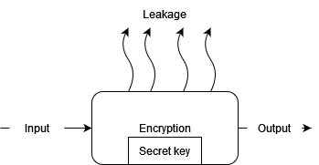
Side-Channel Analysis
Implementations in real world
(Physical) leakage encryption depends on internal computations
Power
Electromagnetic emanation
Timing

Slide 3
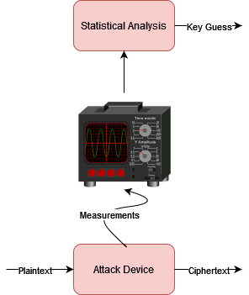
Differential Power Attacks[1]
Hamming Weight
Known input p, unknown key k
Generate hypothetical leakage for all 256 possible keys
Score possible keys using statistical techniques

Slide 4
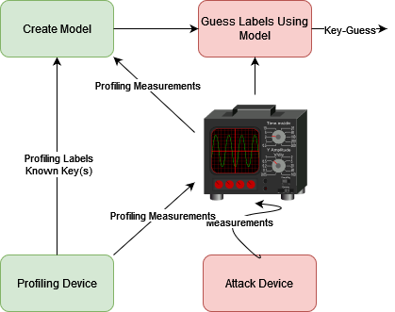
Profiled Side-Channel Attacks[2]
Worst-Case Evaluations
Programmable Copy Device
Using Labels and Traces create model (Classification task)
Predict Attack trace labels using model
Use (accumulated) predictions to guess keys

Slide 5
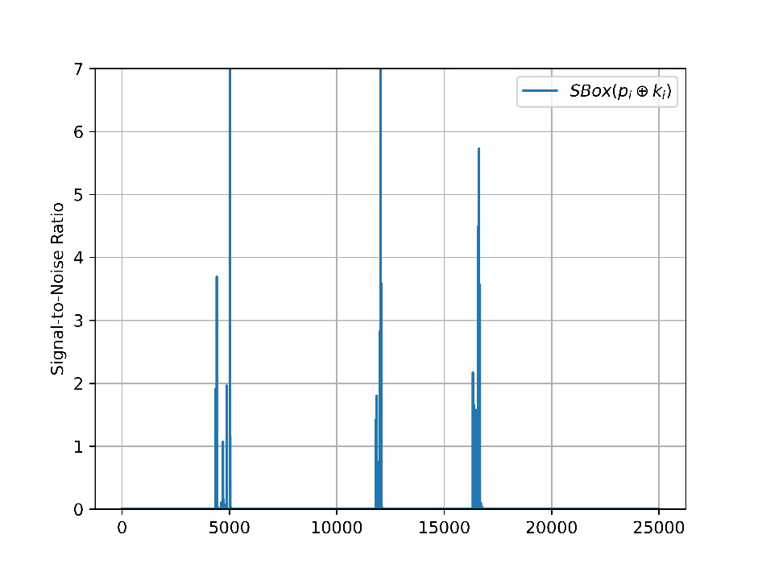
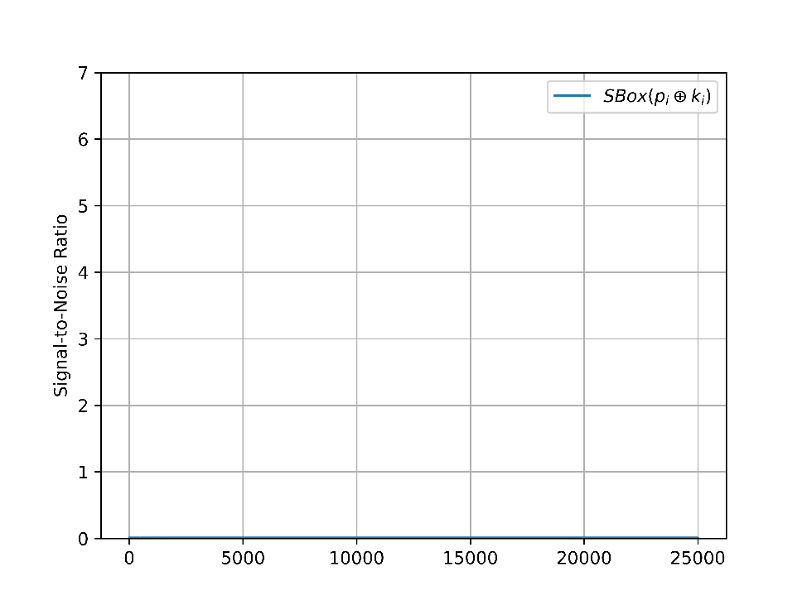
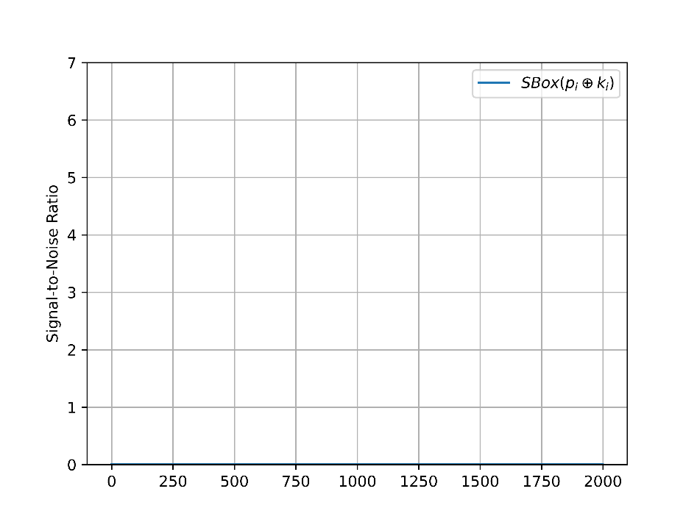
Masking[3]
Masking[3]
Split computation of sensitive value into d shares with some randomness
$x=x_{1}⋄x_{2}…⋄x_{d}$
Recombine shares at end to remove randomness
Unprotected leakage
Protected leakage

Slide 6
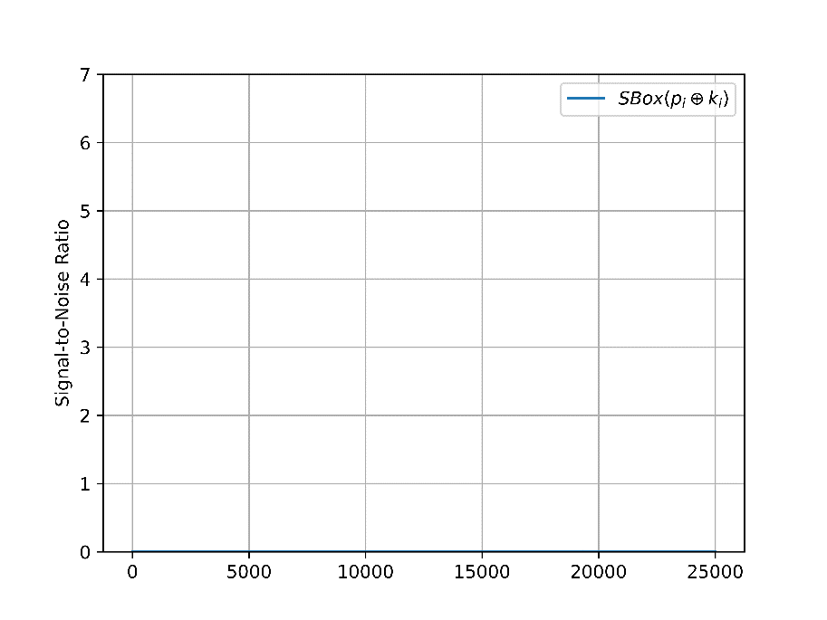
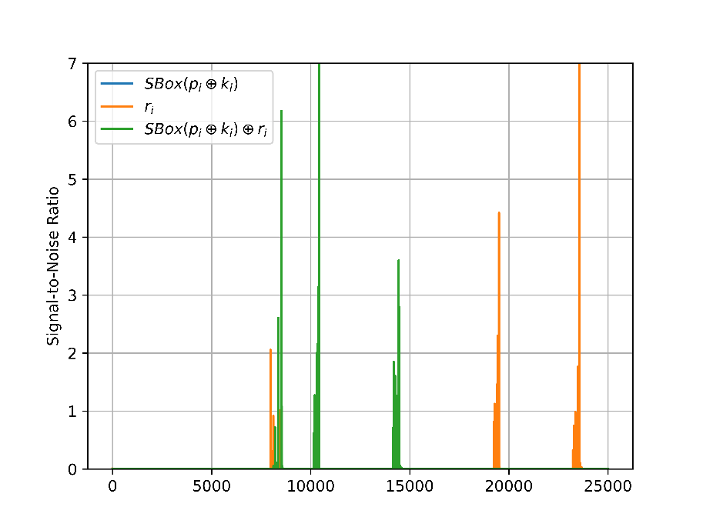
Masking
Computation still leaks, just not directly
If we know randomness used and masking scheme we can still find it
Exploitation now requires finding leakage and recombining values
No first order leakage
2’nd order leakage

Slide 7
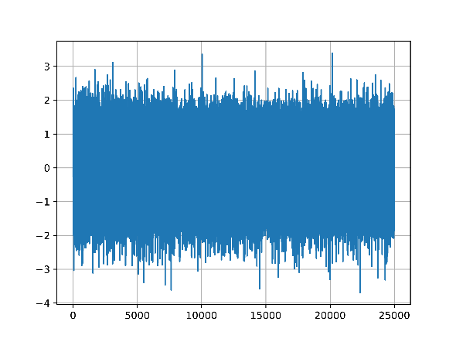
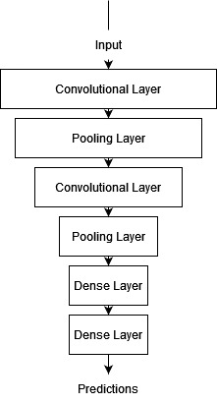
Deep-Learning Based SCA
Profiled SCA model creation is classification
Why not use neural nets?
Can automatically defeat:
masking [4]
misalignment[6]
raw traces [7]
and combinations

Slide 8
Raw traces vs. Feature Selection
If we know masking randomness attacks are ‘easy’
Select only leaky samples
Profile individual shares and do SASCA or do DL on this subset
Attacking raw traces using DL is possible but difficult
Max accuracy low
Traces mostly noise
Model memorizes noise to increase accuracy(overfitting)
Can we do feature selection without masks?

Slide 9
Threat Model
Scheme Aware[5]
Profiling setup
Known implementation
No access to masking randomness
Create reference implementation on similar device with similar masking scheme
On reference device use known masks to do feature selection
Attempt to emulate feature selection on target

Slide 10
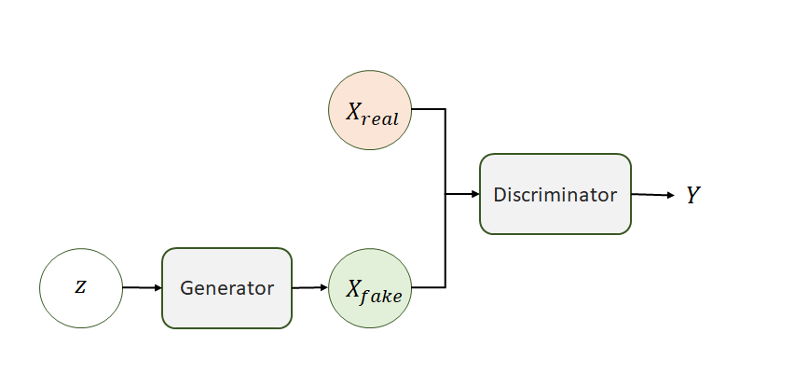
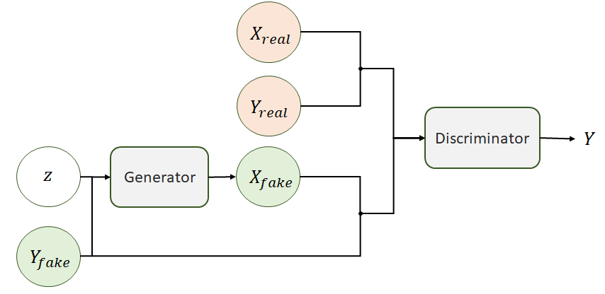
(Conditional) Generative Adversarial Networks
Train Discriminator to distinguish real/generated images
Train Generator to fool discriminator
Networks compete in min-max game [9]
Condition on class label to control generation
Z = Noise, X = image, Y = image label

Slide 11
CGAN-SCA Framework
Scheme Aware threat model[5]
Profiling Device available
Know implementation details
No mask knowledge
Include Reference Device
‘Similar’ implementation
Known masks
Do feature selection
Train CGAN to take profiling traces to imitate feature selection from reference device on target

Slide 12
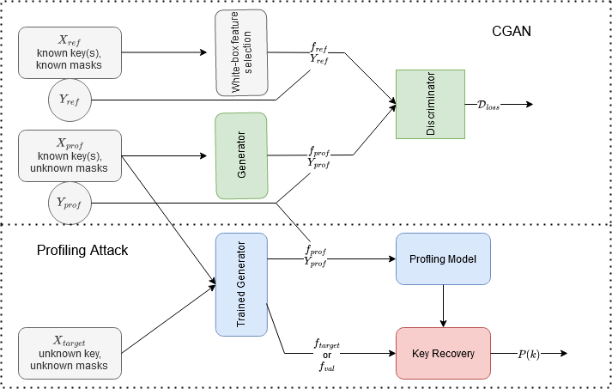

Slide 13
Targets
Dataset | Side-Channel Type | Platform and ISA | Clock Speed | Countermeasure
ASCADf | EM | AVR RISC (8 bits) | 4MHz | Boolean Masking
ASCADr | EM | AVR RISC (8 bits) | 4MHz | Boolean Masking
DPAv4.2 | Power | AVR MIPS (8 bits) | 4MHz | RSM Masking
CHES CTF 2018 | Power | ARM Cortex-M4 (32 bits) | 168MHz | Boolean Masking
ESHARD-AES128 | EM | ARM Cortex-M4 (32 bits) | 30MHz | Boolean Masking

Slide 14
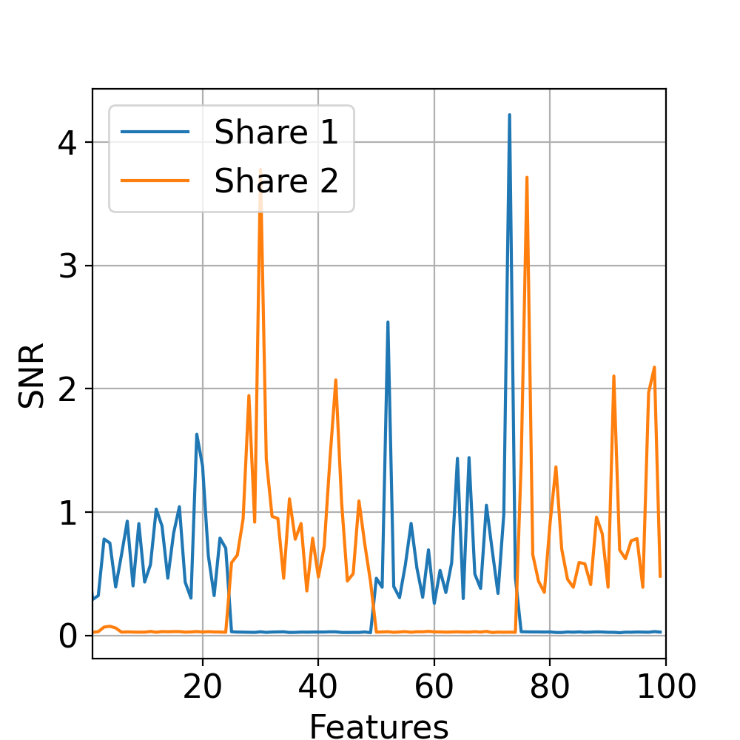
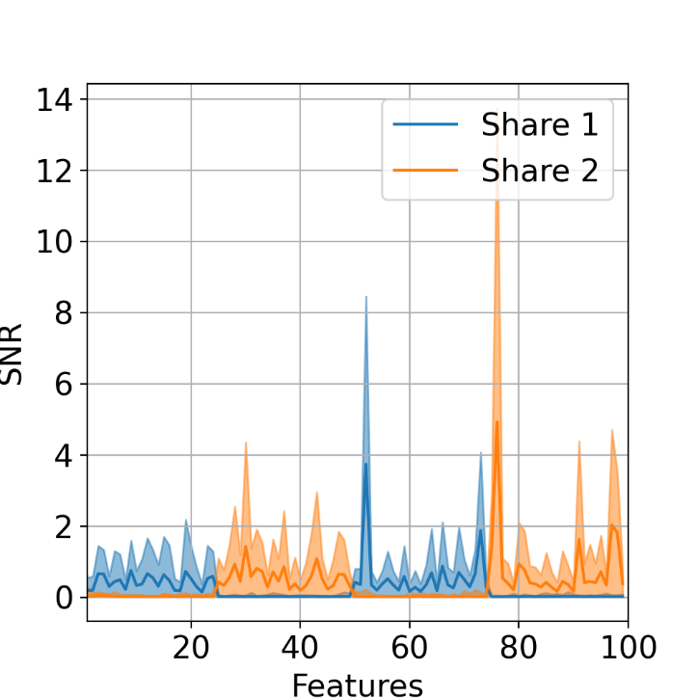
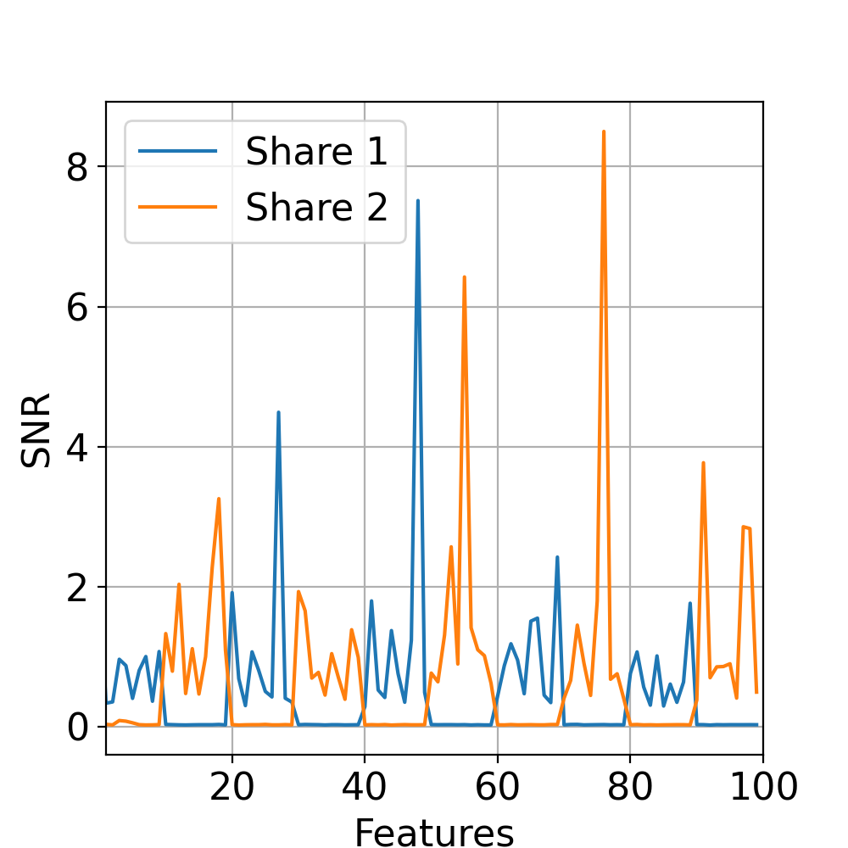
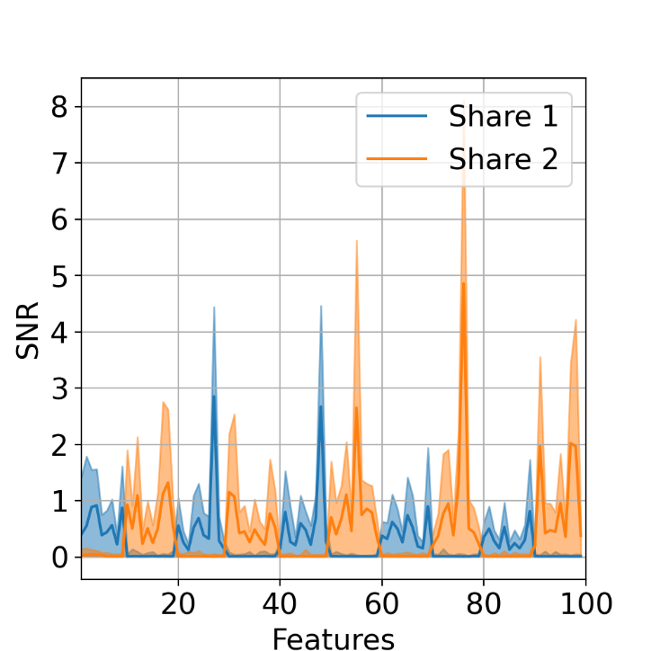
Results
Leakage Patterns
Ref(left)
Target(right)

Slide 15
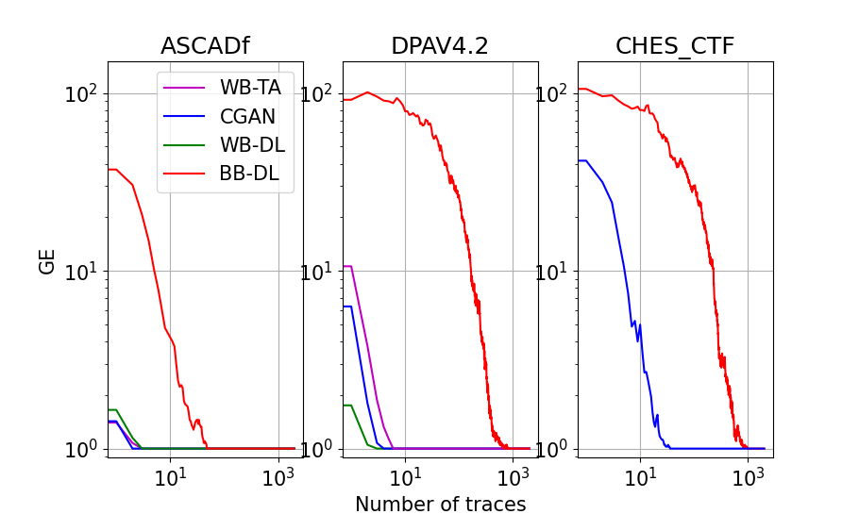
Attack Results

Slide 16
Similarity
Necessary ‘similarity’:
Masking schemes broadly similar (i.e. if ref has 3 shares and target 2 it’s probably not helpful)
The closer the device the better
In ideal settings attacks are as good as with known masks
We approach in close-device, different masking scheme (DPA vs. ASCAD)
In worse settings still significantly improve over Black-box

Slide 17
Conclusion
Using reference device can help in improving attacks
Given the right training setups neural networks can exploit information from these reference devices
Future work:
Waving Scheme-awareness for using reference device[10]
Exploring more options for generative training structures

Slide 18
Fin.

Slide 19
References
[1] Kocher, P.C., Jaffe, J., Jun, B. (1999): Differential power analysis. In: Wiener, M.J. (ed.) Advances in Cryptology - CRYPTO ’99
[2] Chari, S., Rao, J.R., Rohatgi, P.(2002): Template attacks. In: Jr., B.S.K., Koç, Ç.K., Paar, C. (eds.) Cryptographic Hardware and Embedded Systems - CHES 2002
[3] Ishai, Y., Sahai, A., & Wagner, D. (2003). Private circuits: Securing hardware against probing attacks. In Advances in Cryptology-CRYPTO 2003
[4] Kim, J. H., Picek, S., Heuser, A., Bhasin, S., & Hanjalic, A. (2019). Make some noise: Unleashing the power of convolutional neural networks for profiled side-channel analysis. IACR Transactions on Cryptographic Hardware and Embedded Systems, 2019(3)
[5] Masure, L., Cristiani, V., Lecomte, M., & Standaert F.X.(2022). Don’t Learn What You Already Know: Scheme-Aware Modeling for Profiling Side-Channel Analysis against Masking. (2022). IACR Transactions on Cryptographic Hardware and Embedded Systems, 2023(1), 32-59
[6] Cagli, E., Dumas, C., & Prouff, E. (2017). Convolutional neural networks with data augmentation against jitter-based countermeasures: Profiling attacks without pre-processing. In Cryptographic Hardware and Embedded Systems–CHES 2017

Slide 20
References (cont.)
[7] Lu, X., Zhang, C., Cao, P., Gu, D., & Lu, H. (2021). Pay attention to raw traces: A deep learning architecture for end-to-end profiling attacks. IACR Transactions on Cryptographic Hardware and Embedded Systems
[8] Picek, S., Perin, G., Mariot, L., Wu, L., & Batina, L. (2023). Sok: Deep learning-based physical side-channel analysis. ACM Computing Surveys, 55(11), 1-35
[9] Goodfellow, I., Pouget-Abadie, J., Mirza, M., Xu, B., Warde-Farley, D., Ozair, S., ... & Bengio, Y. (2020). Generative adversarial networks. Communications of the ACM, 63(11), 139-144.
[10] C. Xiao, M. Tang, S. Karayalcin and W. Cheng, "LD-PA: Distilling Univariate Leakage for Deep Learning-based Profiling Attacks," in IEEE Transactions on Information Forensics and Security

Slide 21
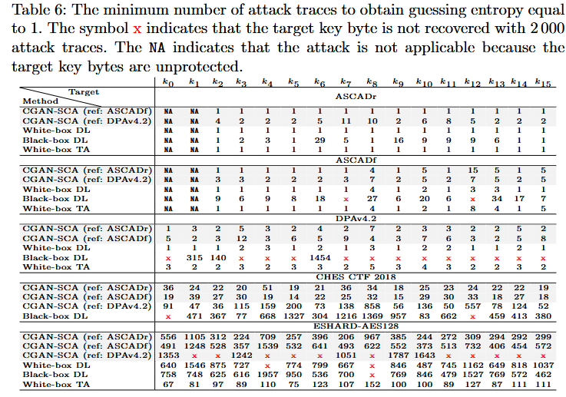
Detailed Attack Results

Slide 22
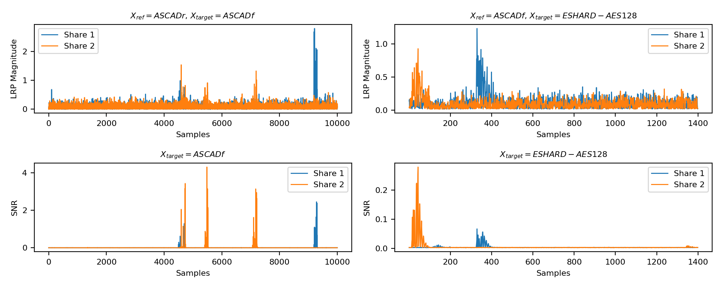
Input visualization

Slide 23
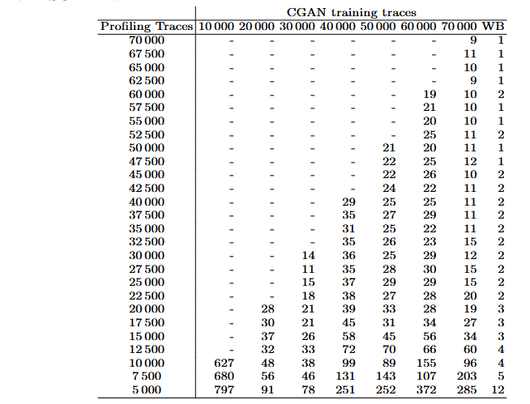
Profiling Complexity

Slide 24
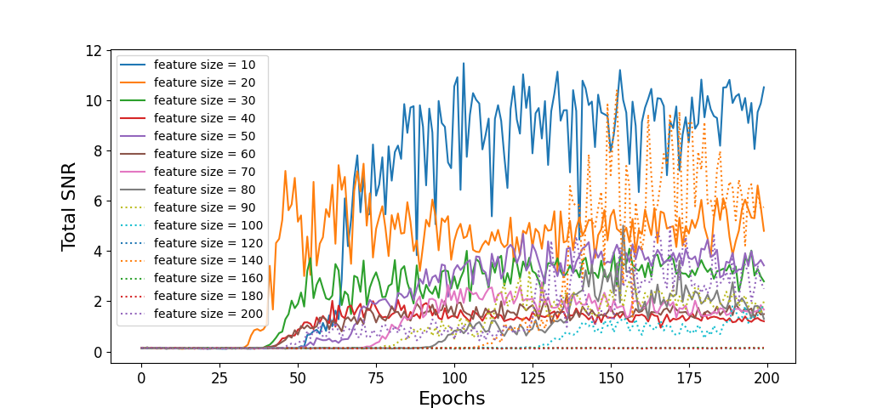
N_f

