Slide 1

Signature-based Witness Encryption with Compact Ciphertext
Gennaro Avitabile¹ Nico Döttling² Bernardo Magri^{3,4} Christos Sakkas³ Stella Wohnig^{2,5}
¹IMDEA Software Institute (Madrid, Spain)
²CISPA Helmholtz Center for Information Security (Saarbrücken, Germany)
³The University of Manchester (United Kingdom)
⁴Primev
⁵Saarland University (Saarbrücken, Germany)

Slide 2
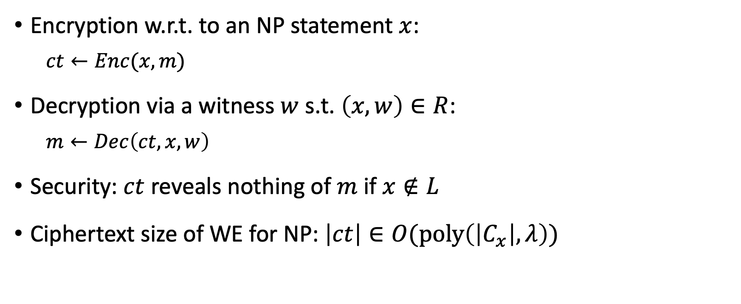
Witness Encryption
Encryption w.r.t. to an NP statement $x$:
  $$ct←Enc(x,m)$$
Decryption via a witness $w$ s.t. $\left(x,w\right)∈R$:
  $$m←Dec\left(ct,x,w\right)$$
Security: $ct$ reveals nothing of $m$ if $x∉L$
Ciphertext size of WE for NP: $\left|ct\right|∈O(poly\left(\left|C_{x}\right|,λ\right))$

Slide 3
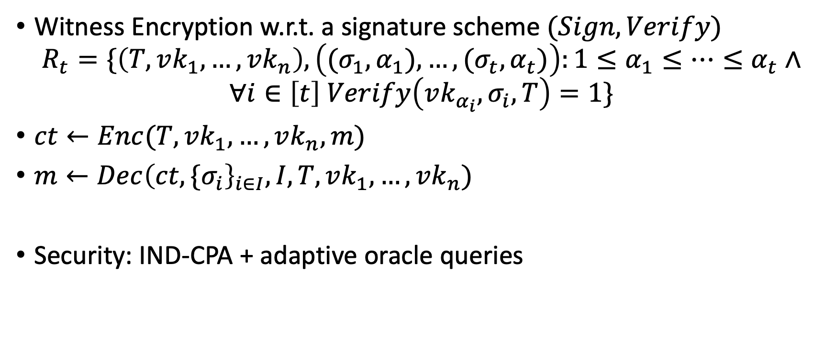
Signature-based Witness Encryption (SWE)
Witness Encryption w.r.t. a signature scheme $(Sign,Verify)$
$$R_{t}=\{\left(T,vk_{1},…,vk_{n}\right),\left({(σ}_{1},α_{1}),…,{(σ}_{t},α_{t})\right):1≤α_{1}≤…≤α_{t}∧$$
$$∀i∈\left[t\right] Verify\left({vk_{α_{i}},σ}_{i},T\right)=1\}$$
$ct←Enc(T,vk_{1},…,vk_{n},m)$
$m←Dec{\left(ct,{\{σ}_{i}\right\}}_{i∈I},I,T,vk_{1},…,vk_{n})$
Security: IND-CPA + adaptive oracle queries
[DHMW24] Döttling et al. Mcfly: Verifiable encryption to the future made practical. FC 2024.

Slide 4









Applications: Time-Release Encryption
1769
1770
...
$$vk_{3}$$
$$vk_{5}$$
$$vk_{4}$$
$$vk_{7}$$
$$vk_{2}$$
$$vk_{1}$$
$$vk_{6}$$

Slide 5
Applications: Time-Release Encryption
1769
1770
...
$$vk_{3}$$
$$vk_{5}$$
$$vk_{4}$$
$$vk_{7}$$
$$vk_{2}$$
$$vk_{1}$$
$$vk_{6}$$

Slide 6
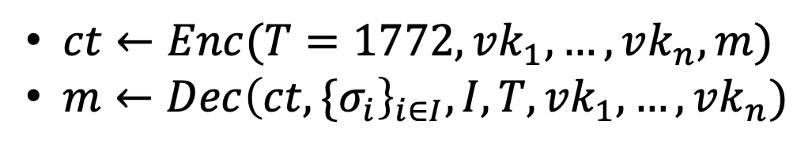
Applications: Time-Release Encryption
1769
1770
1771
1772
...
I want to reveal a secret $m$ when block 1772 is approved:
$ct←Enc(T=1772,vk_{1},…,vk_{n},m)$
$m←Dec{\left(ct,{\{σ}_{i}\right\}}_{i∈I},I,T,vk_{1},…,vk_{n})$

Slide 7
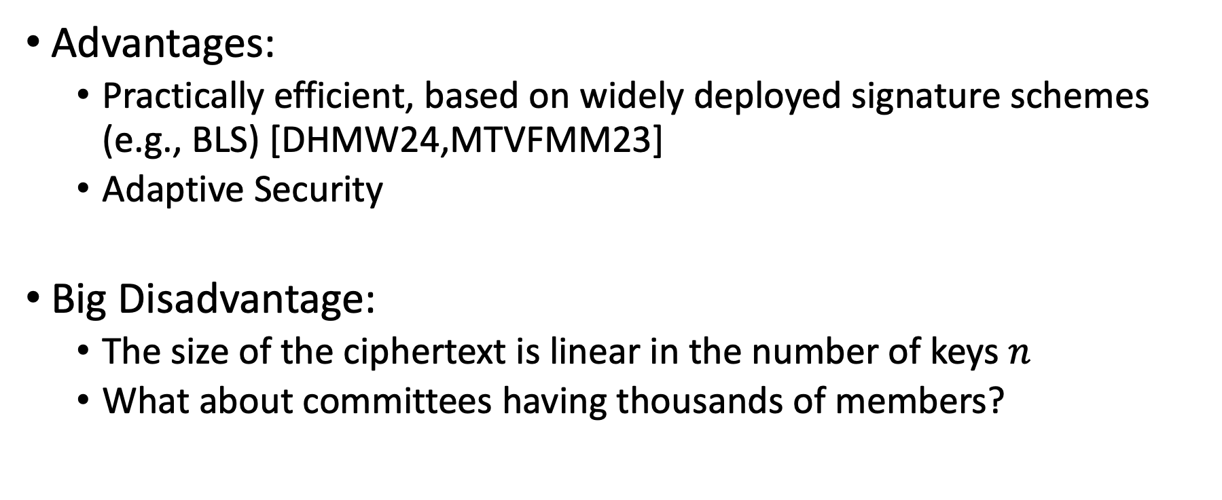
Current SWEs
Advantages:
  Practically efficient, based on widely deployed signature schemes (e.g., BLS) [DHMW24,MTVFMM23]
  Adaptive Security
Big Disadvantage:
  The size of the ciphertext is linear in the number of keys $n$
  What about committees having thousands of members?
[DHMW24] Döttling et al. Mcfly: Verifiable encryption to the future made practical. FC 2024.
[MTVFMM23] Madathil et al. Cryptographic oracle-based conditional payments. NDSS 2023.

Slide 8
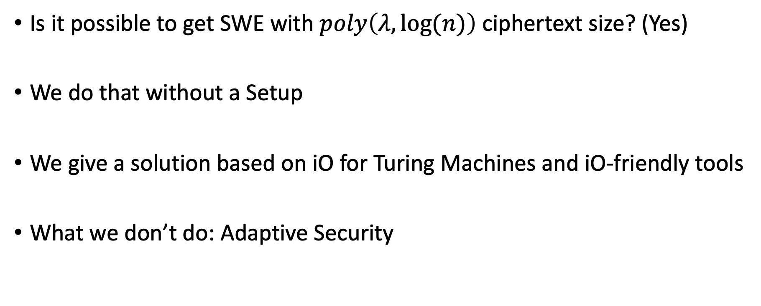
Our Work
Is it possible to get SWE with $poly\left(λ,log⁡(n)\right)$ ciphertext size? (Yes)
We do that without a Setup
We give a solution based on iO for Turing Machines and iO-friendly tools
What we don’t do: Adaptive Security

Slide 9






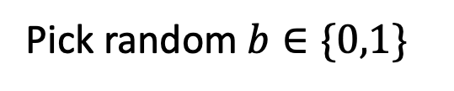


Our Notion of Security
$$😈$$
$$T,i s.t. i∉C∧T≠T^{∗}$$
😇
$$σ_{i}=Sign(sk_{i},T)$$
$$T^{∗}, C⊂\left[n\right], \left|C\right|≤t−1$$
$$vk_{1},…,vk_{n}, {\left\{sk_{i}\right\}}_{i∈C}$$
$$m_{0},m_{1}$$
$$ct=Enc(T^{∗},vk_{1},…,vk_{n},m_{b})$$
Pick random $b∈\{0,1\}$
$$b′$$
Check $b^{′}=b$

Slide 10


iO for Turing Machines
X
Y
OBF ( )
Size S, Time T
X
Y
OBF ( )
Size S, Time T

Slide 11

iO for Turing Machines
X
Y
Efficiency-preserving: Obfuscating only adds poly overhead.
Size matters: The machines must have the same size -> The real program is as big as the biggest program in the security proof.
$$≈$$
X
Y

Slide 12
iO-Friendly Tools
Puncturable PRFs
Puncturable Signatures
SSB Hash

Slide 13
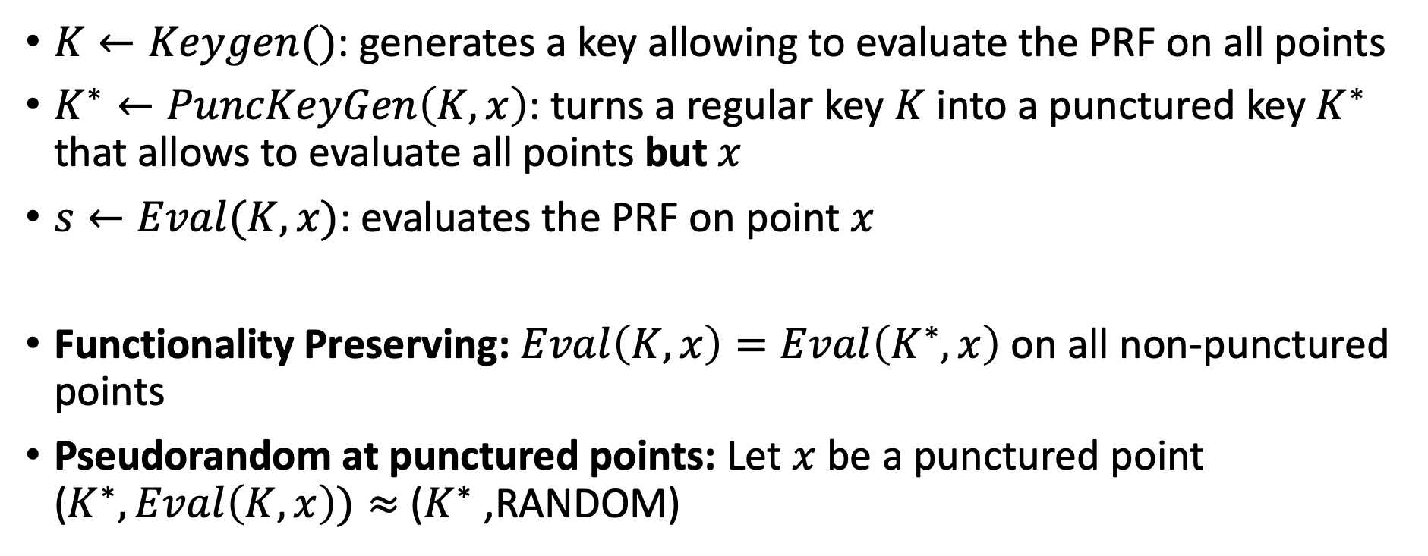
Puncturable PRFs
$K←Keygen()$: generates a key allowing to evaluate the PRF on all points
$K^{∗}←PuncKeyGen\left(K,x\right)$: turns a regular key $K$ into a punctured key $K^{∗}$ that allows to evaluate all points but $x$
$s←Eval(K,x)$: evaluates the PRF on point $x$
Functionality Preserving: $Eval\left(K,x\right)=Eval\left(K^{∗},x\right)$ on all non-punctured points
Pseudorandom at punctured points: Let $x$ be a punctured point ($K^{∗},Eval\left(K,x\right))≈$ ($K^{∗}$,RANDOM)

Slide 14
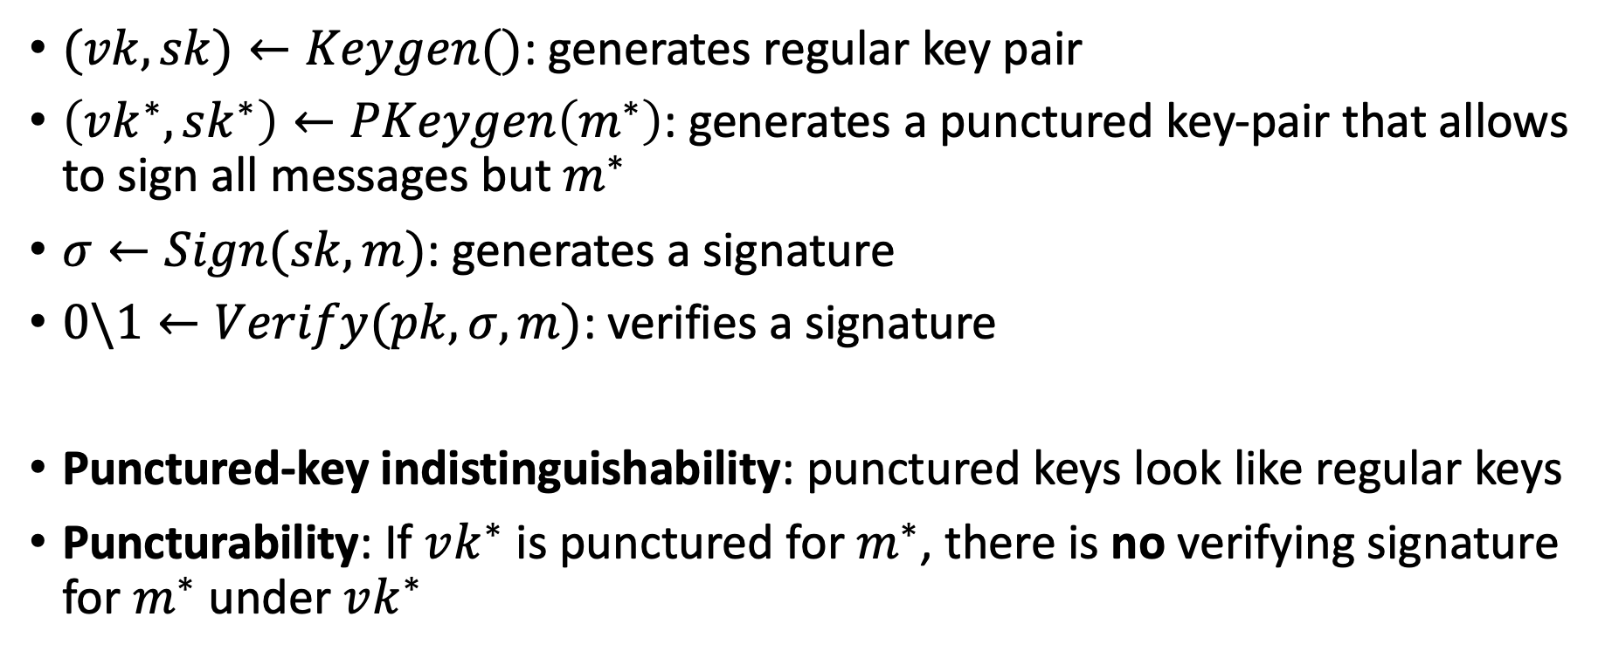
Puncturable Signatures
$(vk,sk)←Keygen()$: generates regular key pair
$\left(vk^{∗},sk^{∗}\right)←PKeygen\left(m^{∗}\right)$: generates a punctured key-pair that allows to sign all messages but $m^{∗}$
$σ←Sign(sk,m)$: generates a signature
$0\backslash 1←Verify(pk, σ,m)$: verifies a signature
Punctured-key indistinguishability: punctured keys look like regular keys
Puncturability: If $vk^{∗}$ is punctured for $m^{∗}$, there is no verifying signature for $m^{∗}$ under $vk^{∗}$

Slide 15

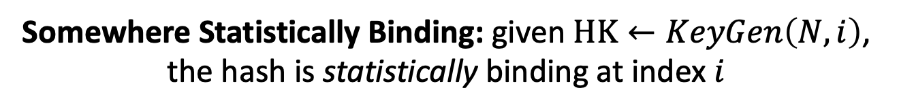
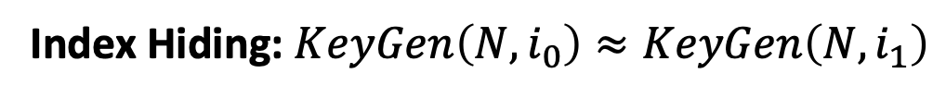

Somewhere Statistically Binding Hash
HK
X₁
X₂
X₃
X₄
…
X_{N}
$$N$$
KeyGen
Hash
Hashing Key (HK)
D=
Short Digest (H)
$$i∈[N]$$
Efficiency: SIZE( ) = $poly\left(\log\left(N\right),λ\right)$ , SIZE( ) = $poly\left(λ\right)$
Hashing Key (HK)
Short Digest (H)
Index Hiding: $KeyGen\left(N,i_{0}\right)≈KeyGen\left(N,i_{1}\right)$
Somewhere Statistically Binding: given $HK←KeyGen\left(N,i\right)$, the hash is statistically binding at index $i$

Slide 16





Somewhere Statistically Binding Hash
HK
$$i∈[N]$$
HK
$$i∈[N]$$
Open
D
Verify
D
Proof ($τ)$
ACCEPT/REJECT
X_{i}
H
H
$$τ$$
Efficiency:
SIZE($τ$)$=poly\left(log\left(n\right),λ\right)$
$Verify$ runs in time $poly\left(\log\left(n\right),λ\right)$

Slide 17
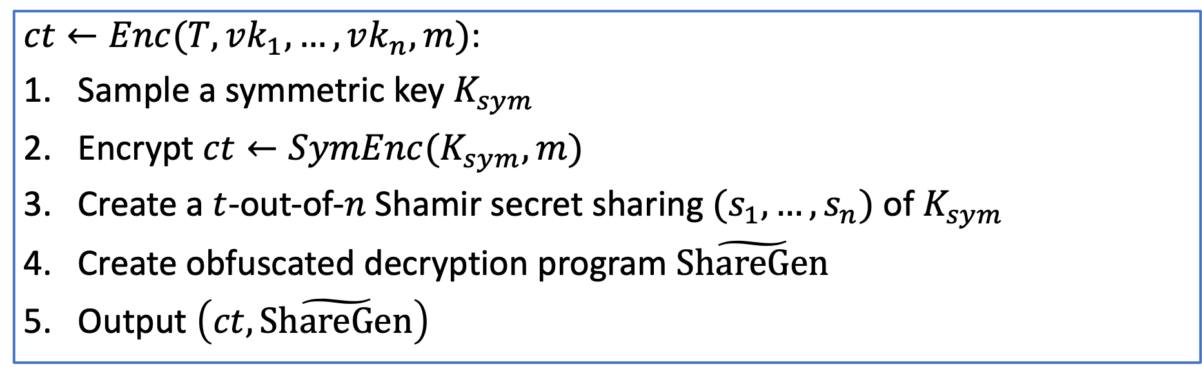
Blueprint - Encryption
$ct←Enc(T,vk_{1},…,vk_{n},m)$:
Sample a symmetric key $K_{sym}$
Encrypt $ct←SymEnc(K_{sym},m)$
Create a $t$-out-of-$n$ Shamir secret sharing $(s_{1},…,s_{n})$ of $K_{sym}$
Create obfuscated decryption program $\tilde{ShareGen}$
Output $\left(ct,\tilde{ShareGen}\right)$

Slide 18
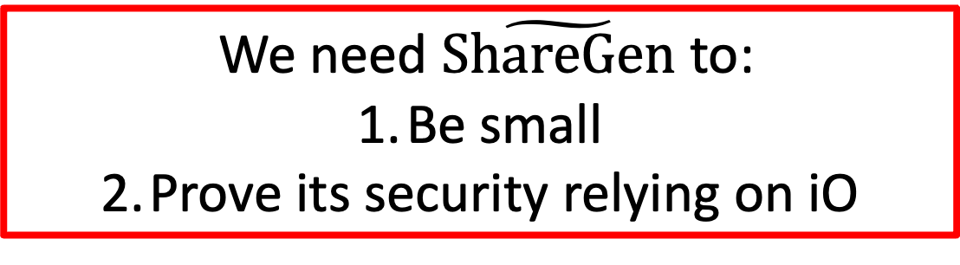
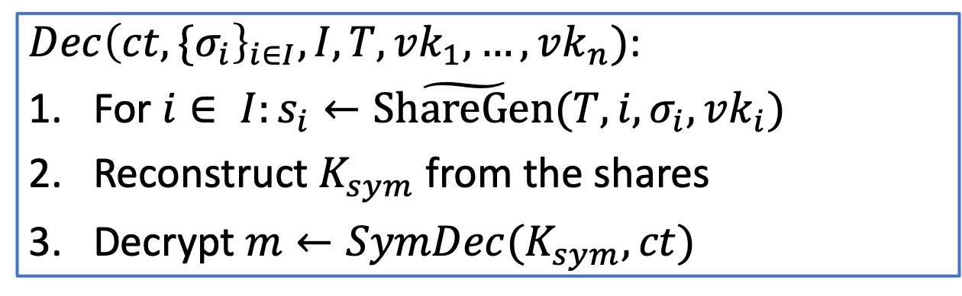
Blueprint - Decryption
$Dec{\left(ct,{\{σ}_{i}\right\}}_{i∈I},I,T,vk_{1},…,vk_{n})$:
For $i∈ I:s_{i}←\tilde{ShareGen}(T,i,σ_{i},vk_{i})$
Reconstruct $K_{sym}$ from the shares
Decrypt $m←SymDec(K_{sym},ct)$
We need $\tilde{ShareGen}$ to:
Be small
Prove its security relying on iO

Slide 19
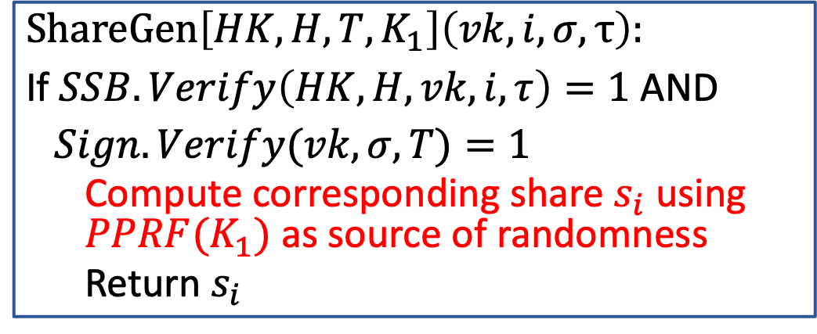

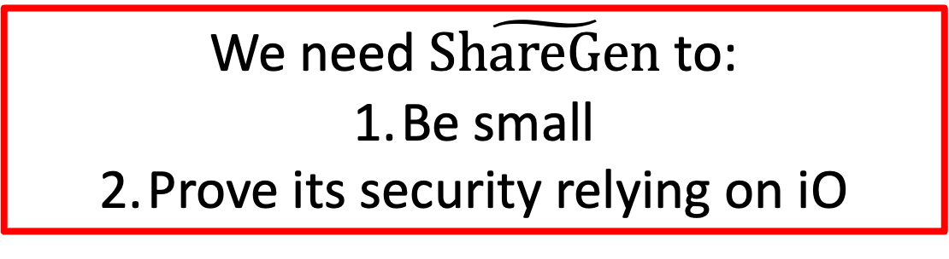

A First Attempt to the $ShareGen$ Program
$$ShareGen\left[HK,H,T,K_{1}\right]\left(vk, i,σ,τ\right):$$
If $SSB.Verify\left(HK,H,vk,i,τ\right)=1$ AND
$Sign.Verify(vk,σ,T)=1$
  Compute corresponding share $s_{i}$ using $PPRF(K_{1})$as source of randomness
  Return $s_{i}$
Compact representation of the keys via SSB hash
HK
$$vk_{1}$$
$$…$$
$$vk_{n}$$
We need $\tilde{ShareGen}$ to:
Be small
Prove its security relying on iO
Hash
H

Slide 20






A First Attempt to Prove Security
$$vk, i,σ,τ$$
$$vk, i,σ,τ$$
$$vk, i,σ,τ$$
Share Generator for ALL keys
Share Generator ONLY for CORRUPT keys
RANDOM Generator ONLY for CORRUPT keys
1
2
$$s_{i}$$
$$s_{i}$$
$$s_{i}$$
1
SIMULTANEOUS Puncturing at $n−t+1$(uncorrelated) points -> makes $K_{1}^{∗}$ of size $Ω(t)$!
2
Replace remaining shares with random values -> hardwire $t−1$ values!

Slide 21

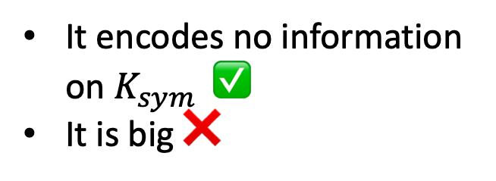

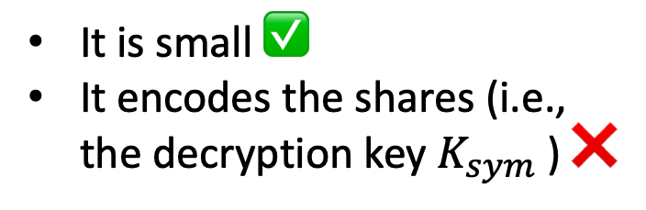
A First Attempt to Prove Security
$$vk, i,σ,τ$$
$$vk, i,σ,τ$$
Small
Share Generator for ALL keys
Hybrid Argument
Big
Random Generator on CORRUPT keys
$$s_{i}$$
$$s_{i}$$
It is small ✅
It encodes the shares (i.e., the decryption key $K_{sym}$ ) ❌
It encodes no information on $K_{sym}$ $\text{✅}$
It is big ❌

Slide 22
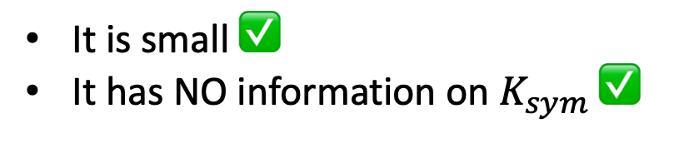





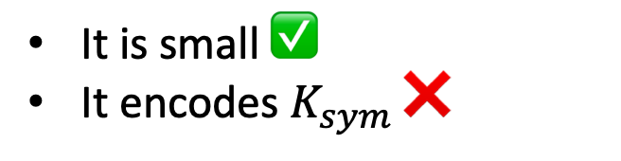

Our Solution
Private Memory:
$$s_{1}$$ | … | $$s_{n}$$
READ
$$vk, i,σ,τ$$
$$s_{i}$$
$$vk, i,σ,τ$$
Small
Share Generator for ALL keys
Hybrid Argument
Small Retrieval Machine
$$s_{i}$$
$$s_{i}$$
It is small ✅
It encodes $K_{sym}$ ❌
It is small ✅
It has NO information on $K_{sym}$✅

Slide 23
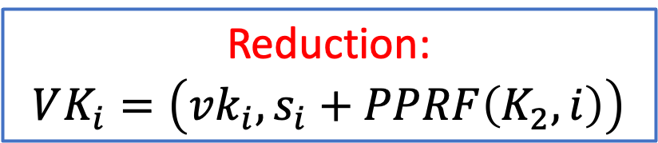
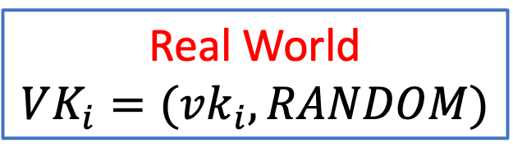

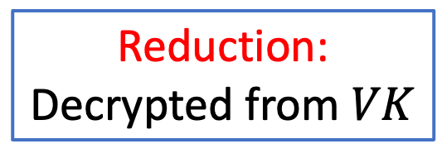

How to Emulate the Memory
1) We augment verification keys with a random string:
Real World
$$VK_{i}=(vk_{i},RANDOM)$$
Reduction:
$$VK_{i}=\left(vk_{i},s_{i}+PPRF\left(K_{2},i\right)\right)$$
$$≈$$
2) We change the computation of the shares:
Real World:
Computed with PRF
Reduction:
Decrypted from $VK$
$$≈$$

Slide 24

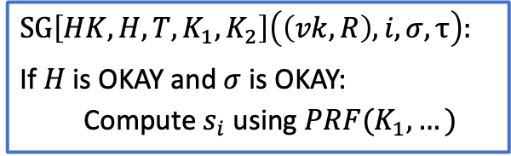



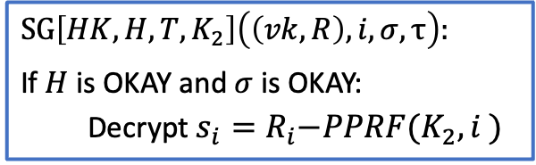



How to Emulate the Memory
$$\left(vk_{1},R_{1}\right),…,(vk_{n},R_{n})$$
$$∀i∈\left[n\right]:(vk_{i},s_{i}+PPRF\left(K_{2},i\right))$$
iO + PPRF
$$SG\left[HK,H,T,K_{1},K_{2}\right]\left(\left(vk, R\right), i,σ,τ\right):$$
If $H$is OKAY and $σ$ is OKAY:
  Compute $s_{i}$ using $PRF(K_{1},…)$
$$SG\left[HK,H,T,K_{2}\right]\left(\left(vk, R\right), i,σ,τ\right):$$
If $H$is OKAY and $σ$ is OKAY:
  Decrypt${ s_{i}=R}_{i}−PPRF(K_{2},i )$
One-by-one Puncturing
Puncture honest signature keys
Standard puncturing argument
PRF + Secret Sharing + IND-CPA
Honest Keys:
$R_{i}=$ random
ALL Keys:
$R_{i}=$ random
Corrupt Keys:
$R_{i}=s_{i}+PPRF(K_{2},i)$
Ciphertext:
$$(SymEnc\left(K,m_{1}\right),\tilde{ShareGen})$$
Ciphertext:
$$(SymEnc\left(K,m_{0}\right),\tilde{ShareGen})$$

