Slide 1
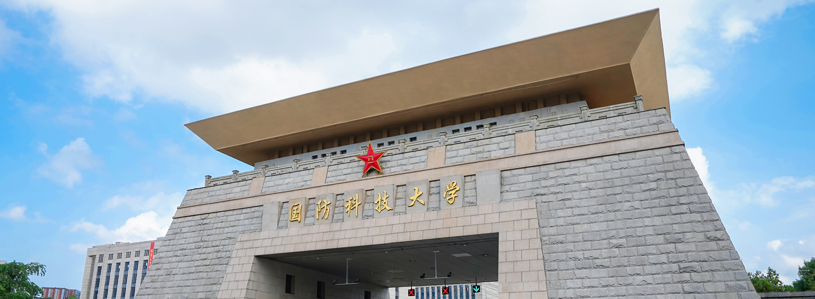
Tighter Proofs for PKE-to-KEM Transformation
in the Quantum Random Oracle Model
Jinrong Chen$†$
$†$ National University of Defense Technology, China
joint work with
Yi Wang$†$, Rongmao Chen*$†$, Xinyi Huang$‡$, Wei Peng$†$
$‡$ Jinan University, China
ASIACRYPT 2024

Slide 2
Overview
01
Background
02
Reductions for KEM
03
Reprogram-after-Measure

Slide 3
Cryptographic Primitives
Public Key Encryption (PKE)
Key Encapsulation Mechanism (KEM)
used for data encryption
used for key management
Gen:
pk
sk
Gen:
pk
sk
Enc:
m
c
Encaps:
k
c
=
=
Dec:
m'
Decaps:
k'

Slide 4
OW-CPA & IND-CCA
PKE’s OW-CPA security
KEM’s IND-CCA security
Challenger
Adversary
Adversary
Challenger
c ≠ c*
(pk, sk) ← Gen(1^{λ})
(pk, sk) ← Gen(1^{λ})
m* $\underset{←}{\$} ℳ$
k $≔$ Decaps(sk, c)
(k₀, c*) ← Encaps(pk)
k₁ $\underset{←}{\$} 𝒦$,
b $\underset{←}{\$} \left\{0, 1\right\}$
c* ← Enc(pk, m*)
Decaps Oracle
pk, c*, k_{b}
pk, c*
output m'
(to guess m*)
output b'
(to guess b)
$${Adv}_{PKE}^{OW−CPA}≔\operatorname{Pr}\left[m^{′}=m^{∗}\right]$$
$${Adv}_{KEM}^{IND−1CCA}≔\left|\operatorname{Pr}\left[b^{′}=b\right]−1/2\right|$$

Slide 5
OW-CPA & IND-1CCA
PKE’s OW-CPA security
KEM’s IND-1CCA security
ROM
H
Random Oracle
only once
Challenger
Adversary
used to simulate hash function
Adversary
Challenger
c ≠ c*
(pk, sk) ← Gen(1^{λ})
(pk, sk) ← Gen(1^{λ})
m* $\underset{←}{\$} ℳ$
k $≔$ Decaps(sk, c)
(k₀, c*) ← Encaps(pk)
k₁ $\underset{←}{\$} 𝒦$,
b $\underset{←}{\$} \left\{0, 1\right\}$
c* ← Enc(pk, m*)
Decaps Oracle
pk, c*, k_{b}
pk, c*
output m'
(to guess m*)
output b'
(to guess b)
$${Adv}_{PKE}^{OW−CPA}≔\operatorname{Pr}\left[m^{′}=m^{∗}\right]$$
$${Adv}_{KEM}^{IND−1CCA}≔\left|\operatorname{Pr}\left[b^{′}=b\right]−1/2\right|$$

Slide 6
OW-CPA & IND-1CCA
PKE’s OW-CPA security
KEM’s IND-1CCA security
QROM
H
Quantum RO
only once
Challenger
Adversary
used to simulate hash function
Adversary
Challenger
U_{H}: |x, y$⟩$ ↦ |x, y⊕H(x)$⟩$
c ≠ c*
(pk, sk) ← Gen(1^{λ})
(pk, sk) ← Gen(1^{λ})
m* $\underset{←}{\$} ℳ$
k $≔$ Decaps(sk, c)
(k₀, c*) ← Encaps(pk)
k₁ $\underset{←}{\$} 𝒦$,
b $\underset{←}{\$} \left\{0, 1\right\}$
c* ← Enc(pk, m*)
Decaps Oracle
pk, c*, k_{b}
pk, c*
output m'
(to guess m*)
output b'
(to guess b)
$${Adv}_{PKE}^{OW−CPA}≔\operatorname{Pr}\left[m^{′}=m^{∗}\right]$$
$${Adv}_{KEM}^{IND−1CCA}≔\left|\operatorname{Pr}\left[b^{′}=b\right]−1/2\right|$$

Slide 7
NIST’s PQC Standardization
Post-quantum KEM in NIST’s PQC Standardization:
Selected Algorithms 2022: CRYSTALS-Kyber
Round 4 Submissions: BIKE, Classic McEliece, HQC
construct CCA-secure KEM from CPA-secure PKE
via Fujisaki-Okamoto (FO) transformation [C:FujOka99]
[C:FujOka99] Eiichiro Fujisaki, Tatsuaki Okamoto: Secure Integration of Asymmetric and Symmetric Encryption Schemes. CRYPTO 1999: 537-554

Slide 8
FO Transformation [C:FujOka99]
CPA-secure PKE $⇒$ CCA-secure KEM
Gen(1^{λ}):
(pk, sk) ← Gen^{P}(1^{λ})
return (pk, sk)
Encaps(pk):
m ←$ $ℳ$
c $≔$ Enc^{P}(pk, m; G(m))
k $≔$ H(m, c)
return (k, c)
Decaps(sk, c):
m' $≔$ Dec^{P}(sk, c)
if Enc^{P}(pk, m'; G(m')) = c then
return k$≔$H(m', c)
else
return ⊥
FO transformation with explicit rejection: KEM_{FO}$≔$FO⊥[PKE, H, G]
Re-encryption is time-consuming and susceptible to side-channel attacks
[C:FujOka99] Eiichiro Fujisaki, Tatsuaki Okamoto: Secure Integration of Asymmetric and Symmetric Encryption Schemes. CRYPTO 1999: 537-554

Slide 9
T_{H} Transformation [EC:HugVau22]
Construction without Re-Encryption
Gen^{P}
Gen(1^{λ}):
(pk, sk) ← Gen^{P}(1^{λ})
return (pk, sk)
Encaps(pk):
m ←$ $ℳ$
c $≔$ Enc^{P}(pk, m)
k $≔$ H(m, c)
return (k, c)
Decaps(sk, c):
m' $≔$ Dec^{P}(sk, c)
if m' = ⊥ : return ⊥
return k$≔$H(m', c)
Gen:
pk
sk
Enc^{P}
Encaps:
m
c
T_{H} transformation: KEM_{H}$≔$T_{H}[PKE, H]
H
Dec^{P}
if PKE is OW-CPA secure
then KEM_{H} is IND-1CCA secure
k
=
≠⊥
=⊥
Decaps:
k'
H
m'
return ⊥
[EC:HugVau22] Loïs Huguenin-Dumittan, Serge Vaudenay: On IND-qCCA Security in the ROM and Its Applications - CPA Security Is Sufficient for TLS 1.3. EUROCRYPT (3) 2022: 613-642

Slide 10
T_{H} Transformation [EC:HugVau22]
Practicality
IND-1CCA secure KEM is useful in PQ-TLS, KEM-TLS, …
T_{H} transformation does not requi-re Re-Encryption like FO trans-formation
Gen(1^{λ}):
(pk, sk) ← Gen^{P}(1^{λ})
return (pk, sk)
Encaps(pk):
m ←$ $ℳ$
c $≔$ Enc^{P}(pk, m)
k $≔$ H(m, c)
return (k, c)
Decaps(sk, c):
m' $≔$ Dec^{P}(sk, c)
if m' = ⊥ : return ⊥
return k$≔$H(m', c)
T_{H} transformation: KEM_{H}$≔$T_{H}[PKE, H]
ROM: ${Adv}_{KEM}^{IND−1CCA}\left(𝒜\right)≤O\left(q^{3}\right)⋅{Adv}_{{PKE}^{′}}^{OW−CPA}\left(ℬ\right)$
if PKE' is deterministic, then ${Adv}_{KEM}^{IND−1CCA}\left(𝒜\right)≤O\left(q^{2}\right)⋅{Adv}_{{PKE}^{′}}^{OW−CPA}\left(ℬ\right)$+$δ$
QROM: left open
[EC:HugVau22] Loïs Huguenin-Dumittan, Serge Vaudenay: On IND-qCCA Security in the ROM and Its Applications - CPA Security Is Sufficient for TLS 1.3. EUROCRYPT (3) 2022: 613-642

Slide 11
T_{RH} Transformation [AC:JMZ23]
Gen(1^{λ}):
(pk, sk) ← Gen^{P}(1^{λ})
return (pk, sk)
Encaps(pk):
m ←$ $ℳ$
c $≔$ Enc^{P}(pk, m)
k $≔$ H(m, c)
return (k, c)
Decaps(sk, c):
m' $≔$ Dec^{P}(sk, c)
if m' = ⊥ then
return ⊥ // T_{H}
return k$≔$H(★,c) // T_{RH}
return k$≔$H(m', c)
KEM_{H}$≔$T_{H}[PKE, H] and KEM_{RH}$≔$T_{RH}[PKE, H]
KEM_{H}’s IND-1CCA security can be tightly reduced to KEM_{RH}’s IND-1CCA security
[AC:JMZ23] Haodong Jiang, Zhi Ma, Zhenfeng Zhang: Post-quantum Security of Key Encapsulation Mechanism Against CCA Attacks with a Single Decapsulation Query. ASIACRYPT (4) 2023: 434-468

Slide 12
T_{RH} Transformation [AC:JMZ23]
T_{RH} transformation
ROM: ${Adv}_{{KEM}_{RH}}^{IND−1CCA}\left(𝒜\right)≤O\left(q^{2}\right)⋅{Adv}_{{PKE}^{′} }^{OW−CPA}\left(ℬ\right)$
if PKE' is deterministic, then ${Adv}_{{KEM}_{RH}}^{IND−1CCA}\left(𝒜\right)≤O\left(q\right)⋅{Adv}_{{PKE}^{′}}^{OW−CPA}\left(ℬ\right)$+$δ$
QROM: ${Adv}_{{KEM}_{RH}}^{IND−1CCA}\left(𝒜\right)≤O\left(q^{2}\right)\sqrt{{Adv}_{{PKE}^{′} }^{OW−CPA}\left(ℬ\right)+…}$
if PKE' is deterministic, then ${Adv}_{{KEM}_{RH}}^{IND−1CCA}\left(𝒜\right)≤O\left(q\right)\sqrt{{Adv}_{{PKE}^{′} }^{OW−CPA}\left(ℬ\right)+…}$
Sec. 5: for KEM = T_{RH}[PKE', H], a $O\left(q\right)$-ROM-loss (and $O\left(q^{2}\right)$-QROM-loss) is unavoidable in general.
Can these losses be further improved?
[AC:JMZ23] Haodong Jiang, Zhi Ma, Zhenfeng Zhang: Post-quantum Security of Key Encapsulation Mechanism Against CCA Attacks with a Single Decapsulation Query. ASIACRYPT (4) 2023: 434-468

Slide 13
Our results
Yes!
Can these losses be further improved?
If PKE' is rigid deterministic, the loss factors are only $O(1)$ in both ROM and QROM!
rigid deterministic PKE':
NTRU, Classic McEliece are constructed from rigid deterministic PKEs
×
c*
: Enc(pk, ·)
determinism implies that there is only a ciphertext
can be encrypted by a plaintext
×
m
m*
m
c₁
m₁
m
m
c₂
m₂
m
m
: Dec(sk, ·)
rigidity implies that Enc(pk, Dec(sk, c)) = c for
every c $∈𝒞$ (Dec(sk, c) ≠ ⊥)
c₃
m₃
m
m
…
…
This implies that the map Enc(pk, ·) is bijective !
（assuming PKE' is perfectly correct）

Slide 14
Proof Sketch in ROM [AC:JMZ23]
List^{H}
ROM
ROM:
(m₁, c₁)
H
(m₂, c₂)
Random Oracle
(m₃, c₃)
…
Decaps Oracle
c' ≠ c*
Adversary
to guess the RO query pair corresponding to the response of the decapsulation oracle
The probability is 1/(q_{H}+1)
i ←$ {1, …, q_{H}+1}
Yes
H(m_{i},c_{i})
Record (i, R).
Once adversary makes the i-th query (m_{i},c_{i}) to RO, return R.
Does (m_{i}, c_{i}) in List^{H} ?
No
R $∈𝒦$

Slide 15
Proof Sketch in ROM (Our Work)
In QROM?
List^{H}
ROM
ROM:
(m₁, c₁)
H
(m₂, c₂)
Random Oracle
(m₃, c₃)
…
Decaps Oracle
c' ≠ c*
Adversary
guess:
Dec(sk, c') = ⊥?
Yes
H(★,c')
successful probability is 1/2
No
Record (c', R). If (m, c') s.t. Enc(pk, m) = c' is queired to RO, return R.
Yes
Does exist (m', c')
in List^{H} s.t. Enc(pk, m')=c' ?
H(m',c')
No
R $∈𝒦$

Slide 16
Techniques used in [AC:JMZ23]
One-way to hiding (O2H):
$$\left|Pr\left[1←A^{\left|H\right\rangle }\left(Z\right)\right]−\operatorname{Pr}\left[1←A^{\left|G\right\rangle }\left(Z\right)\right]\right|≤2q\sqrt{\operatorname{Pr}\left[S∩T≠∅:T←B^{\left|H\right\rangle }\left(z\right)\right]}$$
(Single-classical-query) Measure-and-reprogram:
$$\underset{H}{Pr}\left[x=x_{0}∧V\left(x, H\left(x\right), z\right)=1:\left(x,z\right)←A^{\left|H\right\rangle }\right]≤2{\left(2q−1\right)}^{2}\underset{H,Θ}{Pr}\left[x=x_{0}∧V\left(x,Θ,z\right)=1:\left(x,z\right)←S^{A}\right]+8q^{2}\underset{H,Θ}{Pr}\left[x=x_{0}∧V\left(x,Θ,z\right)=1:\left(x,z\right)←S_{1}^{A}\right]$$
[AC:JMZ23] Haodong Jiang, Zhi Ma, Zhenfeng Zhang: Post-quantum Security of Key Encapsulation Mechanism Against CCA Attacks with a Single Decapsulation Query. ASIACRYPT (4) 2023: 434-468

Slide 17
New tool: Reprogram-after-Measure (RM)
For any quantum oracle algorithm $A^{O, \left|H\right\rangle }$ making at most $q_{H}$ times (quantum) $H$ random oracle queries, where $H :𝓧→𝓨$, and making at most one (classical) $O$ oracle query, where $O :𝓒→𝓩$, there exists an algorithm $B$ that does not need to access the $O$ oracle and the $H$ random oracle, such that
$$\operatorname{Pr}\left[Ev :A^{O, \left|H\right\rangle }\right]≤2\operatorname{Pr}\left[Ev :B\right],$$
for any classical event $Ev$.
The $O$ oracle works as follows:
1. Let $𝓒^{⊥}⊆𝓒$ be a set on which $A$ is not allowed to make the $O$ oracle query.
2. For any $c∈𝓒^{⊥}$ the $O$ oracle always returns $⊥$.
3. For $c∈𝓒∖𝓒^{⊥}$, the $O$ oracle
a) computes $x≔f^{−1}\left(c\right)$,
b) (classically) accesses the $H$ random oracle to obtain $y≔H\left(x\right)$,
c) returns $g(y)$,
where the functions $f :𝓧→𝓒$, $g :𝓨→𝓩$, and there is a unique preimage $x$ for $c∈𝓒∖𝓒^{⊥}$ under $f$.
$B$ only needs to know how to calculate the functions $f$ and $g$ (but does not need to know how to calculate $f^{−1}$).
Theorem 3 (Reprogram-after-Measure).

Slide 18
Proof Sketch in QROM (using RM lemma)
QROM
QROM:
H
Quantum RO
Decaps Oracle
c' ≠ c*
Adversary
guess:
Dec(sk, c') = ⊥?
Yes
H(★,c')
successful probability is 1/2
No
Obtain the response without sk by the RM lemma!

Slide 19
Our Reduction Results
ROM: ${Adv}_{{KEM}_{RH}}^{IND−1CCA}\left(𝒜\right)≤2\left({Adv}_{{PKE}^{′} }^{OW−CPA}\left(ℬ\right)+δ\right)$
QROM: ${Adv}_{{KEM}_{RH}}^{IND−1CCA}\left(𝒜\right)≤4\sqrt{{Adv}_{{PKE}^{′} }^{OW−CPA}\left(ℬ\right)}+2δ$
If PKE' is rigid deterministic, the loss factors are only $O(1)$ in both ROM and QROM

Slide 20
Proof sketch for RM lemma
· Step 1: use Compressed Oracle [C:Zhandry19]
to simulate the quantum random oracle $H$
D can be seen as the “log” of queries
For the query $\left|x, y\right\rangle$:
initial state in
the database register D:
$$\left|\left(⊥,0\right),\left(⊥,0\right),…,\left(⊥,0\right)\right\rangle$$
…
H
D: $2^{−n/2}Σ_{y^{′}}\left|x,y^{′}\right\rangle \left|\left(⊥,0\right),…,\left(⊥,0\right)\right\rangle$
$q_{H}$ pairs
$q_{H}$-1 pairs
decompression
procedure
decompression
procedure
$$O_{x}$$
H
H
H
XYD: $2^{−\frac{n}{2}}\left(Σ_{y}|x,y⊕y^{′}⟩\left|x,y^{′}\right\rangle \right)\left|\left(⊥,0\right),…\right\rangle$
Quantum RO
Compressed Oracle
CStO
Perfectly indistinguishable
[C:Zhandry19] Mark Zhandry: How to Record Quantum Queries, and Applications to Quantum Indifferentiability. CRYPTO (2) 2019: 239-268

Slide 21
Proof sketch for RM lemma
· Step 2: use $O^{B}$ to simulate $O$
where
This step introduces the factor $2$ in the result.

Slide 22
Proof sketch for RM lemma
· Step 3: use ${CStO}^{B}$ to simulate the $H$ random oracle after the $O$ oracle query
where
Perfectly indistinguishable
and

Slide 23
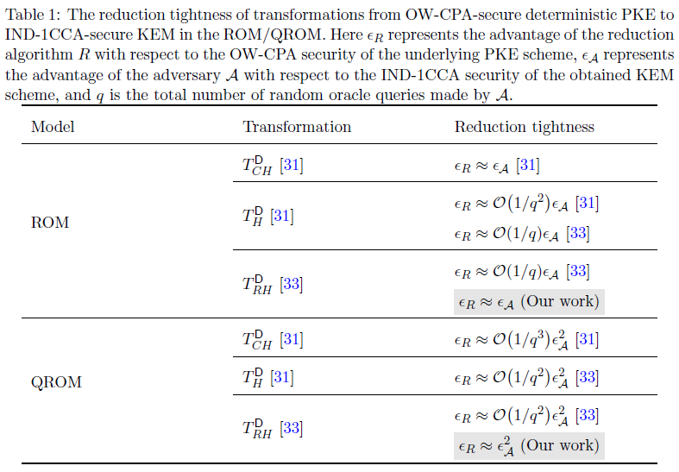
Reduction Tightness
[31] Loïs Huguenin-Dumittan, Serge Vaudenay: On IND-qCCA Security in the ROM and Its Applications - CPA Security Is Sufficient for TLS 1.3. EUROCRYPT (3) 2022: 613-642
[33] Haodong Jiang, Zhi Ma, Zhenfeng Zhang: Post-quantum Security of Key Encapsulation Mechanism Against CCA Attacks with a Single Decapsulation Query. ASIACRYPT (4) 2023: 434-468

Slide 24
Thanks for your attention :-)
Questions?
jinrongchen@nudt.edu.cn

