Slide 1
Crooked Indifferentiability of the Feistel Construction
Jiadong Zhu
Institute of Computing Technology, CAS
Joint work with
Alexander Russell
University of Connecticut
Qiang Tang
The University of Sydney
Notes:
Hello everyone, my name is Jiadong, and today I'd like to give a talk titled "Cooked in Differentiability of the Feistel Construction."
Before my presentation, I would like to express my gratitude to the conference committee for their generous support during this meeting. Unfortunately, I can't meet everyone in person due to visa issues, so I have to give my talk online.
This work is a collaboration with my PhD advisor, Alexander Russell, and Professor Qiang Tang from the University of Sydney. Cooked differentiability is a notion of security, so basically our paper is about constructing something secure using the Feistel cipher.

Slide 2
This talk
Motivations and practical attack
Formal modelling
Construction
Security analysis
Notes:
This talk consists of the following four parts. First, I will explain the motivation behind our research, specifically the practical attack we aim to address in our paper. Second, in the formal modeling section, I will define the security notion we use. Then I will introduce our construction and provide a security analysis demonstrating that our construction is secure.

Slide 3
Motivations and practical attack
Formal modelling
Construction
Security analysis

Slide 4
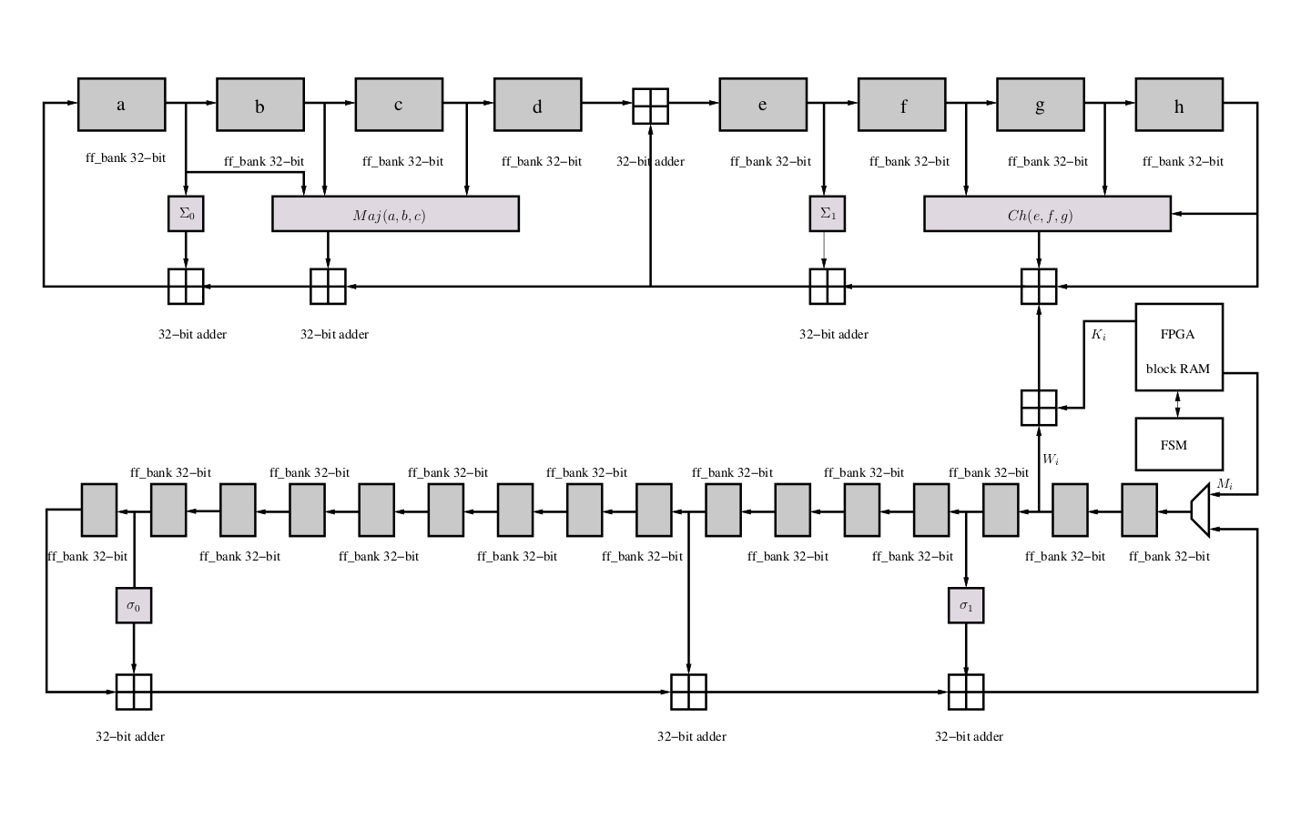
SHA 256
GPU
Backdoor Attack!
Notes:
A lot of cryptographic applications are based on hash functions, such as SHA-256. In many cases, we dont see them directly; instead, they are embedded in software or hardware. Typically, we trust the software and hardware, assuming that the internal hash functions are implemented correctly. But what if they are affected by a backdoor attack?

Slide 5
Ideally
In reality
?
Subversion Attack
Notes:
Ideally, we believe the function behaves as it should, but in reality, who knows? Perhaps an adversary has access to the physical design of the hash function and lanches a subversion attack, which means he changes outputs of the function for certain inputs.

Slide 6
TEST
?
Complex
Time-Comsuming
Requires Skilled Testers
Notes:
To address this problem, a natural thought is to run tests to check whether the function is implemented correctly. For example, we can conduct a white-box test. In a white-box test, the tester has access to the internal code and workings of a certain function. Unfortunately, a white-box test is often infeasible, as it is usually very complex and time-consuming. Understanding the internal structure of complex systems can be challenging, especially for large codebases. Additionally, testers need to have expertise and a deep understanding of the codebase.

Slide 7
TEST
?
Simple
Always Effective?
Notes:
But what about a black-box test? In a black-box test, the tester has no access to the internal code or workings of a function. Instead, the test selects some inputs, queries the function on those inputs, and checke whether the corrsponding outputs are correct. A black-box test is relatively simpler compared to a white-box test, but is it always effective?

Slide 8
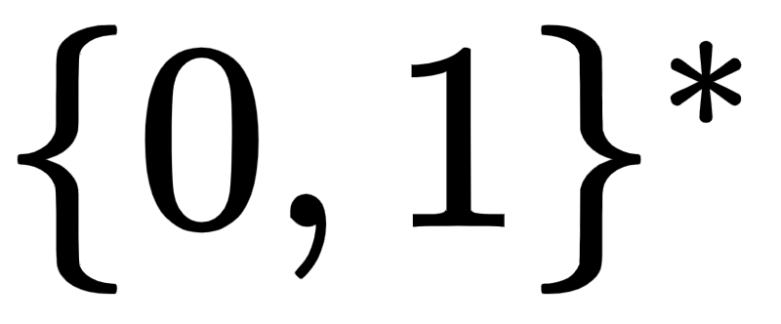
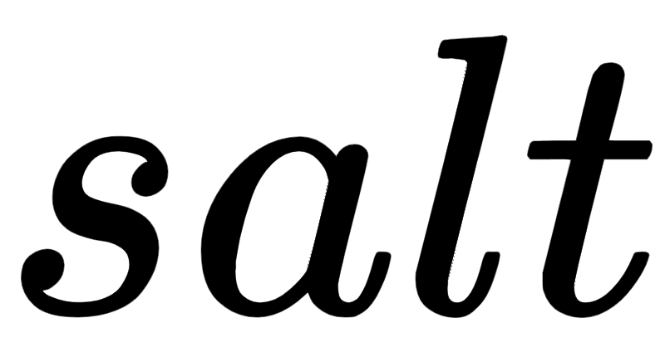
Password hashing scheme:
1. User Registration:
User
User
$
Map same passwords to different fingerprints
Notes:
To answer this question, let's look at an example. This is a password hashing scheme in which a user wants to register for a cellphone application and set up a password. The scheme is based on a hash function H. First, the user sets up their password. Then, the software selects a long random string called a salt, applies H to the password concatenated with the salt and get an output called fingerprint. The reason for adding the salt to the password is to avoid collisions of inputs.

Slide 9
2. User Login:
APP DATABASE
...
...
Secure even if the database is leaked!
Notes:
The pair of strings, salt and fingerprint, is stored in the application's database. When a user wants to log into their account, they provide a string x. If H of x/salt equals fingerprint, then the system confirms it is the correct user. Notice that in this scenario, the system remains secure even if the database is leaked, thanks to the properties of the hash function.

Slide 10
Subversion:
User
Adversary
Notes:
Now, let's add a attck subversion to the above scenario. Here comes an adversary who changes the hash function H to a different function H tilde. The user may still think he is using the original function, but in reality, hes using this compromised version of H without knowing the change.

Slide 11
Subversion:
$
has the same length with the hash output
Attack:
Notes:
For concreteness, let's look at a real example of a subversion attack. The adversary first selects a random string and defines H tilde in the follwing way. For any pair of strings a and b, he sets H tilde of y a b to be a. For all other inputs, he let H tilde equal H. With this subversion, the adversary can log into the user's account by setting x to be y concatenated with fingerprint. You can verify that H tilde of x salt is equal to fingerprint.

Slide 12
1. Cause huge damage!
Can break the whole system
H
2. Very resistant to blackbox test!
Takes too many implementations to find disagreements
Only subverts a small portion of H
Only subverts a small portion
Notes:
Notice that the above attack only subverts a very small portion of H, but it still causes huge damage; it actually breaks the whole system. Moreover, because it only subverts a small part of H, this attack is very resistant to black-box testing. It would take many queries to the function to find an input on which H and H tilde disagree.

Slide 13
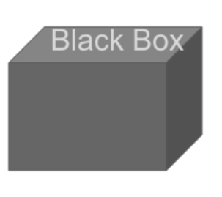
Only using blackbox test is not enough!
large size subversion
Make some slight modifications to the function
small size subversion
?
Notes:
So, using only black-box testing is not enough. Black-box tests may be effective for dealing with large-size subversions, where the adversary subverts the function across a broad range of inputs. However, for small-size subversions, we may need a different approach. In both white-box and black-box tests, we observe how the function is implemented but never intend to change the implementation. Therefore, a natural idea is to make some slight modifications to the function, which may help eliminate the small-size subversion.

Slide 14
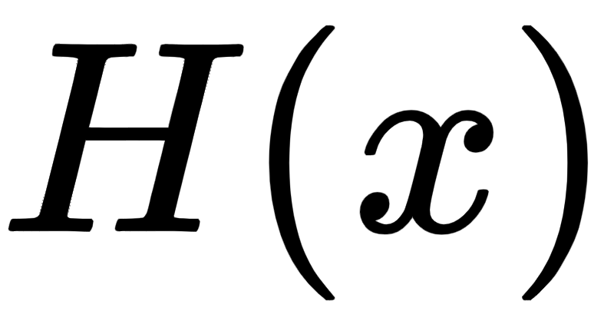
An example:
?
small size subversion
Slight modifications
hard for the adversary to find a subverted input
Resulting Function
?
Notes:
Let me give you an example to explain this idea. Suppose we have a hash function H, and an adversary launches a small-size subversion attack on H. To counter this subversion, we select a random private string r and shift the input by r. The resulting function is C x equals H of (x plus r). Since the adversary doesnt know the value of r, it will be difficult for him to find an input x such that H and H tilde disagree on (x plus r).

Slide 15
What we do in our work:
?
Random Function or Random Permutation
(probably subverted on a negligible portion of the function's inputs)
Slight modifications
Simple Operation
(i.e. basic algebra operation; use the original function as an oracle)
Construction
A construction “as good as” random function or random permutation
?
Notes:
By generalizing the above example, I can explain what we do in our work. First, we are not only interested in a specific hash function; we are focused on protecting primitives like random functions and random permutations. We are specifically concerned with small-size subversion attacks, meaning the functions we are interested in are only subverted on a negligible portion of inputs.
We plan to address subversion by making small modifications to the original functions, but we only allow very simple operations. Essentially, this means we permit only basic algebraic operations and use the original function as an oracle; we dont want to delve into the deep structure of the original function.
Finally, we want our resulting function or construction to be as good as a perfect random function or permutation. Since a random permutation is indistinguishable from a random function, you can technically think of our paper as only dealing with random permutations.
Here, the term 'as good as' is vague, and I will provide a detailed definition later.

Slide 16
Correcting subversion: some attempts
Deterministic correcting never works:
Notes:
Before I define 'as good as,' let's make some attempts to correct a subverted random permutation. First, let's try deterministic correction, but we observe that it never works. For example, suppose we have two deterministic functions, f and g, and we define our construction as f of H tilde of g. The adversary can easily attack this construction by setting H tilde of g(z) to be zero, knowing for sure that g(z) equals f(0). There is no way that the construction behaves like a random permutation.

Slide 17
Using private randomness works
But is unrealistic because random functions(permustions) are public objects
Public randomness is needed.
Notes:
What if we introduce some randomness? If we shift the input by a private random string, we can see that the construction is secure. However, this approach is unrealistic because random functions or permutations are public objects. Thus, we conclude that public randomness is needed.

Slide 18
Motivations and practical attack
Formal modelling
Construction
Security analysis

Slide 19
Define “as good as”:
Indifferentiability [MRC04,CDMP05]
C
H
F
S
D
Indifferentiability Replacement Theorem: F can be replaced by C in a larger system.
Notes:
Usually, in cryptography, when we say 'as good as,' we mean indistinguishability. Our paper adopts a stronger notion of security than regular indistinguishability, known as indifferentiability. In the model of indifferentiability, we begin with an ideal object H, which you can think of as a hash function. We then need to build a certain construction, C, that uses H as an oracle.
We want C to behave like another ideal object F in the following sense: there exists a fourth party called a simulator. The simulator has oracle access to F, and its job is to simulate the behavior of H so that for any distinguisher D, D cannot tell the difference between the pairs (C, H) and (F, S). If such a simulator exists, we say that C is indifferentiable from F.
There is a very nice indifferentiability replacement theorem that states that F can be replaced by C in a larger system.

Slide 20
Formal definition of “Subversion”:
Publishes
Notes:
The above picture has nothing to do with subversion, so let me introduce the concept of subversion. First, we have a distinguisher or adversary D, who publishes a subversion algorithm A. This algorithm subverts H by making queries to it. Specifically, for each input x, to evaluate H tilde of x, A makes polynomial queries to H. We require the subversion algorithm not to subvert too many places, meaning that H tilde differs from H only at a negligible portion of inputs.

Slide 21
Crooked-Indifferentiability
R
R
C
$$\sim$$
H
F
S
H
D
Crooked-Indifferentiability Replacement Theorem: F can be replaced by C in a larger system.
Notes:
Combining the definitions of regular indifferentiability and subversion, we can define our notion of security, which is called crooked indifferentiability. We still begin with the object H, which gets subverted to produce the resulting function H tilde. Then we build a construction C using some public radnoness R and the oracle to H tilde.
We say C is Crooked-Indifferentiable from an ideal obkect F if there is a simulator S that simulates H given the oracle to F, the public randoness R and the public subversion algorithm A. so that (C, H) is indistinguishable from (F, S). Just like regular indifferentiability, crooked indifferentiability also has a very nice replacement theorem, meaning that F can be replaced by C in any larger system.

Slide 22
Motivations and practical attack
Formal modelling
Construction
Security analysis

Slide 23
Construction: Partially inspired by [RTYZ18]
Parameters:

Slide 24
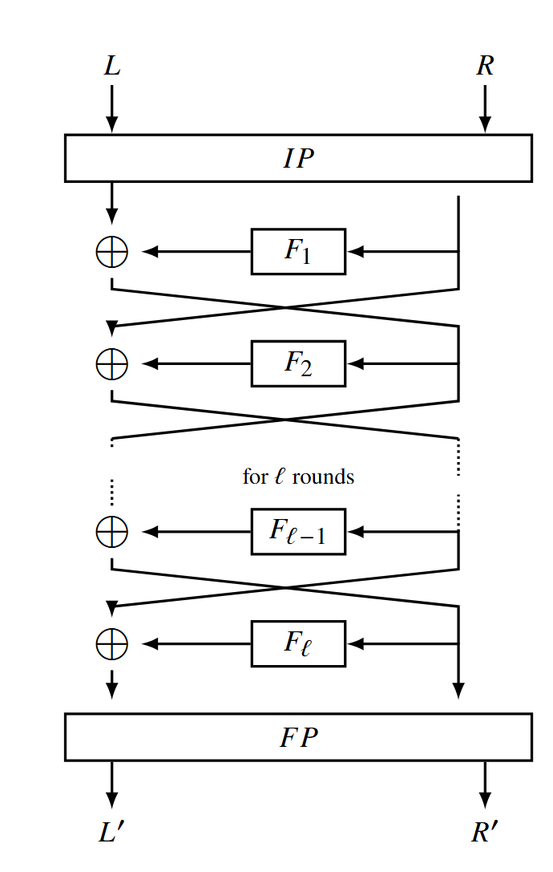
Construction: Based on Feistel Cipher

Slide 25
Construction: Pairwise independent structure
Parameters:

Slide 26
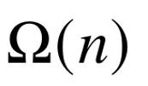
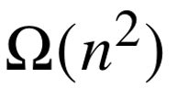
Construction:
Comparison between [RTYZ18] and Our work:
 | [RTYZ18] | Our Work
Functionality | Random Function | Random Function/Permutation
Round of Internal Functions
Number of Random Bits

Slide 27
Motivations and practical attack
Formal modelling
Construction
Security analysis

Slide 28
Analysis: Find a Simulator
R
R
Find a simulator
C
$$\sim$$
F
R.P.
S
F
D

Slide 29
Analysis: Simulation Strategy
Feistel Chain:
Observation:
the simulator needs to evaluate most terms uniformly on a chain
the simlator cannot evalute a full chain uniformly for consistency with R.P.

Slide 30
Analysis: Simulation Strategy
Simulator:
The simulator answer a query uniformly in most cases
When there is a long chain in the private table of the simulator, it aggressively expands it to the full chain by uniformly selecting all but two values and program the last two values for consistency with R.P.

Slide 31
Random permutation: Analysis
Initial chain
Initial chain
Programmed points

Slide 32
Random permutation: Analysis
Initial chain
Programmed points
Initial chain
Programmed points

Slide 33
Random permutation: Analysis
Initial chain
Programmed points
Initial chain
Programmed points

Slide 34
Analysis: Full proof
Two things:
What are some challenges to achieving successful simulation?
Honesty: After programming, the programmed terms turn out to be dishonest (i.e. the programmed points hits the subverted area)
Unpredictability: When the simulator programs, the terms that are going to be programmed have been already evaluated before
Why successfull simulation gurantees crooked-indifferentiabiltiy?
What are some challenges to achieving successful simulation?
The real proof is involved as different chains interact in a complex way.

Slide 35
Analysis: Honesty
Dishonest Area
Honest Area
Initial chain
Programmed points

Slide 36
Analysis: Unpredictbility
Programmed points
Honest Area
Initial chain
Unpredictable Area

Slide 37
Thank You !

