Slide 1
Adaptor Signatures: New Security Definition and A Generic Construction for NP Relations
Asiacrypt 2024
Xiangyu Liu, Ioannis Tzannetos, Vassilis Zikas

Slide 2
Adaptor Signature Scheme
Signature scheme:
key generation: $\left(pk, sk\right)←Gen(1^{λ})$
sign: $σ←Sign\left(sk, m\right)$
verification: $0/1←Ver(pk,m,σ)$
Adaptor Signature (AS) scheme w.r.t. hard relation $R$:
pre-sign: $\tilde{σ}←pSign\left(sk,m,Y\right)$
pre-verification: $0/1←pVer(pk,m,Y,\tilde{σ})$
adaption: $σ←Adapt\left(pk,m,\tilde{σ},y\right)$
extraction: $y/⊥←Ext(pk,m,Y,\tilde{σ},σ)$
$$(Y,y)∈R$$
$Y$ an instance (statement)
$y$ a witness of $Y$

Slide 3
Adaptor Signatures
6. $y←Ext(pk,m,Y,\tilde{σ},σ)$
5. Read σ
Public Bulletin Board
4. Upload $m,σ$
2. Transfer $\tilde{σ}$
Alice
Bob
1. $\tilde{σ}←pSign\left(sk,m,Y\right)$
3. $σ←Adapt\left(pk,m,\tilde{σ},y\right)$
Alice knows $(pk, sk)$and statement $Y$
and wants the witness $y$
Bob knows $(Y,y)$
and wants a signature (of Alice) on $m$

Slide 4
Atomic Swaps based on Adaptor Signatures
Blockchain
4. Read $σ_{A}$
5. $y←Ext({pk}_{A},m_{A},Y,{\tilde{σ}}_{A},σ_{A})$
$σ_{B}←Adapt\left({pk}_{B},m_{B},{\tilde{σ}}_{B},y\right)$
6. Post $m_{B},σ_{B}$
3. Post $m_{A},σ_{A}$
3. $σ_{A}←Adapt\left({pk}_{A},m_{A},{\tilde{σ}}_{A},y\right)$
1. Transfer $Y,{\tilde{σ}}_{B}$
Alice
2. Transfer ${\tilde{σ}}_{A}$
Bob
2. ${\tilde{σ}}_{A}←pSign\left({sk}_{A},m_{A},Y\right)$
1. Sample $(Y,y)$
$${\tilde{σ}}_{B}←pSign\left({sk}_{B},m_{B},Y\right)$$
$m_{A}$: transfer coins from Alice to Bob
$m_{B}$: transfer coins from Bob to Alice

Slide 5
More Applications of AS
Witness for a coin
Multi-hop payments
$y$
$y$
$y$
Alice
Bob
Alice
Bob
Samkie
BTC
BTC
BTC

Slide 6
Security of AS [AEE+21 (ASIACRYPT]
6. $y←Ext(pk,m,Y,\tilde{σ},σ)$
5. Read σ
Public Bulletin Board
4. Upload $m,σ$
2. Transfer $\tilde{σ}$
Alice
Bob
1. $\tilde{σ}←pSign\left(sk,m,Y\right)$
3. $σ←Adapt\left(pk,m,\tilde{σ},y\right)$
Alice knows $(pk, sk)$and statement $Y$
and wants the witness $y$
Bob knows $(Y,y)$
and wants a signature (of Alice) on $m$
Sender’s security:
witness extractability
Receiver’s security
pre-signature adaptability
+Unforgeability

Slide 7
Security of AS
6. $y←Ext(pk,m,Y,\tilde{σ},σ)$
5. Read σ
Public Bulletin Board
4. Upload $m,σ$
2. Transfer $\tilde{σ}$
Alice
Bob
1. $\tilde{σ}←pSign\left(sk,m,Y\right)$
3. $σ←Adapt\left(pk,m,\tilde{σ},y\right)$
Alice knows $(pk, sk)$and statement $Y$
and wants the witness $y$
Bob knows $(Y,y)$
and wants a signature (of Alice) on $m$
+Unforgeability
Sender’s security (witness extractability):
Sender can extract a witness from the valid pre-signature and adapted signature
Receiver’s security (pre-signature adaptability):
Receiver can adapt a valid pre-signature into a full signature with witness $y$

Slide 8
Related Works
ECDSA-based AS [AEE+21 (ASIACRYPT]
Schnorr-based AS [AEE+21 (ASIACRYPT), TZC22 (ISC)]
LWE/SIS-based scheme LAS [EEE20 (ESORICS)]
Code-based scheme AS [KH22 (Cryptogr)]
Isogeny-based scheme IAS [TMM21 (FC)]
Identification (ID) schemes based AS [EFH+21, (PKC)]

Slide 9
Related Works (AS for NP)
The next natural question is can we have adaptor signatures for all NP ?
Dai et al. [DOY22 (INDOCRYPT)] answered to the affirmative.
Let $SIG$ be a normal signature scheme
Pre-signature: $\tilde{σ}=\left(\overline{σ},Y\right)$ s.t. $\overline{σ}←SIG.Sign(sk,\left(m,Y\right))$
(Full) signature: $σ=\left(\overline{σ},Y,y\right)$
The verification algorithm checks the validity of
1. $SIG.ver(pk,\left(m,Y\right),\overline{σ})$
2. $(Y,y)∈R$

Slide 10
Dai’s Construction
(Full) signature: $σ=\left(\overline{σ},Y,y\right)$
While simple it satisfies all security notions of AS:
Unforgeability
Witness Extractability
Pre-signature adaptability
Though it comes with a security risk:
The witness is exposed in plain!

Slide 11
Why is witness exposure a problem?
$$y$$
Alice
Bob
BTC

Slide 12
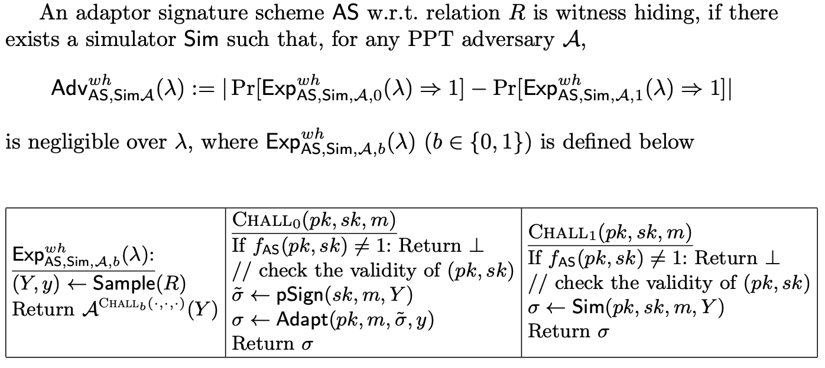
New Security Notion: Witness Hiding
witness $y$ can be extracted from both a pre-signature and an adapted signature (jointly), but not from only one of them alone
Notes:
Short version: More formally, we define witness hiding via the indistinguishability of those two experiments.
Long version: More formally, we define the following two experiments, while in experiment 0, the adversary is given an oracle of signatures via pre-sign-and-then-adapt using the witness, and in experiment 1, the adversary is given an oracle of signatures, simulated without witness. Witness hiding asks that those two experiments are indistinguishable.

Slide 13
Question : Can we have witness-hiding adaptor signatures for all NP ?

Slide 14
Witness-hiding AS vs. Sigma protocols
commitment $cmt$
(random) challenge $ch$
Prover
response $rsp$
Verifier
$$(Y,y)$$
$$(Y)$$
A transcript = $(cmt, ch, rsp)$
Special soundness of Sigma protocols. From two valid transcripts with the same commitment but different challenges, one can extract a witness
Witness extractability of AS. From a valid pre-signature and an adapted signature one can extract a witness

Slide 15
Designing AS for NP Relations
Let $SIG$ be a normal signature scheme
Now the pre-signature
$\tilde{σ}←\left(\overline{σ},Y,(cmt,ch,rsp\right))$ s.t
With witness $y$, $\tilde{σ}$is adapted to
$σ←\left(\overline{σ},Y,(cmt,ch′≠ch,rsp′\right))$
Zero-knowledge of Sigma protocol $⟹$ witness hiding
$$\overline{σ}←SIG.sign\left(sk,\left(m,Y,cmt\right)\right)$$
$(cmt, ch, rsp)$is a transcript for proving $y$
Observation: $ch$ in the pre-signature can be fixed!

Slide 16
Designing AS for NP Relations
Define dummy message $m_{0}$, and now
$\tilde{σ}←\left(\overline{σ},Y,(cmt,{ch=m}_{0},rsp\right))$ s.t
With witness $y$, $\tilde{σ}$is adapted to
$σ←\left(\overline{σ},Y,(cmt,m≠m_{0},rsp′\right))$
$$\overline{σ}←SIG.sign\left(sk,\left(m,Y,cmt\right)\right)$$
$(cmt, ch, rsp)$is a transcript for proving $y$
We need:
the commitment is not related to the witness
given the commitment for dymmy $m_{0}$ and witness, one can open this commitment to any other message as the challenge

Slide 17
Blum’s Sigma Protocol for Hamiltonian Cycle
$${cmt}_{π(G)}$$
$$ch=0$$
$$ch=1$$
Prover
$$rsp=(π,d_{π(G)})$$
$$rsp=(π(H),d_{π(H)})$$
Verifier
$$(G,H)$$
$$(G)$$
$d$: the opening of a commitment
The commitment is not related to the witness
With $H$ and $\left(cmt, ch=0,rsp\right)$,
$cmt$ can be opened to an other
challenge $ch=1$

Slide 18
From Sigma Protocol to AS
the Hamilton cycle problem is NP-complete
Due to Karp reduction, any NP relation $R$ can be transferred into a Sigma protocol

Slide 19
Framework of AS
Karp Reduc.
Hamiltonian Cycle
Relations
NP Relations
Sigma Protocols
(with a specific
adaptable message)
+
Witness Hiding
Adaptor Signatures
for NP
+
Commitments
Signatures
One-way Functions

Slide 20
Conclusion
New security notion (witness hiding)
Construction of witness-hiding AS for NP
One-way functions imply witness hiding AS for NP

Slide 21
References
[AEE+21] Aumayr, L., Ersoy, O., Erwig, A., Faust, S., Hosta ́kova ́, K., Maffei, M., Moreno- Sanchez, P., Riahi, S.: Generalized channels from limited blockchain scripts and adaptor signatures. In: ASIACRYPT 2021.
[TZC22] Tu, B., Zhang, M., Yu, C.: Efficient ecdsa-based adaptor signature for batched atomic swaps. In: ISC 2022.
[EEE20] Esgin, M.F., Ersoy, O., Erkin, Z.: Post-quantum adaptor signatures and pay- ment channel networks. In: ESORICS 2020.
[TMM21] Tairi, E., Moreno-Sanchez, P., Maffei, M.: Post-quantum adaptor signature for privacy-preserving off-chain payments. In: FC 2021.
[KH22] Klamti, J.B., Hasan, M.A.: Post-quantum two-party adaptor signature based on coding theory. Cryptogr. 6(1), 6 (2022).
[EFH+21] Erwig, A., Faust, S., Hosta ́kova ́, K., Maitra, M., Riahi, S.: Two-party adaptor signatures from identification schemes. In: PKC 2021.
[DOY22] Dai, W., Okamoto, T., Yamamoto, G.: Stronger security and generic construc- tions for adaptor signatures. In: INDOCRYPT 2022.

