Slide 1
Perfectly-Secure Multiparty Computation with Linear Communication Complexity over Any Modulus
Daniel Escudero¹, Yifan Song²³, and Wenhao Wang⁴
¹J.P. Morgan AI Research, ²Tsinghua University, ³Shanghai Qi Zhi Institute, ⁴Yale University

Slide 2

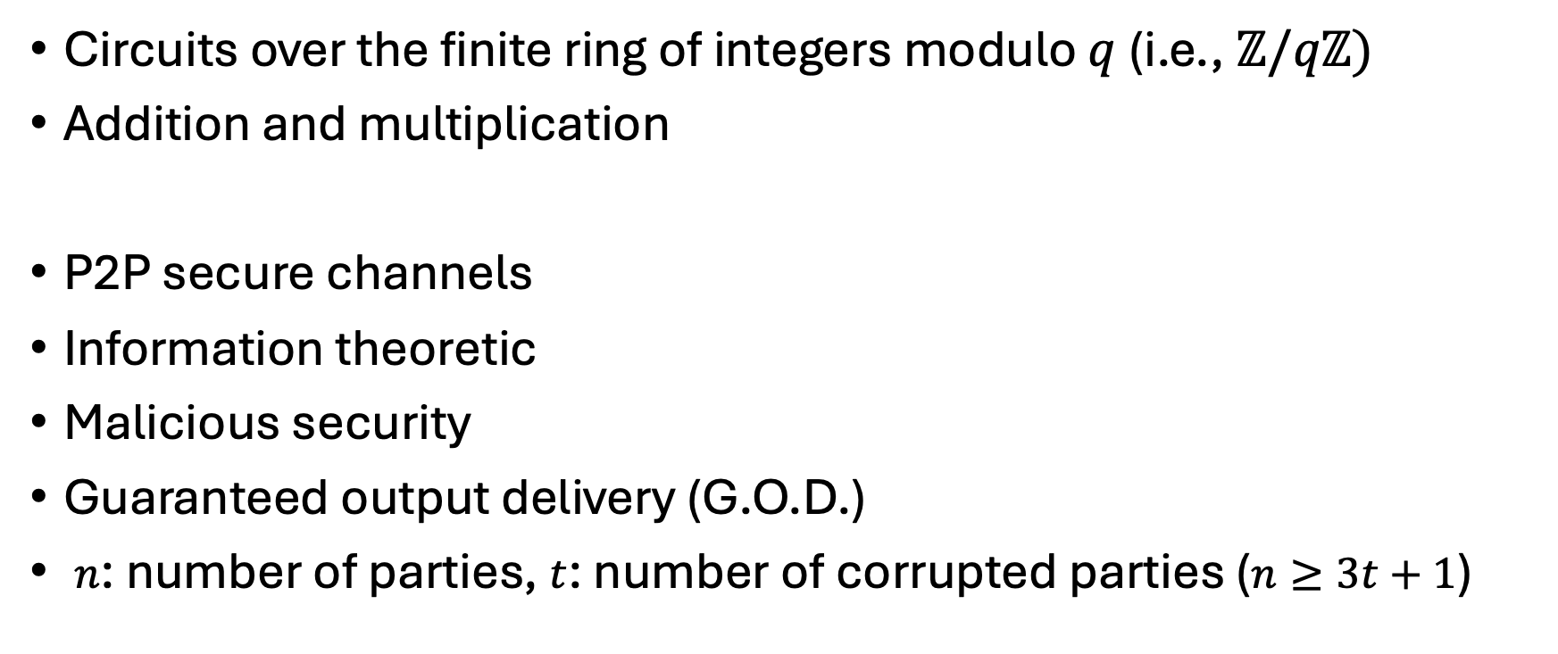
Settings
Circuits over the finite ring of integers modulo $q$ (i.e., $ℤ/qℤ)$
Addition and multiplication
P2P secure channels
Information theoretic
Malicious security
Guaranteed output delivery (G.O.D.)
$n$: number of parties, $t$: number of corrupted parties ($n≥3t+1$)
ADD
MULT
MULT
Perfect Security
Example Circuit $C$

Slide 3
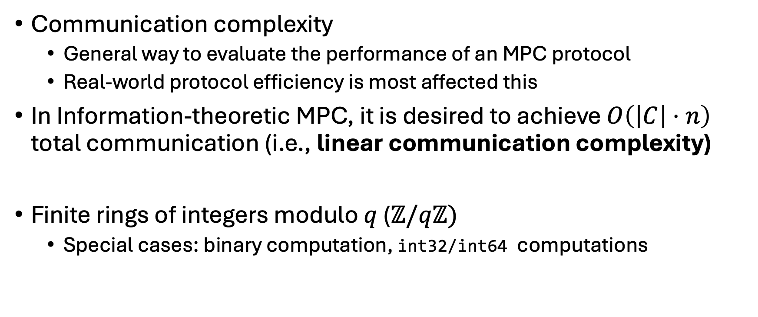
Background
Communication complexity
  General way to evaluate the performance of an MPC protocol
  Real-world protocol efficiency is most affected this
In Information-theoretic MPC, it is desired to achieve $O\left(\left|C\right|⋅n\right)$ total communication (i.e., linear communication complexity)
Finite rings of integers modulo $q$ ($ℤ/qℤ)$
  Special cases: binary computation, int32/int64 computations

Slide 4
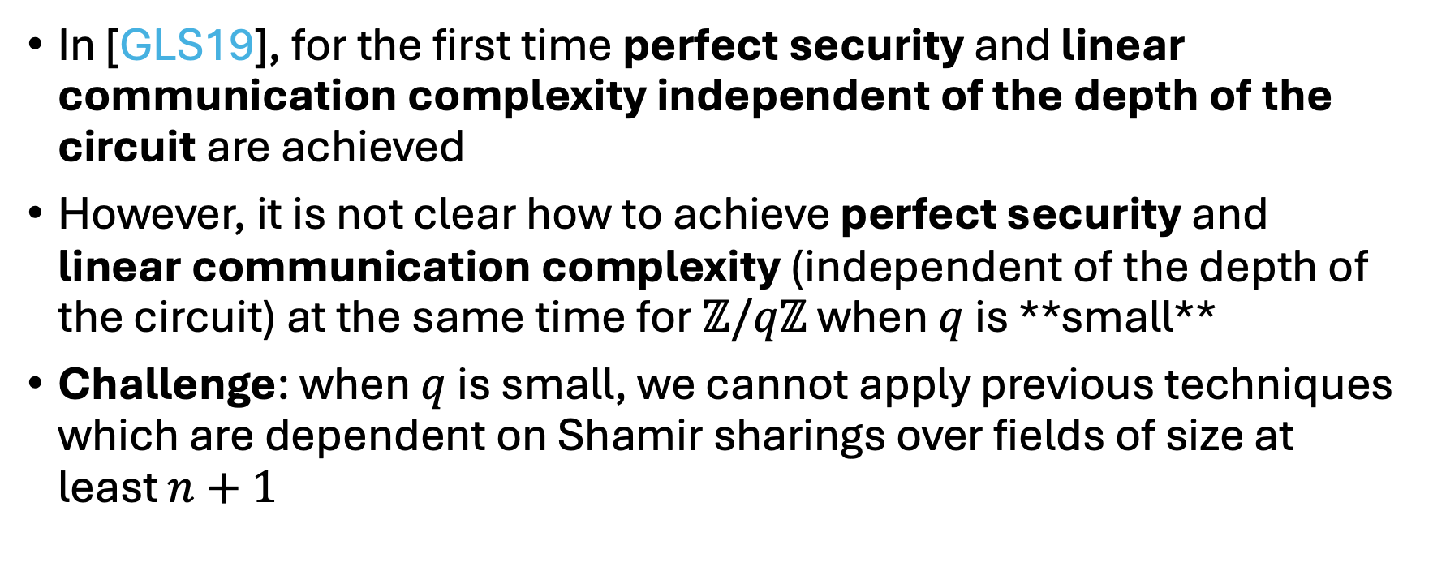
Background (Cont’d)
In [GLS19], for the first time perfect security and linear communication complexity independent of the depth of the circuit are achieved
However, it is not clear how to achieve perfect security and linear communication complexity (independent of the depth of the circuit) at the same time for $ℤ/qℤ$ when $q$ is **small**
Challenge: when $q$ is small, we cannot apply previous techniques which are dependent on Shamir sharings over fields of size at least $n+1$

Slide 5

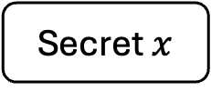
Background: Shamir Secret Sharing
Shamir secret sharing $[x]$: Share 1 element using Reed-Solomon code
Secret $x$

Slide 6
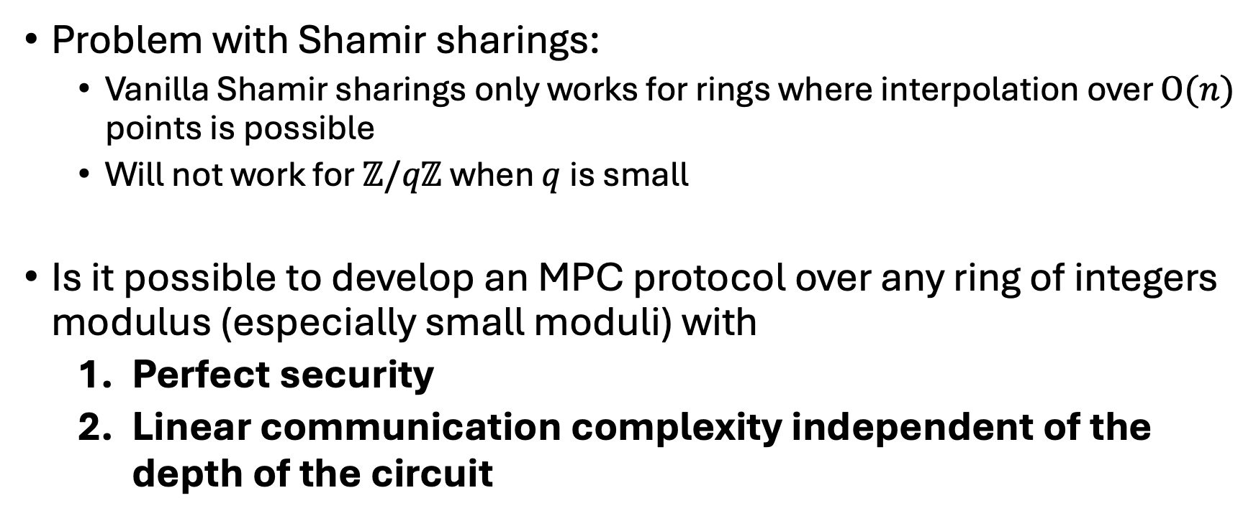
Problem Definition
Problem with Shamir sharings:
  Vanilla Shamir sharings only works for rings where interpolation over $O(n)$ points is possible
  Will not work for $ℤ/qℤ$ when $q$ is small
Is it possible to develop an MPC protocol over any ring of integers modulus (especially small moduli) with
  Perfect security
  Linear communication complexity independent of the depth of the circuit

Slide 7
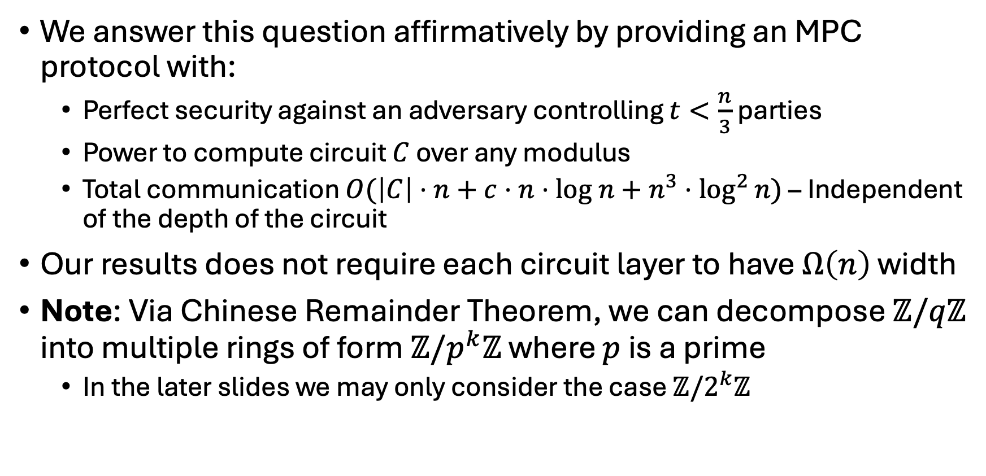
Our Results
We answer this question affirmatively by providing an MPC protocol with:
  Perfect security against an adversary controlling $t<\frac{n}{3}$ parties
  Power to compute circuit $C$ over any modulus
  Total communication $O(\left|C\right|⋅n+c⋅n⋅log n+n^{3}⋅\log^{2}{n})$ – Independent of the depth of the circuit
Our results does not require each circuit layer to have $Ω\left(n\right)$ width
Note: Via Chinese Remainder Theorem, we can decompose $ℤ/qℤ$ into multiple rings of form $ℤ/p^{k}ℤ$ where $p$ is a prime
  In the later slides we may only consider the case $ℤ/2^{k}ℤ$
Notes:
Note that total communication does not scale with the depth of the circuit!
**the focus** is q small, and that that's enough for general moduli

Slide 8
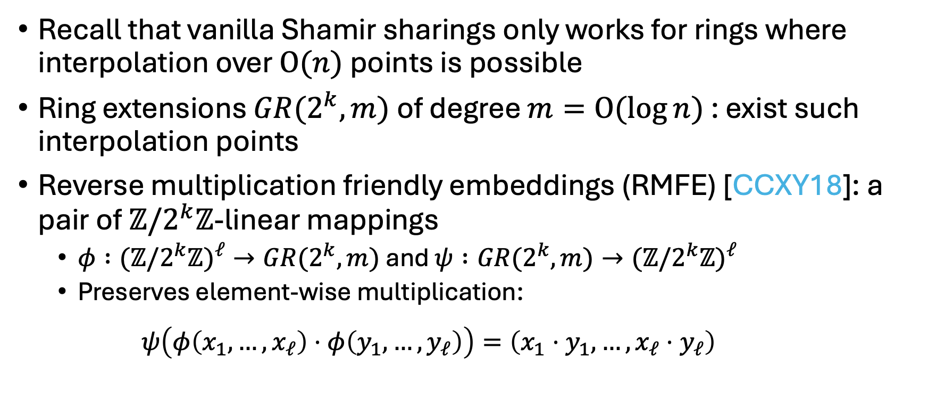
Background: RMFE
Recall that vanilla Shamir sharings only works for rings where interpolation over $O(n)$ points is possible
Ring extensions $GR(2^{k}, m)$ of degree $m=O(\log{n})$ : exist such interpolation points
Reverse multiplication friendly embeddings (RMFE) [CCXY18]: a pair of $ℤ/2^{k}ℤ$-linear mappings
  $φ :(ℤ/2^{k}ℤ)^{ℓ}→GR(2^{k}, m)$ and $ψ :GR(2^{k}, m)→(ℤ/2^{k}ℤ)^{ℓ}$
  Preserves element-wise multiplication:
    $$ψ\left(φ\left(x_{1}, …, x_{ℓ}\right)⋅φ\left(y_{1}, …, y_{ℓ}\right)\right)=\left(x_{1}⋅y_{1}, …,x_{ℓ}⋅y_{ℓ}\right)$$

Slide 9
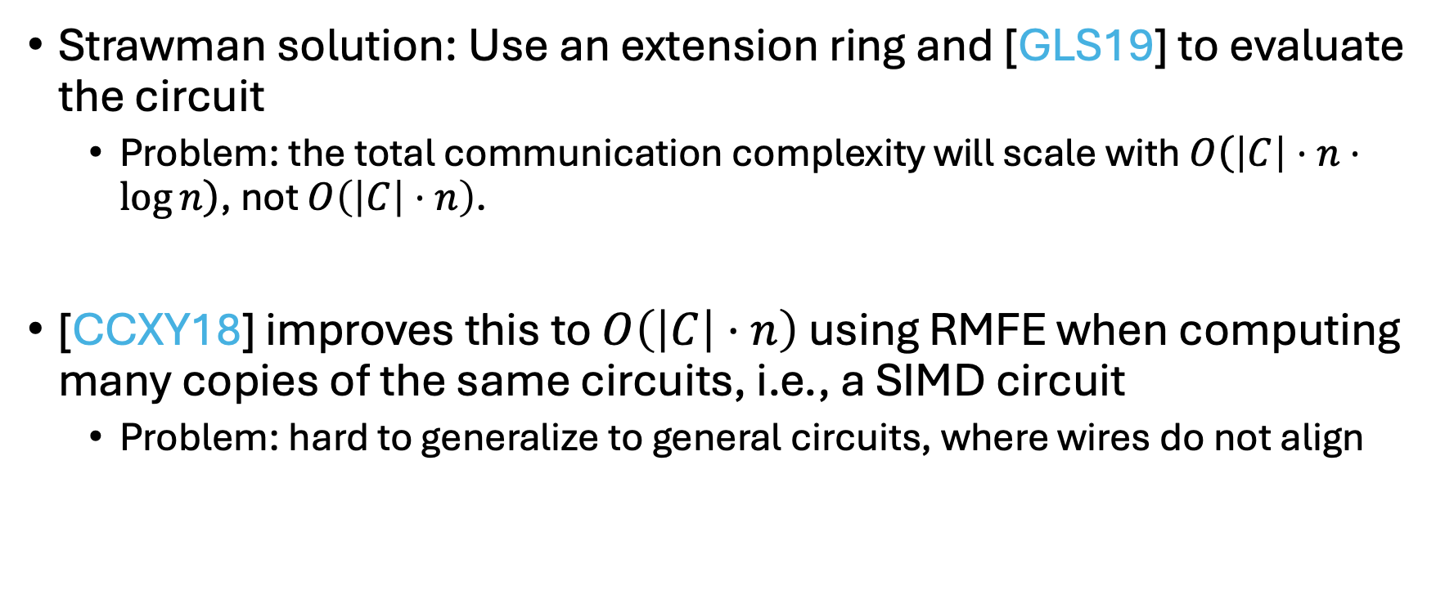
Related Works
Strawman solution: Use an extension ring and [GLS19] to evaluate the circuit
  Problem: the total communication complexity will scale with $O\left(\left|C\right|⋅n⋅\log{n}\right)$, not $O\left(\left|C\right|⋅n\right)$.
[CCXY18] improves this to $O\left(\left|C\right|⋅n\right)$ using RMFE when computing many copies of the same circuits, i.e., a SIMD circuit
  Problem: hard to generalize to general circuits, where wires do not align

Slide 10
Related Works (Cont’d)
$$[φ\left({\vec{x}}_{1}\right)]$$
ADD
$$[φ\left({\vec{x}}_{1}+{\vec{y}}_{1}\right)]$$
$$[φ\left({\vec{y}}_{1}\right)]$$
MULT
$$[φ\left(\left({\vec{x}}_{1}+{\vec{y}}_{1}\right)\right)∗{\vec{x}}_{2}∗{\vec{y}}_{2}]$$
$$[φ\left({\vec{x}}_{2}\right)]$$
MULT
$$[φ\left({\vec{y}}_{2}\right)]$$
$$[φ\left({\vec{x}}_{2}∗{\vec{y}}_{2}\right)]$$
Circuit evaluation example using RMFE in [CCXY18]

Slide 11
Challenge 1: Align wires
In [GPS21] and [GPS22], network routing is proposed to align wires
However, network routing was originally developed for packed Shamir sharings, we need to adapt it to RMFE techniques
Another Gate
Another Gate
ADD
ADD
Network
Routing
MULT
MULT
MULT
MULT
Aligned wires
Wires may not align in a general circuit
Align wires with network routing

Slide 12
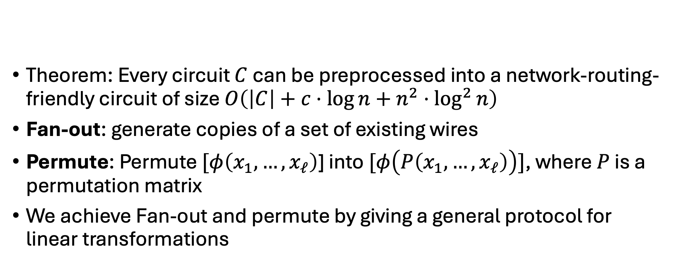
Network Routing with RMFEs
Fan-out
Permute
Collect
Permute
Theorem: Every circuit $C$ can be preprocessed into a network-routing-friendly circuit of size $O\left(\left|C\right|+c⋅\log{n}+n^{2}⋅\log^{2}{n}\right)$
Fan-out: generate copies of a set of existing wires
Permute: Permute $[φ\left(x_{1}, …, x_{ℓ}\right)$] into $[φ\left(P\left(x_{1}, …, x_{ℓ}\right)\right)]$, where $P$ is a permutation matrix
We achieve Fan-out and permute by giving a general protocol for linear transformations

Slide 13
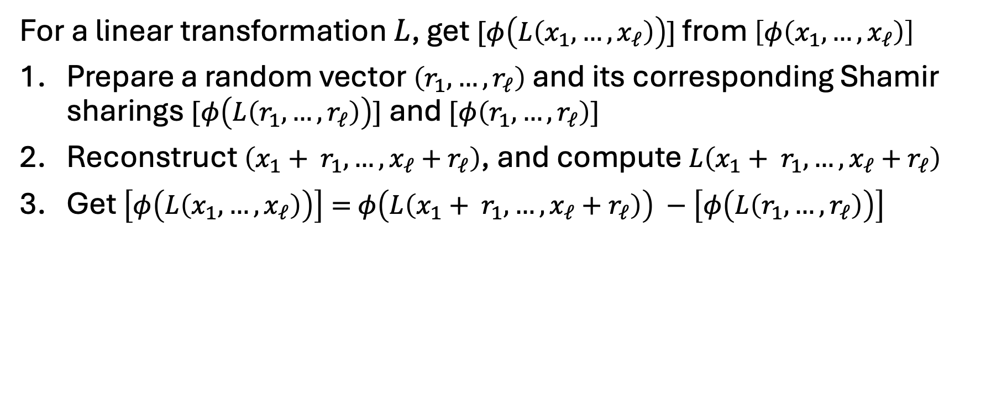
Network Routing with RMFEs: Linear Transformation
For a linear transformation $L$, get $[φ\left(L\left(x_{1}, …, x_{ℓ}\right)\right)]$ from $\left[φ\left(x_{1}, …, x_{ℓ}\right)\right]$
Prepare a random vector $\left(r_{1}, …, r_{ℓ}\right)$ and its corresponding Shamir sharings $[φ\left(L\left(r_{1}, …, r_{ℓ}\right)\right)]$ and $[φ\left(r_{1}, …, r_{ℓ}\right)]$
Reconstruct $\left({x_{1}+ r}_{1}, …, {x_{ℓ}+r}_{ℓ}\right)$, and compute $L\left({x_{1}+ r}_{1}, …, {x_{ℓ}+r}_{ℓ}\right)$
Get $\left[φ\left(L\left(x_{1}, …, x_{ℓ}\right)\right)\right]=$ $φ\left(L\left({x_{1}+ r}_{1}, …, {x_{ℓ}+r}_{ℓ}\right)\right) −\left[φ\left(L\left(r_{1}, …, r_{ℓ}\right)\right)\right]$
Notes:
$O\left(N⋅n⋅m\right)$ communication complexity (if everyone is honest) to transform $N$Shamir sharings

Slide 14
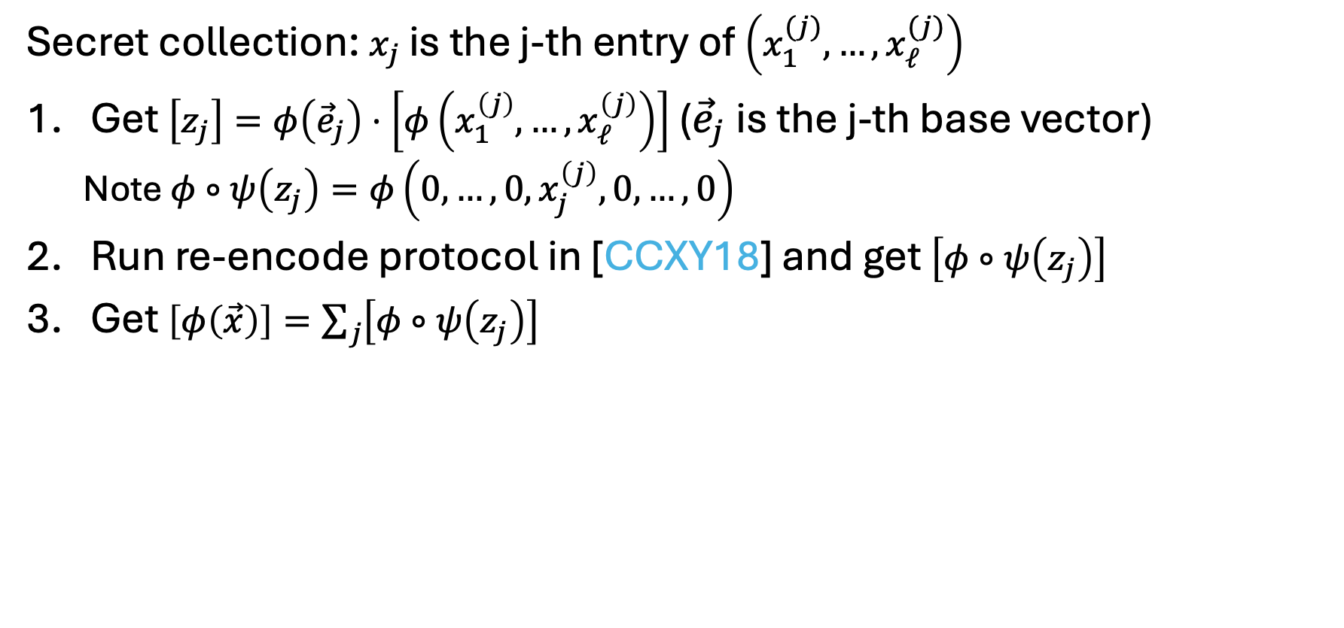
Network Routing with RMFEs: Secret Collection
Secret collection: $x_{j}$ is the j-th entry of $\left(x_{1}^{(j)}, …, x_{ℓ}^{(j)}\right)$
Get $\left[z_{j}\right]=φ\left({\vec{e}}_{j}\right)⋅\left[φ\left(x_{1}^{\left(j\right)}, …, x_{ℓ}^{\left(j\right)}\right)\right]$ (${\vec{e}}_{j}$ is the j-th base vector)
  Note $φ∘ψ\left(z_{j}\right)=φ\left(0, …, 0, x_{j}^{\left(j\right)}, 0, …, 0\right)$
Run re-encode protocol in [CCXY18] and get $\left[φ∘ψ\left(z_{j}\right)\right]$
Get $\left[φ\left(\vec{x}\right)\right]=\sum_{j}{\left[φ∘ψ\left(z_{j}\right)\right]}$
Notes:
$O\left(N⋅n⋅m\right)$communication complexity (if everyone is honest) to collect $N$ Shamir sharings

Slide 15
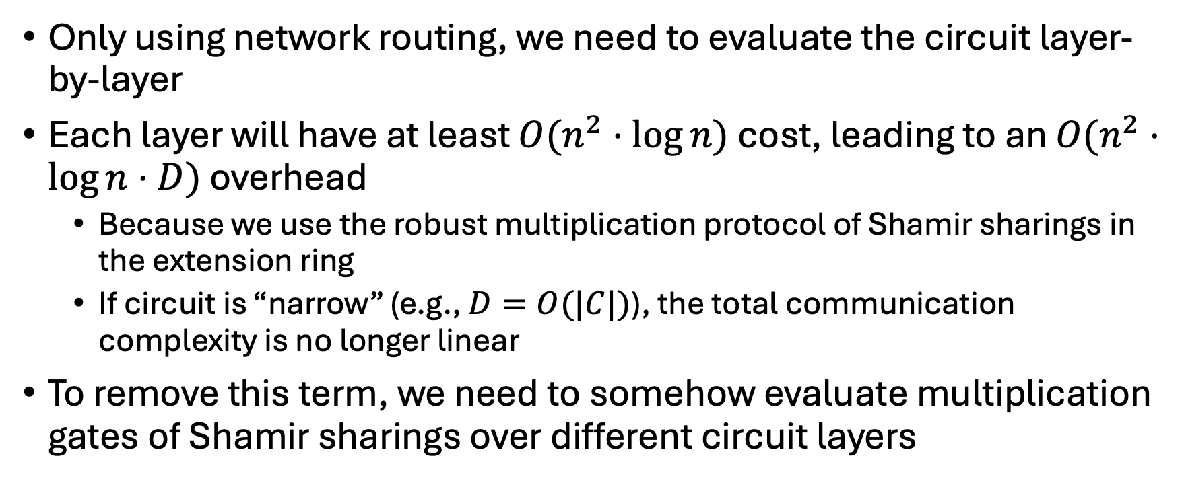
Challenge 2: Remove circuit depth term
Only using network routing, we need to evaluate the circuit layer-by-layer
Each layer will have at least $O(n^{2}⋅\log{n})$ cost, leading to an $O(n^{2}⋅\log{n}⋅D)$ overhead
  Because we use the robust multiplication protocol of Shamir sharings in the extension ring
  If circuit is “narrow” (e.g., $D=O(|C|)$), the total communication complexity is no longer linear
To remove this term, we need to somehow evaluate multiplication gates of Shamir sharings over different circuit layers

Slide 16
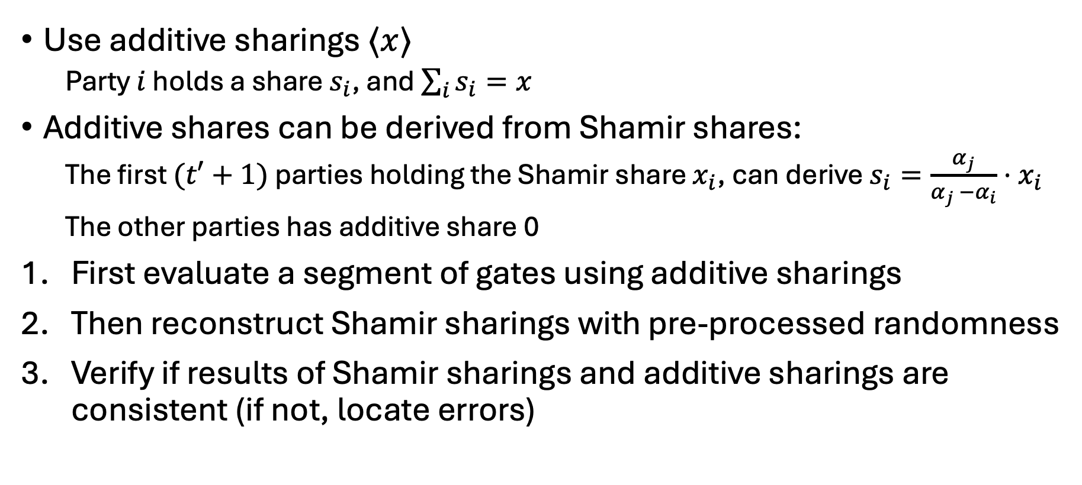
Optimistic Evaluation and Robust Verification
Use additive sharings $⟨x⟩$
  Party $i$ holds a share $s_{i}$, and $\sum_{i}{s_{i}}=x$
Additive shares can be derived from Shamir shares:
  The first $(t′+1)$ parties holding the Shamir share $x_{i}$, can derive $s_{i}=\frac{α_{j}}{α_{j} −α_{i}}⋅x_{i}$
  The other parties has additive share 0
First evaluate a segment of gates using additive sharings
Then reconstruct Shamir sharings with pre-processed randomness
Verify if results of Shamir sharings and additive sharings are consistent (if not, locate errors)

Slide 17
Previous verified segments w/ Shamir sharing outputs
Additive sharings of the next segment
Optimistic Evaluation
Gate outputs in additive sharings
Network Routing
Get intermediate gate input Shamir sharings
Segment Verification
Fault Localization
Robust segment evaluation with Shamir sharings
Inconsistent
Verified segment w/ Shamir Sharing outputs
Check consistency
Consistent

Slide 18
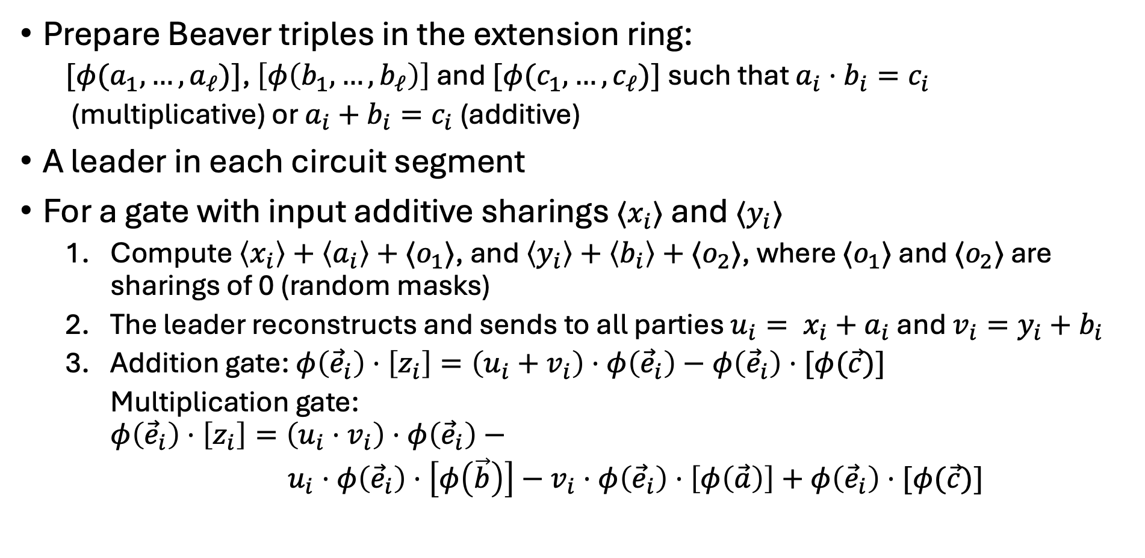
Optimistic Evaluation with Additive Sharings
Prepare Beaver triples in the extension ring:
  $[φ(a_{1}, …,a_{ℓ})]$, $\left[φ\left(b_{1}, …,b_{ℓ}\right)\right]$ and $[φ(c_{1}, …,c_{ℓ})]$ such that $a_{i}⋅b_{i}=c_{i}$
  (multiplicative) or $a_{i}+b_{i}=c_{i}$ (additive)
A leader in each circuit segment
For a gate with input additive sharings $⟨x_{i}⟩$ and $⟨y_{i}⟩$
  Compute $\left\langle x_{i}\right\rangle +\left\langle a_{i}\right\rangle +⟨o_{1}⟩$, and $\left\langle y_{i}\right\rangle +\left\langle b_{i}\right\rangle +⟨o_{2}⟩$, where $⟨o_{1}⟩$ and $⟨o_{2}⟩$ are sharings of 0 (random masks)
  The leader reconstructs and sends to all parties ${u_{i}= x}_{i}+a_{i}$ and ${v_{i}=y}_{i}+b_{i}$
  Addition gate: $φ\left({\vec{e}}_{i}\right)⋅\left[z_{i}\right]=\left(u_{i}+v_{i}\right)⋅φ\left({\vec{e}}_{i}\right)−φ\left({\vec{e}}_{i}\right)⋅[φ(\vec{c})]$
    Multiplication gate:
    $$φ\left({\vec{e}}_{i}\right)⋅\left[z_{i}\right]=\left(u_{i}⋅v_{i}\right)⋅φ\left({\vec{e}}_{i}\right)−$$
    $u_{i}⋅φ\left({\vec{e}}_{i}\right)⋅\left[φ\left(\vec{b}\right)\right]−v_{i}⋅φ\left({\vec{e}}_{i}\right)⋅\left[φ\left(\vec{a}\right)\right]+φ\left({\vec{e}}_{i}\right)⋅[φ(\vec{c})]$

Slide 19
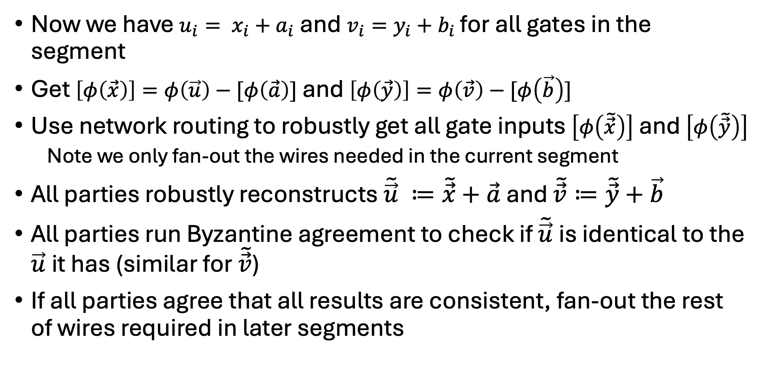
Segment Verification with Shamir Sharings
Now we have ${u_{i}= x}_{i}+a_{i}$ and $v_{i}=y_{i}+b_{i}$ for all gates in the segment
Get $\left[φ\left(\vec{x}\right)\right]=φ\left(\vec{u}\right)−[φ\left(\vec{a}\right)]$ and $\left[φ\left(\vec{y}\right)\right]=φ\left(\vec{v}\right)−[φ\left(\vec{b}\right)]$
Use network routing to robustly get all gate inputs $\left[φ\left(\tilde{\vec{x}}\right)\right]$ and $\left[φ\left(\tilde{\vec{y}}\right)\right]$
  Note we only fan-out the wires needed in the current segment
All parties robustly reconstructs $\tilde{\vec{u}} ≔\tilde{\vec{x}}+\vec{a}$ and $\tilde{\vec{v}}≔\tilde{\vec{y}}+\vec{b}$
All parties run Byzantine agreement to check if $\tilde{\vec{u}}$is identical to the $\vec{u}$it has (similar for $\tilde{\vec{v}}$)
If all parties agree that all results are consistent, fan-out the rest of wires required in later segments

Slide 20
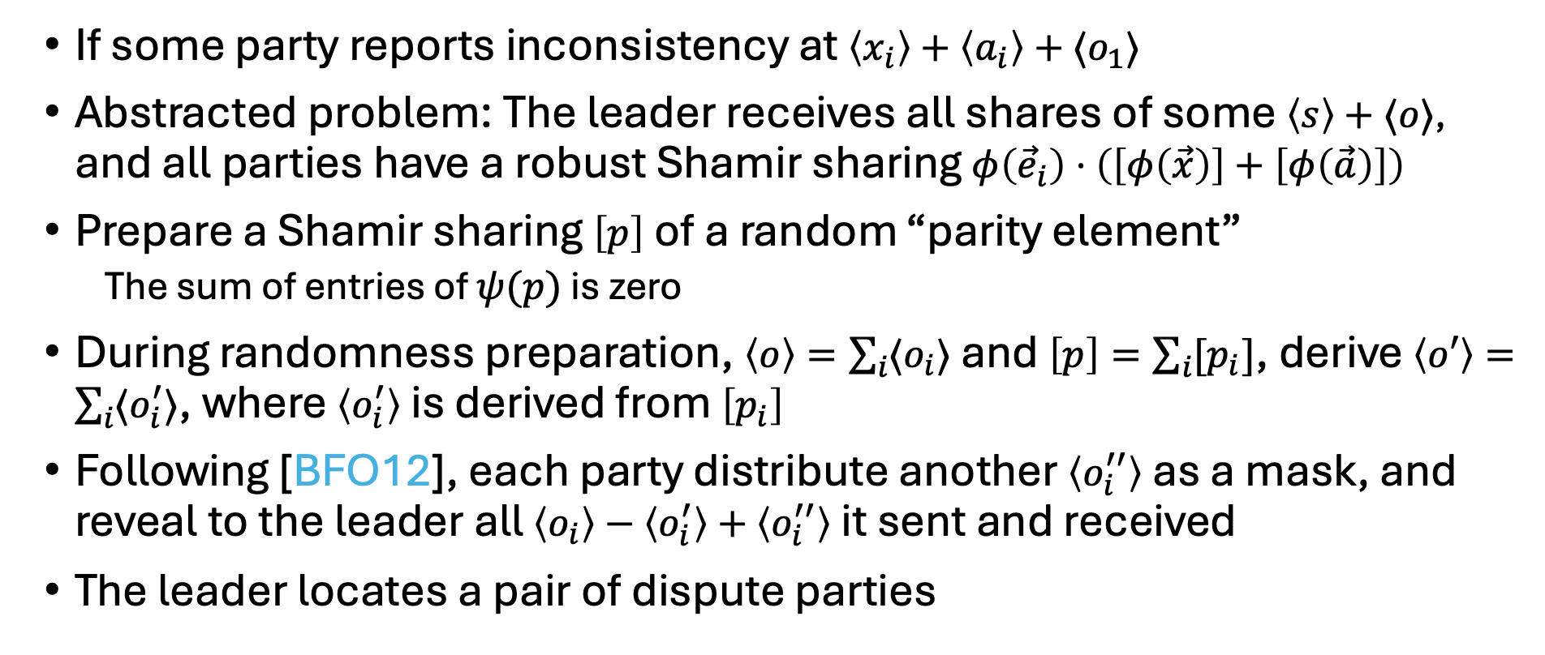
Fault Localization
If some party reports inconsistency at $\left\langle x_{i}\right\rangle +\left\langle a_{i}\right\rangle +⟨o_{1}⟩$
Abstracted problem: The leader receives all shares of some $\left\langle s\right\rangle +⟨o⟩$, and all parties have a robust Shamir sharing $φ\left({\vec{e}}_{i}\right)⋅\left(\left[φ\left(\vec{x}\right)\right]+\left[φ\left(\vec{a}\right)\right]\right)$
Prepare a Shamir sharing $\left[p\right]$ of a random “parity element”
  The sum of entries of $ψ(p)$ is zero
During randomness preparation, $\left\langle o\right\rangle =\sum_{i}{⟨o_{i}⟩}$ and $\left[p\right]=\sum_{i}{[p_{i}]}$, derive $\left\langle o′\right\rangle =\sum_{i}{⟨o_{i}^{′}⟩}$, where $\left\langle o_{i}^{′}\right\rangle$ is derived from $\left[p_{i}\right]$
Following [BFO12], each party distribute another $\left\langle o_{i}^{′′}\right\rangle$ as a mask, and reveal to the leader all $\left\langle o_{i}\right\rangle −\left\langle o_{i}^{′}\right\rangle +\left\langle o_{i}^{′′}\right\rangle$ it sent and received
The leader locates a pair of dispute parties

Slide 21
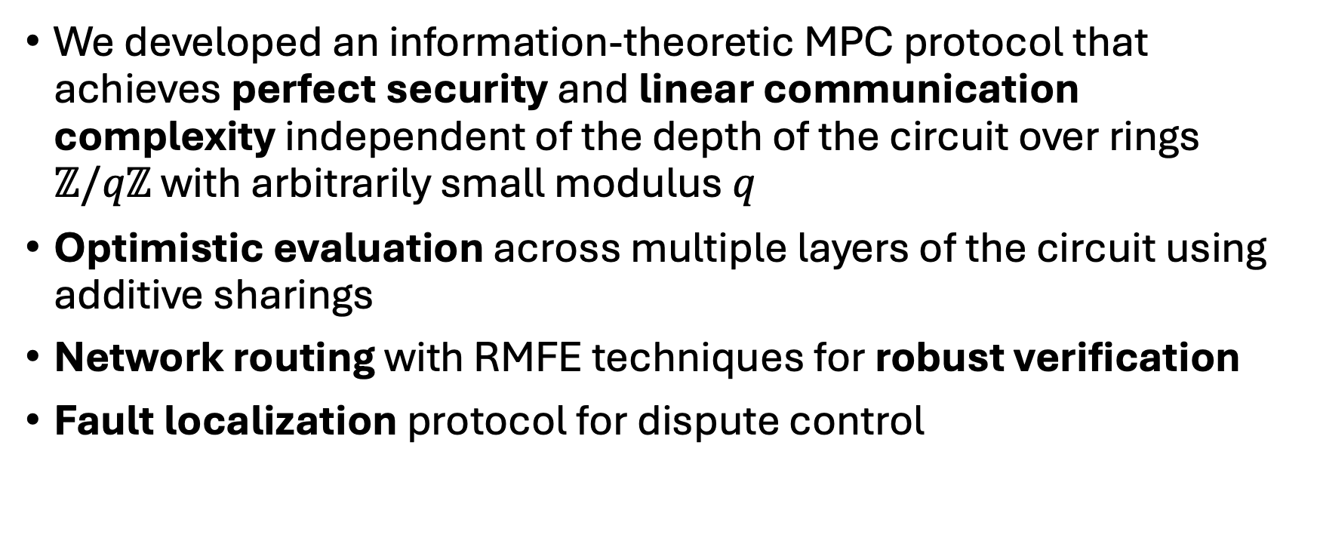
Takeaways
We developed an information-theoretic MPC protocol that achieves perfect security and linear communication complexity independent of the depth of the circuit over rings $ℤ/qℤ$ with arbitrarily small modulus $q$
Optimistic evaluation across multiple layers of the circuit using additive sharings
Network routing with RMFE techniques for robust verification
Fault localization protocol for dispute control

Slide 22
Thank you!

