Slide 1
Quantum Money from Class Group Actions on Elliptic Curves
Hart Montgomery
Linux Foundation
Shahed Sharif
CSU San Marcos
Notes:
Hello everyone! I’m Hart and today I’ll be talking about quantum money from class group actions on elliptic curves. This is a joint work with Shahed Sharif.

Slide 2
Talk Outline
Quantum money background
Why do we care about quantum money?
Starting point of our scheme: invariant money [LMZ’23]
Our construction: quantum lightning from isogenies
There are many interesting opportunities for future work that we will discuss throughout the talk.
We will also employ a wide range of both quantum techniques and number theory and unfortunately cannot give the proper background for all of them in this talk. Sorry about this!
Notes:
Let’s briefly go over the outline for today’s talk. I’ll explain some background about and define quantum money, and then mention why I think we should care about it. I’ll then go over an attack on a general class of lattice-based quantum money schemes that breaks the recent candidate construction of Khesin, Lu, and Shor. We will then transition to talking about a new generic approach for building quantum money as well as a number of different ways for potentially instantiating this generic construction.
This paper seems to open more problems than it solves so I will frequently mention possibilities for future work.

Slide 3
Group Actions
What Is Quantum Money?
Main idea: use quantum no-cloning + cryptography to create verifiable “money” that cannot be duplicated.
Picture Definition
We use the “mini-scheme” paradigm from [Aaronson-Christiano ‘12]:
[Wiesner ‘70]
Gen()
, σ
Secret-Key Quantum Money:
=
✓
Ver( , σ)
✘
Public-Key Quantum Money:
[Aaronson ‘09]
Thm [Aaronson-Christiano’12]:
Mini-scheme + Signatures = Full scheme
=
+
Public
Verification
Notes:
So let’s get started. What is quantum money? Fundamentally, the main idea is to use quantum no-cloning and cryptography to create unduplicatable, verifiable money. Quantum money dates back to the famous scheme of Wiesner, although public key quantum money–which lets anyone verify quantum banknotes, and what we will focus on today–was not defined until Aaronson’s seminal 2009 paper. In this work, we use the popular definition from the Aaronson-Christiano 2012 paper that lets us focus on schemes with single banknotes.
Quantum money consists of two algorithms: Gen, which outputs a bill and a serial number, and verify, which takes a bill and a serial number and either accepts or rejects the bill. Aaronson and Christiano show that, with digital signatures, this is enough to build a full money scheme.

Slide 4
Group Actions
Security: Quantum Money vs. Lightning
Quantum Money
Quantum Lightning
[LAFGHKS’10, Zhandry’19]
Gen()
, σ
σ, ,
1
2
,
1
2
Ver( , σ)
Ver( , σ)
Ver( , σ)
Ver( , σ)
1
2
1
2
✓
✓
✓
✓
Notes:
But what about security? Here, we also define security for quantum lightning, which is an even stronger primitive than quantum money that we will focus on today. In a quantum money security game, an adversary is given a banknote and a serial number, and asked to generate two banknotes that verify for that particular serial number.
On the other hand, in quantum lightning, the adversary wins if they generate two banknotes that verify under a serial number of their choice.

Slide 5
Group Actions
Security: Quantum Money vs. Lightning
Quantum Money
Quantum Lightning
[LAFGHKS’10, Zhandry’19]
Gen()
, σ
σ, ,
1
2
,
1
2
Ver( , σ)
Ver( , σ)
Ver( , σ)
Ver( , σ)
1
2
1
2
Classical Analogue:
Second Preimage Resistance
Classical Analogue:
Collision Resistance
✓
✓
✓
✓
Notes:
It isn’t perfectly accurate, but I like to think of quantum money as sort of analogous to “superposition” second preimage resistance and quantum lightning as analogous to “superposition” collision resistance.

Slide 6
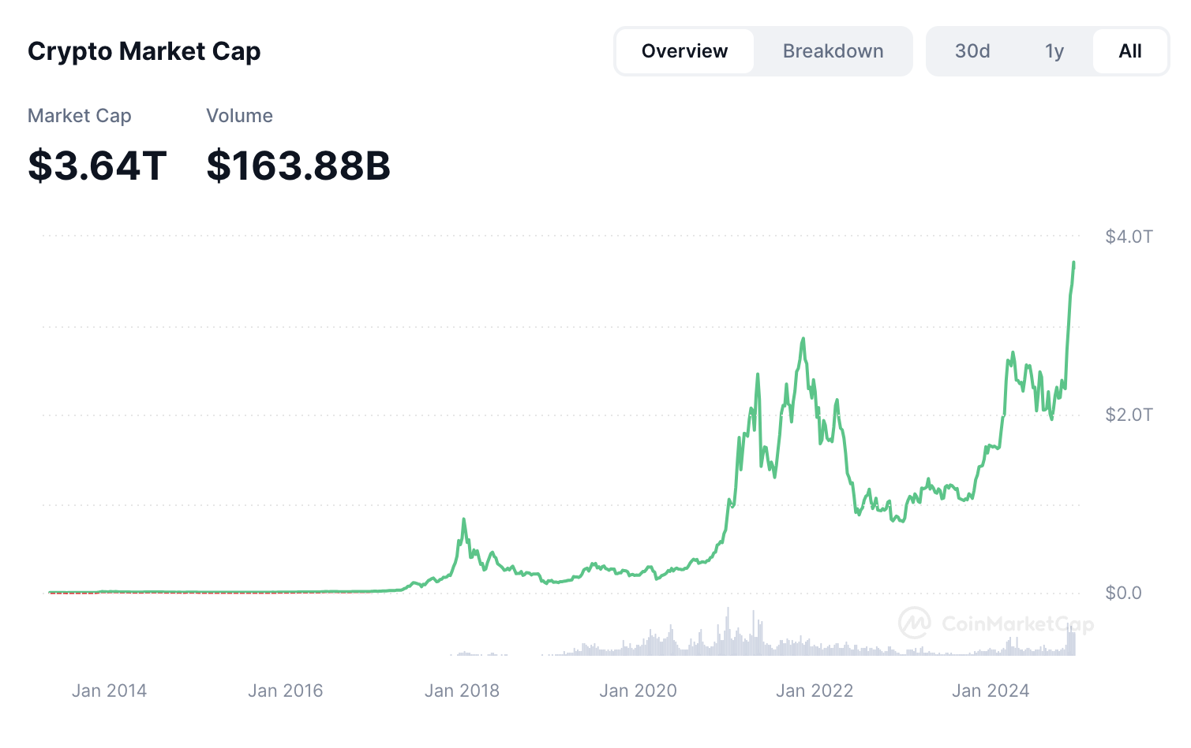
Why Care about Quantum Money?
Insights into quantum money may help us with cryptographic proofs:
Unruh’s [Unruh ‘16] notion of collapsing hash functions are extremely useful for proofs that require rewinding or similar arguments and very similar to quantum lightning.
The “right” notion of quantum commitments [Unruh ‘16] is also closely related to quantum lightning.
Zhandry [Zhandry ‘19] shows that an impossibility result for quantum lightning makes many quantum cryptographic security proofs much easier!
Quantum Money Can Replace Blockchains for Cryptocurrencies and NFTs
Some advantages of quantum money over blockchain:
Fully decentralized: no need to run any consensus protocols! No-cloning solves double-spending.
Optimally scalable: no need for non-transacting parties to do any work!
Perfectly private: non-transacting parties see nothing!
Breaks Vitalik Buterin’s famous blockchain trilemma, which states that no blockchain can have scalability, security, and decentralization!
coinmarketcap.com
Notes:
So why should we care about quantum money? Well, for one, it has the potential to give us great insight into cryptographic proofs. There’s a long line of work on proving rewinding proofs or certain other interactive protocols secure in a quantum world, and these are made easier with what is called “collapsing” hash functions, which are hash functions where it is hard to tell whether or not the input is in superposition–the opposite of quantum lightning, if you will. So ruling out quantum lightning schemes actually has a pretty big benefit to cryptography.
However, building them would undoubtedly be even more exciting. Here’s a graph of the cryptocurrency market cap–almost 4 trillion today, if the markets have held up. In the very long term, if or when everyone has quantum wallets, quantum money could replace blockchain-based cryptocurrencies and NFTs as the most popular choice of decentralized currency or token.
Quantum money has a number of big advantages over blockchains. It would be fully decentralized, and there would be no need to run consensus protocols since no-cloning would essentially solve double spending. It would be optimally scalable since there wouldn’t be many nodes on a blockchain that had to process all of the transactions. And finally, at least for strong definitions of quantum money, it would be perfectly private since there wouldn’t have to be any communication with the blockchain.
We want to emphasize that quantum money would break Vitalik Buterin’s famous blockchain trilemma, which states that no blockchain can simultaneously have scalability, security, and decentralization. It might be true classically, but not quantumly!

Slide 7
Lots of People Care about Quantum Money!
Notes:
So why should we care about quantum money? Well, for one, it has the potential to give us great insight into cryptographic proofs. There’s a long line of work on proving rewinding proofs or certain other interactive protocols secure in a quantum world, and these are made easier with what is called “collapsing” hash functions, which are hash functions where it is hard to tell whether or not the input is in superposition–the opposite of quantum lightning, if you will. So ruling out quantum lightning schemes actually has a pretty big benefit to cryptography.
However, building them would undoubtedly be even more exciting. Here’s a graph of the cryptocurrency market cap–over 1 trillion today, if the markets have held up. In the very long term, if or when everyone has quantum wallets, quantum money could replace blockchain-based cryptocurrencies and NFTs as the most popular choice of decentralized currency or token.
Quantum money has a number of big advantages over blockchains. It would be fully decentralized, and there would be no need to run consensus protocols since no-cloning would essentially solve double spending. It would be optimally scalable since there wouldn’t be many nodes on a blockchain that had to process all of the transactions. And finally, at least for strong definitions of quantum money, it would be perfectly private since there wouldn’t have to be any communication with the blockchain.
We want to emphasize that quantum money would break Vitalik Buterin’s famous blockchain trilemma, which states that no blockchain can simultaneously have scalability, security, and decentralization. It might be true classically, but not quantumly!

Slide 8
Quantum Money is Hard!
Scheme: assumption
[Aaronson’09]: random stabilizer states
[Farhi-Gosset-Hassidim-Lutomirski-Shor’10]: Knots
[Aaronson-Christiano’12]: Polynomial Hiding Subspaces
[Kane’18]: Modular Forms
[Zhandry’19]: Quadradic Systems of Equations
[Zhandry’19]: Quantum-secure iO
[Kane-Sharif-Silverberg’21]: Quaternion Algebras
[Khesin-Lu-Shor’22]: Lattices
[Liu-Montgomery-Zhandry’23] Invariant Schemes
Cryptanalysis
✘
[Lutomirski-Aaronson-Farhi-
Gosset-Hassidim-Kelner-Shor’10]
?
little published cryptanalysis effort
✘
[Pena-Faugère-Perret’14,
Christiano-Sattath’16]
?
[Bilyk-Doliskani-Gong’22] analysis
✘
[Roberts’21]
?
Little work on post-quantum iO
?
No published cryptanalysis effort
✘
[Liu-Montgomery-Zhandry’23]
?
No concrete schemes
Notes:
Although quantum money potentially has huge applications, it has proven so far to be very hard to build. Lots of exceptionally smart people have tried to build quantum money, and about all that we have at this point is candidate constructions without strong security analyses. In fact, we don’t have a single quantum lightning scheme with a security proof that does not involve abstract oracles.

Slide 9
But there is hope? Concrete Constructions!
Scheme: assumption
[Zhandry’23]: New Interactive (Quantum) Oracle Assumption using Group Actions
[This work]: Natural (but Quantum) Assumption over Elliptic Curve Isogenies
[Bostanci-Nehoran-Zhandry’VeryNew]: New (Entirely Classical!) Assumption using Nonabelian Group Actions
Cryptanalysis
?
YOUR
NAME
HERE?
?
?
Notes:
In this work, we show how to build quantum lightning using a generic construction, which may have many potential instantiations. Unfortunately, we are also stuck using oracles and non-standard assumptions, but the generality of our construction is something that we believe to be novel.
We also show that the recent KLS22 scheme is unfortunately part of a large class of lattice-based schemes that cannot possibly work.
I do want to take a moment and emphasize that the authors of this work were exceptionally nice and communicative with us throughout this process; it was a pleasure talking with them about quantum money and they really helped us understand their scheme in great detail.
Finally, we do note that our new framework for constructions does address the knot construction and can be construed as more security analysis. We’ll discuss this later on.

Slide 10
Quantum Lightning from Walkable Invariants [LMZ’23]
Set Y
O₁₆
O₁₄
Elements y_{j}
O₁₅
O₁
O₁₃
O₆
I : X → Y
O₅
O₁₁
O₂
O₁₂
O₇
O₄
O₁₀
O₃
O₉
O₈
Invariant:
∀_{j}, I(O_{j}) → y_{j}
∀_{i,j}, σ_{i}(O_{j}) → O_{j}
σ_{i} : X → X
Set X
Subsets O_{j}, Elements x_{j}
Notes:
Our generic construction uses what is called a “walkable invariant”. We have a set X with subsets O, and a set Y, coupled with mappings with the following properties: We have an invariant mapping I that maps X to Y, and a bunch of permutations on X which we refer to as sigmas.
Importantly, we require that I maps every element in a subset O to the same output, and also that the sigmas map elements in a particular subset O back to that same subset.

Slide 11
Quantum Lightning from Walkable Invariants [LMZ’23]
Set Y
O₁₆
O₁₄
Elements y_{j}
O₁₅
O₁
O₁₃
O₆
I : X → Y
O₅
O₁₁
O₂
O₁₂
O₇
O₄
O₁₀
O₃
O₉
O₈
Invariant:
∀_{j}, I(O_{j}) → y_{j}
∀_{i,j}, σ_{i}(O_{j}) → O_{j}
Set X
Subsets O_{j}, Elements x_{j}
Notes:
So the sigmas really look something like this.

Slide 12
Quantum Lightning from Walkable Invariants [LMZ’23]
Sets:
Set X
Subsets O_{j}, Elements x_{j}
Set Y
Elements y_{j}
Gen():
Sample a superposition |ψ> = 1/√|X| ∑_{x∈X} |x>
of all elements in X.
Compute in superposition and measure the output of the map
x → I(x) = y
Output = |ψ>, σ = y.
|ψ> := |P_{y}> = 1/√|P_{y}| ∑_{x∈Py} |x>
Note that P_{y} is “superposition of all orbits that map to y”
Maps:
I : X → Y
σ_{i} : X → X
Invariants:
∀_{j}, I(O_{j}) → y_{j}
∀_{i,j}, σ_{i}(O_{j}) → O_{j}
Verify( , y):
Thm [LMZ’23]: If the σ_{i} s are “mixing enough”, then this approx. verif. is “close” to real verif.
Check that I(|ψ>) = y.
Compute the (approximate) projection given by
∑_{O∈Py} |O><O| where O ranges over all orbits in P_{y}
and |O> = 1/√|O| ∑_{x∈O} |x>.
Very Rough Idea from [FGH+12]:
Use the permutations to randomize the superposition, then check that it’s still the same as before
Notes:
So how can we use this structure to build quantum lightning? Our construction turns out to be pretty simple. We sample a superposition of all elements of X, compute the invariant I in an additional register, and measure this output. Our Gen() protocol is actually very similar in nature to the lattice-based candidate.
Our verification scheme is a actually a little complicated: we use an approximate self-projection that essentially uses the permutations to randomize the superposition, then check that it’s still the same, which it should be for correctly generated money.
This is an idea borrowed directly from the quantum money from knots paper, and, in this work, we prove a theorem that shows our verification process works if the permutations mix “enough”.

Slide 13
Assumptions of the Generic Construction
Hardness of Path Finding
Knowledge of Path Assumption
Path-finding problem: given two elements x₁, x₂ ∈ X, find a sequence of permutations σ₁, … , σ_{n} such that
x₂ = σ_{n}( … (σ₁(x₁)) … ).
(Informal) For any QPT unitary* algorithm that outputs two elements x₁, x₂ ∈ X, there is an efficient extractor E that outputs a “path” (in terms of σs) between them when possible.
Classical Analogue: Discrete logarithm (DLog)
Set elements → group elements
Permutations → exponents
g₂ = (((g₁)^{σ1})...)^{σn}
…although technically closer to group action DLog (GADLog)
Classical Analogue: Knowledge of exponent assumptions.
“If an algorithm outputs two group elements, it must know the exponent of one relative to another.”
Very reasonable for most schemes.
Notes:
Our construction needs two assumptions for security, which we call the hardness of path finding and the knowledge of path assumptions.
The path-finding problem is essentially an analogue of discrete log modified to our setting: given two x’s, find a path of permutations between them. We emphasize that while discrete log itself is obviously easy quantumly, certain analogues like group action discrete log–which are actually closer in spirit to this problem–are not.
The knowledge of path assumption is substantially more complicated. Very informally, it says that if an algorithm outputs two x’s, then there is an efficient extractor that can output a “path” between them in terms of the sigma. This is a sort of quantum variant of knowledge of exponent assumptions.
The path finding problem tends to boil down to essentially standard assumptions in our constructions, while the knowledge of path assumption does not and needs to be much more extensively studied.

Slide 14
Assumptions of the Generic Construction
Hardness of Path Finding
Knowledge of Path Assumption
Path-finding problem: given two elements x₁, x₂ ∈ X, find a sequence of permutations σ₁, … , σ_{n} such that
x₂ = σ_{n}( … (σ₁(x₁)) … ).
(Informal) For any QPT unitary* algorithm that outputs two elements x₁, x₂ ∈ X, there is an efficient extractor E that outputs a “path” (in terms of σs) between them.
Broken in [Zhandry’23]!
[Zhandry’23] shows (essentially) how to generate a random set element with no known path.
This breaks the assumption… but not in a useful way.
[Zhandry’23] “patches” this assumption; we will do something similar.
Classical Analogue: Discrete logarithm (DLog)
Set elements → group elements
Permutations → exponents
g₂ = (((g₁)^{σ1})...)^{σn}
…although technically closer to group action DLog (GADLog)
Classical Analogue: Knowledge of exponent assumptions.
“If an algorithm outputs two group elements, it must know the exponent of one relative to another.”
Very reasonable for most schemes.
Notes:
Our construction needs two assumptions for security, which we call the hardness of path finding and the knowledge of path assumptions.
The path-finding problem is essentially an analogue of discrete log modified to our setting: given two x’s, find a path of permutations between them. We emphasize that while discrete log itself is obviously easy quantumly, certain analogues like group action discrete log–which are actually closer in spirit to this problem–are not.
The knowledge of path assumption is substantially more complicated. Very informally, it says that if an algorithm outputs two x’s, then there is an efficient extractor that can output a “path” between them in terms of the sigma. This is a sort of quantum variant of knowledge of exponent assumptions.
The path finding problem tends to boil down to essentially standard assumptions in our constructions, while the knowledge of path assumption does not and needs to be much more extensively studied.

Slide 15
Group Actions
Candidate from Group Actions [LMZ’23]
The invariant scheme is structurally very similar to and inspired by the structure of group actions. With some important caveats, it is possible to build a candidate quantum money scheme.
Walkable Sets (X, Y)
Group Action (G, X, ★)
Gen():
Sample a superposition |ψ> = 1/√|X| ∑_{x∈X} |x>
of all elements in X.
Compute in superposition and measure the output of the map
x → I(x) = y
Output = |ψ>, σ = y.
Sample a superposition |ψ> = 1/√|X| ∑_{x∈X} |x>
of all elements in X.
Compute in superposition and measure the output of the map
x → I(x) = y
Output = |ψ>, σ = y.
Verify( , y):
Use permutations σ_{i} to rerandomize the state for our (approximate) projection, as in σ_{n}( … (σ₁(x)) … ).
Use the group action to rerandomize the state for our (approximate) projection, as in g_{n} ★ ( … (g₁ ★ x₁) … ).
Notes:
Now let’s consider an instantiation of our generic construction with group actions. We had group actions in mind when we were writing down the scheme, so the notation is quite similar. First, recall the generic construction.
Note the banknote generation of the protocols is extremely similar; I’m going to gloss over the invariant right now because we’ll need an oracle for that, although it is a natural thing for some group actions as we’ll see shortly.
The verification processes are also extremely similar, and we can view the group action as a sort of permutation as well.

Slide 16
Group Actions
Candidate from Group Actions [LMZ’23]
The invariant scheme is structurally very similar to and inspired by the structure of group actions. With some important caveats, it is possible to build a candidate quantum money scheme.
Walkable Sets (X, Y)
Group Action (G, X, ★)
Gen():
Sample a superposition |ψ> = 1/√|X| ∑_{x∈X} |x>
of all elements in X.
Compute in superposition and measure the output of the map
x → I(x) = y
Output = |ψ>, σ = y.
Sample a superposition |ψ> = 1/√|X| ∑_{x∈X} |x>
of all elements in X.
Compute in superposition and measure the output of the map
x → I(x) = y
Output = |ψ>, σ = y.
Verify( , y):
Use permutations σ_{i} to rerandomize the state for our (approximate) projection, as in σ_{n}( … (σ₁(x)) … ).
Use the group action to rerandomize the state for our (approximate) projection, as in g_{n} ★ ( … (g₁ ★ x₁) … ).
Notes:
Now let’s consider an instantiation of our generic construction with group actions. We had group actions in mind when we were writing down the scheme, so the notation is quite similar. First, recall the generic construction.
Note the banknote generation of the protocols is extremely similar; I’m going to gloss over the invariant right now because we’ll need an oracle for that, although it is a natural thing for some group actions as we’ll see shortly.
The verification processes are also extremely similar, and we can view the group action as a sort of permutation as well.

Slide 17
Group Actions
Candidate from Group Actions [LMZ’23]
[LMZ’23] does not show how to actually build an instantiable construction of quantum money from group actions because they did not know how to satisfy certain requirements of their scheme with group actions.
Some Caveats:
We need oblivious samplability of set elements. This is not known for many cryptographic group actions. We also need a “pseudoinvertible” sampling algorithm.
We need regular (or close to regular) group actions (although these are typically what is used in cryptography).
We need a new security proof, since [Zhandry’23] broke an assumption used in the proof from [LMZ’23].
This work: we solve all of these problems with new results on elliptic curve isogenies.
This requires us to advance the state of the art of “pure” math on elliptic curves.

Slide 18
Recall: [LMZ’23] Idea from Isogenies
Elliptic curve isogenies can sometimes be viewed as group actions [ADMP20].
Here is a rough potential construction along the lines of the group action construction.
Recall: An isogeny ψ: E → E is a surjective group morphism between elliptic curves.
Isogenies only map between curves with the same number of points.
Core Idea:
Let our “set” consist of sets of elliptic curves E with some related structure.
Set our invariant to be the number of points in the elliptic curves.
Use isogenies ψ_{i} as our “permutations” σ_{i}.
A few outstanding problems/large assumptions to make this work:
We have to assume it’s possible to efficiently “obliviously” sample elliptic curves (not known).
The knowledge of path assumption is a problem for a security proof.
Notes:
We also show a potential construction from elliptic curve isogenies. This might not be surprising since many isogeny protocols can be viewed as group actions.

Slide 19
Some Isogeny Definitions
For a large prime p, represent isomorphism classes of elliptic curves over F_{p} by pairs (j, b) ∈ F_{p} ×Z, where b ∈ {0, 1} except in the following cases: 
If j ≡ 1728 mod p and p ≡ 1 (mod 4), then 0 ≤ b ≤ 3. 
If j ≡ 0 mod p and p ≡ 1 (mod 3), then 0 ≤ b ≤ 5.
j is just the standard j-invariant, represented as an integer, and b is the twist.
Sampling Distributions:
U_{p}: the uniform probability distribution on isomorphism classes of elliptic curves over F_{p}, given by uniformly randomly choosing a pair (j, b) as above (with appropriate restrictions).
D_{p}: the Weierstrass distribution from the literature. Note that U_{p} and D_{p} are statistically close (we prove this) so we will use them interchangeably.
દ_{sf,3p} be the set of elliptic curves E over F_{p} such that ∆_{Fr}(E) ≥ 3p and ∆_{Fr}(E) is square-free.
For an elliptic curve E/F_{p}:
t = t(E) = p + 1 − #E(F_{p}) be the trace of Frobenius on E
t / 2 √p be the normalized trace
∆_{Fr} := ∆_{Fr}(E) be 4p − t² the Frobenius discriminant
K = K(E) = Q(√−∆_{Fr})
D = D(E) be the discriminant of K.
Notes:
We also show a potential construction from elliptic curve isogenies. This might not be surprising since many isogeny protocols can be viewed as group actions.

Slide 20
Some Isogeny Definitions
For a large prime p, represent isomorphism classes of elliptic curves over F_{p} by pairs (j, b) ∈ F_{p} ×Z, where b ∈ {0, 1} except in the following cases: 
If j ≡ 1728 mod p and p ≡ 1 (mod 4), then 0 ≤ b ≤ 3. 
If j ≡ 0 mod p and p ≡ 1 (mod 3), then 0 ≤ b ≤ 5.
j is just the standard j-invariant, represented as an integer, and b is the twist.
YUCK! Math. Do I have to?
No! Our goal with this paper (and presentation) was to make theorems self-contained enough where non-isogeny experts can use them in future work!
Sampling Distributions:
U_{p}: the uniform probability distribution on isomorphism classes of elliptic curves over F_{p}, given by uniformly randomly choosing a pair (j, b) as above.
D_{p}: the Weierstrass distribution from the literature. Note that U_{p} and D_{p} are statistically close (we prove this) so we will use them interchangeably.
દ_{sf,3p} be the set of elliptic curves E over F_{p} such that ∆_{Fr}(E) ≥ 3p and ∆_{Fr}(E) is square-free.
For an elliptic curve E/F_{p}:
t = t(E) = p + 1 − #E(F_{p}) be the trace of Frobenius on E
t / 2 √p be the normalized trace,
∆_{Fr} := ∆_{Fr}(E) be 4p − t² the Frobenius discriminant,
K = K(E) = Q(√−∆_{Fr})
D = D(E) be the discriminant of K.
Notes:
We also show a potential construction from elliptic curve isogenies. This might not be surprising since many isogeny protocols can be viewed as group actions.

Slide 21
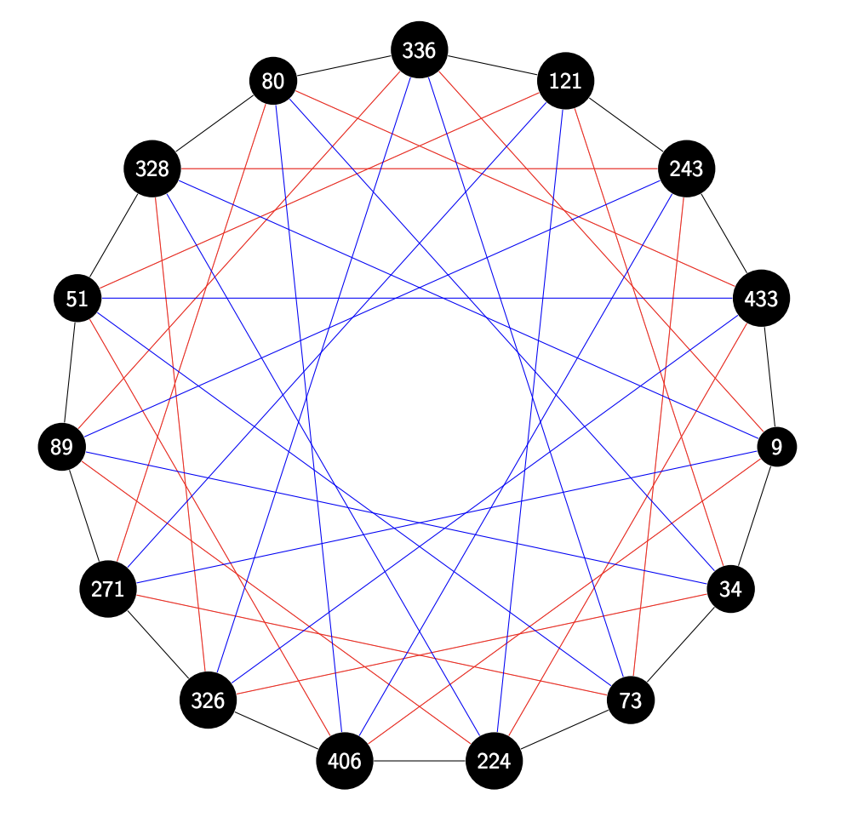
A Pretty Picture of an Isogeny Graph
vertex labels are j-invariants;
twisting data is left out
black edges are the isogenies coming from the primes above 3
red edges for those above 5
blue edges for those above 11
(7 is inert, so is trivial in the class group)
Edges are undirected because the two primes give dual isogenies: one prime goes one way, the conjugate prime goes the other way.
p = 461
class group size = 15
t = 15, we we are working over the quadratic field defined by x² - 15x + 461 = 0
Notes:
We also show a potential construction from elliptic curve isogenies. This might not be surprising since many isogeny protocols can be viewed as group actions.

Slide 22
Group Actions
Instantiation from Group Actions [LMZ’23]
The invariant scheme is structurally very similar to and inspired by the structure of group actions. With some important caveats, it is possible to build a candidate quantum money scheme.
Some Caveats:
We need oblivious samplability of set elements. This is not known for many cryptographic group actions. We also need a “pseudoinvertible” sampling algorithm.
We need regular (or close to regular) group actions (although these are typically what is used in cryptography).
We need a new security proof, since [Zhandry’23] broke an assumption used in the proof from [LMZ’23].
Problem #1
How can we sample superpositions of random isogeny classes?
This work: we solve all of these problems with new results on Elliptic Curve Isogenies.
This requires us to advance the state of the art of “pure” math on elliptic curves.

Slide 23
Group Actions
Sampling Superpositions of Elliptic Curves
How we represent isogeny classes is important:
Recall: we represent elliptic curves over F_{p} by a pair (j, b) where j ∈ F_{p} represents the j-invariant and b is twisting data.
Basic Idea
Sample a uniform value j.
Based on j, choose a value for b appropriately at random. Note that this can be done in superposition.
Sample and check the Frobenius discriminant so we end up with our “nice” class of elliptic curves દ_{sf,3p} .
If we don’t end up with a curve (or superposition) in our “nice” class, repeat the algorithm until we do.
To our knowledge, it is not known how to do this for supersingular curves.
We can also use Weierstrass Form, but it complicates things later.

Slide 24
Group Actions
Computing the Invariant: #Points on Curve
Schoof’s algorithm lets us compute the number of points on an elliptic curve (classically) in polynomial time.
As suggested by [LMZ’23], we will use the number of points on an elliptic curve as our invariant.
Recall: elliptic curves are isogenous iff they have the same number of points.
Sampling a Random Equivalence (Isogeny) Class
Start with a superposition of all elliptic curves over F_{p} in our nice class દ_{sf,3p}.
In an adjacent register, compute the number of points on the elliptic curve in superposition.
Measure the adjacent register and discard the contents of this register..
Output: a superposition over all elliptic curves in દ_{sf,3p} in some isogeny class over F_{p}.
We can generate a superposition over a random isogeny class this way, but, importantly, not a targeted one.

Slide 25
Group Actions
Sampling Superpositions of Elliptic Curves
How we represent isogeny classes is important:
Recall: we represent elliptic curves over F_{p} by a pair (j, b) where j ∈ F_{p} represents the j-invariant and b is twisting data.
Problem #2
We need to be able to sample uniform superpositions over LARGE isogeny classes with some reasonable probability in order for our sampling algorithm to be efficient!
We don’t even know how large isogeny classes are over a fixed F_{p} on average!
Basic Idea
Sample a uniform value j.
Based on j, choose a value for b appropriately at random. Note that this can be done in superposition.
Sample and check some other parameters so we end up with our “nice” class of elliptic curves દ_{sf,3p} .
If we don’t end up with a curve (or superposition) in our “nice” class, repeat the algorithm until we do.
To our knowledge, it is not known how to do this for supersingular curves.
We can also use Weierstrass Form, but it complicates things later.
Care is required: “natural” ways to sample run into index erasure problems.

Slide 26
Sampling Random Isogeny Classes
Theorem: Let p > 2⁶³ be prime. Given an ordinary elliptic curve E / F_{p} , let ථ be End(E).
If an elliptic curve E is drawn from either the distribution D_{p} or the distribution U_{p}, then with probability at least 14%, E ∈ દ_{sf,3p} and both the class group of ථ and the isogeny class of E have size at least 0.089 √p / log p .
What this means: we can obliviously sample random elliptic curves over F_{p} that have large class groups and isogeny classes with (good) constant probability for p > 2⁶³.
Previous work either restricts to isogeny classes of supersingular elliptic curves (which constitute a negligible fraction of all elliptic curves mod p), or relies on heuristics stating that the class group associated to a random elliptic curve mod p has size O( √p).

Slide 27
Group Actions
Instantiation from Group Actions [LMZ’23]
The invariant scheme is structurally very similar to and inspired by the structure of group actions. With some important caveats, it is possible to build a candidate quantum money scheme.
Problem #3
Most isogeny tools focus on supersingular isogenies. Can we still compute and work with non-supersingular isogenies?
Some Caveats:
We need oblivious samplability of set elements. This is not known for many cryptographic group actions. We also need a “pseudoinvertible” sampling algorithm.
We need regular (or close to regular) group actions (although these are typically what is used in cryptography).
We need a new security proof, since [Zhandry’23] broke an assumption used in the proof from [LMZ’23].
This work: we solve all of these problems with new results on Elliptic Curve Isogenies.
This requires us to advance the state of the art of “pure” math on elliptic curves.

Slide 28
Computing Isogenies [DKS’18]
Theorem [DKS’18]: . Let E be an elliptic curve over F_{p} with complex multiplication by ථ, and let l ⊂ ථ be a prime ideal of norm ℓ, where ℓ is a rational prime. Let M(p) be the cost of one arithmetic operation in F_{p}.
Then there is a classical algorithm which computes the isogeny φ_{l} in time O (ℓM(p) log ℓ log log ℓ log p).
What this means: we can efficiently compute isogenies in the random isogeny classes that we sample. We will set ℓ to be polylogarithmic in p.
This is a theorem from [DKS’18], which is a very useful (and often overlooked) paper on isogenies! It relates to the “Elkies steps”.

Slide 29
Computing Isogenies [DKS’18]
Theorem [DKS’18]: . Let E be an elliptic curve over F_{p} with complex multiplication by ථ, and let l ⊂ ථ be a prime ideal of norm ℓ, where ℓ is a rational prime. Let M(p) be the cost of one arithmetic operation in F_{p}.
Then there is a classical algorithm which computes the isogeny φ_{l} in time O (ℓM(p) log ℓ log log ℓ log p).
Problem #4
Can we compute these prime ideals?
What this means: we can efficiently compute isogenies in the random isogeny classes that we sample. We will set ℓ to be polylogarithmic in p.
This is a theorem from [DKS’18], which is a very useful (and often overlooked) paper on isogenies! It relates to the “Elkies steps”.

Slide 30
Building the Generating Set of Isogenies
For a imaginary quadratic field K with discriminant D, let ථ_{K} be the ring of integers of K, and define the Bach generating set B_{K} to be the set of ideal classes of unramified primes 𝔩 of O_{K} with N(𝔩) < 6(log D) 2.
Bach [Bac90]: assuming GRH, B_{K} generates Cl(ථ_{K}).
Theorem (abbreviated): There exists an efficient classical algorithm to generate a list of prime ideals 𝔩_{i} representing B_{K}.
What this means: we can create a “generating set” that lets us compute all possible isogenies.
Analogy: sampling generators for a group (so you can generate the whole group).

Slide 31
Quantum Lightning from Walkable Invariants [LMZ’23]
Sets:
Set X
Subsets O_{j}, Elements x_{j}
Set Y
Elements y_{j}
Gen():
Sample a superposition |ψ> = 1/√|X| ∑_{x∈X} |x>
of all elements in X.
Compute in superposition and measure the output of the map
x → I(x) = y
Output = |ψ>, σ = y.
Define|ψ> := |P_{y}> = 1/√|P_{y}| ∑_{x∈Py} |x>
Note that P_{y} is “superposition of all orbits that map to y”
Problem #5
Are we mixing fast enough using B_{K}?
Imagine trying to generate the whole group (Z_{p}, +) for some large prime p using just group operations and “small” generators (1, 2, 3).
It would take exponential operations to “mix” and generate the whole group!
Maps:
I : X → Y
σ_{i} : X → X
Invariants:
∀_{j}, I(O_{j}) → y_{j}
∀_{i,j}, σ_{i}(O_{j}) → O_{j}
Verify( , y):
Thm [LMZ’23]: If the σ_{i} s are “mixing enough”, then this approx. verif. is “close” to real verif.
Check that I(|ψ>) = y.
Compute the (approximate) projection given by
∑_{O∈Py} |O><O| where O ranges over all orbits in P_{y}
and |O> = 1/√|O| ∑_{x∈O} |x>.
Very Rough Idea from [FGH+12]:
Use the permutations to randomize the superposition, then check that it’s still the same as before
Notes:
So how can we use this structure to build quantum lightning? Our construction turns out to be pretty simple. We sample a superposition of all elements of X, compute the invariant I in an additional register, and measure this output. Our Gen() protocol is actually very similar in nature to the lattice-based candidate.
Our verification scheme is a actually a little complicated: we use an approximate self-projection that essentially uses the permutations to randomize the superposition, then check that it’s still the same, which it should be for correctly generated money.
This is an idea borrowed directly from the quantum money from knots paper, and, in this work, we prove a theorem that shows our verification process works if the permutations mix “enough”.

Slide 32
Distribution of Class Group Generators
For a finite abelian group G, we say that a sequence h₁, . . . , h_{t} ∈ G is weakly Erdos-Renyi if, for every g ∈ G, ∃ e₁, . . . , e_{t} ∈ {0, 1} such that g = h₁^{e1} h₂^{e2} · · · h_{t}^{et} .
Bach-Erdos-Renyi Game: Given a parameter λ, an adversary wins if it can find an imaginary quadratic field K with discriminant D > 2^{λ} such that the classes B_{K} ⊂ Cl(ථ_{K}) are not weakly Erdos-Renyi.
Assumption: The Bach-Erdos-Renyi Game is hard.
We justify this assumption in the paper; it is known to be true for randomly chosen sequences in abelian groups with high probability.
We argue in the paper why we think B_{K} behaves sufficiently randomly.

Slide 33
Distribution of Class Group Generators
Theorem: Fix an isogeny class I_{N} ⊂ દ_{sf,3p}. Let X be the graph with vertex set I_{N} and for which E, E′ are adjacent iff ∃[𝔩] ∈ B_{K} such that [𝔩] ∗ E = E′.
Suppose B_{K} is weakly Erdos-Renyi for Cl(ථ_{K}), and let r = #B_{K}. Then the second largest eigenvalue µ₂ of the adjacency matrix of X satisfies µ₂ ≤ r − 1/(16.5r²).
What this means: if the assumption holds, then the isogeny graph is (essentially) an expander. We don’t have to do too much computation to “randomize” an initial elliptic curve over an isogeny class. Our isogeny classes are “mixing enough” to fit the template of the invariant money scheme.
Analogy: if you are familiar with expander graphs, you can think of the assumption as assuming the isogeny graph is an expander, which means it “mixes” enough.

Slide 34
Our Construction, in a Nutshell
Gen():
Sample a superposition |ψ> = 1/√|દ_{sf,3p}| ∑_{E∈X} |E> where X is all curves in દ_{sf,3p}.
Compute in superposition and measure the number of points N in E using Schoof’s algorithm.
Output = |ψ>, σ = N.
Verify( , σ):
Check that |ψ> is properly formatted as an elliptic curve in દ_{sf,3p} and the number of points is N.
Compute the (approximate) projection-valued measure given by ∑_{E∈X} |X><X| and apply it to the state |ψ>.
Accept if the measurement passes.
Main difference in Verify from before: we only have a single orbit for each honest money state and can use a slightly different proof.
Notes:
So how can we use this structure to build quantum lightning? Our construction turns out to be pretty simple. We sample a superposition of all elements of X, compute the invariant I in an additional register, and measure this output. Our Gen() protocol is actually very similar in nature to the lattice-based candidate.
Our verification scheme is a actually a little complicated: we use an approximate self-projection that essentially uses the permutations to randomize the superposition, then check that it’s still the same, which it should be for correctly generated money.
This is an idea borrowed directly from the quantum money from knots paper, and, in this work, we prove a theorem that shows our verification process works if the permutations mix “enough”.

Slide 35
Group Actions
Instantiation from Group Actions [LMZ’23]
The invariant scheme is structurally very similar to and inspired by the structure of group actions. With some important caveats, it is possible to build a candidate quantum money scheme.
Problem #6
What about security?
Is there a nice assumption?
A generic proof?
Some Caveats:
We need oblivious samplability of set elements. This is not known for many cryptographic group actions. We also need a “pseudoinvertible” sampling algorithm.
We need regular (or close to regular) group actions (although these are typically what is used in cryptography).
We need a new security proof, since [Zhandry’23] broke an assumption used in the proof from [LMZ’23].
This work: we solve all of these problems with new results on Elliptic Curve Isogenies.
This requires us to advance the state of the art of “pure” math on elliptic curves.

Slide 36
Basic Security
Very simple (although ad-hoc) assumption:
Elliptic Curve Superposition Problem Assumption: No efficient adversary can create two uniform superpositions over an isogeny class in દ_{sf,3p}.
Theorem: Our quantum lightning construction is secure assuming the ECSP assumption holds.
What this means: we have a very simple (and seemingly fundamental) quantum assumption for quantum money.
We encourage you to try to break it!

Slide 37
Building a Generic Proof
Hardness of Path Finding
Knowledge of Path Assumption
This is just the GA-DLog problem on isogenies, or the problem of finding an isogeny between two isogenous elliptic curves.
(Approximately) If a (quantum) adversary creates two elliptic curves in an isogeny class in દ_{sf,3p}, then it must be possible to extract an isogeny between them from the adversary.
False by [Zhandry’23]!
BUT: [Zhandry’23] counterexample only generates random elliptic curves without a path in an isogeny class, not useful ones.
We can fix like [Zhandry’23] does.
Standard* assumption.
We must fix!
Notes:
Our construction needs two assumptions for security, which we call the hardness of path finding and the knowledge of path assumptions.
The path-finding problem is essentially an analogue of discrete log modified to our setting: given two x’s, find a path of permutations between them. We emphasize that while discrete log itself is obviously easy quantumly, certain analogues like group action discrete log–which are actually closer in spirit to this problem–are not.
The knowledge of path assumption is substantially more complicated. Very informally, it says that if an algorithm outputs two x’s, then there is an efficient extractor that can output a “path” between them in terms of the sigma. This is a sort of quantum variant of knowledge of exponent assumptions.
The path finding problem tends to boil down to essentially standard assumptions in our constructions, while the knowledge of path assumption does not and needs to be much more extensively studied.

Slide 38
Security Proof Intuition
Hardness of Path Finding + Knowledge of Path Assumption PRIME → Secure Quantum Lightning
New Knowledge of Path Assumption (Approximately): if there exists an adversary that “wins some game” or “does something” while creating two elliptic curves in an isogeny class in દ_{sf,3p} in a way that it is not possible to extract an isogeny between them, then there must also exist an adversary that solves the same problem with (roughly) the same advantage that does not do this (violate the knowledge of path).
[Zhandry’23] uses a similar fix but his assumption is more complicated because he needs to work in the Fourier domain.
Note that their are no known counterexamples at this point.
The security proof in our paper follows in a similar way as that of [LMZ’23] with these modifications.
Notes:
We don’t have time for the full proof here, but in the paper we show that any scheme in our model where the hardness of path finding and knowledge of path assumptions hold gives us a secure quantum lightning scheme.
To give some intuition, we first claim that verifying lighting states include whole subspaces; this makes our subsequent analysis easier.
An easy case is when the adversary gives two non-negligible weights on a desired subset; we can use the knowledge of path extractor here to find a path that violates the hardness of path assumption for that particular subset.
A harder case is when the adversary gives us two lightning states with potentially no weights on the same subsets. In this case we need to show that we can trick the adversary and force it to work with superpositions of subsets of our choices. This is a pretty tricky proof but it really highlights the power of the knowledge of path assumption.
In a way, it’s a sort of superposition collision-resitance implies superposition one-wayness reduction.

Slide 39
Any Questions?
Full Paper: ia.cr/2024/1585

Slide 40
Group Actions
Cryptographic Group Actions
(G, X, ★):
G is a group
X is a set
★ is a map G ✕ X → X
Properties:
Identity: if e is the identity element of G, then
∀x ∈ X, e ★ x = x.
Composability: for any g, h ∈ G and any x ∈ X,
we have (gh) ★ x = g ★ (h ★ x).
Long history in cryptography [Cou06], [RS06], … , [ADMP20], [AEKRR22].
For now, we assume an Effective Group Action (EGA):
Group operations and group action operations are efficiently computable
Efficient ways to sample uniformly random group elements
Set elements have unique representation
Group Action DLog:
Given x₁, x₂ ∈ X, find g such that g ★ x₁ = x₂ .
Notes:
Our next instatiation is from cryptographic group actions. Group actions are simple enough that we present almost everything we need from them on a single slide.
QUANTUM-SECURE GROUP ACTION CANDIDATES.

Slide 41
Quantum Lightning from Walkable Invariants [LMZ’23]
Set Y
O₁₆
O₁₄
Elements y_{j}
O₁₅
O₁
O₁₃
O₆
I : X → Y
O₅
O₁₁
O₂
O₁₂
O₇
O₄
O₁₀
O₃
O₉
O₈
Invariant:
∀_{j}, I(O_{j}) → y_{j}
∀_{i,j}, σ_{i}(O_{j}) → O_{j}
Set X
Subsets O_{j}, Elements x_{j}
Notes:
So the sigmas really look something like this.

Slide 42
More Accurate Isogeny Picture
Set Integers #E(F_{p})
Elements Integers
O₆
Note:
Single orbit
I : X → Y
Invariant:
Isogenies exist between curves E, E’ iff #E(F_{p})=#E’(F_{p})
Set Elliptic Curves over F_{p}
Subsets Curves with same #E(F_{p}) Elements Elliptic curves
Notes:
So the sigmas really look something like this.

