Slide 1
Quantum Public-Key Encryption with Tamper-Resilient Public Keys from One-Way Functions
Fuyuki Kitagawa (NTT),
Tomoyuki Morimae (Kyoto Univ.),
Ryo Nishimaki (NTT),
Takashi Yamakawa (NTT & Kyoto Univ.)
arXiv:2304.01800
Slides made by Tomoyuki Morimae

Slide 2
Public-key Encryption (PKE):
(KeyGen, Enc, Dec)
Receiver
Sender
$$m?$$
$$message:m$$
$$pk$$
$$sk,pk←KeyGen(1^{λ})$$
$$ct←Enc(pk,m)$$
$$ct$$
$$m←Dec(sk,ct)$$
They do not need to share key in advance!

Slide 3
PKE needs computational assumption
Cryptomania
PKE
Multiparty computation
Key exchange
[IR89]
PRGs
Zero knowledge
Minicrypt
OWFs
Commitments
SKE
Digital signatures
PKE needs stronger assumptions than OWFs
3

Slide 4
What happens in the Q world?
Statistical security[BB84]
?
Multiparty computation
Cryptomania
PKE
Key exchange
[BCKM21,GLSV21]
PRGs
Zero knowledge
Minicrypt
OWFs
Commitments
SKE
Digital signatures
Can we realize PKE from OWFs?
4

Slide 5
YES
(Concurrent to [Malavolta, Walter, 2024])

Slide 6
Quantum Public-key Encryption (QPKE)
Receiver
Sender
Quantum
$$pk$$
$$sk←SKGen(1^{λ})$$
$$pk←PKGen(sk)$$
$$ct←Enc(pk,m)$$
Classical
$$ct$$
$$m←Dec(sk,ct)$$
We construct QPKE from OWFs!

Slide 7
Subtle issue: authentication
$$pk should be authenticated‼$$
Receiver
Sender
$$sk′,pk′←KeyGen(1^{λ})$$
$$sk,pk←KeyGen(1^{λ})$$
$$pk′$$
$$pk$$
$$ct←Enc(pk′,m)$$
$$ct$$
$$m←Dec(sk′,ct)$$
In classical PKE, pk is authenticated by, e.g., digital signatures

Slide 8
Quantum authenticated channel?
Quantum authenticated channel
Receiver
Sender
$$pk$$
$$sk,pk←KeyGen(1^{λ})$$
However, quantum authentication channel→quantum secure channel
The problem becomes trivial!
[Coladangelo 2023] and [Barooti, Grilo, Huguenin-Dumittan, Malavolta, Sattath, Vu, Walter, 2023]
assume Q authenticated channel…

Slide 9
In our QPKE,
Quantum channels are NOT authenticated
(2)Classical channels are authenticated
This is the same as the classical PKE

Slide 10
Construction

Slide 11
$$b∈\{0,1\}$$
$$x_{0},x_{1}←{\left\{0,1\right\}}^{λ}$$
$$pk=\left|0\right\rangle \left|x_{0}\right\rangle +\left|1\right\rangle |x_{1}⟩$$
$$sk=(x_{0},x_{1})$$
$$ct_{b}=\left|0\right\rangle \left|x_{0}\right\rangle +{\left(−1\right)}^{b}\left|1\right\rangle |x_{1}⟩$$
$$b←Dec(sk,ct)$$
If the adversary can distinguish $ct_{0}$and $ct_{1}$, it can get both $x_{0}$ and $x_{1}$.
[Aaronson, Atiya, Susskind, 2020]
[Hhan, Morimae, Yamakawa, 2022]
Q authenticated channel is necessary

Slide 12
$$vk$$
$$b∈\{0,1\}$$
$$sigk,vk←Sign.KeyGen(1^{λ})$$
$$sk=sigk$$
$$pk=\left|0\right\rangle \left|σ(0)\right\rangle +\left|1\right\rangle |σ(1)⟩$$
Verify signature coherently
If OK, the state is
$$α\left|0\right\rangle \left|σ\left(0\right)\right\rangle +β\left|1\right\rangle |σ\left(1\right)⟩$$
$$ct_{b}=α\left|0\right\rangle \left|σ(0)\right\rangle +{\left(−1\right)}^{b}β\left|1\right\rangle |σ(1)⟩$$
If the adversary can distinguish $ct_{0}$and $ct_{1}$, it can get both $σ\left(0\right)$ and$σ(1)$.
Many copies of $pk$ cannot be distributed

Slide 13
$$b∈\{0,1\}$$
$$sigk,vk←Sign.KeyGen(1^{λ})$$
$$sk=sigk$$
$$pk=(r,\left|0\right\rangle \left|σ\left(0r\right)\right\rangle +\left|1\right\rangle |σ(1r))$$
$$r←{\left\{0,1\right\}}^{λ}$$
$$ct_{b}=(r,\left|0\right\rangle \left|σ\left(0r\right)\right\rangle +{\left(−1\right)}^{b}\left|1\right\rangle |σ(1r)⟩)$$
$ct$ is quantum

Slide 14
$$b∈\{0,1\}$$
$$sigk,vk←Sign.KeyGen(1^{λ})$$
$$sk=sigk$$
$$pk=(r,\left|0\right\rangle \left|σ\left(0r\right)\right\rangle +\left|1\right\rangle |σ(1r))$$
$$r←{\left\{0,1\right\}}^{λ}$$
Measure
$$\left|0\right\rangle \left|σ\left(0r\right)\right\rangle +{\left(−1\right)}^{b}\left|1\right\rangle |σ(1r)⟩$$
in the Hadamard basis to obtain $d$
$$ct=(r,d)$$
$$b=d⋅(0|\left|σ\left(0r\right)⊕1\right||σ(1r))$$
Can the receiver detect decryption error?

Slide 15
$$sk,pk←KeyGen(1^{λ})$$
$$pk$$
$$ct←Enc(pk,m||σ(m))$$
$$ct$$

Slide 16
CCA security
$$pk$$
$$ct^{∗}$$
$$sk,pk←KeyGen(1^{λ})$$
Error oracle
$$ct^{∗}$$
$$ct(≠ct^{∗})$$
Decryption oracle
$$⊤/⊥$$
$$Dec(sk,ct)$$
We give a generic compiler from CPA to CCA
Such a general compiler is an open problem in classical PKE!

Slide 17
Open problems

Slide 18
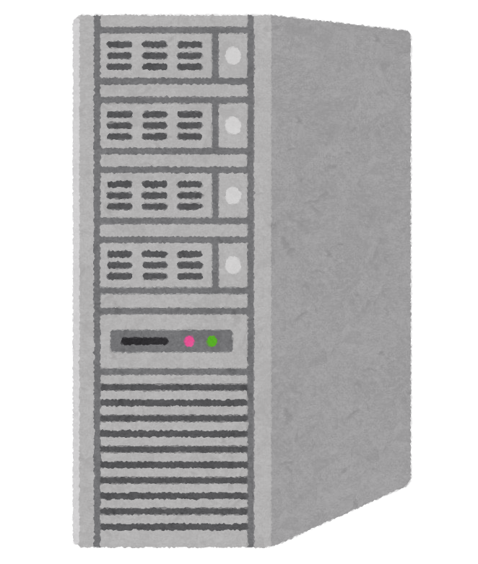
Open problem 1: classical pk is possible?
If pk is classical…
If pk is quantum…
$$pk$$
$$|pk⟩$$
$$pk$$
$${\left|pk\right\rangle }^{⊗t}$$
$$pk$$
$$|pk⟩$$
$$pk$$
$$|pk⟩$$
$$pk$$
$$|pk⟩$$
Partial negative result shown by [Li, Li, Li, Liu, 2024]

Slide 19
Open problem 2: QPKE from weaker assumptions?
PKE
Cryptomania
Multiparty computation
?
PRGs
Zero knowledge
Minicrypt
OWFs
SKE
Commitments
Digital signatures
Microcrypt
EFI
PRSGs
OWSGs
Pessiland
No classical crypto
19

Slide 20
Thank you！

