Slide 1
Reusable Online-Efficient Commitments
Nir Bitansky
New York University &
Tel Aviv University
Omer Paneth
Tel Aviv University
Dana Shamir
Tel Aviv University

Slide 2

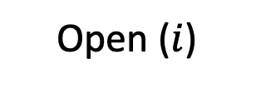



Online-Efficient Commitments
$$x$$
preprocess
$$\tilde{x}$$
Offline
commit
Sender
Receiver
$$\log\left(|x|\right)$$
Online
$$\tilde{x}$$
$$dig$$
Open ($i$)

Slide 3
Existing Solutions
Merkle tree (in the CRS model)
Keyless multi-collision resistant hash (Non-standard assumption)
From RingLWE [Lin-Mook-Wichs24]
  Privately verifiable: receiver must keep digest secret
  Selective rejection attack: verification bit leaks information on the digest
Sender
Receiver
open
Private digest
accept / reject

Slide 4
Dream Goal: public digest
This work: private digest, but verification bit can be made public
Assuming RingLWE
[Lin-Mook-Wichs24]: private digest, verification bit must be kept private

Slide 5
Our Approach
Sender
Receiver
open
Private digest
accept / reject
Leakage resilient Crypto:
  Algebraic leakage lemma [Chung-Kalai-Liu-Raz11]
New algebraic commitment
  inspired by linear commitments of [Ishai-Kushilevitz-Ostrovsky07]

Slide 6
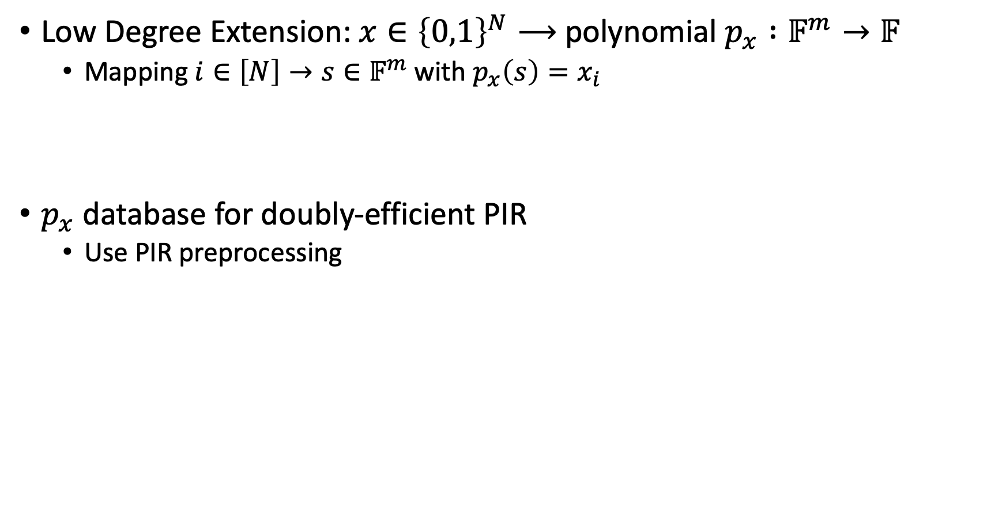



Algebraic Encoding
Low Degree Extension: $x∈{\left\{0,1\right\}}^{N}⟶$ polynomial $p_{x} :𝔽^{m}→𝔽$
  Mapping $i∈\left[N\right]→s∈𝔽^{m}$ with $p_{x}\left(s\right)=x_{i}$
$p_{x}$ database for doubly-efficient PIR
  Use PIR preprocessing
$$PIR.Q(s)$$
Sender
Receiver
$$PIR.A\left(p_{x}\left(s\right)\right)$$
$$\tilde{p_{x}}$$

Slide 7

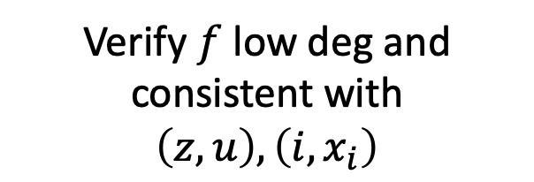









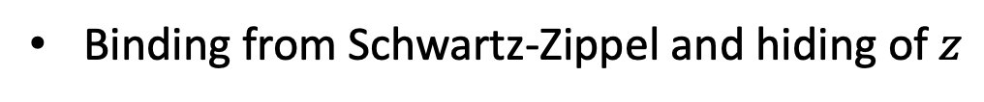
The Commitment
Commit
Sender
$$PIR.Q\left(z∼𝔽^{m}\right)$$
Receiver
$$PIR.A\left(u=p_{x}\left(z\right)\right)$$
$$\tilde{p_{x}}$$
$$dig= \left(z, u\right)$$
Open
$$𝔽^{m}$$
$$S$$
$$i , PIR.Q(S)$$
$$z$$
$$x_{i} , PIR.A\left(f=p_{x}∘S\right)$$
$$i$$
accept / reject
Verify $f$ low deg and consistent with $\left(z,u\right), \left(i,x_{i}\right)$
Binding from Schwartz-Zippel and hiding of $z$

Slide 8
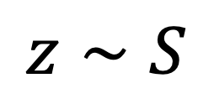
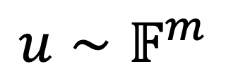

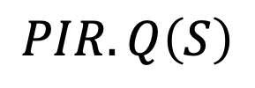


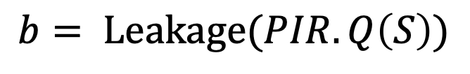
The Leakage Lemma [Chung-Kalai-Liu-Raz11]
$$S$$
$$i$$
$$PIR.Q\left(S\right)$$
$$b= Leakage(PIR.Q\left(S\right))$$
$$z∼S$$
$$≈$$
$$u∼𝔽^{m}$$

Slide 9
Additional Challenges
Private polynomial evaluation over large fields
Extraction of polynomials over large fields
(inspired by [Barak-Goldreich08])

Slide 10

Future Directions
Dream Goal: public digest
This work: private digest, but verification bit can be public
From RingLWE
From CRH ?
[Lin-Mook-Wichs24]: private digest, verification bit must be private
Thank you!

