Slide 1
On Sequential Functions and Fine-Grained Cryptography
Jiaxin Guan¹, Hart Montgomery²
1 New York University
2 Linux Foundation

Slide 2
Let me start by telling you about a dream…

Slide 3
Found Myself in Pessiland
Here's the graphical representation of Impagliazzo's Pessiland[Imp95]. It reflects the bleak and desolate nature of a world without one-way functions, where most cryptographic structures are broken or non-existent.
- ChatGPT

Slide 4
Young man, to return to thy own realm, thou must seek out a relic named Sequential Functions within this Pessiland, and with it, forge some manner of cryptogrpahic artifice.
Fortune be thy guide!

Slide 5
Sequential Functions (Very Informally)
Continuous Iterative Sequential Functions (CISFs)
$$f\left(x\right)=Round^{T}(x)$$
$$f(x)$$
$$f(x)$$
$$≈$$

Slide 6
Time-Released Cryptography
Standard Model Cryptography
FHE
……
IBE
VDF
[BBBF18]
TLP
[RSW96]
PKE
[BGJ+16]
CRHF
Seq. Fun.
OWF
?

Slide 7
Our Results (“On Sequential Functions”)
Theorem 1
Assuming the existence of a PSPACE oracle, then there exists an oracle $𝒪$ and a function $f^{𝒪}$, such that $f^{𝒪}$ is a sequential function, but not a one-way function.
Theorem 2
(The decisional variants of) Continuous Iterative Sequential Functions (CISFs) are PSPACE-complete.
Theorem 3
(The decisional variants of) more general Sequential Functions (Dynamic SFs) are not in PSPACE.

Slide 8
Goal: $f$ that is sequential, but not one way
A failed attempt:
$$𝒫$$
$${ 𝒫 }^{−1}$$
$$𝒫$$
$$x$$
$$⊕$$
$$x⊕𝒫(x)$$
Sadly this doesn’t work…
Davies-Meyer Construction

Slide 9
Our Oracle Separation
Generic Group Model:${ ℤ}_{p}$ with unknown order $p$
Access through “Labels” $L:ℤ_{p}→{\left\{0,1\right\}}^{n}$, for $2^{n}≫p$
$Labels$
$${\left\{0,1\right\}}^{n}$$
$$𝒪_{g}$$
$$ℓ_{a}$$
$$ℓ_{g⋅a}$$
$${ ℤ}_{p}$$
$$L$$
$$C$$
$${ 𝒪}_{Inv}$$
$$x/⊥$$
$$y$$
$$C\left(x\right)=y$$
Runs in time $|C|$

Slide 10
Challenge: Handling Recursion
Allow input circuits to $𝒪_{Inv}$ to contain $𝒪_{Inv}$ gates recursively!
$$𝒪_{g}$$
$${ 𝒪}_{Inv}$$
……
$${ 𝒪}_{Inv}$$
$$𝒪_{g}$$
✓ Non-One-Wayness

Slide 11
Constructing the sequential $f$
$$T$$
$$𝒪_{g}$$
$$𝒪_{g}$$
$$𝒪_{g}$$
……
$$𝒪_{g}$$
$$x$$
$$f\left(x\right)≔𝒪_{g}^{T}(x)$$

Slide 12
Goal: Proving Sequentiality
Intuition: $𝒪_{Inv}$ does not help with shortcutting!
Label
$$x=ℓ_{a}$$
$$ℓ_{ga}$$
$$ℓ_{g^{2}a}$$
$$ℓ_{g^{3}a}$$
$$ℓ_{g^{T}a}$$
……
Group Element
$$a$$
$$ga$$
$$g^{2}a$$
$$g^{3}a$$
$$g^{T}a$$

Slide 13
Challenge: $𝒪_{Inv}$ may instantiate new labels!
Exists $x$, s.t. $𝒪_{g}\left(x\right)$ begins with 1
$$𝒪_{g}$$
Exists $x$, s.t. $𝒪_{g}\left(x\right)$ begins with 10
$$10000000$$
$$11000000$$
$$11100000$$
$${ 𝒪}_{Inv}$$
$$x$$
Exists $x$, s.t. $𝒪_{g}\left(x\right)$ begins with 101
……
$$10000000$$
$$10000000/11000000$$
$$10000000/10100000$$
Exists $x$, s.t. $𝒪_{g}\left(x\right)$ begins with 10101101

Slide 14
Challenge: $𝒪_{Inv}$ may instantiate new labels!
Label
$$x=ℓ_{a}$$
$$ℓ_{ga}$$
$$ℓ_{g^{2}a}$$
$$ℓ_{g^{3}a}$$
$$ℓ_{g^{T}a}$$
……
……
Group Element
$$a$$
$$ga$$
$$g^{2}a$$
$$g^{3}a$$
$$g^{T}a$$

Slide 15
Challenge: $𝒪_{Inv}$ may instantiate new labels!
$$ℓ_{a}$$
$$ℓ$$
$$ℓ_{ga}$$
3. Arc joins happen with negligible probability
1. Any labels instantiated by $𝒪_{Inv}$ is either “connected” to the green arc, or randomly located on the cycle
$$a$$
$$ℓ$$
……
$$ga$$
$$ℓ_{g^{2}a}$$
$$ℓ$$
$$g^{2}a$$
$$g^{3}a$$
$$ℓ_{g^{3}a}$$
$$ℓ$$
2. In $d$ steps, an arc cannot be extended by more than $d$ labels, assuming no “joining” of arcs
$$d$$
$$d$$
……
$$ℓ$$
$$g^{T}a$$
✓ Sequentiality
$$ℓ_{g^{T}a}$$
$$ℓ$$
$$ℓ$$
$$ℓ$$
$$ℓ$$

Slide 16
Challenge: $𝒪_{Inv}$ may respond $⊥$
The more “useful” a ⊥ response is,
the less likely such a ⊥ will happen
All Possible Label Assignments
Consistent with Prior Queries
$$𝒪_{g}$$
$$10000000$$
A ⊥ response impacts the label distributions minimally
$${ 𝒪}_{Inv}$$
$$⊥$$
Label Assignments where$C\left(x\right)=y$ is insatisfiable
And this impact is distributed evenly along the entire cycle
$$10000000$$
✓ Sequentiality

Slide 17
Now that thou hast discovered Sequential Functions in Pessiland, thou shouldst complete the final task: to craft cryptographic artifices therewith.

Slide 18
Our Results (“Fine-Grained Cryptography”)
Standard Primitives
Fine-Grained Primitives
Sub-exponential
Polynomial

Slide 19
Our Results (“Fine-Grained Cryptography”)
Theorem 4
Assuming CISFs, there exist fine-grained SKE and MAC.
Theorem 5
Assuming Verifiable Delay Functions (VDFs) and null iO, there exists fine-grained PKE.
Theorem 6
Assuming Commutative Sequential Functions, there exists fine-grained key exchange.

Slide 20
Building SKE from CISF
Intuition: An adversary cannot catch up with sequential computations!
$$x$$

Slide 21
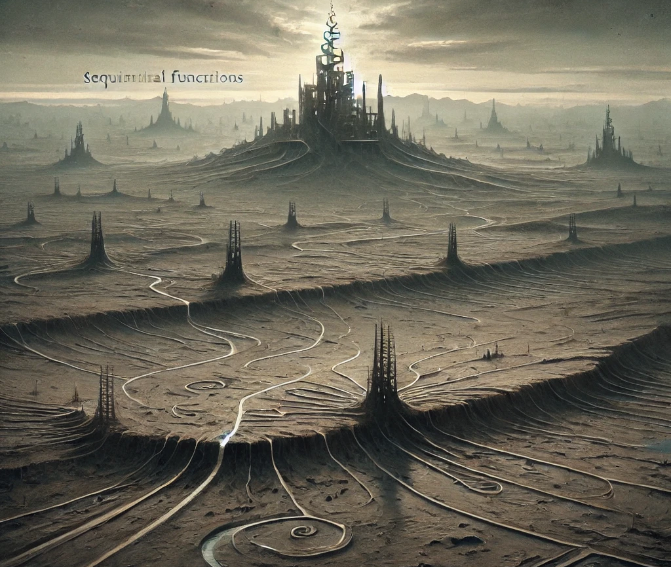
A Way out through Sequential Functions
Here's the graphical representation of the part of Pessiland where sequential functions exist, offering some hope for building fine-grained cryptographic primitives. The scene captures the emerging possibilities, despite the surrounding desolation.
- ChatGPT
Farewell!

Slide 22
Open Problems
Our inversion oracle takes time proportional to the circuit size, as opposed to depth. So we rule out OWFs that require super-polynomial time to invert, but not more fine-grained ones.
Can we get a tighter separation?
Our PKE construction from VDF + null iO requires certain properties of the VDF.
Can we build from plain VDF?
Can we build less fine-grained cryptographic primitives from Sequential Functions?
Can we build Sequential Functions from standard assumptions?

Slide 23
Thank you!
eprint.iacr.org/2024/1050
jiaxin@guan.io

