Slide 1
Pseudorandom error-correcting codes
Miranda Christ and Sam Gunn
Notes:
Hi, I’m Sam Gunn and I’m going to be talking about pseudorandom error-correcting codes, or what I’ll call pseudorandom codes for short.
This is based on joint work with Miranda Christ, a PhD student at Columbia

Slide 2
Background
Train an ML classifier to distinguish
Notes:
Pseudorandom codes are a cryptographic object, but I’m going to try to convince you that they come up very naturally in the context of detecting AI-generated content.
As generative AI becomes increasingly powerful, it’s becoming more and more important to have ways to detect AI-generated content.
I don’t think I need to convince you that this could be a big problem for society.
But since this problem arises from ML, maybe the most obvious way to solve it is to use more ML.
That is, you might simply train an ML classifier to do it.

Slide 3
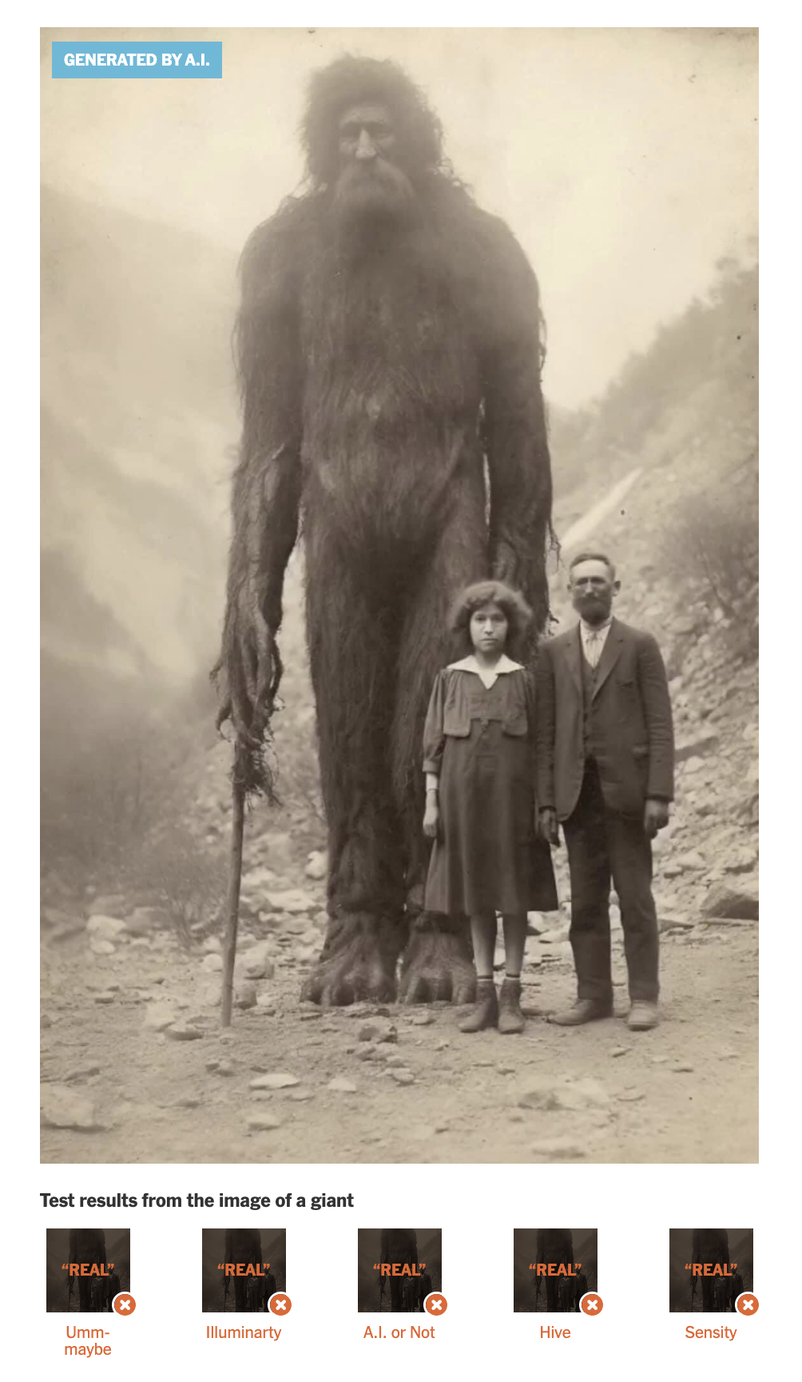
Post-hoc detection
GPTZero, Hive, A.I. or Not, …
(Answer: fairly easy, even if you’re not trying)
Notes:
This is called post-hoc detection, and there are a ton of websites online that do it.
The problem is that none of them really work that well.
For AI-generated images, the Times has a survey with similar findings.
Here’s an image of a giant that fooled all the major AI detectors they tried.
Now you could try to improve these detectors, but ultimately they’re fighting an uphill battle: As generative AI gets better, I expect them to produce content that is statistically indistinguishable from real content, at which point there’s nothing that post-hoc detection can do.

Slide 4
Watermarking
Modify the generative algorithm to embed a hidden pattern in the content
Notes:
Fortunately, there’s an alternative --- watermarking.
In watermarking, we intentionally modify the AI algorithm to embed a hidden pattern in the generated content.
This identifies a specific model rather than any AI model.
And let me just say up front, we’re not going to worry too much about making the hidden pattern “unremovable.”
It turns out that this is a very difficult problem, even to formalize, and it’s already an interesting problem to get watermarks with robustness to non-trivial classes of perturbations.
Even if a watermark can be removed, if we achieve good robustness then removing it should be either expensive or reduce the quality of the content.

Slide 5
Watermarking template
randomness
content
input/prompt
Notes:
OK so how do we embed a hidden pattern in AI-generated content?
We’re going to exploit the fact that generative AI algorithms have the following form: You take some input or prompt, you sample some randomness, and you run some algorithm to produce the content.
Our watermark will work by altering this randomness in a detectable way.

Slide 6
Watermarking template
randomness recovery
with a detector
randomness
tampered randomness
content
input/prompt
PROBLEM 1: tampering may hurt the quality of the content.
Notes:
A natural way to embed a watermark is then to sample pseudorandomness instead of true randomness.
This way, the watermarked content is actually computationally indistinguishable from un-watermarked content, so you don’t have to worry that the watermark degrades the quality or anything.
Of course, you want to be able to test for the presence of the watermark, so you’re going to need a way to partially invert the generative algorithm to get back the randomness.
Fortunately, in all generative AI scenarios I’m aware of, such a “randomness recovery” algorithm exists.
By running the randomness recovery algorithm, you can get back the randomness and then test whether it’s truly random or pseudorandom, as long as you have a trapdoor for detecting the pseudorandomness.
And trapdoor pseudorandom generators are easy to build from pseudorandom functions.
But there’s a problem: I don’t know of any randomness recovery algorithms (in any watermarking setting) that perfectly recover the randomness.
Instead, randomness recovery will only give you some noisy version of the random string.
As a result, existing works on watermarking have had to either use a fixed, memorized random string (thereby introducing correlations across generations), or else to exploit more structure about the particular generation algorithm to get around this issue.

Slide 7
Watermarking template
randomness recovery
with a detector
randomness
tampered randomness
content
input/prompt
Use indistinguishability to argue about quality!
PROBLEM 1: tampering may hurt the quality of the content.
Notes:
A natural way to embed a watermark is then to sample pseudorandomness instead of true randomness.
This way, the watermarked content is actually computationally indistinguishable from un-watermarked content, so you don’t have to worry that the watermark degrades the quality or anything.
Of course, you want to be able to test for the presence of the watermark, so you’re going to need a way to partially invert the generative algorithm to get back the randomness.
Fortunately, in all generative AI scenarios I’m aware of, such a “randomness recovery” algorithm exists.
By running the randomness recovery algorithm, you can get back the randomness and then test whether it’s truly random or pseudorandom, as long as you have a trapdoor for detecting the pseudorandomness.
And trapdoor pseudorandom generators are easy to build from pseudorandom functions.
But there’s a problem: I don’t know of any randomness recovery algorithms (in any watermarking setting) that perfectly recover the randomness.
Instead, randomness recovery will only give you some noisy version of the random string.
As a result, existing works on watermarking have had to either use a fixed, memorized random string (thereby introducing correlations across generations), or else to exploit more structure about the particular generation algorithm to get around this issue.

Slide 8
Watermarking template
randomness recovery
with a trapdoor
randomness
pseudorandomness
content
input/prompt
PROBLEM 1: tampering may hurt the quality of the content.
PROBLEM 2: randomness recovery is almost never perfect.
Notes:
A natural way to embed a watermark is then to sample pseudorandomness instead of true randomness.
This way, the watermarked content is actually computationally indistinguishable from un-watermarked content, so you don’t have to worry that the watermark degrades the quality or anything.
Of course, you want to be able to test for the presence of the watermark, so you’re going to need a way to partially invert the generative algorithm to get back the randomness.
Fortunately, in all generative AI scenarios I’m aware of, such a “randomness recovery” algorithm exists.
By running the randomness recovery algorithm, you can get back the randomness and then test whether it’s truly random or pseudorandom, as long as you have a trapdoor for detecting the pseudorandomness.
And trapdoor pseudorandom generators are easy to build from pseudorandom functions.
But there’s a problem: I don’t know of any randomness recovery algorithms (in any watermarking setting) that perfectly recover the randomness.
Instead, randomness recovery will only give you some noisy version of the random string.
As a result, existing works on watermarking have had to either use a fixed, memorized random string (thereby introducing correlations across generations), or else to exploit more structure about the particular generation algorithm to get around this issue.

Slide 9
Watermarking template
randomness recovery
randomness
pseudorandom code
content
input/prompt
Pseudorandom code (PRC):
Pseudorandomness with a robust trapdoor detection algorithm
(decoding)
Notes:
So we propose replacing the randomness with samples from a pseudorandom code instead.
Pseudorandom codes, or PRCs, give you pseudorandomness with a trapdoor detection algorithm that is also robust to errors.
In fact, we will construct PRCs that actually encode messages (with a constant information rate).
This means that we can embed not only watermarks in the generated content, but also arbitrary information like a secret message, a user ID, a timestamp, etc.
And to the best of our knowledge, it wasn’t known how to construct anything like this before our work.

Slide 10
PRC Definition
A pseudorandom code (PRC) is a pair of algorithms $Enc,Dec$ satisfying:
Pseudorandomness: For any polynomial-time distinguisher $𝒟$,
$\left|\operatorname{Pr}\left[𝒟^{Enc\left(k; ⋅\right)}\left(1^{λ}\right)=1\right]−\operatorname{Pr}\left[𝒟^{ℛ}\left(1^{λ}\right)=1\right]\right|=negl(λ)$.
Error correction: If $x=Enc(k; m)$ and $e$ has low (constant) weight, then
$\operatorname{Pr}\left[Dec\left(k;x⊕e\right)=m\right]=1−negl(λ)$.
*For the purposes of this talk we will only consider binary PRCs and random bit-flips
**We construct a stronger public-key version of PRCs
Notes:
Before we go any further, I should probably spell out what a PRC is in more detail.
A PRC is defined by an encoding and a decoding algorithm.
The encoding algorithm is required to satisfy pseudorandomness, which is probably exactly what you think it is: Any polynomial number of adaptive queries to an encoding oracle should be indistinguishable from an oracle that just gives a fresh random response to each query.
And if an encoded message is subjected to a bounded number of bit-flip errors, then the decoding algorithm should still recover the message with high probability.
For this talk we’ll only consider binary PRCs, because in many settings it turns out to be much easier to build randomness recovery algorithms with binary errors.
We’ll also only consider bit-flip errors, but we show in the paper how to extend to handle deletions as well.
But of course you could generalize this definition to arbitrary alphabets and error channels (and we state a general definition in our paper).
Also, here I’ve just defined “secret-key” PRCs, but in our paper we actually construct the stronger public-key version, analogous to public-key encryption.

Slide 11
Constructing a PRC
A natural attempt is to combine a pseudorandom encryption scheme $(Encrypt, Decrypt)$ with an error-correcting code $(Encode, Decode)$.
Robust encryption
But…
$Encode(Encrypt\left(k; m\right))$ is not pseudorandom
$Encrypt(k; Encode\left(m\right))$ is not robust
Every code bit must satisfy both robustness and pseudorandomness!
Nothing (Trash)
Notes:
Alright so hopefully you’re wondering how we go about building these things.
A natural attempt is to try to combine pseudorandom encryption with error correction.
You can trivially get secret-key pseudorandom encryption with a PRF, and error-correcting codes are of course well-known.
So what happens if you take a pseudorandom encryption of an error-corrected message?
It’s pseudorandom, but you totally lost any robustness afforded by the error-correcting code.
Ok and what if we error-correct a pseudorandom encryption?
Well now decoding is robust to errors, but not pseudorandom!
The issue is that every bit you use should be both pseudorandom and robust, and these primitives only give you one or the other.

Slide 12
Constructing a PRC
LPN says that noisy samples from random linear codes are pseudorandom,
$(A, As⊕e)≈(A, u)$.
We show how to sample a random linear code $A$ with a robust trapdoor $P$:
$$\left(P,A\right)←KeyGen\left(1^{λ}\right)$$
Such that
The marginal distribution of $A$ is uniformly random
The matrix $P$ lets us distinguish $As⊕e$ from $u$
Notes:
We take a different approach.
Since we have a question about error-correcting codes, it seems natural to try to see if we can use LPN to build PRCs.
LPN says that noisy samples from a random linear subspace of F2 are pseudorandom.
So are we done? Do we just encode 1-bit messages as either random strings, or noisy samples from a random linear subspace?
No, because LPN says that these samples are pseudorandom even if you know what the subspace is.
But we show that it’s possible to sample small random linear subspaces together with a trapdoor for decoding.
Crucially, this trapdoor will work even if the codeword is subjected to a high rate of errors.
The way we do this is simple.
First we sample a random parity check matrix where the rows have sparsity log(n).
This will serve as the detection key.
Then we sample a random m-dimensional subspace of the kernel of P, with generator matrix A.
The first technical theorem that we prove is that the marginal distribution on A is actually statistically random, as long as m is not too big (like log^2 n).
So by sub-exponential LPN, noisy samples from the image of A are pseudorandom — but if you know P, then you can easily distinguish them.
On the next slide we’ll spell this out a bit more carefully.

Slide 13
Constructing a PRC
Theorem (this work):
Let $P$ be a random matrix from $𝔽_{2}^{0.99n×n}$ such that each row has exactly $(\log{n})$ 1’s.
Let $A$ be a random matrix from $𝔽_{2}^{n×\log^{2}n}$ such that $PA=0$.
Then $A$ is $negl(n)$-close to uniform in statistical distance.
$$A$$
is statistically random
$$1 0 1$$
$$P$$
$$1 0 0 1 1 0$$
$$0 1 1$$
$$0 0 0$$
$$0 0 1 1 0 1$$
$$1 0 0$$
$$0 0 0$$
$$=$$
$$0 1 1 0 1 0$$
$$0 1 0$$
$$0 0 0$$
$$1 1 0 0 0 1$$
$$1 1 1$$
$$0 0 0$$
$$1 1 0$$

Slide 14
Constructing a PRC
Pseudorandom by our theorem + LPN!
$$Enc\left(A;b\right):$$
To encode $b=0$, output a random string $u∈𝔽_{2}^{n}$.
To encode $b=1$, sample $s←𝔽_{2}^{\log^{2}{n}}$ and error $e$ and output $As⊕e$.
$$Dec\left(P;x\right):$$
Output $1$ if $wt\left(Px\right)≪r/2$.
Otherwise output 0.
$≪r/2$ if $P,e,e′$ are sparse enough
If $x=e^{′}⊕Enc(A;0)$, $wt\left(Px\right)≈r/2$.
If $x=e^{′}⊕Enc\left(A;1\right)$, $wt\left(Px\right)=wt\left(PAs⊕Pe⊕Pe′\right)= wt(Pe⊕Pe′)$.
Notes:
To encode 0, we’ll just output a random string.
To encode 1, we’ll output As+e where e is a random low-weight noise vector and s is a random string from F2^m.
By our theorem from the previous slide together with sub-exponential LPN, As+e is pseudorandom.
To decode, we’ll count the number of satisfied parity checks.
That is, we’ll multiply the given string by P and count the number of 0’s and 1’s.
If significantly more than half of the parity checks are satisfied, then we output 1; otherwise we output 0.
Why does this work?
Suppose that we’re attempting to decode x, which was generated as an encoding of either 0 or 1 that subsequently had some low-weight error vector added to it.
Well if x is a noisy encoding of 0, then we expect about half of the parity checks to be satisfied because x is uniformly random.
And if x is a noisy encoding of 1, then since PA=0, we’re just counting the number of parity checks that are satisfied by the error.
Note that the error has two parts — e, that was added by the encoder for pseudorandomness, and e’, that was added as noise that we want to be robust to.
But as long as e + e’ has low weight, e+e’ will satisfy significantly more than half of the parity checks.
This will work as long as the noise is bounded away from 1/2 by a constant, if we choose P to have rows of sparsity some small fraction of log(n).

Slide 15
Improving the rate
If $Enc′,Dec′$ is an error-correcting code (not pseudorandom), then we can encode a message as
$$Enc\left(A;u_{1}\right), …, Enc\left(A;u_{λ}\right), PRG\left(u_{1},…,u_{λ}\right)⊕Enc′(m)$$
where $u_{1},…, u_{λ}$ are random bits.
For long messages $m$, the information rate approaches that of $Enc′$
Notes:
OK so that’s how we encode 1 bit in a PRC.
But for many applications we’d like to be able to encode longer messages.
Of course we could do this by just encoding each bit separately, but then the rate would only be 1/n.
Ideally we’d like to encode a linear number of bits.
Fortunately, there’s an easy way to do this, by combining the 1-bit PRCs from the previous slide with standard error-correcting codes.
The idea is to just encode a random lambda-bit string by using the 1-bit PRC separately on each bit, and to then use this string as a seed for a PRG that hides a standard error-correcting encoding of the message.
For long messages m, since lambda is just the security parameter, the information rate approaches that of the standard error-correcting code.

Slide 16
Watermarking template
randomness recovery
randomness
pseudorandom code
content
input/prompt
Now we have these!
Pseudorandom code (PRC):
Pseudorandomness with a robust trapdoor detection algorithm
Notes:
Now that we’ve seen the definition and a construction of PRCs, we can actually use our watermarking template.
If there’s one thing I want you to take away from this talk, it’s this picture.
Next, I’ll show you three applications of this template to watermarking various types of content.
The first two applications aren’t included in the paper, because there wasn’t much to prove about them except experiments.

Slide 17
Watermarking template: examples
Generative image models: Sample from the latent space with PRC signs [Gunn & Zhao ??]
Images
“Latent space”
Generative process
To generate new images: Apply generative process to a random Gaussian

Slide 18
Watermarking template: examples
Generative image models: Sample from the latent space with PRC signs [Gunn & Zhao ??]
Images
“Latent space”
Generative process
pseudorandom
To generate new images: Apply generative process to a random Gaussian

Slide 19
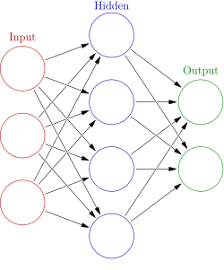
Watermarking template: examples
Neural networks: Initialize the weights with PRC signs
$$.4$$
$$.3$$
$$−.3$$
$$−.2$$
$$.1$$
$$−.5$$
$$.2$$
$$−.4$$
$$−.1$$
$$−.1$$
$$−.1$$
$$.2$$
$$.1$$
$$.2$$
$$.1$$
$$−.1$$
$$−.2$$
$$−.3$$
Random initial network
Trained network

Slide 20
Watermarking template: examples
LLM outputs: Bias the text towards a PRC codeword [Aar22, KGW+23, CGZ23]
$p$=0.7
$p$=0.3

Slide 21
Public attribution for LLMs
We would sometimes like for a user to be able to prove that a given output came from a particular model. This is called attribution [FGJ+23].
Attribution should be unforgeable --- which means that robustness is actually a bad thing!
Using PRCs, we show that you can get the best of both worlds: We’ll give a scheme that can be simultaneously used for standard watermarking and for attribution.
Notes:
In the context of LLMs, there’s another nice thing you can do with PRCs.

Slide 22
Public attribution for LLMs
$$τ_{1}$$
$$τ_{2}$$
Sample $τ_{1}$ with bias towards $PRC.Enc(pk; 0)$
Sample $τ_{2}$ with bias towards $PRC.Enc\left(pk; sign\left(τ_{1}\right)\right)$
…
Standard watermark detection checks if $τ$ is close to a PRC codeword.
Attribution checks if the signature is valid for the given text.

Slide 23
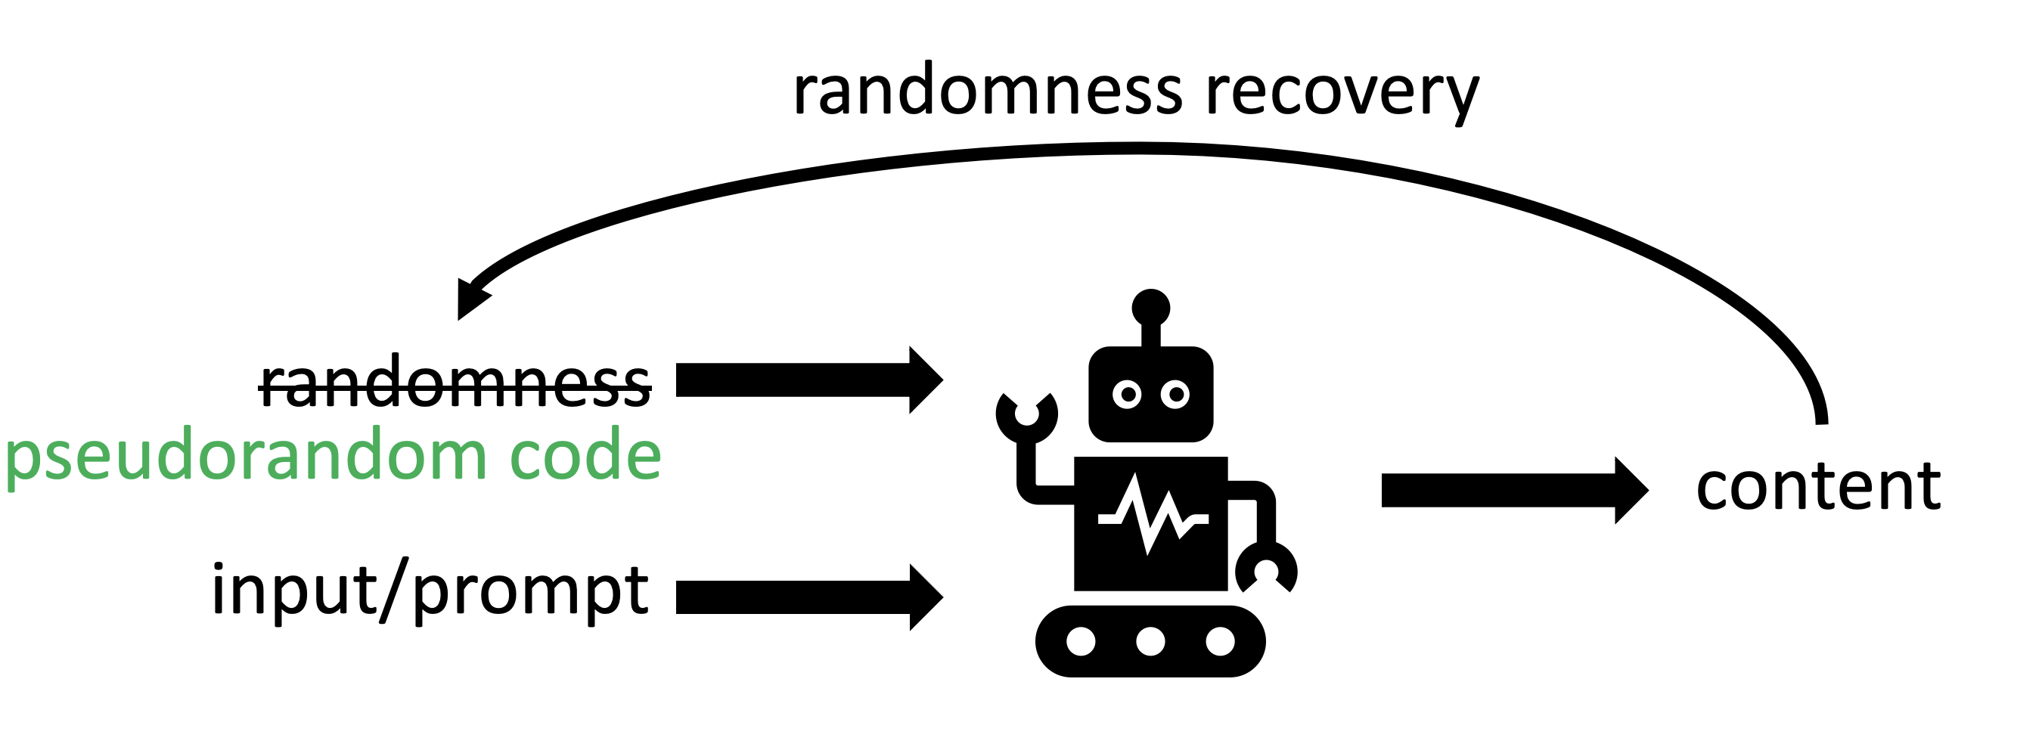
Takeaway
PRCs are a natural tool for hiding information in generative AI outputs

Slide 24
Takeaway
PRCs are a natural tool for hiding information in generative AI outputs
Yielding watermarking schemes simultaneously satisfying…
Undetectability
Robustness to high error rates and even deletions
Unforgeable public attribution
Linear information rate

Slide 25
Recent work
[Golowich & Moitra 24] construct polynomial-alphabet pseudorandom codes with robustness to adversarial edits.
[Cohen, Hoover & Schoenbach 24] define “adaptive robustness” for watermarks and show that the [CGZ23] scheme has this property for low error rates.
[Alrabiah, Ananth, Christ, Dodis, Gunn ??] show that the scheme from this talk is adaptively robust for constant error rates.

Slide 26
Open questions
Can we construct a pseudorandom code without quasipolynomial-time attacks?
Are there other useful ways to tamper with the randomness in ML algorithms? [GKVZ22]

Slide 27
Thanks!
[Aar22] S. Aaronson, “Leaning Into Uninterpretability for AI Alignment,” https://www.scottaaronson.com/talks/leaning-harvard.ppt, 2022.
[KGWKMG23] J. Kirchenbauer, J. Geiping, Y. Wen, J. Katz, I. Miers and T. Goldstein, “A Watermark for Language Models,” 2023.
[CGZ23] M. Christ, S. Gunn and O. Zamir, “Undetectable Watermarks for Language Models,” 2023.
[FGJMM23] J. Fairoze, S. Garg, S. Jha, S. Mahloujifar, M. Mahmoody and M. Wang, “Publicly-Detectable Watermarking for Language Models,” 2023.
[Zam24] O. Zamir, “Excuse me sir, your language model is leaking (information),” 2024.
[CG24] M. Christ and S. Gunn, “Pseudorandom error-correcting codes,” 2024.
[CHS24] A. Cohen, A. Hoover, G. Schoenbach, “Watermarking Language Models for Many Adaptive Users,” 2024.
[GM24] N. Golowich and A. Moitra, “Edit Distance Robust Watermarks for Language Models,” 2024.
[GKVZ22] S. Goldwasser, M. Kim, V. Vaikuntanathan, O. Zamir, “Planting Undetectable Backdoors in Machine Learning Models”

