Slide 1
Collision Resistance from Multi-collision Resistance for all Constant Parameters
Jan Buzek and Stefano Tessaro
University of Washington

Slide 2




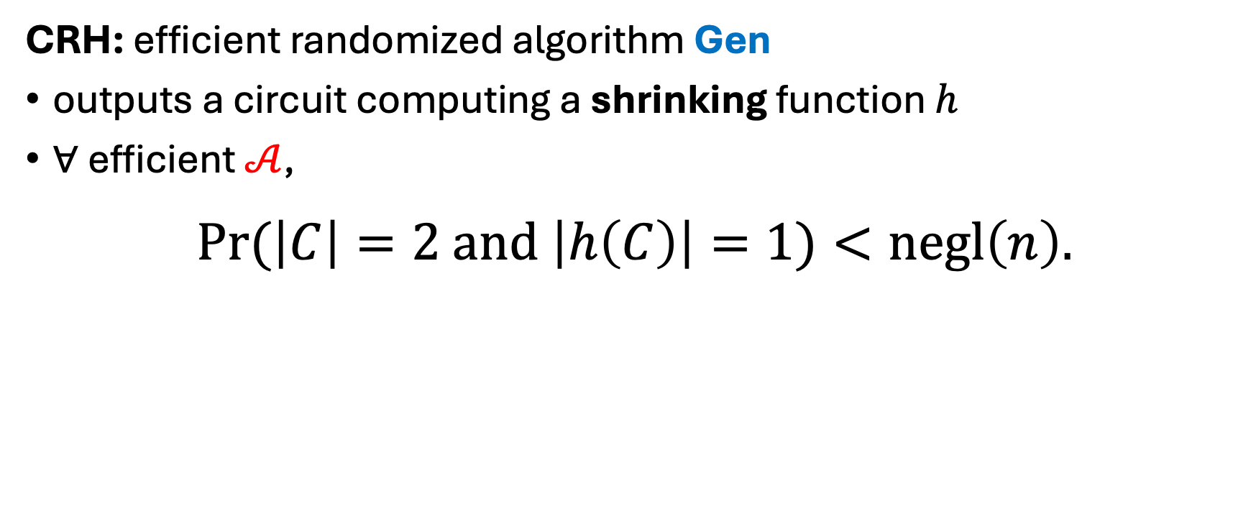


Collision Resistance
$$x_{1}$$
$$h$$
$$h$$
$$x_{2}$$
CRH: efficient randomized algorithm Gen
outputs a circuit computing a shrinking function $h$
$∀$efficient $𝒜$,
$$\operatorname{Pr}{(\left|C\right|=2 \text{and} \left|h\left(C\right)\right|=1)}<\text{negl}\left(n\right).$$
$h$ $←$ Gen
$$C←𝒜(h)$$
Notes:
In particular, any efficient adversary, when given a function h sampled from the CRH, should be able to find two inputs with the same image under h with at most negligible probability in the security parameter n.

Slide 3

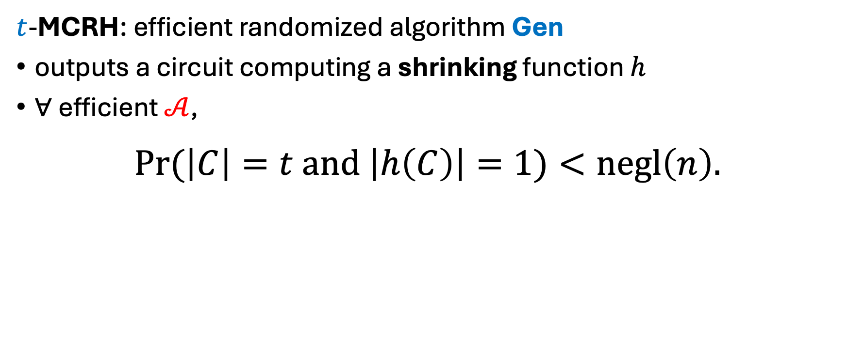
Multi-collision Resistance
$$x_{1}$$
$$h$$
$$h$$
$$x_{2}$$
$t$-MCRH: efficient randomized algorithm Gen
outputs a circuit computing a shrinking function $h$
$∀$efficient $𝒜$,
$$\operatorname{Pr}{(\left|C\right|=t \text{and} \left|h\left(C\right)\right|=1)}<\text{negl}\left(n\right).$$
…
$$h$$
$$x_{t}$$
$h$ $←$ Gen
$$C←𝒜(h)$$

Slide 4

MCRHs: Observations
$t$-MCRH does not become stronger as $t$ increases
CRH $⇒ t$-MCRH for all $t≥2$
MCRH $⇒$ OWF

Slide 5
MCRHs: Applications
Sufficient for many applications of CRHs:
Constant round statistically hiding commitments [BDRV17]
Succinct arguments for NP [KNY18]
3 message zero knowledge arguments [BKP19]

Slide 6
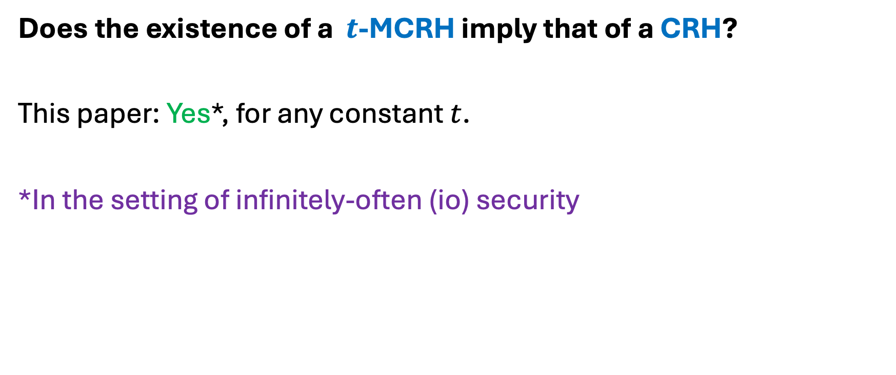
Main Result
Does the existence of a $t$-MCRH imply that of a CRH?
This paper: Yes*, for any constant $t$.
*In the setting of infinitely-often (io) security
standard security = secure ∀ sufficiently large $n$
io security = secure for infinitely many $n$

Slide 7







Prior Works
Rothblum and Vasudevan, Crypto ’22
MCRHs with
$$t∈\{3, 4\}$$
$$⇒$$
CRHs
$$⇒$$
$$⇓$$
$$⇓$$
This Work
MCRHs with constant $t$
$$⇒$$
Distributional CRHs
Komargodski and Yogev, Crypto ’18
* All results are in the infinitely often setting

Slide 8

Shrinkage matters
For CRHs, we can extend the domain arbitrarily
For MCRHs, such strong results are not known, so we specify the domain and range, i.e.
$t$-MCRH: ${\left\{0, 1\right\}}^{2n}→{\left\{0, 1\right\}}^{n}$
For CRHs, we can extend the domain arbitrarily
For MCRHs, such strong results are not known

Slide 9
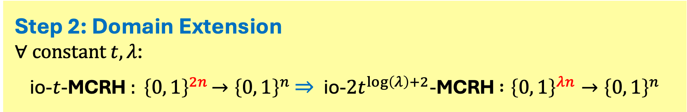
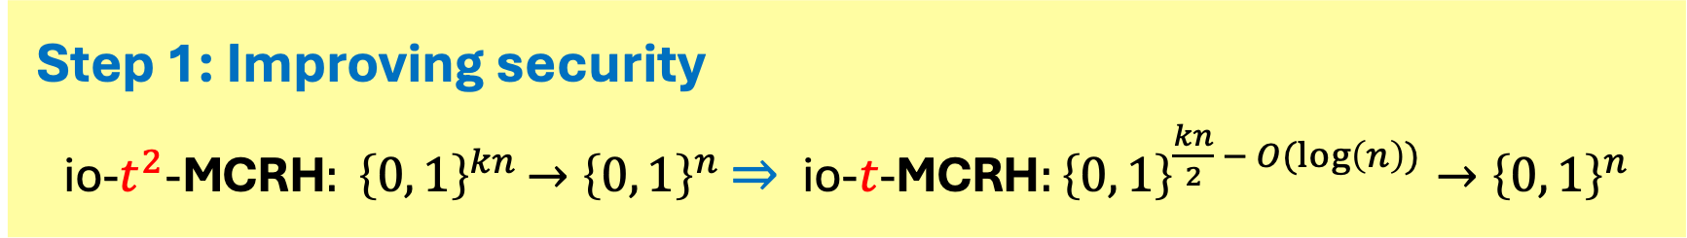
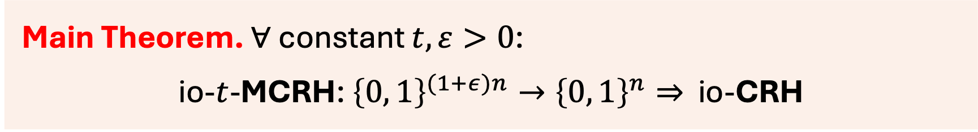
Main Theorem. $∀$ constant $t,ε>0$:
io-$t$-MCRH: ${\left\{0, 1\right\}}^{(1+ε)n}→{\left\{0, 1\right\}}^{n}⇒$ io-CRH
Proof overview:
Step 1: Improving security
io-$t^{2}$-MCRH${: \left\{0, 1\right\}}^{kn}→{\left\{0, 1\right\}}^{n}$ $⇒$ io-$t$-MCRH$:{\left\{0, 1\right\}}^{\frac{kn}{2} − O(\log\left(n\right))}→{\left\{0, 1\right\}}^{n}$
Step 2: Domain Extension
$∀ \text{constant} t, λ$:
io-$t$-MCRH${: \left\{0, 1\right\}}^{2n}→{\left\{0, 1\right\}}^{n}$ $⇒$ io-$2t^{\log\left(λ\right)+2}$-MCRH $:{\left\{0, 1\right\}}^{λn}→{\left\{0, 1\right\}}^{n}$
Notes:
Blueprint similar
non-constructive

Slide 10
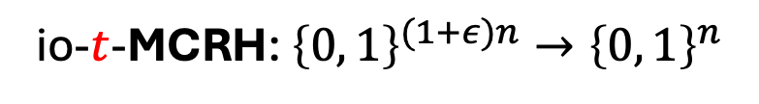
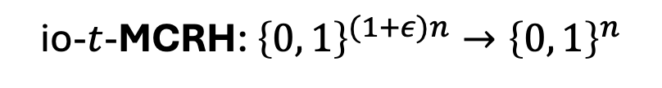
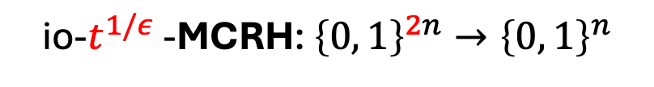
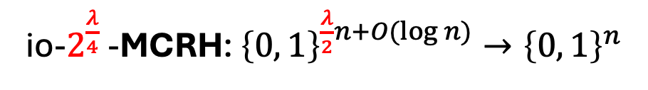
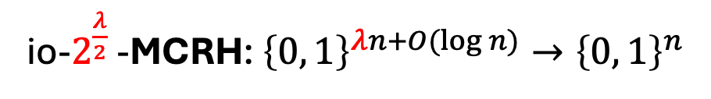
How to combine?
io-$t$-MCRH: ${\left\{0, 1\right\}}^{(1+ε)n}→{\left\{0, 1\right\}}^{n}$
io-$2^{\frac{λ}{2}}$ -MCRH: ${\left\{0, 1\right\}}^{λn+O(\log{n})}→{\left\{0, 1\right\}}^{n}$
Step 2
Step 1
io-$2^{\frac{λ}{4}}$ -MCRH: ${\left\{0, 1\right\}}^{\frac{λ}{2}n+O(\log{n})}→{\left\{0, 1\right\}}^{n}$
io-$t^{1/ε}$ -MCRH: ${\left\{0, 1\right\}}^{2n}→{\left\{0, 1\right\}}^{n}$
Step 1
Merkle-Damgård
…
io-$t$-MCRH: ${\left\{0, 1\right\}}^{(1+ε)n}→{\left\{0, 1\right\}}^{n}$
Step 1
io-CRH

Slide 11
Main Theorem. $∀$ constant $t,ε>0$:
io-$t$-MCRH: ${\left\{0, 1\right\}}^{(1+ε)n}→{\left\{0, 1\right\}}^{n}⇒$ io-CRH
Proof overview:
Step 1: Improving security
io-$t^{2}$-MCRH${: \left\{0, 1\right\}}^{kn}→{\left\{0, 1\right\}}^{n}$ $⇒$ io-$t$-MCRH$:{\left\{0, 1\right\}}^{\frac{kn}{2} − O(\log\left(n\right))}→{\left\{0, 1\right\}}^{n}$
Step 2: Domain Extension
$∀ \text{constant} t, λ$:
io-$t$-MCRH${: \left\{0, 1\right\}}^{2n}→{\left\{0, 1\right\}}^{n}$ $⇒$ io-$2t^{\log\left(λ\right)+2}$-MCRH $:{\left\{0, 1\right\}}^{λn}→{\left\{0, 1\right\}}^{n}$
Uses K-wise independent hashing + hash trees, similar to prior works, but simpler and better parameters (see paper!)

Slide 12



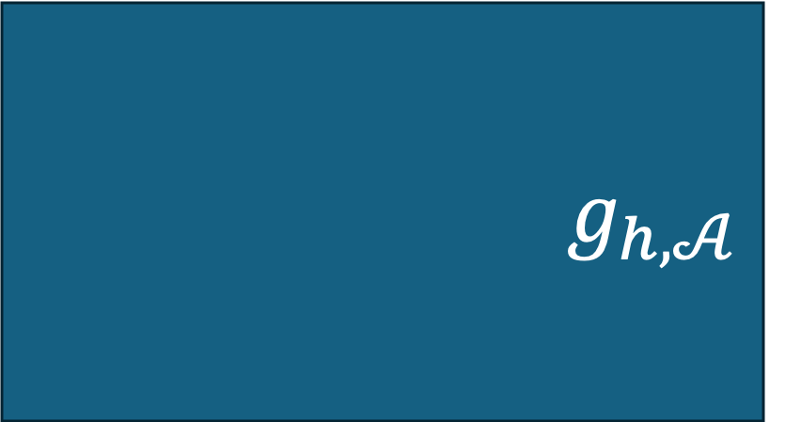
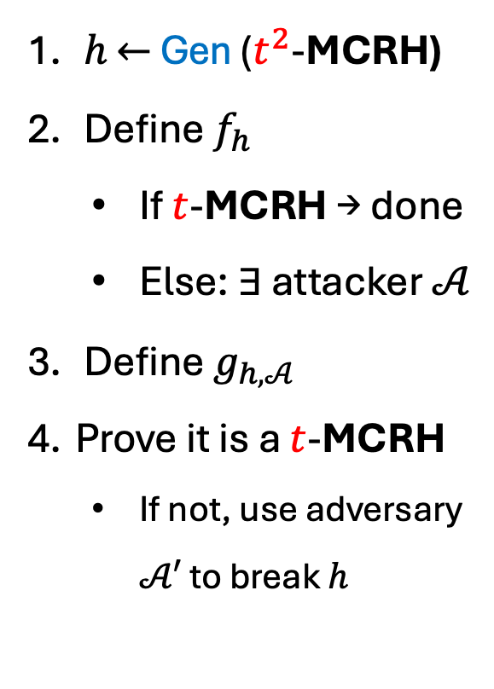

Step 1 – Blueprint
Similar blueprint as [RV22]
$h$ $←$ Gen ($t^{2}$-MCRH)
Define $f_{h}$
  If $t$-MCRH → done
  Else: ∃ attacker $𝒜$
Define $g_{h,𝒜 }$
Prove it is a $t$-MCRH
  If not, use adversary $𝒜′$ to break $h$
$$g_{h,𝒜 }$$
$$f_{h}$$
$$𝒜$$
$$𝒜′$$
$$h$$
Notes:
Use adversary!
why io

Slide 13

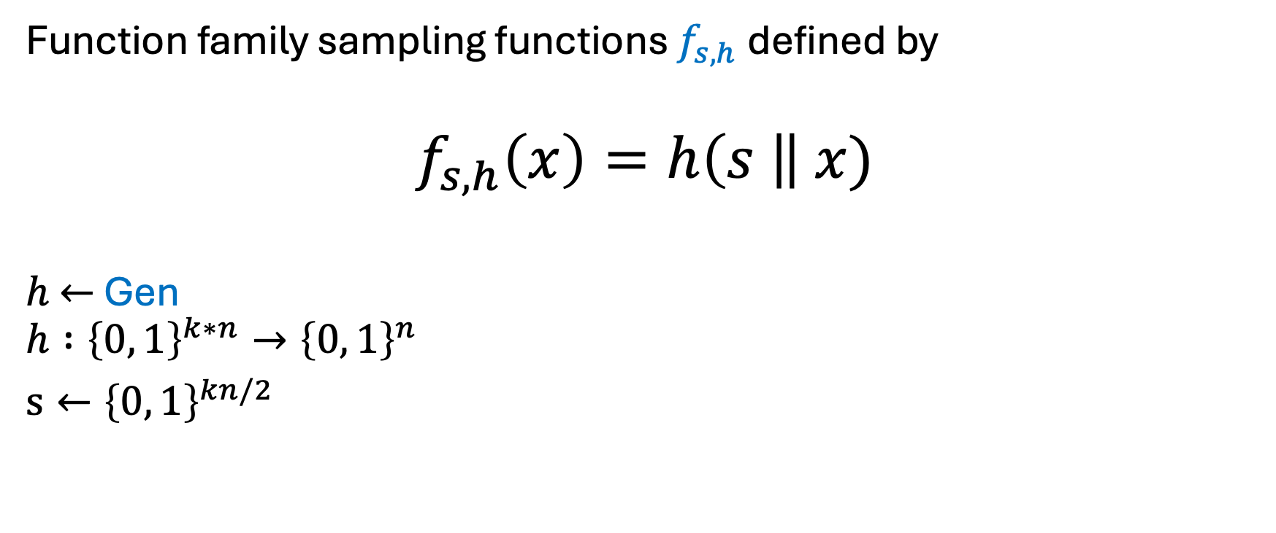


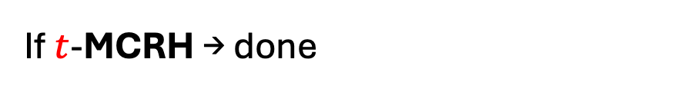

Defining $f$
$$f_{s,h}$$
$$h$$
Function family sampling functions $f_{s, h}$defined by
$$f_{s, h}\left(x\right)=h\left(s \right\| x)$$
$h$ $←$ Gen
$$h :{\left\{0, 1\right\}}^{k∗n}→{\left\{0, 1\right\}}^{n}$$
$s←{\left\{0, 1\right\}}^{kn/2}$
If $t$-MCRH → done
Else: ∃ attacker $𝒜$
Notes:
Perfect Adversary!

Slide 14

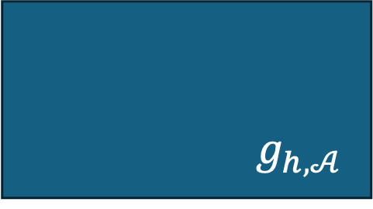
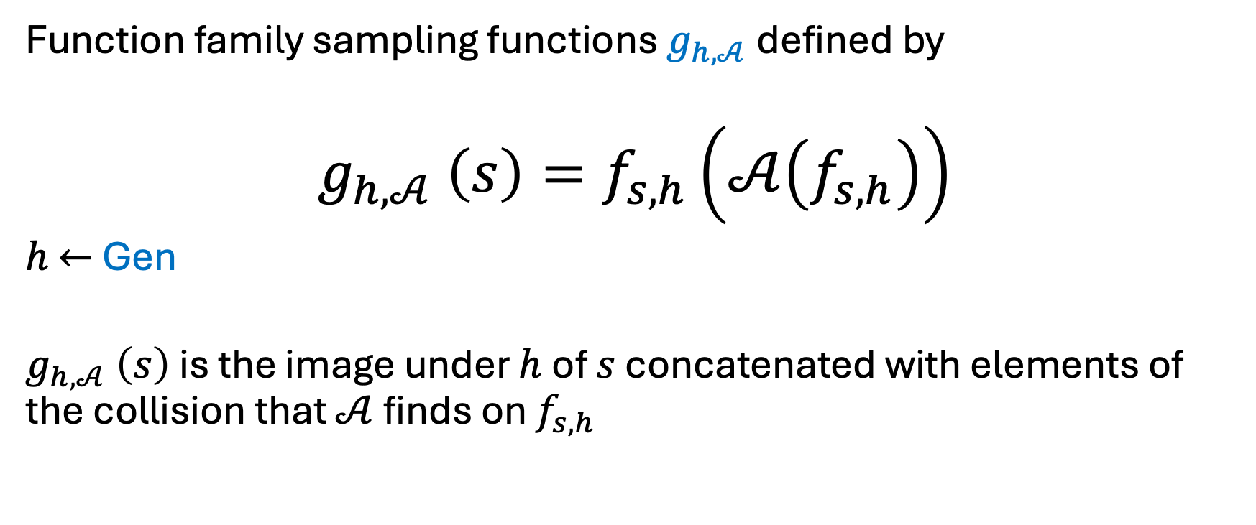




Defining $g$
$$g_{h,𝒜 }$$
$$f_{s, h}$$
$$𝒜$$
$$s$$
$$h$$
Function family sampling functions $g_{h, 𝒜}$defined by
$$g_{h, 𝒜} \left(s\right)=f_{s,h}\left(𝒜\left(f_{s,h}\right)\right)$$
$h$ $←$ Gen
$g_{h, 𝒜} \left(s\right)$ is the image under $h$of $s$ concatenated with elements of the collision that $𝒜$ finds on $f_{s, h}$
Notes:
I wanted to highlight how this relates to h, which is that A finding a collision on f means it finds a collision on h which shares a prefix s.
G is simply a function that takes that prefix s as input and outputs the image of the collision on h that shares that prefix.

Slide 15



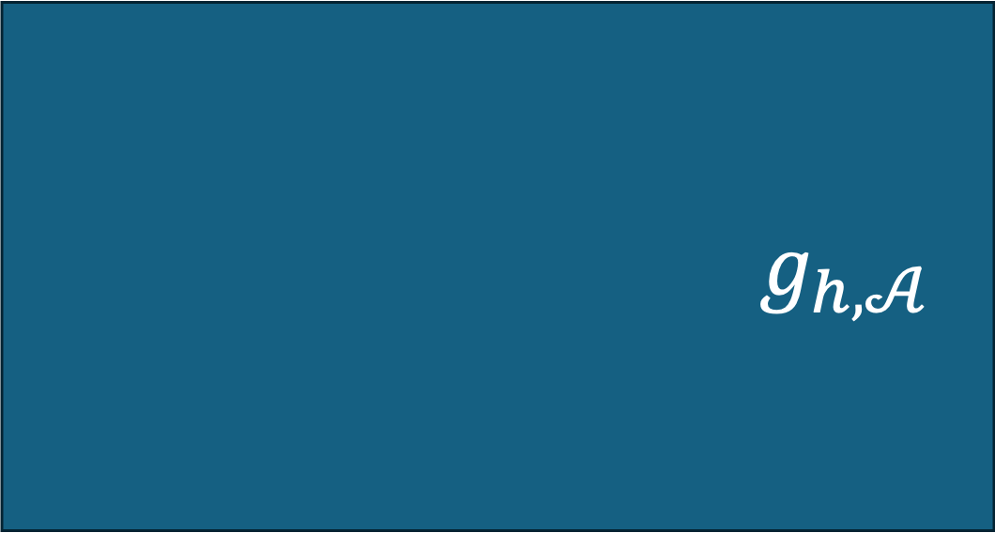
Step 1: Proof Blueprint
$$g_{h,𝒜 }$$
$$f_{s, h}$$
$$𝒜$$
h
$$𝒜′$$
s

Slide 16



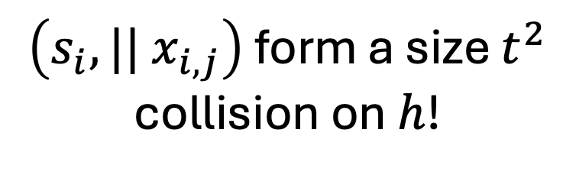











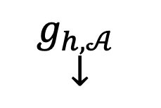







The Reduction
$$f_{s_{1},h}$$
$$↓$$
$$x_{1, 1}$$
$$𝒜$$
$$t=3$$
$$x_{1, 2}$$
$$s_{1}$$
$$g_{h,𝒜 }$$
$$↓$$
$$x_{1, 3}$$
$$f_{s_{2},h}$$
$$↓$$
$$x_{2, 1}$$
$$𝒜′$$
$$s_{2}$$
$$𝒜$$
$$h$$
$$x_{2, 2}$$
$$x_{2, 3}$$
$$f_{s_{3},h}$$
$$↓$$
$$x_{3, 1}$$
$$s_{3}$$
$$𝒜$$
$\left(s_{i},||{ x}_{i, j}\right)$ form a size $t^{2}$ collision on $h$!
$$x_{3, 2}$$
$$x_{3, 3}$$

Slide 17



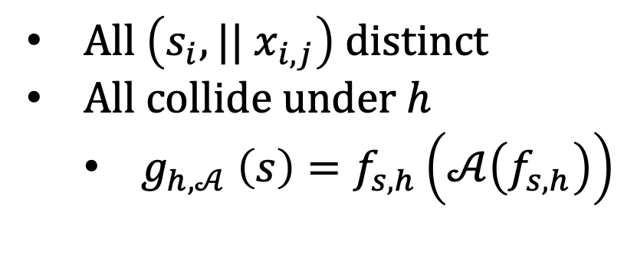





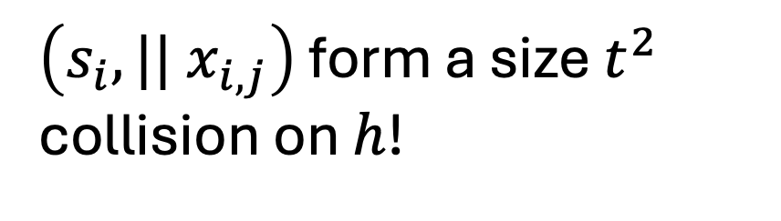




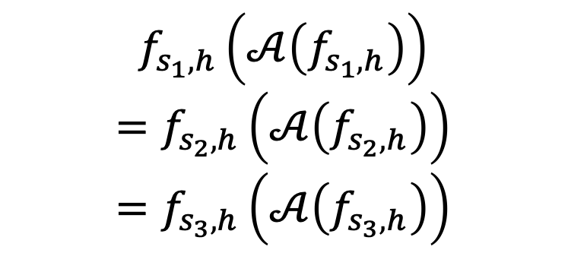




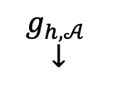




The Reduction
$$f_{s_{1},h}$$
$$↓$$
$$x_{1, 1}$$
$$𝒜$$
$$s_{1}$$
$$x_{1, 2}$$
$\left(s_{i},||{ x}_{i, j}\right)$ form a size $t^{2}$ collision on $h$!
$$g_{h,𝒜 }$$
$$↓$$
$$x_{1, 3}$$
$$f_{s_{2},h}$$
$$↓$$
$$𝒜′$$
$$x_{2, 1}$$
$$h$$
$$s_{2}$$
$$𝒜$$
$$x_{2, 2}$$
$$x_{2, 3}$$
All $\left(s_{i},||{ x}_{i, j}\right)$ distinct
All collide under $h$
  $g_{h, 𝒜} \left(s\right)=f_{s,h}\left(𝒜\left(f_{s,h}\right)\right)$
$$f_{s_{3},h}$$
$$↓$$
✅
$$x_{3, 1}$$
$$s_{3}$$
$$𝒜$$
✅
$$x_{3, 2}$$
$$x_{3, 3}$$
$$f_{s_{1},h}\left(𝒜\left(f_{s_{1},h}\right)\right)$$
$$=f_{s_{2},h}\left(𝒜\left(f_{s_{2},h}\right)\right)$$
$$=f_{s_{3},h}\left(𝒜\left(f_{s_{3},h}\right)\right)$$
✅

Slide 18

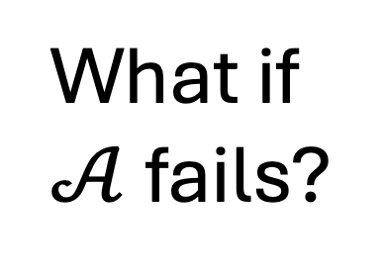




Imperfect Adversaries
Unrealistic assumption: Adversaries work with probability $1$.
$$g_{h,𝒜 }$$
$$f_{h}$$
What if $𝒜$ fails?
$$𝒜$$
$$h$$

Slide 19
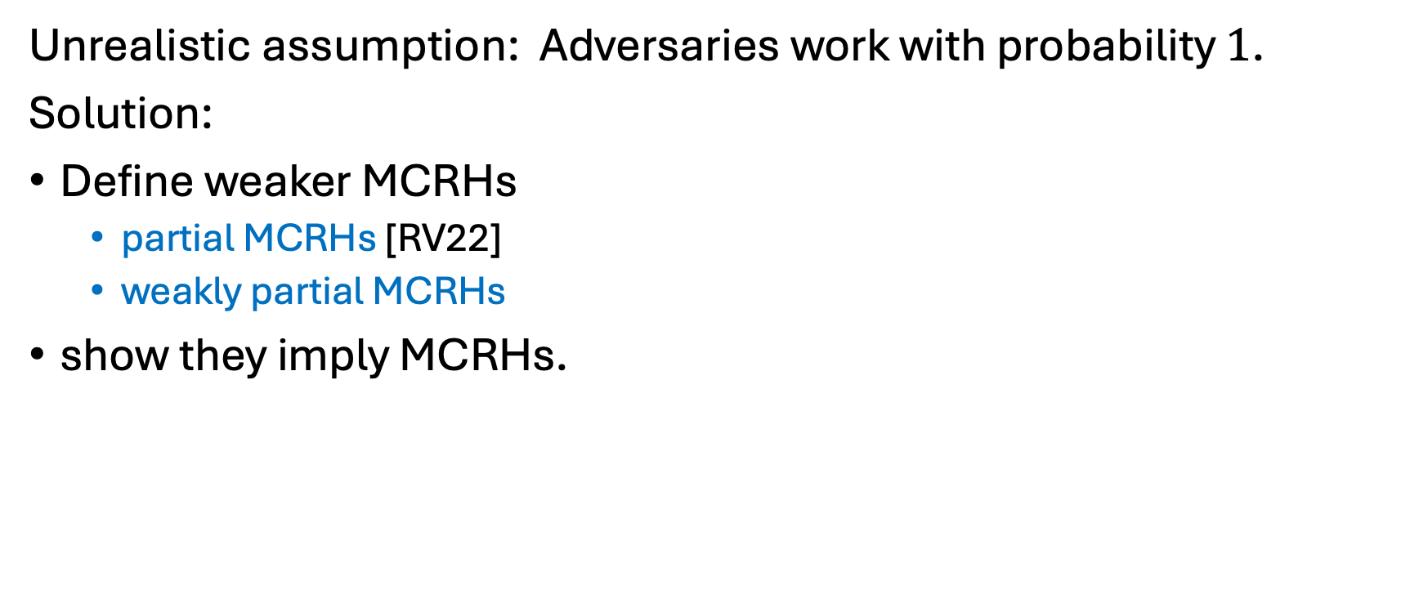
Imperfect Adversaries
Unrealistic assumption: Adversaries work with probability $1$.
Solution:
Define weaker MCRHs
  partial MCRHs [RV22]
  weakly partial MCRHs
show they imply MCRHs.

Slide 20
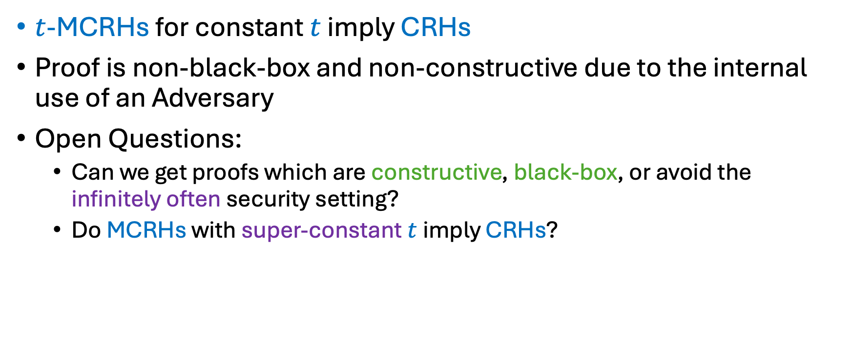
Summary
$t$-MCRHs for constant $t$ imply CRHs
Proof is non-black-box and non-constructive due to the internal use of an Adversary
Open Questions:
  Can we get proofs which are constructive, black-box, or avoid the infinitely often security setting?
  Do MCRHs with super-constant $t$imply CRHs?
Thank you!

