Slide 1
Certifying Private Probabilistic Mechanisms
Presented by Zoë Ruha Bell, Crypto 2024
Paper with Shafi Goldwasser, Michael P. Kim, & Jean-Luc Watson
Find at https://eprint.iacr.org/2024/938
Notes:
More broad but focus on DP for today

Slide 2
Today: Differential Privacy

Slide 3
What is Differential Privacy?
Motivation: allow external analysis of sensitive databases (DBs)
DB Curator
𝐃={x₁,x₂, …}
Query function 𝐟
Analyst
Probabilistic mechanism M_{f}(D)
Notes:
Ex: Netflix withdrawing movie rating DB after deanonymization attacks (2007)
NIH advising against publicly releasing data from clinical trials due to a case where participants were ID’d as part of the diagnosed group (2008)
NYC excluding demographic info from CitiBike rental service DB due to potential to reveal sensitive info
Analyst is treated as the untrusted party, so give randomized answer that looks like…

Slide 4
What is Differential Privacy?
Motivation: allow external analysis of sensitive databases (DBs)
Ex.: how many residents of Census block 9821 have income ≥$200k?
DB Curator
𝐃={x₁,x₂, …}
Query function 𝐟
Analyst
Probabilistic mechanism M_{f}(D)
Notes:
Ex: Netflix withdrawing movie rating DB after deanonymization attacks (2007)
NIH advising against publicly releasing data from clinical trials due to a case where participants were ID’d as part of the diagnosed group (2008)
NYC excluding demographic info from CitiBike rental service DB due to potential to reveal sensitive info (2021)
Analyst is treated as the untrusted party, so give randomized answer that looks like…

Slide 5
What is Differential Privacy?
Motivation: allow external analysis of sensitive databases (DBs)
Differential Privacy (DP): can’t tell if an individual is "in" the DB vs "excluded" from the DB
DB Curator
𝐃={x₁,x₂, …}
Query function 𝐟
Analyst
Probabilistic mechanism M_{f}(D)
Notes:
Ex: Netflix withdrawing movie rating DB after deanonymization attacks (2007)
NIH advising against publicly releasing data from clinical trials due to a case where participants were ID’d as part of the diagnosed group (2008)
NYC excluding demographic info from CitiBike rental service DB due to potential to reveal sensitive info (2021)
Analyst is treated as the untrusted party, so give randomized answer that looks like…

Slide 6
What is Differential Privacy?
Motivation: allow external analysis of sensitive databases (DBs)
Differential Privacy (DP): can’t tell if an individual is "in" the DB vs "excluded" from the DB
Definition: a mechanism M_{f} is (𝝴,𝝳)-DP if ∀DB D, individuals x, outputs Y
Pr [ M_{f}(D) ∈ Y ] ≤ e^{𝝴} · Pr [ M_{f}(D\{x}) ∈ Y ] + 𝝳
and
Pr [ M_{f}(D\{x}) ∈ Y ] ≤ e^{𝝴} · Pr [ M_{f}(D) ∈ Y ] + 𝝳
Notes:
View should look nearly the same no matter which database we’ve got
Smaller epsilon is better!
“Probability that the DP condition is violated,” it’s possible that an event could definitively distinguish b/t the databases
Or, mechanism is delta-close (in statistical distance) from an epsilon-DP mechanism
Smaller delta is better!
Standard is to only consider delta which is negligible in the size of the database as providing meaningful privacy

Slide 7
Differential Privacy in Practice
Issues:
Incorrect implementations/bugs [CDEGH+ 2024]
Low transparency [TKBWW 2017]
Conclusion: we need to certify
Notes:
Painstaking after-the-fact effort or relies on internal access to the company’s code

Slide 8
Cryptographic Paradigm for Regulatory Compliance
Institutions prove to auditors…
(in a formal mathematical sense)
that they are utilizing mechanisms for trustworthiness…
(expressed as mathematical definitions)
at design-time.
(catching misbehavior as it occurs, not after-the-fact)
Notes:
Bamberger, Canetti, Goldwasser, Wexler, & Zimmerman “Verification Dilemmas in Law & the Promise of ZKPs” Berk Tech Law Journal (’22)

Slide 9
Trust Models for DP
 | Centralized DP | Local/MPC DP | Certified DP
Trusted Curator | ✅ | ❌ | ❌
Curator has DB | ✅ | ❌ | ✅
Notes:
We’ve used DP to hide information from the analyst, but do we trust the curator to follow the protocol?
Can’t ask for prevention, but can ask for detection
In local and distributed DP, the parties whose data it is are assumed to have control over their own data
This isn’t always reasonable (e.g. the Census, clinical trials, etc.), so we consider what can be done when the Engine does have full access to the DB
Of course, this is also a weaker protection in its own way exactly b/c the Engine gets full access to the database, they could always reveal private information in a separate channel, but as long as we have an Analyst to check their work we can verify DP

Slide 10
Outline
Security Definitions
Construction
Implementation

Slide 11
Certified Differential Privacy
Curator/Prover
D={x₁, …}
Function f
Analyst/Auditor/Verifier
Correctness: The release of an honest Curator queried by an honest Analyst is (𝝴, 𝝳)-DP
Dishonest-Curator DP: Whenever a Curator degrades DP, an honest Analyst proportionally catches them & raises a failure flag ⊥, i.e. the release is (𝝴, 𝝳+O(Pr[⊥]))-DP
Dishonest-Analyst DP: Every release of an honest Curator is (𝝴, 𝝳)-DP
Answer Q
Notes:
Note: catching DP violations, not preventing them
This is the best we can do in the case of a single untrusted data curator

Slide 12
Certified Probabilistic Mechanism
Prover
𝚹
Query q
Verifier
Probabilistic mechanism M_{q}:
input parameters 𝚹 → random Output
Correctness: For honest P and honest V, Output ~ M_{q}(𝚹)
Cheating-Prover Soundness: When P̃ deviates significantly from M_{q}(𝚹), honest V detects, so
Pr[Output = ⊥] ≈ TV(Output, M_{q}(𝚹))
Cheating-Verifier Soundness: Even if Ṽ deviates, Output ~ M_{q}(𝚹) conditioned on Output ≠ ⊥ (hiding P’s input 𝚹 & internal randomness)
Output
Notes:
Note: Input parameters need not be a database, query need not be a function
The more distribution changes the higher chance of being caught
This is new compared to previous trust settings

Slide 13
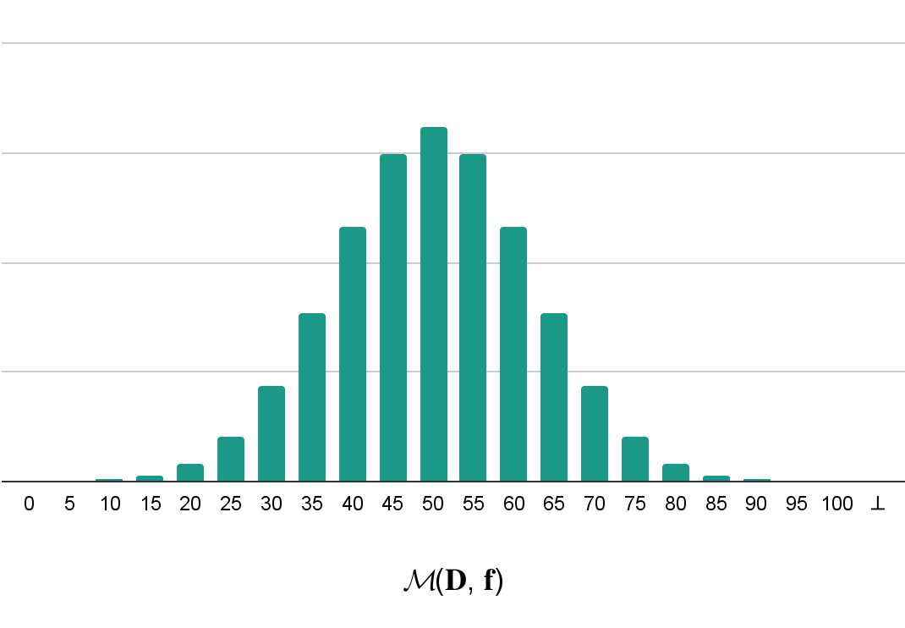
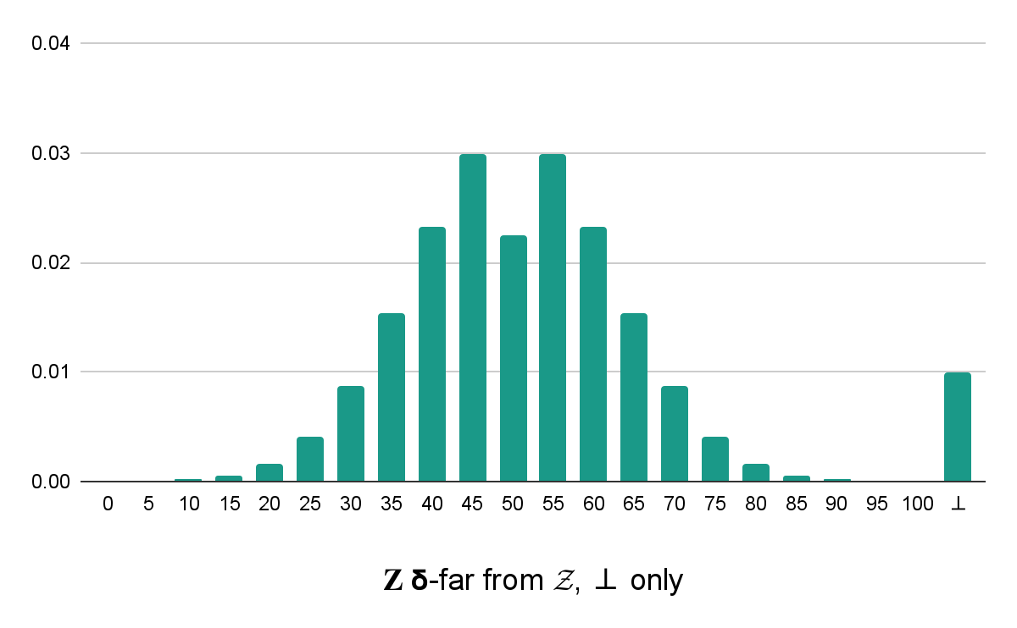
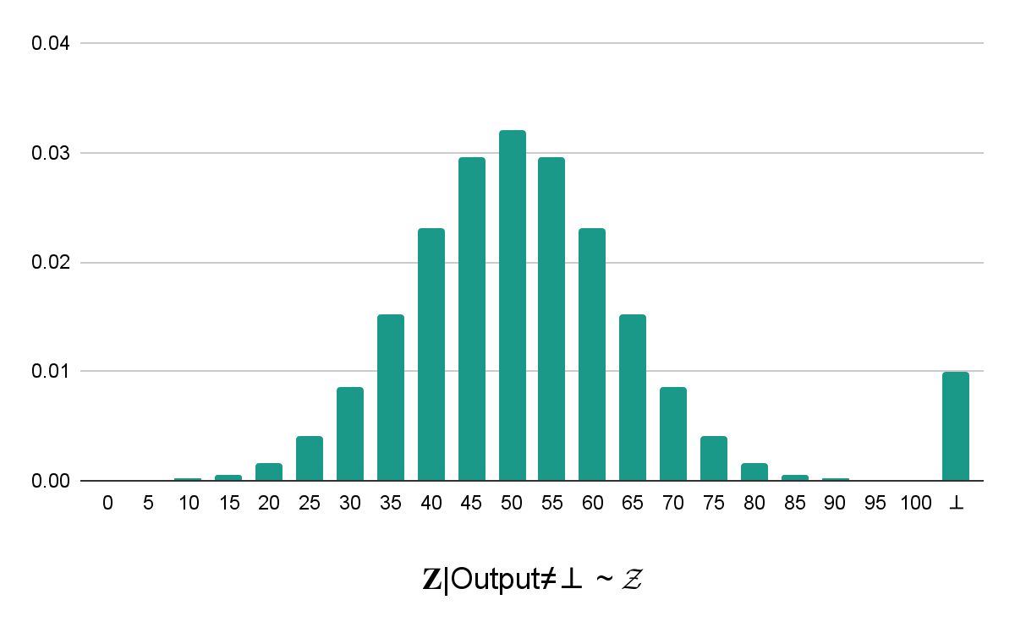
Certified Probabilistic Mechanism
Prover
𝚹
Query q
Verifier
Probabilistic mechanism M_{q}:
input parameters 𝚹 → random Output
Output
Correctness:
intended distribution
Cheating-Prover Soundness:
Pr[⊥] ≈ TV(actual, intended)
Cheating-Verifier Soundness:
intended when ≠⊥

Slide 14
What is Needed for “Hiding”
Generic techniques can add Zero Knowledge (ZK)
For DP, witness indistinguishability (WI) suffices: for a given Output,
View_{D}(Ṽ) = View_{D’}(Ṽ)
Prover
D={x₁, …}
Verifier
Verifier
Prover
D’={x₁’,…}
Output
Output
Notes:
“Our definition of CPMs is carefully designed to allow the verifier to be convinced of the integrity of the outcome they observe, and learn nothing more.
The ability to control what information is and isn’t released through the certification procedure is critical for this notion to be used in legally-mandated certification”
For experts in the audience…

Slide 15
What is a Random Variable Commitment Scheme?
Idea: “commit to random variable Z ~ distribution 𝓩”
Ex: draw a permutation of a card deck uniformly at random to play blackjack
Dealer & Player shuffle the deck together
Binding: Dealer can open the resulting commitment 𝐂 to a single value
Hiding: Player does not know which value 𝐂 is a commitment to
Distributional Soundness: Dealer & Player are both convinced that 𝐂 is to a value Z ~ 𝓩
Notes:
Shuffling together = outputting a commitment together
First two are basic binding and hiding—the Dealer should be able to reveal the order of the cards and be bound to a single order when doing so, the Player should not know the order of the cards
But both the Dealer and Player should be confident that the card ordering is a random permutation of the deck
What does this third property mean mathematically?

Slide 16
Certified Additive Noise Mechanisms
For Z ~ 𝓩, a distribution independent of f and D, let
M_{f}(D) = f(D) + Z
Setup:
Commit(D)
Commit(Z) — a “RV Commitment”
Query f:
Commit(D) → Commit(f(D))
Commit(f(D)) ⊕ Commit(Z) = Commit(M_{f}(D))
M_{f}(D)
f(D)
Z
Notes:
Only RVCS is interactive
Otherwise rejection sampling can distort the distribution

Slide 17
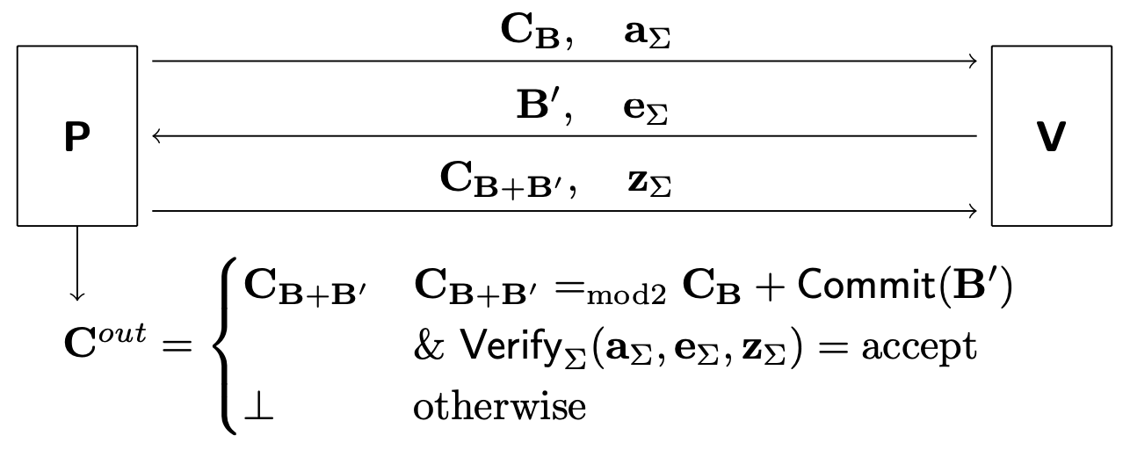
Protocol to Generate a Random Bit Commitment
Prover
Verifier
∧
Notes:
Minimally interactive (Impossible to use e.g. Fiat-Shamir to remove interaction; is inherently interactive)
Verifier only uses public randomness

Slide 18
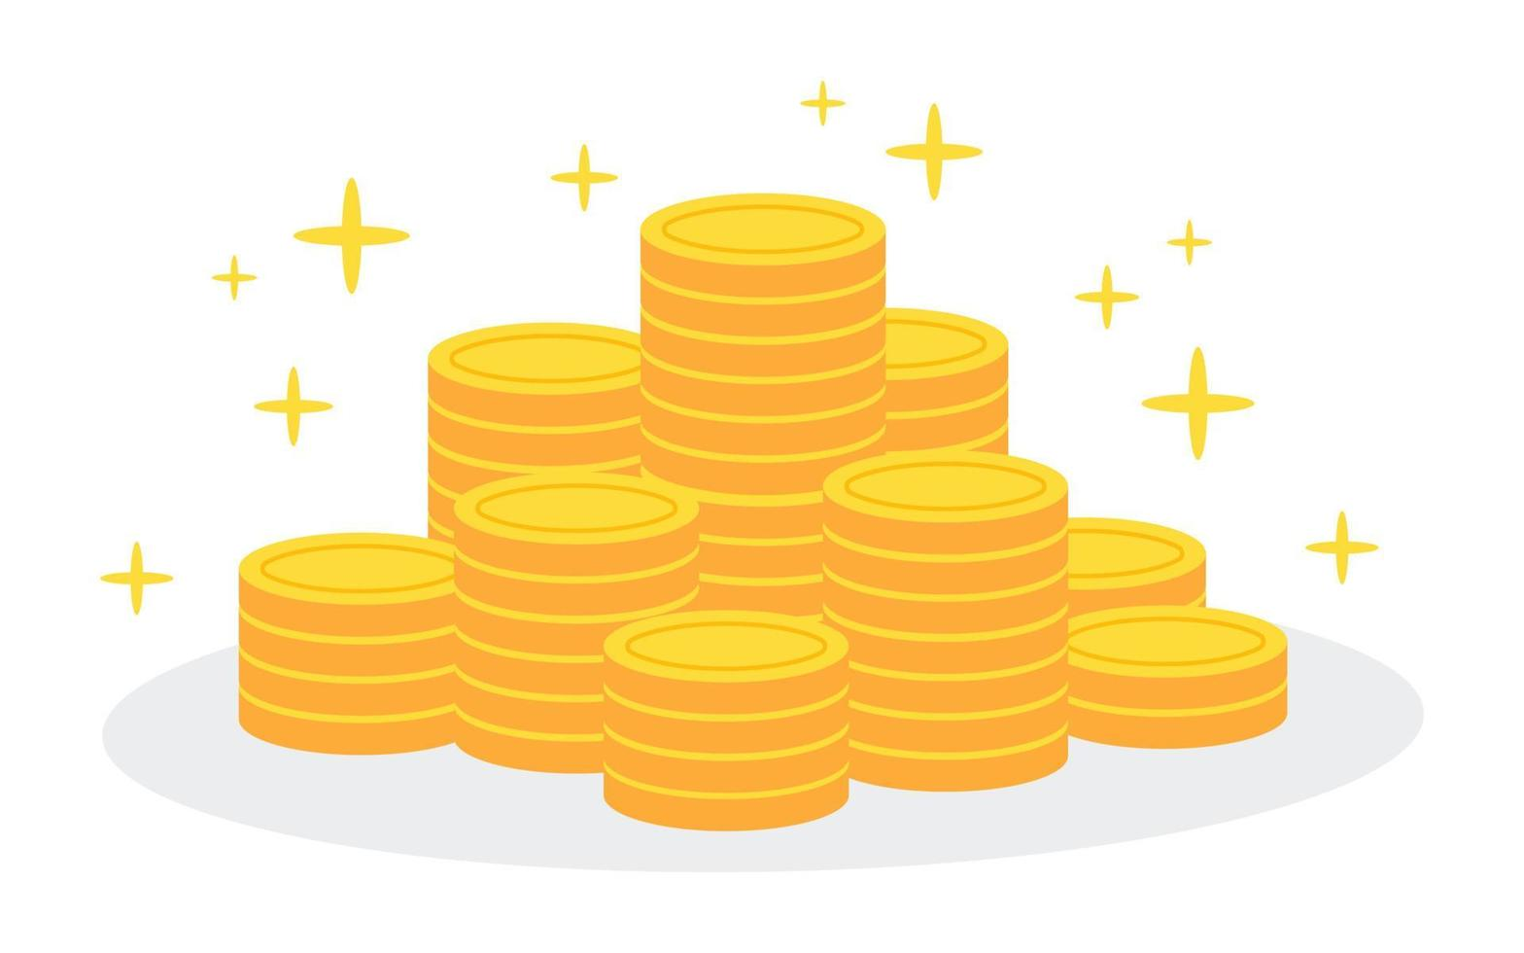
Public Certifiability from Public Randomness
Prover
Our Random Variable Bit Commitments turn such trustworthy public random bits into trustworthy private random bits
Verifier
Notes:
Instead of the Verifier sending coins, can get from NIST
Prover timestamps each commitment and tracks the history in a hash chain

Slide 19
Instantiation of Certified Counting Queries
Counting queries for arbitrary predicate f: {0,1}^{d} → {0,1}
f(D) = Σ_{x∈D} f(x)
Binomial mechanism
B_{f}(D) = f(D) + Binomial(N, ½) - N/2
for N = 8 log(2/δ) / ε² ≈ 8 (log²(|D|) + 1)
Only using a lightweight cryptographic primitive (Pedersen commitments)

Slide 20
Querying Income on the Census PUMS Dataset
DB of n = 7,000 individuals, dimension d = 37 (age, sex, edu, income)
Privacy budget ε = 1
Query: How many individuals have income over $262,144?
Query degree k = 6, sparsity s = 63
Commitment time = 136 s + randomness generation time = 494 ms
Querying time = 1.9 ms
Notes:
Clarify polynomial
Mention parallelizability

Slide 21
Complexity Analysis
* Can be made non-interactive with standard techniques
** N = 8 log(2/δ) / ε² total bits
 | # rounds of interaction | # expensive operations
Commitment Phase | 3* | n · |M| ≤ n · 2^{d}
Random Bit Generation | 3 | 16 per bit**
Querying Phase | 1 | 4 · s_{f}
Notes:
Can parallelize

Slide 22
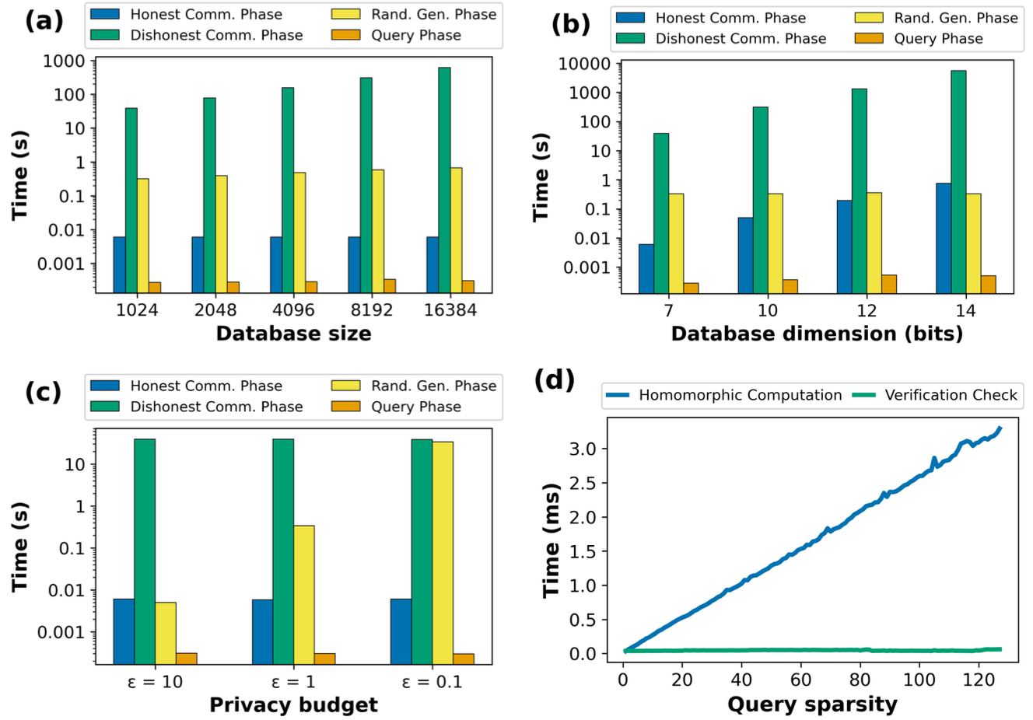
Notes:
Query phase time is short and constant with respect to database size, dimension, and privacy budget
Even as vary sparsity large (to max 2^d=2^7), querying remains a few milliseconds

Slide 23
Summary of Contributions
Introduce DP trust setting: certified DP
Define cryptographic guarantee: certified probabilistic mechanisms
Define primitive: random variable commitments
Provide construction for additive noise mechanisms
Provide trustworthy private random bits from public random bits
Instantiate for counting queries with Binomial noise
Implement & evaluate this protocol

Slide 24
Future Directions
Certifying differentially private machine learning (DP-ML)
Certifying data deletion from machine learning models (MUL)
Certifying fairness
Other probabilistic mechanisms?

Slide 25
Questions?

Slide 26
Certified Differential Privacy
Curator/Prover
D={x₁, …}
Function f
Analyst/Auditor/Verifier
Correctness: The release of an honest Curator queried by an honest Analyst is (𝛂, 𝛃)-accurate & (𝝴, 𝝳)-DP
Dishonest-Curator DP: Whenever a Curator degrades accuracy or DP, an honest Analyst proportionally catches them & raises a failure flag ⊥, i.e. the release is (𝛂, 𝛃+O(Pr[⊥]))-accurate & (𝝴, 𝝳+O(Pr[⊥]))-DP
Dishonest-Analyst DP: Every release of an honest Curator is (𝝴, 𝝳)-DP
Answer Q
Notes:
Note: catching DP violations, not preventing them
This is the best we can do in the case of a single untrusted data curator

Slide 27
Public Certifiability from Public Randomness
Where could we get a source of trustworthy public random bits?
The NIST Interoperable Randomness Beacon:
“Intends to promote the availability of trusted public randomness as a public utility. This can be used for example for auditability & transparency of services that depend on randomized processes.”
Our Random Variable Bit Commitments turn such trustworthy public random bits into trustworthy private random bits
Notes:
Instead of the Verifier sending coins, can get from NIST
Prover timestamps each commitment and tracks the history in a hash chain

Slide 28
Complexity Analysis
Notes:
Can parallelize

