Slide 1
Limits on the Power of Prime-Order Groups: Separating Q-Type from Static Assumptions
George Lu Mark Zhandry
Notes:
Hello, my name is George Lu and today I’ll be talking about our paper – Limit on the power of prime-order groups…
Joint work with mark zhandry

Slide 2
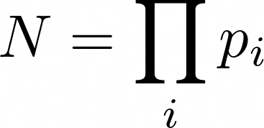
Composite Order Groups
Optional: Pairings
Notes:
Ok, maybe contrary to what the title would lead you to believe, we’re going to start by talking about composite order groups.
Cyclic group, generator, and the order of the group is the product of several distinct (large) prime factors
Optionally, and to get a lot of the functionality mentioned next, there’ll be pairings in some of these groups

Slide 3
The Power of Composite Order Groups
Homomorphic Encryption [BGN05]
NIZKs [GOS06a]
Traitor Tracing [BSW06]
(Round optimal) Blind signatures [MSF10]
Hierarchal IBE [Wat09]
Adaptively Secure ABE [LOSTW10]
Multi-Authority ABE [LW10]
And more…
Notes:
Now there’s been a great deal of success in achieving advanced crypto primitives (or security notions) using composite order groups, from encryptions schemes, proof systems, signatures…

Slide 4
The Power of Composite Order Groups
Subgroup Decision
Notes:
Now what’s made composite order groups so useful is this security assumption of subgroup decision. Since our composite order group can be decomposed into a bunch of prime-order subgroups, subgroup decision essentially says that an adversary won’t be able to tell which sets of subgroups a term comes from.
This comes in pretty useful in a lot of security proofs, where you can undetectably add noise by inserting it into certain subgroups..

Slide 5
Drawbacks
Hardness of factoring
Space
~10x Group Size
Time
>200x Slower pairings
Security
Leaking factoring breaks subgroup decision!
Notes:
Unfortunately, composite order groups also come with a great deal of largely practical downsides,
The problem basically that they’re big and slow, and this stems from the fact that we need to guard against factoring the order of the group. Since we have subexponential time factoring algorithms a lot more efficient than discrete log, in order to get the same security level as prime order groups, we need to set the order of the group (and correspondingly the representation size) to be several times larger than otherwise, which also increases the time for all our group operations. And finally, the fact that factoring exists means that you have to be sure that whoever generated the group doesn’t retain the factoring or anything, as they can use it to break subgroup decision.

Slide 6
Translating Composite Order to Prime Order
DDH!
DLin or SXDH
[CS03, Gjø04, GS08, OT09, Wat09b, Fre10, Lew12, SC12, LM15]
Notes:
As a result, there’s been another long line of work attempting to translate composite to prime order groups. So the high level idea is that we’re going to approximate these subgroups of the composite order group with linear subspaces encoded in the exponent of a prime order group. Now if we look at this simple example, notice that deciding if a random element is in the equivalent ‘G_1’, or (g, g^a) is just deciding whether c is g^ab, which of course we can reduce to ddh. More generally, we’ve seen that a lot of these features of composite order groups can be reduced to the hardness of dlin or sxdh.

Slide 7
Translating Composite Order to Prime Order
Homomorphic Encryption [BGN05] → [Fre10] ✓
NIZKs [GOS06a] → [GOS06b] ✓
Traitor Tracing [BSW06] → [Fre10] ✓
(Round optimal) Blind signatures [MSF10] → [SC12] ✓
Hierarchal IBE [Wat09] → [Lew12] ✓
Adaptively Secure ABE [LOSTW10] → [OT10] ✓
Multi-Authority ABE [LW10] → [OT12] ✓
Everything…?
Notes:
This approach has been really successful, and in fact all of these results I’ve mentioned before have had a prime order analogue. It’s also even been informally mentioned in a couple of these works that maybe ‘everything’ constructed in composite order groups can have some prime order analogue.

Slide 8
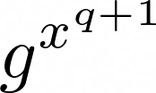
Q-Type Assumptions
Assumptions which are parameterized (and grow) with some value q
Example: q-Strong DDH
Structure enables compression
Family of Assumptions
Stronger attacks as q grows
Notes:
So mild spoilers, or if you read the title, we show that this is in fact not the case. But to discuss our result, sorry we’re going to have to through one more definition.
So in general, q-type assumptions are any assumption which is parameterized with a value q, and the number of group elements given out in the assumption grows with q. But typically, like in our example of q-strong DDH, this shows up in the form of successive powers of a random element.
Q-type assumptions are somewhat desirable in building cryptography as they allow us to build more structured, smaller cryptosystems while still having a security proof. The downside, however, is that we’re making a stronger assumption – in fact we’re making a family of assumptions and there are generic attacks that also grow stronger as q grows.

Slide 9
Q-Type Assumptions in Composite Order Groups
Deja Q Framework [CM14,CMM16,Wee16]
Some q-type assumptions ⇐ Subgroup Decision
Broadcast Encryption
(Hierarchal) IBE
Attribute-Based Encryption
Compact Parameters!
Can Deja Q be shown from prime order groups?
Notes:
Interestingly enough, in the setting of composite order groups, there’s been a line of work on what’s been called the Deja-Q framework, which reduces some classes of q-type assumptions to subgroup decision, which is of course a fixed size assumption. Using their translation, they’ve been able to show a couple schemes which enjoy both the compression/compactness of q-type assumptions while still benefitting from having security based on a static assumption.
And now, just like before, we can ask if this is a technique we can translate into prime order groups.

Slide 10
Our Results
Theorem 1 [Informal]
There does not exist a black-box reduction from any q-type assumption to any $≤q−1$ size assumption in prime order groups for $q∈poly(λ)$.
Theorem 2 [Informal]
There does not exist a black-box reduction from any q-type assumption to any $≤\sqrt{q−1}$ size assumption in prime order bilinear groups for $q∈poly(λ)$.
Notes:
In our work, we show that you cannot reduce a q-type assumption to any smaller assumption in prime order groups, and a … square root in bilinear groups

Slide 11
Generic Group Model
Label 3
L
“01110110”
3 = “01110110”
“01110110” + “10000011”
+
“10010101”
“01110110” = 3
“10000011” = 5
3+5 = 8 = “10010101”
Notes:
Our results are shown in the GGM.
For anyone whose unfamiliar, in the ggm we model a group is a set of oracles, where we can interact with group elements through their discrete log. The oracles have access internal table mapping these group elements to random handles. You can use these labels to do what you’re able to do ‘generically’ with a group, namely the group operation and checking equality,

Slide 12
Black Box Reduction
Notes:
Now if we want to say, reduce strong ddh to ddh, what we want is an algorithm which acts as an adversary for ddh, but to give it some additional leverage, it’s going to get access to *some* adversary for our q-type assumption. Now if this is any adversary which can break q-ddh with non negligible advantage, then the guarantee is that our reduction should be able to break ddh with nonneglible advantage as well.
What it means for the reduction to be black box is that it interacts with both the group (in the form of GGM oracle) as well as the adversary in a black box way

Slide 13
Ruling Out Black Box Reductions
Meta-Reductions [BV98]
Notes:
So how do people rule out reductions between assumptions?
Recall, a reduction is an algorithm that is given access to an adversary (in our case for a q-type assumption) and needs to use it to break another assumption – in our case, ddh. However, if we’re able to look at the reduction, including their interactions with both the generic group oracles as well as the adversary, and efficiently simulate these interactions, then we’ve essentially created an efficient adversary for our base assumption (ddh) without any external help, meaning that the assumption being reduced to was broken to begin with.
This type of proof techniques are called meta-reductions, first explored in BV98

Slide 14
Observation 1
Notes:
Now in our specific case, our meta-reduction is going to rely on two observations. The first is that since our reduction is given a relatively small number of elements and needs to produce a large number, a black box adversary needs to produce these new group elements as a linear combination of the group elements it’s given. And by looking at the ggm oracle calls, we can actually figure out this linear combination M, which means we’ve restricted the values of h to a relatively low rank subspace.

Slide 15
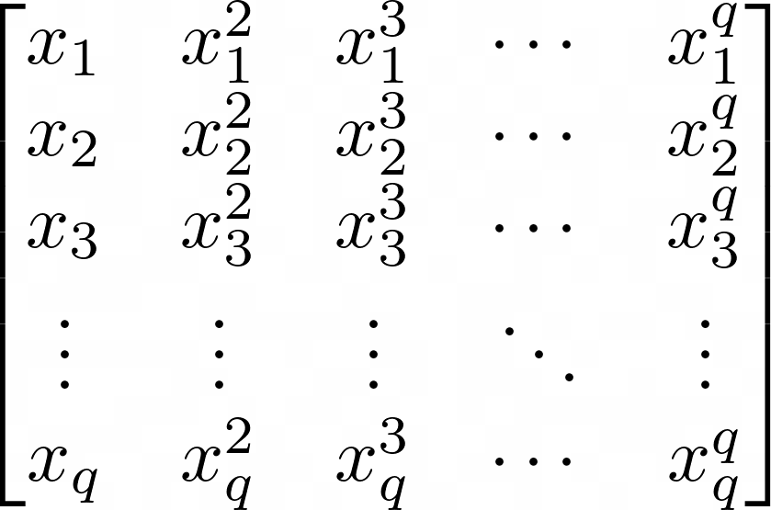
Observation 2
Rank q
Notes:
Now our second observation is that in assumptions containing these powers, very few actually lie in *any* fixed low rank subspace.
This comes from the pretty well known fact that given the evaluation of any q points on various powers gives a full rank matrix.
If

Slide 16
Reduction
Notes:
Putting this all together, what our meta-reduction does is simulate the reduction, and wait for it to query its ‘adversary’. Whenever such a query happens, our meta-reduction looks at how these group elements were created, and finds all values of x which could have possibly fallen into this span. Now since there are only a couple such values, our meta-reduction can query the ggm oracle on its own and find out which case it’s in, and using this knowledge of x to break the assumption.

Slide 17
Thank you!
Read our paper 2024/993

Slide 18
Conclusion
Black box separation of static and q-type assumptions
Implications to prime-order groups
No direct translation of Deja Q
Open Questions
Assumptions with multiple “q”-type variables
From Assumptions to Primitives
Evading impossibility

