Slide 1
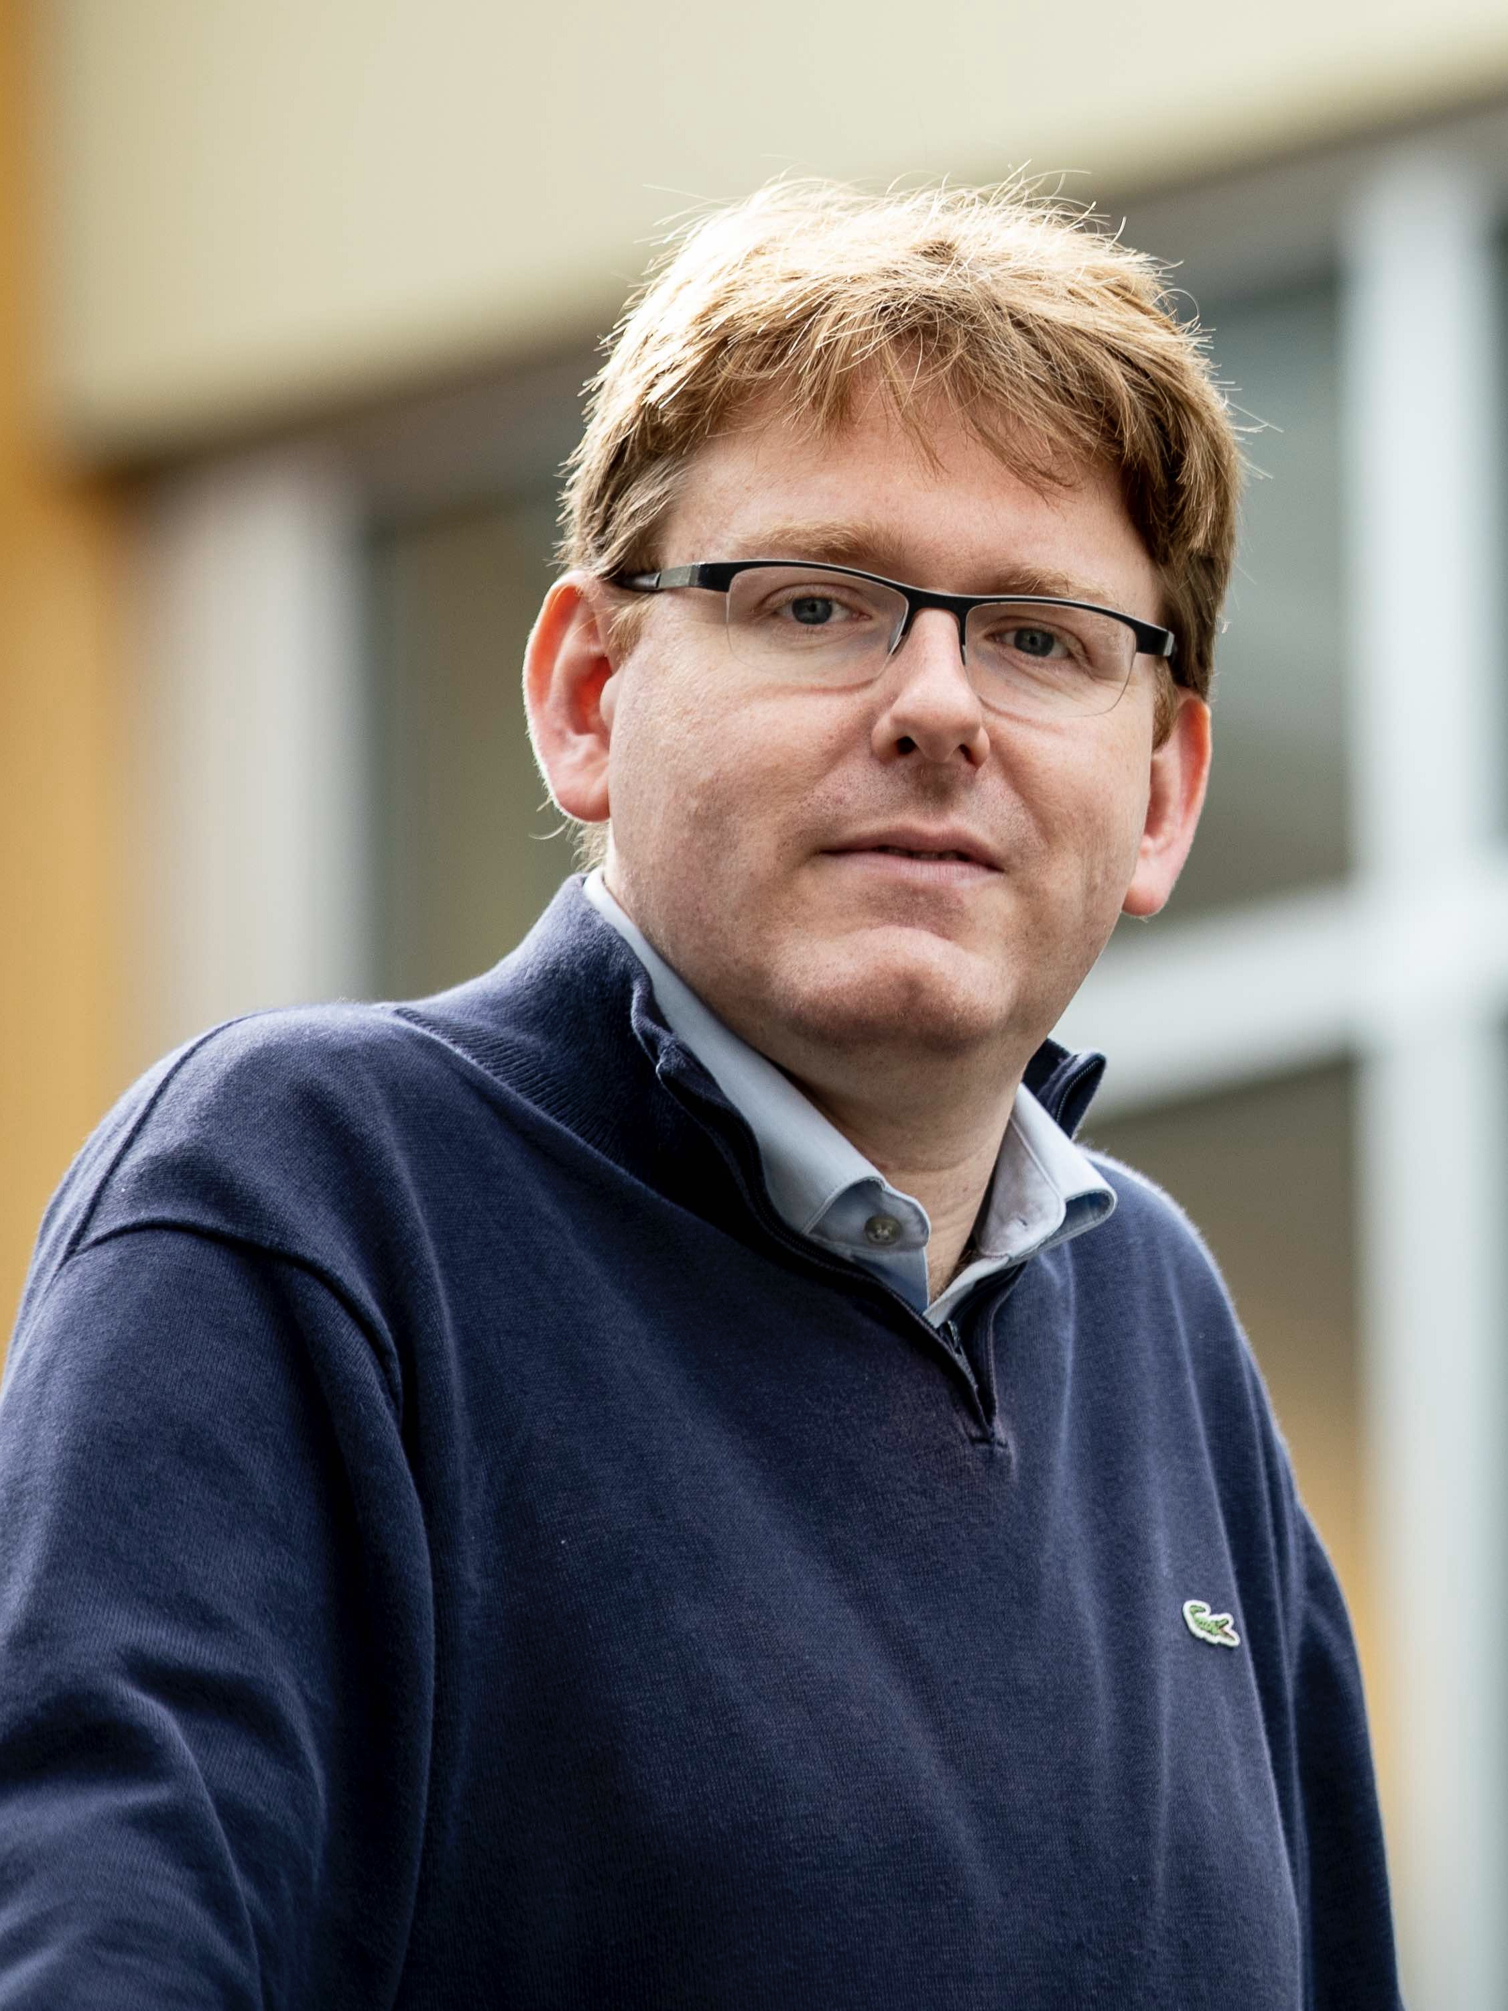
Pairing-Free Blind Signatures from CDH Assumptions
Rutchathon (Champ) Chairattana-Apirom
Stefano Tessaro
Chenzhi Zhu
CRYPTO’24

Slide 2
Blind Signatures [Chaum ‘83]
One-more unforgeability (OMUF): Users cannot produce more message-signature pairs than # of sessions.
$$sk$$
$$(sk,vk)\overset{\$}{⟵}\text{KeyGen}$$
$vk$, $m$
Blind
Blindness: Signer learns no information about $(m,σ)$
$$σ$$
$\text{Verify}\left(vk,m,σ\right)=$ Accept
Applications: anonymous tokens, e-cash, credentials, etc.
Notes:
To start with, blind signatures are protocols involving a signer and a user.
The signer holds the secret signing key, and
> the user interacts with the signer to sign a message of its choice.
> At the end, the user learns a valid signature of the message.
In blind signatures, we consider two security properties.
> First is blindness, where no malicious signer can learn anything about the message and the signature.
> Next is one-more unforgeability, where no user can produce more message-signature pairs than # of signing sessions it engages in.
> Blind signatures also give rise to applications such as anonymous tokens, credentials, and electronic cash.

Slide 3
Goal: Blind signatures from pairing-free curves in the ROM
Already have sigs from pairing-free curves (Schnorr, EC-DSA, …)
Pairing-free curves widely available (e.g., browser libraries)
First step towards instantiations from lattices &
isogenies
Why care?
Deprecating RSA
Interesting & important theoretical question
Notes:
In this talk, our focus is constructing blind signatures from pairing-free elliptic curves in the random oracle model.
But why do we particularly want “pairing-free” blind signatures?
1. First, since we already have digital signatures from pairing-free curves, naturally we want a blind signing protocol for variants of these signatures.
2. Second, the implementations of pairing-free curves are more widely available than their pairing-based counterparts.
3. Third, often pairing-free constructions lend itself towards lattice or isogeny-based instantiations.
4. Next, we want to deprecate RSA due to larger modulus sizes.
5. Finally, the question is theoretically interesting and important, as we have less cryptographic tools in pairing-free settings than in pairing-based.

Slide 4
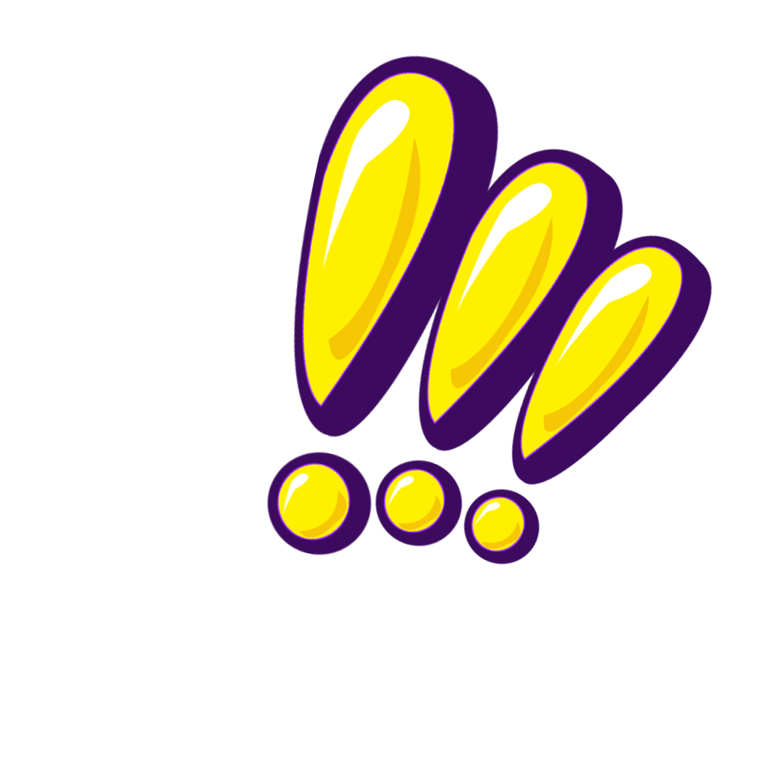
Goal: Blind signatures from pairing-free curves in the ROM
+ BB use of group
Pairing-free constructions are possible via MPC-based techniques or the generic construction by Fischlin [Fischlin ‘06], but these rely on non-black-box use of the group.
Notes:
For the record, it is already possible to construct blind signatures from pairing-free curves via MPC or the generic construction by Fischlin. However, these require non-black-box use of the group. In particular, they model group operation as a circuit and apply heavy machineries, such as generic NIZK, on the circuit.
Hence, we also want to use the group in a black-box way.

Slide 5
Prior works: Pairing-free in ROM + BB-use of groups
Scheme | Provably secure # of sessions | OMUF Assumption | AGM? | Blindness Assumption
Blind Schnorr [CP93] | $$polylog(λ)$$ [FPS20] | OMDL | AGM | Stat
Okamoto-Schnorr | $$polylog(λ)$$ [PS96, HKL19] | DL |  | Stat
Tight – ROS attack [BLLOR20] utilizing $O(λ)$ concurrent sessions
Notes:
With that out of the way, let's talk about the history of constructing pairing-free blind signatures in the random oracle model.
The first schemes proposed in the 90s were only proved secure for bounded number of concurrent signing sessions.
> It also turned out that we cannot do better as the recent ROS attack breaks OMUF of these schemes in polynomial time by using a bit more concurrent sessions.

Slide 6
Prior works: Pairing-free in ROM + BB-use of groups
Scheme | Provably secure # of sessions | OMUF Assumption | AGM? | Blindness Assumption
Blind Schnorr [CP93] | $$polylog(λ)$$ [FPS20] | OMDL | AGM | Stat
Okamoto-Schnorr | $$polylog(λ)$$ [PS96, HKL19] | DL |  | Stat
Abe [A01,KXL22] | | unbounded | | DL | AGM | DDH
CBS [FPS20] |  | OMDL + mROS | AGM | Stat
TZ / Snowblind [TZ22,CKMTZ23] |  | DL | AGM | Stat
Main question: Do we need AGM for unbounded concurrent security?
Notes:
In the early 2000s, Abe gave a scheme which was shown secure for unbounded # of concurrent sessions, but the proof turned out to be flawed.
It was not until recently that scheme was shown secure by additionally relying on the algebraic group model.
Other more efficient schemes are also only proved secure assuming the AGM.
> Thus, it has been a 30-year long-standing problem whether we can construct an unbounded concurrently secure pairing-free scheme which only depends on the ROM.

Slide 7
Our main results
Construction I. 4-move BS scheme OMUF-secure in the ROM under the Chosen Target CDH assumption
Construction II. 4-move BS scheme OMUF-secure in the ROM under the CDH assumption
Notes:
In this work, we answer this question affirmatively by giving two constructions.
> The first construction is a ’4-move blind signature scheme’ ‘concurrently one-more unforgeable’ assuming the ROM and the chosen-target CDH assumption, which is a one-more variant of the CDH assumption.
> Our second construction then improves from the first one by relying only on the ‘plain’ CDH assumption.
I note that these constructions have some trade-offs which I will address later in the talk

Slide 8
Our main results
Construction I. 4-move BS scheme OMUF-secure in the ROM under the Chosen Target CDH assumption
Notes:
Now, let’s talk about the technical details of our first construction.

Slide 9
Starting point – Signatures from CDH+ROM
Goh-Jarecki $VK=sk G$, $H=h(m)$
$σ=(Y=sk H,$ $R_{G}=rG,R_{H}=rH,z=r+c⋅sk)$
where $c=h′(m,H,Y,R_{G},R_{H})$
DLEQ Proof ${DL}_{G}\left(VK\right)={DL}_{H}(Y)$
Notes:
Note that in this talk I will use additive notations for groups where we write a scalar times a group element instead of exponentiation.
Our starting point is a signature scheme based on CDH and ROM, which is the GJ signature.
The scheme can be viewed as a pairing-free analogue of BLS signature where the verification key is sk times a generator G, and the signing starts by hashing the message into a group element H and compute Y as sk times H.
> However, to publicly verify without pairings, the signer adds a proof (R_G, R_H, z) that Y is computed honestly by showing that the discrete log of Y base H and verification key base G are equal.

Slide 10
First step – Interactive GJ
$$sk$$
$$m,VK=sk G$$
$$H←h(m)$$
$$r\overset{\$}{←}ℤ_{p}$$
$Y=sk H$, $R_{G}=rG$, $R_{H}=rH$
$c←h′(m,H,Y,R_{G},R_{H})$
$$z=r+c sk$$
$$σ=(Y,R_{G},R_{H},z)$$
Blindable? OMUF secure? (under CDH?)
Notes:
Our first step is to make the scheme interactive.
The user first sends the hash, the signer sends back the element Y, and they both participate in a sigma protocol computing the proof.
> We then ask if we can blind the protocol and if it is one-more unforgeable.

Slide 11
Blinding
$$m,VK=sk G$$
$$sk$$
$$H^{′}←h(m)$$
$$H=δH′$$
$$δ\overset{\$}{←}ℤ_{p}^{∗},ε,γ\overset{\$}{←}ℤ_{p}$$
$$r\overset{\$}{←}ℤ_{p}$$
$Y=sk H$, $R_{G}=rG$, $R_{H}=rH$
$$R_{G}^{′}=R_{G}+εG+γVK$$
$$R_{H}^{′}=δ^{−1}\left(R_{H}+γY\right)+εH^{′}$$
$c=γ+h′(m,H^{′}, Y′,R_{G}^{′},R_{H}^{′})$
$$Y^{′}=δ^{−1}Y$$
$$z=r+c sk$$
$$σ=(Y′,R_{G}^{′},R_{H}^{′},z+ε)$$
Notes:
For blinding, since the protocol can be seen as issuing a BLS signature + a Schnorr-type proof, we blind the protocol in two steps:
1. Blind the hash and the element Y as in blind BLS.
2. Blind the proof (specifically, the challenge c and the response z) as in blind Schnorr signatures.

Slide 12
OMUF Security proof
(Ideal) goal: Reduction from CDH
Main challenge: Simulate signing without knowledge of $sk$
Notes:
For OMUF proof, our ideal goal is to replicate the reduction from CDH of Goh-Jarecki signatures.
However, in this case, we need to simulate interactive signing without knowing the sk.

Slide 13
Program as result of $h$ query of forgery
CDH instance = $X=xG, Y=yG$
Arbitrary group element
$$VK=X$$
$$H∈𝔾$$
$Y=x⋅H$, $R_{G},R_{H}$
$$ℬ$$
OMUF adv. $𝒜$
How to compute without $x$?
CDH adv. $ℬ$
“Solution”: Stronger assumption!
Notes:
We then consider the reduction receiving a CDH instance: group elements X, forwarded as the verification key to the adversary, and Y, used to program the random oracle.
> In the signing sessions, the adversary sends an arbitrary group element H, and
> the reduction needs to compute Y = x H but without knowing x or the discrete log of H.
> To deal with this issue, we instead rely on a stronger assumption.

Slide 14
OMUF Assumption – Chosen Target CDH [Boldyreva ‘03]
$$H$$
$$X=xG$$
DH
$$cnt\text{++}$$
$$xH$$
$$\left(i_{1},Y_{i_{1}}\right),…,\left(i_{k},Y_{i_{k}}\right)$$
Chal
$$C_{i}\overset{\$}{←}𝔾$$
Win if $\left(i_{1},…,i_{k} \text{distinct}\right)∧$
$$\left(k>cnt\right)∧(∀j:Y_{i_{j}}=xC_{i_{j}})$$
$$i\text{++}$$
Assumption used for Blind BLS, 2HashDH OPRF, …
Notes:
And this assumption is the Chosen Target CDH assumption, introduced to prove security of blind BLS signature.
A variant of the assumption is also used for the security of 2HashDH OPRF protocol.
> In the Chosen Target CDH game, the adversary receives an instance X and has access to two oracles.
> The first one is the DH oracle which outputs x times H on a query H and keeps a counter of the number of queries made to it so far.
> The second one is the challenge oracle, which returns a random group element challenge on each query.
> The goal of the adversary is to output more CDH solutions than the number of calls to the DH oracle, where the solutions will be with respect to distinct challenges.

Slide 15
OMUF Proof – Reduction
$$X=xG$$
$$h(m)$$
Chal
$$C_{i}\overset{\$}{←}𝔾$$
$$C_{i}$$
$$i\text{++}$$
i$dx\left[m\right]←i$
$$\left(m_{1}^{∗},σ_{1}^{∗}=\left(Y_{1}^{∗},R_{G,1}^{∗},R_{H,1}^{∗},z_{1}^{∗}\right)\right),…$$
$$\left({\text{i}dx[m}_{1}^{∗}],Y_{1}^{∗}\right),…$$
OMUF adv. $𝒜$
$$ℬ$$
$σ_{i}^{∗}$valid $⟹Y_{i}^{∗}=xh\left(m_{i}^{∗}\right)$ w.h.p.
Chosen-target CDH adv. $ℬ$
Notes:
Now, the new reduction goes as follows.
The verification key is still set to the instance X.
> The random oracle queries are now replied with challenges from the challenge oracle.
> For the forgeries, since the signatures are valid, the soundness of the proofs implies that with high probability, the Y portion of the signature is equal to x times the hash. Thus, the reduction wins the game by forwarding these Y to its challenger as the CDH solutions.

Slide 16
OMUF Proof – Reduction – Signing session
$$X=xG$$
$$H∈𝔾$$
$$H∈𝔾$$
DH
$$xH$$
$$Y=xH$$
$$R_{G},R_{H}= ??$$
$$cnt\text{++}$$
$$c$$
$$z= ??$$
$$ℬ$$
OMUF adv. $𝒜$
Chosen-target CDH adv. $ℬ$
HVZK does not work b/c $c$ adversarially chosen
Notes:
> For the signing simulation, the DH oracle lends itself nicely into computing Y.
> Still, the reduction needs to simulate the proof without knowing sk, and we cannot use the HVZK simulator because the challenge is adversarially chosen.

Slide 17
Solution: Change the protocol
$$sk$$
$$m,VK=skG$$
$$H$$
$$Y=sk H$$
+
Blinded proof that
${DL}_{G}\left(VK\right)={DL}_{H}(Y)$
Notes:
Our solution to this issue is to change the protocol.
This is done by replacing the proof that Y is computed honestly with …

Slide 18
Solution: Change the protocol
crs = $W∈𝔾$
$$sk$$
$$m,VK=skG$$
$$H$$
$$Y=sk H$$
+
Blinded OR-proof that
${DL}_{G}\left(VK\right)={DL}_{H}(Y)$ or
signer knows ${DL}_{G}\left(W\right)$
Witness indistinguishable
Notes:
An OR-proof that Y is computed honestly, or the signer knows discrete log of a group element W in the CRS.
This CRS W will be generated transparently, so that the signer does not know its discrete log.
Note that this proof is witness-indistinguishable, as it can be generated in two modes using one of the two witnesses.

Slide 19
Interactive Signing $x$-mode
crs = $W$
$$x$$
$$m,VK=xG$$
$$H$$
$$r,z^{′},e\overset{\$}{←}ℤ_{p}$$
$Y=xH$, $R_{G}=rG$, $R_{H}=rH$
$$A=z′G−eW$$
$$c$$
$$z=r+\left(c−e\right)x,z′,e$$
$$σ=(Y,R_{G},R_{H},A,z,z′,e)$$
Actual signing protocol, still blindable.
Notes:
The first one uses the secret key, and this is what the actual protocol does.
Note that this modified proof is still blindable.

Slide 20
Interactive Signing $w$-mode
crs = $W=wG$
$$w\overset{\$}{←}ℤ_{p}$$
$$m,VK$$
$$H$$
$$a,z,d\overset{\$}{←}ℤ_{p}$$
$Y=xH$, $R_{G}=zG−dX$,
$$R_{H}=zH−dY,A=aG$$
$$c$$
$$z,z^{′}=a+\left(c−d\right)w,e=c−d$$
$$σ=(Y,R_{G},R_{H},A,z,z′,e)$$
Reduction sets $W$ & uses $w$-mode + DH oracle to simulate signing sessions
Notes:
The second mode uses the discrete log of the CRS W, and the simulation uses this mode.
> In particular, the reduction will set up the CRS so that it knows the discrete log w, and simulating using w and the DH oracle.

Slide 21
Are we done?
No! Valid signature$σ^{∗}=(Y,R_{G},R_{H},A,z,z′,e)$ does not necessarily satisfy $Y=x h(m^{∗})$ [Follows from existence of $w$-mode]
Key Step: outputting $σ^{∗}$ with$Y≠x h(m^{∗})$ yields DL $w$ of $W$.
Related issue: existence of $w$-mode breaks perfect blindness
Solution 1: Computational blindness based on DL
Solution 2: Add proof (not blinded) that $Y=xH$
post-quantum blind in the QROM!
Notes:
It might look like we are done, but we are not quite done yet!
Previously, we used the soundness of the proof to argue that the forgeries contain Y that is x times the hash.
With the OR-proof, the same argument does not apply as the proof also accepts dlog w as a witness.
> Our key observation is that if the adversary outputs Y not equal to x times hash, we can extract discrete log of W and break DLOG.
We note that the formal analysis requires a careful use of the forking lemma and is quite non-trivial.
> There is also a related issue where the signer can break blindness by sending a bad Y in the signing protocol.
> We can deal with that in two ways.
1. We use the same observation to show computational blindness, or
2. We require the signer to send a proof that Y is computed honestly. We conjecture that this solution achieves post-quantum blindness in the QROM.

Slide 22
Weakening the assumption
Construction II. 4-move BS scheme OMUF secure in the ROM under the CDH assumption
Notes:
Next, let’s talk about how we weaken the assumption.

Slide 23
Abstracting our construction
$$H$$
Blind BLS Signing (w/o public verification)
Pairing-based blind sig (w/o public verification)
$$Y=skH$$
$R_{G}=rG$, $R_{H}=rH$ $$A=z′G−eW$$
WI blinded proof of correct evaluation
WI blinded proof of correct evaluation
$$c$$
$$z=r+\left(c−e\right)sk,z′,e$$
Notes:
> To weaken our assumption, we abstract our first construction which can be seen as a blind BLS signing (without pairing) + blinded proof of honest signing into
> a paradigm consisting of a pairing-based blind signature (without pairing) + a blinded proof of honest signing.

Slide 24
Abstracting our construction
CT-CDH
CDH
Blind BLS Signing (w/o public verification)
RaiChoo Signing (w/o public verification) [Hanzlik, Loss, Wagner, ‘23]
WI blinded proof of correct evaluation
WI blinded proof of correct evaluation
Notes:
To construct a scheme from CDH, we instantiate the paradigm with Rai-Choo, a pairing-based scheme secure in the ROM based on CDH and give a corresponding proof of honest signing.

Slide 25
Caveat – Weak OMUF
Both schemes only satisfy a weaker notion of OMUF
Adversary cannot produce more signatures than # of started sessions
Adversary cannot produce more signatures than # of completed sessions
vs
(Likely) often sufficient (e.g., anonymous tokens), but not always (e.g., fair exchange from [Hanzlik, Loss, Thyagarajan, Wagner, ‘24])
Notes:
Now, there is caveat I have hidden under the rug until now, which is that our schemes achieve only a weaker notion of OMUF.
> In this notion, we require that the adversary cannot produce more signatures than # of “started” sessions.
> This is in contrast to the usual notion which counts the # of “completed” sessions.
> We think that this weaker notion suffices for some applications, but not for others (such as in fair exchange).

Slide 26
Caveat – Why Weak OMUF?
$$X=xG$$
$$H∈𝔾$$
$$H∈𝔾$$
DH
$$xH$$
$$Y=xH$$
$$R_{G},R_{H}, A$$
$$cnt\text{++}$$
$$c$$
$$z,z′,e$$
$$ℬ$$
OMUF adv. $𝒜$
Reduction needs DH oracle at the “start” of each session.
Chosen-target CDH adv. $ℬ$
Notes:
To see why we only achieves this weaker notion, we take a step back to the reduction from CTCDH.
> In the simulation, the DH oracle is queried every start of a signing session.
Hence, the reduction needs more forgeries than the number of started sessions to produce enough CDH solutions.

Slide 27
Achieving regular OMUF
$$X=xG$$
$$H∈𝔾$$
Ideal Goal
$$Y=xH$$
$$R_{G},R_{H}, A$$
$$H∈𝔾$$
$$c$$
DH
$$xH$$
$$z,z′,e$$
$$ℬ$$
OMUF adv. $𝒜$
$$cnt\text{++}$$
Chosen-target CDH adv. $ℬ$
Notes:
To achieve the regular notion, we ideally want to delay the DH oracle query to the last move of the protocol.

Slide 28
Solution: Commit & Reveal
Good news: We can give commitment scheme with sufficiently strong equivocation to apply the trick to CDH-based scheme!
$$sk$$
crs = $W$
$$m,VK=sk G$$
$$H$$
$Com(Y,ρ_{Y})$, $Com(R_{H},ρ_{R})$, $R_{G}$, $A$
$$c$$
$z,z′,e$, $Y$, $R_{H}$, $ρ_{Y}$, $ρ_{R}$
Commitment scheme requirements:
① Homomorphism (for blindness)
② Equivocation (for OMUF reduction)
③ Secure under CDH (or DL)
Do not know how to do this,
unless dlog of values we
equivocate to is known
[Bagherzandi, Cheon, Jarecki ‘08] [Pan, Wagner ‘23]
Notes:
We could achieve this by committing to the element Y and opening it in the last move.
In the simulation, we will send a random commitment in the second move and equivocate to the DH oracle’s output later.
> However, existing commitments need to know the discrete log of the group element you equivocate to, and this does not quite work for our first construction.
> Fortunately, we were able to give a commitment with equivocation that suffices for our CDH-based scheme.

Slide 29
Conclusion: Pairing-free Blind Signature in ROM (w/o AGM)
Construction I. 4-move BS scheme OMUF-secure in the ROM under the Chosen Target CDH assumption
* Weak OMUF notion
Construction II. 4-move BS scheme OMUF-secure in the ROM under the CDH assumption
Regular OMUF notion
Communication and signature sizes [# group elements & scalars] depend linearly on security parameter
Notes:
To conclude the talk, our work answers the question of constructing pairing-free blind signatures in the ROM without relying on the AGM by giving two 4-move blind signature constructions:
The first one is based on chosen target CDH and satisfies a weaker OMUF notion.
The second one is based on plain CDH and achieves regular OMUF.
Also, this construction is much less efficient with communication & signature sizes depending linearly on the security parameter, due to the efficiency of RaiChoo.

Slide 30
Open problems
Schemes are not Schnorr – what is the best we can do for proper Schnorr? (e.g., [Fuchsbauer, Wolf, EUROCRYPT ‘24])
Reduce round complexity for CDH based schemes – three moves? simpler protocols?
Efficiency improvements – remove linear dependency on security parameters for CDH construction?
Blind Signatures from DL or OMDL w/o AGM
Thank you! https://eprint.iacr.org/2023/1780
Notes:
For related open problems:
These schemes and prior works mentioned does not produce Schnorr signatures. What can we do for blind signing of Schnorr?
Our schemes are 4-move, can we get 3 moves or simpler protocols?
Construction II has larger communication + signature, can we remove that linear dependency?
Finally, it is open whether we can get schemes from DLOG or OMDLOG w/o AGM.
Thank you, and please check out our eprint!

