Slide 1



Loquat: A SNARK-Friendly Post-Quantum Signature based on the Legendre PRF with Applications in Ring and Aggregate Signatures
Xinyu Zhang^{1,2}, Ron Steinfeld¹, Muhammed Esgin¹, Joseph Liu¹, Dongxi Liu², Sushmita Ruj³
Crypto 2024
August 18th - August 22nd 2024, Santa Barbara, USA

Slide 2
Agenda
Motivations
Contributions
Technical Overview
Performances
Conclusion

Slide 3

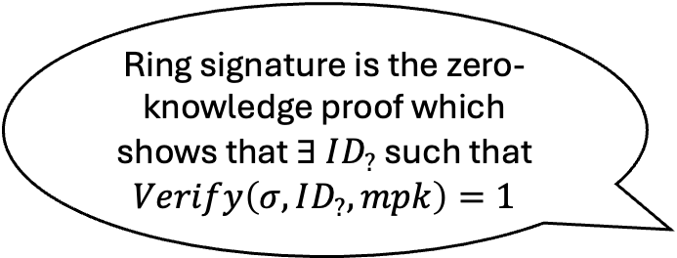
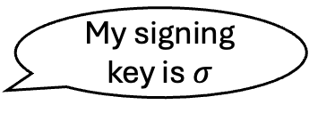






Motivations
Proving the validity of signatures using a zero-knowledge proof.
  E.g., ID-based Ring Signature [BLSS22]
My signing key is $σ$
😇
ID
👩
PKG
$$\left(msk, mpk\right)$$
$$σ=sign\left(ID, msk\right)$$
Ring signature is the zero-knowledge proof which shows that $∃ ID_{?}$ such that $Verify\left(σ, ID_{?}, mpk\right)=1$
$$ID_{1}$$
$$ID_{2}$$
$$ID_{3}$$
$$ID_{4}$$
$$σ$$

Slide 4




Motivations
Proving the validity of signatures using a zero-knowledge proof.
  E.g., SNARK-based Aggregate Signature
Accept
Translate to a circuit, then prove the circuit output is 1 (valid) using a generic SNARK.
$$Verify\left(pk_{1},m_{1},σ_{1}\right)$$
$$Verify\left(pk_{2},m_{2},σ_{2}\right)$$
$$\left(pk_{1},m_{1},σ_{1}\right)$$
$$\left(pk_{2},m_{2},σ_{2}\right)$$

Slide 5
Motivations
Why not using existing symmetric-key based post-quantum signatures?
  OTS and stateful MTS have limited use cases.
  MPCitH-based signatures have extremely large verification circuits.
  SPHINCS+ has a lot of hash functions in KeyGen and Sign.
SNARK-Friendly Signature based on Symmetric Key Primitives

Slide 6
Contributions
Loquat: Legendre PRF-based SNARK-friendly post-quantum signature
  A balanced choice between signature performance and SNARK friendliness
More Efficient Post-Quantum ID-based Ring Signature
  Plug and Play with the Framework from [BLSS22]
SNARK-based Post-Quantum Aggregate Signature
  Aurora: Logarithmic Aggregate Signature Size
  Fractal: Constant Aggregate Signature Size with Proof Recursion

Slide 7




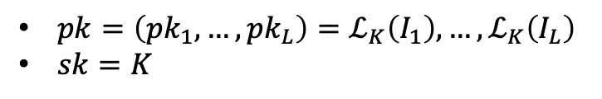


Technical Overview
Proving the witness of the Legendre PRF
LegRoast [BD20]: Instantiate ZKP with MPCitH
Legendre PRF based key pair:
Sig. Size: 16KB
Sign/Verify(C): 2.8 ms
Verification Circuit Size: 1,143,351
$pk=\left(pk_{1},…,pk_{L}\right)=ℒ_{K}\left(I_{1}\right),…,ℒ_{K}\left(I_{L}\right)$
$sk=K$
$$pk_{1}$$
$$pk_{2}$$
$$pk_{L}$$
Prove using some ZKP
Loquat: Convert the design of key identification protocol of the Legendre PRF to the design of multivariate polynomial commitment, which can be constructed by univariate sumcheck.
PRF
PRF
…
PRF
Sig. Size: 57KB
Sign (Python): 5.04s
Verify (Python): 0.21s
Verification Circuit Size: 148,825
$$\left(K, I_{1}\right)$$
$$\left(K, I_{2}\right)$$
$$\left(K, I_{L}\right)$$

Slide 8
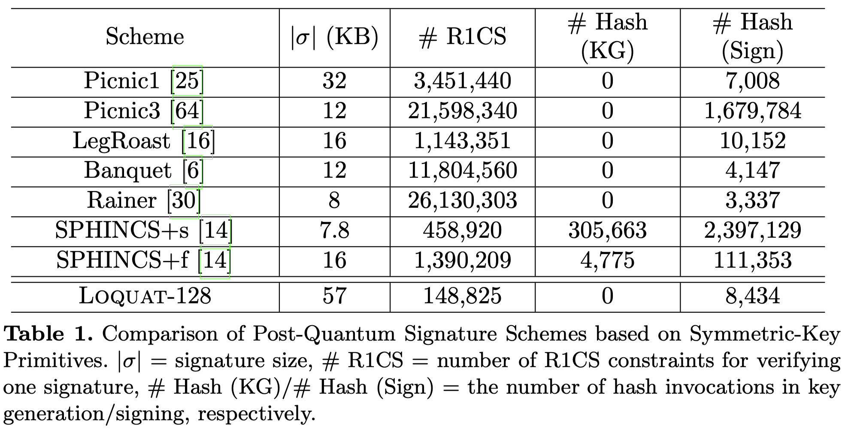
Performance - Loquat

Slide 9
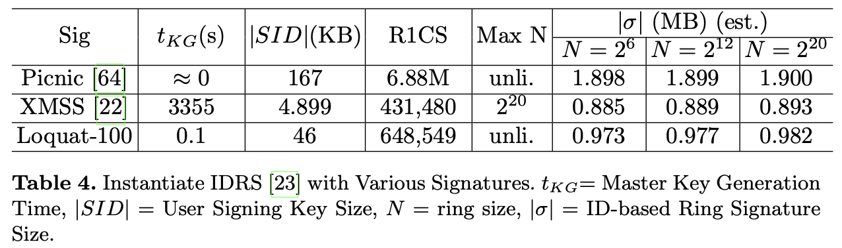
Performance of PQRS
KeyGen for Loquat is significantly more efficient than XMSS!!

Slide 10
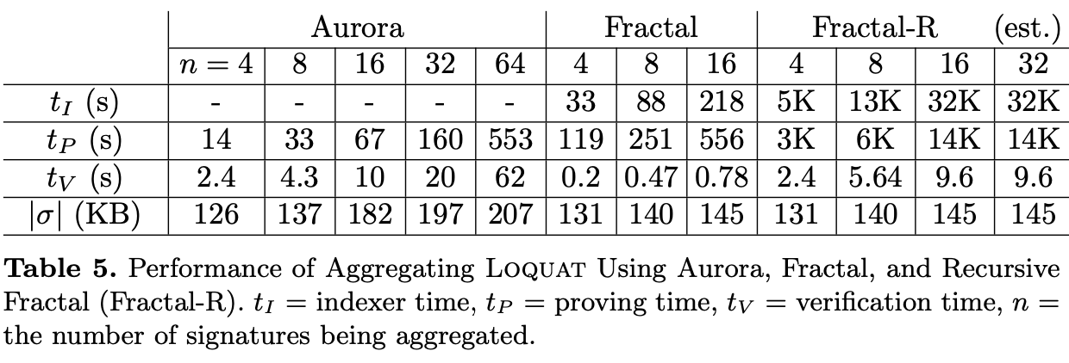
Performance of PQAS
Better PQAS performance if use more efficient SNARKs

Slide 11
Conclusion
Loquat: SNARK-friendly post-quantum signature from the Legendre PRF
  More efficient ID-based ring signature.
  Post-quantum aggregate signature from symmetric key primitives.

Slide 12
THANK YOU!

Slide 13
References
[BCR+19] Ben-Sasson, E., Chiesa, A., Riabzev, M., Spooner, N., Virza, M., Ward, N.P.: Aurora: Transparent succinct arguments for r1cs. In: Eurocrypt. pp. 103–128. Springer (2019)
[ZXZS20] Zhang, J., Xie, T., Zhang, Y., Song, D.: Transparent polynomial delegation and its applications to zero knowledge proof. In: 2020 IEEE S&P. pp. 859–876. IEEE (2020)
[BLSS22] Buser, M., Liu, J.K., Steinfeld, R., Sakzad, A.: Post-quantum id-based ring signa- tures from symmetric-key primitives. In: ACNS. pp. 892–912. Springer (2022)
[COS20] Chiesa, A., Ojha, D., & Spooner, N. Fractal: Post-quantum and transparent recursive proofs from holography. In EUROCRYPT. pp. 769-793. Springer (2020).
[BD20] Beullens, W., & Delpech de Saint Guilhem, C.: LegRoast: Efficient post-quantum signatures from the Legendre PRF. In PQCrypto. pp. 130-150. Springer (2020)

