Slide 1
Secret Sharing with Certified Deletion
James Bartusek and Justin Raizes
Notes:
Pop quiz: Store data securely, but don’t trust individual storage providers. What do we do?

Slide 2
6 total shares
Any set of $≥3$ is authorized
Unauthorized sets have no information
$sh_{1}$ $sh_{2} sh_{3}$ $sh_{4}$ $sh_{5}$ $sh_{6}$
Notes:
We’re cryptographers, use secret sharing! In general, any authorized set can reconstructed the secret, but no unauthorized set learns anything about the secret.
Very common access structure: any k out of n can reconstruct. This is called a threshold access structure.

Slide 3
6 total shares
Any set of $≥3$ is authorized
Unauthorized sets have no information
Security:
$sh_{1}$ $sh_{2} sh_{3}$ $sh_{4}$ $sh_{5}$ $sh_{6}$
Notes:
If 2 servers compromised, its still safe. Information theoretic, no computational assumptions!

Slide 4
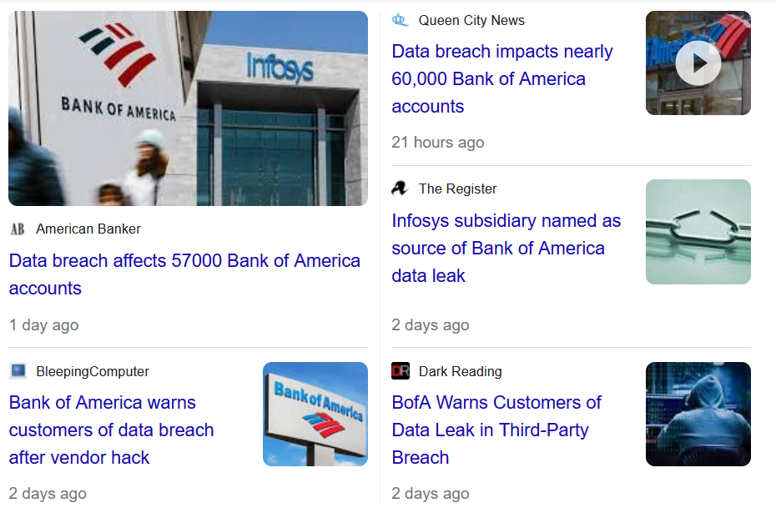
6 total shares
Any set of $≥3$ is authorized
Unauthorized sets have no information
Security:
$sh_{1}$ $sh_{2} sh_{3}$ $sh_{4}$ $sh_{5}$ $sh_{6}$
Notes:
Is it really safe to assume that additional data won’t be leaked over long periods of time? There’s a reason you update your passwords every so often – you do that, RIGHT? Screenshot taken same day I started making this presentation. Data breaches happen FREQUENTLY.

Slide 5
6 total shares
Any set of $≥3$ is authorized
Unauthorized sets have no information
Security:
$sh_{1}$ $sh_{2} sh_{3}$ $sh_{4}$ $sh_{5}$ $sh_{6}$
Notes:
If 3 servers compromised, no security anymore!

Slide 6
Can we achieve security against an adversary who can eventually corrupt an authorized set of shares?

Slide 7
Classical shares can always be copied.
Tripartitum Psalterium Eadwini, Trinity College R.17.1
Notes:
Classical case: can always copy.

Slide 8
[BI20]: Quantum mechanics enables certifiable deletion of secret information.

Slide 9
[BI20]: Quantum mechanics enables certifiable deletion of secret information.
[BI20, BK23]: 2-of-2 secret sharing with certified deletion
Notes:
Prior work constructed a very limited form of secret sharing with certified deletion, where there are two shares and both are needed to reconstruct the secret.

Slide 10
Secret Sharing with Certified Deletion
secret
$|sh_{1}〉$ $|sh_{2}〉 |sh_{3}〉$ $|sh_{4}〉$ $|sh_{5}〉$ $|sh_{6}〉$
Notes:
Split a classical secret into quantum shares.

Slide 11
Secret Sharing with Certified Deletion
secret
$|sh_{1}〉$ $|sh_{2}〉 |sh_{3}〉$ $|sh_{4}〉$ $|sh_{5}〉$ $|sh_{6}〉$
Notes:
It’s possible to perform a destructive measurement on a share to delete the information it contains.

Slide 12
Secret Sharing with Certified Deletion
Okay, here’s your confirmation certificate:
############
I want to cancel my subscription. Please delete my information.
Client
Storage Provider
Notes:
User who suspects a data breach (or just doesn’t want to keep paying the provider) can request the storage provider to delete their info. If the verification passes, nothing was leaked!

Slide 13
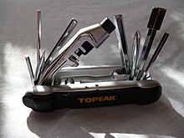
Contributions
Definitions
Constructions
New Tools:
High Rate Randomness
Extractors for Certain
Quantum Entropy Sources
Notes:
We give new definitions that capture access structures beyond 2-of-2 secret sharing, as well as constructions. Along the way, we develop a new high rate randomness extractor for certain quantum entropy sources.

Slide 14
Talk Outline
Definitions
No-Signaling Certified Deletion
Adaptive Certified Deletion
Construction: Adaptive Certified Deletion
Security Intuition
Open Problems

Slide 15
Encryption with Certified Deletion [BI20]
1
2
3
$m_{0}$ or $m_{1}$?
$$|Enc\left(k, m\right)〉$$
$$|Enc\left(k, m\right)〉$$
$$|Enc\left(k, m\right)〉$$
$$k$$
Notes:
To figure out a good definition, let’s start by recalling the definition for encryption with certified deletion.
Adversary starts with a ciphertext. It deletes it by producing a valid certificate. Then, it gets the key and tries to guess the message.

Slide 16
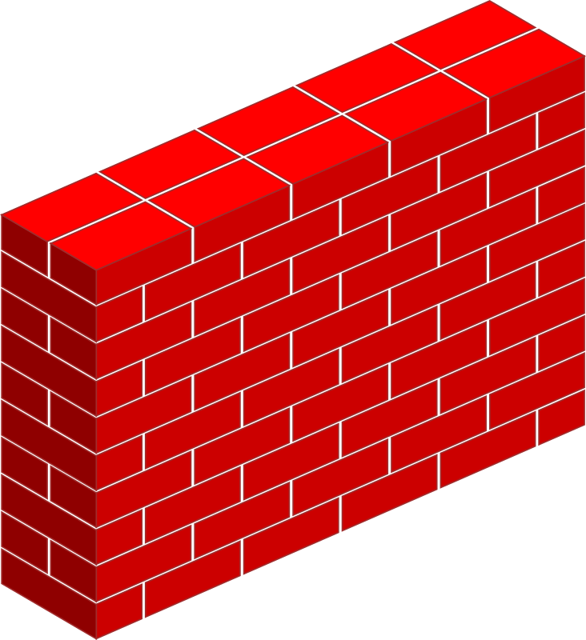
Starting Definition
7 total shares Any 5 are authorized
Notes:
Adv gets some shares, shown on the left side of the wall. It can’t access the rest of the shares on the right.
The left side is similar to the ciphertext, and the right side is similar to the key.

Slide 17
Starting Definition
7 total shares Any 5 are authorized
Notes:
It deletes a few. Deletion = produces a valid certificate.

Slide 18
Starting Definition
7 total shares Any 5 are authorized
Notes:
Gets the rest if it deleted enough
Not meaningful for all access structures, though…

Slide 19
Starting Definition
9 total shares Any 5 are authorized
Already authorized!
Notes:
What if the rest of the shares already form an authorized set?

Slide 20
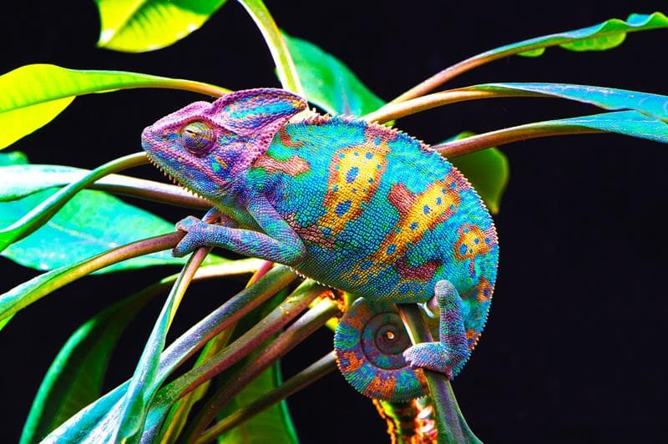
No-Signaling Certified Deletion Adaptive Certified Deletion
Incomparable!
Notes:
Quantum case: 2 definitions.
No signaling: “fast but distributed” adversary
Adaptive: “slow” adversary

Slide 21
No-Signaling Certified Deletion
Definition

Slide 22
6 total shares Any 3 are authorized
$$sh_{1}$$
$$sh_{6}$$
$$sh_{2}$$
$$sh_{5}$$
$$sh_{3}$$
$$sh_{4}$$

Slide 23
6 total shares Any 3 are authorized
$$sh_{1}$$
$$sh_{6}$$
$$sh_{2}$$
$$sh_{5}$$
$$sh_{3}$$
$$sh_{4}$$
Notes:
Multi-part adversary. Each part controls an unauthorized set of shares. They can be entangled, but cannot communicate.

Slide 24
6 total shares Any 3 are authorized
$$sh_{1}$$
$$sh_{6}$$
$$sh_{2}$$
$$sh_{5}$$
$$sh_{3}$$
$$sh_{4}$$
Notes:
Adversaries delete some number of shares without communicating.

Slide 25
6 total shares Any 3 are authorized
$$sh_{1}$$
$$sh_{6}$$
$$sh_{2}$$
$$sh_{5}$$
$$sh_{3}$$
$$sh_{4}$$
Notes:
If the remaining shares form an unauthorized set, the adversaries get to combine their views

Slide 26
$$sh_{1}$$
$$sh_{6}$$
$$sh_{1}$$
$$sh_{6}$$
$$≈$$
Trace
Distance
$$sh_{2}$$
Secret: $s_{0}$
$$sh_{5}$$
$$sh_{2}$$
Secret: $s_{1}$
$$sh_{5}$$
$$sh_{3}$$
$$sh_{4}$$
$$sh_{3}$$
$$sh_{4}$$
Notes:
For security, the combined view should be independent of the secret. For any secrets s0 and s1, the final combined view is close in trace distance Pause here for questions

Slide 27
Theorem
There exists a secret sharing scheme with no-signaling certified deletion security for any monotone access structure $𝕊$.
$𝕊$ is a set of authorized sets.
Monotone: If A is authorized, then any superset of A is also authorized.

Slide 28
Adaptive Certified Deletion
Definition

Slide 29
6 total shares Any 3 are authorized
Time =
0
$$sh_{1}$$
$$sh_{6}$$
$$sh_{2}$$
$$sh_{4}$$
$$sh_{3}$$
$$sh_{5}$$
Notes:
Start with the same split as before. At the start, the adversary does not see any of these shares
One at a time, the adversary gets to do one of two things

Slide 30
6 total shares Any 3 are authorized
Time =
1
$$sh_{1}$$
$$sh_{6}$$
Corrupt $sh_{1}$
$$sh_{2}$$
$$sh_{4}$$
$$sh_{3}$$
$$sh_{5}$$
Notes:
It can corrupt a share of its choice

Slide 31
6 total shares Any 3 are authorized
Time =
2
$$sh_{6}$$
$sh_{1}$’s certificate: ######
$$sh_{2}$$
$$sh_{4}$$
$$sh_{1}$$
$$sh_{3}$$
$$sh_{5}$$
Notes:
It can delete a share by giving out the certificate. If the certificate is invalid, the experiment immediately aborts

Slide 32
6 total shares Any 3 are authorized
Time =
3
$$sh_{6}$$
Corrupt $sh_{5}$
$$sh_{2}$$
$$sh_{4}$$
$$sh_{1}$$
$$sh_{3}$$
$$sh_{5}$$
Notes:
The adversary gets to keep doing this as long as it likes

Slide 33
6 total shares Any 3 are authorized
Time =
4
$$sh_{6}$$
Corrupt $sh_{4}$
$$sh_{2}$$
$$sh_{4}$$
$$sh_{1}$$
$$sh_{5}$$
$$sh_{3}$$
Notes:
The only constraint is that the set of shares which is corrupted but not yet deleted cannot be authorized. In this example, if the adversary controls 2 non-deleted shares, then their next options are to delete a share or end the experiment early.

Slide 34
6 total shares Any 3 are authorized
Time =
4
$$sh_{6}$$
Constraint: The set of corrupted shares that have not yet been deleted cannot be authorized.
If the adversary corrupts 1 more share, it violates the constraint. So, it has to delete next.
$$sh_{2}$$
$$sh_{4}$$
$$sh_{4}$$
$$sh_{1}$$
$$sh_{5}$$
$$sh_{3}$$
Notes:
The only constraint is that the set of shares which is corrupted but not yet deleted cannot be authorized. In this example, if the adversary controls 2 non-deleted shares, then their next options are to delete a share or end the experiment early.

Slide 35
6 total shares Any 3 are authorized
Time =
5
$$sh_{6}$$
Constraint: The set of corrupted shares that have not yet been deleted cannot be authorized.
$sh_{4}$’s certificate: ######
$$sh_{2}$$
$$sh_{4}$$
$$sh_{1}$$
$$sh_{5}$$
$$sh_{3}$$

Slide 36
6 total shares Any 3 are authorized
Time =
10
I’m done
$$sh_{6}$$
$$sh_{4}$$
$$sh_{2}$$
$$sh_{1}$$
$$sh_{5}$$
$$sh_{3}$$
Notes:
Save us some time by skipping to the end of the experiment, where the adversary has corrupted all of the shares.

Slide 37
Secret: $s_{0}$
Secret: $s_{1}$
$$≈$$
Trace
Distance
I’m done
I’m done
$$sh_{6}$$
$$sh_{6}$$
$$sh_{4}$$
$$sh_{2}$$
$$sh_{4}$$
$$sh_{2}$$
$$sh_{1}$$
$$sh_{5}$$
$$sh_{3}$$
$$sh_{1}$$
$$sh_{5}$$
$$sh_{3}$$
Notes:
Adaptive security requires that the final view is independent of the secret. More specifically, for any two secrets s0 and s1, the adversary’s final view must be close in trace distance.
Pause for questions

Slide 38
Theorem
There exists a threshold secret sharing scheme with adaptive certified deletion security.
This scheme does not use entanglement.
$n$ total shares
Any $k$ are authorized
Notes:
No entanglement: each qubit can be prepared separately.
For sake of time, I won’t discuss why adaptive and no-signaling certified deletion are incomparable. You can look at the paper, or I’m happy to talk about it after the presentation.

Slide 39
Adaptive Certified Deletion
Construction
Threshold Access structure: n total shares, any k are authorized.
Notes:
Construction is specific to threshold access structures.

Slide 40
[BI20, BK23]: 2-of-2 Secret Sharing with Certified Deletion
secret
$|qsh〉$ $csh$
Notes:
Prior work studied a very limited form of secret sharing with certified deletion. Bartusek and Khurana did this explicitly, and Broadbent and Islam’s one-time-pad with certified deletion can also be viewed as this flavor of secret sharing.
Split a secret into a quantum share and a classical share

Slide 41
[BI20, BK23]: 2-of-2 Secret Sharing with Certified Deletion
$|qsh〉$ $csh$
Notes:
Adversary gets access to just the quantum share, then deletes it

Slide 42
[BI20, BK23]: 2-of-2 Secret Sharing with Certified Deletion
$s_{0}$ or $s_{1}$?
$|qsh〉$ $csh$
Notes:
Then, it gets access to the classical share. Even with this, it cannot decide if the secret was s0 or s1
For now, details of the construction are not important
Note: ONLY the quantum share can be deleted

Slide 43
Can we use 2-of-2 as a black-box?
secret
$|qsh〉$ $csh$
No-signaling construction uses 2-of-2 as a black box
The classical share cannot be deleted!
Using this observation, there is an adaptive attack on the no-signaling construction.

Slide 44
Unwrapping [BK23]
$$csh$$
$$|qsh⟩$$
Data Check Data Data Check Data
Notes:
In BK23’s 2-of-2 scheme, the quantum share contains some data qubits which encode the secret, along with some check qubits which only contain dummy information used to verify certificates.

Slide 45
Unwrapping [BK23]
Θ:
Data Check Data Data Check Data
$$csh$$
$$|qsh⟩$$
Data Check Data Data Check Data
Notes:
To decode the secret, we would need to know where the check indices are, so the classical share contains a mapping theta showing which qubits are used for which purpose.

Slide 46
Unwrapping [BK23]
Necessary for decoding but can’t be deleted!
$θ$:
Data Check Data Data Check Data
$$csh$$
$$|qsh⟩$$
Data Check Data Data Check Data
Notes:
To decode the secret, we would need to know where the check indices are, so the classical share contains a mapping theta showing which qubits are used for which purpose.

Slide 47
Protect $θ$
Secret Sharing
with Adaptive
Certified Deletion
Notes:
If we can protect theta, then we get secret sharing with adaptive certified deletion. However, to protect theta against adaptive attacks, we seem to need secret sharing with adaptive certified deletion.

Slide 48
New Approach:
Reconstruction without knowledge of
the data indices
Notes:
Base the approach on Shamir’s polynomial secret sharing, where shares are evaluations of a polynomial. It turns out this also has good error-correcting properties!

Slide 49
Anatomy of a share
Polynomial $f$ over a finite field $𝕂$ such that $f\left(0\right)=s$
Degree $d$
$t$ points per share
Share:
$$\left|f\left(1\right)\right\rangle ⊗ \left|f\left(2\right)\right\rangle ⊗ QFT\left|y_{1}\right\rangle ⊗ \left|f\left(4\right)\right\rangle ⊗ QFT\left|y_{1}\right\rangle ⊗ …$$
Verification key:
* * $y_{1}$ * $y_{2}$ $…$
Data
Notes:
Each share consists of many evaluations of f.

Slide 50
Anatomy of a share
Polynomial $f$ over a finite field $𝕂$ such that $f\left(0\right)=s$
Degree $d$
$t$ points per share
$r$ checks per share
Share:
$$\left|f\left(1\right)\right\rangle ⊗ \left|f\left(2\right)\right\rangle ⊗ QFT\left|y_{1}\right\rangle ⊗ \left|f\left(4\right)\right\rangle ⊗ QFT\left|y_{1}\right\rangle ⊗ …$$
Verification key:
* * $y_{1}$ * $y_{2}$ $…$
Check
Data
Notes:
These evaluations are mixed with some random Fourier basis elements which act as check positions.

Slide 51
Anatomy of a share
Polynomial $f$ over a finite field $𝕂$ such that $f\left(0\right)=s$
Degree $d$
$t$ points per share
$r$ checks per share
Measuring in the computational basis destroys $y_{1}$
Share:
$$\left|f\left(1\right)\right\rangle ⊗ \left|f\left(2\right)\right\rangle ⊗ QFT\left|y_{1}\right\rangle ⊗ \left|f\left(4\right)\right\rangle ⊗ QFT\left|y_{1}\right\rangle ⊗ …$$
Verification key:
* * $y_{1}$ * $y_{2}$ $…$
Check
Data
Notes:
You can only measure a given state in either the Hadamard basis or the computational basis. Whichever one you choose destroys any information that was encoded in the other basis.

Slide 52
Anatomy of a share
Polynomial $f$ over a finite field $𝕂$ such that $f\left(0\right)=s$
Degree $d$
$t$ points per share
$r$ checks per share
Measuring in the computational basis destroys $y_{1}$
Measuring in the Hadamard basis destroys $f(4)$
Share:
$$\left|f\left(1\right)\right\rangle ⊗ \left|f\left(2\right)\right\rangle ⊗ QFT\left|y_{1}\right\rangle ⊗ \left|f\left(4\right)\right\rangle ⊗ QFT\left|y_{1}\right\rangle ⊗ …$$
Verification key:
* * $y_{1}$ * $y_{2}$ $…$
Check
Data
Notes:
Likewise, if you measure a data position in the Fourier basis, you destroy the data. Intuitively,

Slide 53
Deletion
Polynomial $f$ over a finite field $𝕂$ such that $f\left(0\right)=s$
Degree $d$
$t$ points per share
$r$ checks per share
Certificate: $x_{1}$ $x_{2}$ $x_{3}$ $x_{4}$ $x_{5}$ $…$
Share:
$$\left|f\left(1\right)\right\rangle ⊗ \left|f\left(2\right)\right\rangle ⊗ QFT\left|y_{1}\right\rangle ⊗ \left|f\left(4\right)\right\rangle ⊗ QFT\left|y_{1}\right\rangle ⊗ …$$
Verification key:
* * $y_{1}$ * $y_{2}$ $…$
Check
Data
Notes:
To delete a share, measure it in the Fourier basis. To verify a certificate, check that it matches at the check positions.

Slide 54
Reconstruction
Polynomial $f$ over a finite field $𝕂$ such that $f\left(0\right)=s$
Degree $d$
$t$ points per share
$r$ checks per share
Share:
$$\left|f\left(1\right)\right\rangle ⊗ \left|f\left(2\right)\right\rangle ⊗ QFT\left|y_{1}\right\rangle ⊗ \left|f\left(4\right)\right\rangle ⊗ QFT\left|y_{2}\right\rangle ⊗ …$$
Share:
$$\left|f\left(11\right)\right\rangle ⊗ QFT\left|y_{3}\right\rangle ⊗ \left|f\left(13\right)\right\rangle ⊗ \left|f\left(14\right)\right\rangle ⊗ QFT\left|y_{4}\right\rangle ⊗ …$$
Share:
$$\left|f\left(51\right)\right\rangle ⊗ \left|f\left(51\right)\right\rangle ⊗ QFT\left|y_{5}\right\rangle ⊗ \left|f\left(54\right)\right\rangle ⊗ QFT\left|y\right\rangle ⊗ …$$
Notes:
When reconstructing, we have a large number of evaluations of f mixed with some check positions, which are uncorrelated with f.

Slide 55
Reconstruction
Polynomial $f$ over a finite field $𝕂$ such that $f\left(0\right)=s$
Degree $d$
$t$ points per share
$r$ checks per share
Error
Error
Share:
$$\left|f\left(1\right)\right\rangle ⊗ \left|f\left(2\right)\right\rangle ⊗ QFT\left|y_{1}\right\rangle ⊗ \left|f\left(4\right)\right\rangle ⊗ QFT\left|y_{2}\right\rangle ⊗ …$$
Error
Error
Share:
$$\left|f\left(11\right)\right\rangle ⊗ QFT\left|y_{3}\right\rangle ⊗ \left|f\left(13\right)\right\rangle ⊗ \left|f\left(14\right)\right\rangle ⊗ QFT\left|y_{4}\right\rangle ⊗ …$$
Error
Error
Share:
$$\left|f\left(51\right)\right\rangle ⊗ \left|f\left(51\right)\right\rangle ⊗ QFT\left|y_{5}\right\rangle ⊗ \left|f\left(54\right)\right\rangle ⊗ QFT\left|y\right\rangle ⊗ …$$
Notes:
These check positions are essentially errors. If we have enough other points on f, we can correct the errors.

Slide 56
Reconstruction
Polynomial $f$ over a finite field $𝕂$ such that $f\left(0\right)=s$
Degree $d$
$t$ points per share
$r$ checks per share
Error
Error
Share:
$$\left|f\left(1\right)\right\rangle ⊗ \left|f\left(2\right)\right\rangle ⊗ QFT\left|y_{1}\right\rangle ⊗ \left|f\left(4\right)\right\rangle ⊗ QFT\left|y_{2}\right\rangle ⊗ …$$
Tune $d$, $t$, $r$ so that:
$k−1$ shares reveal $<d$ points of $f$
$k$ shares can correct $kr$ errors to recover f
Error
Error
Share:
$$\left|f\left(11\right)\right\rangle ⊗ QFT\left|y_{3}\right\rangle ⊗ \left|f\left(13\right)\right\rangle ⊗ \left|f\left(14\right)\right\rangle ⊗ QFT\left|y_{4}\right\rangle ⊗ …$$
Error
Error
Share:
$$\left|f\left(51\right)\right\rangle ⊗ \left|f\left(51\right)\right\rangle ⊗ QFT\left|y_{5}\right\rangle ⊗ \left|f\left(54\right)\right\rangle ⊗ QFT\left|y\right\rangle ⊗ …$$
Notes:
We can set the parameters carefully so that k-1 shares reveal nothing about the secret, but k shares can correct the errors to recover the secret.

Slide 57
Adaptive Certified Deletion
Security Intuition
Notes:
Construction is specific to threshold access structures.

Slide 58
Lazy Preparation of Shares
6 total shares Any 3 are authorized
Uniformly random
Challenger’s copy:
$$c_{1}$$
$$c_{2}$$
Copy
Adversary’s copy:
$$c_{1}$$
$$c_{2}$$
Notes:
Until the polynomial is fully specified, the challenger can sample new points for it uniformly at random. This covers the first two shares and a little of the third.

Slide 59
Lazy Preparation of Shares
6 total shares Any 3 are authorized
Uniform superposition
Challenger’s copy:
$$c_{1}$$
$$c_{2}$$
$c_{3}$
Copy
Adversary’s copy:
$$c_{1}$$
$$c_{2}$$
Notes:
Before it corrupts a third share, the adversary has to delete a share.

Slide 60
Lazy Preparation of Shares
6 total shares Any 3 are authorized
Uniform superposition
Interpolated
Polynomial Interpolation
Challenger’s copy:
$$c_{1}$$
$$c_{2}$$
$$c_{2}$$
$c_{3}$
Copy in computational basis
Adversary’s copy:
$$c_{1}$$
$$c_{2}$$
$c_{3}$
Notes:
The third share to be corrupted has some redundancy, so we use polynomial interpolation to find it.

Slide 61
Lazy Preparation of Shares
6 total shares Any 3 are authorized
Uniform superposition
Interpolated
Polynomial Interpolation
Challenger’s copy:
$$c_{1}$$
$$c_{2}$$
$c_{3}$
$$c_{4}$$
$$c_{5}$$
$$c_{6}$$
Copy in computational basis
Adversary’s copy:
$$c_{1}$$
$$c_{2}$$
$c_{3}$
$$c_{4}$$
$$c_{5}$$
$$c_{6}$$
Notes:
We can keep doing polynomial interpolations to find the rest of the shares.

Slide 62
Next Share Looks Random
6 total shares Any 3 are authorized
Uniform superposition
Challenger’s copy:
$$c_{1}$$
$$c_{2}$$
$c_{3}$
Copy
Adversary’s copy:
$$c_{1}$$
$$c_{2}$$
Notes:
Let’s go back and argue that each new share looks uniformly random. This is clearly true for the first two shares the adversary receives.

Slide 63
Next Share Looks Random
6 total shares Any 3 are authorized
Uniform superposition
When adversary deletes, this becomes high entropy.
Challenger’s copy:
$$c_{1}$$
$$c_{2}$$
$c_{3}$
Copy
Adversary’s copy:
$$c_{1}$$
$$c_{2}$$
Notes:
Before it receives the first interpolated share, the adversary has to delete something. We are able to use the fact that the second share was uniformly random to show that when the adversary deletes its copy of c2, the challenger’s copy of c2 becomes high entropy in the adversary’s view.

Slide 64
Secret Sharing: Step 3 – Extract
6 total shares Any 3 are authorized
Uniform superposition
Interpolated
Polynomial Interpolation
Theorem
Polynomial interpolation is a good randomness extractor for this source of randomness.
Challenger’s copy:
$$c_{1}$$
$$c_{2}$$
$$c_{2}$$
$c_{3}$
Copy in computational basis
Adversary’s copy:
$$c_{1}$$
$$c_{2}$$
$c_{3}$

Slide 65
Open Questions
Adaptive certified deletion for general access structures?
Stronger definition that captures both distributed and adaptive attacks?
Public Verification?
Other threshold primitives?
High rate commitments with certified deletion?
Notes:
Our results strengthen secret sharing to resist new classes of attacks, but there are many more questions.

