Slide 1
Game Theoretically Fair Distributed Sampling
Sri AravindaKrishnan Thyagarajan, University of Sydney
Pratik Soni, University of Utah
Ke Wu, University of Michigan, Ann Arbor
Author order are randomized
Notes:
I'm happy to share a line of my work about game theoretic fairness, especially, the complete

Slide 2
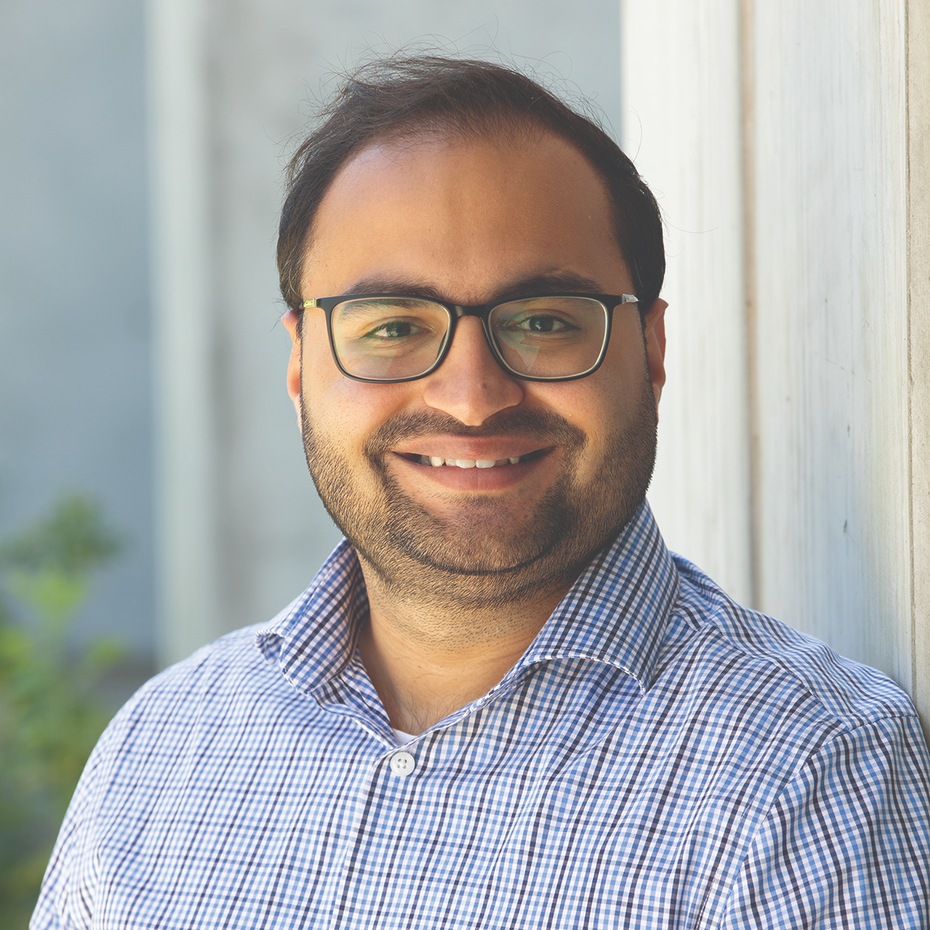
Who will present the paper?
Pratik
Ke
If outcome 0, Pratik!
If outcome 1, Ke!
Notes:
Imagine that next year this workshop will be hold in person. So Pratyay and Aniket needs to decide what to eat during a break.
Pratyay prefers sushi but Aniket prefers cake
None of them can pursuade each other, so they decide to toss a random coin.

Slide 3
Public bulletin board
[Blum 83]
Notes:
As cryptographers, they decide to use Blum’s coin toss protocol.
They first each commits to a random coin and posts the commitments to some public bulletin board.

Slide 4
1
$$⊕$$
0
=
Outcome 1
[Blum 83]
Notes:
After that, they each open our commitment and reveal the random bit inside

Slide 5
0
[Blum 83]
Notes:
Aniket is smart and strategic. He can wait for Pratyay to first open his bits. It’s 0. so Aniket knows if he opens his commitment, He's gonna to lose the game. So what if he refuse to open? Then pratyayjust automatically wins and we will still, have cake for next year.
So even if Aniket doesn't follow the protocol, he cannot gain benefits
This protocol sounds good, it solves our problem.

Slide 6
Coin toss
Correctness: if all honest, output is uniformly random.
Strong fairness: strategic player cannot bias the output.
Impossible due to [Cle86]
Notes:
Formally, in coin toss protocol, our goal is to toss a uniform random coin. We care about two properties.
The notion considered in classical cryptography literature
This was proved to be impossible by Cleve in 1986. When there are two users tossing a coin, and the protocol is polynomially many round, a strategic player can always bias the output.
Even in Blum’s coin toss, I can always bias the output towards 1 by intentionally lose the game. But a rational player will not do this.

Slide 7
Coin toss
Correctness: if all honest, output is uniformly random.
Game-theoretic fairness: a strategic player cannot benefit themselves.
Kai-Min Chung,Yue Guo,Wei-Kai Lin,Rafael Pass,and Elaine Shi.
Game-theoretic notions of fairness in multi-party coin toss. In TCC, 2018.
Notes:
Blum’s coin toss actually achieves a weaker notion of fairness, a game-theoretic flavor of fairness.
In Blum's coin toss we just saw, even if Pratyay doesn't follow the protocol, he cannot increase the probability of him winning the game
This notion was first formally proposed in Chung, Guo, Lin, Pass and Shi's TCC 2018 work
So we've seen a game-theoretic fair protocol for two-party coin toss.
What about multi-party coin toss?

Slide 8
How about multi-party multi-sided coin toss?
Prefer 0
Prefer 1
Utility=$\left\{\begin{aligned}1, if I like output \\ 0, otherwise\end{aligned}\right.$
Prefer 2
Prefer 3
Notes:
In multi-party coin toss, many players get together to decide a uniformly random coin.
Let's say we want to do a 4-sided coin toss.
Here every player has a publicly known preference.
we call those who prefer pitts as pitts-supporters, and those who prefer ann arobor as ann-supporters
A player gets utility 1 if the outcome matches their preference, and 0 otherwise.
Some of them may form a coalition, and their goal is to increase their joint utility., which is the sum of every coalition member’s utility.
For example,

Slide 9
Multi-party $m$-sided coin toss
Correctness: if all honest, output is uniformly random.
Game-theoretic fairness: a strategic coalition cannot increase its expected joint utility
Honest protocol is a Nash equilibrium!
Notes:
Again in
the game-theoretic fairness is now defined w.r.t. a coalition
honest protocol is a nash equilirium, everyone is incentivized to follow the protocol honestly.

Slide 10
Why game-theoretic fairness?
Randomness widely used in decentralized applications.
Lotteries
Leader election
Games
Strong fairness possible only if honest majority.
Notes:
why not stick to strong fairness?
In all these applications, we need randomness generated in a decentralized manner, among mutual distrustful players
Unfortunately, it is known that
In many decentralized applications, we may not have honest majority. It is possible that an adversary create many pseudonyms and control a majority number of the pseudonyms running the randomness generation task.

Slide 11
Why game-theoretic fairness?
Notes:
Such kinds of attack is happening in real-world. There are people creating many pseudonyms to juice value from the solana blockchain.

Slide 12
Why game-theoretic fairness?
Randomness widely used in decentralized applications.
Lotteries
Leader election in BFT consensus
Games
Strong fairness possible only if honest majority.
Want fairness against majority-sized coalition!
Notes:
In many decentralized application, it is not reasonable to assume honest majority so we do need some reasonable fairness against majority-sized coalition
So, this is the reason why we care about game-theoretic fairness.

Slide 13
Feasibility: game-theoretic fairness
Under what size of coalition is it possible to achieve game-theoretic fairness?
$$n/2$$
Binary coin toss [CGL+18 , WAS22]
Notes:
People have studied game theoretic fairness for some specific tasks.
Chung et al and my previous work with asharov and shi gave a complete characterization on the size of the coaltiion we can tolerate for gt fair binary coin toss.
There they showed that we can indeed tolerate majority-sized coalition

Slide 14
Feasibility: game-theoretic fairness
Under what size of coalition is it possible to achieve game-theoretic fairness?
$$n$$
Leader election [CCWS21]
Notes:
But the whole middle space is unknown to us.
So we ask this question, under what size of coalition is it possible to achieve fairness?
Exactly where should we draw the line between feasibility and infeasibility?

Slide 15
Feasibility: game-theoretic fairness
Under what size of coalition is it possible to achieve game-theoretic fairness?
$$n/2$$
$$n$$
$m$-sided coin toss
Notes:
The whole landscape of GT fairness for multi-sided coin toss is unknown to us. Exactly where should we draw the line between feasibility and impossibility?

Slide 16
Our results
$m$-sided coin toss:
Protocol tolerates majority-sized coalition for any $m$.
Distributed sampling:
Protocol tolerates majority-sized coalition for any efficiently sampleable $m$-outcome distributions.
Impossibility result:
Nearly optimal impossibility result for a broad range of parameters.
Notes:
We also extend this protocol to a broader setting of distributed sampling where players want together sample randomness from some non-uniform distributions. Here our protocol achieves game theoretic fairness also against majority sized coalitions.

Slide 17
In this talk
Direct composition does not work
Our protocol
Notes:
The rest of the talk will focus on the upper bounds

Slide 18
In this talk
Direct composition does not work
Our protocol
Notes:
In the rest of this talk,
we will focus on binary coin toss.
... and briefly how to generalize the idea
Due to the time limit, I will not be able to talk about the full protocol description, but I do want to show you the landscape

Slide 19
Naïve idea: Direct composition for 4-sided coin
0-supp
1-supp
2-supp
3-supp
00
01
10
11
Composing with two binary coins
Notes:
Imagine that we want to toss a 4-sided coin.
A naïve idea is to toss two binary coins, and if the two coins are 00, then we get outcome 0, if the two coins are 10, we get outcome 2. simple mapping

Slide 20
00-supp
01-supp
10-supp
11-supp
First GT-fair binary coin
00-supp
10-supp
01-supp
11-supp
Second GT-fair binary coin
Notes:
Now let’s write the player’s preference using this two-bits version.
Clearly, each player has a publicly known preference of the first coin and a preference of the second coin.
Now let’s decide the first coin. We let the players who prefer 0 of the first coin play against the players who prefer 1 for the first coin.
Similarly, to decide the second binary coin, we let the players who prefer 0 for the second coin play against those who prefer 1 for the second coin.
And we use these two coins to compose a 4-sided coin.
Does this protocol work?

Slide 21
Direct composition does not work!
1st coin
00-supp
01-supp
10-supp
11-supp
Behave honestly in the first coin toss
2nd coin
00-supp
10-supp
01-supp
11-supp
If first coin = 0, bias the second coin to 1
Notes:
Unfortunately it does not tolerate majority-sized coalition.
Let’s say this coalition contains these 5 players, the 00-supporter, two 01-supporter, and the two 10-supporter.
They adopt the following strategy: they behave honestly in the first coin toss. Then if the first coin =0, they will bias the second coin to 1. Note this coalition is able to perform this attack because it controls more players preferring 0 in the second coin compared to players preferring 1 in the second coin. So they can always bias towards second coin towards 1 because in the view of the second coin toss, this coalition prefers 0. However, in fact, conditioned on first coin being 0, this coalition actually prefers 1. So this coalition can perform this strategy to increase their joint utility. This protocol does not achieve GT fairness against coalition of size 5.

Slide 22
Direct composition does not work!
1st coin
00-supp
01-supp
10-supp
11-supp
2nd coin
00-supp
10-supp
01-supp
11-supp
Inconsistent coalition’s preference!
Notes:
In general, composition does not work because there's a mismatch of the coalition's preference in different instances of the binary coin toss.

Slide 23
In this talk
Direct composition does not work
Our protocol (semi-malicious)
Notes:
this failure of composition implies that we need to design a multi-sided coin toss protocol from scratch.
So now let me show you a clean protocol that achieves GT fairness against majority sized coalition.

Slide 24
Our Protocol
Output $c_{0}+c_{1}$
$$c_{0}$$
$$c_{1}$$
Reveal first
Reveal second
commits
$$c_{0}$$
3-out-of-5 SS
$$c_{1}$$
0-supp
1-supp
2-supp
3-supp
Notes:
The remaining players each share a random coin using 5-out-of-7 shamir secret sharing. So any 5 players can resonctruct. We use this c1 to denote the sum of the ramining players' secrets.

Slide 25
Our Protocol
Output $c_{1}$
$$⊥$$
$$c_{1}$$
Reveal second
commits
$$c_{0}$$
3-out-of-5 SS
$$c_{1}$$
0-supp
1-supp
2-supp
3-supp
Notes:
The two authorities first choose two random coins.
If the coalition wants to rewrite any coin, it must happen at this point.
After that, the pitts group first reveal coin c0. so now the value c0 is available on the public bulletin board.
Then the ann arbor group reveal the coin c1.
Note that here the reveal order matters and later we will see why.
After we have both c0 and c1 revealed, we output the xor of the two random bits.

Slide 26
Our Protocol
What should we output?
$$c_{0}$$
$$⊥$$
Reveal first
commits
$$c_{0}$$
3-out-of-5 SS
$$c_{1}$$
0-supp
1-supp
2-supp
3-supp
Notes:
The two authorities first choose two random coins.
If the coalition wants to rewrite any coin, it must happen at this point.
After that, the pitts group first reveal coin c0. so now the value c0 is available on the public bulletin board.
Then the ann arbor group reveal the coin c1.
Note that here the reveal order matters and later we will see why.
After we have both c0 and c1 revealed, we output the xor of the two random bits.

Slide 27
Our Protocol
Output 0!
$$c_{0}$$
$$⊥$$
Reveal first
commits
$$c_{0}$$
3-out-of-5 SS
$$c_{1}$$
0-supp
1-supp
2-supp
3-supp
Notes:
The two authorities first choose two random coins.
If the coalition wants to rewrite any coin, it must happen at this point.
After that, the pitts group first reveal coin c0. so now the value c0 is available on the public bulletin board.
Then the ann arbor group reveal the coin c1.
Note that here the reveal order matters and later we will see why.
After we have both c0 and c1 revealed, we output the xor of the two random bits.

Slide 28
Fairness against coalition of size 3
commits
$$c_{0}$$
3-out-of-5 SS
$$c_{1}$$
0-supp
1-supp
2-supp
3-supp
If coalition does not contain 0-supporter
Incentivized to reconstruct $c_{1}$
$c_{0}$ random, $c_{1}$ independent from $c_{0}$ and reconstructed
Notes:
This punishment mechanics guarantees reconstruction of the second coin.

Slide 29
Fairness against coalition of size 3
commits
$$c_{0}$$
3-out-of-5 SS
$$c_{1}$$
0-supp
1-supp
2-supp
3-supp
If coalition contains 0-supporter
$c_{1}$ random and reconstructed
Notes:
This punishment mechanics guarantees reconstruction of the second coin.

Slide 30
A game-theoretically fair against coalition of size 3.
Our impossibility: no protocol tolerates 4-sized coalition.
Can we generalize?
Notes:
now we have go over all possible coalitions of size 4, and we see that any such coalition cannot increase their expected utility

Slide 31
Generalization: $m$-sided coin toss
0: least preferred outcome
If $n≥\left(2m−\frac{1}{2}\right)n_{0}$, tolerate $t=n−m⋅n_{0}+\left\lceil \frac{n_{0}}{2}\right\rceil$
Otherwise, tolerate $t=\frac{m}{2m−1}n−\frac{m}{2\left(2m−1\right)}⋅n_{0}$
Notes:
We can see here that the landscape of gt fairness is very different from that of the strong fairness. here, the size of the coalition we can tolerate depends not only on n, but also fraction of 0-supporters, or the fraction of players preferring the least-preferred outcome.

Slide 32
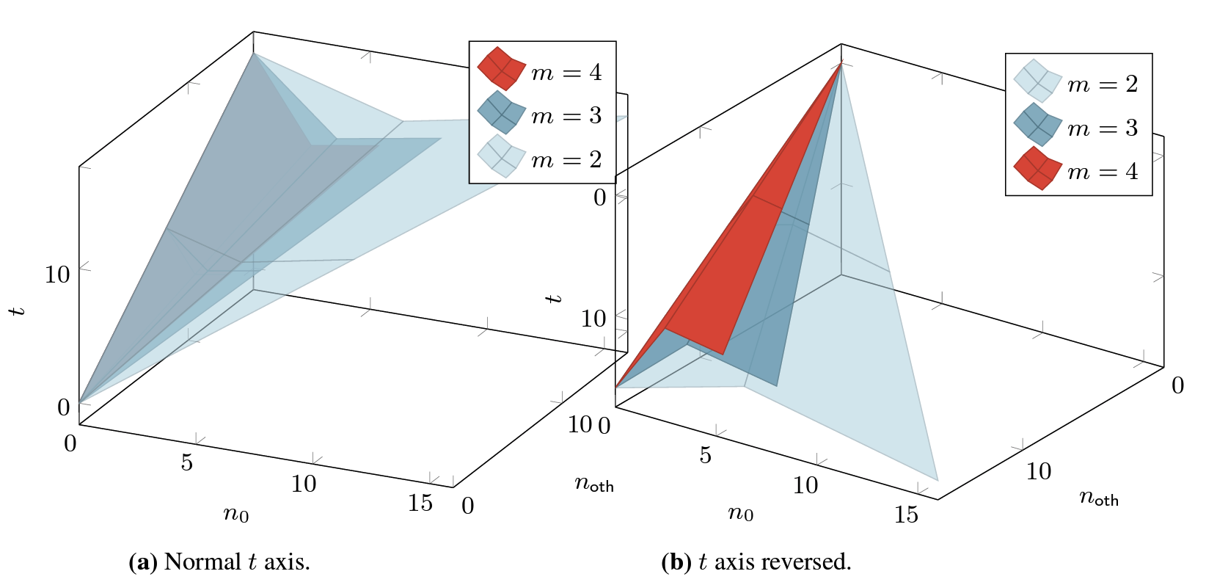
Visualization
Notes:
This formula is quite hard to parse so let me directly show you this visualization. This figure shows the size of the coaltiion we can tolerate t, as a function of the number of 0-supporters n0, and the number of other players.
The second figure here reverses the t axis for better comparison.
First, we can tolerate majority sized for any m.
we can see that for each m, we have a smooth phase transition in between the planes. As the number of sides m increases, the size of the coalition we can tolerate decreases.

Slide 33
Conclusion
Game-theoretic fairness: strategic coalition cannot gain benefit by deviating.
2. Landscape very different from strong fairness.
Notes:
GT fairness captures the incentives of players, It guarantees that …
We can indeed achieve game-theoretic fairness against corrupted majority and the landscape

Slide 34
Open problems
How do we make it more practical?
Introducing incentives in other cryptographic primitives based on the application scenario.
Notes:
The most related one is how do we make it practical. Our protocol runs in constant rounds against semi-malicious coalition bur quadratic rounds against malicious coalition. Is there a way to reduce the round complexity and communication complexity to make it practical and deployable?
In this talk, we see that introducing incentives circumvents fundamental impossibilities in cryptography. So can we introduce incentives in other cryptographic primitives used in decentralized applications to achieve better results? Cryptography usually assumes a worst-case adversary, but on decentralized applications where currencies are involved, people deviate to gain benefits. Can we model these incentives to get better constructions?

Slide 35
Thank you!
kewucse@umich.edu
eprint: 2024/223

