Slide 1
Is ML-Based Cryptanalysis Inherently Limited? Simulating Cryptographic Adversaries via Gradient-Based Methods
Avital Shafran, Eran Malach, Thomas Ristenpart, Gil Segev, Stefano Tessaro
Crypto 2024

Slide 2
ML-based cryptanalysis
Cryptanalysis is known to be a notoriously labor-intensive and complex process
Given that ML has revolutionized many manual tasks
E.g. anomaly detection, language translation, autonomous driving
A natural question:
Can recent ML methods be used to replace classical labor-intensive cryptanalytic approaches?

Slide 3
ML-based cryptanalysis
Most previous works focused on attacking block ciphers and the LWE problem
Gohr [Goh19] presented the first neural distinguisher for attacking the SPECK block cipher
Many follow-ups and extentions to other block ciphers
Wenger, Chen, Charton, and Lauter [WCCL22] presented SALSA for attacking the LWE problem
Follow-ups: SALSA Picante, SALSA Verde, SALSA Fresca

Slide 4
Basic idea

Slide 5
Basic idea

Slide 6
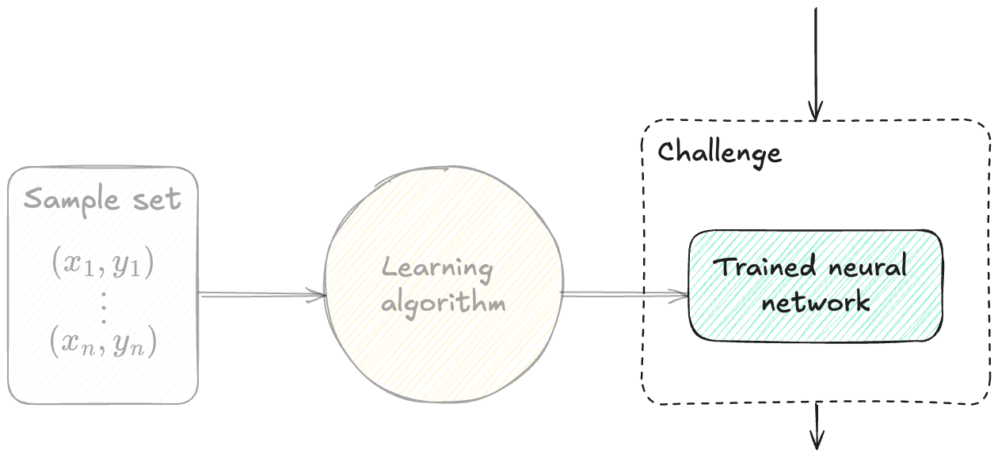
Basic idea

Slide 7
Basic idea
Gohr [Goh19]:

Slide 8
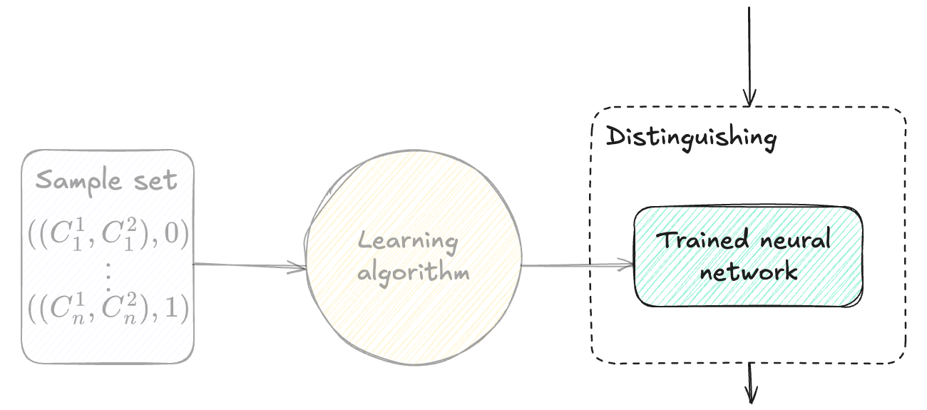
Basic idea
Gohr [Goh19]:

Slide 9
Basic idea
Wenger et al. [WCCL22]:

Slide 10
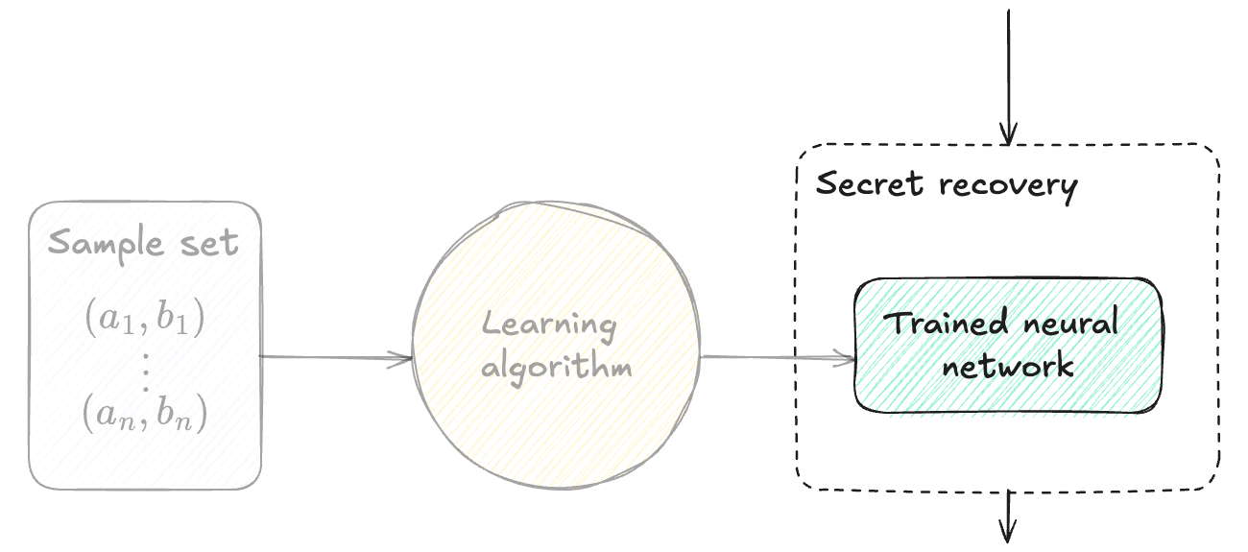
Basic idea
Wenger et al. [WCCL22]:

Slide 11
Our work
Motivated by a key difference in accessing the underlying data:
Classical methods directly process individual samples (e.g. plaintext-ciphertext pairs)
ML-based methods process samples via gradient-based computations, that are averaged over multiple samples
Are ML-based cryptanalytic methods inherently limited due to their seemingly restricted access to the underlying data?
No
Yes
Any sample-based adversary can be “simulated” by a gradient-based one
There exist sample-based adversaries that cannot be “simulated” by gradient-based ones

Slide 12
Our contributions
A unifying framework for capturing both sample-based and gradient-based adversaries
General feasability result: Any sample-based adversary can be simulated by a gradient-based one
In all of our results, no significant loss in efficiency
Running time and query complexity of the gradient-based adversary

Slide 13
Our framework: Adversaries
Sample-based adversaries
Captures wide range of fundamental cryptographic applications
E.g., given $S=\left\{\left(x, F_{sk}\left(x\right)\right)\right\}$ unpredictability : $A\left(S\right)=\left(x^{∗},y^{∗}\right)$; key recovery: $A\left(S\right)=sk$
Gradient-based adversaries

Slide 14
Our framework: Adversaries
Sample-based adversaries
Captures wide range of fundamental cryptographic applications
E.g., $S=\left\{\left(x, F_{sk}\left(x\right)\right)\right\}$ $𝒜\left(S\right)=\left(x^{∗},y^{∗}\right)∉S$
Gradient-based adversaries

Slide 15
Our framework: Gradient oracle
A learner attempts to estimate a mapping between $𝒳$ to $𝒴$
For modeling the common ML methodology, we introduce a gradient oracle:

Slide 16
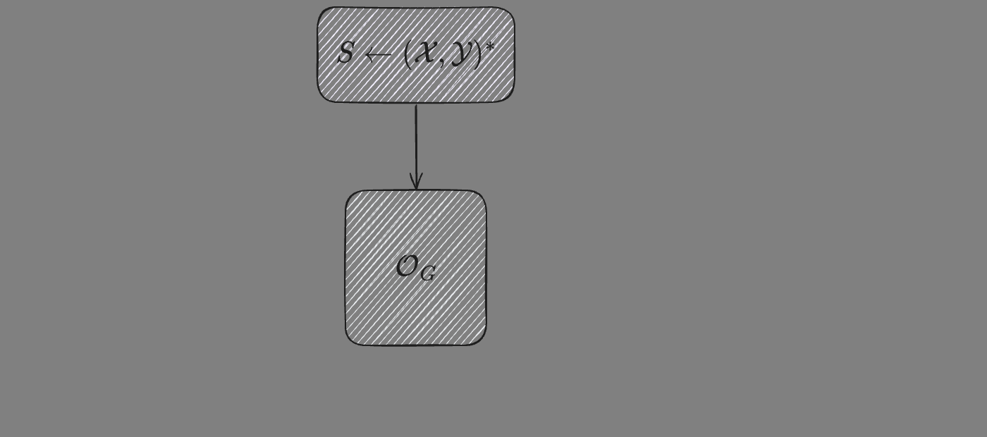
Our framework: Gradient oracle
A learner attempts to estimate a mapping between $𝒳$ to $𝒴$
For modeling the common ML methodology, we introduce a gradient oracle:

Slide 17
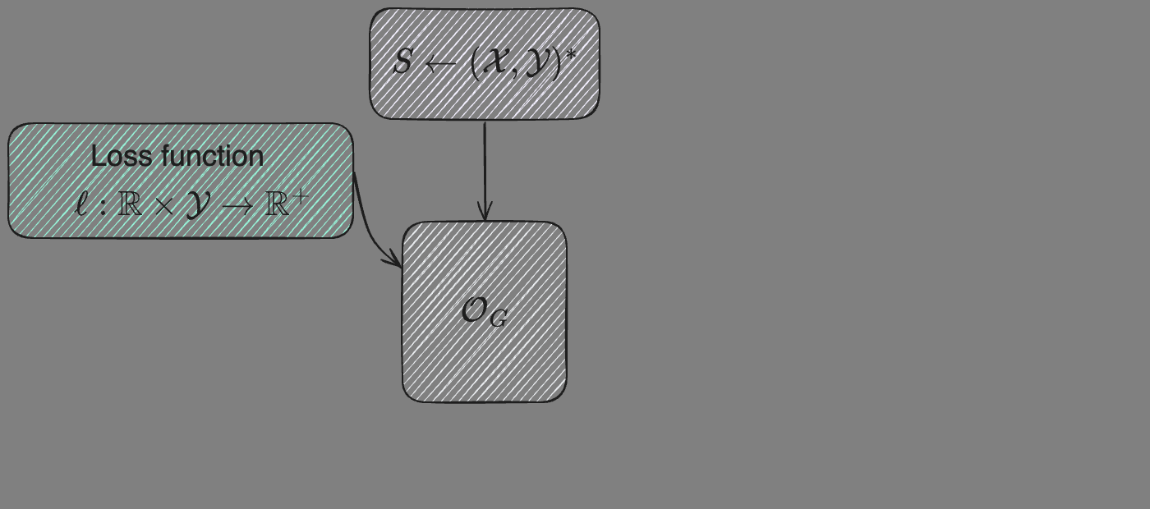
Our framework: Gradient oracle
A learner attempts to estimate a mapping between $𝒳$ to $𝒴$
For modeling the common ML methodology, we introduce a gradient oracle:

Slide 18
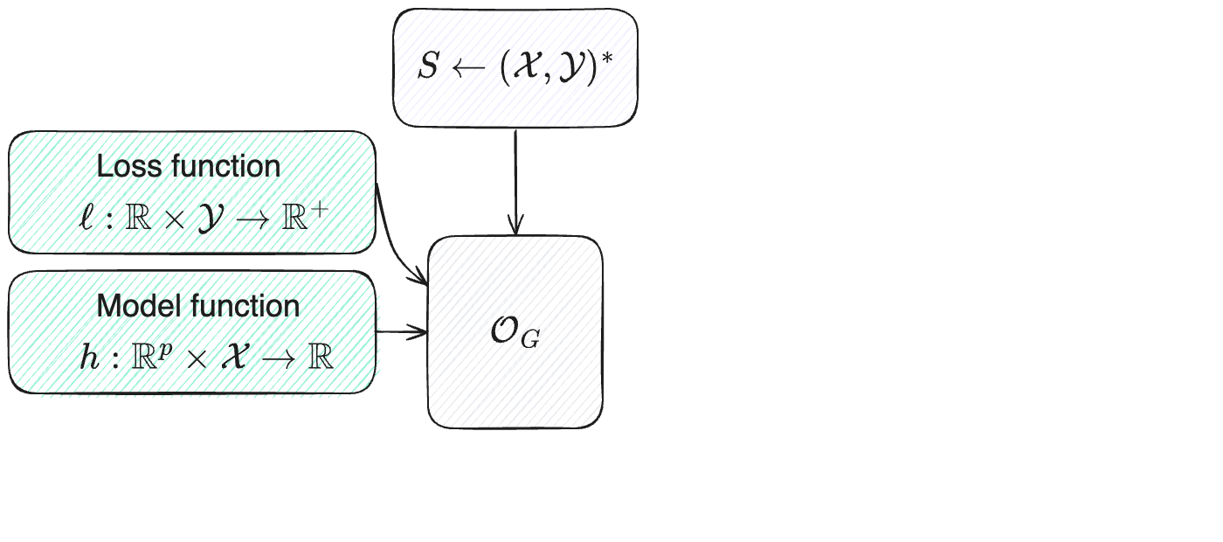
Our framework: Gradient oracle
A learner attempts to estimate a mapping between $𝒳$ to $𝒴$
For modeling the common ML methodology, we introduce a gradient oracle:

Slide 19
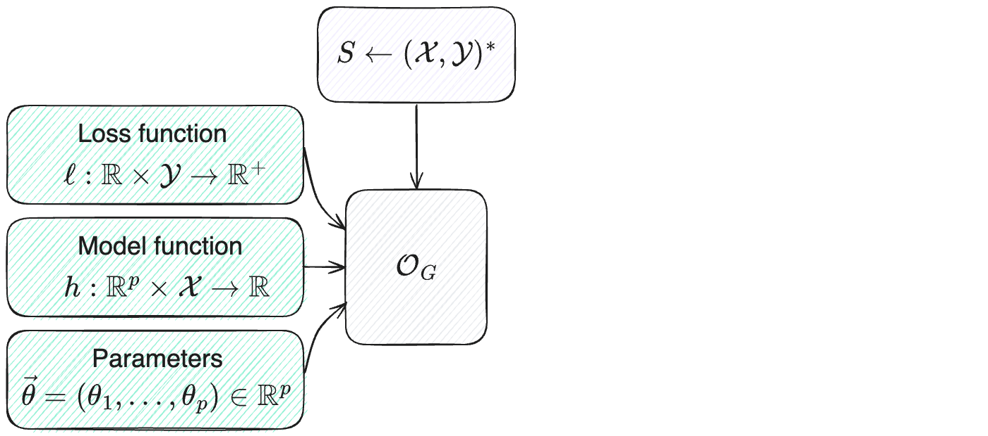
Our framework: Gradient oracle
A learner attempts to estimate a mapping between $𝒳$ to $𝒴$
For modeling the common ML methodology, we introduce a gradient oracle:

Slide 20
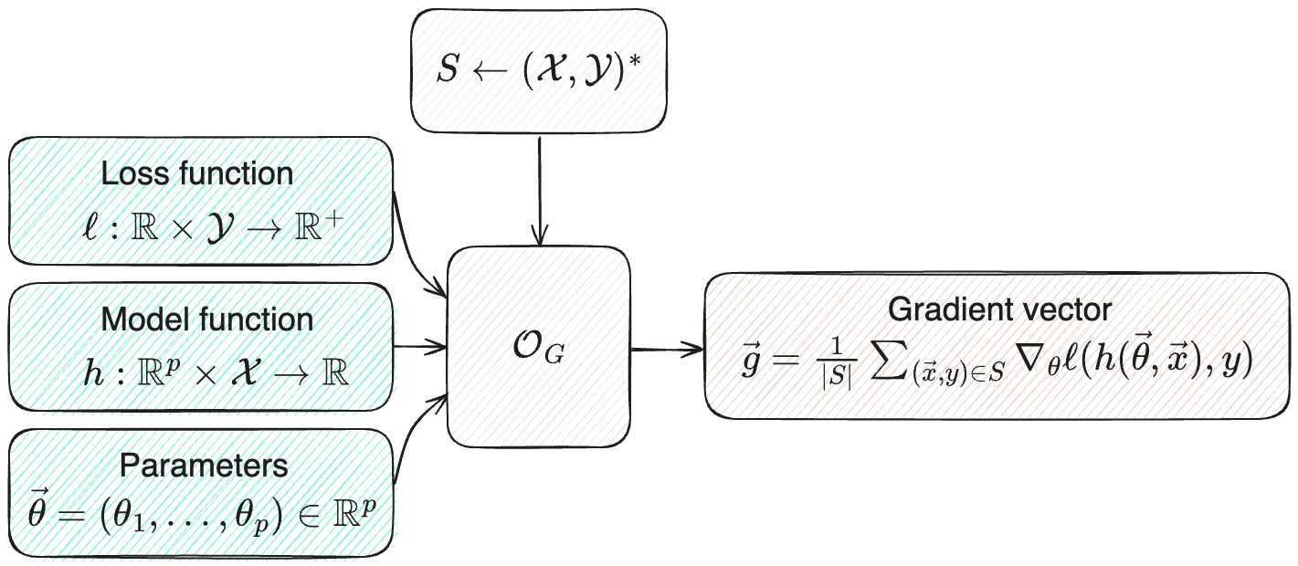
Our framework: Gradient oracle
A learner attempts to estimate a mapping between $𝒳$ to $𝒴$
For modeling the common ML methodology, we introduce a gradient oracle:

Slide 21
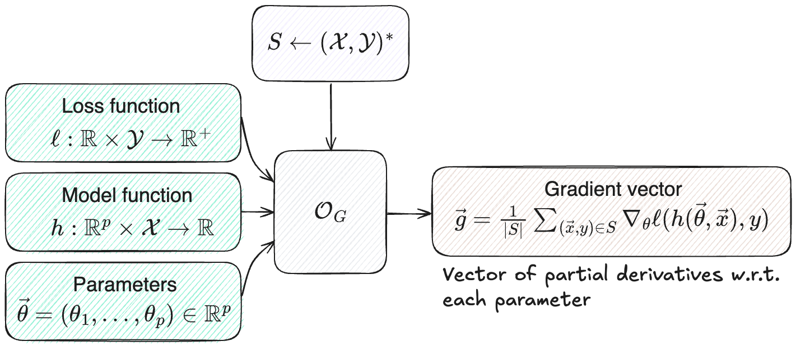
Our framework: Gradient oracle
A learner attempts to estimate a mapping between $𝒳$ to $𝒴$
For modeling the common ML methodology, we introduce a gradient oracle:

Slide 22
Our framework: Adversaries
Sample-based adversaries
Captures wide range of fundamental cryptographic applications
E.g., $S=\left\{\left(x, F_{sk}\left(x\right)\right)\right\}$ $𝒜\left(S\right)=\left(x^{∗},y^{∗}\right)∉S$
Gradient-based adversaries

Slide 23
Our framework: Adversaries
Sample-based adversaries
Captures wide range of fundamental cryptographic applications
E.g., $S=\left\{\left(x, F_{sk}\left(x\right)\right)\right\}$ $𝒜\left(S\right)=\left(x^{∗},y^{∗}\right)∉S$
Gradient-based adversaries

Slide 24
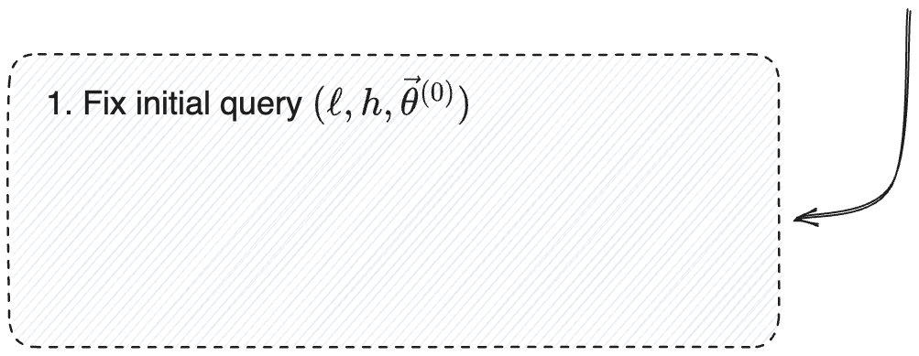
Our framework: Adversaries
Sample-based adversaries
Captures fundamental applications
E.g.,
Gradient-based adversaries
$h$ and $ℓ$ are fixed

Slide 25
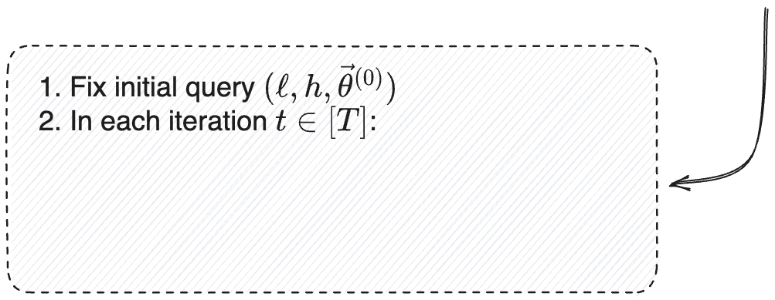
Our framework: Adversaries
Sample-based adversaries
Captures fundamental applications
E.g.,
Gradient-based adversaries
$h$ and $ℓ$ are fixed

Slide 26
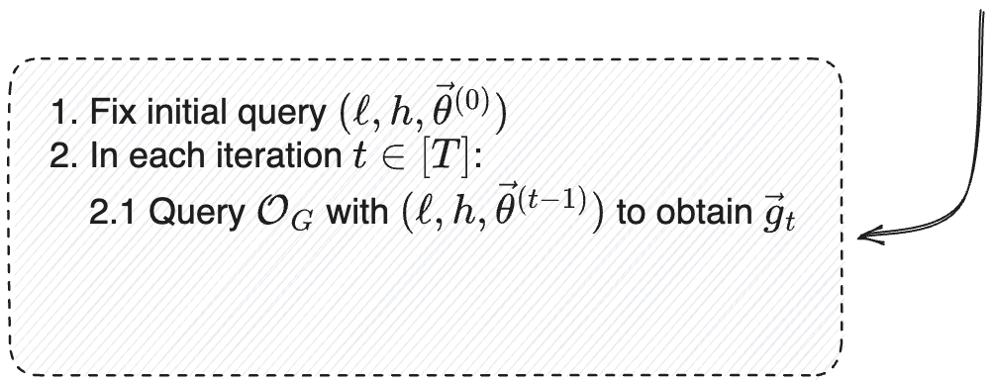
Our framework: Adversaries
Sample-based adversaries
Captures fundamental applications
E.g.,
Gradient-based adversaries
$h$ and $ℓ$ are fixed

Slide 27
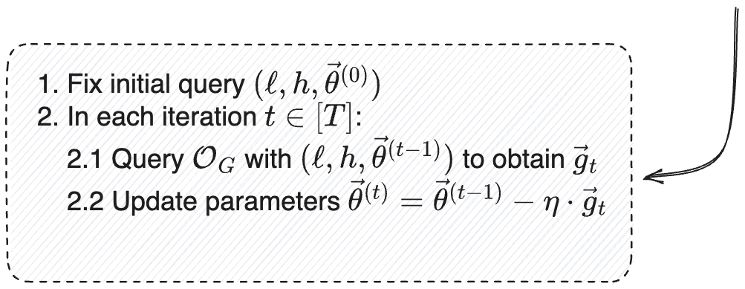
Our framework: Adversaries
Sample-based adversaries
Captures fundamental applications
E.g.,
Gradient-based adversaries
$h$ and $ℓ$ are fixed
$η$ is the step size or learning rate

Slide 28
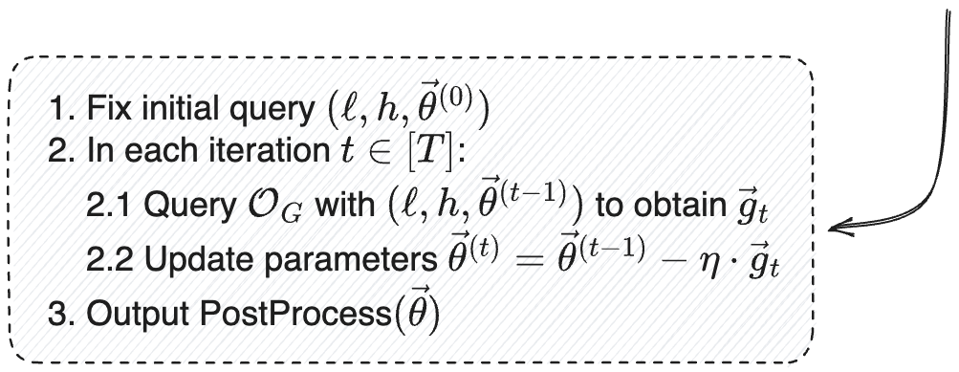
Our framework: Adversaries
Sample-based adversaries
Captures fundamental applications
E.g.,
Gradient-based adversaries
$h$ and $ℓ$ are fixed
$η$ is the step size or learning rate

Slide 29
Our framework: Adversaries
Sample-based adversaries
Captures wide range of fundamental cryptographic applications
E.g., $S=\left\{\left(x, F_{sk}\left(x\right)\right)\right\}$ $𝒜\left(S\right)=\left(x^{∗},y^{∗}\right)∉S$
Gradient-based adversaries
Framework and results easily adapted to other popular algorithms (SGD, ADAM, etc.)

Slide 30
Our framework: Adversaries
Sample-based adversaries
Captures wide range of fundamental cryptographic applications
E.g., given $S=\left\{\left(x, F_{sk}\left(x\right)\right)\right\}$ unpredictability : $A\left(S\right)=\left(x^{∗},y^{∗}\right)$; key recovery: $A\left(S\right)=sk$
Gradient-based adversaries
Framework and results easily adapted to other popular algorithms (SGD, ADAM, etc.)
A gradient-based adversary $ℬ$ is said to $ε$-simulate a sample-based adversary $𝒜$ if for any distribution $𝒟$ over ${\left(𝒳×𝒴\right)}^{∗}$ it holds that:
$$\text{SD}\left(\left(S,𝒜\left(S\right)\right), \left(S, ℬ^{𝒪_{G}\left(S, ⋅,⋅,⋅\right)}\left(1^{\left|S\right|}\right)\right)\right)≤ε$$
Where $S←D$

Slide 31
Our framework: Adversaries
Sample-based adversaries
Captures wide range of fundamental cryptographic applications
E.g., given $S=\left\{\left(x, F_{sk}\left(x\right)\right)\right\}$ unpredictability : $A\left(S\right)=\left(x^{∗},y^{∗}\right)$; key recovery: $A\left(S\right)=sk$
Gradient-based adversaries
Framework and results easily adapted to other popular algorithms (SGD, ADAM, etc.)
In our results we prove a stronger notion: a universal gradient-based adversary $ℬ$ that black-box $ε$-simulates any sample-based one
$$\text{SD}\left(\left(S,𝒜\left(S\right)\right), \left(S, ℬ^{𝒪_{G}\left(S, ⋅,⋅,⋅\right),𝒜(⋅)}\left(1^{\left|S\right|}\right)\right)\right)≤ε$$
Oracle access to $𝒜$

Slide 32
Our approach
We construct a black-box gradient-based adversary $ℬ$ that simulates any sample-based adversary $𝒜$
Some of our simulations were inspired by works on the power and limitations of differential-based learning in comparison to PAC learning

Slide 33
Our approach
We construct a black-box gradient-based adversary $ℬ$ that simulates any sample-based adversary $𝒜$
Some of our simulations were inspired by works on the power and limitations of differential-based learning in comparison to PAC learning

Slide 34
Our approach
We construct a black-box gradient-based adversary $ℬ$ that simulates any sample-based adversary $𝒜$
Some of our simulations were inspired by works on the power and limitations of differential-based learning in comparison to PAC learning

Slide 35
Our approach
We construct a black-box gradient-based adversary $ℬ$ that simulates any sample-based adversary $𝒜$
Some of our simulations were inspired by works on the power and limitations of differential-based learning in comparison to PAC learning

Slide 36
Our approach
We construct a black-box gradient-based adversary $ℬ$ that simulates any sample-based adversary $𝒜$
Some of our simulations were inspired by works on the power and limitations of differential-based learning in comparison to PAC learning [AS20, AKMSS21]

Slide 37
Perfect simulation via DFS-based extraction
Theorem: There exists a gradient-based adversary $ℬ$ that black-box perfectly-simulates any sample-based adversary
$ℬ$ runs in time $T_{ℬ}\left(\left|S\right|, \left|𝒳\right|, \left|𝒴\right|\right)=O\left(\left|S\right|⋅\log\left|𝒳\right|⋅(\log\left|𝒳\right|+\log\left|𝒴\right|)\right)$
$ℬ$ issues $Q_{ℬ}\left(\left|S\right|, \left|𝒳\right|, \left|𝒴\right|\right)=O\left(\left|S\right|⋅\log\left|𝒳\right|\right)$ gradient queries
Main idea: Run a DFS-based exploration for extracting all samples
A sample is extracted if it uniquly matches some prefix $z$
For the reminder of this talk we will assume $𝒳={\left\{0,1\right\}}^{n}$ and $𝒴=\{0,1\}$

Slide 38
Perfect simulation via DFS-based extraction
Given any prefix $z$, we can issue a gradient query $(ℓ,h, \vec{θ})$ that enables to distintinguish between three cases:
Starting from an empty prefix $z=ε$:
If no sample $x_{i}$ is prefixed with $z$ – terminate
If a single sample $x_{i}$ is prefixed with $z$: extract $(x_{i}, y_{i})$ from the response
If more than one sample $x_{i}$ is prefixed with $z$: recursively invoke on $z0, z1$
No sample $x_{i}$ starts with $z$
Exactly one sample $x_{i}$ starts with $z$
More than one sample $x_{i}$ starts with $z$

Slide 39
Query construction
Enables to count prefix matches
$$\vec{g}=\frac{1}{\left|S\right|}\sum_{\left(\vec{x},y\right)∈S}{∇_{θ}ℓ\left(h\left(\vec{θ},\vec{x}\right),y\right)}=\frac{1}{\left|S\right|}\sum_{\left(\vec{x},y\right)∈S }{ℓ^{′}\left(h\left(\vec{θ},\vec{x}\right),y\right)⋅}∇_{θ}h\left(\vec{θ},\vec{x}\right)$$
Enables to extract $y$
Enables to extract $x$

Slide 40
Query construction
$$\vec{g}=\frac{1}{\left|S\right|}\sum_{\left(\vec{x},y\right)∈S}{∇_{θ}ℓ\left(h\left(\vec{θ},\vec{x}\right),y\right)}=\frac{1}{\left|S\right|}\sum_{\left(\vec{x},y\right)∈S }{ℓ^{′}\left(h\left(\vec{θ},\vec{x}\right),y\right)⋅}∇_{θ}h\left(\vec{θ},\vec{x}\right)$$
$$\vec{g}=\frac{1}{\left|S\right|}\sum_{\left(\vec{x},y\right)∈S}{\left(2+y\right)⋅}\left(\vec{x}, 1\right)⋅1_{x_{1…k}=z}$$

Slide 41
Query construction
$$\vec{g}=\frac{1}{\left|S\right|}\sum_{\left(\vec{x},y\right)∈S}{∇_{θ}ℓ\left(h\left(\vec{θ},\vec{x}\right),y\right)}=\frac{1}{\left|S\right|}\sum_{\left(\vec{x},y\right)∈S }{ℓ^{′}\left(h\left(\vec{θ},\vec{x}\right),y\right)⋅}∇_{θ}h\left(\vec{θ},\vec{x}\right)$$
$$\vec{g}=\frac{1}{\left|S\right|}\sum_{\left(\vec{x},y\right)∈S}{\left(2+y\right)⋅}\left(\vec{x}, 1\right)⋅1_{x_{1…k}=z}$$

Slide 42
Query construction
$$\vec{g}=\frac{1}{\left|S\right|}\sum_{\left(\vec{x},y\right)∈S}{∇_{θ}ℓ\left(h\left(\vec{θ},\vec{x}\right),y\right)}=\frac{1}{\left|S\right|}\sum_{\left(\vec{x},y\right)∈S }{ℓ^{′}\left(h\left(\vec{θ},\vec{x}\right),y\right)⋅}∇_{θ}h\left(\vec{θ},\vec{x}\right)$$
$$\vec{g}=\frac{1}{\left|S\right|}\sum_{\left(\vec{x},y\right)∈S}{\left(2+y\right)⋅}\left(\vec{x}, 1\right)⋅1_{x_{1…k}=z}$$
Used to count matches
Used to extract $y_{i}$
Used to extract $x_{i}$

Slide 43
Query construction
$$\vec{g}=\frac{1}{\left|S\right|}\sum_{\left(\vec{x},y\right)∈S}{∇_{θ}ℓ\left(h\left(\vec{θ},\vec{x}\right),y\right)}=\frac{1}{\left|S\right|}\sum_{\left(\vec{x},y\right)∈S }{ℓ^{′}\left(h\left(\vec{θ},\vec{x}\right),y\right)⋅}∇_{θ}h\left(\vec{θ},\vec{x}\right)$$
DFS step outcome based on value of ${\left(\vec{g}\right)}_{n+1}$
$$\vec{g}=\frac{1}{\left|S\right|}\sum_{\left(\vec{x},y\right)∈S}{\left(2+y\right)⋅}\left(\vec{x}, 1\right)⋅1_{x_{1…k}=z}$$
$${\left(\vec{g}\right)}_{n+1}=0$$
terminate
$${0<\left(\vec{g}\right)}_{n+1}<4/|S|$$
extract
$${4/|S|≤\left(\vec{g}\right)}_{n+1}$$
$$\text{extend}$$

Slide 44
Query construction
$$\vec{g}=\frac{1}{\left|S\right|}\sum_{\left(\vec{x},y\right)∈S}{\left(2+y\right)⋅}\left(\vec{x}, 1\right)⋅1_{x_{1…k}=z}$$
Denote by $S_{z}⊆S$ the samples $\left(\vec{x}, y\right)∈S$ for which $\vec{x}$ is prefixed with $z$
No matches
$$S_{z}=∅$$
$$\vec{g}=\frac{1}{\left|S\right|}⋅\left(0, …,0\right)$$
$${\left(\vec{g}\right)}_{n+1}=0$$

Slide 45
Query construction
$$\vec{g}=\frac{1}{\left|S\right|}\sum_{\left(\vec{x},y\right)∈S}{\left(2+y\right)⋅}\left(\vec{x}, 1\right)⋅1_{x_{1…k}=z}$$
Denote by $S_{z}⊆S$ the samples $\left(\vec{x}, y\right)∈S$ for which $\vec{x}$ is prefixed with $z$
Single match
$$S_{z}=\left\{\left({\vec{x}}^{′},y^{′}\right)\right\}$$
$$\vec{g}=\frac{1}{\left|S\right|}⋅\left(2+y^{′}\right)⋅({\vec{x}}^{′},1)$$
$${\left(\vec{g}\right)}_{n+1}=\frac{\left(2+y^{′}\right)}{\left|S\right|}<\frac{4}{|S|}$$

Slide 46
Query construction
$$\vec{g}=\frac{1}{\left|S\right|}\sum_{\left(\vec{x},y\right)∈S}{\left(2+y\right)⋅}\left(\vec{x}, 1\right)⋅1_{x_{1…k}=z}$$
Denote by $S_{z}⊆S$ the samples $\left(\vec{x}, y\right)∈S$ for which $\vec{x}$ is prefixed with $z$
Multiple matches
$$S_{z}=\left\{{(\vec{x}}_{1},y_{1}),{(\vec{x}}_{2},y_{2})\right\}$$
$$\vec{g}=\frac{1}{\left|S\right|}\left(\left(2+y_{1}\right)⋅\left({\vec{x}}_{1},1\right)+\left(2+y_{2}\right)⋅\left({\vec{x}}_{2},1\right)\right)$$
$${\left(\vec{g}\right)}_{n+1}=\frac{\left(2+y_{1}\right)+\left(2+y_{2}\right)}{|S|}≥\frac{4}{|S|}$$

Slide 47
Statistical simulation with fully parallelizable gradient queries
DFS-based exploration is sequantial and cannot be parallelized
Inapplicable to parallelizable cryptanalysis
We refine our simulation to be fully parallelizable
Randomize each iteration using pairwise-independent hashing
All gradient queries can be issued at a single round
At the cost of a statistical and not perfect simulation

Slide 48
Statistical simulation via Gradient Descent
Previous simulations hold for general gradient-based adversaries that can query the oracle in an arbitrary manner
GD-based adversaries follow a particular algorithm
Non-adaptive queries
We refine our simulation to adversaries that run GD
Encode all guesses and results in the parameters
At the cost of a slightly less efficient simulation

Slide 49
Conclusions
We initiated an exploration of the theory of ML-based cryptanalysis
We introduced a unifying framework for capturing both sample-based and gradient-based adversaries
We established a general feasability result: Any sample-based adversary can be simulated by a gradient-based one
Are ML-based cryptanalytic methods inherently limited due to their seemingly restricted access to the underlying data?
No
Thank you for listening!

