Slide 1
Reducing the CRS Size in Registered ABE Systems
Rachit Garg George Lu Brent Waters David Wu
Notes:
Hello, my name is George Lu and this talk will be about
This is joint work with …
Acknowledge joint session with
“A Modular Approach to Registered ABE for Unbounded Predicates”
I’ll be introducing some shared background on registered abe and our results and Junichi will cover the results in their paper

Slide 2
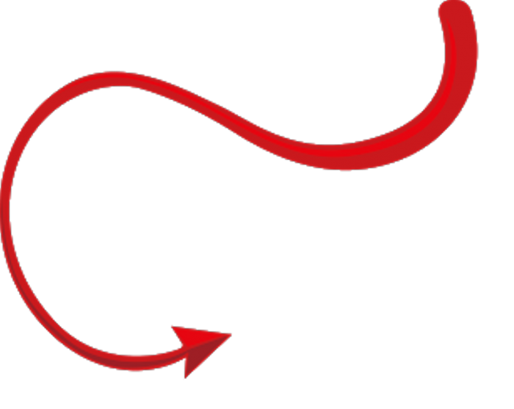
Attribute Based Encryption [SW05, GPSW06]
sk_{faculty + CS}
sk_{faculty + math}
pk
sk_{student + CS}
ct_{CS AND faculty}
Notes:
[cover in less time]
We begin with a notion of attribute-based encryption, which is a more expressive generalization of public key encryption where you have a single master public key, but instead of only having a single secret key, there’s the ability to generate attribute secret keys, which allows encryptors to specify what function on attributes should be allowed to decrypt. In this small example, we can imagine a system where users are given attributes based on their department and position, and an encryptor, without knowing exactly who this applies to, can say something like I only want cs faculty to read this. And so here user 1 will be able to read the message, but users 2 & 3 won’t, even if colluding.

Slide 3
Key Exfiltration Problem
sk_{faculty + CS}
sk_{faculty + math}
pk
sk_{student + CS}
msk
Notes:
Although this ability to define policies over ciphertexts is powerful, in a lot of practical use cases ABE runs into this issue of trust. That’s because if you want to use ABE, the person who is in charge of generating the secret keys is in possession of a master secret, which allows them to decrypt *any* ciphertext. And in practice, this single point of failure is pretty undesirable, since you now have to worry about both your central authority potentially being corrupt, or maybe even accidentally leaking their master secret.

Slide 4
Registration Model [GHMR18,HLWW23]
_{faculty + CS}
_{faculty + math}
ct_{CS AND faculty}
_{student + CS}
mpk
mpk'
mpk’’
No Master Secret!
Notes:
So to kind of get the best of both worlds – keeping the expressivity of abe while maintaining the trust model of public key encryption, the registration model was proposed, first in the context of ibe and then later generalized to abe. In a registered abe scheme, instead of being issued a secret key, users generate their own public/secret keypairs. By sending only their public key to this key curator, the curator is able to maintain and update a *short* master public key which function essentially exactly like an ABE key. However, the key differences between the key curator and the central authority in abe is 1) as mentioned before, the curator only needs to use the public key to generate their master public key, and 2) the curator is actually a deterministic algorithm, and doesn’t need to maintain any private state or randomness to register keys. These constructions of registration based encryption and registered abe have all been in the common reference string model.

Slide 5
Prior Constructions
Pairings [HLWW23, ZZGQ23, FFMMRV23 (RIPE)
ZLZGQ24 (R-IPFE)]
Obfuscation/WE [HLWW23, FWW23, FFMMRV23 (RFE), DPY23 (RFE)]
Bounded User
Quadratic (structured) CRS
Boolean Formulas
Black Box/Concrete Efficiency
Unbounded User
Unstructured CRS
Circuits
Non-black box
Notes:
Since registered abe was introduced, there’s actually been a lot of work done in the area of constructing registered ABE. These constructions generally fall into 2 groups – constructions from pairing groups and constructions from stronger primitives like obfuscation or witness encryption.
[talk differences]
Quadratic w.r.t. number of users
For our talk, we will primarily be focusing on pairing-based registered ABE, and improving the functionality and efficiency

Slide 6
Our Results
CRS
Unbounded Attribute Space (Large Universe) R-ABE
Nearly Linear n^{1+o(1)} CRS R-ABE
Notes:
In our work, we gain two major improvements over prior work. The first is that by using a partitioning style proof, we can get a large-universe registered ABE scheme, where the crs does not a-priori limit the number of attributes both per user or per ciphertext. Next, we’re also able to shrink the asymptotic size of the CRS of our registered ABE scheme from quadratic to almost linear *in the number of users*.
For the purpose of this talks, we’ll be primarily focusing on how to get this second improvement.

Slide 7
Why Quadratic?
Cross terms
Attribute terms
User terms
Faculty
CS
g^{t1}
×
g^{u1}
✓
1
×
g^{u2}
×
g^{u2}
g^{t3u1}
g^{t3u2}
g^{t3u3}
g^{t2}
g^{u3}
Correctness
Security
g^{t3}
✓
1
×
g^{t3}
g^{u1+u2}
g^{u2+u3}
g^{u1+u2}
g^{u2+u3}
Faculty only
CS only
Notes:
Now to talk about our improvement, first we’re going to need to understand why prior registered abe schemes needed this quadratic crs. So for registered abe schemes to control based on policy, there’s going to be a bunch of user terms needed for decryption, as well as some attribute-specific exponents. What our scheme is going to do is include these attribute terms to blind the ciphertext only when a user doesn’t have an attribute. Now for the curator to succinctly compress these into a master public key, they’re just gonna multiply them together. Now, say if an encryptor wants a ciphertext that can only be read by faculty, they’re going to include this faculty-only key term in the ciphertext.
But when say user 3 wants to decrypt, they’re going to need to pair their user term with the ciphertext, which is going to produce all these
Insight for compression is

Slide 8
Compressing Cross-Terms
g^{t1u1}
g^{t1u2}
g^{t1u3}
User 1
g^{t2u1}
g^{t2u2}
g^{t2u3}
User 2
g^{t3u1}
g^{t3u2}
g^{t3u3}
User 3
Notes:
Now if we want to hope to compress our CRS, we need to compress these cross terms, sampling them from some structured distribution where some subsets of them are equal.

Slide 9
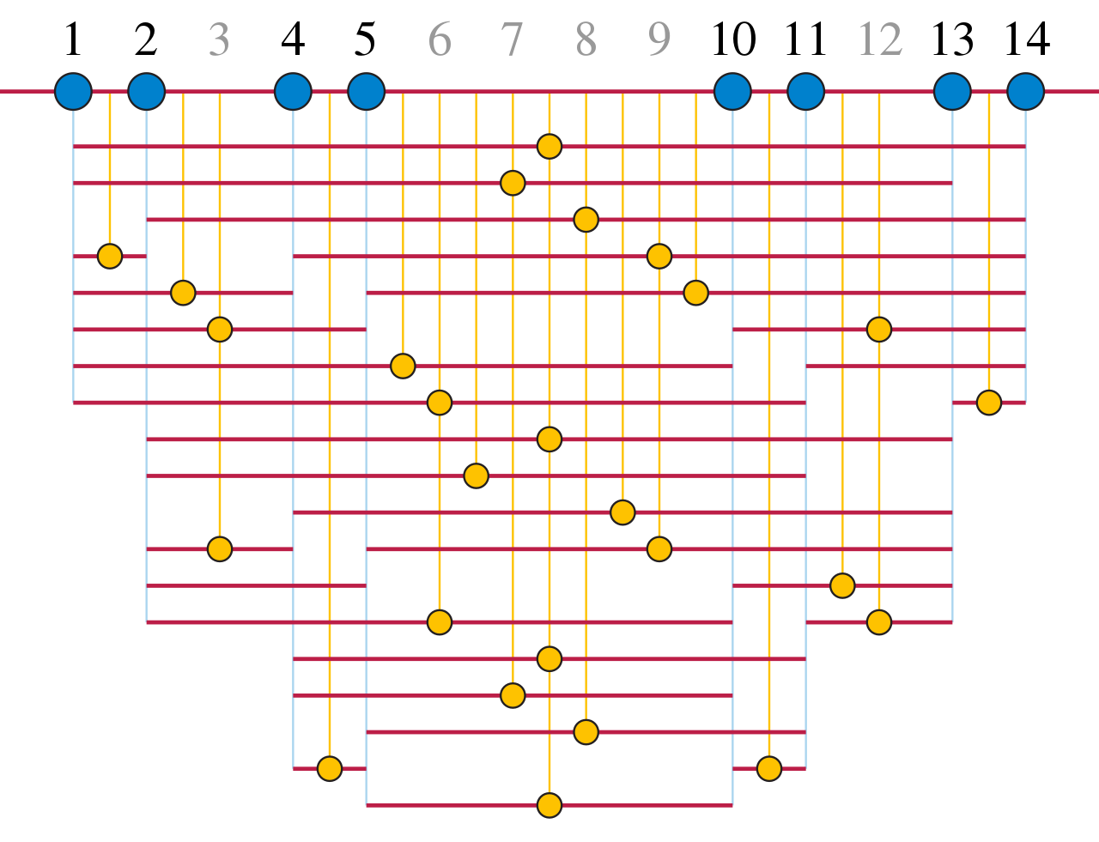
Ensuring Security
45x smaller CRS on 10⁴ Users!
u_{i} ,t_{i} = a ^{di}
Sample u_{i} ,t_{i} as powers of a?
Correctness:
Security:
g ^{ui tj} : i ≠ j ∈ [n]
Progression-Free Sets! [ET36,SS42,Beh46,Elk10]
= g ^{adi+dj}
g ^{uk tk} : k ∈ [n]
= g ^{a2dk}
d_{i} + d_{j} ≠ 2d_{k}
n^{1+o(1)}
Notes:
How we’re going to do this is just sample u, t as powers of a common exponent a. Now remember we do have a couple requirements on a for correctness and security, in that we have to give out all powers of a which are the sum of two different users, but at the same time it’s important for security we don’t give out powers of a equal to double the power of any particular user. This particular requirement is actually a well studied combinatorial problem in progression or 3-arithmetic progression free sets. And it turns out if you want a progression-free set of n elements, we can construct it with positive integers of size at most n^{1+o(1)}, which in turn bounds the powers of a we need to give out.
This change of sampling the crs is both an asymptotic *and* a concrete improvement in crs size. Just as an example, with 10k users, our crs is 45x smaller than without using progression free sets

Slide 10
Our Results
Unbounded Attribute Space (Large Universe) R-ABE
Nearly Linear n^{1+o(1)} CRS R-ABE (and BARGs!)
Notes:
Finally, I’d like to mention that this technique of using progression-free sets to reduce CRS size is actually more broadly applicable than just to the setting of registered ABE. Since cross-term cancellation is a technique that appears in many contexts
In our paper, we also construct a modification of the Waters-Wu BARG with a nearly linear CRS as well down from quadratic.

Slide 11
Thank you!
Read our paper 2024/749

Slide 12
Open Questions
Linear (or sublinear) CRS registered ABE from Pairings?
Subquadratic CRS registered ABE under fixed-size assumptions?

