Slide 1
Compact Key Storage A Modern Approach to Key Backup and Delegation
Yevgeniy Dodis
NYU
Daniel Jost
NYU
Antonio Marcedone
Zoom

Slide 2
(Cloud) Backup
Premise:
users want security
but they also don’t want to lose their data
➔ Applications need to offer a secure backup solution

Slide 3
(Cloud) Backup for E2E Messaging
App
meep meep
C
s
meep meep
App
C =
meep meep
s
C
Encryption secret
App
meep meep
s
Notes:
Existing solutions
Plaintext
Focus on safe-keeping secret
Encryption deemed trivial

Slide 4
(Cloud) Backup for E2E Messaging
Cloud storage
Cloud storage
Backup
$$K_{D}$$
c =
meep meep
App
meep meep
Backup
s
C
$$K_{R}$$
Backup secret
Cloud storage
meep meep
App
C =
meep meep
s
C
Backup
$$K_{T}$$
App
meep meep
s

Slide 5
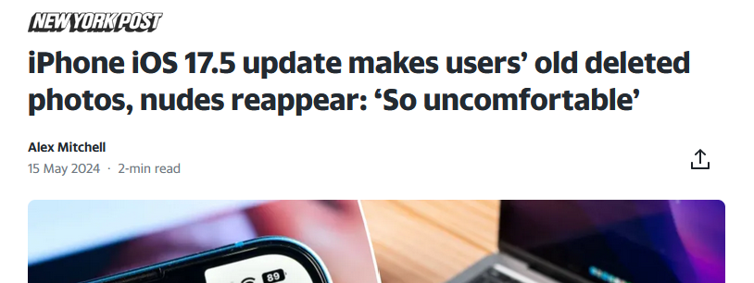
(Cloud) Backup for E2E Messaging
Cloud storage
Observations
Existing solutions use static backup key
Research focused on securing this key
HSM, secret sharing (PPSS), DPaSE, …
Each user maintains their own backup
not storage or bandwidth efficient
No PCS or FS
No efficient (selective) erasure of data
No advanced functionality such as delegation
New device
New group member / auditor
Note: Apple since has clarified that iCloud backups were not involved in the incident. (Also, iCloud backups are not E2EE by default.)
c =
meep meep
App
meep meep
Backup
s
C
$$K_{R}$$
meep meep
App
C =
meep meep
s
C
App
meep meep
s

Slide 6
Compact Key Storage
Other users don’t need to upload
Cloud storage
Application secret gets backed up
s
CKS
Application cyphertext gets backed up
$${st}_{D}$$
CKS
Compact state evolves with each message
$${st}_{R}$$
meep meep
App
C
s
meep meep
App
C =
meep meep
s
CKS
C
$${st}_{T}$$
App
meep meep
s

Slide 7
Cloud Backup
Trivial: encryption under static key
Content
compaction
State
Backup

Slide 8
Traditional literature on backup (HSM, PPSS, DPaSE,…)
Content
compaction
State
Backup

Slide 9
Compact Key Storage
Content
compaction
State
Backup

Slide 10
Compact Key Storage
Orthogonal!
Content
compaction
State
Backup

Slide 11
Compact Key Storage
Traditional backup
Works on plaintext messages
Each user maintains their own backup
Uses static backup key
No PCS or FS
No advanced functionality such as delegation
CKS
Works on application secrets
Shared among all users of a group chat
Uses dynamic secret state
PCS and FS
Efficient delegation
Orthogonal to existing work

Slide 12
Outline
Background and Motivation
Compact Key Storage
Schemes
Defining Security

Slide 13
$$st_{0}$$
$$st_{0}$$
$$ST_{0}$$
$$st_{0}$$
Example: Everyone in the group receives the same sequence of secrets ${(s}_{1},…, s_{n})$

Slide 14
$$st_{0}$$
$$st_{0}$$
new secret
$$ST_{0}$$
$$s_{1}$$
$$st_{0}$$
Example: Everyone in the group receives the same sequence of secrets ${(s}_{1},…, s_{n})$

Slide 15
$$st_{1}$$
$$st_{up}$$
Every party locally appends the secret to their state:
$U.Append\left(st_{i}, i, s_{i+1}\right)→(st_{i+1}, st_{up})$
$$st_{1}$$
$$st_{up}$$
$$ST_{0}$$
$$s_{1}$$
$$st_{1}$$
$$st_{up}$$

Slide 16
$$st_{1}$$
Every party locally appends the secret to their state:
$U.Append\left(st_{i}, i, s_{i+1}\right)→(st_{i+1}, st_{up})$
Afterwards, at least one party uploads to the server
$\left\langle U.Upload\left(st_{up}\right) ↔S.Upload\left(ST_{i}\right)\right\rangle →ST_{i+1}$
$$st_{1}$$
$$ST_{0}$$
$$st_{1}$$
$$st_{up}$$
Upload

Slide 17
$$st_{1}$$
Every party locally appends the secret to their state:
$U.Append\left(st_{i}, i, s_{i+1}\right)→(st_{i+1}, st_{up})$
Afterwards, at least one party uploads to the server
$\left\langle U.Upload\left(st_{up}\right) ↔S.Upload\left(ST_{i}\right)\right\rangle →ST_{i+1}$
$$st_{1}$$
$$ST_{1}$$
$$st_{1}$$

Slide 18
$$st_{2}$$
$$st_{up}$$
$$st_{1}$$
$$st_{1}$$
$$st_{up}$$
$$st_{2}$$
Upload
$$ST_{1}$$
$$ST_{2}$$
$$s_{2}$$
$$st_{2}$$
$$st_{up}$$
$$st_{1}$$

Slide 19
$$st_{n}$$
Grows linearly in n
$$st_{n}$$
$$ST_{n}$$
$$st_{n}$$
Grows sublinear in n

Slide 20
$$st_{n}$$
A user can retrieve a secret for epoch $e≤n$ with the help of the server:
$s_{e} ← \left\langle U.Retrieve\left(st_{n }, e\right) ↔S.Retrieve\left(ST_{n}\right)\right\rangle$
$$s_{e}$$
$$st_{n}$$
$$ST_{n}$$
Retrieve
$$st_{n}$$
recovers one of the secrets

Slide 21
$$st_{n}$$
Fine-grained delegation of epochs E:
$msg← \left\langle U.Grant\left(st_{n }, E\right) ↔S.Grant\left(ST_{n}\right)\right\rangle$
$st_{E}← \left\langle U.Accept\left(msg\right) ↔S.Accept\left(ST_{n}\right)\right\rangle$
$$st_{n}$$
$$ST_{n}$$
Grant
$$st_{n}$$
Accept
$$msg$$
delegates a subset of the secrets to
$$st_{E}$$

Slide 22
$$st_{n}$$
Fine-grained erasure of epochs E:
$st_{n−E}← \left\langle U.Erase\left(st_{n}, E\right) ↔S.Erase\left(ST_{n}\right)\right\rangle$
$$st_{n−E}$$
$$st_{n}$$
Erase
$$ST_{n}$$
$$st_{n}$$
erases some secrets
$$st_{E}$$

Slide 23
CKS Properties
Correctness
An honest user interacting with an honest server must always recover the correct secrets
Must hold even if other users are malicious
Integrity
An honest server interacting with a malicious server
Recovers the correct secret
Or produces an error
Denial-of-service attacks always possible
Security
Intuitively: CKS must not harm confidentiality of secrets, even if server malicious
Tricky to formalize! → See end of the talk

Slide 24
Outline
Background and Motivation
Compact Key Storage
Schemes
Defining Security

Slide 25
CKS Schemes
This talk
 | All-or-nothing scheme | Interval scheme
Setting | Users know all keys | Users know subset of keys
Delegation | Prefixes | Intervals
Erasure | None | Intervals (local state grows)
State size | Constant | Logarithmic
Key retrieval | Linear time | Logarithmic time

Slide 26
All-or-nothing Scheme
Assume all users insert the same secrets: $s_{1},s_{2},s_{3},…$
$$s_{1}$$
$$s_{2}$$
$$s_{3}$$
Derive
Derive
Derive
$$(K_{0}, T_{0})$$
$$(K_{1}, T_{1})$$
$$(K_{2}, T_{2})$$
$$(K_{3}, T_{3})$$
$$(C_{1}, T_{0})$$
$$(C_{2}, T_{1})$$
$$(C_{3}, T_{2})$$
State after inserting secrets $(s_{1},…, s_{i})$
$st_{i} ≐(i, K_{i}, T_{i})$
$K_{i}$ = symmetric encryption key
$T_{i}$ = authentication tag

Slide 27
All-or-nothing Scheme
$$s_{1}$$
$$s_{2}$$
$$s_{3}$$
Derive
Derive
Derive
$$(K_{0}, T_{0})$$
$$(K_{1}, T_{1})$$
$$(K_{2}, T_{2})$$
$$(K_{3}, T_{3})$$
Initial (public) state
$$(C_{1}, T_{0})$$
$$(C_{2}, T_{1})$$
$$(C_{3}, T_{2})$$
Sent to the server (in U.Upload)
Server computes $T_{2}$itself
Stores mapping $\left(2,T_{2}\right)→(C_{2},T_{1})$

Slide 28
All-or-nothing Scheme
$H$: hash function modeled as Random Oracle
SE.ENC: deterministic one-time-CPA secure symmetric encryption scheme
$$s_{1}$$
Derive
$$s_{2}$$
Derive
$K_{2}=H\left(K_{1}\right|s_{2})$
$C_{2}=SE.Enc(K_{2}, \left(K_{1},s_{2}\right))$
$T_{2}=H\left(C_{2}\right|T_{1})$
$$s_{3}$$
Derive
Note:
This is essentially Convergent Encryption (CE)
However, abstraction of CE as Message Locked Encryption (MLE) not applicable for our use-case
$$(K_{0}, T_{0})$$
$$(K_{1}, T_{1})$$
$$(K_{2}, T_{2})$$
$$(K_{3}, T_{3})$$
$$(C_{1}, T_{0})$$
$$(C_{2}, T_{1})$$
$$(C_{3}, T_{2})$$

Slide 29
All-or-nothing Scheme
$$s_{1}$$
$$s_{2}$$
$$s_{3}$$
Derive
Derive
Derive
Checks validity of $\left(C_{2},T_{1}\right)$ w.r.t $T_{2}$
Decrypts $C_{2}$ to obtain $(s_{2}, K_{1})$
$$(K_{0}, T_{0})$$
$$(K_{1}, T_{1})$$
$$(K_{2}, T_{2})$$
$$(K_{3}, T_{3})$$
$$(C_{1}, T_{0})$$
$$(C_{2}, T_{1})$$
$$(C_{3}, T_{2})$$
$$(K_{0}, T_{0})$$
Invert
$$(K_{1}, T_{1})$$
Invert
$$(K_{2}, T_{2})$$
Invert
$$(K_{3}, T_{3})$$
$$s_{1}$$
$$s_{2}$$
$$s_{2}$$

Slide 30
Outline
Background and Motivation
Compact Key Storage
Schemes
Defining Security

Slide 31
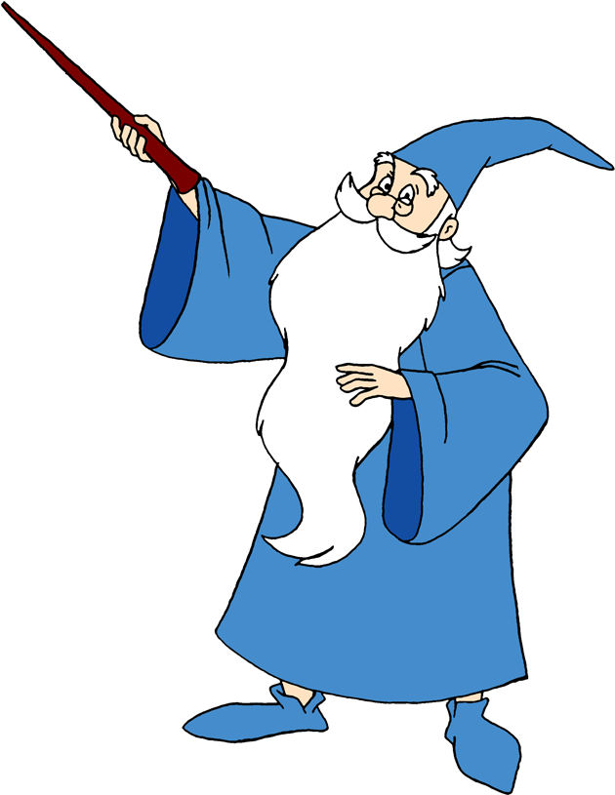
CKS Security
Runs CKS using $(s_{1}^{b},…, s_{n}^{b})$
→ ${st}_{U}^{′}$
Retrieves secrets $(s_{1}^{′}, …, s_{n}^{′})$ using own user state ${st}_{U}^{′}$ and received server state ${St}_{S}$
Outputs $b^{′}=0$ iff $s_{i}^{′}=s_{i}^{b}$ for all i
Sample bit b
Samples secrets $(s_{1}^{0},…, s_{n}^{0})$ and $(s_{1}^{1},…, s_{n}^{1})$
Runs CKS using $(s_{1}^{0},…, s_{n}^{0})$:
$\left(st_{U}, st_{up}\right)←U.Append\left(st_{U}, s_{i}^{0}\right)$
$\left\langle U.Upload(st_{up}) ↔S.Upload({St}_{S})\right\rangle →St_{S}$
Intuitive goal: Secrets must remain pseudorandom given the server state & the ciphertexts
→ Impossible!
$$b′$$
$$\left(s_{1}^{b}, …, s_{n}^{b}\right)$$
$${St}_{S}$$
If $b=0$, then $s_{i}^{′}=s_{i}^{b}$ by correctness
If $b=1$, then ${St}_{S}$ independent of $\left(s_{1}^{b}, …, s_{n}^{b}\right)$
If $\left|st_{U}^{′}\right|≪\left|s_{1}^{b}\right|+ ⋯ + \left|s_{n}^{b}\right|$ then check fails w.o.p.

Slide 32
CKS Security
Alternatives for defining security?
Unpredictability of secrets?
→ Insufficient for many (legacy) applications
Directly prove security of CKS-enhanced applications (e.g. Signal)
→ Tedious
Weaker CKS functionality?
→ (follow up work)
What is the most general security we can obtain?

Slide 33
CKS Security: Preservation Security
Achievable in ROM / idealized model
Impossible in standard model
need to exclude “contrived” applications that depend on CKS scheme
“CKS-compatible” application
Must have sequence of secrets/keys…
Security must withstand testing of guesses for secrets
no issue for IND-CPA encryption, signatures, Signal, …
issue for One-time Pad
Preservation security: Any CKS-compatible application must remain secure when the CKS scheme is applied
Note:
Signal / MLS / Zoom are not contrived apps
Impossibility in standard model does not mean that insecure for specific apps.

Slide 34
CKS Security: Preservation Security
Could be useful beyond CKS! e.g. deterministic PKE, UCE, …
“CKS-compatible” application
Must have sequence of secrets/keys…
Security must withstand testing of guesses for secrets
no issue for IND-CPA encryption, signatures, Signal, …
issue for One-time Pad
Preservation security: Any CKS-compatible application must remain secure when the CKS scheme is applied

Slide 35
Images: clipartmax.com

