Slide 1
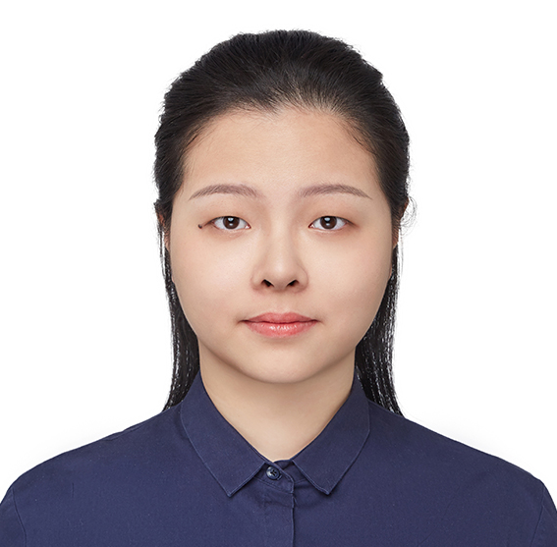
Memory-Sample Lower Bounds for LWE
Mingqi Lu¹
Junzhao Yang²
Tsinghua University
CRYPTO 2024
August, 2024

Slide 2
Learning in a Stream
Setup. Secret $x∼X$, Sample $a∼A$
Learning task described by Learning Matrix $M:A×X→Y$
Given a stream
$$\left(a_{1}, M\left(a_{1},x\right)\right)$$
$$\left(a_{2}, M\left(a_{2},x\right)\right)$$
$$⋮$$
$$(a_{T}, M\left(a_{T},x\right))$$
Learner reads in one pass with limited memory and outputs $x$ w.p. $0.99$
Example. (Learning Parity)
Secret and samples are n-bit vectors $X=A=ℤ_{2}^{n}$
Given inner products $M\left(a,x\right)=\left\langle a,x\right\rangle mod 2$

Slide 3
Memory-Sample Trade-off
Upper bounds for Learning Parity
Memorizing samples: $O(n^{2})$ memory and $O(n)$ samples
Enumerating secret: $O(n)$ memory and $2^{O(n)}$ samples
Raz first proved an information-theoretic lower bound
[Raz’ 18] Learners with $≤n^{2}/25$ memory cannot learn $x$ from $2^{O(n)}$ samples with non-negligible success probability
No intermediate algorithms!

Slide 4
Motivation
Can we get a similar information-theoretic lower bound for LWE?
n
x
+
e
n
T
A

Slide 5
Learning with Error (LWE)
n
x
+
e
n
T
A
Setup. Secret $x∼ℤ_{q}^{n}$, Sample $a∼ℤ_{q}^{n}$, Error$e∼𝒟$
Learning Matrix $M\left(a,x\right)=\left\langle a,x\right\rangle mod q$
Error Distribution $𝒟$ (Discrete Gaussians / Bounded uniform)
Given a stream
$$\left(a_{1}, M\left(a_{1},x\right)+e_{1}\right)$$
$$\left(a_{2} M\left(a_{2},x\right)+e_{2}\right)$$
$$⋮$$
$$(a_{T}, M\left(a_{T},x\right)+e_{T})$$
Learner reads in one pass with limited memory and outputs $x$ w.p. $0.99$

Slide 6
Our Results
For LWE with modulus $q$ and error distribution $𝒟_{ℤ,σ}$,
Any learner either uses $Ω\left(\frac{k^{2}}{log⁡(q/σ)}\right)$ memory or $2^{Ω(k)}$ samples, where $k=n\log{(\frac{q}{q−φ\left(q\right)})}$
In some regimes (e.g. $q$ is product of large primes$),$lower bound is tight
$Ω\left(n^{2}\frac{\log^{2}{q}}{log⁡(q/σ)}\right)$ matches with information-theoretic upper bound
In other cases, lower bound is almost tight (ignoring log factors)
Remark. Lower Bounds are unconditional and generalize to
Learning with Rounding (LWR)

Slide 7
Technical Overview
Build on the “extractor framework” proof of [Garg-Raz-Tal’ 18]
If the learning matrix has some “extractor property”, then implies LB
Generalize from $ℤ_{2}$to $ℤ_{q}$
Our new characterization “q-balanced” learning matrix
Adapt the extractor-based proof to q-balanced
Show LWE is q-balanced using reductions to almost orthogonality
Adapt analysis of error to $q$ labels
This is similar to [Garg-Kothari-Liu-Raz’ 21] (Learning Parity with Noise)

Slide 8
From $ℤ_{2}$to $ℤ_{q}$
Recall $a,x∈ℤ_{q}^{n},$
$$M\left(a,x\right)=\left\langle a,x\right\rangle mod q$$
First attempt: Write learning matrix by bits
Given$log q$ bits of labels $M^{(1)}\left(a,x\right),M^{(2)}\left(a,x\right)…$
Apply LB to $log q$ learning matrices?
Failed! Samples are NOT independent
$ℤ_{2}$ lower bounds cannot trivially imply $ℤ_{q}$

Slide 9
The Extractor Property
[GRT’ 18] $M :A×X→\{1,−1\}$ is $\left(k, l,r\right) L_{2}$-extractor if for every $f :X→ℝ_{+}$ with ${\left\|f\right\|}_{2}/{\left\|f\right\|}_{1}≤2^{l}$ , we have at most $2^{−k}$ fraction of rows $a$ that
$$\frac{|⟨M(a),f⟩|}{‖{\left.f\right\|}_{1}}>2^{−r}$$
Intuition. When secret $x∼\frac{f}{‖{\left.f\right\|}_{1}}$, we have $M(a,x)$ is balanced for most $a$

Slide 10
Our Characterization: q-balanced
[This work] $M :A×X→[q]$ is q-balanced with parameter $\left(k, l,r\right)$if for every $f :X→ℝ_{+}$ with ${\left\|f\right\|}_{2}/{\left\|f\right\|}_{1}≤2^{l}$ , we have at most $2^{−k}$ fraction of rows $a$ that
where $M_{a}^{=i}\left(x\right)=1$ iff $M\left(a,x\right)=i$
Intuition. When secret $x∼\frac{f}{‖{\left.f\right\|}_{1}}$, we have $M(a,x)$ is balanced for most $a$
$$\operatorname{Pr}\left[M\left(a,x\right)=i\right]≈1/q$$

Slide 11
From $ℤ_{2}$to $ℤ_{q}$: Our Idea
Recall $a,x∈ℤ_{q}^{n},$
$$M\left(a,x\right)=\left\langle a,x\right\rangle mod q$$
Our idea: Generalize to q-balanced
Two Directions:
1. Adapt the extractor-based proof to q-balanced
The most tedious and technical part
2. Show LWE is q-balanced

Slide 12
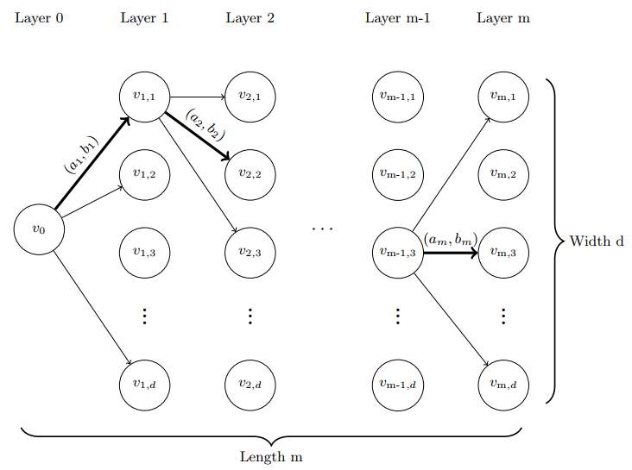
Direction #1: Computation Model
Unbounded computational power & Limited memory!
(Read-Once) Branching Program.
A DAG with $T+1$ layers with each layer containing $w$ vertices. Taking input $\left(a_{1},b_{1}\right),⋯,\left(a_{T},b_{T}\right)$, computational path
Starts from $v_{0}$ in layer $0$,
Moves along edge $(a_{i}, b_{i})$ from layer $i−1$ to layer $i,$
Arrive at some $v_{T}$in layer $T$ and outputs $x(v_{T})$.

Slide 13
Direction #1: Proof Sketch
Posterior distribution: $ℙ_{x|v}\left(x^{′}\right)= Pr\left[x=x^{′} \right| reach v]$
Low success probability when reaching a vertex $v$ with spread posterior
For fixed target $t$ with concentrated posterior, bound the probability of reaching $t$ by $2^{−Ω(n^{2})}$
Progress Measure towards $t$. Define similarity $⟨ℙ_{x|t},ℙ_{x|v}⟩$, by q-balanced
For most sample $a$, similarity does not increase
For negligible many $a$, similarity blows up by at most $q$. This must happen $Ω(n)$ times to reach $t$

Slide 14
Direction #2: LWE is q-balanced
The Reduction.
$M^{′\left(a,i,x\right)}=\left\{\begin{aligned}q−1 M\left(a,x\right)=i \\ −1 M\left(a,x\right)≠i\end{aligned}\right.$
1. Rows of $M′$are almost orthogonal
2. Almost orthogonal implies q-balanced

Slide 15
Discussions on the Noisy Case
Error analysis naturally generalize to q-balanced matrix using similar ideas of [GKLR’ 21]
But this does NOT give tight lower bounds for LPN (Learning Parity with Noise)
The Reason. Error of LPN is “noisier” than LWE
LB depends on$log (q⋅\max_{i∈[q]}{𝒟(i))}$
UB depends on $log q −H(𝒟)$ (bits of info per sample)
Only match in the error regime of LWE

Slide 16
Thanks for listening!
Questions are welcomed.

