Slide 1
Compressing Unit-Vector Correlations via Sparse Pseudorandom Generators
Amit Agarwal, Elette Boyle, Niv Gilboa, Yuval Ishai, Mahimna Kelkar, Yiping Ma

Slide 2
Motivation: Offline-Online secure computation (aka “Preprocessing” model)
$$f$$
Correlated Randomness
Examples : Beaver Triples, Random OT
Offline Phase
$$r_{A}$$
$$r_{B}$$
$$x$$
$$r_{A}$$
$$y$$
$$r_{B}$$
Online Phase
Online communication and round decreases
$$f(x, y)$$
$$f(x, y)$$
Notes:
Let me first start with the motivation. A popular paradigm in MPC is so called offline-online model (or the preprocessing model). Let’s say Alice and Bob wish to securely compute a function f on their private inputs x and y. The protocol will be divided into two phases – offline phase and online phase. In the offline phase, the inputs are unknown and parties interact using random inputs to generate some form of correlated randomness. In the online phase, when the parties receive their private inputs, they can consume the correlated randomness to securely compute the desired function.

Slide 3
What is a (additive) correlation ?
Example
Uniform distribution over all triples $\left(a, b, c=a⋅b\right)$
We have a public distribution $D$
Sample $r ←D$
Additively secret-share $r$ among parties.
Correlated Randomness (w.r.t. distribution $D$)
$$r←D$$
$$r_{A}$$
$$r_{B}$$
$$r_{A}+r_{B}=r$$
Notes:
Now let me define the notion of correlated randomness a bit more formally. It is defined w.r.t. some fixed public distribution D. We sample an element r from the distribution D and additively secret share it among the parties.
As an example, if the distribution D is the uniform distribution over triples (a, b, c) where c = a. b, then the resulting correlation is what we know as “Beaver Triple”

Slide 4
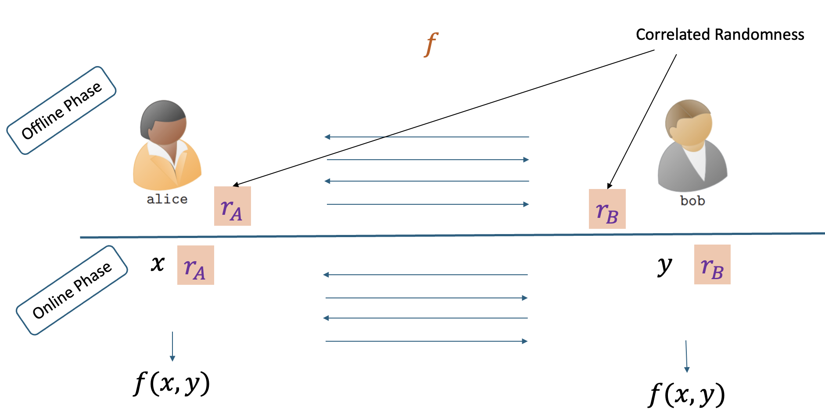
Challenge in offline-online MPC
How to efficiently generate and store many independent instances of correlated randomness ?

Slide 5
Pseudorandom Correlation Generator (PCG) [BCGI18, BCGKIS19]
Correctness: $\left(r_{A}, r_{B}\right)≈Share{\left(r\right)}_{r←D^{n}}$
Security: $\left(s_{A}, r_{B}\right)≈{\left(s_{A},r −r_{A}\right)}_{r←D^{n}}$
PCG.Gen
Short Correlated seeds
$$s_{A}$$
$$s_{B}$$
Communication Efficiency
Sublinear in the length of output correlated randomness
PCG.Expand
PCG.Expand
$$r_{A}$$
$$r_{B}$$
Long Correlated (Pseudo)Randomness
$$n$$
$$n$$
Notes:
An interesting line of works on so-called “Pseudorandom Correlation Generators” (PCG) was initiated in this 2018 paper by Boyle et. Al. and made efficient in the followup work in 2019 where it was shown that so-called Vector OLE, OT and related correlations can be generated very efficiently using the LPN assumption. Now let’s see what this object PCG really is.
Think of a PCG as a *distributed* form of a PRG. Here, we will have two or more parties, each holding short *correlated* seeds which they can expand into long *correlated* (pseudo)randomness, where the correlation is defined w.r.t a fixed public distribution (e.g. triple distribution etc)
The major benefit of such an object is
Communication efficiency: The expansion procedure requires communication which is sublinear in the length of output correlated randomness, and, in some cases, even completely silent.
Let’s say that the length of our PCG output is n.
Correctness says that the joint distribution of the expanded PCG output of both parties is indistinguishable from an additive sharing of a sample from n copies of the distribution D which defines our correlation
Let’s say Alice is corrupt and Bob is honest. Security says that joint distribution of the seed of the corrupted party and the expanded output of the honest party is indistinguishable from the joint distribution of the seed of corrupt party and a reverse sampled output of the honest party.
Outside of scope of current work: How to generate the short correlated seeds efficiently in a distributed way.

Slide 6
Limitations of existing works
Efficient PCGs are limited to simple correlations.
Multiplication triples
Random Oblivious Transfer (ROT)
Oblivious Linear Evaluation (OLE)
Extension to richer correlations is possible but practically inefficient.
We provide a practical PCG for a useful correlation called “Unit Vector correlation”.

Slide 7
Unit Vector (UV) Correlation
Applications
Secure Lookup table evaluations
Online optimal PIR
Middle ground between FHE and OT based generic MPC
$D :$ Uniform distribution over all unit vectors of a fixed length
FHE
Computation
UV
OT
$$r_{A}$$
+
$$r_{B}$$
=
$$r$$
Communication
where $r$ is a random unit vector (with elements in some ring R) where the non-zero location is secret
Question: How to efficiently generate and compactly store many independent instances of such correlations ?
Notes:
Earlier in my slides I mentioned that a correlation w.r.t. a distribution D is simply an additive sharing of a sample r from the distribution. If we set the distribution D to be a uniform distribution over all unit vectors of a fixed length, then the induced correlation is called Unit vector correlation. In other words, parties will hold shares of a unit vector where the non-zero location is random and hidden to each party.
FHE-based protocol (optimal communication but heavy computation) and OT-based protocols (lightweight computation but linear communication). UV correlations allow slightly sublinear communication at a moderate computational cost, which may often strike the right balance in practice.
Can we design a PCG for UV correlations ?

Slide 8
PRG + HSS framework for designing PCG [BCG+17], [BCG+19]
PRG
HSS
PRG + HSS $→$ PCG
PCG.Gen
$$s$$
$$x$$
$$s$$
$$HSS.Share$$
PRG.Expand
$$HSS.Share$$
$$s_{A}$$
$$s_{B}$$
$$r$$
$$x_{A}$$
$$x_{B}$$
$$HSS.{Eval}_{f}$$
$$HSS.{Eval}_{f}$$
$$HSS.{Eval}_{f}$$
$$f$$
$$HSS.{Eval}_{f}$$
$$y_{A}$$
$$y_{B}$$
$$r_{A}$$
$$r_{B}$$
$$y_{A}+y_{B}=f\left(x\right)$$
Notes:
Given a short uniform seed s, PRG lets you expand it into a long pseudorandom string r
HSS is a sort of “distributed” form of FHE. It allows you to share an input x across two or more parties. Then parties can homomorphically evaluate a function f on their input shares to derive output shares s.t. the output shares add up to f(x)
Given these two primitives, PRG and HSS, designing a PCG for a distribution D is straightforward. We simply use the HSS Share procedure to secret share the PRG seed to the parties. Then parties can run the HSS Eval procedure w.r.t. a function f where we set f to be PRG Expansion function composed with another function that maps a uniform distribution to the required distribution D. Homomorphically evaluating this function using HSS would lead to additive correlation w.r.t. distribution D

Slide 9
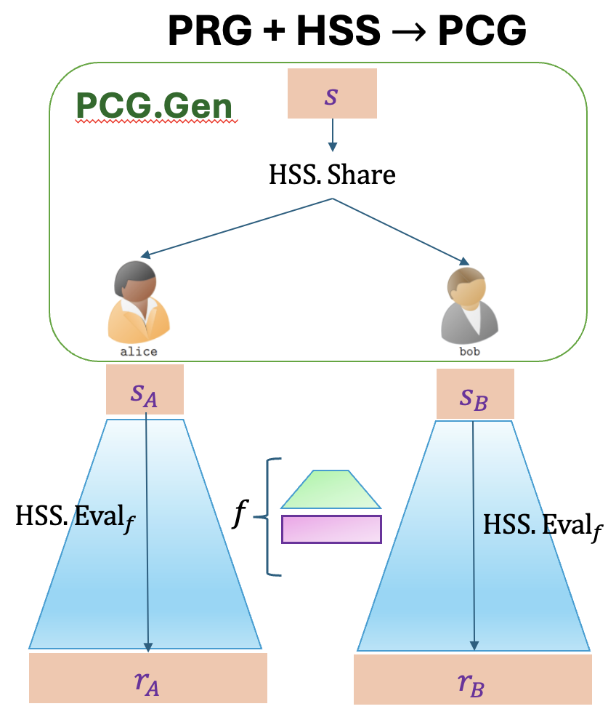
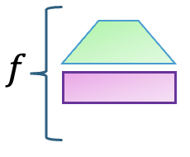
Challenge
Downside : Evaluating inside HSS is quite costly!
Reason : is a high-degree computation
Our solution : Design a low-degree equivalent of
Sparse PRG
Notes:
What’s the issue in directly using this framework to get a PCG for UV correlation ? High (computational) cost due to the need to compute a high-degree function mapping uniform output of a PRG to a non-uniform distribution

Slide 10
Difference between Standard PRG and Sparse PRG
Arbitrary seed distribution
Sparse
Pseudorandom Generator (Sparse PRG)
Pseudorandom Generator (PRG)
Seed/Input
1 | 0 | 0 | 1 | 0 | 1 | 1 | 0
0 | 1 | 0 | 0 | 1 | 0 | 0 | 0 | 0 | 0 | 1 | 0 | 0 | 0 | 1 | 0 | 0 | 0 | 0 | 1
Uniform distribution
Output
Sparse distribution
Notes:
Difference: Output distribution. Input distribution. Explain why arbitrary seed distribution is necessary for our goals.
Security of sparse PRG is defined w.r.t. ideal sparse distribution with the same sparsity parameter.
Regular Sparse PRG: Every consecutive block of B output bits should contain a single non-zero value at a (pseudo) random location.
Looking ahead, we would execute such a Sparse PRG inside HSS to get a PCG for unit vector correlation. For this to be efficient, we need to construct a low degree Sparse PRG where degree is defined by interpreting each output bit as a multivariate polynomial over the input bits and taking the max total degree across all output bits.

Slide 11
How to construct Sparse PRG ?
Map the uniform output bits of a standard PRG to a non-uniform sparse distribution ?
Caveat : Increases the degree of the PRG.
Supply a standard PRG with non-uniform seed bits (instead of uniform seed bits) ?
Caveat : Security (Pseudorandomness) doesn’t seem to hold.
Our approach : Leverage non-binary local PRGs.

Slide 12
Constructing Sparse PRG
Sparse
Pseudorandom Generator (Sparse PRG)
Non-Binary
Pseudorandom Generator (PRG)
4 | 2 | 3
4 | 2 | 3
Encode the output symbols in sparse format
2 | 1 | 3 | 3 | 4
0 | 1 | 0 | 0 | 1 | 0 | 0 | 0 | 0 | 0 | 1 | 0 | 0 | 0 | 1 | 0 | 0 | 0 | 0 | 1
Inputs and Outputs are symbols from some alphabet $Σ$ (instead of bits)
Correctness:
Security (Pseudorandomness) :
Low Degree:
$$Σ=\{1, 2, 3, 4\}$$
Notes:
By simply encoding the output symbols of such a non-binary PRG in a sparse format, we get correctness and security automatically. The sparse encoding used here is specifically the unit-vector encoding (or what some people call as one-hot encoding). Each vector is of length equal to the alphabet size. The non-zero location in the vector corresponds to the symbol number. For example, the symbol 2 gets mapped to 0100, the symbol 4 gets mapped to 0001 and so on.
So we get correctness and security but it is not clear what the degree is. In fact, the degree in general can be as high as the seed length. To get low degree, we will require an additional property from the underlying non-binary PRG called small locality.

Slide 13
Constructing Low Degree Sparse PRG
Non-Binary
Local
Pseudorandom Generator (PRG)
Low degree Sparse
Pseudorandom Generator (Sparse PRG)
4 | 2 | 3
0 | 0 | 0 | 1 | 0 | 1 | 0 | 0 | 0 | 0 | 1 | 0
Encode the output and input symbols in sparse format
2 | 1 | 3 | 3 | 4
0 | 1 | 0 | 0 | 1 | 0 | 0 | 0 | 0 | 0 | 1 | 0 | 0 | 0 | 1 | 0 | 0 | 0 | 0 | 1
Inputs and Outputs are symbols from some alphabet $Σ$ (instead of bits)
Correctness:
Security (Pseudorandomness) :
Low Degree:
$$Σ=\{1, 2, 3, 4\}$$
Notes:
In a PRG with small locality, each output symbol depends only on small subset of input symbols. In this picture, the output symbol depends only on 2 input symbols.
So now here is the idea: Given such PRGs with low locality, if we additionally encode the *input* symbols in a sparse unit vector format, then the resulting Sparse PRG will have small degree. In fact, the locality of the PRG on the left will translate into the degree of Sparse PRG on the right. In this picture, we will get a degree 2 Sparse PRG.

Slide 14
Constructing Low Degree Sparse PRG
Non-Binary
Local
Pseudorandom Generator (PRG)
Low degree Sparse
Pseudorandom Generator (Sparse PRG)
 | $$x$$ | $$y$$
 |  |  |  | $$x_{1}$$ | $$x_{2}$$ | $$x_{3}$$ | $$x_{4}$$ | $$y_{1}$$ | $$y_{2}$$ | $$y_{3}$$ | $$y_{4}$$
Encode the output and input symbols in sparse format
 |  | $$z$$
 |  |  |  |  |  |  |  | $$z_{1}$$ | $$z_{2}$$ | $$z_{3}$$ | $$z_{4}$$
$$z=f(x, y)$$
$$f\left(x, y\right)≡\left(x\overset{?}{=}1\right)\left(y\overset{?}{=}1\right)f\left(1, 1\right)+\left(x\overset{?}{=}1\right)\left(y\overset{?}{=}2\right)f\left(1, 2\right)+…+\left(x\overset{?}{=}4\right)\left(y\overset{?}{=}4\right)f\left(4, 4\right)$$
$$=x_{1}⋅y_{1}⋅f\left(1, 1\right)+x_{1}⋅y_{2}⋅f\left(1, 2\right)+…+x_{4}⋅y_{4}⋅f(4, 4)$$
Notes:
Suppose z is an output variable which is computed by applying a local function f to the input variables x and y.
In the sparse PRG world, we have encodings of these variables in the sparse unit-vector format.
f applied to x, y is equivalent to this expression on the right which says that if x is 1, y is 1, we output f(1, 1) or if x = 1, y = 2, we output f(1, 2) and so on…
While the equality checks are high-degree computations in the standard domain, they become low degree computations in the sparse domain. Specifically, we can rewrite f(x, y) as x1 times y1 times f(1, 1) + x2 times y2 times f(1, 2) and so on…
The degree of this expression is 2 which is equal to the locality of the PRG on the left.

Slide 15
Summary
$d$ local PRG over alphabet $Σ$
Sparse encoding of input and output symbols
Information theoretic HSS with $dt +1$ parties and $t$ corruptions [BGW88]
$d$ degree Sparse PRG with sparsity $Σ$
HSS for computing degree $d$ polynomials
Computational HSS with 2 parties and 1 corruption
DCR [OSY21, RS21]
QR [BL, DGM]
group/pairing based [BGI16,BCGIKS19]
lattice-based [DHRW16,BKS19]
PCG for unit-vector correlations

Slide 16
Further optimizations
Compressing PCG seed size using multiplicative DPF
The output shares of the DPF form a CNF/RSS sharing hence can be multiplied (upto a certain limit)
Improvement over the prior 3 party 1 secure mult DPF [BKO22]
Helps reducing the PCG seed size from $O\left(k B\right)$ to $O(λ k\log{B)}$
Other applications: Search a document that contains all $d$ keywords using $d+1$ non-colluding servers (previous constructions required $2^{d}$ non-colluding servers)
Support for HSS with multiplicative reconstruction
Most HSS schemes with additive reconstruction require solving DDLOG for every multiplication – forms a computation bottleneck
We show that a variant of UV correlation (Weight-1 correlation) can be generated using HSS with just multiplicative reconstruction.
Enables us to use [BGI16] DDH/Elgamal based HSS and [BCG+19] Subgroup Decision/BGN based HSS
This variant of UV correlation can be converted into standard UV correlation with low communication.

Slide 17
Other contributions
$$x_{i}∈Z_{2B}$$
Candidates for non-binary local PRG
$d$ local binary PRG $→$ $d$ local non-binary PRG
E.g. 5 local Goldreich style binary PRG with TSA predicate
3 local non-binary PRG
“Sparse LWR” : FFT friendly candidate (inspired from Sparse LPN and standard LWR)
BBKK17 : Candidate based on non-abelian groups
2 local non-binary PRG
Difference from indistinguishability obfuscation (iO) use-case [LT17]
iO requires large input alphabet whereas we require large output alphabet.
Barriers on the parameters of 2-local non-binary PRG [BBKK17, LV17]
Rules out some iO constructions but not PCG applications
$$x_{1}$$
$$x_{2}$$
$$x_{3}$$
$$y$$
$$y ∈Z_{B}$$
$$π_{1}\left(x_{1}\right)$$
$$+$$
$$π_{2}\left(x_{2}\right)$$
$$+$$
$$π_{3}\left(x_{3}\right)$$
$$\left\lfloor \frac{. }{2}\right\rfloor$$

Slide 18
Other contributions
Support for variants of Unit-Vector correlation
Authenticated Unit vector : $(u, Δ⋅u)$
(Authenticated) Lookup table correlation: A randomly shifted truth-table along with the shift amount.
Tensor correlation

Slide 19
Cost estimates
4 party 1 corruption (generalizes to $3t+1$ parties $t$ corruption)
Length 16 Unit Vectors
Throughput : ${10}^{5}$ UV per second
Seed size: 300 KB
Compression Ratio: 79
2 party 1 corruption (using DCR based HSS with CRT packing)
Length 8 Unit Vectors
Throughput : 1 UV per second
Seed size: 102 MB
Compression Ratio: 22
Notes:
2.6 GHz Machine
We provide concrete cost estimates in the paper for different instantiations of our PCG

Slide 20
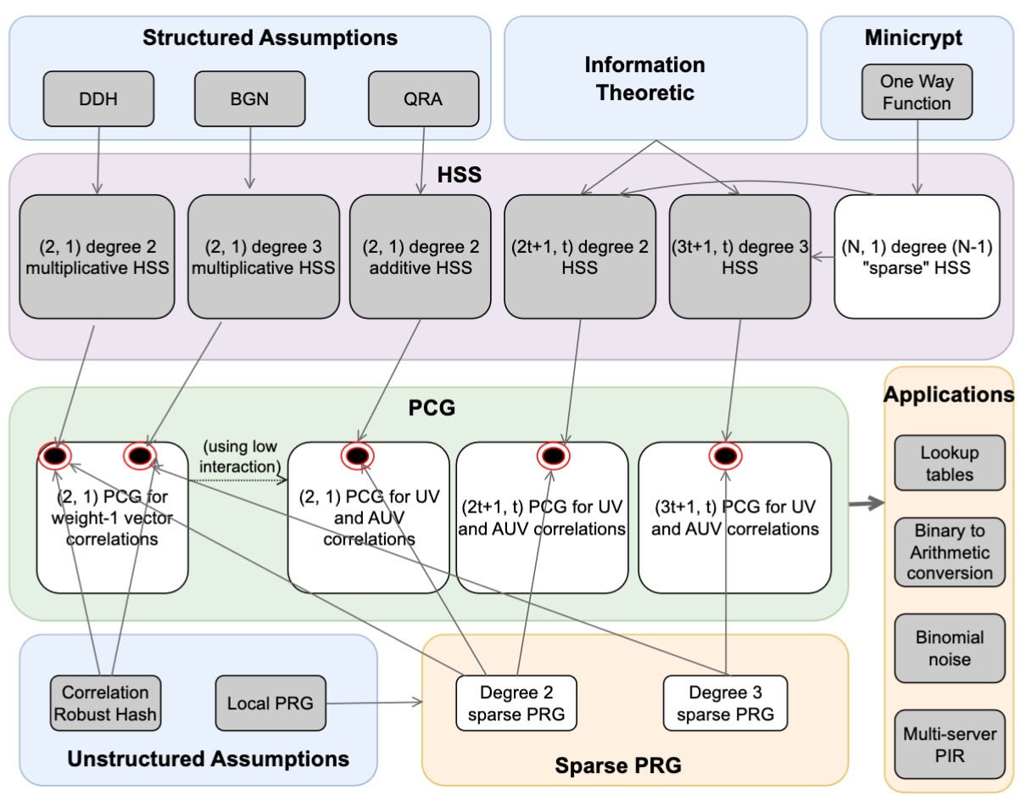
Thanks

Slide 21
Analogy to electricity consumption
Offline Phase
Batch
Optimization
$$r_{A}$$
$$r_{B}$$
Batch
Optimization
$$x$$
$$f$$
$$y$$
Online Phase
Online communication and round decreases
Online efficiency
$$f(x, y)$$
$$f(x, y)$$

Slide 22
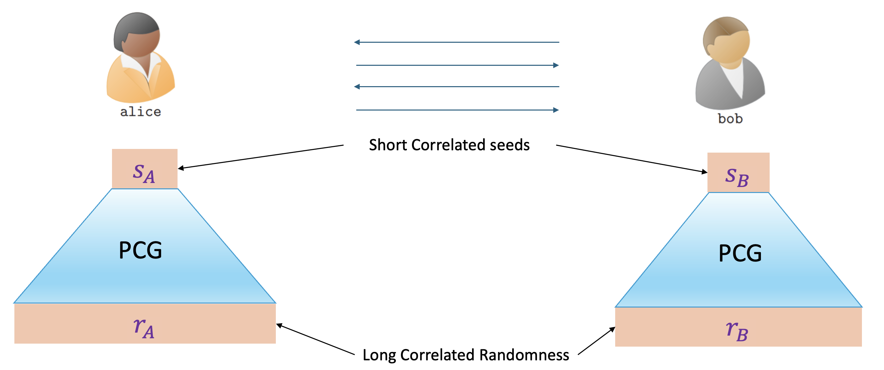
Analogy to electricity
Offline Phase
Online Phase
Notes:
Think of the short seeds as a battery/capacitor. They hold a lot of potential energy/ correlated pseudorandomness.
Dual benefit: Efficient expansion and compressed storage

Slide 23
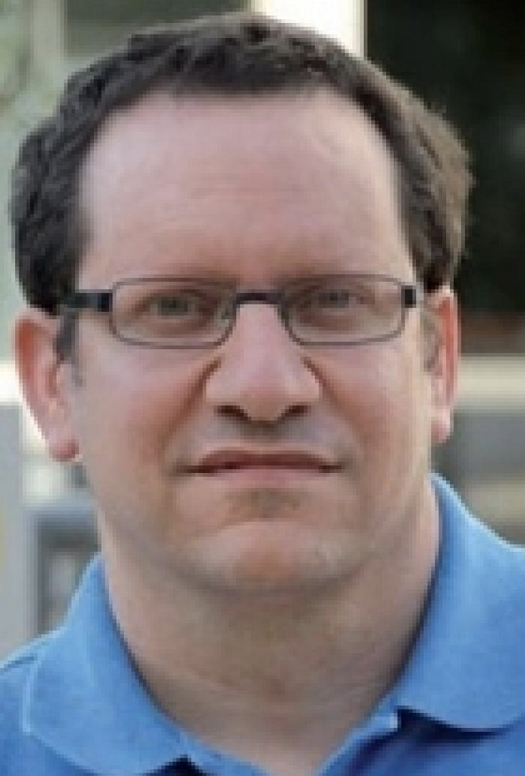
Prior Works: Pseudorandom Correlation Generators (PCG)
Many more recent works and optimizations
2018
2019

Slide 24
Outline
PCG
Intuition
Definition and security properties
Brief history, different types of correlations
UV correlations, applications
Constructing PCG for UV correlations
PRG + HSS framework
What it is ?
Issues
Sparse PRG
Definition
Construction
Compiling to PCG using HSS

Slide 25
Timing
PCG defn and motivation: 3 mins
UV correlation (AUV, Wt1) and motivation: 3 mins
General PRG + HSS framework : 2 mins
Sparse PRG : 5 mins
Local PRG candidates : 5 mins
HSS candidates : 3 mins
Mult DPF : 4 mins

Slide 26
(N, 1) multiplicative DPF
(N, 1) CNF sharing of the output – Enables (N – 1) multiplications on the output domain
Technique: Extension of the classical (2, 1) to > 2 parties

Slide 27
PRG + HSS framework for designing PCG
$$x_{1}$$
$$HSS.Eval(f, x_{1})$$
$$y_{1}$$
$$x$$
$$HSS.Share$$
$$y=f\left(x\right)$$
$$x_{2}$$
$$HSS.Eval(f, x_{2})$$
$$y_{2}$$
Notes:
Explain the framework. (Probably requires defining HSS first)
Out

Slide 28
How low can we go ?
Low Locality non-binary PRG candidates
Locality 2 ?
Locality 3 ?
Impossibility results on superlinear stretch for binary local PRG upto locality 4
Landscape for non-binary local PRG
Impossibility results only hold for a much lower locality : Barak et. Al, Lombardi et. Al.
3 local candidate in Barak et. Al.
We propose a new 2 local and 3 local candidate
2 local candidate: Motivated towards enabling degree 2 HSS during compilation
3 local candidate: Motivated towards concrete efficiency

Slide 29
Pseudorandom Correlation Generator (PCG)
PCG.Gen
$$s_{A}$$
$$s_{B}$$
PCG.Expand
PCG.Expand
$$r_{A}$$
$$r_{B}$$
Notes:
Think of a PCG as a *distributed* form of a PRG. Here, we will have two or more parties, each holding short *correlated* seeds which they can expand into long *correlated* (pseudo)randomness, where the correlation is defined w.r.t a fixed public distribution (e.g. triple distribution, unit vector distribution etc)
The major benefit of such an object is
Computational efficiency: Compared to generating the long correlated pseudorandomness from scratch using generic MPC techniques, the PCG expansion procedure requires only “light-weight” crypto
Communication efficiency: The expansion procedure requires communication which is sublinear in the length of output correlated randomness, and, in some cases, even completely silent.
Outside of scope of current work: How to generate the short correlated seeds efficiently in a distributed way.

Slide 31
