Slide 1
Privacy-Preserving Dijkstra
Ben Ostrovsky
Santa Monica
High School
Caltech

Slide 2
Our setting
Constant number of servers (could be 2)
Honest-but-curious
All inputs and outputs are secret-shared

Slide 3
Our setting (cont.)
Servers can execute “atomic” secure operations: add, multiply, compare, etc.
We count # of rounds and # of atomic operations
Main question: How do we process graphs obliviously?

Slide 4
Plan
Graph Representations
Our Results
Techniques
Conclusions

Slide 5
Processing Adjacency Lists (AL)
1
2
3
2
2
3
1
3
3
⊥

Slide 6
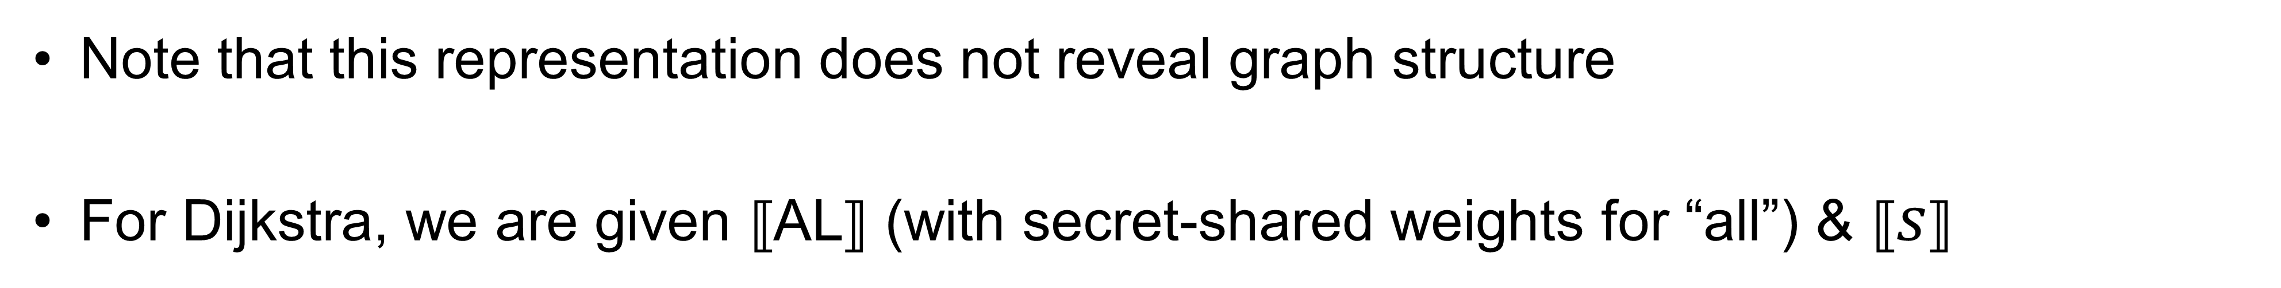
Secret shared AL:
2
1
2
3
2
3
3
⟦AL⟧ = ⟦1,1⟧ ⟦0,2⟧ ⟦0,3⟧ ⟦1,2⟧ ⟦0,3⟧ ⟦1,3⟧
1
3
Note that this representation does not reveal graph structure
For Dijkstra, we are given ⟦AL⟧ (with secret-shared weights for “all”) & ⟦$s$⟧

Slide 7
Changing Graph Representation
In ⟦AL⟧, different vertices may have different degrees
How do we hide degree distribution?

Slide 8



d-Normalized Replicated Adjacency List
$$d$$
$$d$$
$$d$$
⊥
For example d=3

Slide 9
d-Normalized Replicated Adjacency List
{
“Replicated Vertex name”
⊥
⊥
⊥
Padded with bots to length d=3
⊥
⊥
⊥
Easy counting argument:
Let $d=⌈\frac{2E}{V}⌉$ and$provision 2V$ (potentially replicated) vertices, then any graph can be $d$-normalized

Slide 10
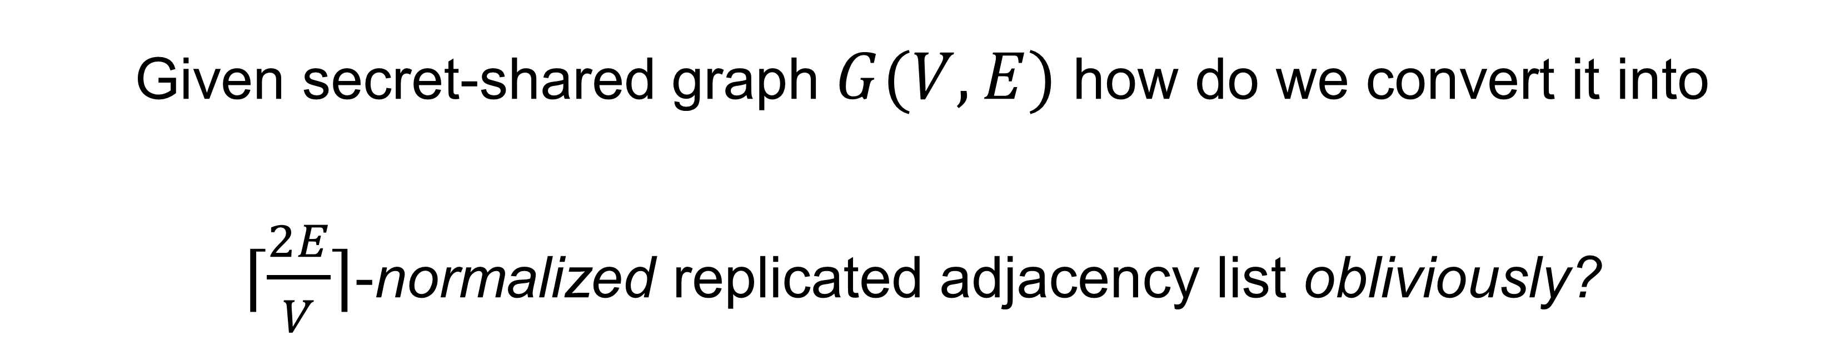
Rephrasing main question:
Given secret-shared graph $G(V,E)$ how do we convert it into
$⌈\frac{2E}{V}⌉$-normalized replicated adjacency list obliviously?
d x 2V
oblivious
⟦AL⟧

Slide 11
Plan
Graph Representations
Our Results
Techniques
Conclusions
11

Slide 12
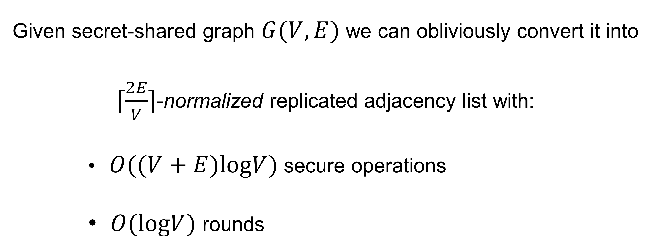
Result 1
Given secret-shared graph $G(V,E)$ we can obliviously convert it into
$⌈\frac{2E}{V}⌉$-normalized replicated adjacency list with:
              $O((V+E)logV)$ secure operations
              $O(logV)$ rounds

Slide 13
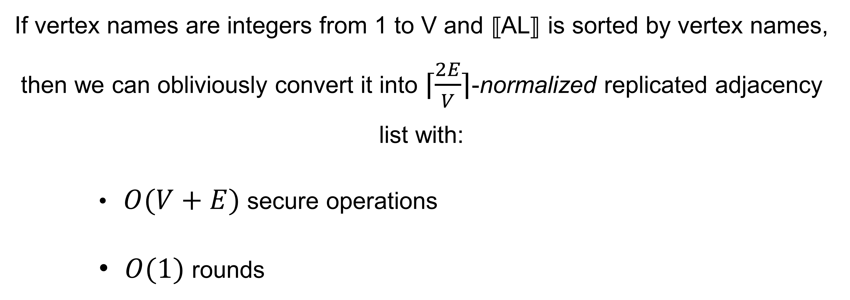
Result 2
If vertex names are integers from 1 to V and ⟦AL⟧ is sorted by vertex names, then we can obliviously convert it into $⌈\frac{2E}{V}⌉$-normalized replicated adjacency list with:
              $O(V+E)$ secure operations
              $O(1)$ rounds

Slide 14
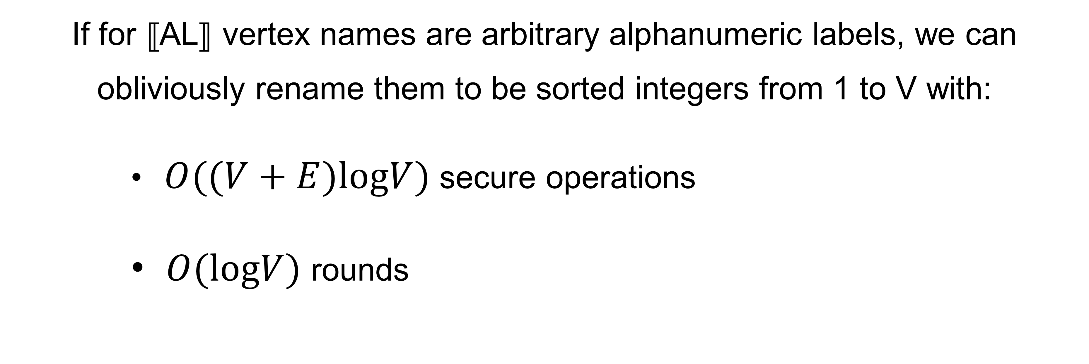
Result 3
If for ⟦AL⟧ vertex names are arbitrary alphanumeric labels, we can obliviously rename them to be sorted integers from 1 to V with:
              $O((V+E)logV)$ secure operations
              $O(logV)$ rounds
If you are paying attention, 2+3 implies result 1

Slide 15
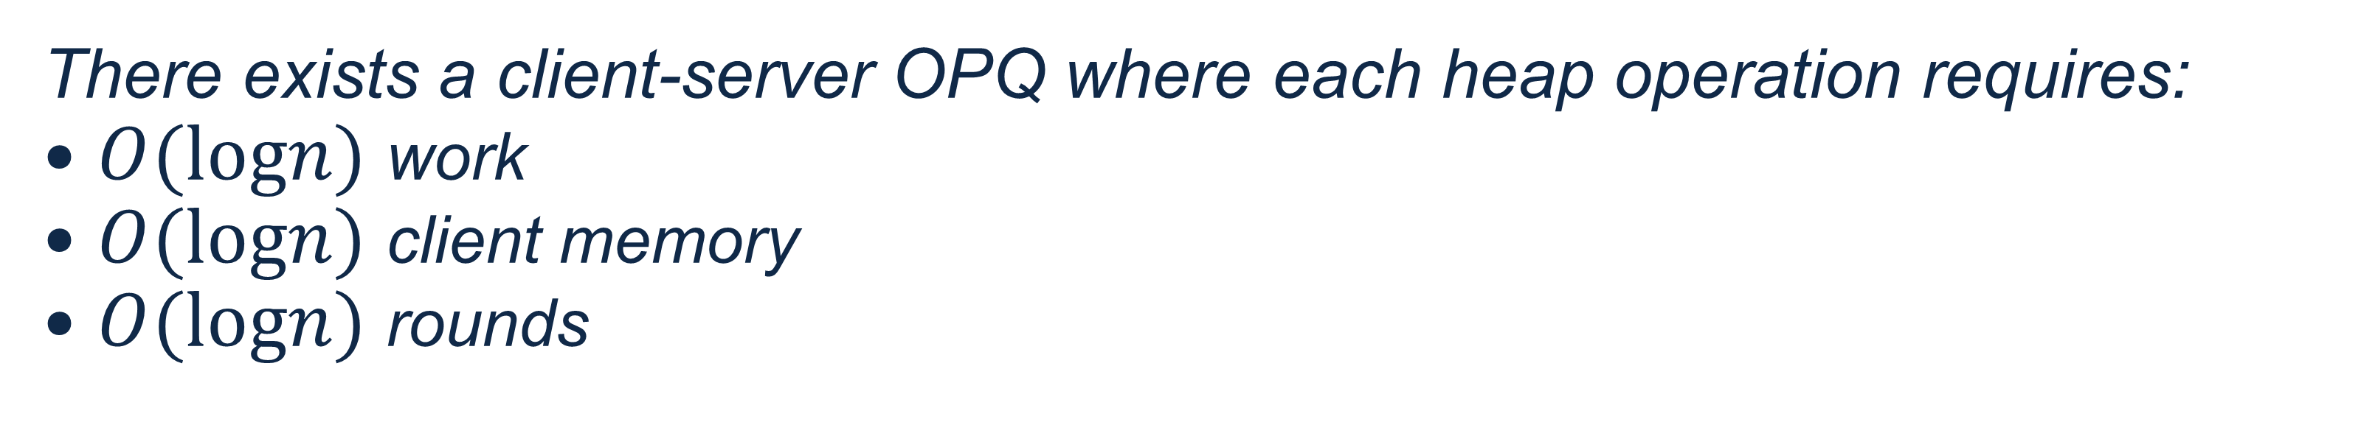
Client-Server Oblivious Priority Queue (OPQ)
Jafargholi, Larsen, Simkin: Optimal oblivious priority queues. SODA 2021
Theorem [JLS21]:
There exists a client-server OPQ where each heap operation requires:
$O(logn)$ work
$O(logn)$ client memory
$O(logn)$ rounds

Slide 16
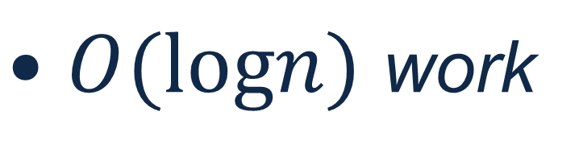

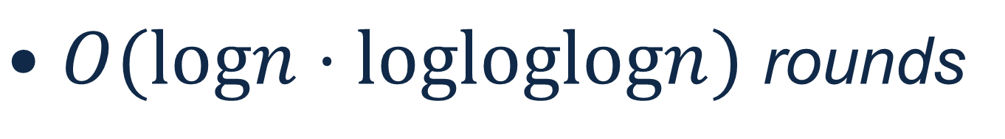
Result 4
Theorem [JLS21]:
There exists a client-server OPQ where each heap operation requires:
$O(logn)$ work
$O(logn)$ client memory
$O(logn)$ rounds
No trusted clients in MPC
Theorem (Informal):
Assuming SISO-PRF, there exists an MPC OPQ where each heap operation requires
$O(logn)$ work
(No clients)
$O(logn⋅logloglogn)$ rounds

Slide 17

Result 4
Theorem [JLS21]:
There exists a client-server OPQ where each heap operation requires:
$O(logn)$ work
$O(logn)$ client memory
$O(logn)$ rounds
No trusted clients in MPC
Theorem (Informal):
Assuming SISO-PRF, there exists an MPC OPQ where each heap operation requires
$O(logn)$ work
(No clients)
$O(logn⋅logloglogn)$ rounds

Slide 18
Result 4
Theorem [JLS21]:
There exists a client-server OPQ where each heap operation requires:
$O(logn)$ work
$O(logn)$ client memory
$O(logn)$ rounds
No trusted clients in MPC
Theorem (Informal):
Assuming SISO-PRF, there exists an MPC OPQ where each heap operation requires
$O(logn)$ work
$O(logn⋅logloglogn)$ rounds
Parallel insert

Slide 19
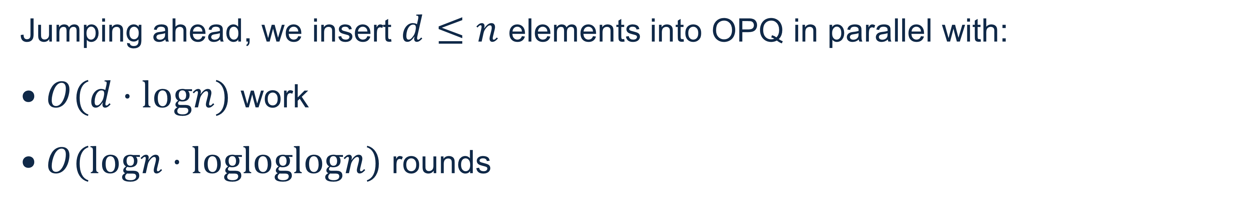
Result 4
Theorem (Informal):
Assuming SISO-PRF, there exists an MPC OPQ where each heap operation requires
$O(logn)$ work
$O(logn⋅logloglogn)$ rounds
Parallel insert
Jumping ahead, we insert $d≤n$ elements into OPQ in parallel with:
$O(d⋅logn)$ work
$O(logn⋅logloglogn)$ rounds

Slide 20
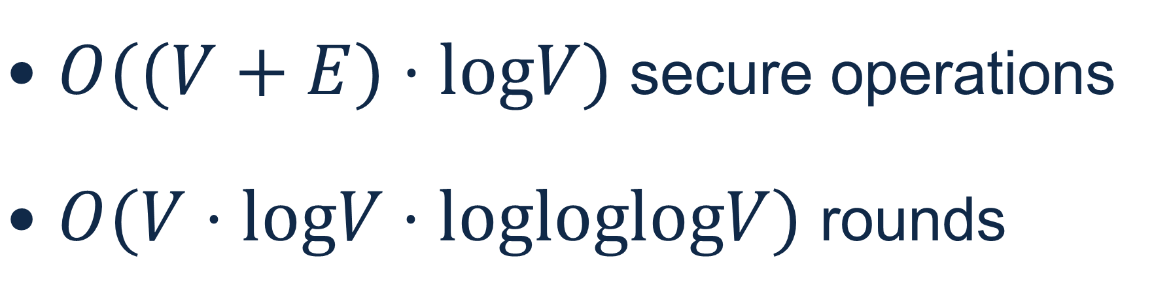
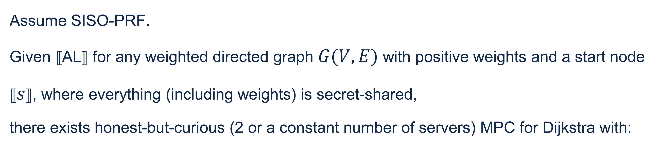
Result 5
Assume SISO-PRF.
Given ⟦AL⟧ for any weighted directed graph $G(V,E)$ with positive weights and a start node ⟦$s$⟧, where everything (including weights) is secret-shared,
there exists honest-but-curious (2 or a constant number of servers) MPC for Dijkstra with:
$O((V+E)⋅logV)$ secure operations
$O(V⋅logV⋅logloglogV)$ rounds

Slide 21
Plan
Graph Representations
Our Results
Techniques
Conclusions
21
21

Slide 22
Plan
Graph Representations
Our Results
Techniques (expanded)
Conclusions
22
22

Slide 23

Plan
Graph Representations
Our Results
Techniques (expanded)
  Computing $d$-normalized representation
  Alphanumeric Names
  Oblivious Priority Queue
  Secure Dijkstra
Conclusions
23
23

Slide 24

Plan
Graph Representations
Our Results
Techniques (expanded)
  Computing $d$-normalized representation
  Alphanumeric Names
  Oblivious Priority Queue
  Secure Dijkstra
Conclusions
24
24

Slide 25
Input
V/E Predicate:
1 0 0 0 0 1 0 0 0 1 0
Secret Shared AL
Recall that V/E predicate tells apart vertices and edges.

Slide 26
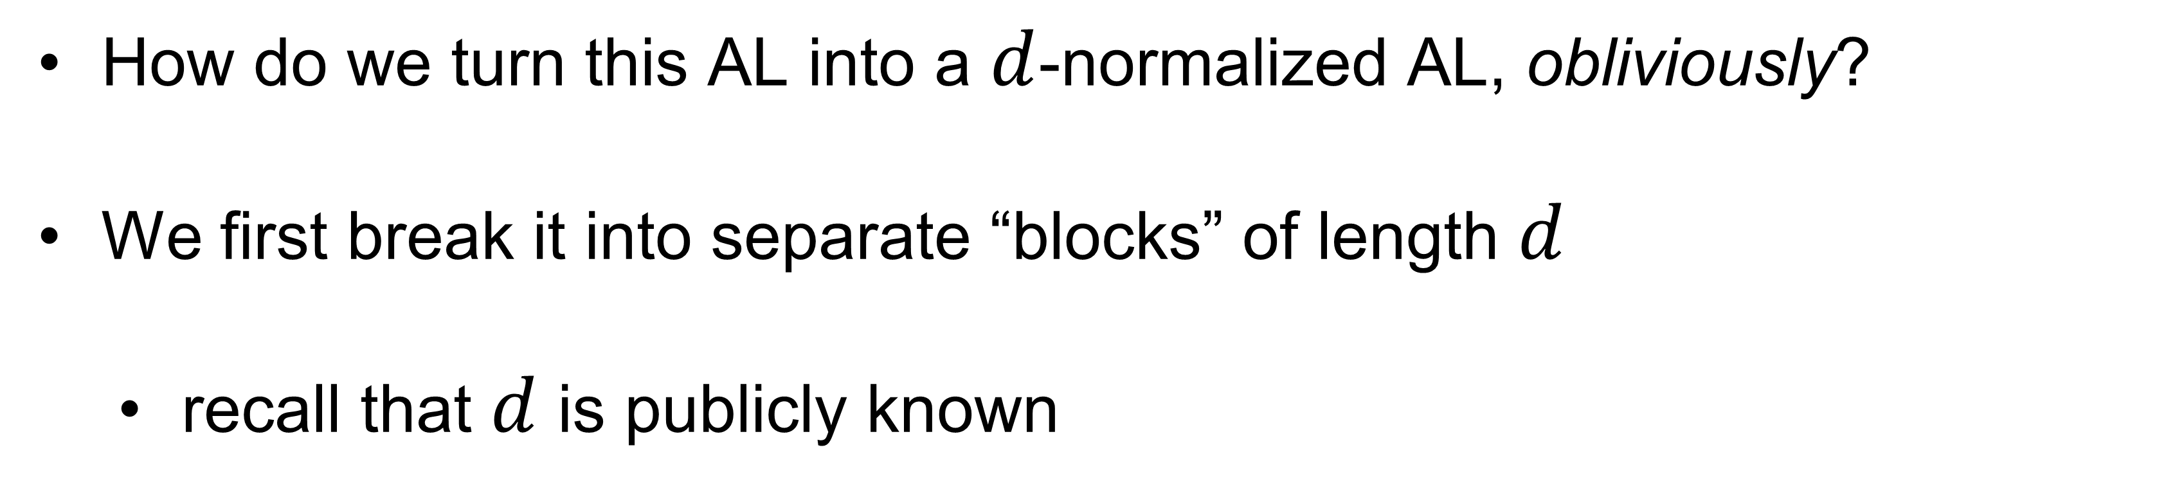
Representation
How do we turn this AL into a $d$-normalized AL, obliviously?
We first break it into separate “blocks” of length $d$
    recall that $d$ is publicly known

Slide 27
Representation
⊥
0
1
1
Pad the last block to length d
Notice some adjacency lists “spill over” into next block(s)
Mark spill-over blocks

Slide 28
Representation
⊥
0
1
1
Pad the last block to length d
Notice some adjacency lists “spill over” into next block
Mark spill-over blocks

Slide 29
Align Vertically
⊥

Slide 30
Wishful thinking:
Each vertex’s adjacency list “wants to be” in its own exclusive rows
Like this…
⊥

Slide 31
Wishful thinking:
Each vertex’s adjacency list “wants to be” in its own exclusive rows
Like this…
How do we do this obliviously?
We need to compute address (row and column) for each element
⊥

Slide 32
Computing Columns
Count elements in each block (silently)
1
2
3
4
1
2
3
4
1
2
3
4

Slide 33
Computing Columns
Count elements in each block (silently)
1
2
3
4
1
2
3
4
1
2
3
4

Slide 34
Computing Columns
Count elements in each block (silently)
1
2
3
4
1
2
3
4
1
2
3
4

Slide 35
Column:
1
2
3
4
Columns are set, now we need to compute rows…
⊥

Slide 36
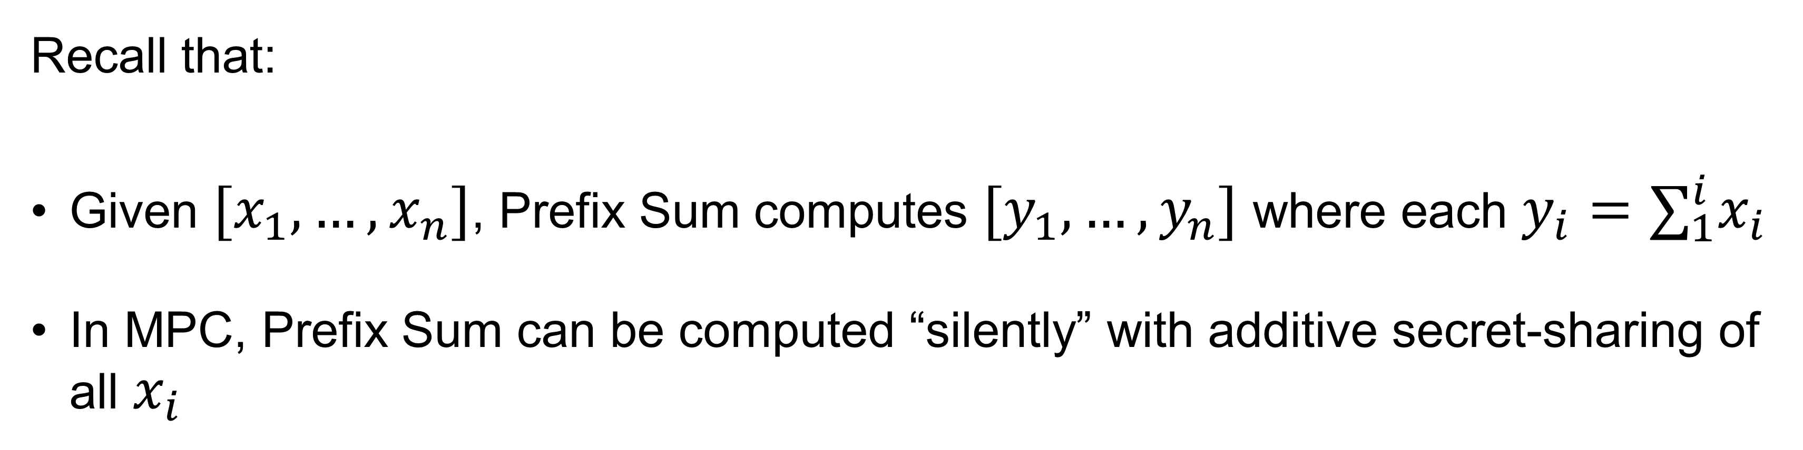
Prefix Sum
Recall that:
Given $[x_{1},…,x_{n}]$, Prefix Sum computes $[y_{1},…,y_{n}]$ where each $y_{i}=∑_{1}^{i}x_{i}$
In MPC, Prefix Sum can be computed “silently” with additive secret-sharing of all $x_{i}$

Slide 37
Utilizing Prefix Sum
V/E:
1
0
0
0
0
1
0
0
0
1
0
0
Prefix Sum:
1
1
1
1
1
2
2
2
2
3
3
3
Each edge now “knows” which vertex it belongs to
Recall that we marked spill-over blocks

Slide 38
Calculating Rows
V/E:
1
0
0
0
0
1
0
0
0
1
0
0
0
1
1
Prefix Sum:
1
1
1
1
2
2
3
3
3
4
4
5
5
5
Recompute Prefix Sum with spill-over bits
— this is the row # for each element!

Slide 39
Calculating Rows
V/E:
1
0
0
0
0
1
0
0
0
1
0
0
0
1
1
Prefix Sum:
1
1
1
1
2
2
3
3
3
4
4
5
5
5
Recompute Prefix Sum with spill-over bits
— this is the row # for each element!

Slide 40
Calculating Rows
1
0
0
0
0
1
0
0
0
1
0
0
0
1
1
1
1
1
2
3
3
3
1
4
5
5
5
Recompute Prefix Sum with spill-over bits
— this is the row # for each element!

Slide 41
Calculating Rows
1
0
0
0
0
1
0
0
0
1
0
0
1
1
1
1
2
3
3
3
4
5
5
5
0
1
1
Recompute Prefix Sum with spill-over bits
— this is the row # for each element!

Slide 42

1
1
1
1
2
However, there are still problems:
3
3
3
Empty space reveals information
4
5
5
5
And (potentially) less than $2V$ rows

Slide 43
  We still need:
Create unique ⊥ for each empty location
Pad obliviously to 2V rows with ⊥’s as needed
How?

Slide 44










Where do we need to put unique $⊥$’s?
$$⊥$$
$$⊥$$
$$⊥$$
$$⊥$$
$$⊥$$
$$⊥$$
$$⊥$$
$$⊥$$
$$⊥$$

Slide 45



Where do we need to put unique $⊥$’s?
$$⊥$$
$$⊥$$
$$⊥$$
$$⊥$$
$$⊥$$
$$⊥$$
$$⊥$$
$$⊥$$
$$⊥$$

Slide 46
Where do we need to put unique $⊥$’s?

Slide 47




Where do we need to put unique $⊥$’s?
$$⊥$$
$$⊥$$
$$⊥$$
$$⊥$$
$$⊥$$
$$⊥$$
$$⊥$$
$$⊥$$
$$⊥$$
$$⊥$$
$$⊥$$

Slide 48




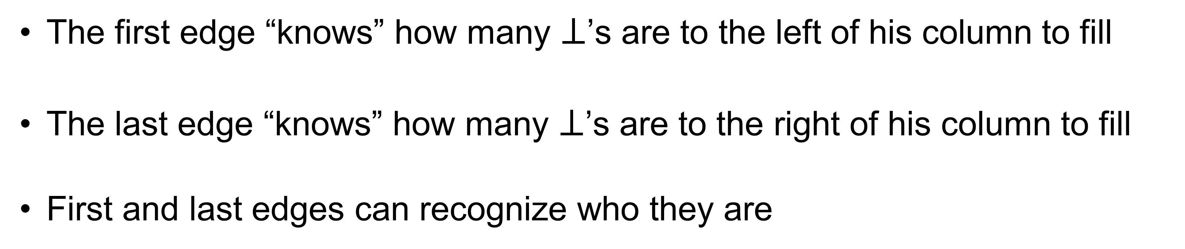






Marking of first and last edge
$$⊥$$
$$⊥$$
$$⊥$$
$$⊥$$
$$⊥$$
$$⊥$$
$$⊥$$
$$⊥$$
$$⊥$$
$$⊥$$
$$⊥$$
The first edge “knows” how many $⊥$’s are to the left of his column to fill
The last edge “knows” how many $⊥$’s are to the right of his column to fill
First and last edges can recognize who they are

Slide 49




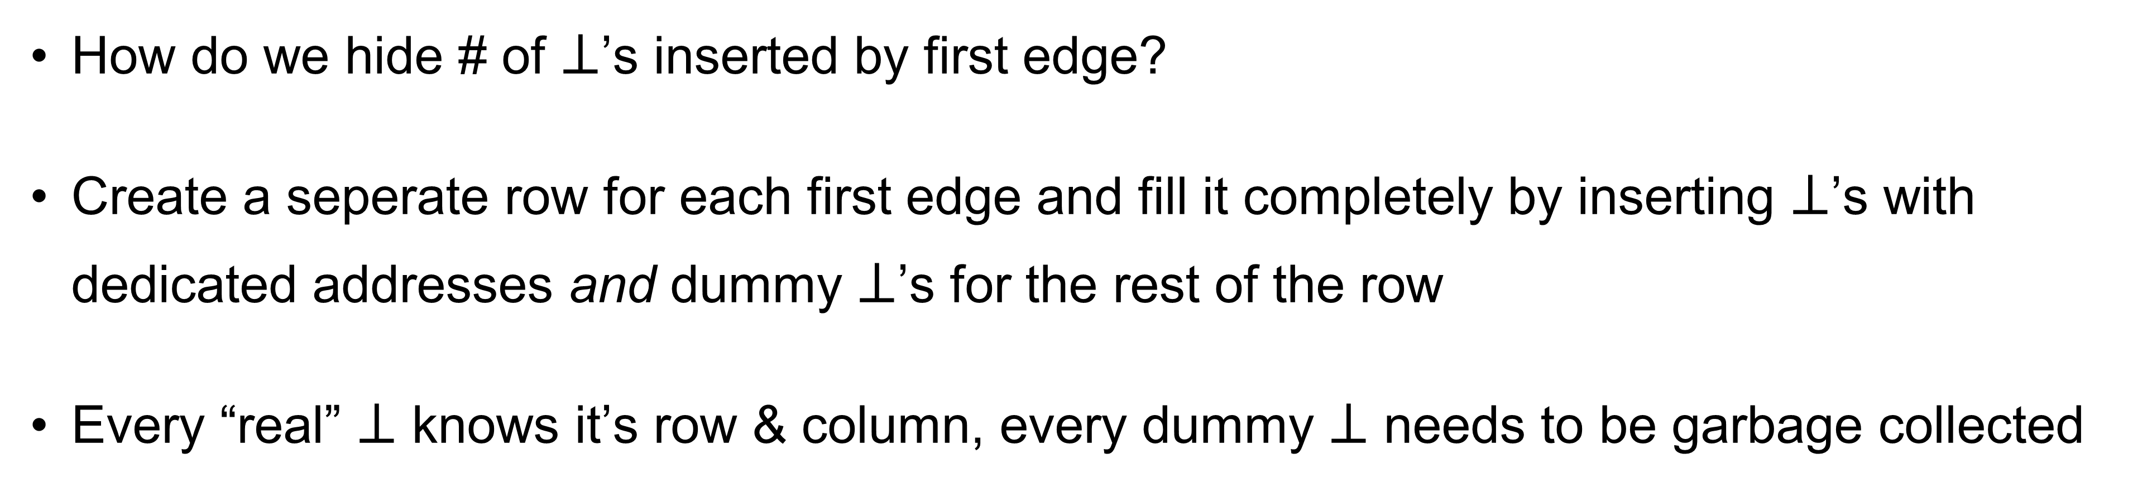






Adding $⊥$’s obliviously
$$⊥$$
$$⊥$$
$$⊥$$
$$⊥$$
$$⊥$$
$$⊥$$
$$⊥$$
$$⊥$$
$$⊥$$
$$⊥$$
$$⊥$$
$$⊥$$
$$⊥$$
$$⊥$$
$$⊥$$
How do we hide # of $⊥$’s inserted by first edge?
Create a seperate row for each first edge and fill it completely by inserting $⊥$’s with dedicated addresses and dummy $⊥$’s for the rest of the row
Every “real” $⊥$ knows it’s row & column, every dummy $⊥$ needs to be garbage collected

Slide 50
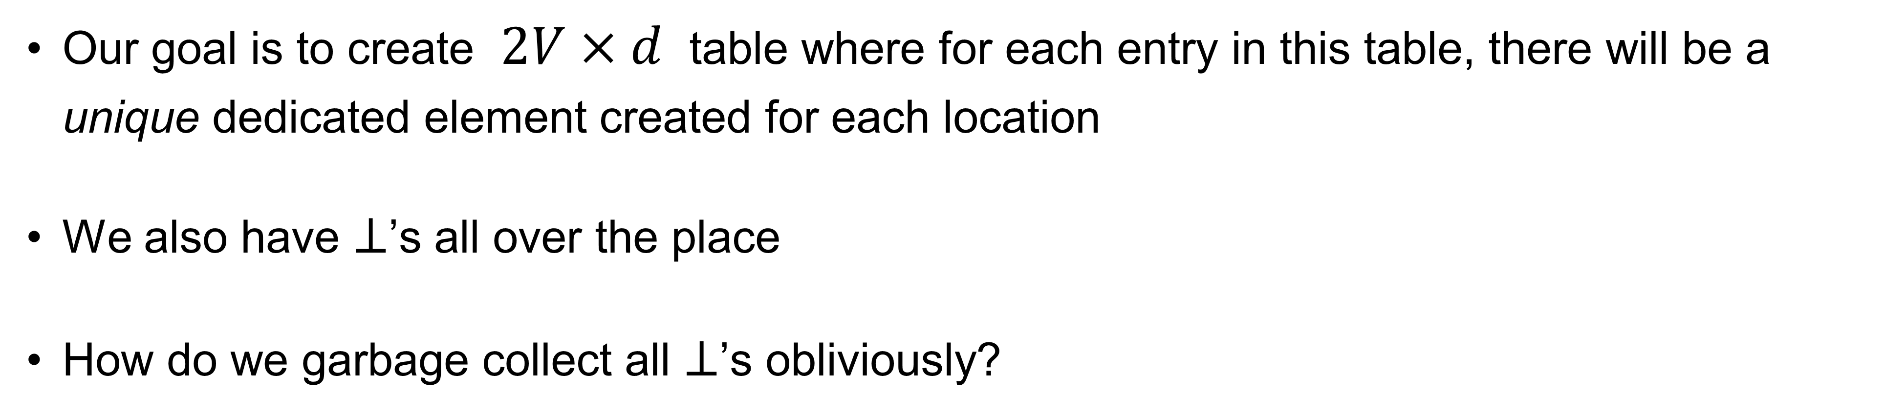
Situation so far…
Our goal is to create $2V×d$ table where for each entry in this table, there will be a unique dedicated element created for each location
We also have $⊥$’s all over the place
How do we garbage collect all $⊥$’s obliviously?

Slide 51



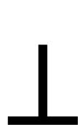










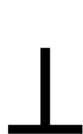
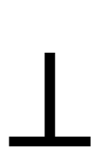



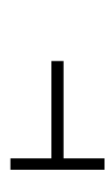






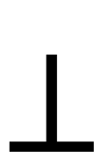
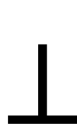



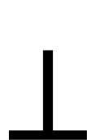
Garbage collection
$$⊥$$
$$⊥$$
$$⊥$$
$$⊥$$
$$⊥$$
$$⊥$$
$$⊥$$
(1 1)
(1,2)
(1,3)
(1,4)
(2,1)
(2,2)
(2 3)
(2 4)
$$⊥$$
$$⊥$$
$$⊥$$
$$⊥$$
$$⊥$$
$$⊥$$
$$⊥$$
$$⊥$$
$$⊥$$
(3 1)
(3 2)
(3 3)
$$⊥$$
$$⊥$$
$$⊥$$
(3,4)
(4,1)
(4 2)
(4 3)
(4 4)
$$⊥$$
(5 1)
$$⊥$$
$$⊥$$
$$⊥$$
$$⊥$$
$$⊥$$
$$⊥$$
$$⊥$$
$$⊥$$
$$⊥$$
(5 2)
(5,3)
(5 4)
$$⊥$$
$$⊥$$
$$⊥$$
$$⊥$$
$$⊥$$

Slide 52
First, we shuffle
$$⊥$$
$$⊥$$
$$⊥$$
$$⊥$$
$$⊥$$
$$⊥$$
$$⊥$$
(1 1)
(1,2)
(1,3)
(1,4)
(2,1)
(2,2)
(2 3)
(2 4)
$$⊥$$
$$⊥$$
$$⊥$$
$$⊥$$
$$⊥$$
$$⊥$$
$$⊥$$
$$⊥$$
$$⊥$$
(3 1)
(3 2)
(3 3)
$$⊥$$
$$⊥$$
$$⊥$$
(3,4)
(4,1)
(4 2)
(4 3)
(4 4)
$$⊥$$
(5 1)
$$⊥$$
$$⊥$$
$$⊥$$
$$⊥$$
$$⊥$$
$$⊥$$
$$⊥$$
$$⊥$$
$$⊥$$
(5 2)
(5,3)
(5 4)
$$⊥$$
$$⊥$$
$$⊥$$
$$⊥$$
$$⊥$$

Slide 53




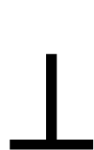

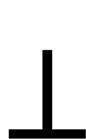







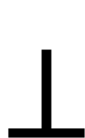










First, we shuffle
$$⊥$$
$$⊥$$
$$⊥$$
$$⊥$$
$$⊥$$
$$⊥$$
(3 1)
$$⊥$$
$$⊥$$
(4 3)
$$⊥$$
(2 4)
$$⊥$$
$$⊥$$
(2,1)
$$⊥$$
$$⊥$$
(3 2)
(4 4)
$$⊥$$
$$⊥$$
$$⊥$$
$$⊥$$
$$⊥$$
$$⊥$$
$$⊥$$
$$⊥$$
$$⊥$$
$$⊥$$
(1,2)
(1 1)
(5,3)
(3,4)
(4 2)
$$⊥$$
(1,3)
$$⊥$$
(5 1)
(2 3)
$$⊥$$
$$⊥$$
$$⊥$$
$$⊥$$
$$⊥$$
$$⊥$$
$$⊥$$
$$⊥$$
(2,2)
(5 2)
(1,4)
(3 3)
(4,1)
(5 4)
$$⊥$$

Slide 54

Next, we disclose locations of all $⊥$’s and erase
$$⊥$$
$$⊥$$
$$⊥$$
$$⊥$$
$$⊥$$
$$⊥$$
$$⊥$$
$$⊥$$
$$⊥$$
$$⊥$$
$$⊥$$
$$⊥$$
$$⊥$$
$$⊥$$
(3 1)
(4 3)
(2 4)
(2,1)
(3 2)
(4 4)
$$⊥$$
$$⊥$$
$$⊥$$
$$⊥$$
(1,2)
$$⊥$$
(1 1)
(5,3)
$$⊥$$
(3,4)
$$⊥$$
$$⊥$$
$$⊥$$
(4 2)
$$⊥$$
(1,3)
$$⊥$$
(5 1)
(2 3)
$$⊥$$
$$⊥$$
$$⊥$$
(2,2)
$$⊥$$
$$⊥$$
(5 2)
$$⊥$$
(1,4)
(3 3)
$$⊥$$
(4,1)
$$⊥$$
(5 4)
$$⊥$$

Slide 55
Next, reveal all remaining addresses
Why is this secure?
Recall that we shuffled first, and
Created a single dedicated item for each table location
$$⊥$$
$$⊥$$
$$⊥$$
$$⊥$$
$$⊥$$
(3 1)
(4 3)
(2 4)
(2,1)
(3 2)
(4 4)
$$⊥$$
$$⊥$$
$$⊥$$
$$⊥$$
(1,2)
(1 1)
(5,3)
(3,4)
(4 2)
(1,3)
(5 1)
(2 3)
$$⊥$$
$$⊥$$
$$⊥$$
(2,2)
(5 2)
(1,4)
(3 3)
(4,1)
(5 4)

Slide 56
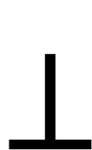

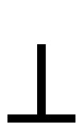
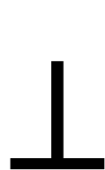
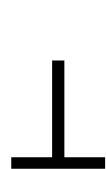
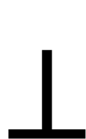
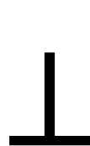
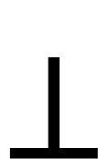
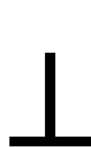
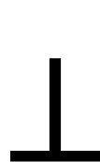
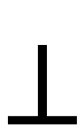

$$⊥$$
Next, reveal all remaining addresses
Why is this secure?
Recall that we shuffled first, and
Created a single dedicated item for each table location
(1 1)
(1,2)
(1,3)
(1,4)
(2,2)
$$⊥$$
$$⊥$$
(2,1)
(2 3)
(2 4)
$$⊥$$
$$⊥$$
(3 1)
(3 2)
$$⊥$$
(3,4)
(3 3)
$$⊥$$
$$⊥$$
$$⊥$$
(4,1)
(4 2)
(4 3)
(4 4)
$$⊥$$
$$⊥$$
$$⊥$$
(5 4)
(5 1)
(5 2)
(5,3)
… and everything is $d$-normalized!
Actually, not the full solution, I did not tell you how to fill the remaining empty rows — see the paper

Slide 57

Plan
Graph Representations
Our Results
Techniques (expanded)
  Computing $d$-normalized representation
  Renaming Vertices
  Oblivious Priority Queue
  Secure Dijkstra
Conclusions
57

Slide 58
Dealing with graphs with arbitrary vertex names…
Zues
Poseidon
Athena
Hades
Poseidon
Hades
Athena
Athena
Poseidon
Hades
Athena
Athena
Zues
Hades

Slide 59
Adjacency List
Zues
Poseidon
Athena
Hades
Poseidon
Hades
Athena
Athena
Poseidon
Hades
Athena
Athena
Zues
Hades

Slide 60
Adjacency List
Zues
Poseidon
Athena
Hades
Poseidon
Hades
Athena
Hades
Athena
Athena
Athena
Poseidon
Zues
Hades

Slide 61
Number each element
1
2
3
4
5
6
7
8
9
10
Zues
Poseidon
Athena
Hades
Poseidon
Hades
Athena
Hades
Athena
Athena
Eventually, all elements can return to their original spot, which they will remember

Slide 62
Utilizing Prefix Sum again
Zues
Poseidon
Athena
Hades
Poseidon
Hades
Athena
Hades
Athena
Athena
1
2
3
4
Using Prefix Sum, we can silently give “new” vertex names to each vertex

Slide 63
Shuffle and Sort by alphanumeric names
Zues
Poseidon
Athena
Hades
Poseidon
Hades
Athena
Hades
Athena
Athena
1
2
3
4

Slide 64
Shuffle and Sort by alphanumeric names
Hades
Athena
Zues
Athena
Poseidon
Athena
Athena
Poseidon
Hades
Hades
1
4
2
3

Slide 65
Shuffle and Sort by alphanumeric names
Athena
Athena
Athena
Athena
Hades
Hades
Hades
Poseidon
Poseidon
Zues
4
3
2
1

Slide 66
Name Spreading
Athena
Athena
Athena
Athena
Hades
Hades
Hades
Poseidon
Poseidon
Zues
4
4
4
4
3
3
3
2
2
1
We wish to spread new name of Athena to all edges that point to Athena
and to all other names

Slide 67
Name Spreading Game
Athena
Edges to Athena

Slide 68
Name Spreading Game

Slide 69
Rules

Slide 70
Generalized Rule
Athena
Athena
Athena
Hades

Slide 71
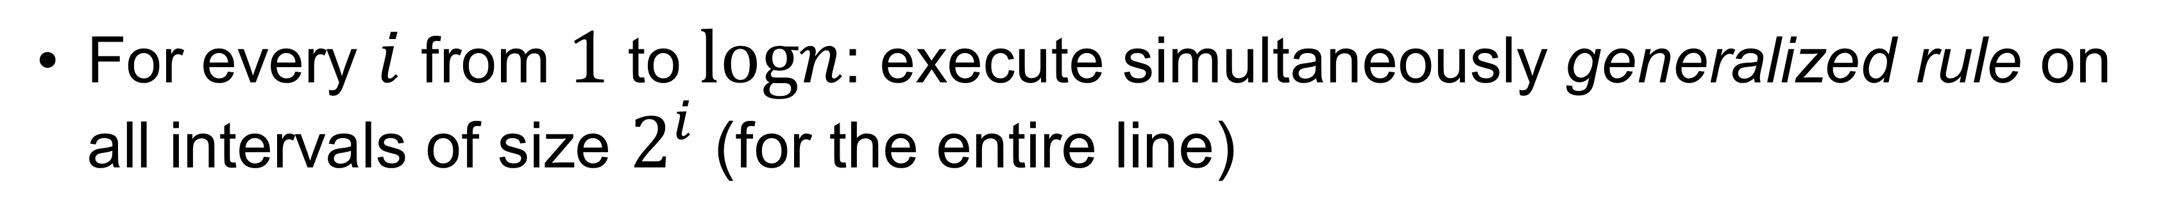
The algorithm
[
[
[
[
[
[
[
[
[
[
[
…
…
For every $i$ from $1$ to $logn$: execute simultaneously generalized rule on all intervals of size $2^{i}$ (for the entire line)

Slide 72
The algorithm
[
[
[
[
[
[
[
[
[
[
[
…
…
[
[
[
[
[
[
[
[
[
[
[
For every $i$ from $1$ to $logn$: execute simultaneously generalized rule on all intervals of size $2^{i}$ (for the entire line)
Do it in a “brick pattern” for each $i$ before going to $2^{i+1}$

Slide 73
The algorithm
[
[
[
[
[
[
[
[
[
[
[
…
…
[
[
[
[
[
[
[
[
[
[
[
For every $i$ from $1$ to $logn$: execute simultaneously generalized rule on all intervals of size $2^{i}$ (for the entire line)
Do it in a “brick pattern” for each $i$ before going to $2^{i+1}$

Slide 74
The algorithm
…
…

Slide 75
The algorithm
…
…

Slide 76
The algorithm
…
…

Slide 77
The algorithm
…
…

Slide 78
The algorithm
…
…

Slide 79
The algorithm
…
…

Slide 80
The algorithm
…
…
Half or less remains
All larger intervals up to the entire line will not affect yellow

Slide 81
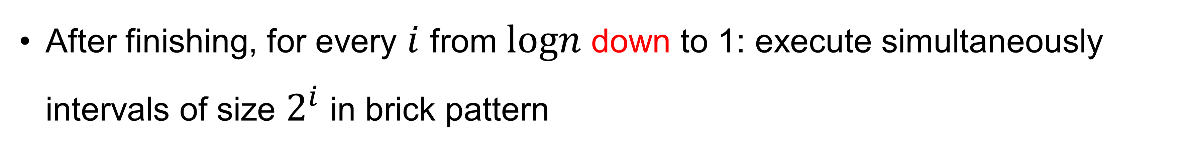
The algorithm
…
…
After finishing, for every $i$ from $logn$ down to 1: execute simultaneously intervals of size $2^{i}$ in brick pattern

Slide 82
The algorithm
…
…

Slide 83
The algorithm
…
…

Slide 84
The algorithm
…
…

Slide 85
The algorithm
…
…

Slide 86
The algorithm
[
[
[
[
[
[
[
[
[
[
[
…
…
[
[
[
[
[
[
[
[
[
[
[
In the paper, we prove that after $4logn+2$ rounds, the line is fully colored

Slide 87
Remember the original positions?
1
2
3
4
5
6
7
8
9
10
Zues
Poseidon
Athena
Hades
Poseidon
Hades
Athena
Hades
Athena
Athena

Slide 88
Once we have new names, shuffle and place into original positions…
10
9
3
7
8
6
4
5
2
1
Athena
Athena
Athena
Athena
Hades
Hades
Hades
Poseidon
Poseidon
Zues
4
4
4
4
3
3
3
2
2
1

Slide 89
Once we have new names, shuffle and place into original positions…
4
10
8
3
2
6
1
7
5
9
Hades
Athena
Hades
Athena
Poseidon
Hades
Zues
Athena
Poseidon
Athena
3
4
3
4
2
3
1
4
2
4

Slide 90
Once we have new names, shuffle and place into original positions…
1
2
3
4
5
6
7
8
9
10
Zues
Poseidon
Athena
Hades
Poseidon
Hades
Athena
Hades
Athena
Athena
1
2
4
3
2
3
4
3
4
4
… and now we have renamed the graph!

Slide 91

Plan
Graph Representations
Our Results
Techniques (expanded)
  Computing $d$-normalized representation
  Alphanumeric Names
  Oblivious Priority Queue (See the paper)
  Secure Dijkstra (See the paper)
Conclusions
91
91

Slide 92
Plan
Graph Representations
Our Results
Techniques
Conclusions
92

Slide 93
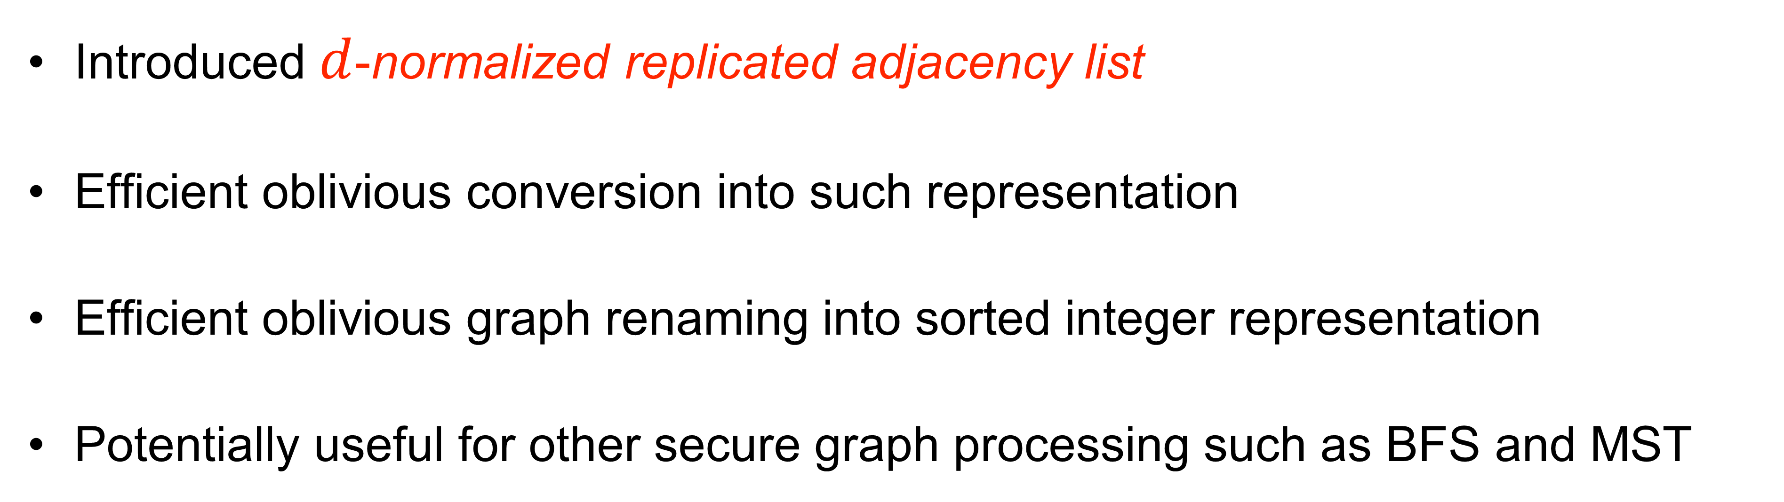
Conclusions
Introduced $d$-normalized replicated adjacency list
Efficient oblivious conversion into such representation
Efficient oblivious graph renaming into sorted integer representation
Potentially useful for other secure graph processing such as BFS and MST

Slide 94
Thank you!
Questions?
ia.cr/2024/988

