Slide 1



STIR 🥣
Reed-Solomon Proximity Testing with Fewer Queries
Gal Arnon
Giacomo Fenzi
Alessandro Chiesa
Eylon Yogev

Slide 2

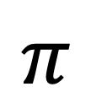

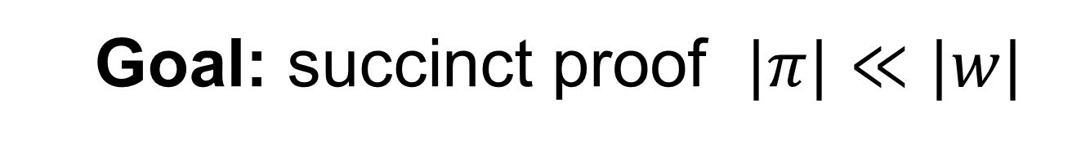
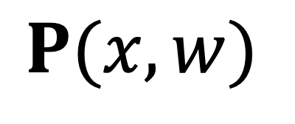
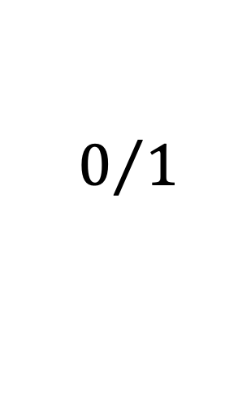
Succinct Non-Interactive Arguments of Knowledge
(SNARKs)
Random
Oracle
$$P(x,w)$$
Claim:
I know $w$ s.t. $(x,w)∈R$
$$V(x)$$
$$π$$
$$0/1$$
  Goal: succinct proof $|π|≪|w|$

Slide 3









SNARKs in Practice
Instantiating random oracle gives amazing SNARKs:
  Transparent setup (choice of hash)
  Highly efficient implementations (no public-key crypto)
  Plausibly post-quantum secure (secure in QROM)
Used to secure billions of dollars in real-world blockchains
And many more…
3

Slide 4
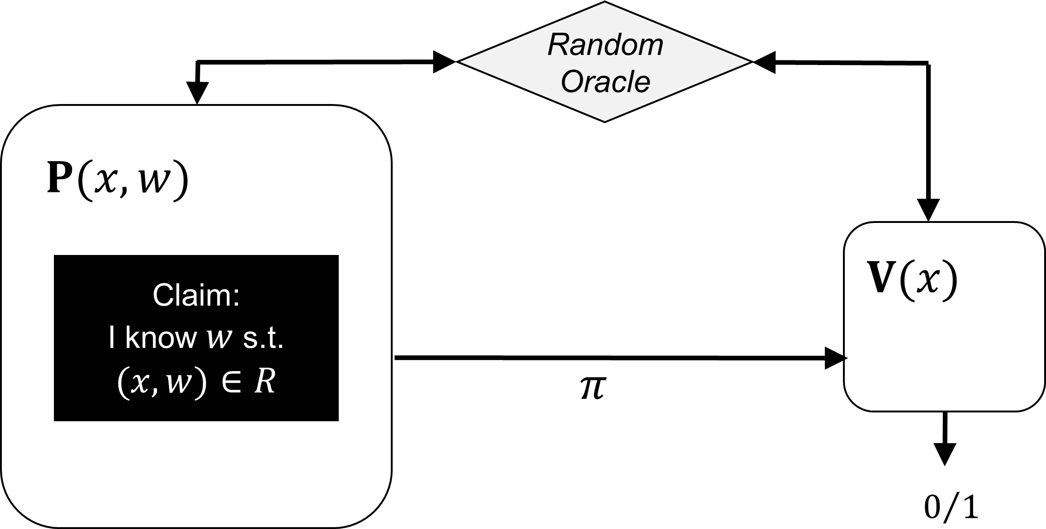
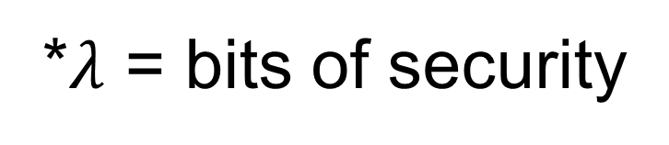
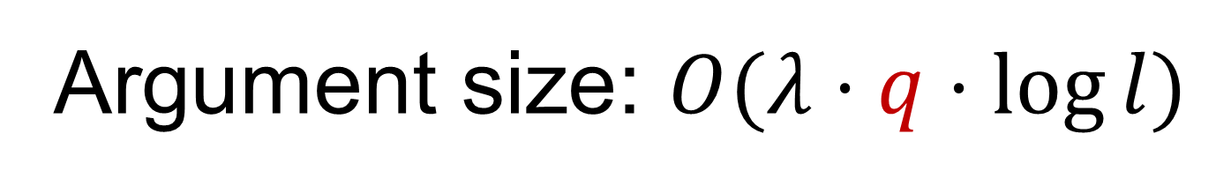


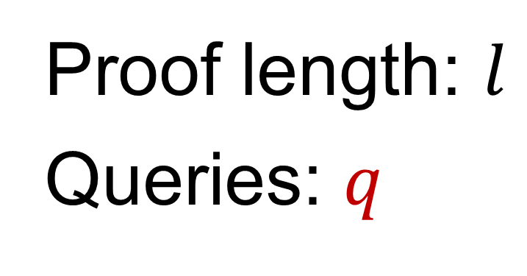
SNARKs from Interactive Oracle Proofs (IOPs)
IOP
SNARK in the ROM
(Interactive analog of PCPs)
BCS transformation
$$P$$
$$V$$
Reed-Solomon Proximity Test
Main bottleneck
Argument size: $O(λ⋅q⋅\log{l})$
Proof length: $l$
Queries: $q$
*$λ$ = bits of security

Slide 5
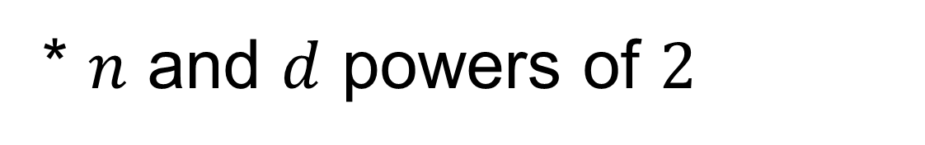


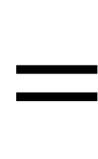
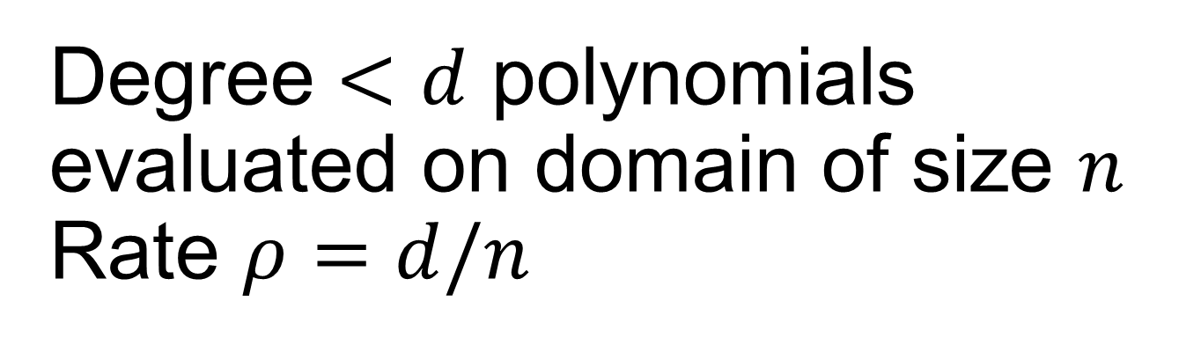

IOPs of Proximity for RS Codes
$$=$$
Degree $<d$ polynomials evaluated on domain of size $n$ Rate $ρ=d/n$
* finite field $𝔽$
$$RS\left[n, d,ρ\right]$$
* $n$ and $d$ powers of $2$
* evaluation domain is a multiplicative subgroup
$$f$$
V
$f∈RS[n,d, ρ]⟹$ $V$ accepts
P
$f$ is far from $RS[n, d,ρ]⟹$ $V$ accepts w.p. ${ε_{rbr}≤2}^{−λ}$
(round-by-round soundness for BCS transformation)
Goal: minimize verifier queries to both $f$ and prover messages

Slide 6

Our results

Slide 7
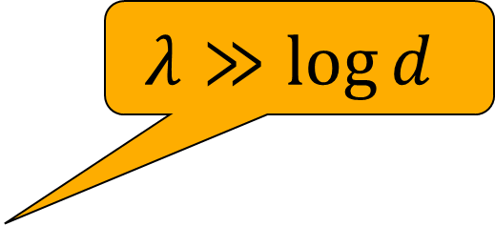
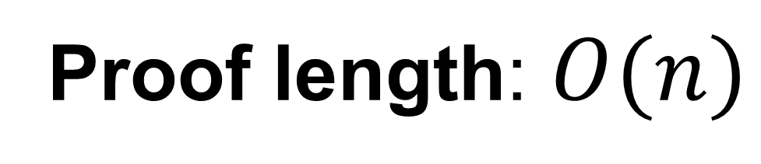

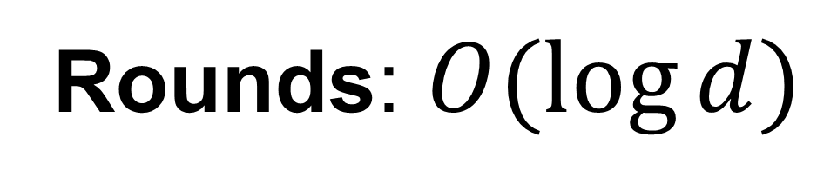

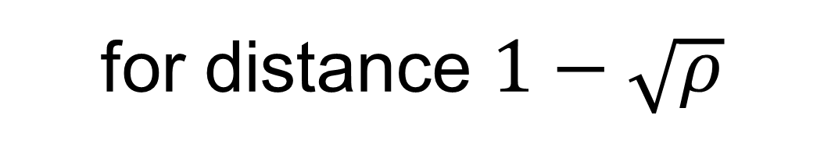

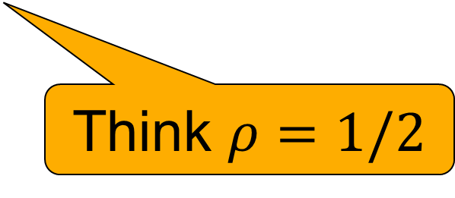
STIR 🥣: An IOPP for RS
Rounds: $O(\log{d})$
Proof length: $O(n)$
$$λ≫\log{d}$$
Queries: $O\left(λ⋅log\left(\frac{log d}{−log\sqrt{ρ}}\right)+log d\right)$
for distance $1−\sqrt{ρ}$
Think $ρ=1/2$
Previously (FRI):
Queries: $O\left(λ⋅\frac{log d}{−log\sqrt{ρ}}\right)$
*For both: can replace $\sqrt{ρ}$ with $ρ$ under “list-decoding” assumption to improve constants

Slide 8

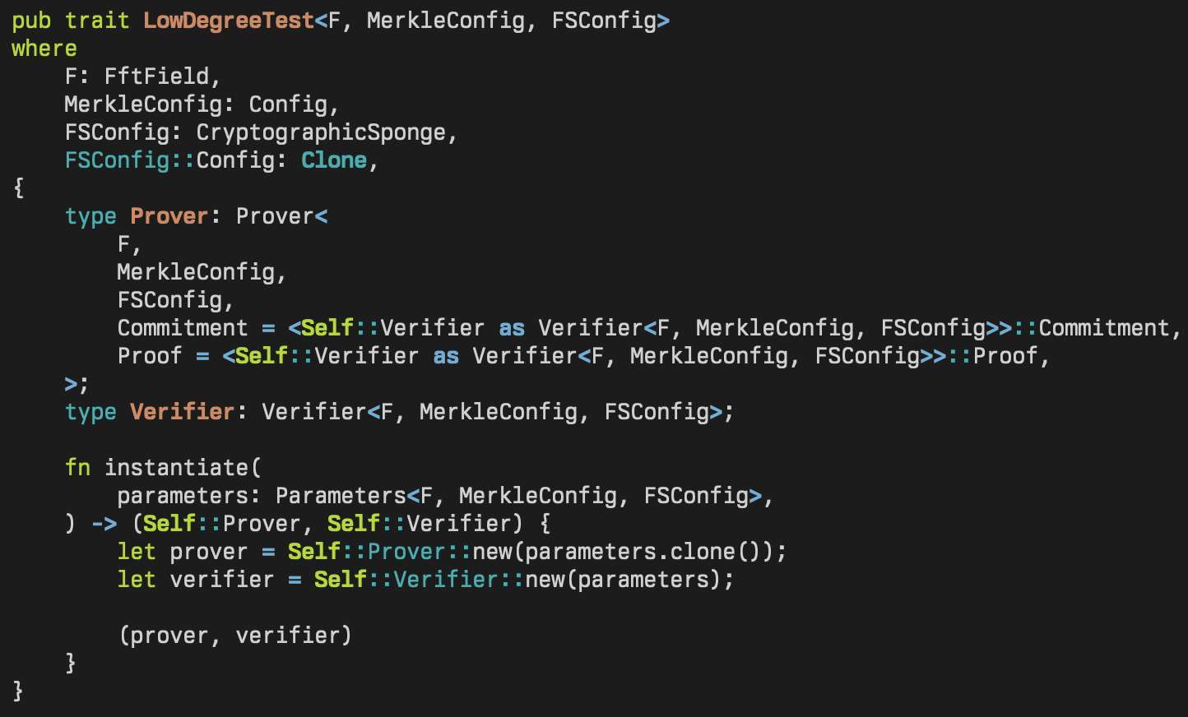
Implementation
Rust 🦀 implementation, available at WizardOfMenlo/stir
Arkworks as backend, 192-bit field for benchmarks, reasonably optimized
Implemented both FRI and STIR

Slide 9
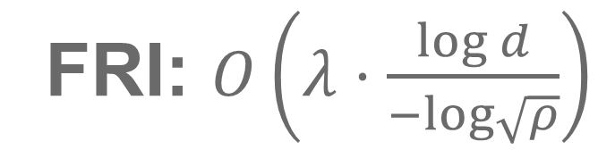
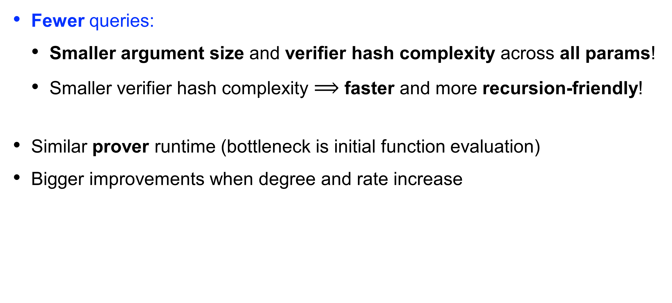
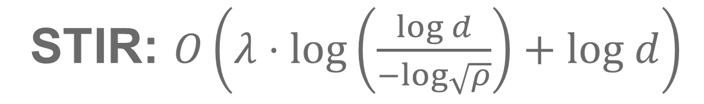
Comparison to FRI
STIR: $O\left(λ⋅log\left(\frac{log d}{−log\sqrt{ρ}}\right)+log d\right)$
FRI: $O\left(λ⋅\frac{log d}{−log\sqrt{ρ}}\right)$
Fewer queries:
  Smaller argument size and verifier hash complexity across all params!
  Smaller verifier hash complexity $⟹$ faster and more recursion-friendly!
Similar prover runtime (bottleneck is initial function evaluation)
Bigger improvements when degree and rate increase

Slide 10
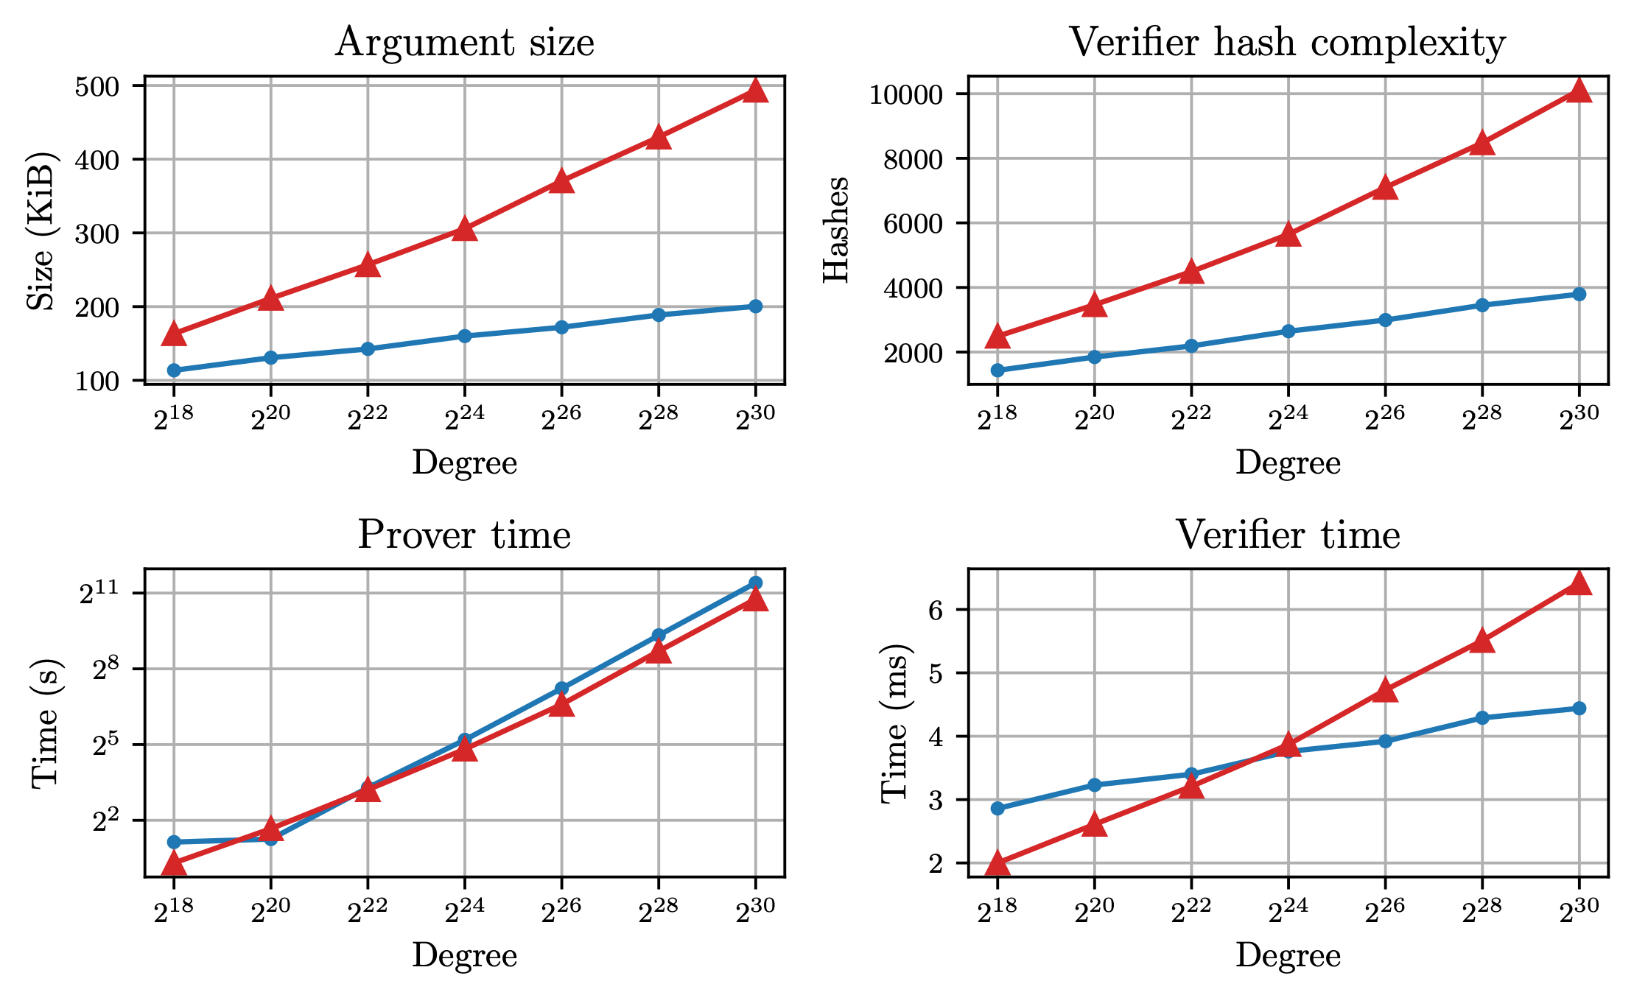
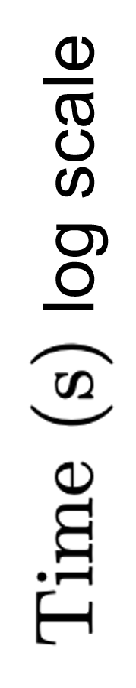
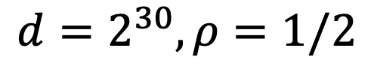
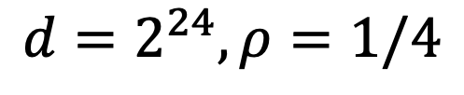
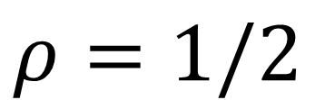
Comparison to FRI
128 bits of security
($λ=$106 + 22 bits of PoW + “list-decoding” assumption)
$$ρ=1/2$$
 | FRI | STIR
Size (KiB) | 177 | 107
Hashes | 3.5k | 1.8k
$$d=2^{24},ρ=1/4$$
 | FRI | STIR
Size (KiB) | 494 | 200
Hashes | 10k | 3.8k
$$d=2^{30},ρ=1/2$$

Slide 11
Techniques

Slide 12


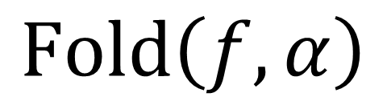


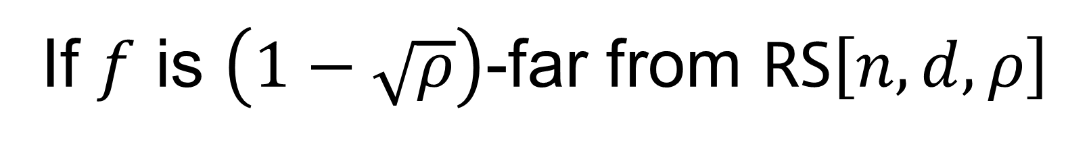




Review: RS Folding
Rate preserving
Reduce $RS[n, d,ρ]$ to $RS[n/k,d/k,ρ]$ (think $k=16$)
$$n$$
$$P$$
$$V$$
Roughly, for $k=2$:
$$f$$
$$α←𝔽$$
$$Fold\left(f,α\right)=f_{even}+α⋅f_{odd}$$
$$Fold\left(f,α\right)$$
Can extend to all $k$ = power of $2$
Virtual function
$$n/k$$
Local: Compute $Fold(f,α)$ at any point with $k$ queries to $f$
Distance Preserving:
If $f$ is $\left(1−\sqrt{ρ}\right)$-far from $RS\left[n,d,ρ\right]$
$⟹$ w.h.p. $Fold\left(f,α\right)$ is $\left(1−\sqrt{ρ}\right)$-far from $RS[n/k,d/k,ρ]$

Slide 13
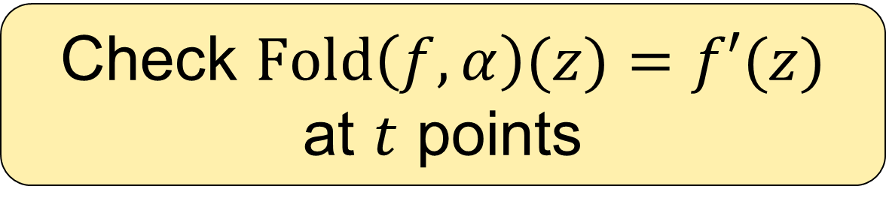
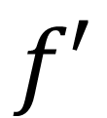



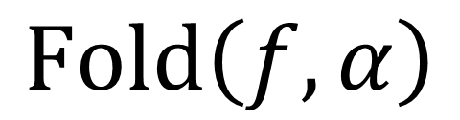
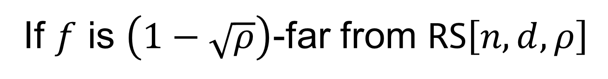


(think $k=16$)
Review: FRI Iteration
$$P$$
$$f$$
$$V$$
$$α←𝔽$$
Recurse
$$Fold\left(f,α\right)$$
Claimed to be same polynomial
Check $Fold\left(f,α\right)(z)=f′(z)$
at $t$ points
$$f′$$
*In full FRI protocol consistency checks correlated between rounds
Suppose $f′∈RS\left[n/k,d/k,ρ\right]$
If $f$ is $\left(1−\sqrt{ρ}\right)$-far from $RS\left[n,d,ρ\right]$
$⟹$ w.h.p. $Fold\left(f,α\right)$ is $\left(1−\sqrt{ρ}\right)$-far from $f′$
For $ε_{rbr}=2^{−λ}$ make $t=\frac{λ}{−\log{\sqrt{ρ}}}$ queries per round
$⟹$ Accept w.p. ${\left(\sqrt{ρ}\right)}^{t}$

Slide 14
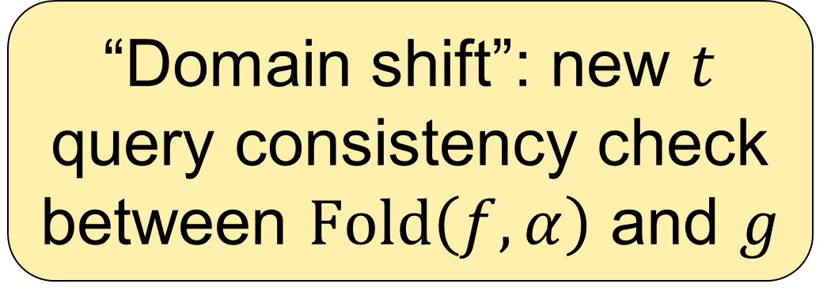

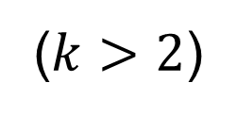



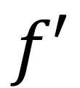
(think $k=16$)
STIR: Shift To Improve Rate
Idea: smaller rate is easier to test
$$n$$
$$P$$
$$f$$
$$V$$
$$α←𝔽$$
$$n/k$$
($k>2$)
$$Fold\left(f,α\right)$$
Recurse
Claimed to be same polynomial
$$n/2$$
“Domain shift”: new $t$ query consistency check between $Fold\left(f,α\right)$ and $g$
$$g$$
$$f′$$
Domain shift defines virtual function $f′$ s.t.:
$Fold\left(f,α\right)$ is $\left(1−\sqrt{ρ}\right)$-far from $RS\left[\frac{n}{k},\frac{d}{k},ρ\right]$
Larger distance!
Smaller rate!
$⟹$except w.p. ${\left(\sqrt{ρ}\right)}^{t}$: $f′$ is $\left(1−\sqrt{ρ′}\right)$-far from $RS\left[\frac{n}{2},\frac{d}{k},ρ^{′}=\frac{2}{k}⋅ρ\right]$

Slide 15
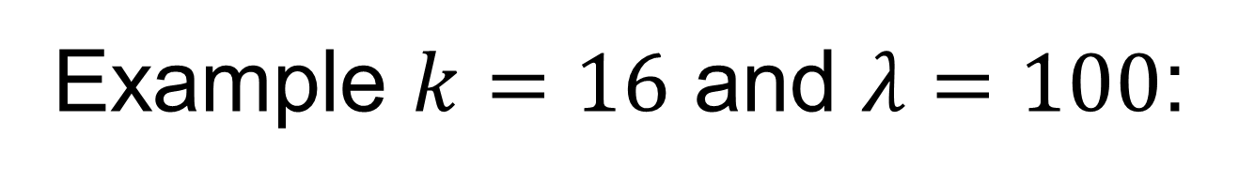
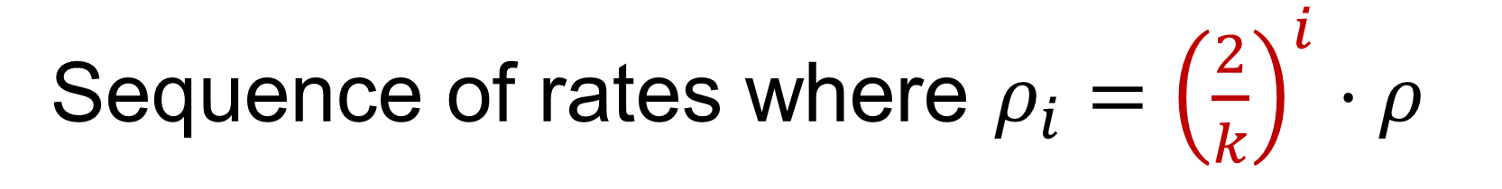
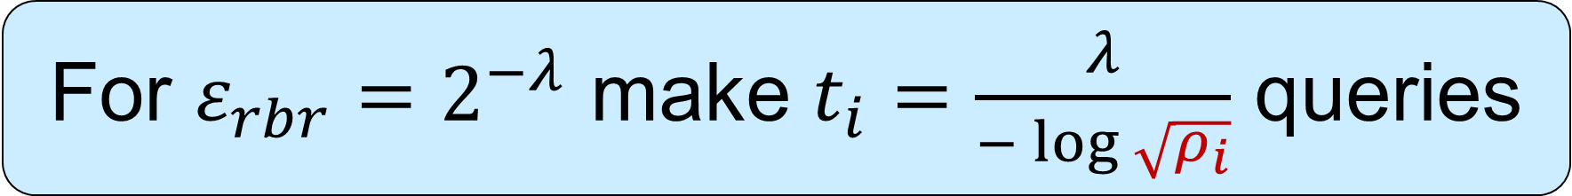
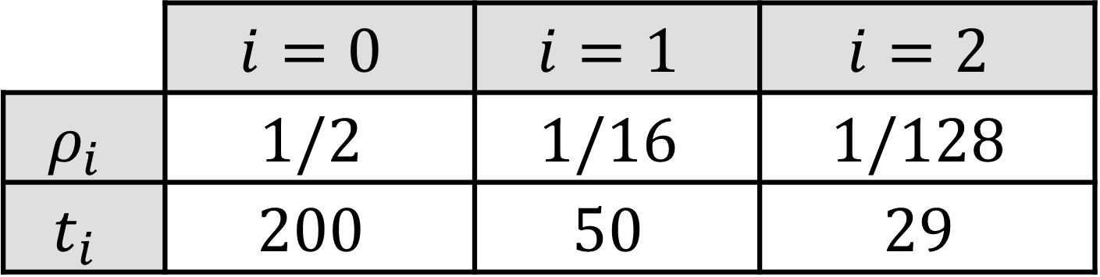
(think $k=16$)
STIR: Shift To Improve Rate
Idea: smaller rate is easier to test
$$n$$
$$P$$
$$f$$
$$V$$
$$α←𝔽$$
$$n/k$$
($k>2$)
$$Fold\left(f,α\right)$$
Recurse
Claimed to be same polynomial
$$n/2$$
“Domain shift”: new $t$ query consistency check between $Fold\left(f,α\right)$ and $g$
$$g$$
$$f′$$
Sequence of rates where $ρ_{i}={\left(\frac{2}{k}\right)}^{i}⋅ρ$
For $ε_{rbr}=2^{−λ}$ make $t_{i}=\frac{λ}{−\log{\sqrt{ρ_{i}}}}$ queries
Example $k=16$ and $λ=100$:
 | $$i=0$$ | $$i=1$$ | $$i=2$$
$$ρ_{i}$$ | $$1/2$$ | $$1/16$$ | $$1/128$$
$$t_{i}$$ | $$200$$ | $$50$$ | $$29$$
Fewer queries each round!
…

Slide 16



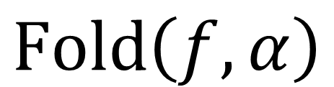


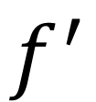
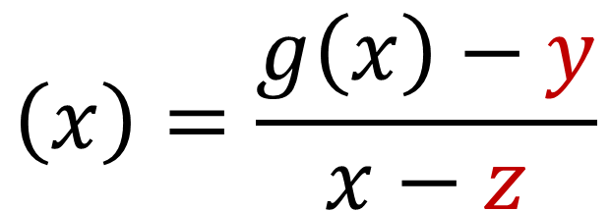

Domain shifting
$$n/k$$
$$n/2$$
$$Fold\left(f,α\right)$$
$$y$$
$$g$$
$$\left(x\right)=\frac{g\left(x\right)−y}{x−z}$$
$$z$$
$$f^{′}$$
$Fold\left(f,α\right)$ and $g$ claimed to be evaluations of same polynomial
Goal: $Fold\left(f,α\right)$ is $\left(1−\sqrt{ρ}\right)$-far from $RS\left[\frac{n}{k},\frac{d}{k},ρ\right]$
$⟹$ w.h.p. $f′$ is $\left(1−\sqrt{ρ′}\right)$-far from $RS\left[\frac{n}{2},\frac{d}{k},ρ^{′}\right]$
Temporary assumption: unique polynomial $p$ is $\left(1−\sqrt{ρ′}\right)$-close to $g$
$Fold\left(f,α\right)$ is $\left(1−\sqrt{ρ}\right)$-far from $p$
Claim (see paper): $f′$ is $\left(1−\sqrt{ρ^{′}}\right)$-far from $RS\left[\frac{n}{2},\frac{d}{k},ρ^{′}\right]$ iff $p\left(z\right)≠y$
*In fact, degree is $\frac{d}{k}−1$.
Fixed with degree correction
$⟹$ except w.p. $\sqrt{ρ}$: $f′$ is $\left(1−\sqrt{ρ′}\right)$-far from $RS\left[\frac{n}{2},\frac{d}{k},ρ′\right]$
*Can be amplified to ${\left(\sqrt{ρ}\right)}^{t}$ with $t$ queries

Slide 17
Domain shifting
$$n/k$$
$$n/2$$
$$Fold\left(f,α\right)$$
$$y$$
$$g$$
$$\left(x\right)=\frac{g\left(x\right)−y}{x−z}$$
$$z$$
$$f^{′}$$
$Fold\left(f,α\right)$ and $g$ claimed to be evaluations of same polynomial
Goal: $Fold\left(f,α\right)$ is $\left(1−\sqrt{ρ}\right)$-far from $RS\left[\frac{n}{k},\frac{d}{k},ρ\right]$
$⟹$ w.h.p. $f′$ is $\left(1−\sqrt{ρ′}\right)$-far from $RS\left[\frac{n}{2},\frac{d}{k},ρ^{′}\right]$
Removing assumption: many polynomials $\left(1−\sqrt{ρ′}\right)$-close to $g$
Problem: polynomials close to $g$ can cover all of $Fold\left(f,α\right)$
Solution: out-of-domain sampling sub-protocol (see paper)
“forces” prover to choose a unique polynomial

Slide 18



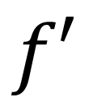


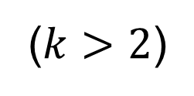
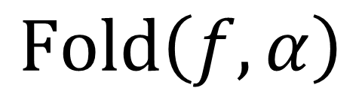



STIR: Shift To Improve Rate
$$n$$
$$P$$
$$f$$
$$V$$
$$α←𝔽$$
$$n/k$$
($k>2$)
$$Fold\left(f,α\right)$$
Recurse
Domain shift queries
$$n/2$$
$$g$$
Out-of-domain sampling sub-protocol
$$f′$$

Slide 19
Conclusion

Slide 20



Summary
STIR🥣: a new IOPP for RS codes
Queries: $O\left(λ⋅log\left(\frac{log d}{−log\sqrt{ρ}}\right)+log d\right)$
Not covered in this talk:
New efficient degree correction technique
Concretely efficient high-soundness compiler for poly-IOPs
Poly-IOP
+
RS IOPP
(STIR)
=
IOP
galarnon42.github.io
I’m on the postdoc market!
20

