Slide 1
Succinctly-Committing
Authenticated Encryption
Mihir Bellare
University of California San Diego
Viet Tung Hoang
Florida State University
CRYPTO 2024— August 22, 2024

Slide 2
What Should Symmetric Encryption Provide?
Classical encryption
Example: CBC, CTR
Provide privacy only
Many attacks on
TLS, WEP, IPSec
Authenticated encryption Example: GCM, OCB, CCM
Provide privacy and authenticity
Recent attacks show that privacy and auth are not enough
Shadowsocks
Amazon Cloud encryption
Message franking
Subscribe with Google
pw-based key exchange
Tunnel proxy

Slide 3
What We Need: Committing Security
Many definitions [GH03,ABN10, FOR17, GLR17,ADG+22, MLGR23, BH22, CR22]
Optimally strong and simple
Intuition: It’s hard to produce a ciphertext collision
Enc
C
Enc
Standard schemes (GCM, CCM, ChaCha20/Poly1305) are all broken [GLR17, MLGR23]

Slide 4
The Current Landscape of Committing AE
Committing security (bits)
Goal
CTX [CR22]
libsodium
128
96
96
Padding fix [ADG+22]
Padding fix [ADG+22]
64
[BH22]
Want: ≥ 80-bit security (preferably 128-bit), as attacks here are offline
GCM
0
16B
32B
48B
Expansion |C| - |M|

Slide 5
Why Should We Care?
Having 32B Expansion is Undesirable
Legacy software
16B tags are ubiquitous
Real-time app
Energy-constrained device
Commonly 10B tags
[Struik13]: Short tags save energy

Slide 6
The Goal Seems Impossible At The First Glance
Even for empty message
Birthday attack on committing security:
…
Enc
Enc
Enc
Collison?
Implication: For τ-bit expansion, can have at best τ/2 bits of committing security

Slide 7
Implication of The Birthday Attack
Committing
security (bits)
[NSS24]: Bypass impossibility by assuming msg has enough redundancy that is known to encryption
Goal
libsodium
128
CTX [CR22]
Can’t get here
unconditionally
Padding fix [ADG+22]
64
[BH22]
GCM
0
Expansion
16B
32B
48B

Slide 8
Our Work: Achieve Goal for General Messages
What birthday attack actually means:
for 128-bit committing security
What prior work implicitly assume:
Expansion must be a constant for all message length

Slide 9
Bypassing Impossibility: Variable Expansion
Expansion
32B
The eventual expansion is 16B
16B
0
16B
Message length

Slide 10
Today’s Roadmap
1. Achieve 128-bit committing security faster than CTX [CR22]
CTY transform
Standard AE
Committing AE
(32B expansion)
Optimal overhead: Hash(K, N, A)
Tag-based schemes (like GCM or CCM)
2. Shorten ciphertext but still preserve committing strength
Committing AE
(32B expansion)
SC transform
Succinctly
Committing AE
Two AES-256 calls
Need stronger auth
(that is met by CTY)
16B expansion for message ≥ 16B

Slide 11
Achieving Committing AE (With 32B Expansion)
Warmup: The CTX Transform
[CR22]
K
N
A
M
Enc
Standard AE
T
C
H
Issue: AD is processed twice

Slide 12
Improving CTX: Our Transform CTY
K
N
A
M
K
N
Empty AD
Enc
Standard AE
T
C
H
Optimal overhead: hashing AD is inherent for committing security

Slide 13
Small Change But Appreciable Difference
Overhead on GCM (%)
Intel Xeon Gold 6240
5B AD
CTY

Slide 14
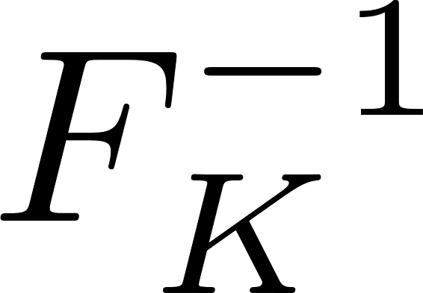
A Stepping Stone for Succinctly-Committing AE
Invertible PRF (IPF) That is Also Collision-Resistant
M
C
C
M
Want:
PRF security
Collision resistance: Hard to find and such that

Slide 15
Why Would Collision-Resistant IPF Help?
Collision-Resistant IPF (with proper domain and range) is an easier version of Succinctly-Committing AE
committing
Succinctly Committing AE
Collision-Resistant IPF
No nonce and AD
N
A
Enc
C
K
M
C
M
Short, say 0B – 16B
arbitrary
constant size, say

Slide 16
How To Use Collision-Resistant IPF
The Shortening-Ciphertext (SC) Transform
Message M
P
S
Collision-resistant IPF
Enc
Key
Committing AE of 32B tag
C
T
R
32B
Expansion , which is 16B for messages at least 16B

Slide 17
SC Preserves Committing Security of Base AE
Message M
P
S
Collision-resistant IPF
Enc
Key
Committing AE of 32B tag
C
T
R
Theorem: For any adversary A, can build adversaries B and D such that

Slide 18
Why SC Preserves Committing Security
Message M
P
S
Commit via AE
C
T
S
Commit via IPF
C
R

Slide 19
How To Build A (Collision-Resistant) IPF?
IPF is a special case of Pseudorandom Injection, another characterization of Misuse-resistant AE [RS06]
Two existing paradigms to build IPF
Encode-then-Encipher (EtE)
SIV
M
pad
M
PRF
IV
IV-based Enc
Blockcipher

Slide 20
Collision-Resistant IPF Via EtE Paradigm
0-16B
Theorem: For an adversary A making q ideal-cipher queries,
M
Blockcipher
K
Can be instantiated from Rijndael-256
C
32B

Slide 21
Collision-Resistant IPF Via SIV Paradigm
The Hash-then-Mask (HtM) Construction
The conceptual view of HtM
128 bits
M
pad
M
pad
E
K
T
T
Instantiate hash functions via (truncated) Davies-Meyer
X
Instantiate E from AES

Slide 22
Collision-Resistant IPF Via SIV Paradigm
The Hash-then-Mask (HtM) Construction
The conceptual view of HtM
128 bits
Build H and G on top of n-bit blockcipher E
M
pad
Theorem: For adversary A making q ideal-cipher queries
T
X

Slide 23
Intuition for Strong Collision Resistance of HtM
There’s a circularity between M and T
M
mask
Can produce a tag collision with birthday attack, but ciphertexts won’t match
Hash
Hash
derive
Proof is very complex due to out-of-order
and backward queries
T
Approach: - Use a tedious case study of how adversary makes queries
- Apply concentration bounds from ball-into-bin analyses

Slide 24
It’s Time To Have Committing AE Standard?
Many apps need committing security but each has its own (suboptimal) scheme
This won’t happen if we have committing AE standards.
Our schemes offer a good starting choice
Standard AE
CTY
Committing AE
(32B expansion)
SC
Succinctly
Committing AE
optimal
cheap

