Slide 1
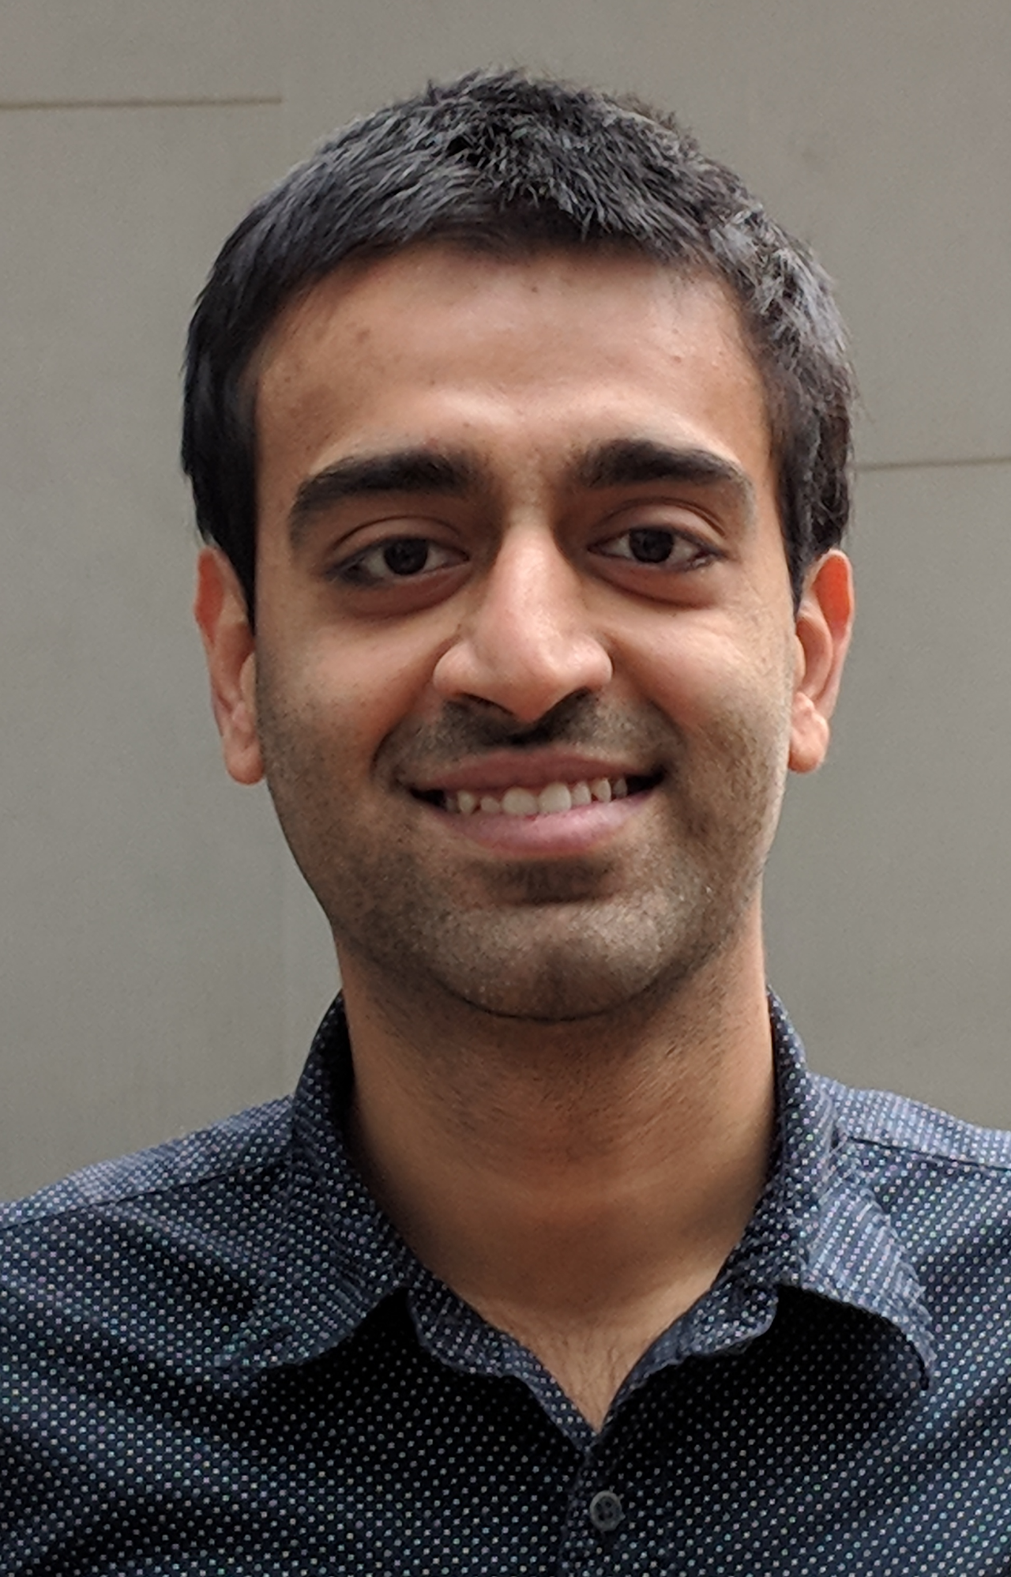
A modular approach to unclonable cryptography
Amit Behera, Prabhanjan Ananth
Ben-Gurion University
UC Santa Barbara
https://arxiv.org/abs/2311.11890
This work was co-funded by the European Union (ERC-2022-COG, ACQUA, 101087742).

Slide 2
Introduction

Slide 3
Unclonable
Quantum Cryptography
Quantum Orange
No Cloning theorem.
Crypto primitives
Unforgeable money, copy-protected program
[Wie83,..,Aar09,AC02,Zha21, AL21,CLLZ21,etc..]
Quantum Computer
Classically
not possible
Notes:
Again, I want to emphasize there is no classical analog for Unclonable cryptography

Slide 4
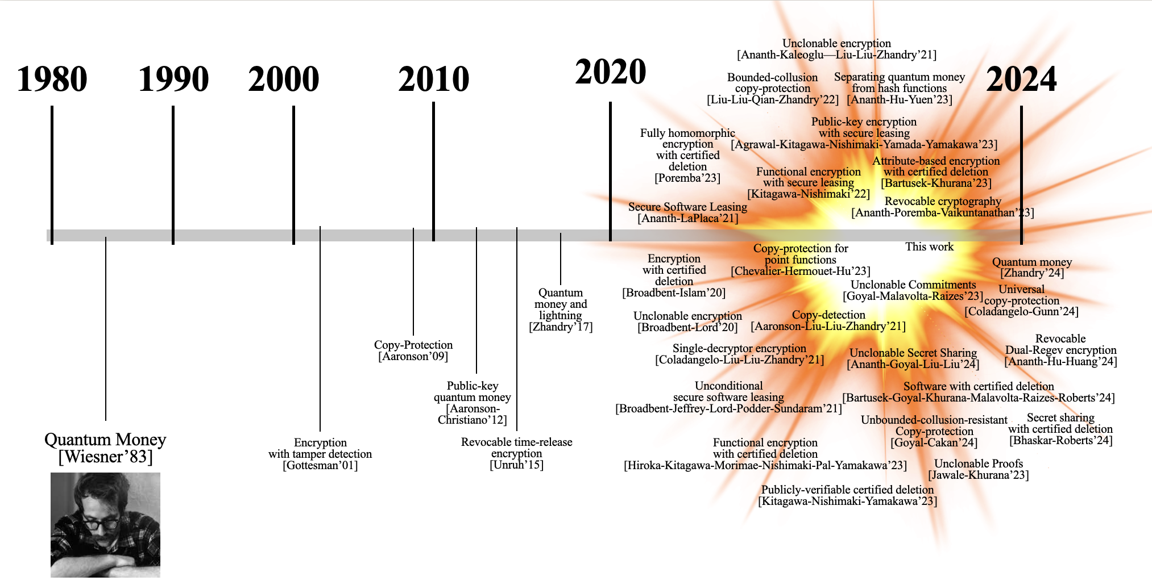
Unclonable Cryptography

Slide 5
Foundational questions in unclonable cryptography

Slide 6
Unclonable Cryptography (UC)
1980
1990
2000
2010
2020
2024
Revocable Cryptography
Revocable dual
regev encryption
Encryption with
certified deletion
Fully homomorphic encryption
with certified deletion
This work
Unclonable proofs
Unclonable secret sharing
Copy-detection
Single-Decryptor Encryption
Functional encryption
with certified deletion
Secure software leasing
Quantum money and lightning
[Zhandry’17]
Secret sharing with
certified deletion
Copy-protection
[Aaronson’09]
Encryption with
certified deletion
Quantum money
[Wiesner’83]
Encryption
with tamper-detection
[Gottesman’01]
Publicly verifiable
certified deletion
Public key quantum money
[Aaronson-Christiano’12]
Revocable time-release encryption
[Aaronson-Christiano’12]
Notes:
Unclonable cryptography started in the 80s with the seminar work of Weisner, and remained pretty static untill 2010s when interstin in UC got reignited. In the last five years, there were an unprecendented number of works in UC.

Slide 7
Quantum money Unforgeable money using quantum states
$$|\$_{1}⟩$$
$$|\$_{2}⟩$$
$$|\$_{3}⟩$$
$Verify$($|\$⟩$)
Notes:
We do not know how to instantiate iO from standard assumptions.

Slide 8
Quantum money Unforgeable money using quantum states
Private Verification: Well understood!
Weisner’s construction [Wie’83], Security analysis [MVW’13], etc.
Can exist without one-way functions as well [Ji-Liu-Song’18].
Public Verification: Not so much!
Generic assumptions: Post-quantum indistinguishability obfuscation [Zhandry’17].
Sophisticated mathematical tools [Farhi-Gosset-Lutomirski-Shor’10, Kane-Sharif-Silverberg’22], etc.
Notes:
We do not know how to instantiate iO from standard assumptions.

Slide 9
Open Problem
Publicly verifiable quantum money from other generic assumptions?
(so far: only know from iO)

Slide 10
Quantum Copy-protection (Correctness) Aaronson’09
$$\text{(}\text{Security}\text{)}$$
B
(A,B,C) are called a non-local adversary
$$x_{B}$$
$${ans}_{B}$$
A
$$σ_{B}$$
$$|f⟩$$
$$x_{B},x_{C}←D$$
$$σ_{C}$$
$Eval$($\left|f\right\rangle ,x$)
C
Challenger
Software company
Challenger
$$f←D_{F}$$
$$ans=f(x)$$
$${ans}_{C}$$
$$|f⟩←Copyprotect(f)$$
For every (A,B,C),
$\operatorname{Pr}\left[ans_{B}=f\left(x_{B}\right), ans_{C}=f\left(x_{C}\right)\right]≈_{negl}Pr⁡[trivial guess]$
Notes:
These kind of adversaries involving adversaries with no communication are called non local adversaries, taking a leaf from quantum non-local games.

Slide 11
Important challenge distributions
$D=D_{Ind}:$ ${(x}_{B},x_{C})$where$x_{B}←D_{B},x_{C}←D_{C}$.
$D=D_{Identical}:$ $\left(x,x\right)$where$x←D′$.

Slide 12
Feasibility of Quantum Copy-protection
Learnable function: trivially impossible
[Ananth-LaPlaca’21]: Showed a class of unlearnable functions that cannot be copy-protected.
Pseudorandom functions: [Coladangelo-Liu-Liu-Zhandry’22]
Point functions: [Coladangelo-Majenz-Poremba’20, Ananth-Kaleoglu-Liu-Liu-Zhandry’22, Ananth-Kaleoglu-Liu’23].
Which classes of functionalities can be copy-protected?
Notes:
Different adversarial structures compared to usual cryptographic primitives.
Many traditional techniques are not applicable.
Feasibility: Hard to find

Slide 13
Feasibility of Quantum Copy-protection
Impossible
Learnable functionalities
Possible
Evasive functions
Signing functionalities
[Liu-Liu-Qian-Zhandry’22]
[Ananth-LaPlaca’21]
Point functions
[Chevalier-Hermouet-Vu’23]
PRFs,
Decryption functionalities
[Coladangelo et al 21]
Which classes of functionalities can be copy-protected?
Notes:
Different adversarial structures compared to usual cryptographic primitives.
Many traditional techniques are not applicable.
Feasibility: Hard to find

Slide 14
Unclonable Encryption (Syntax) Broadbent-Lord’19
Encryption with quantum ciphertext
Encryptor
User
$$|ct_{m}⟩$$
$$k$$
$$k←Keygen\left(1^{λ}\right)$$
$$\left|ct_{m}\right\rangle ←Enc(k,m)$$
$Dec$($k,\left|ct_{m}\right\rangle$)
$$m$$
Notes:
Tuplet of quantum polytime algorithms (Keygen, Enc, Dec)

Slide 15
Unclonable Search Security
Challenger
B
$$k$$
Challenger
$$m_{B}$$
$$σ_{B}$$
A
$$|ct_{m}⟩$$
$$σ_{C}$$
C
Challenger
$$k←Keygen\left(1^{λ}\right)$$
$$m←{\left\{0,1\right\}}^{poly(λ)}$$
$$\left|ct_{m}\right\rangle ←Enc(k,m)$$
$$k$$
$$m_{C}$$
$$m_{B}=m_{C}=m$$
For every (A,B,C), $\operatorname{Pr}\left[ \right]=negl.$
Winning condition

Slide 16
Unclonable Indistinguishable Security
Challenger
B
$$k$$
Challenger
$${(m}_{0},m_{1})$$
$$b_{B}$$
$$σ_{B}$$
A
$$|ct_{b}⟩$$
$$σ_{C}$$
C
Challenger
$$k←Keygen\left(1^{λ}\right)$$
$$b←\left\{0,1\right\}$$
$$\left|ct_{b}\right\rangle ←Enc(k,m_{b})$$
$$k$$
$$b_{C}$$
For every (A,B,C), $\operatorname{Pr}\left[b_{B}=b_{C}=b\right]≈_{ }\frac{1}{2}$
Winning condition
Notes:
Similarly, we can also define Unclonable indistinguishability security where the main difference is that there is puncture points for B and C are the same.

Slide 17
Unclonable Indistinguishable Security
B
$$k$$
Encryptor
$${(m}_{0},m_{1})$$
$$b_{B}$$
$$σ_{B}$$
A
$$|ct_{b}⟩$$
$$σ_{C}$$
$$k←keygen\left(1^{λ}\right)$$
$$b←\left\{0,1\right\}$$
$$\left|ct_{b}\right\rangle ←enc(k,m_{b})$$
C
$$k$$
$$b_{C}$$
For every (A,B,C), $\operatorname{Pr}\left[b_{B}=b_{C}=b\right]≈_{ }\frac{1}{2}$

Slide 18
Feasibility of unclonable Encryption
Unclonable search security (relatively easier):
Using BB84 states [Broadbent-Lord’20]:
(for n-bit messages, the success probability is ${0.85}^{n}$)
Unclonable-Indistinguishable Security (harder):
Using BB84 in QROM [Ananth-Kaleoglu-Li-Liu-Zhandry’22,Ananth-Kaleoglu-Liu’23].
With quantum decryption keys [Ananth-Kaleoglu-Yuen’24].

Slide 19
Open Problem
Unclonable-indistinguishability in the plain model.
Feasibility or impossibility?
Notes:
So the question that remains open here is constructing unclonable indistingiushable encryption in plain model.

Slide 20
Summary of open problems
Quantum Money:
Public-key quantum money from generic assumptions (other than iO).
Copy-Protection:
Characterizing the class of copy-protectable functionalities.
Unclonable Encryption:
Feasibility or impossibility of unclonable-indistinguishable encryption in the plain model.
Need of the hour: Better abstraction!

Slide 21
Summary of open problems
Public quantum money
Quantum Copy protection
Unclonable (indistinguishable) encryption
Improving the generic assumption from iO
Feasibility or infeasibility in the plain
model
Notes:
In summary the main open questions are finding construction of public quantum money from other generic assumptions, pushing and characterizing the feasibility of copy protection, and finally building unclonable encryption in the plain model.
Existing results face similar barriers and rely on similar techniques. This lack of modularity makes it hard to get feasibiility results. Hence we need a better abstraction, which is what we address in this work.
And this is the line of research we pursue in this work.

Slide 22
Need of the hour: Better abstraction
Is there a single tool that resolves some of these questions?

Slide 23
Inspiration from Classical Cryptography
Indistinguishability Obfuscation (iO)
[Garg-Gentry-Halevi-Raykova-Sahai-Waters’13]
Revolutionized classical cryptography
Round complexity of secure multiparty computation
[Garg-Gentry-Halevi-Raykvova’13,...]
Succinct randomized encodings
[Bitansky-Garg-Lin-Pass-Seth-Telang’13,Canetti-Holmgren-Jain-Vaikuntanathan’13,Bishop-Koppula-Waters’15]
Instantiability of random oracle model
[Rothblum-Rothblum-Kalai’16]
Advanced encryption systems for Turing machines and RAM machines
[...,Ananth-Sahai’16,...]
Notes:
Indeed, a similar line of work has been proven fruitful in classical cryptography where the advent of iO produced a great number of feasibility results.

Slide 24
Unclonable Pucturable Obfuscation (UPO)
A new abstraction

Slide 25
Unclonable Pucturable Obfuscation (Syntax)
${|ρ}_{C}⟩←Obf\left(1^{λ},C\right)$
$y←Eval({|ρ}_{C}⟩,x)$
Correctness: For every circuit $C,$
$$Pr\left[y←Eval\left(|ρ_{C}⟩,x\right);{|ρ}_{C}⟩←Obf\left(1^{λ}, C\right):y=C\left(x\right)\right]=1.$$

Slide 26
Circuit classes of interest
Keyed Circuit Classes: $\{C_{k}:k∈{\left\{0,1\right\}}^{poly(λ)}\}$
Puncturable Circuit Classes: Additional QPT algorithm, $Puncture$
$G_{k^{∗}}←Puncture\left(k,x_{B},x_{C}\right)$
where $G_{k^{∗}}\left(x\right)=$
$$C_{k}\left(x\right), x∉\left\{x_{B},x_{C}\right\}$$
$$⊥, x∈\{x_{B},x_{C}\}.$$
Only requires a correctness guarantee so includes all circuit classes!

Slide 27
Unclonable Puncturable Obfuscation Security (Independent security)
B
$$x_{B}$$
Challenger
$$k$$
$$b_{B}$$
$$σ_{B}$$
A
$$|ρ⟩$$
$$σ_{C}$$
C
$$x_{B}, x_{C}←{\left\{0,1\right\}}^{l}$$
$$b←\left\{0,1\right\}$$
If $b=0$,$|ρ⟩ ←Obf\left(C_{k}\right)$
If $b=1, |ρ⟩←Obf\left(G_{k^{∗}}\right),$
where
$G_{k^{∗}}←Puncture\left(k,x_{B},x_{C}\right)$
$$x_{C}$$
$$b_{C}$$
For every (A,B,C), $\operatorname{Pr}\left[b_{B}=b_{C}=b\right]≈_{ }\frac{1}{2}.$
Notes:
We can also think of other challenge distributions on x_B and x_C where x_B and x_C can be arbitrarily correlated. One such challenge distribution is the identical challenge distribution where x_B and x_C are the same string.

Slide 28
Unclonable Puncturable Obfuscation Security (Identical Challenge)
B
$$x$$
Challenger
$$k$$
$$b_{B}$$
$$σ_{B}$$
A
$$|ρ⟩$$
$$σ_{C}$$
C
$$x←{\left\{0,1\right\}}^{l}$$
$$b←\left\{0,1\right\}$$
If $b=0$,$|ρ⟩ ←Obf\left(C_{k}\right)$
If $b=1, |ρ⟩←Obf\left(G_{k^{∗}}\right),$
where
$G_{k^{∗}}←Puncture\left(k,x\right)$
$$x$$
$$b_{C}$$
For every (A,B,C), $\operatorname{Pr}\left[b_{B}=b_{C}=b\right]≈_{ }\frac{1}{2}.$
Notes:
In the identical challenge security, we can also define UPO security for identical challenges where the main difference is that there is puncture points for B and C are the same.

Slide 29
Applications of UPO

Slide 30
Puncturable function classes.
${\left\{C_{k}\right\}}_{k∈K}:$ class of functionalities with long outputs.
For $k∈K$, $Puncture (k, x_{B}, x_{C}))→g_{x_{B},x_{C}}$.
Correctness: $g_{x_{B},x_{C}}\left(x\right)=$
$$C_{k}\left(x\right), x∉\left\{x_{B},x_{C}\right\}$$
$$⊥, x∈\{x_{B},x_{C}\}.$$
$Security:$ Given $g_{x_{B},x_{C}}$ computationally hard to output $C_{k}(x_{B})$ or $C_{k}(x_{C})$ for a randomly sampled $k$ and any $x_{B}, x_{C}.$
Notes:
(Uptill correctness) this is the same as what we saw before with puncturable circuit classes and therefore includes all functionalities, but next we also require the puncturable security definition.

Slide 31
Common puncturable functionalities
Puncuturable PRF.
Puncturable Digital signatures.
Puncturable encryption.

Slide 32
Quantum Copy-Protection: prior works
UPO applications
Impossible
Possible
Learnable functionalities
This work
Puncturable
functionalities
Evasive functions
Signing functionalities
[Liu-Liu-Qian-Zhandry’22]
[Ananth-LaPlaca’21]
Point functions
[Chevalier-Hermouet-Vu’23]
PRFs,
Decryption functionalities
[Coladangelo et al 21]
k-point functions
Evasive function class
with exactly k preimages of 1’s.
Notes:
This is what the picture looked for Copy protection before UPO. UPO showed that not just PRF, signing and decryption functionalities all puncturable function classes are copy-protectable. It also pushed the feasability landscape in the evasive regime as it shows that not just point functions but k-point functions are also copy protectable, where for any k, k-point functions are a functiion class of all boolean functions with exactly k-preimages of 1.

Slide 33
Other applications
UPO + other well-studied assumptions imply:
Unclonable encryption.
First feasibility results in the plain model.
Public quantum money.
Previous works use incomparable assumptions.
Notes:
Not just copy-protection but UPO implies UE and Public quantum money. This demonstrates that UPO is indeed an useful tool for Unclonable cryptography.

Slide 34
Construction

Slide 35
Direct Construction of UPO
UPO exists assuming:
Post-quantum iO.
Learning with Errors.
Simultaneous Inner Product Conjectures (Two different versions).

Slide 36
Subsequent and Concurrent Works
[Coladangelo-Gunn’23] Quantum state indistinguishability obfuscation (quantum state iO):
Application: Copy-protection for decision and search puncturable functionalities.
Construction: in the oracle model [Coladangelo-Gunn’23, Bartusek-Brakerski-Vaikuntanathan’24].

Slide 37
UPO from Quantum State indistinguishability Obfuscation (QSiO)
Quantum state iO + unclonable encryption for bits
UPO
Notes:
This gives evidence that UPO could be an weaker assumption than QsiO

Slide 38
Technical section: How to use UPO

Slide 39
Case study: Copy-protection of puncturable function classes.
$Copyprotect(C_{k})=UPO.obf(C_{k})$.
$Eval\left(ρ,x\right)=UPO.eval\left(ρ,x\right).$

Slide 40
Copy-protection security
B
$${ans}_{B}$$
$$σ_{B}$$
A
$$|C_{k}⟩$$
$$x_{B},x_{C}←D$$
$$σ_{C}$$
Challenger
C
$$C_{k}←D_{F}$$
$${ans}_{C}$$
$$p_{A,B,C}=Pr\left[ans_{B}=C_{k}\left(x_{B}\right), ans_{C}=C_{k}\left(x_{C}\right)\right]$$
Notes:
The intuition being under UPO, it should not be possible to distinguish between the punctured circuit and the unpunctured circuit. By puncturing security, one cannot win in the punctured case and therefore by an hybrid argument this should hold even in the unpunctured true game. But traditional hybrid argument does not work in the non-local case. So here is what we do.

Slide 41
Reduction to UPO security (A’,B’,C’) against UPO
A’
Randomly samples a function $F_{k}$ and sends $k$ to Challenger.
Run A on the state sent by the challenger.
Outputs the output of A along with $f$ for both B’ and C’.
B’
Runs B on the challenge and the output of A.
Check if B’s response is correct using the description of $f$.
Output 0 if B is correct and 1 otherwise.
C’ (Similarly)

Slide 42
Reduction to UPO security (A’,B’,C’) against UPO
B’${ans}_{B}←$
B$\left(x_{B}\right)$
B’ $\left(x_{B}\right)$
$b_{B′}$=$1_{{{ans}_{B}≠C}_{k}(x_{B}) }$
Challenger
$$k$$
$${k,σ}_{B}$$
A’
$$|ρ⟩$$
0 if B succeeds
$${k,σ}_{C}$$
Samples $k$
C’ $\left(x_{C}\right)$
Gets $σ_{BC}←$
A$(ρ)$
B’${ans}_{C}←$
C$\left(x_{C}\right)$
Outputs $(k, σ_{BC} )$
$b_{C′}$=$1_{{{ans}_{C}≠C}_{k}(x_{C}) }$
0 if C succeeds

Slide 43
Reduction to UPO security (A’,B’,C’) against UPO
B’${ans}_{B}←$
B$\left(x_{B}\right)$
B’ $\left(x_{B}\right)$
$b_{B′}$=$1_{{{ans}_{B}≠C}_{k}(x_{B}) }$
Challenger
$$k$$
$${k,σ}_{B}$$
A’
$$|ρ⟩$$
0 if B succeeds
$${k,σ}_{C}$$
Samples $k$
C’ $\left(x_{C}\right)$
Gets $σ_{BC}←$
A$(ρ)$
B’${ans}_{C}←$
C$\left(x_{C}\right)$
Outputs $(k, σ_{BC} )$
$b_{C′}$=$1_{{{ans}_{C}≠C}_{k}(x_{C}) }$
0 if C succeeds

Slide 44
Reduction to UPO security (A’,B’,C’) against UPO
B’
Runs ${ans}_{B}←B(x_{B})$.
Outputs$0 if{{ans}_{B}=C}_{k}\left(x_{B}\right)$
${{1 if ans}_{B}≠C}_{k}(x_{B})$
A’
Samples $F_{k}$
Runs $σ_{BC}←A(ρ)$
Outputs $(k, σ_{BC} )$
$$x_{B}$$
$${k,σ}_{B}$$
UPO
Challenger
$$k$$
$$|ρ⟩$$
UPO
Challenger
$$x_{B},x_{C}←D$$
$$k,σ_{C}$$
C’
Runs ${ans}_{C}←C(x_{C})$.
Outputs$0 if{{ans}_{B}=C}_{k}\left(x_{C}\right)$
${{1 if ans}_{B}≠C}_{k}(x_{C})$
$$x_{C}$$

Slide 45
Reduction to UPO security (A’,B’,C’) against UPO
B’
Outputs
0 if B succeeds
1 if B fails
A’
Samples $F_{k}$
Runs $σ_{BC}←A(ρ)$
Outputs $(k, σ_{BC} )$
$$x_{B}$$
$${k,σ}_{B}$$
UPO
Challenger
$$k$$
$$|ρ⟩$$
UPO
Challenger
$$x_{B},x_{C}←D$$
$$k,σ_{C}$$
C’
Outputs
0 if C succeeds
1 if C fails
$$x_{C}$$

Slide 46
Reduction to UPO security (A’,B’,C’) against UPO
Same view for
A,B,C as CP game
b=0
B’
Outputs
0 if B succeeds
1 if B fails
A’
Samples $F_{k}$
Runs $σ_{BC}←A(ρ)$
Outputs $(k, σ_{BC} )$
$$x_{B}$$
$${k,σ}_{B}$$
UPO
Challenger
$$k$$
$$|ρ⟩$$
UPO
Challenger
$$x_{B},x_{C}←D$$
$$k,σ_{C}$$
C’
Outputs
0 if C succeeds
1 if C fails
$x_{B}, x_{C}←{\left\{0,1\right\}}^{l},$
$|ρ⟩←Obf\left(C_{k}\right)$
$$x_{C}$$
$$\operatorname{Pr}\left[b_{B′}=b_{C′}=0|b=0\right]=_{ }p_{A,B,C}.$$

Slide 47
Reduction to UPO security (A’,B’,C’) against UPO
Puncturing security
b=1
B’
Outputs
0 if B succeeds
1 if B fails
A’
Samples $F_{k}$
Runs $σ_{BC}←A(ρ)$
Outputs $(k, σ_{BC} )$
$$x_{B}$$
$${k,σ}_{B}$$
UPO
Challenger
$$k$$
$$|ρ⟩$$
UPO
Challenger
$$x_{B},x_{C}←D$$
$$k,σ_{C}$$
C’
Outputs
0 if C succeeds
1 if C fails
$x_{B}, x_{C}←{\left\{0,1\right\}}^{l},$
$$G_{k^{∗}}←Puncture\left(k,x_{B},x_{C}\right),$$
$|ρ⟩←Obf\left(G_{k^{∗}}\right)$
$$x_{C}$$
$$\operatorname{Pr}\left[b_{B′}=b_{C′}=1|b=1\right]=_{ }1−negl.$$

Slide 48
Putting the two cases together
$$\operatorname{Pr}\left[b_{B′}=b_{C′}=0|b=0\right]=_{ }p_{A,B,C}.$$
$$\operatorname{Pr}\left[b_{B′}=b_{C′}=1|b=1\right]=_{ }1−negl.$$
$\operatorname{Pr}\left[b_{B′}=b_{C′}=b\right]=_{ }\frac{1−negl+p_{A,B,C}}{2}⇒p_{A,B,C}$ is neglilgible.

Slide 49
Reduction to UPO security (A’,B’,C’) against UPO
Same view for
A,B,C as CP game
b=1
B’
Outputs
0 if B succeeds
1 if B fails
A’
Samples $F_{k}$
Runs $σ_{BC}←A(ρ)$
Outputs $(k, σ_{BC} )$
$$x_{B}$$
$${k,σ}_{B}$$
UPO
Challenger
$$k$$
UPO
Challenger
$$|ρ⟩$$
$$x_{B},x_{C}←D$$
$$k,σ_{C}$$
C’
Outputs
0 if C succeeds
1 if C fails
$$x_{B}, x_{C}←{\left\{0,1\right\}}^{l}$$
$$b←\left\{0,1\right\}$$
$$|ρ⟩←Obf\left(G_{k^{∗}}\right),$$
where
$G_{k^{∗}}←Puncture\left(k,x_{B},x_{C}\right)$
$$x_{C}$$
$$\operatorname{Pr}\left[b_{B′}=b_{C′}=0|b=0\right]=_{ }p_{A,B,C}.$$

Slide 50
Reduction to UPO security (A’,B’,C’) against UPO
B
b=0
B’
Challenger
$$x_{B}$$
Challenger
$$k$$
$$b_{B′}$$
$${k,σ}_{B}$$
A’
$$|ρ⟩$$
0 if B succeeds
$${k,σ}_{C}$$
C
Samples $k$
C’
Challenger
$$x_{B}, x_{C}←{\left\{0,1\right\}}^{l}$$
$$|ρ⟩ ←Obf\left(C_{k}\right)$$
Gets $σ_{BC}←$
A$(ρ)$
$$x_{C}$$
Outputs $(k, σ_{BC} )$
$$b_{C′}$$
$$\operatorname{Pr}\left[b_{B′}=b_{C′}=0|b=0\right]=_{ }p_{A,B,C}.$$
Same view for
A,B,C as CP game
0 if C succeeds
Notes:
Same as saying 1 if B fails

Slide 51
Reduction to UPO security (A’,B’,C’) against UPO
B
b=0
B’
Challenger
$$k$$
$$b_{B′}$$
$$σ_{B}$$
A’
$$|ρ⟩$$
0 if B succeeds
$$σ_{C}$$
C’
C
$$x_{B}, x_{C}←{\left\{0,1\right\}}^{l}$$
$$|ρ⟩ ←Obf\left(F_{k}\right)$$
A
$$b_{C′}$$
$$\operatorname{Pr}\left[b_{B′}=b_{C′}=0|b=0\right]=_{ }p_{A,B,C}.$$
Same view as for A,B,C
0 if C succeeds

Slide 52
Reduction to UPO security (A’,B’,C’) against UPO
B
b=1
B’
Challenger
$$x_{B}$$
Challenger
$$k$$
$$b_{B′}$$
$$σ_{B}$$
A’
$$|ρ⟩$$
1 if B fails
$$σ_{C}$$
C
A
C’
Challenger
$$x_{B}, x_{C}←{\left\{0,1\right\}}^{l}$$
$$b←\left\{0,1\right\}$$
$$|ρ⟩←Obf\left(G_{k^{∗}}\right),$$
where
$G_{k^{∗}}←Puncture\left(k,x_{B},x_{C}\right)$
$$x_{C}$$
$$\operatorname{Pr}\left[b_{B′}=b_{C′}=1|b=1\right]=_{ }1−negl.$$
$$\operatorname{Pr}\left[b_{B′}=b_{C′}=b\right]=_{ }\frac{1−negl+p_{A,B,C}}{2}.$$
$$b_{C′}$$
Puncturing security
1 if C fails
Notes:
Hence by UPO security, p_A,B,C must be negligible.

Slide 53
Conclusion
A new approach to unclonable cryptography via UPO:
Copy-protection for puncturable functionalities.
Copy-protection for a large class of evasive functionalities.
Unclonable enryption.
Public-key quantum money.

Slide 54
Open problems
Coming up with new constructions of UPO without using iO.
Copy-protection of new function classes using UPO.

Slide 55
Thank you!

Slide 56
Details on direct construction

Slide 57
Simultaneous Inner Product Conjecture Identical case
$Q$Prime,
Family of auxiliary quantum states${\left\{ρ_{x}\right\}}_{x∈F_{Q}^{λ}}$
Precondition: For any B,C
$x ← F_{Q}^{λ}$
$$\operatorname{Pr}\left[x_{B}=x=x_{C}\right]=negl$$
$$ρ_{x}$$
B
C
$$x_{B}$$
$$x_{C}$$

Slide 58
Simultaneous Inner Product Conjecture Identical case
$m_{0} = 0, m_{1}←F_{Q}$
$b ← \left\{0, 1\right\}, r ← F_{Q}^{λ}$
$x ← F_{Q}^{λ}$
$$\operatorname{Pr}\left[b_{B}=b=b_{C}\right]=\frac{1}{2}+negl$$
$$ρ_{x}$$
B
C
$$(r,⟨r, x⟩ + m_{b})$$
$$(r,⟨r, x⟩ + m_{b})$$
$$b_{B}$$
$$b_{C}$$

Slide 59
Simultaneous Inner Product Conjecture Independent case
$Q$Prime,
Family of auxiliary quantum states${\left\{ρ_{x}\right\}}_{x∈F_{Q}^{λ}}$
Precondition: For any B,C
$x_{B},x_{C} ← F_{Q}^{λ}$
$$\operatorname{Pr}\left[x_{B}=x_{B}^{′}=x_{C}=x_{C}′\right]=negl$$
$$ρ_{x_{B},x_{C}}$$
B
C
$$x_{B}′$$
$$x_{C}′$$

Slide 60
Simultaneous Inner Product Conjecture Independent case
$m_{0} = 0, m_{1}^{B},m_{1}^{C}←F_{Q}$
$b ← \left\{0, 1\right\}, r_{B},r_{C} ← F_{Q}^{λ}$
$x_{B},x_{C} ← F_{Q}^{λ}$
$$\operatorname{Pr}\left[b_{B}=b=b_{C}\right]=\frac{1}{2}+negl$$
$$ρ_{x_{B},x_{C}}$$
B
C
$$(r_{B},⟨r_{B}, x_{B}⟩ + m_{b}^{B})$$
$$(r_{C},⟨r_{C}, x_{C}⟩ + m_{b}^{C})$$
$$b_{B}$$
$$b_{C}$$

Slide 61
Simultaneous Inner-product conjecture implies Unclonable encryption (Folklore)
Single Decryptor encryption with search security + simultaneous inner product conjecture with identical challenges
Unclonable encryption
Our work shows that the conjecture is also usefule for building other unclonable primitives.

Slide 62
Discussion Necessary assumptions for UPO
If Simultaneous IP is true:
Post-quantum iO implies UPO.
Is iO necessary for UPO? Not clear!
Possibility: UPO is a weaker assumption than iO.
Consequences:
Existing copy protection results from weaker assumptions.
Public quantum money from weaker assumptions.

Slide 63
Discussion Necessary assumptions for UPO
If Simultaneous IP is false:
UPO could still exist!

Slide 64
Construction of UPO
We use a tailored copy-protection of a PRF scheme (using techniques from Coladangelo-Liu-Liu-Zhandry’22).
To obfuscate a circuit C,
Copy protect a PRF key k,
Obfuscate using iO, the following circuit: on input (x, y), output C(x) if and only if y = PRF(k, x).

Slide 65
Conclusion
A new approach to unclonable cryptography via UPO:
Copy-protection for puncturable functionalities.
Copy-protection for a large class of evasive functionalities.
Unclonable enryption.
Public-key quantum money.

Slide 66
What is Cryptography?
Achieving computational tasks
in the presence of adversaries.

Slide 67
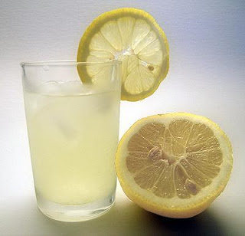
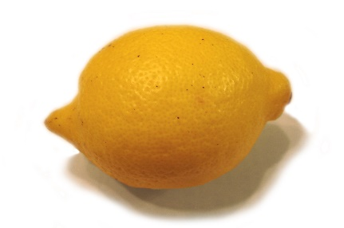
Classical lemons (factoring, discrete log, etc)
Classical Protocols (Encryption, Digital Signatures, etc)
Classical model
of computing
Fundamental tasks
Unforgeable money, Copy-protection, etc.
001010010010…….
Notes:
Classical hard problems easy on quantum computers.
Classically secure protocols aren't safe against quantum adversaries.
Shor’s factoring algorithms.

Slide 68
Quantum Money Wiesner’83
$$|\$_{1}⟩$$
$$|\$_{2}⟩$$
$$|\$_{3}⟩$$
Private Verification
$inf=$secret key
Public verification
$inf=p$ublic key
Bank
${Verify}_{inf}$($|\$⟩$)

Slide 69
Security of Quantum money
$$σ_{1}$$
$$\left|\$_{1}\right\rangle$$
$$Verify(⋅)$$
$$σ_{2}$$
$$Verify(⋅)$$
$$\left|\$_{2}\right\rangle$$
$$\left|\$_{l}\right\rangle$$
QPT adversary
$$σ_{l+1}$$
Notes:
And here is a little illustration of security, if Alice gave the white rabbit 3 tokens, then he could not use those to sign 4 distinct documents. Of course we require it for any polynomial number of tokens given to the adversary. We usually require the adversary to be a QPT algorithm, that is a quantum algorithm that runs in polynomial time. Another thing I want to emphasize is that we give the also give the rabbit access to a verification oracle.

Slide 70
Important challenge distributions
$D=D_{Ind}:$ ${(x}_{B},x_{C})$where$x_{B}←D_{B},x_{C}←D_{C}$.
$D=D_{Identical}:$ $\left(x,x\right)$where$x←D′$.

Slide 71
Unclonable Search Security
B
$$k$$
Encryptor
$$m_{B}$$
$$σ_{B}$$
A
$$|ct_{m}⟩$$
$$σ_{C}$$
$$k←keygen\left(1^{λ}\right)$$
$$m←{\left\{0,1\right\}}^{poly(λ)}$$
$$\left|ct_{m}\right\rangle ←enc(k,m)$$
C
$$k$$
$$m_{C}$$
For every (A,B,C), $\operatorname{Pr}\left[m_{B}=m_{C}=m\right]=negl.$

Slide 72
Need of the hour Better abstraction!
Goals:
Resolves these above questions.
Pedagogical reason: making existing constructions modular.

Slide 73
Preimage samplable evasive function
$F:$ class of evasive functionalities.
There exists an evasive function class $H$, equipped with $GenPuncture (h, x^{∗},1))→g_{x^{∗}}$.
Correctness: $g_{x^{∗}}\left(x\right)=$
$$h\left(x\right), x≠x^{∗}\left\{x_{B},x_{C}\right\},$$
$$1, x=x^{∗}.$$
$Preimage sample$-$ability:$ The following two distributions are computationally indistinguishable:
$(f,x^{∗})$ where $f←F,x^{∗}←f^{−1}\left(1\right).$
$(g_{x^{∗}},x^{∗})$ where $h←H,x^{∗}←{\left\{0,1\right\}}^{ℓ}.$

Slide 74
Common preimage samplable functionalities
Point functions. (Auxilliary function class: 2-point functions)
Boolean functions with exactly k pre-images of 1 or k-point functions.
(Auxilliary function class: (k+1)-point functions)

Slide 75
UPO allows Hybrid argument

Slide 76
Simultaneous Inner Product Conjecture
$$m_{0} = 0, m_{1}←F_{Q}$$
$$b ← \{0, 1\},$$
$$r ← F_{Q}^{λ}$$
$$ρ_{x}$$
B
C

Slide 77
Subsequent and Concurrent Works
[Coladangelo-Gunn’23] Quantum state indistinguishability obfuscation (quantum state iO):
Construction: in the quantum oracle model.
Application: Copy-protection for decision and search puncturable functionalities.
Subsequent work [Bartusek-Brakerski-Vaikuntanathan’24]: quantum state iO in the classical oracle model.

Slide 78
UPO from Quantum State iO? (Our work)
Quantum state iO + unclonable encryption for bits
UPO

Slide 79
Implications (Combined with [Coladangelo-Gunn’23]+[Bartusek-Brakerski-Vaikuntanathan’24])
Best Possible Unclonable encryption relative to a classical oracle.
Feasibility for the copy-protection of a large class of function classes based on a classical oracle.

Slide 80
Introduction
Cryptography: Achieving computational tasks in the presence of adversaries.
Takes a hard problem (lemon) and produces a Protocol (lemonade) that is safe even in the presence of adversaries.

Slide 81
UPO allows Hybrid argument

Slide 82
Simultaneous Inner Product Conjecture
$$m_{0} = 0, m_{1}←F_{Q}$$
$$b ← \{0, 1\},$$
$$r ← F_{Q}^{λ}$$
$$ρ_{x}$$
B
C

Slide 83
Simultaneous Inner Product Conjecture
$$m_{0} = 0, m_{1}←F_{Q}$$
$$b ← \{0, 1\},$$
$$r ← F_{Q}^{λ}$$
$$ρ_{x}$$
B
C

Slide 84
Implications (Combined with [Coladangelo-Gunn’23]+[Bartusek-Brakerski-Vaikuntanathan’24])
Best Possible Unclonable encryption relative to a classical oracle.
Feasibility for the copy-protection of a large class of function classes based on a classical oracle.

