Slide 1
Signatures with Memory-Tight Security in the Quantum Random Oracle Model
草川 恵太/Keita Xagawa (Technology Innovation Institute)
2024-05-19 (Tue) @ EUROCRYPT2024 See also https://eprint.iacr.org/2023/1734

Slide 2
Tightness of reductions
Suppose that we have a reduction 🤖 for an adversary 👾 against primitive
Reduction is tight if Adv(🤖) ≈ Adv(👾) and Time(🤖) ≈ Time(👾)
The looser a reduction is,
the harder the underlying problem is and
the less efficient a scheme is to keep security level
※ Consider Adv(🤖) ≤ q Adv(👾) and Time(🤖) ≈ Time(👾) with different q
🤖
👾

Slide 3
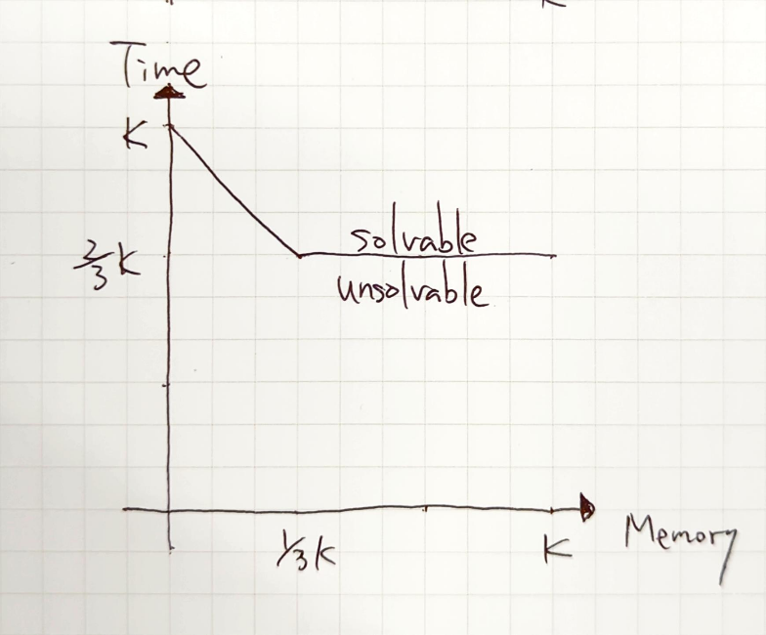
Memory-time trade-off
Some problems allow memory-time trade-off:
3-CR: (2^{(1-α)κ}, 2^{ακ}, O(1))-algorithm for α < 1/3 [JL07]
Factoring, DLOG over prime field, LPN, LWE, etc.
※(Time, Memory, Advantage)
[JL07] Joux and Lucks (ASIACRYPTO2007)

Slide 4
Memory tightness [ACFK17]
While the reduction is tight (Time(🤖) ≈ Time(👾), Adv(🤖) ≈ Adv(👾)) it might be Mem(🤖) ≫ Mem(👾)
→ Time(🤖) ≈ Mem(🤖) in the worst case
👾 = (2²⁵⁶,O(1),O(1)) ⇨ 🤖 can be (2²⁵⁶,2²⁵⁶,O(1)) and the problem can be solvable
Reduction is memory-tight if Mem(🤖) ≈ Mem(👾),
that is, Mem(🤖) – Mem(👾) = poly(k)
🤖
👾
👾
🤖
※(Time, Memory, Advantage)
[ACFK17] Auerbach, Cash, Fersch, Kiltz (CRYPTO2017)

Slide 5
SOTA of memory-tight proofs for signatures
[ACFK17]:
EUF-CMA of RSA-FDH in ROM (Adv. loss: O(q_{s}))
[DGJL21]:
msEUF-CMA of RFS[LID,H] in ROM *
msEUF-CMA of RSA-FDH in ROM **
msEUF-CMA of BLS in ROM **
[GGJT22]:
msEUF-CMA of RSA-PFDH in ROM
* RFS means salted FS, lot of conditions ** The Katz-Wang technique gives tighter sec.
[ACFK17] Auerbach, Cash, Fersch, Kiltz (CRYPTO2017)
[DGJL21] Diemert, Geller, Jager, Lyu (ASIACRYPT2021)
[GGJT22] Ghoshal, Ghosal, Jaeger, Tessaro (EUROCRYPT2022)

Slide 6
Questions on PQC
LID-based signatures: Dilithium, Racoon, G+G, Lossy CSI-FiSh, ALTEQ, etc. PSF-based signatures: Falcon, Mitaka, Zalcon, HAWK, etc.
Q1: Can we construct memory-tight reductions for LID-based signatures?
Q2: Can we construct memory-tight reductions for PSF-based signatures?
Q3: Can we construct memory-tight reductions for advanced securities?
advanced security = PO/BU/sBU
PO: access to quantum signing oracle q times and produce q+1 pairs of (m*,σ*)
sBU: access to quantum filtered signing oracle and produce (m*,σ*) in a filter

Slide 7
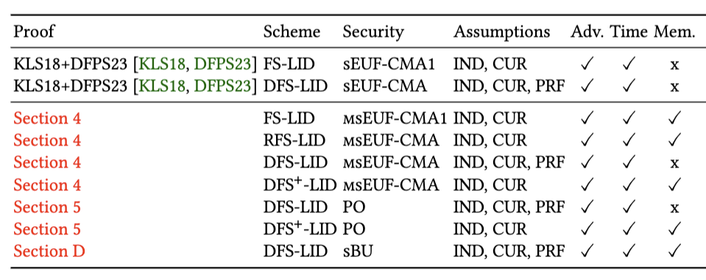
Our results: Memory-tight proofs for FSwA[LID,H,B]
※ [DFMS22] is memory-loose because of adaptive programming and compressed oracle

Slide 8
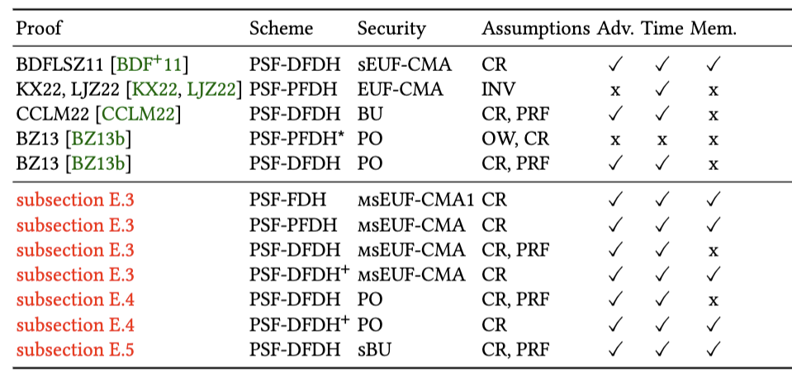
Our results: Memory-tight proof for FDH[PSF,H]

Slide 9
Signature and Security

Slide 10
Signature and sEUF-CMA security
Syntax:
Gen(1^{k}) → (vk,sk)
Sign(sk,m) → σ
Vrfy(vk,m,σ) → 0/1
sEUF-CMA Security:
For any QPT 👾,
Pr[👾^{SIGN}(vk) → (m*,σ*) : Vrfy(vk,m*,σ*) = 1 and (m*,σ*) ∉ Q] = negl.
👾
vk
(vk,sk) ← Gen(1^{k})
m_{i}
SIGN:
σ_{i} ← Sign(sk,m_{i})
Add (m_{i},σ_{i}) to Q
σ_{i}
(m*,σ*)
return Vrfy(vk,m*,σ*)
and (m*, σ*) ∉ Q

Slide 11
Multi-challenge sEUF-CMA security [ACFK17]
msEUF-CMA Security:
For any QPT 👾,
Pr[👾^{SIGN,FORGE}(vk): win = true] = negl.
👾
vk
(vk,sk) ← Gen(1^{k})
m_{i}
SIGN:
σ_{i} ← Sign(sk,m_{i})
Add (m_{i},σ_{i}) to Q
σ_{i}
(m*,σ*)
FORGE:
win ← true
if Vrfy(vk,m*,σ*)
and (m*, σ*) ∉ Q
[ACFK17] Auerbach, Cash, Fersch, Kiltz (CRYPTO2017)

Slide 12
Fiat-Shamir with Aborts on Lossy ID

Slide 13
Lossy Identification (LID) [AFLT12, AFLT16]
LID Syntax:
Gen(1^{k}) → (vk,sk)
LossyGen(1^{k}) → vk*
P₁(sk) → (w,st)
P₂(sk,w,c,st) → z/⊥
V(vk,w,c,z) → 0/1
(w,st) ← P₁(sk)
w
c
c ← C
z ← P₂(sk,w,c,st)
(z may be ⊥)
z
0/1 ← V(vk,w,c,z)
[AFLT12] Abdalla, Fouque, Lyubashevsky, Tibouchi (EUROCRYPT2012)
[AFLT16] Abdalla, Fouque, Lyubashevsky, Tibouchi (JoC 2016)
[KLS18] Kiltz, Lyubashevsky, Schaffner (EUROCRYPT2018)

Slide 14
Lossy ID [AFLT12, AFLT16]
Properties:
Key Indistinguishability: vk ~_{c} vk*
Lossiness: ∀A, Pr[〈A,V〉(vk*)=1] = negl.
SHVZK: ∃PPT Sim s.t. (w,c,z) ← Sim(vk,U(C)) ~_{s} (w,c,z) ← 〈P(sk),V〉(vk)
CUR: hard to find (w,c,z,z’) s.t. V(vk,w,c,z) = V(vk,w,c,z’) = 1
(w,st) ← P₁(sk)
w
c
c ← C
z ← P₂(sk,w,c,st)
(z may be ⊥)
z
0/1 ← V(vk,w,c,z)
[AFLT12] Abdalla, Fouque, Lyubashevsky, Tibouchi (EUROCRYPT2012)
[AFLT16] Abdalla, Fouque, Lyubashevsky, Tibouchi (JoC 2016)
[KLS18] Kiltz, Lyubashevsky, Schaffner (EUROCRYPT2018)

Slide 15
Fiat-Shamir with Abort on LID [Lyu09,AFLT12,KLS18]
Signature FSwA[LID,H,B] :
Gen(1^{k}) → (vk,sk)
Sign(sk,m) → σ = (w,z) (w,st)←P₁(sk) c=H(m,w) z←P₂(sk,w,c,st) repeat until z≠⊥ at most B times
Vrfy(vk,m,σ) → 0/1 c=H(m,w) return V(vk,w,c,z)
Thm. [KLS18]: FSwA[LID,H,B] is sEUF-CMA1 in QROM tightly
(w,st) ← P₁(sk)
w
c = H(m,w)
c
z ← P₂(sk,w,c,st)
repeat until z ≠ ⊥
z
0/1 ← V(vk,w,c,z)
[Lyu09] Lyubashevsky (AC2009)
[AFLT12] Abdalla, Fouque, Lyubashevsky, Tibouchi (EC2012)
[KLS18] Kiltz, Lyubashevsky, Schaffner (EC2018)

Slide 16
Proof sketch for EUF-CMA [PS96,PS00]
G0: Original game
(G1: Derandomize SIGN)
G2: Program H on each signing query
G3: Replace P₁ and P₂ with Sim (SHVZK)
(G4: Abort if (m*,w*) is used by SIGN (CUR))
G5: Use forking lemma to show Pr[👾 wins in G5] is negl.
[PS96] Pointcheval and Stern (EUROCRYPT1996)
[PS00] Pointcheval and Stern (JoC 2000)

Slide 17
Proof sketch for sEUF-CMA1 [AFLT12, KLS18]
G0: Original game
G1: Derandomize SIGN
G2: Program H to return c on (m,w), where SIGN returns (w,c,z) on m
G3: Replace P₁ and P₂ with Sim (SHVZK)
G4: Abort if (m*,w*) is used by SIGN (CUR)
G5: Replace vk with vk* (Key Ind.)
Pr[👾 wins in G5] is negl. (Lossiness)
[AFLT12] Abdalla, Fouque, Lyubashevsky, Tibouchi (EUROCRYPT2012)
[AFLT16] Abdalla, Fouque, Lyubashevsky, Tibouchi (JoC 2016)
[KLS18] Kiltz, Lyubashevsky, Schaffner (EUROCRYPT2018)

Slide 18
Subtle errors in the previous proofs
[DFPS23]:
Fix the previous proof
(s)EUF-CMA proof in QROM adaptive reprogramming [GHHM21]
(s)EUF-CMA1 proof in QROM history-free programming [KLS18]
Give an ill-formed example for unbounded FSwA
[BBD+23]:
Fix the previous proof
EUF-CMA proof in QROM adaptive reprogramming [GHHM21]
machine-verifiable proof in EasyCrypt for EUF-CMA proof in ROM
[DFPS23] Devevey, Fallahpour, Passelègue, Stehlé (CRYPTO2023)
[BBD+23] Barbosa, Barthe, Doczkal, Don, Fehr, Grégoire, Huang, Hülsing, Lee, Wu (CRYPTO2023)

Slide 19
On memory-tightness of sEUF-CMA proofs
[DFPS23]:
sEUF-CMA proof in QROM adaptive reprogramming [GHHM21]
sEUF-CMA1 proof in QROM history-free programming [KLS18]
Problems:
Reprogramming requires q_{S} memory
sEUF-CMA1 proof requires q_{S} memory to maintain Q
[DFPS23] ignores CUR

Slide 20
Proof sketch for sEUF-CMA1 [AFLT12,KLS18,DFPS23]
G0: Original game
G1: Derandomize SIGN
G2: Program H to return c on (m,w), where SIGN returns (w,c,z) on m
G3: Replace P₁ and P₂ with Sim (SHVZK)
G4: Abort if (m*,w*) is used by SIGN (CUR: need to maintain Q)
G5: Replace vk with vk* (Key Ind.: need to maintain Q)
Pr[👾 wins in G5] is negl. (Lossiness)
[AFLT12] Abdalla, Fouque, Lyubashevsky, Tibouchi (EUROCRYPT2012)
[KLS18] Kiltz, Lyubashevsky, Schaffner (EUROCRYPT2018)
[DFPS23] Devevey, Fallahpour, Passelègue, Stehlé (CRYPTO2023)

Slide 21
Our New Proof

Slide 22
Our approach
Problem 1: Reprogramming requires q_{S} memory → Adapt “history-free programming” [AFLT12,KLS18,DFPS23]
Problem 2: msEUF-CMA1 requires q_{S} memory to maintain Q → Modify games to forget Q as [DGJL21]
Problem 3: [DFPS23] ignores CUR → Correct the proof

Slide 23
Proof sketch for msEUF-CMA1
G0: Original game
G1: Derandomize SIGN
G1’: win←true if (w*,z*) ≠ (w⁺,z⁺) generated by SIGN(m*) instead of if (m*,σ*) ∉ Q
G2: Program H to return c on (m,w), where SIGN returns (w,c,z) on m
G3: Replace P₁ and P₂ with Sim (SHVZK)
G4: Abort if (m*,w*) is used by SIGN (CUR)
G5: Replace vk with vk* (Key Ind.)
Pr[👾 wins in G5] is negl. (Lossiness)

Slide 24
Intuition
G1: win←true if (m*,(w*,z*)) ∉ Q
G1’: win←true if (w*,z*) ≠ (w⁺,z⁺) generated by SIGN(m*)
If m* is asked to SIGN, then G1 = G1’
O.w., G1 ≠ G1’ iff 👾 submits (m*,w*,z*) s.t. (w*,z*)=(w⁺,z⁺) for non-asked m*
👾 should guess w⁺ generated by SIGN(m*)
Lemma A: If H∞(w) ≥ α in LID, then H∞(w⁺ | H) ≥ α – lg(B)
Lemma B: The diff. is at most q_{F} B 2^{-α}
See https://ia.cr/2023/1734

Slide 25
Proof sketch for msEUF-CMA1
G0: Original game
G1: Derandomize SIGN
G1’: win←true if (w*,z*) ≠ (w,z) generated by SIGN(m*) instead of if (m*,σ*) ∉ Q
G2: Program H to return c on (m,w), where SIGN returns (w,c,z) on m
G3: Replace P₁ and P₂ with Sim (SHVZK)
G4: Abort if (m*,w*) is used by SIGN (CUR: memory-tight reduction)
G5: Replace vk with vk* (Key Ind.: memory-tight reduction)
Pr[👾 wins in G5] is negl. (Lossiness)
See https://ia.cr/2023/1734 for the full paper

Slide 26
Summary

Slide 27
Summary
Results:
New memory-tight msEUF-CMA security proof for LID-based signatures
New memory-tight sBU and PO security proofs for LID-based signatures
Memory-tight msEUF-CMA security proofs etc. for PSF-based signatures
BU -/-> PO (counterexample of [AMRS20])
Open problems:
Make EUF-CMA security proof for non-PSF-based signatures in the QROM [KX24] memory-tight
Give memory-tight mIND-CCA security proof for PQ-PKE/KEM
ia.cr/2023/1734
[AMRS20] Alagic, Majenz, Russell, Song (EUROCRYPT2020)
[KX24] Kosuge and Xagawa (PKC2024, https://ia.cr/2022/1359)

Slide 28
For questions

Slide 29
PO Securities

Slide 30
(Multi-challenge) Plus-One Security [BZ13a,BZ13b]
Plus-One Security:
Pr[👾^{|SIGN〉,FORGE}(vk): #L > q] = negl.
where L = {(m_{i},σ_{i})} is the list maintained by FORGE
👾
vk
(vk,sk) ← Gen(1^{k})
m_{i}
|SIGN〉:
σ_{i} ← Sign(sk,m_{i})
σ_{i}
(m*,σ*)
FORGE:
if Vrfy(vk,m*,σ*) and (m*,σ*) is new,
then add (m*,σ*) to L
[BZ13a] Boneh, Zhandry (EUROCRYPT2013) : PO for MAC
[BZ13b] Boneh, Zhandry (CRYPTO2013) : PO for Sig

Slide 31
PSF-DFDH is PO-secure in QROM
G0: Original game (Note: win←true if #L > q)
G1: Replace PRF with RF
G2: Replace (SIGN, H): H then Inv with Samp with F
G3: Abort if σ*=Samp(RF(m*)) for any m* in L
Pr[👾 wins in G3] is negl. (Collision-Resistance of PSF)
👾
vk
(vk,sk) ← Gen(1^{k})
m_{i}
|SIGN〉:
y=H(m_{i})
σ_{i} =Inv(sk,m_{i};PRF(m_{i}))
σ_{i}
(m*,σ*)
FORGE:
if Vrfy(vk,m*,σ*) and (m*,σ*) is new,
then add (m*,σ*) to L

Slide 32
Lemma for G2 vs. G3
G3: Abort if σ*=Samp(RF(m*)) for any m* in L
👾 should guess _all_ #L signatures while it queries at most q (<#L) times
Lemma [C:BZ13]: Let H: X → Y be a function, where H(x) is drawn according to D_{x}. Let α = min_{x} H∞(D_{x}). Let 👾 be a quantum adversary making q queries to |H>.
Then, Pr[👾 produces q+1 input/output pairs of H] ≤ (q+1) / floor(2^{α})

Slide 33
Is DFS-LID PO-secure in QROM?
G0: Original game (Note: win←true if #L > q)
G1: Replace PRF with RF
…
Gi’: win←true if (w*,z*) ≠ (w,z) generated by SIGN(m*) instead of if #L > q
(…)
Pr[👾 wins in Gn] is negl. (Lossiness)
👾
vk
(vk,sk) ← Gen(1^{k})
m_{i}
|SIGN〉:
σ_{i} ← Sign(sk,m_{i})
σ_{i}
(m*,σ*)
FORGE:
if Vrfy(vk,m*,σ*) and (m*,σ*) is new,
then add (m*,σ*) to L

Slide 34
Proof Sketch: DFS-LID PO-secure in QROM
G0: Original game (win←true if #L > q)
G1: Replace PRF with RF
G1’: win←true if (w*,z*) ≠ (w,z) generated by SIGN(m*) and #L > q
G1’’: win←true if (w*,z*) ≠ (w,z) generated by SIGN(m*)
G2: Program H to return c on (m,w), where SIGN returns (w,c,z) on m
G3: Replace P₁ and P₂ with Sim (SHVZK)
G4: Abort if (m*,w*) is used by SIGN (CUR: memory-tight reduction)
G5: Replace vk with vk* (Key Ind.: memory-tight reduction)
Pr[👾 wins in G5] is negl. (Lossiness)

Slide 35
Proof Sketch: G1 vs. G1’
G0: Original game (win←true if #L > q)
G1: Replace PRF with RF
G1’: win←true if (w*,z*) ≠ (w,z) generated by SIGN(m*) and #L > q
Observation: G1 and G1’ differ if 👾 outputs (w,z) generated by SIGN(m*) for all m*
Lemma [C:BZ13]: Let H: X → Y be a function, where H(x) is drawn according to D_{x}. Let α = min_{x} H∞(D_{x}). Let 👾 be a quantum adversary making q queries to |H>.
Then, Pr[👾 produces q+1 input/output pairs of H] ≤ (q+1) / floor(2^{α})
Lemma A: If H∞(w) ≥ α in LID, then H∞(w⁺ | H) ≥ α – lg(B)

Slide 36
Proof Sketch: G1’ vs. G1’’
G0: Original game (win←true if #L > q)
G1: Replace PRF with RF
G1’: win←true if (w*,z*) ≠ (w,z) generated by SIGN(m*) and #L > q
G1’’: win←true if (w*,z*) ≠ (w,z) generated by SIGN(m*)
We just relax the winning condition. Thus,
Pr[👾 wins in G1’] ≤ Pr[👾 wins in G1’’]

Slide 37
Proof Sketch: DFS-LID PO-secure in QROM
G0: Original game (win←true if #L > q)
G1: Replace PRF with RF
G1’: win←true if (w*,z*) ≠ (w,z) generated by SIGN(m*) and #L > q (min-entropy)
G1’’: win←true if (w*,z*) ≠ (w,z) generated by SIGN(m*) (relaxation)
G2: Program H to return c on (m,w), where SIGN returns (w,c,z) on m
G3: Replace P₁ and P₂ with Sim (SHVZK)
G4: Abort if (m*,w*) is used by SIGN (CUR: memory-tight reduction)
G5: Replace vk with vk* (Key Ind.: memory-tight reduction)
Pr[👾 wins in G5] is negl. (Lossiness)

Slide 38
BU/sBU Securities

Slide 39
(Multi-challenge) Blinded Unforgeability [AMRS20]
BU Security:
Pr[👾^{|B SIGN〉,FORGE}(vk): win = true] = negl.
where B is a random filter over MS
👾
vk
(vk,sk) ← Gen(1^{k})
m_{i}
|B SIGN〉:
σ_{i} ← Sign(sk,m_{i}) if m_{i} in B, σ_{i} = ⊥
σ_{i}
(m*,σ*)
FORGE:
win ← true
if Vrfy(vk,m*,σ*) and m* in B
[AMRS20] Alagic, Majenz, Russell, Song (EUROCRYPT2020)

Slide 40
(Multi-challenge) strong Blinded Unforgeability [AMRS20]
sBU Security:
Pr[👾^{|B SIGN〉,FORGE}(vk): win = true] = negl.
where B is a random filter
👾
vk
(vk,sk) ← Gen(1^{k})
m_{i}
|B SIGN〉:
σ_{i} ← Sign(sk,m_{i}) if (m_{i},σ_{i}) in B, σ_{i} = ⊥
σ_{i}
(m*,σ*)
FORGE:
win ← true
if Vrfy(vk,m*,σ*) and (m*,σ*) in B
[AMRS20] Alagic, Majenz, Russell, Song (EUROCRYPT2020)

Slide 41
Proof sketch for sBU of DFS-LID
G0: Original game
G1: Replace PRF with RF
G1’: win←true if (w*,z*) ≠ (w,z) generated by SIGN(m*) instead of if (m*,σ*) ∉ Q
G2: Program H to return c on (m,w), where SIGN returns (w,c,z) on m
G3: Replace P₁ and P₂ with Sim (SHVZK)
G4: Abort if (m*,w*) is used by SIGN (CUR: memory-tight reduction)
G5: Replace vk with vk* (Key Ind.: memory-tight reduction)
Pr[👾 wins in G5] is negl. (Lossiness)
See https://ia.cr/2023/1734 for the full paper
Same as msEUF-CMA1 of FS-LID !

Slide 42
Counterexample for BU-/->PO

Slide 43
Counterexample for BU->PO
[AMRS20] conjectured BU->PO
Our Thm.: BU -/-> PO
Consider BU-secure signature SIG
Make it BU-secure but sEUF-CMA-insecure by adding a redundant bit (call it SIG’)
PO -> sEUF-CMA BU -/-> sEUF-CMA Thus, SIG’ cannot be PO-secure
[AMRS20] Alagic, Majenz, Russell, Song (EUROCRYPT2020)

