Slide 1
Garbled Circuit Lookup Tables with Logarithmic Number of Ciphertexts
David Heath (UIUC)
Vladimir Kolesnikov (Georgia Tech)
Lucien K. L. Ng (Georgia Tech)

Slide 2
Multiparty Computation (MPC)
$$x$$
$$y$$
$$f(⋅,⋅)$$
MPC
$$f(x, y)$$

Slide 3
Garbled Circuit (GC)
😄 Constant Rounds
😄 Symmetric Key Primitives
😭 Limited Choices of Gates
Garbler (G)
Evaluator (E)
Garbling Material $M$
(Getting Input Labels)

Slide 4
Circuits as a Composition of Gates
Description of a function F
Composition of XOR & AND
Garbled XOR & AND
XOR gates: $XOR\left(x, y\right)=x⊕y$
AND gates: $AND\left(x, y\right)=x⋅y$
for $x,y∈\{0, 1\}$

Slide 5
Communication Cost: AND and XOR Gates
 | AND Gate | XOR Gate
Classic Yao’s [Yao86] | $$4 κ$$ | $$4 κ$$
Row Reduction [NPS99] | $$3 κ$$ | $$3 κ$$
Free XOR [KS08] | $$3 κ$$ | $$0$$
Half Gate [ZRE15] | $$2 κ$$ | $$0$$
3/2 Gate [RR21] | $$≈1.5 κ$$ | $$0$$
35 Years
$κ=128$ in practice

Slide 6
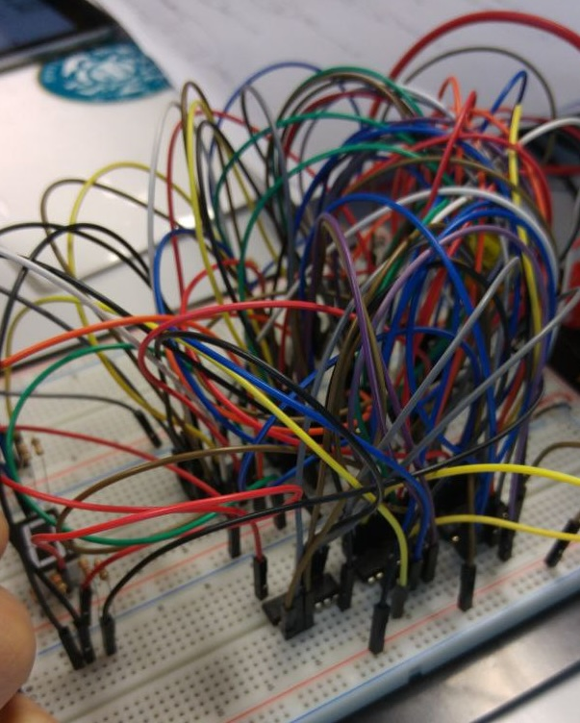
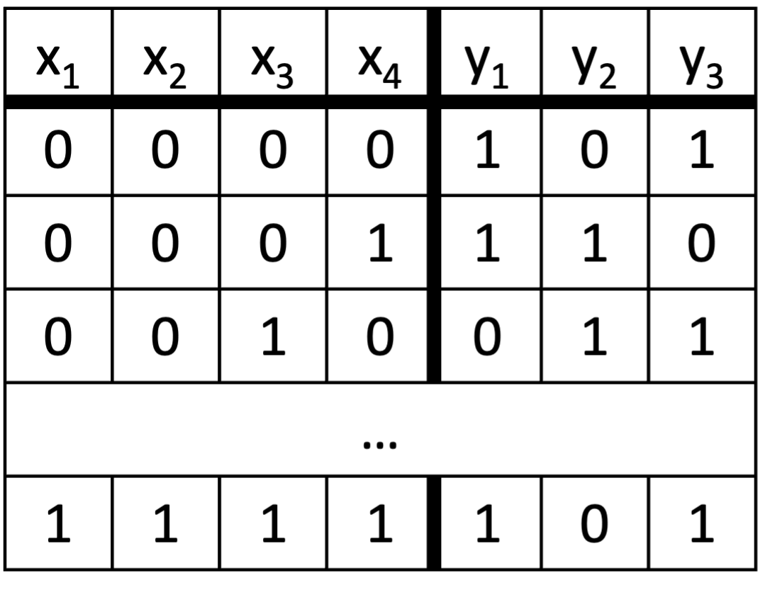
More Expressive Gate: Garbled Lookup Table (GLUT)
vs.
x₁
y₁
x₂
LUT
y₂
x₃
y₃
x₄
(Messy) Fan-in-2 AND-XOR Circuit

Slide 7
LUT Applications
Privacy Preserving Machine Learning (PPML)
LUTs are used to compute highly-complicated functions and operations
SiRnn [RRGGS21] uses 1020-row LUTs for $1/\sqrt{x}$
SecFloat [RBSG22] uses 256-row LUTs to convert fix-points to float-points
Beacon [RBGSS23] uses 2¹²-row LUTs for tanh and sigmoid over half-floats
Deterministic Finite Automata (DFA)
Substring Search (KMP Algorithm)
DNA Pattern Matching
New Opportunity to Optimize Circuits
Analogy to Field Programmable Gate Array (FPGA)

Slide 8
Naïve GLUT
Inputs | Output | Output Labels
$${00}_{2}$$ | $$0_{2}$$
$${01}_{2}$$ | $$0_{2}$$
$${10}_{2}$$ | $$1_{2}$$
$${11}_{2}$$ | $$0_{2}$$
Toy Example: $n=2$ and $x=2={10}_{2}$
Assume G has a $4$-row $1$-column LUT $F$
$$x\left[1\right]=0$$
$$x\left[1\right]=1$$
$$x\left[0\right]=0$$
$$x\left[0\right]=1$$
$$x\left[1\right]=1$$
$$x\left[0\right]=0$$
$$Enc( , )$$
$$Enc( , )$$
$$Enc( , )$$
$$Enc( , )$$
Each row (ciphertext) costs $κ$ bits to send, totaling to $4⋅κ$ bits.

Slide 9
Cost of our GLUT
$n$ = # input bits, $m$ = # output bits
Communication Cost: $≈n\left(m+1\right)κ+2^{n}m$ Bits
Comp. Cost: $O\left(2^{n}(1+\frac{m}{κ})+nm\right)$ Hash Eval + $O(2^{n}mκ)$ Bit Ops.
Compare to Naïve GLUT: Row-by-row encryption for the LUT
$O(2^{n}mκ)$ Bits of Communication
$O\left(2^{n}m\right)$ Hash Eval + $O(2^{n}mκ)$ Bit Ops.

Slide 10
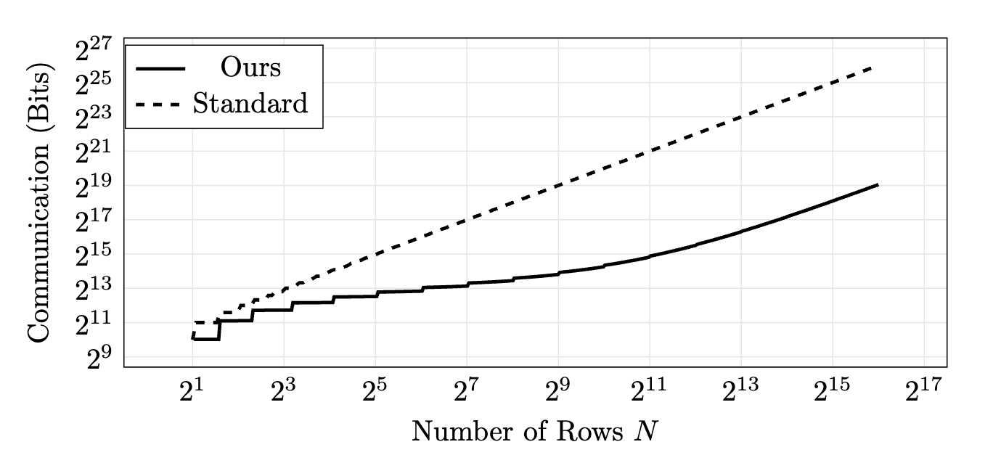
Our GLUT Comm. Cost Improvement
100x
10x
(Number of Rows) $N=2^{n}$
(Number of Columns) $m=8$
(Security Parameters) $κ=128$

Slide 11
Background

Slide 12
Viewing Labels as Garbled (Secret) Sharing
Garbled share of $x∈\{0, 1\}$: $⟦x⟧=≪X^{G},X^{E}≫≝≪X, X⊕x⋅Δ≫$
$Δ∈_{\$}{\left\{0,1\right\}}^{κ}$ is a global key and only known by G
$x⋅Δ=(x⋅Δ_{0},…,x⋅Δ_{κ−1})$
Invariant: $X^{G}⊕X^{E}=x⋅Δ$
$$X∈_{\$}\{0,1\}^{κ}$$
$$X⊕x⋅Δ$$

Slide 13
Passing Secret Sharing into Gates
$$X^{G}$$
$$X^{E}$$
$$x$$
$$Z^{G}$$
XOR GATE
$$z=x⊕y$$
$$y$$
$$Z^{E}$$
$$Y^{G}$$
$$Y^{E}$$
: Logical Value

Slide 14
Free XOR [KS08]
XOR gates require no communication
$⟦x⟧=≪X, X⊕x⋅Δ≫$, $⟦y⟧=≪Y, Y⊕y⋅Δ≫$
$$⟦x⊕y⟧ \\ =≪X⊕Y,(X⊕x⋅Δ)⊕(Y⊕y⋅Δ)≫ \\ =≪X⊕Y,(X⊕Y)+(x⊕y)⋅Δ≫$$
You can verify that the invariant still hold

Slide 15
Remark: Functions and LUTs are equivalent
We can write function $f:{\left\{0, 1\right\}}^{n}→{\left\{0, 1\right\}}^{m}$ into a Boolean vector
$$F=(f\left(0\right), f\left(1\right), …, f(2^{n}−1))$$
Or we define a function according to a LUT
$$f\left(i\right)=F\left[i\right] ∀i∈{\left\{0,1\right\}}^{n}$$
We use upper case to denote TABLE and lower case for function

Slide 16
One-Hot Garbling (OHG) [HK21b]
Assume G and E have $⟦x⟧$, and E knows $x$
$x$ is an $n$-bit integer represented in a vector of Boolean shares
$⟦x⟧=\left(⟦x\left[n−1\right]⟧,…,⟦x\left[0\right]⟧\right)$
G and E can construct a one-hot encoding $⟦H\left(x\right)⟧$
$$0$$
⋮
$$0$$
$$1$$
$$0$$
⋮
$$0$$
$$H(x)[i]=\left\{\begin{aligned}1, x=i \\ &0, o.w.\end{aligned}\right.$$
$$H\left(x\right)=$$
$x$-th

Slide 17
One-Hot Garbling (cont.)
Cost: G sends to E $n⋅κ$ bits, and they compute $O(2^{n})$ hash evals
Inputs:
$$X_{G}$$
$$X_{E}$$
$$x$$
such that $X_{E}=X_{G}⊕xΔ$
$$\text{Hash}(⋅)$$
Outputs:
$$S_{0}$$
$$S_{1}$$
$$S_{2}$$
$$S_{3}$$
$S_{i}∈{\{0,1\}}^{κ}$
$$S_{0}$$
$$S_{1}$$
$$S_{2}⊕Δ$$
$$S_{3}$$
Toy example: $x=2$ as a $n=2$-bit integer

Slide 18
From OHG to Privacy-Free Lookup
Let’s start in the case of clear text
Assume we have a $2^{n}$-row LUT $F$ and a one-hot vector $H(x)$
We can compute $\left\langle F\right.,\left.H(x)\right\rangle =F[x]$
$\left\langle a\right.,\left.b\right\rangle =\sum_{i∈{\left\{0,1\right\}}^{n}}{a_{i}⋅b_{i}}$ is inner-product over $2^{n}$-entry vectors
$$\left\langle F\right.,\left.H(x)\right\rangle =\left\langle \left[\begin{matrix}F[0] \\ \begin{aligned}⋮ \\ F[x] \\ ⋮\end{aligned} \\ F[2^{n}−1]\end{matrix}\right]\right., \left.\left[\begin{matrix}0 \\ \begin{aligned}⋮ \\ 1 \\ ⋮\end{aligned} \\ 0\end{matrix}\right]\right\rangle =$$
$$F\left[0\right] ⋅0$$
$$⊕⋯ \\ ⊕F\left[x\right] ⋅1 \\ ⊕⋯ \\ ⊕F\left[2^{n}−1\right]⋅0$$
$$=F\left[x\right]$$

Slide 19
Privacy-Free Lookup (Cont.)
We assume G and E hold
public $2^{n}×1$ LUT $F$
one-hot garbled share $⟦H(x)⟧$
They compute $⟦F[x]⟧=\left\langle F\right.,\left.⟦H(x)⟧\right\rangle =≪\left\langle F\right.,\left.H{\left(x\right)}^{G}\right\rangle ,\left\langle F\right.,\left.H{\left(x\right)}^{E}\right\rangle ≫$
No Communication thanks to Free XOR!
$$\left\langle \left[\begin{matrix}F[0] \\ \begin{aligned}⋮ \\ F[x] \\ ⋮\end{aligned} \\ F[2^{n}−1]\end{matrix}\right]\right., \left.\left[\begin{matrix}S_{0} \\ \begin{aligned}⋮ \\ S_{x} \\ ⋮\end{aligned} \\ S_{n−1}\end{matrix}\right]\right\rangle$$
$$\left\langle \left[\begin{matrix}F[0] \\ \begin{aligned}⋮ \\ F[x] \\ ⋮\end{aligned} \\ F[2^{n}−1]\end{matrix}\right]\right., \left.\left[\begin{matrix}S_{0} \\ \begin{aligned}⋮ \\ S_{x}⊕Δ \\ ⋮\end{aligned} \\ S_{n−1}\end{matrix}\right]\right\rangle$$
Difference of their shares $=F\left[x\right]⋅S_{x}⊕F\left[x\right]⋅\left(S_{x}⊕Δ\right)=F\left[x\right]⋅Δ$ $⟹\left\langle F\right.,\left.⟦H(x)⟧\right\rangle$ is shares of $F\left[x\right]$

Slide 20
How to Hide the Index?
OHG reveals $x$ to E to construct $⟦H(x)⟧$
But we want privacy-preserving lookup (for arbitrary function $f$)
How can the parties compute $⟦F(x)⟧$ without learning $x$?

Slide 21
Our Approach: logrow

Slide 22
Garbled Lookup Table (GLUT)
Inputs:
LUT of a function $f$
$$A^{G}$$
$$A^{E}$$
such that $⟦a⟧=≪A^{G},A^{E}≫$
Output:
$$Y^{G}$$
$$Y^{E}$$
such that $⟦f(a)⟧=≪Y^{G},Y^{E}≫$
And their views should be simulatable

Slide 23
1st Attempt: Masking the Index
Goal: The parties want to compute $⟦F(a)⟧$
$$⟦a⟧$$
$$α∈_{\$}\{{0,1\}}^{n}$$
$⟦x⟧=⟦a⊕α⟧$ (by injection)
Reveal $a⊕α$
$$x=a⊕α$$
$$⟦H(x)⟧$$
$$bad\left(x\right)≝f(x⊕α)$$
Send $BAD$
$⟦f(a)⟧=$ $\left\langle BAD\right.,\left.⟦H(x)⟧\right\rangle$
because $\left\langle BAD\right.,\left.H(x)\right\rangle =bad\left(a⊕α\right)=f\left(\left(a⊕α\right)⊕α\right)=f(a)$
$$a⊕α$$

Slide 24
2nd Attempt: Masking $bad$
$⟦a⟧$, $⟦x⟧$,$⟦H(x)⟧$
$⟦a⟧$, $⟦x⟧$,$⟦H(x)⟧$, $x=a⊕α$
sample a uniformly random function $r:\{0,1\}^{n}→\{0,1\}m$
$f^{′}\left(x\right)≝f\left(x⊕α\right)⊕r\left(x\right)$
Send $F′$
$F^{′}=π_{α}\left(F\right)⊕R$, and $R$ is a uniformly random mask
$$⟦f^{′}\left(x\right)⟧=\left\langle F′\right.,\left.⟦H(x)⟧\right\rangle =⟦f\left(a\right)⟧⊕⟦r\left(x\right)⟧$$
$$⟦f^{′}\left(x\right)⟧=⟦f\left(x⊕α\right)⊕r\left(x\right)⟧=⟦f\left(a\right)⟧⊕⟦r\left(x\right)⟧$$
$$=\left(a⊕α\right)⊕α=a$$
If G and E have $⟦r\left(x\right)⟧$, they can get $⟦f\left(a\right)⟧=⟦f^{′}\left(x\right)⟧⊕⟦r\left(x\right)⟧$!

Slide 25
Evaluating $⟦r\left(x\right)⟧$
Naively, evaluating a function requires $2^{n}mκ$ bits of communication
Observation: Evaluating $⟦r\left(x\right)⟧$ is an easier than evaluating $⟦f\left(a\right)⟧$
$f$ is an arbitrary function, while $r$ is a uniformly random function
Our core contribution: efficient evaluation of $⟦r\left(x\right)⟧$
$$\left(⟦x⟧,⟦H\left(x\right)⟧\right)→⟦r\left(x\right)⟧$$
Communication Cost: $n⋅m⋅κ$ bits

Slide 26
Half-Hidden Uniform Function
$r_{0}:{\left\{0,1\right\}}^{n}→{\left\{0,1\right\}}^{m}$
If $x\left[n−1\right]=0$, then E knows $X{\left[n−1\right]}^{E}=X{\left[n−1\right]}^{G}$
If $x\left[n−1\right]=1$, then E knows $X{\left[n−1\right]}^{E}=X{\left[n−1\right]}^{G}⊕Δ$
$$X{\left[n−1\right]}^{G}$$
$$X{\left[n−1\right]}^{G}⊕Δ$$
$$Hash(∙)$$
$$Hash(∙)$$
$$R_{0}^{ℓ}≝$$
0 | 1 | 0 | 0
$$R_{0}^{r}≝$$
1 | 1 | 1 | 0
$$R_{0}≝R_{0}^{ℓ}||R_{0}^{r}=$$
0 | 1 | 0 | 0 | 1 | 1 | 1 | 0
Note: $x[n−1]$ is the most significant bit of $x$

Slide 27
Half-Hidden Uniform Function (Cont.)
Goal: G and E compute $⟦r_{0}(x)⟧=\left\langle R_{0}\right.,\left.⟦H(x)⟧\right\rangle$
Toy Example: $x=2$, so $x\left[1\right]=0$
$$S_{2}⊕Δ$$
$$H{\left(x\right)}^{G}:$$
$$S_{0}$$ | $$S_{1}$$ | $$S_{2}$$ | $$S_{3}$$ | $$S_{4}$$ | $$S_{5}$$ | $$S_{6}$$ | $$S_{6}$$
$$H{\left(x\right)}^{E}:$$
$$S_{0}$$ | $$S_{1}$$ | $$S_{2}^{′}$$ | $$S_{3}$$ | $$S_{4}$$ | $$S_{5}$$ | $$S_{6}$$ | $$S_{6}$$
$R_{0}$:
0 | 1 | 0 | 0 | 1 | 1 | 1 | 0
$R_{0}$:
0 | 1 | 0 | 0 | ? | ? | ? | ?
$$\left\langle R_{0}\right.,\left.H{\left(x\right)}^{G}\right\rangle :$$
$$\left\langle R_{0}^{ℓ},{H(x)}_{G}^{ℓ}\right\rangle ⊕\left\langle R_{0}^{r},{H(x)}_{G}^{r}\right\rangle$$
$$\left\langle R_{0}\right.,\left.H{\left(x\right)}^{E}\right\rangle :$$
$$\left\langle R_{0}^{ℓ},{H(x)}_{G}^{ℓ}\right\rangle ⊕ ???$$
$\left\langle R_{0}^{ℓ},{H(x)}_{G}^{ℓ}\right\rangle ⊕Hash\left({X\left[n−1\right]}_{G}⊕Δ\right)$
$\left\langle R_{0}^{r},{H(x)}_{G}^{r}\right\rangle ⊕Hash({X\left[n−1\right]}_{G})$
Communication Cost: $2mκ$ bits

Slide 28
Row Reduction
Let’s halve the communication cost: $2mκ→mκ$ bits
$⟦r_{0}(x)⟧≝\left\langle R_{0}\right.,\left.⟦H\left(x\right)⟧\right\rangle ⊕ ≪Z,Z≫$
$Z≝\left\langle R_{0}^{r},{H(x)}_{G}^{r}\right\rangle ⊕Hash({X\left[n−1\right]}_{G})$
$\left\langle R_{0}^{ℓ},{H(x)}_{G}^{ℓ}\right\rangle ⊕Z⊕Hash\left({X\left[0\right]}_{G}⊕Δ\right)$
$\left\langle R_{0}^{r},{H(x)}_{G}^{r}\right\rangle ⊕Z⊕Hash\left({X\left[0\right]}_{G}\right)=0$

Slide 29
Masking the Open Half via Recursion
$r\left(x\right)≝r_{0}\left(x\right)⊕r′(x\left[0:n−1\right])$
$R_{0}$:
0 | 1 | 0 | 0 | ? | ? | ? | ?
Discarding the most significant bit
$$2^{n}$$
$R′$:
? | ? | ? | ?
$$2^{n}/2$$
Our Problem Now: $\left(⟦x[0:n−1]⟧,⟦H\left(x[0:n−1]\right)⟧\right)→⟦r′\left(x\right)⟧$ for a random $r′:\{0,1\}^{n−1}→\{{0,1\}}^{m}$
Just a smaller version of our current problem!
Original problem: $\left(⟦x⟧,⟦H\left(x\right)⟧\right)→⟦r\left(x\right)⟧$ for random $r:\{0,1\}^{n}→\{{0,1\}}^{m}$

Slide 30
Unwinding the Recursion
$$x$$
$R_{0}$:
0 | 1 | 0 | 0 | 1 | 1 | 1 | 0
$R_{0}$:
0 | 1 | 0 | 0 | 1 | 1 | 1 | 0
$R_{1}$:
1 | 1 | 0 | 1 | 1 | 1 | 0 | 1
$R_{1}$:
1 | 1 | 0 | 1
$R_{2}$:
1 | 0 | 1 | 0 | 1 | 0 | 1 | 0
$R_{2}$:
1 | 0
$R_{3}$:
1 | 1 | 1 | 1 | 1 | 1 | 1 | 1
$R_{3}$:
1
$R$:
1 | 1 | 0 | 0 | 0 | 1 | 1 | 0

Slide 31
Putting Everything Together for Getting $⟦F\left(a\right)⟧$
$$⟦a⟧$$
$$α∈_{\$}\{{0,1\}}^{n}$$
$⟦x⟧=⟦a⊕α⟧$ (by injection)
Reveal $a⊕α$
$$x=a⊕α$$
$$⟦H(x)⟧$$
Comm. Cost: $n⋅κ$ bits
$$\left(x_{G},Δ\right)→r_{0}, r_{1},…,r_{n}$$
$${row}_{0},…, {row}_{n−1}$$
$$⟦r(x)⟧$$
Comm. Cost: $n⋅m⋅κ$ bits
$f^{′}\left(x\right)≝f\left(x⊕α\right)⊕r\left(x\right)$
Send $F′$
$$⟦f^{′}\left(x\right)⟧=\left\langle F′\right.,\left.⟦H(x)⟧\right\rangle =⟦f\left(a\right)⟧⊕⟦r\left(x\right)⟧$$
$$⟦f\left(a\right)⟧=⟦f^{′}\left(x\right)⟧⊕⟦r\left(x\right)⟧$$
Comm. Cost: $2^{n}⋅m$ bits
vs. Classic Yao’s $2^{n}⋅m⋅κ$ bit of communication

Slide 32
Garbling Circuit with logrow
😄 Constant Rounds
😄 Symmetric Key Primitives
😄 More Expressive Gate: Garbled Lookup Table
without $κ$ factor blowup on the table size
with #ciphertexts = O(log(table size))

