Slide 1
Pauli Manipulation Detection Codes & Applications to Quantum Communication over Adversarial Channels
Thiago Bergamaschi – UC Berkeley
Eurocrypt 24’

Slide 2
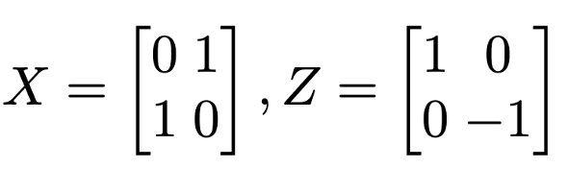
Motivation & Setup: Quantum Error-Detection
Question When can a quantum code, detect an arbitrary Pauli error?
Recall The set of n qubit Pauli operators are tensor products of
bit flip & phase flip operations

Slide 3
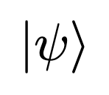
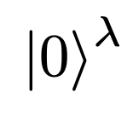
Motivation & Setup: Quantum Error-Detection
Question When can a quantum code, detect an arbitrary Pauli error?
Quantum codes are subspaces of complex, n qubit Hilbert spaces

Slide 4
Motivation & Setup: Quantum Error-Detection
Question When can a quantum code, detect an arbitrary Pauli error?
Quantum codes are subspaces of complex, n qubit Hilbert spaces
Measurement

Slide 5
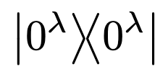
Motivation & Setup: Quantum Error-Detection
Question When can a quantum code, detect an arbitrary Pauli error?
Quantum codes are subspaces of complex, n qubit Hilbert spaces

Slide 6
PMD Codes and their Classical Friends
Def. An PMD code, defined by a subspace , satisfies

Slide 7
PMD Codes and their Classical Friends
Def. An PMD code, defined by a subspace , satisfies
Idea 1. The measurement detects E with high probability:

Slide 8
PMD Codes and their Classical Friends
Def. An PMD code, defined by a subspace , satisfies
Idea 1. The measurement detects E with high probability:
A quantum analog to the Algebraic Manipulation Detection (AMD) codes
[CDF+08], which detect fixed bit-flip errors with high probability.
(independent from internal randomness)

Slide 9
Detecting without Perturbing
Def. An PMD code, defined by a subspace , satisfies
Idea 1. The measurement detects E with high probability:
Idea 2. PMD codes detect errors, without perturbing the corrupted state

Slide 10
Related Classical Work
AMD codes have found ample interest in Crypto & Coding Theory.
Robust Secret Sharing [CDF 08, CDD+ 15, LCG+ 18] …
By combining list-decodable error correcting codes with AMDs
Non-Malleable Codes [DPW 10, CG 13, AGM+ 15] …
A relaxation of error correction & detection, when neither are possible
As well as connections to extractors, MPC, & more.

Slide 11
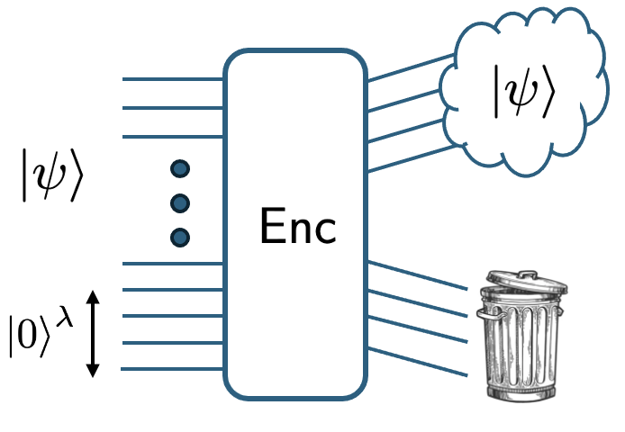
Results & Outline
I. Quantum Secret Sharing on
the Quantum Singleton bound
By combining PMD codes w/
Quantum List Decoding
II. Quantum Tamper-Detection for
Qubit-wise Channels
By combining PMD codes w/
Classical Non-Malleable Codes
III. Constructions
Via pseudorandom stabilizer codes
(not today)

Slide 12
Approximate Quantum Error Correction or Secret Sharing
No-cloning imposes a fundamental limit on Quantum Error Correction

Slide 13
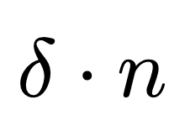
Approximate Quantum Error Correction or Secret Sharing
No-cloning imposes a fundamental limit on Quantum Error Correction
The Quantum Singleton Bound
Goal Approach this bound, efficiently

Slide 14
Approximate Quantum Error Correction or Secret Sharing
No-cloning imposes a fundamental limit on Quantum Error Correction
The Quantum Singleton Bound
Goal Approach this bound, efficiently
Main Theorem A family of codes of rate correcting a
fraction of adversarial erasures, up to inverse-exponential error.

Slide 15
Approximate Quantum Error Correction or Secret Sharing
No-cloning imposes a fundamental limit on Quantum Error Correction
The Quantum Singleton Bound
Goal Approach this bound, efficiently
Main Theorem A family of codes of rate correcting a
fraction of adversarial erasures, up to inverse-exponential error.
The ability to recover implies the secrecy of the erased half. Secret Sharing!
[G99, C99, S00, CGS05, BGG23]

Slide 16
Approximate Quantum Error Correction or Secret Sharing
Classical codes can correct up to n-1 erasures and n/2 errors, exactly.
Question Why do we need approximation? Further coding bounds…

Slide 17
Approximate Quantum Error Correction or Secret Sharing
Classical codes can correct up to n-1 erasures and n/2 errors, exactly.
Question Why do we need approximation? Further coding bounds…
For adversarial errors, can correct exactly only up to n/4 [CGS 05].
For erasures, can correct exactly over qubits only up to ~ n/3
We need approximation to achieve the Singleton Bound
(over small alphabets)

Slide 18
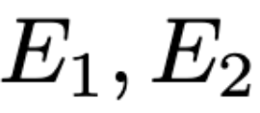
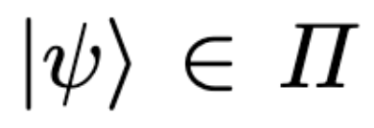
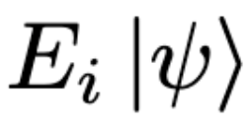
The Sparse Pauli Channel Lemma
Let be two (known) Pauli’s, and some PMD state.
Question Given , can we recover ?

Slide 19
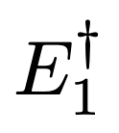
The Sparse Pauli Channel Lemma
Let be two (known) Pauli’s, and some PMD state.
Question Given , can we recover ?
Here’s a simple algorithm
Apply , and measure . If successful, victory!
If unsuccessful, we still have

Slide 20
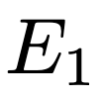
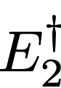
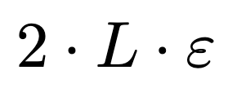
The Sparse Pauli Channel Lemma
Let be two (known) Pauli’s, and some PMD state.
Question Given , can we recover ?
Here’s a simple algorithm
Apply , and measure . If successful, victory!
If unsuccessful, we still have
2. So, revert , apply , and try again!
Lemma Can recover from a list of Pauli’s, up to error

Slide 21
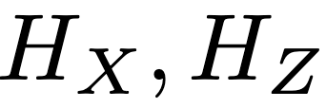
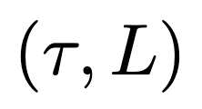
Quantum List Decoding from errors & erasures
CSS Codes are the Quantum Analog of Linear Codes
Specified by two parity check matrices, , satisfying
Def. A Classical Linear code is list-decodable if at most errors (erasure-patterns) of weight agree with any given syndrome.

Slide 22
Quantum List Decoding from errors & erasures
CSS Codes are the Quantum Analog of Linear Codes
Specified by two parity check matrices, , satisfying
Def. A Classical Linear code is list-decodable if at most errors (erasure-patterns) of weight agree with any given syndrome.
Def. [LS08,BGG23,B23] A CSS code is list-decodable if at most distinct errors (erasure-patterns) of weight agree with any given syndrome.
Lemma Efficient erasure list-decodable codes exist.

Slide 23
From List-Decoding to Approximate Quantum Error Correction
To construct an AQECC, we simply compose the two
The syndrome measurement s produces a sparse Pauli Channel, which we list decode into candidate errors
Iteratively try to detect which error occurred, using the PMD

Slide 24
Results & Outline
I. Quantum Secret Sharing on
the Quantum Singleton bound
By combining PMD codes w/
Quantum List Decoding
II. Quantum Tamper-Detection for
Qubit-wise Channels
By combining PMD codes w/
Classical Non-Malleable Codes
III. Constructions
Via pseudorandom stabilizer codes
(not today)

Slide 25
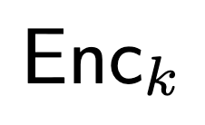
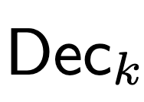
A Detour through Quantum Authentication
In a QAS, a sender and receiver who share a secret key,
communicate a quantum state over an untrusted channel
Either
or
[BCG+02] Quantum Authentication implies Encryption
Question What can we achieve in a keyless, coding setting?

Slide 26
Quantum Tamper-Detection in the “Qubit-wise” Model
Qubits are sent to one of n non-communicating and unentangled adversaries
Either
or
Note fundamentally impossible with classical ciphertexts!
Theorem A Tamper-Detection Code for Qubit-wise channels of rate 1-o(1).

Slide 27
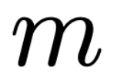
Classical Non-Malleable Codes
Non-Malleability is possible in the bit-wise setting [DPW10]

Slide 28
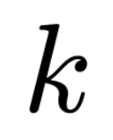
Non-Malleable Secret Keys
Non-Malleability is possible in the bit-wise setting [DPW10]
Idea [B23, BGJR23] Encrypt (OTP) the quantum state using a NM secret key
If k is recovered, state is encrypted: Pauli error on the state
If k is not recovered, state is scrambled:
a product state!

Slide 29
Product-State Evasive Subspaces, which detect Pauli Errors
If k is recovered, state is encrypted: Pauli error on the state
If k is not recovered, state is scrambled:
a product state!

Slide 30
Product-State Evasive Subspaces, which detect Pauli Errors
If k is recovered, state is encrypted: Pauli error on the state
If k is not recovered, state is scrambled:
a product state!

Slide 31
Product-State Evasive Subspaces, which detect Pauli Errors
If k is recovered, state is encrypted: Pauli error on the state
If k is not recovered, state is scrambled:
a product state!

Slide 32
Product-State Evasive Subspaces, which detect Pauli Errors
If k is recovered, state is encrypted: Pauli error on the state
If k is not recovered, state is scrambled:
a product state!
Idea If the state is encrypted, the “best attack” is a Pauli channel.
Use the inner PMD code to detect!

Slide 33
Product-State Evasive Subspaces, which detect Pauli Errors
If k is recovered, state is encrypted: Pauli error on the state
If k is not recovered, state is scrambled:
a product state!
Idea If the state is encrypted, the “best attack” is a Pauli channel.
Use the inner PMD code to detect!
Idea If the state is scrambled, the state is a product-state.
Syndrome measurement should reject! [AN20]

Slide 34
Product-State Evasive Subspaces, which detect Pauli Errors
If k is recovered, state is encrypted: Pauli error on the state
If k is not recovered, state is scrambled:
a product state!
Idea If the state is encrypted, the “best attack” is a Pauli channel.
Use the inner PMD code to detect!
Idea If the state is scrambled, the state is a product-state.
Syndrome measurement should reject! [AN20]
Idea Pseudorandom Pauli pads + concatenation to improve rate.

Slide 35
Future Work
What other forms of Quantum Tamper-Detection are possible?
See [BB23] for exciting developments in the 3-split-state model.
What about Quantum Non-Malleability?
See [BGJR23] addressing the entangled split-state model & secret sharing.
How close can we (efficiently) get to the no-cloning bound?
Bottlenecks in constructing List-Decodable stabilizer codes.
Bounds and new explicit constructions of PMD codes.
Can we match the probabilistic method?

Slide 36
Thanks!

