Slide 1

Polynomial Time
Cryptanalytic Extraction of Neural Network Models
Isaac A. Canales-Martínez
Jorge Chavez-Saab
Anna Hambitzer
Francisco Rodríguez-Henríquez
Nitin Satpute (TII, UAE)
Adi Shamir (Weizmann Institute, Israel)

Slide 2
The Problem We Consider
  Billions of dollars are currently spent on training Deep Neural Networks, which are then provided to the public as a black-box via an API
  How difficult is it to precisely extract (interpolate, steal…) all the internal weights of a black-box DNN?
  More specifically, how many queries and how much time is required to achieve this task, as a function of the #parameters of the network

Slide 3
This problem had been studied for more than 30 years
  In 1993, Blum and Rivest showed that it is NP-hard to decide if a given set of input/output pairs can be realized by this particular 2-layer 3-neuron network.
  However, this was a known input attack, whereas we are interested in a chosen input attack

Slide 4
The best previous result for ReLU-based DNN’s
  At CRYPTO 2020 Carlini, Jagielski and Mironov presented an algorithm that required a polynomial number of queries but an exponential amount of time to process all the given input/output pairs

Slide 5
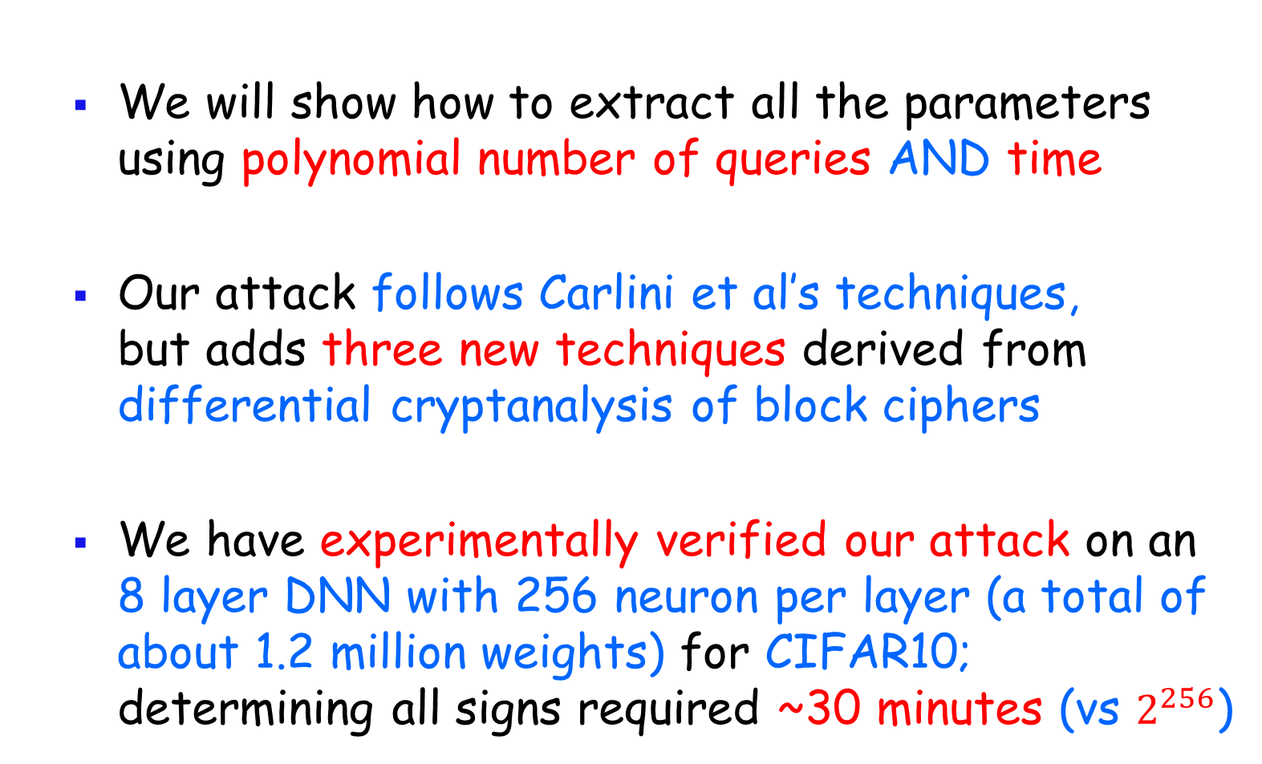
Our new result
  We will show how to extract all the parameters using polynomial number of queries AND time
  Our attack follows Carlini et al’s techniques, but adds three new techniques derived from differential cryptanalysis of block ciphers
  We have experimentally verified our attack on an 8 layer DNN with 256 neuron per layer (a total of about 1.2 million weights) for CIFAR10; determining all signs required ~30 minutes (vs $2^{256}$)

Slide 6
The structure of DNN’s

Slide 7
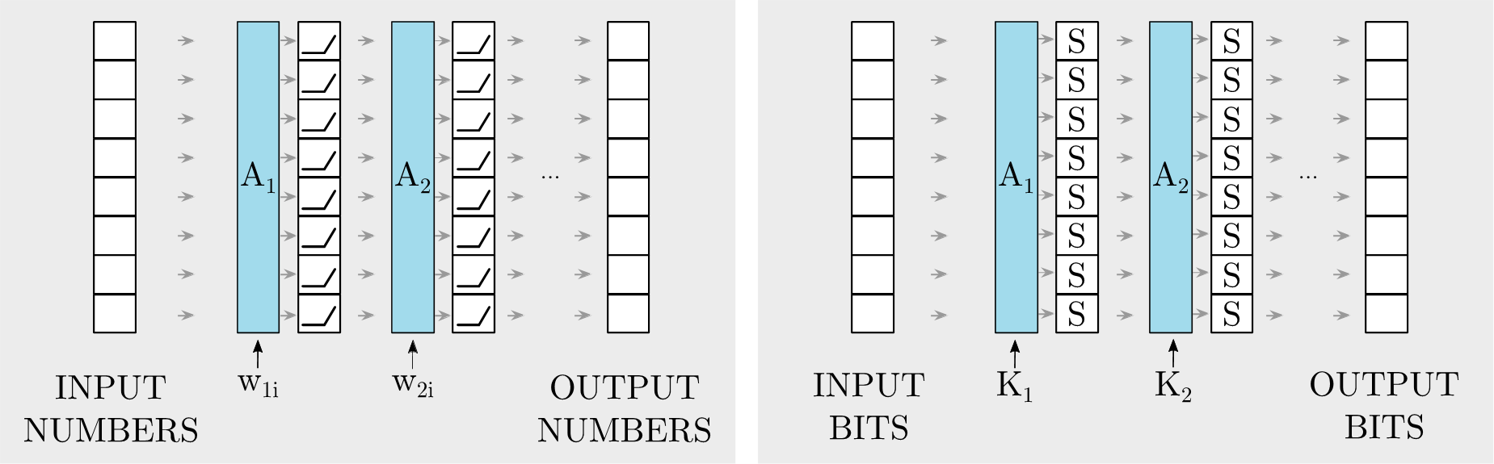
The similarity between DNN’s and block ciphers

Slide 8
Simplifying assumptions in this talk
(all these assumptions can be relaxed)
  Plain vanilla fully connected ReLU-based DNN’s
  Known architecture, with same number d of neurons in each one of r layers
  The neuronal weights and biases, and the network’s inputs and outputs are infinitely precise reals
  Arithmetic operations on such reals take unit time
  Situations that should not happen do not happen

Slide 9
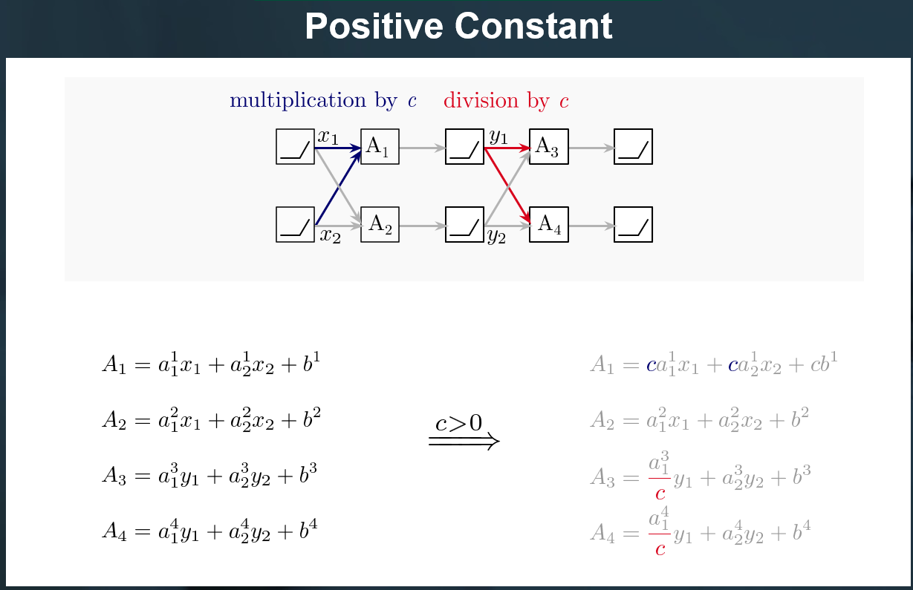
Deep Neural Networks have many symmetries and thus cannot be uniquely defined by queries
  ReLU’s are positively-multiplicatively-linear: ReLU(c*x)=c*ReLU(x) for any c>0 (but not for c<0)

Slide 10
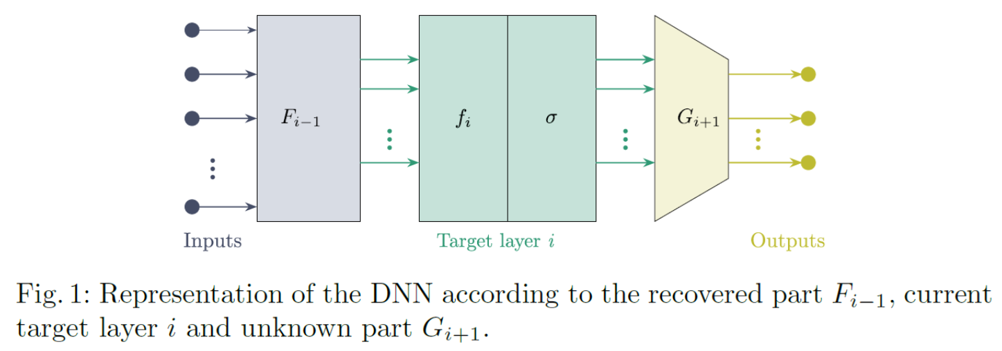
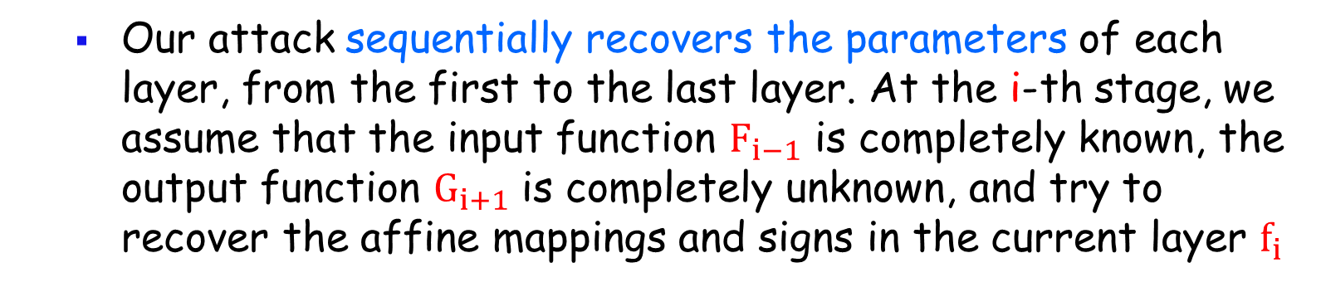
An overview of the attack
  Our attack sequentially recovers the parameters of each layer, from the first to the last layer. At the i-th stage, we assume that the input function $F_{i−1}$ is completely known, the output function $G_{i+1}$ is completely unknown, and try to recover the affine mappings and signs in the current layer $f_{i}$

Slide 11
Critical points in the input space
  A critical point is defined as a point in the input space in which the input to some ReLU is 0
  In the vicinity of any non-critical point x, the DNN behaves as an affine function A
  When we move in the input space in a certain direction and cross some critical point x, the behavior of the function switches from one affine function to a different one

Slide 12
How the input space is partitioned
  We can segment the input space into convex regions (cells) where in each cell the DNN behaves as a different linear mapping. The boundaries are exactly where some ReLU input switches signs

Slide 13
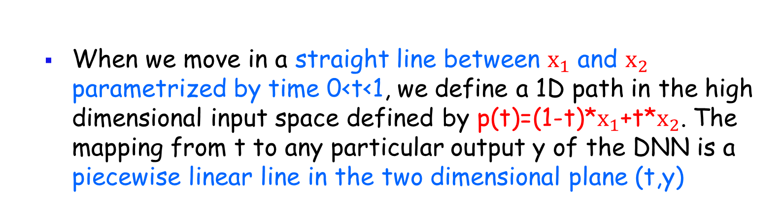
How the input space is partitioned
  When we move in a straight line between $x_{1}$ and $x_{2}$ parametrized by time 0<t<1, we define a 1D path in the high dimensional input space defined by p(t)=(1-t)*$x_{1}$+t*$x_{2}$. The mapping from t to any particular output y of the DNN is a piecewise linear line in the two dimensional plane (t,y)

Slide 14
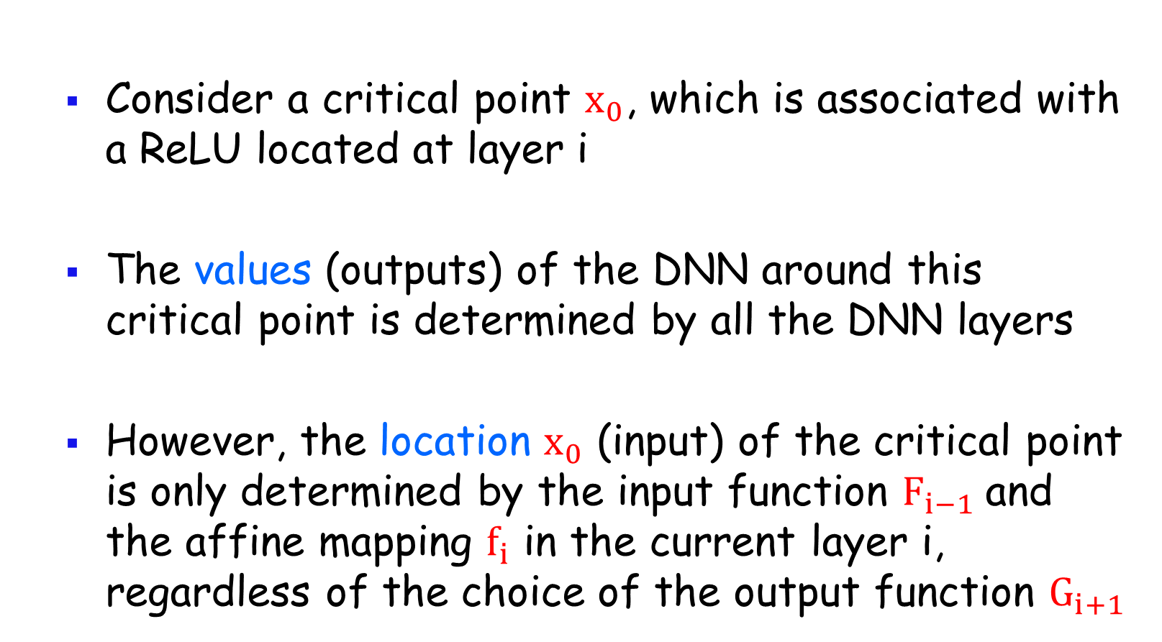
How are critical points defined by DNN layers?
  Consider a critical point $x_{0}$, which is associated with a ReLU located at layer i
  The values (outputs) of the DNN around this critical point is determined by all the DNN layers
  However, the location $x_{0}$ (input) of the critical point is only determined by the input function $F_{i−1}$and the affine mapping $f_{i}$ in the current layer i, regardless of the choice of the output function $G_{i+1}$

Slide 15
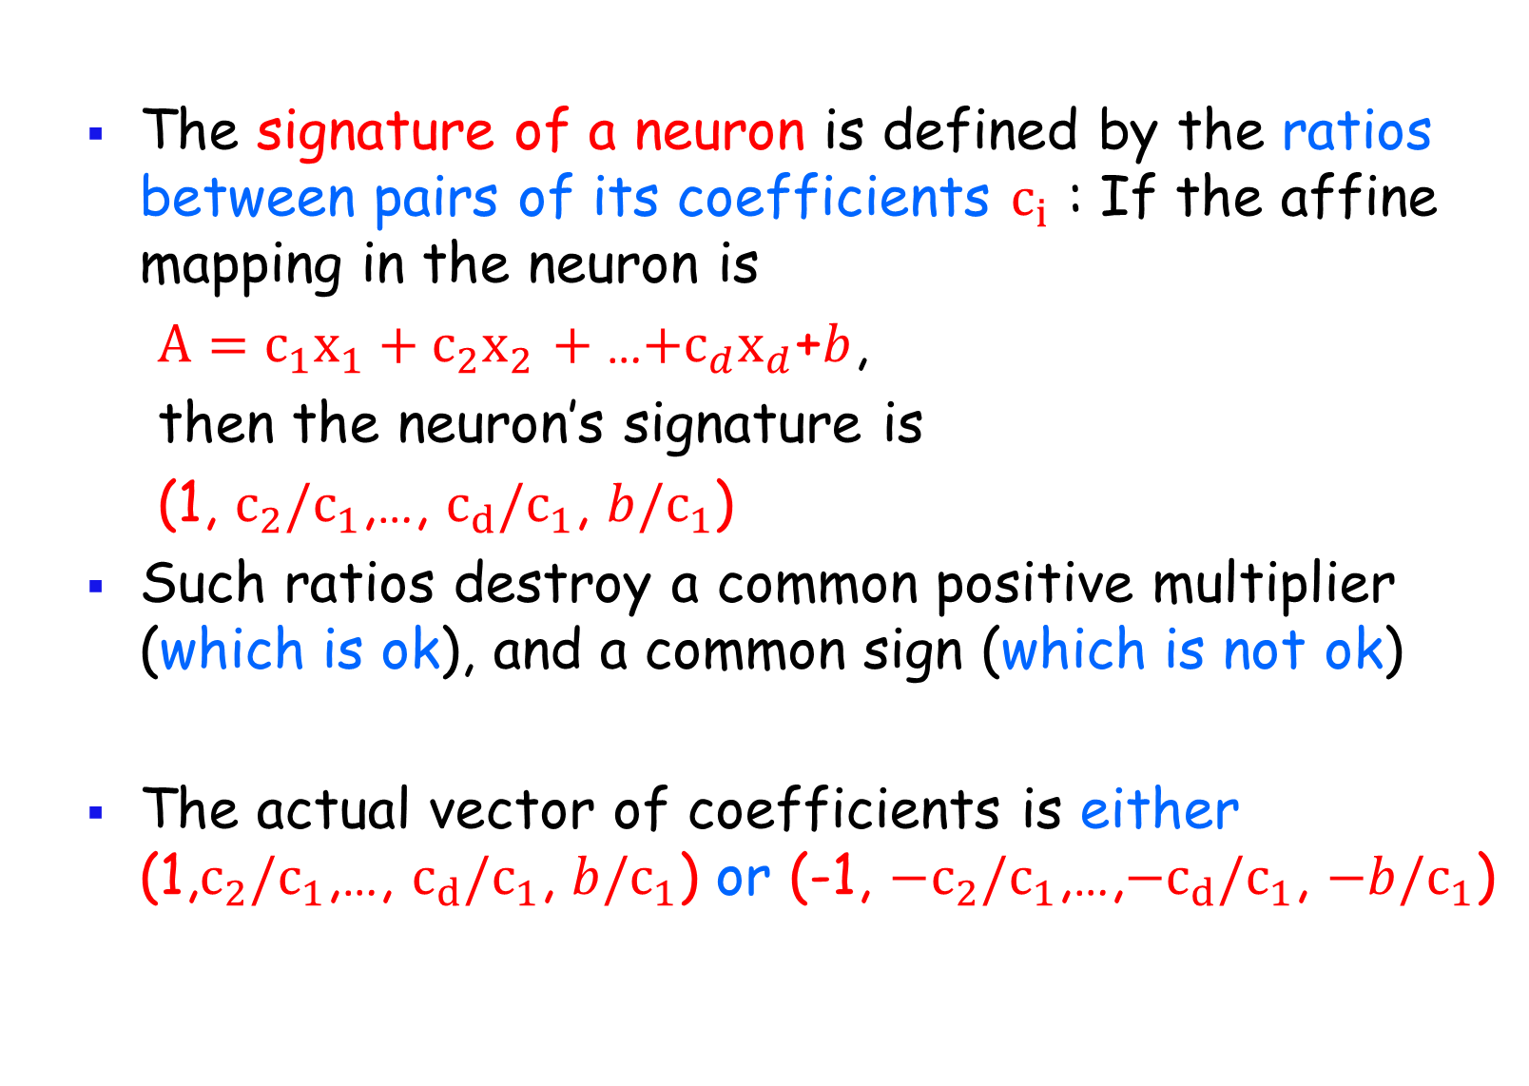
The signature of a neuron
  The signature of a neuron is defined by the ratios between pairs of its coefficients $c_{i}$ : If the affine mapping in the neuron is
  ${A=c}_{1}{x_{1}+c}_{2}x_{2}$ $+$…${{+c}_{d}x}_{d}$+$b$,
  then the neuron’s signature is
  (1, ${c_{2}/c}_{1}$,…, $c_{d}{/c}_{1}$, $b{/c}_{1}$)
  Such ratios destroy a common positive multiplier (which is ok), and a common sign (which is not ok)
  The actual vector of coefficients is either (1,${c_{2}/c}_{1}$,…, $c_{d}{/c}_{1}$, $b{/c}_{1}$) or (-1, ${{−c}_{2}/c}_{1}$,…,${−c}_{d}{/c}_{1}$, $−b{/c}_{1}$)

Slide 16

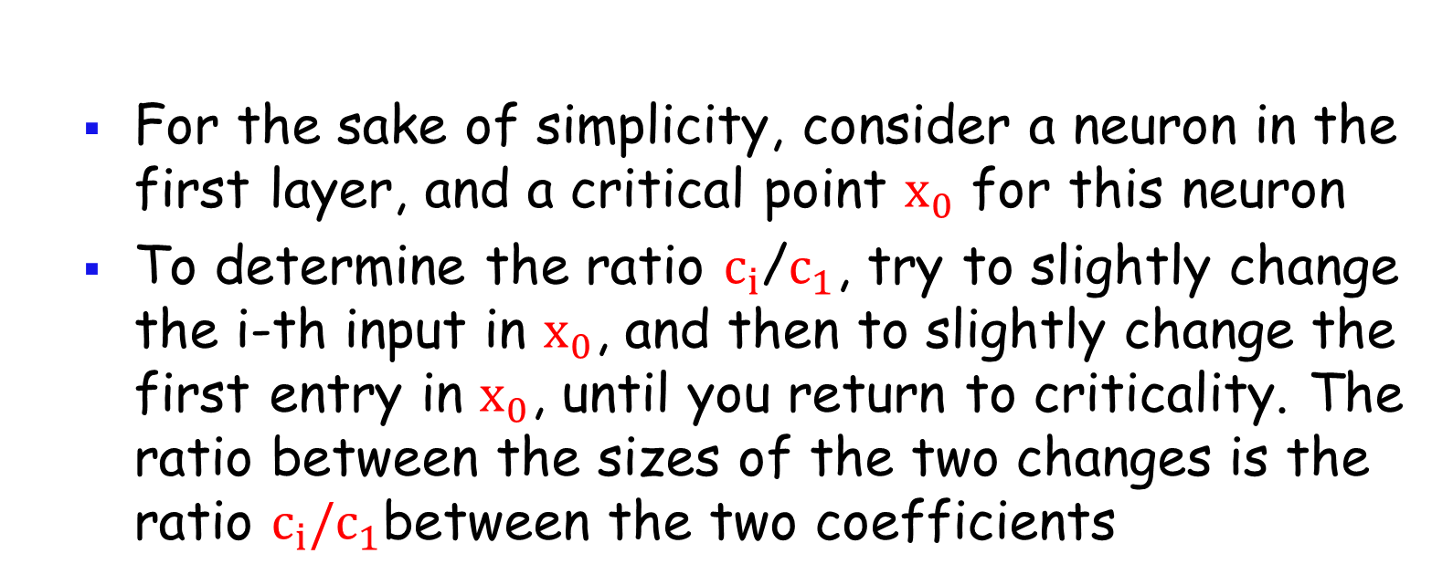
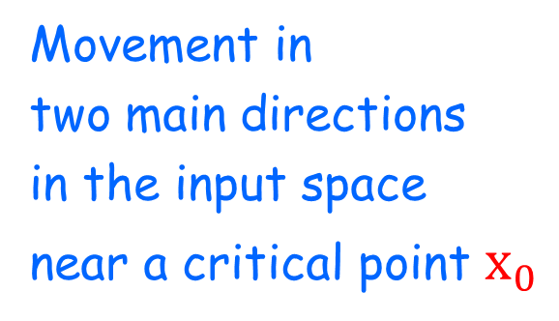

Main idea in CJM paper: Finding the ratio between any two weights in a critical neuron
  For the sake of simplicity, consider a neuron in the first layer, and a critical point $x_{0}$ for this neuron
  To determine the ratio $c_{i}$/$c_{1}$, try to slightly change the i-th input in $x_{0}$, and then to slightly change the first entry in $x_{0}$, until you return to criticality. The ratio between the sizes of the two changes is the ratio ${c_{i}/c}_{1}$between the two coefficients
Movement in
two main directions
in the input space
near a critical point $x_{0}$
${ x′}_{0}$

Slide 17
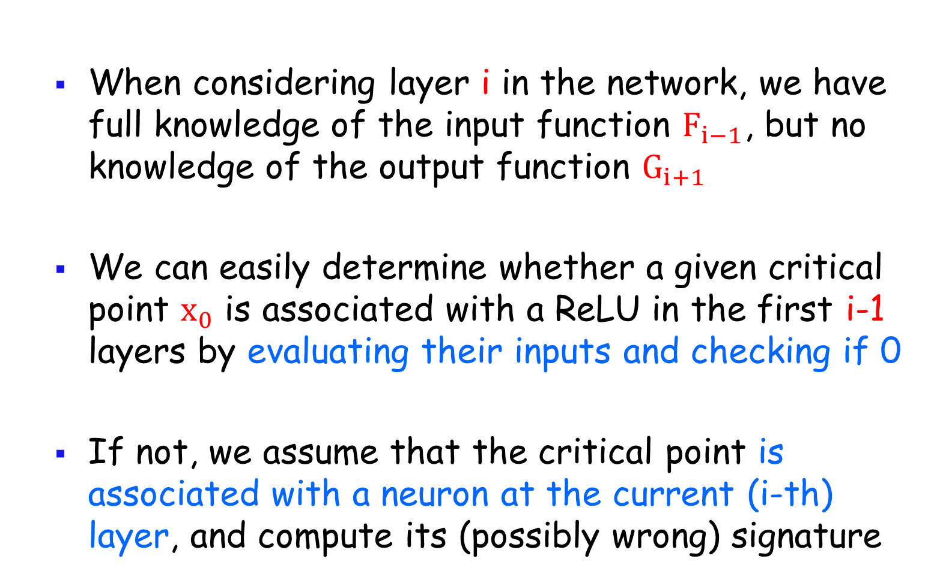
How to determine the layer associated with a critical point
  When considering layer i in the network, we have full knowledge of the input function $F_{i−1}$, but no knowledge of the output function $G_{i+1}$
  We can easily determine whether a given critical point $x_{0}$ is associated with a ReLU in the first i-1 layers by evaluating their inputs and checking if 0
  If not, we assume that the critical point is associated with a neuron at the current (i-th) layer, and compute its (possibly wrong) signature

Slide 18
How to determine the layer associate with a critical point
  We collect the signatures which are associated with a large number of critical points and which are not already known to be in the first i-1 layers
  Among them, every signature which occurs multiple times is assumed to be associated with a neuron in the current layer, and any signature which occurs only once is assumed to be associated with neurons occurring in later layers in the network

Slide 19
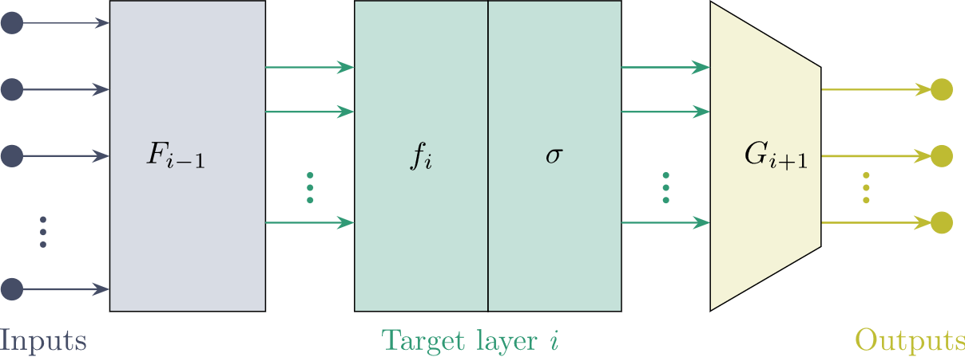
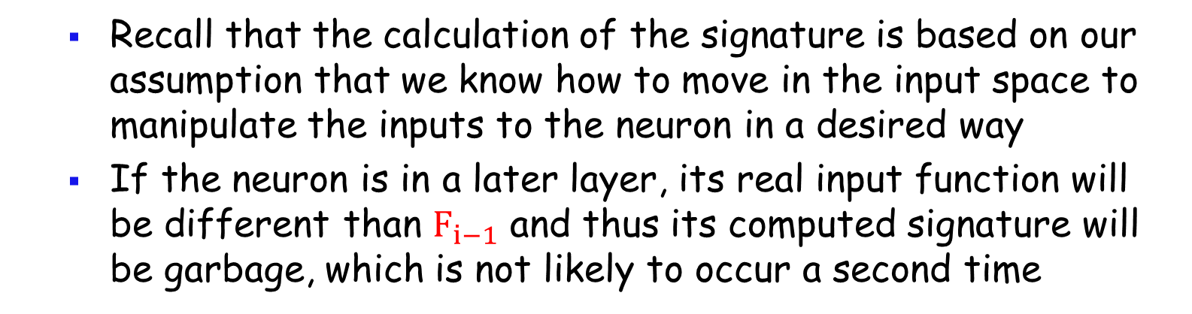
Why this is likely to identify the layer
  Recall that the calculation of the signature is based on our assumption that we know how to move in the input space to manipulate the inputs to the neuron in a desired way
  If the neuron is in a later layer, its real input function will be different than $F_{i−1}$ and thus its computed signature will be garbage, which is not likely to occur a second time

Slide 20
A new technique: Finding the sign of a neuron by vigorously wiggling its output
  Suppose that the affine output of the current neuron is predicted to be -3, but may also be +3
  If we change (wiggle) the output of the affine expression, then a change around -3 will be blocked by the ReLU, while a change around +3 is likely to propagate all the way to the final output
  The problem is that any change in the input space which affects the current neuron is also likely to affect other neurons in the current layer

Slide 21
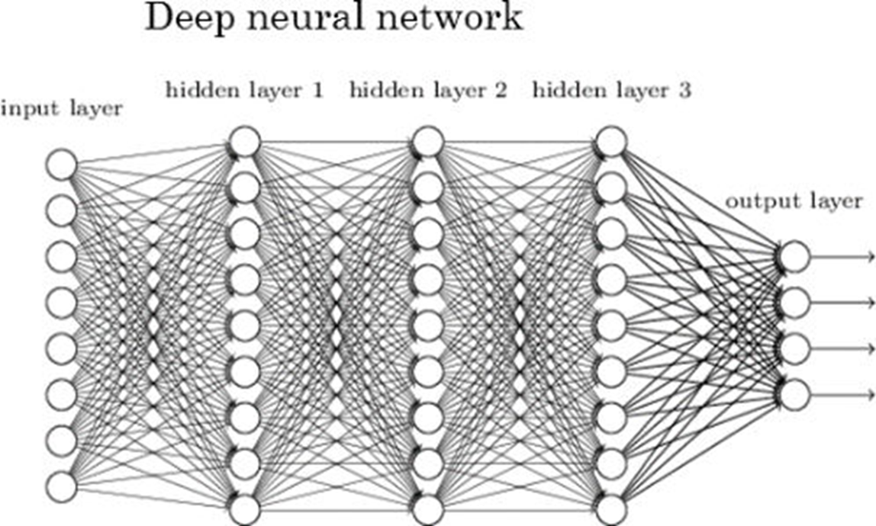
A new technique: Finding the sign of a neuron by vigorously wiggling its output
  We want to maximally wiggle the value of the red neuron with minimal effect on all the other neurons

Slide 22
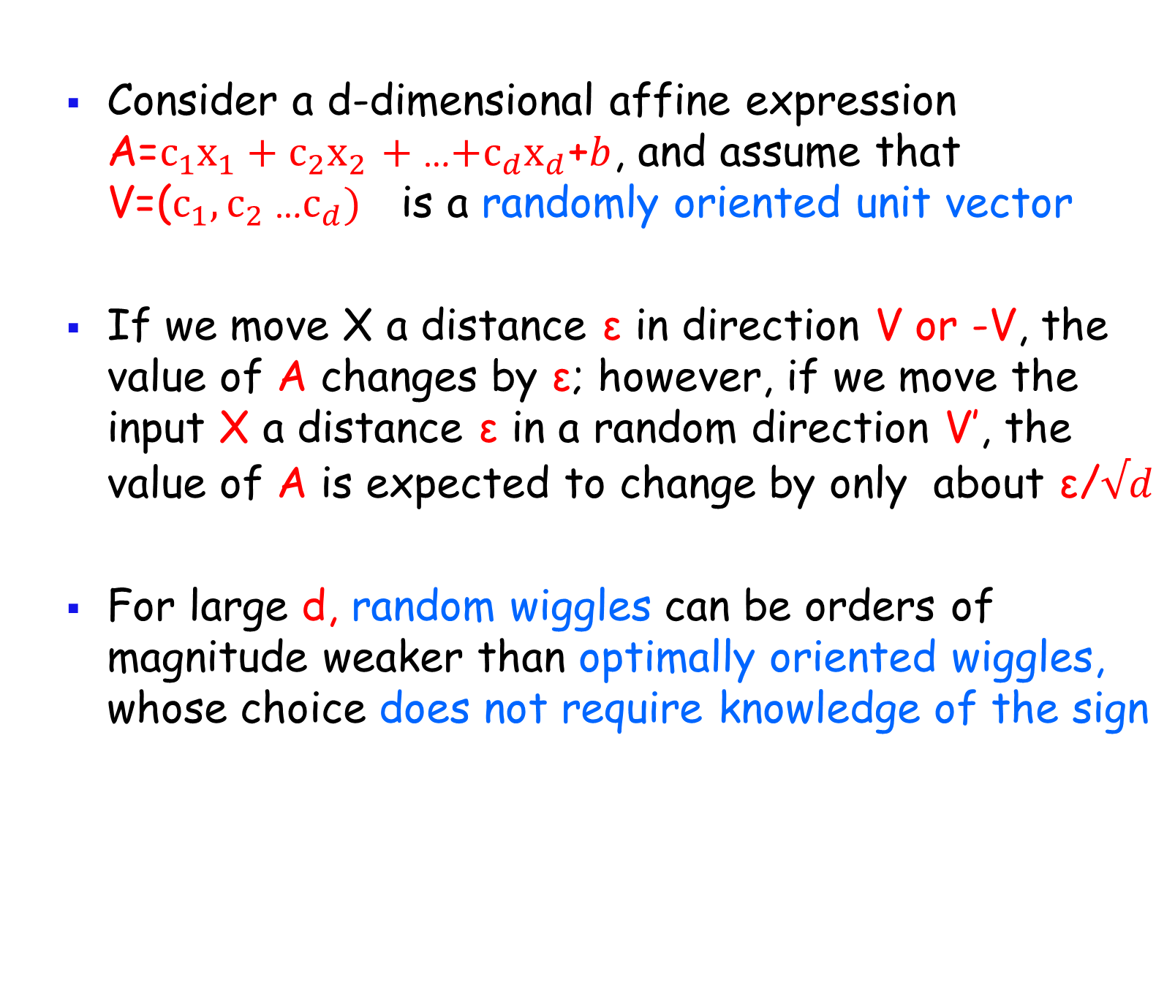
A new technique: Finding the sign of a neuron by vigorously wiggling its output
  Consider a d-dimensional affine expression A=$c_{1}{x_{1}+c}_{2}x_{2}$ $+$…${{+c}_{d}x}_{d}$+$b$, and assume that V=($c_{1}{, c}_{2}$…${c_{d}) }_{}$is a randomly oriented unit vector
  If we move X a distance ε in direction V or -V, the value of A changes by ε; however, if we move the input X a distance ε in a random direction V’, the value of A is expected to change by only about $\text{ε}$/$√d$
  For large d, random wiggles can be orders of magnitude weaker than optimally oriented wiggles, whose choice does not require knowledge of the sign

Slide 23
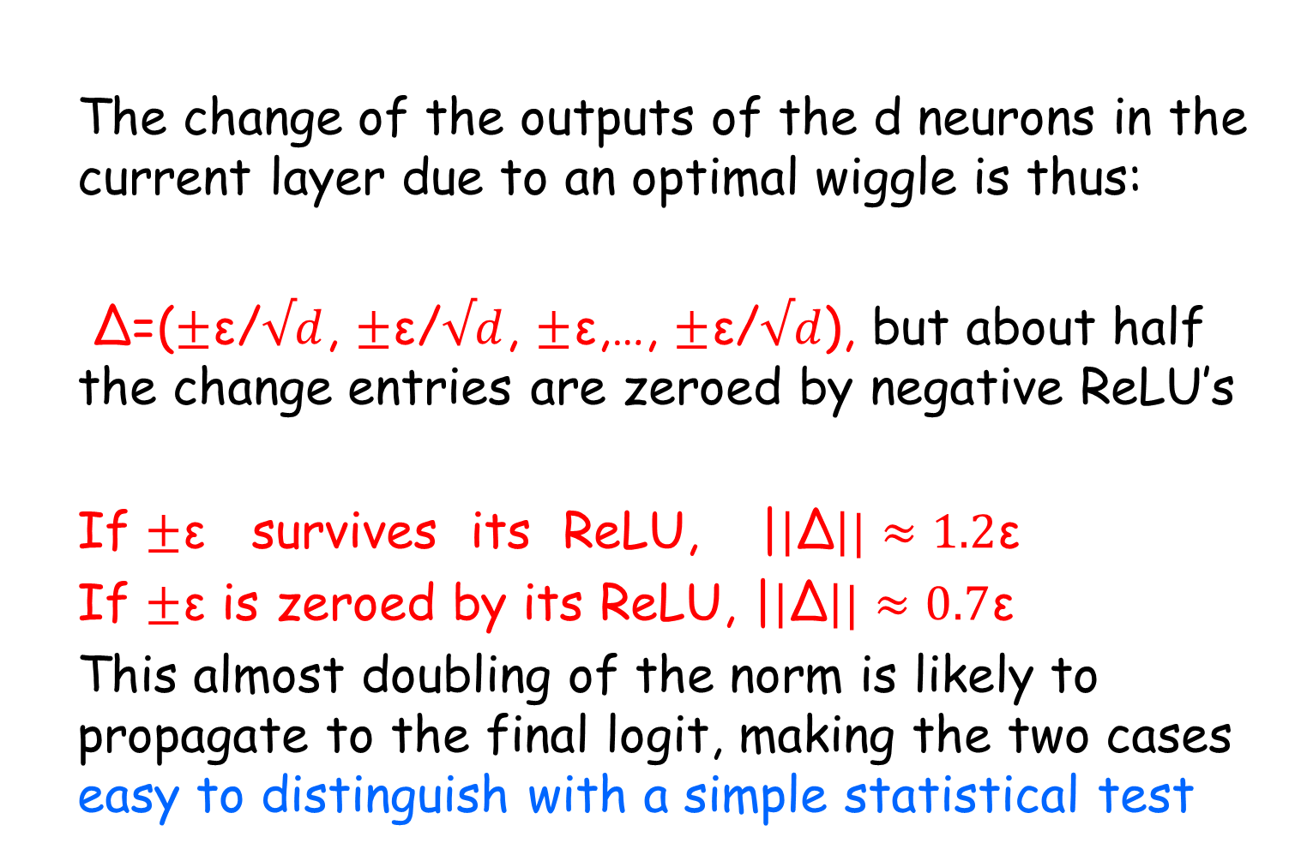
The new idea: wiggle the input vector in a carefully chosen direction
  The change of the outputs of the d neurons in the current layer due to an optimal wiggle is thus:
  Δ=($±\text{ε}$/$√d$, $±\text{ε}$/$√d$, $±\text{ε}$,…, $±\text{ε}$/$√d$), but about half the change entries are zeroed by negative ReLU’s
  If $±\text{ε}$ survives its ReLU, |$\left|\text{Δ}\right||≈1.2\text{ε}$
  If $±\text{ε}$ is zeroed by its ReLU, |$\left|\text{Δ}\right||≈0.7\text{ε}$
  This almost doubling of the norm is likely to propagate to the final logit, making the two cases easy to distinguish with a simple statistical test

Slide 24





Gathering sufficient statistical evidence for the correct sign of a particular neuron
  The black lines are where A=0. The green directions optimally increase the value of L if its sign is correct, and the red directions optimally increase the value of A if its sign is negated. We choose the color that better wiggles the output

Slide 25
Experimental results for an 8-layer, 256-neuron per layer DNN for CIFAR10

Slide 26
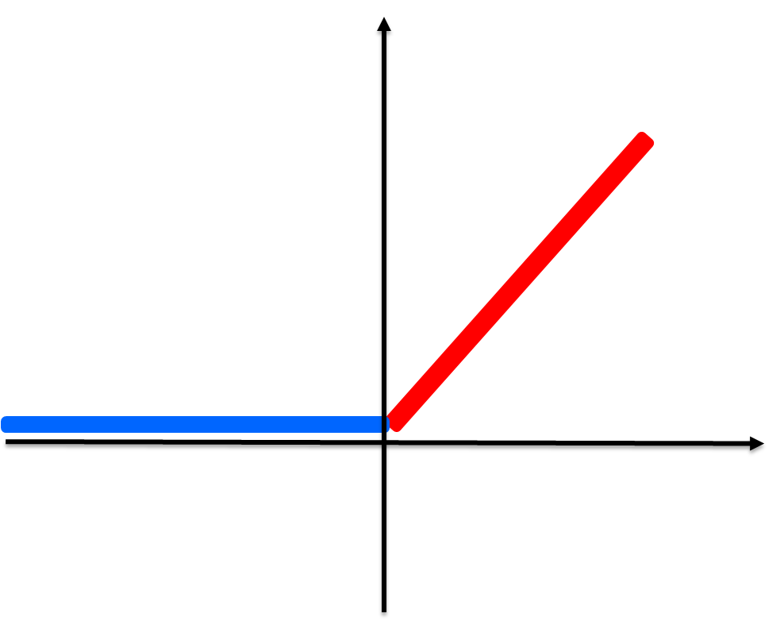
A second technique based on second order differential cryptanalysis
  Consider the two functions of ReLU(A) and ReLU(-A)
  Their second derivatives are exactly the same:

Slide 27
A second technique based on second order differential cryptanalysis
  We can use it to derive a system of linear equations in the coefficients of the output linear mapping
  However, it can only be used to find the weights of the last layer, where the output function is fixed
  Fortunately, this is exactly the layer in which the wiggling technique sometimes struggles, due to insufficient randomization of the output function

Slide 28
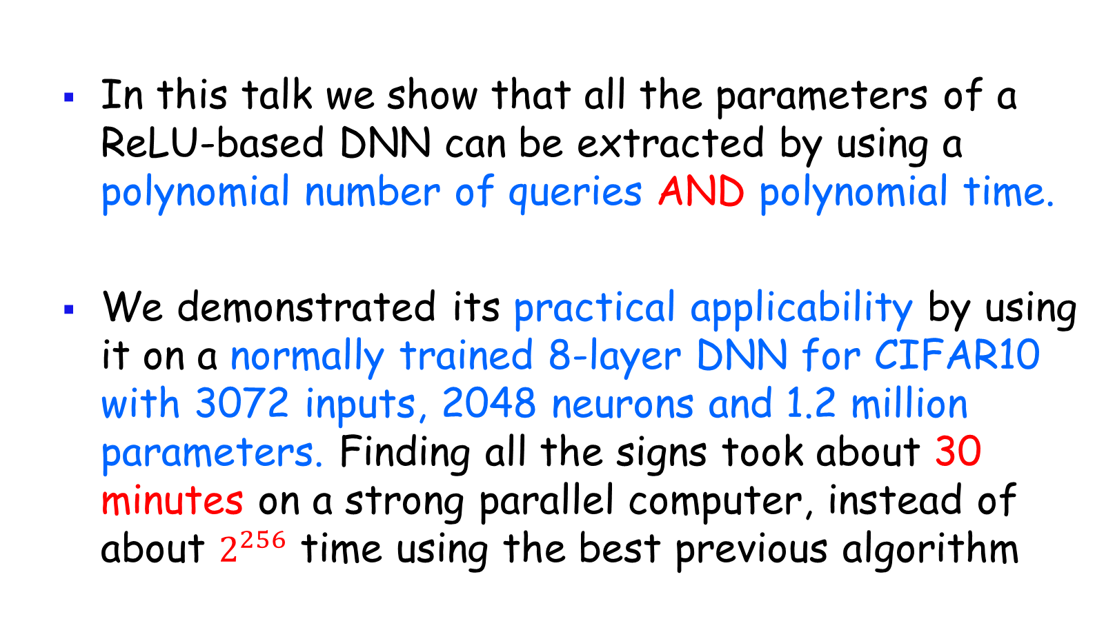
Concluding Remarks
  In this talk we show that all the parameters of a ReLU-based DNN can be extracted by using a polynomial number of queries AND polynomial time.
  We demonstrated its practical applicability by using it on a normally trained 8-layer DNN for CIFAR10 with 3072 inputs, 2048 neurons and 1.2 million parameters. Finding all the signs took about 30 minutes on a strong parallel computer, instead of about $2^{256}$ time using the best previous algorithm

