Slide 1
Non-malleable Codes With Optimal Rate for Poly-Size Circuits
Marshall Ball New York University
Ronen Shaltiel University of Haifa
Jad Silbak Northeastern University

Slide 2
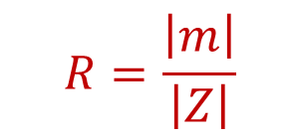



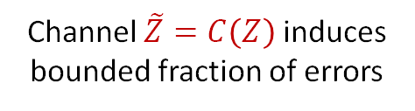
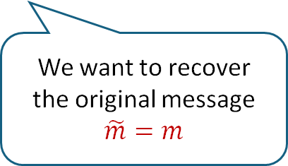

Error-Correcting Codes
$$R=\frac{\left|m\right|}{\left|Z\right|}$$
Channel $\tilde{Z}=C\left(Z\right)$ induces bounded fraction of errors
$$m$$
$$Z=Enc(m)$$
$$Dec(\tilde{Z})$$
$$\tilde{m}$$
We want to recover the original message
$$\tilde{m}=m$$

Slide 3
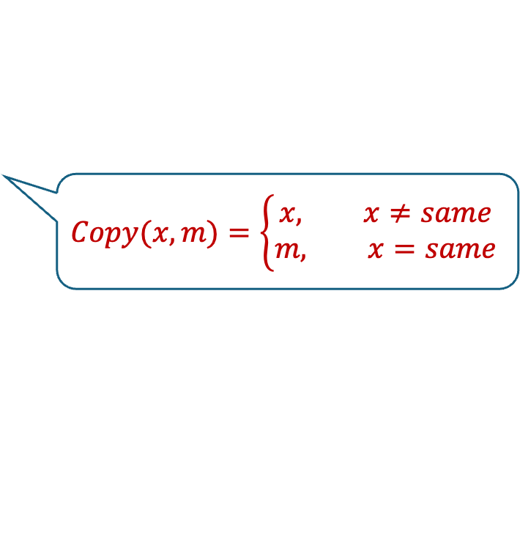


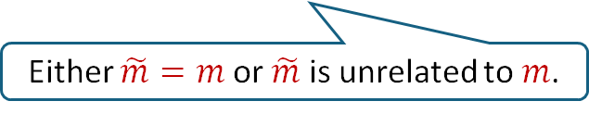
Non-malleable Codes
$$R=\frac{\left|m\right|}{\left|Z\right|}$$
Channel $\tilde{Z}=C\left(Z\right)$ induces bounded fraction of errors
$$m$$
$$Z=Enc(m)$$
$$Dec(\tilde{Z})$$
$$\tilde{m}$$
Either $\tilde{m}=m$ or $\tilde{m}$ is unrelated to $m$.
Introduced by Dziembowski, Pietrzak, and Wichs [DPW09].
Def: $(Enc,Dec)$ is a non-malleable code for the class of channels $𝒞$ if $∀C∈𝒞$ and $∀m,Dec(Enc(m))=m$, and $∃$ a distribution $D_{C}$ over ${\left\{0,1\right\}}^{|m|}∪\{same,⊥\}$ s.t. for $∀m$:
$$Dec\left(C(Enc\left(m\right))\right) ≈ Copy\left(D_{c},m\right)$$
Statistical VS Computational
$$Copy(x, m)=\left\{\begin{aligned}x, x≠same \\ m, x=same\end{aligned}\right.$$

Slide 4
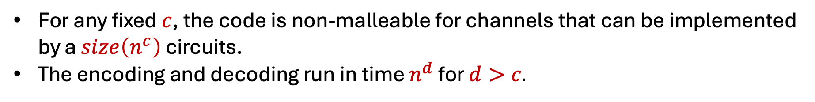
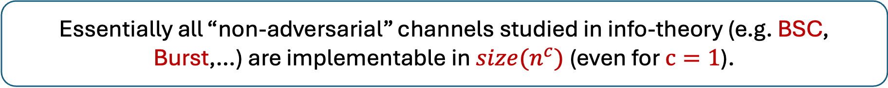
Non-malleable Codes for Poly-Size Circuits
This work: Codes for channels that are poly-size circuits.
For any fixed $c$, the code is non-malleable for channels that can be implemented by a $size\left(n^{c}\right)$ circuits.
The encoding and decoding run in time $n^{d}$ for $d>c.$
Essentially all “non-adversarial” channels studied in info-theory (e.g. BSC, Burst,…) are implementable in $size(n^{c})$(even for $c=1$).

Slide 5
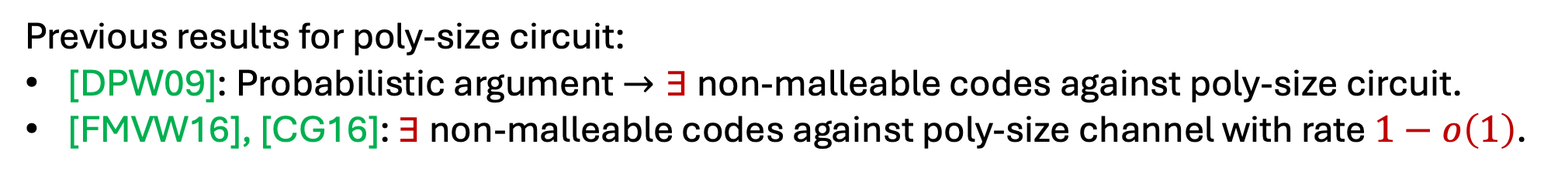
Previous Results for Non-malleable Codes for Poly-Size Circuits
Previous results for poly-size circuit:
[DPW09]: Probabilistic argument$→∃$ non-malleable codes against poly-size circuit.
[FMVW16], [CG16]: $∃$ non-malleable codes against poly-size channel with rate $1−o\left(1\right)$.
Faust, Mukherjee, Venturi, and Wichs.
Cheraghchi and Guruswami

Slide 6
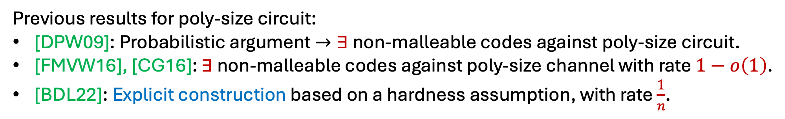
Previous Results for Non-malleable Codes for Poly-Size Circuits
Previous results for poly-size circuit:
[DPW09]: Probabilistic argument$→∃$ non-malleable codes against poly-size circuit.
[FMVW16], [CG16]: $∃$ non-malleable codes against poly-size channel with rate $1−o\left(1\right)$.
[BDL22]: Explicit construction based on a hardness assumption, with rate $\frac{1}{n}$.
Ball, Dachman-Soled and Loss

Slide 7
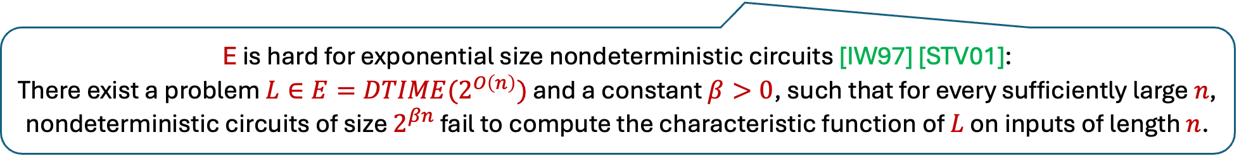
Previous Results for Non-malleable Codes for Poly-Size Circuits
Previous results for poly-size circuit:
[DPW09]: Probabilistic argument$→∃$ non-malleable codes against poly-size circuit.
[FMVW16], [CG16]: $∃$ non-malleable codes against poly-size channel with rate $1−o\left(1\right)$.
[BDL22]: Explicit construction based on a hardness assumption, with rate $\frac{1}{n}$.
E is hard for exponential size nondeterministic circuits [IW97] [STV01]:
There exist a problem $L∈E=DTIME(2^{O\left(n\right)})$ and a constant $β>0$, such that for every sufficiently large $n$, nondeterministic circuits of size $2^{βn}$ fail to compute the characteristic function of $L$ on inputs of length $n$.

Slide 8
Our results: non-malleable codes with optimal rate
Thm: If E is hard for exponential size nondeterministic circuits, $∀$constant $c$, we construct a non-malleable code against circuits of size $n^{c}$, with rate $R = 1 − o(1)$.
Like [BDL22], we achieve a distinguishing advantage that is an arbitrary fixed inverse polynomial, rather than negligible.
There are barriers for achieving negligible indistinguishabity from nondeterministic hardness assumptions
Assuming strong cryptographic assumptions, you can get negligible error.
Ball, Dachman-Soled, Kulkarni, Lin, and Malkin [BDKLM19].
Dachman-Soled Komargodski and Pass [DKP21].

Slide 9
Our results: non-malleable codes with optimal rate
Thm: If E is hard for exponential size nondeterministic circuits, $∀$constant $c$, we construct a non-malleable code against circuits of size $n^{c}$, with rate $R = 1 − o(1)$.
Like [BDL22], we achieve a distinguishing advantage that is an arbitrary fixed inverse polynomial, rather than negligible.
We only achieve computational indisting. ([BDL22] achieves statistical indisting.).
Our technique can get statistical indisting. if “hard to sample functions” (HTS) a notion that was introduced and constructed by [SS24] could be improved.

Slide 10
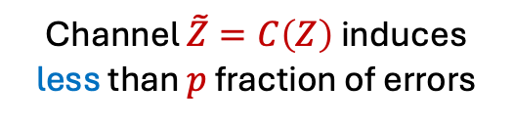

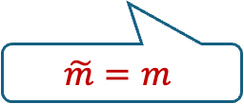
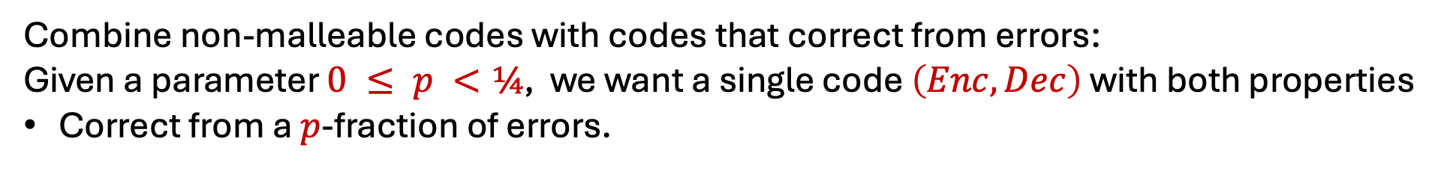



Best of both worlds: Composing non-malleable codes with codes that correct from errors
$$m$$
$$Z=Enc(m)$$
$$Dec(\tilde{Z})$$
$$\tilde{m}$$
Channel $\tilde{Z}=C\left(Z\right)$ induces less than $p$ fraction of errors
$$\tilde{m}=m$$
Combine non-malleable codes with codes that correct from errors:
Given a parameter $0 ≤ p <¼$, we want a single code $\left(Enc,Dec\right)$ with both properties
Correct from a $p$-fraction of errors.

Slide 11
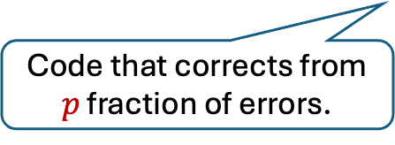

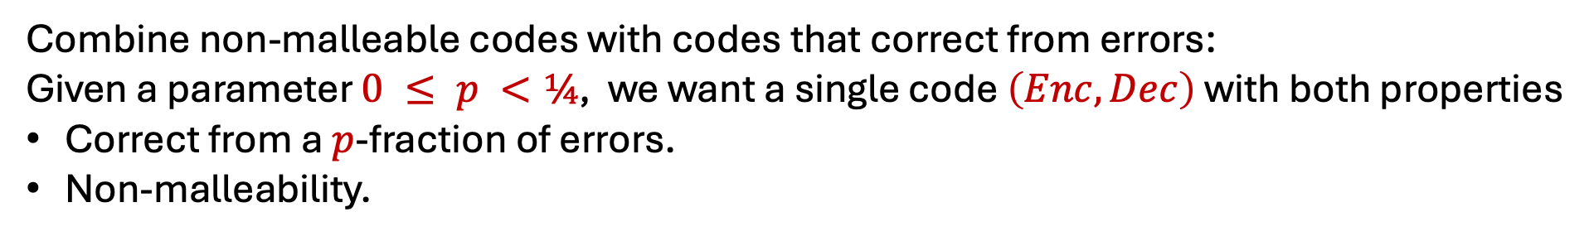

Best of both worlds: Composing non-malleable codes with codes that correct from errors
$$m$$
$$Z=Enc(m)$$
$$Dec(\tilde{Z})$$
$$\tilde{m}$$
Channel $\tilde{Z}=C\left(Z\right)$ induces less than $p$ fraction of errors
more
$\tilde{m}$ is unrelated to $m$.
Combine non-malleable codes with codes that correct from errors:
Given a parameter $0 ≤ p <¼$, we want a single code $\left(Enc,Dec\right)$ with both properties
Correct from a $p$-fraction of errors.
Non-malleability.
$$Enc\left(m\right)=Enc_{p}(Enc_{NM}\left(m\right))$$
Code that corrects from $p$ fraction of errors.
non-malleable code

Slide 12
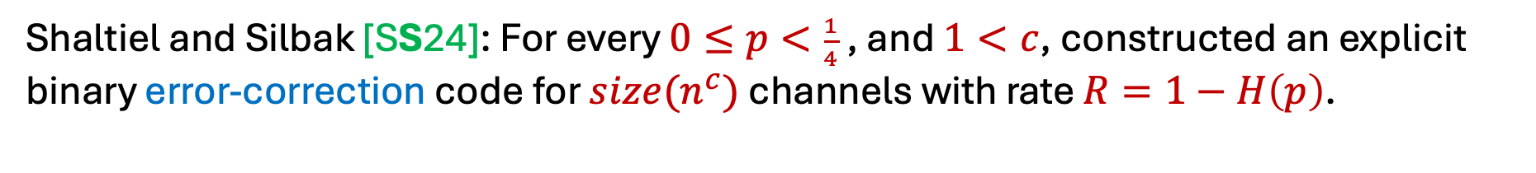
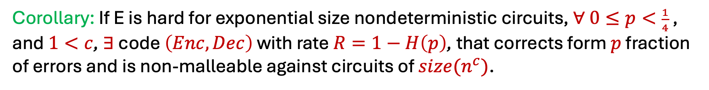
Best of both worlds: Composing non-malleable codes with codes that correct from errors
Shaltiel and Silbak [SS24]: For every $0≤p<\frac{1}{4}$ , and $1<c$, constructed an explicit binary error-correction code for $size(n^{c})$channels with rate $R=1−H\left(p\right)$.
Better than what is possible against information theoretic adversaries
Under the same hardness assumption
Corollary: If E is hard for exponential size nondeterministic circuits, $∀$ $0≤p<\frac{1}{4}$ , and $1<c$, $∃$ code $\left(Enc,Dec\right)$ with rate $R=1−H\left(p\right)$, that corrects form $p$ fraction of errors and is non-malleable against circuits of $size(n^{c})$.

Slide 13
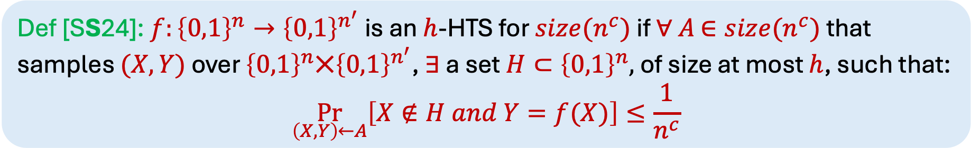
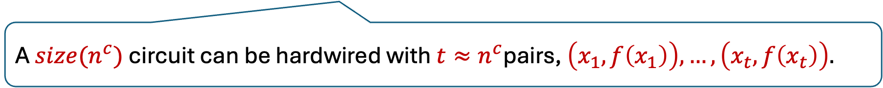
Hard to Sample Functions (HTS)
Def [SS24]: $f:{\left\{0,1\right\}}^{n}→{\left\{0,1\right\}}^{n^{′}}$ is an $h$-HTS for ${size(n}^{c})$ if $∀$ $A$ $∈{size(n}^{c})$ that samples $(X,Y)$ over ${\left\{0,1\right\}}^{n}⨉{\left\{0,1\right\}}^{n^{′}}$, $∃$ a set $H⊂{\left\{0,1\right\}}^{n},$ of size at most $h$, such that:
$$\underset{\left(X,Y\right)←A}{Pr}\left[X∉H and Y=f(X)\right]≤\frac{1}{n^{c}}$$
A ${size(n}^{c})$ circuit can be hardwired with $t≈n^{c}$pairs, $\left(x_{1},f\left(x_{1}\right)\right),…,\left(x_{t},f\left(x_{t}\right)\right).$
For $h=poly(n^{c}$), essentially implies that all valid pairs are “hardwired” in the circuit.
Notes:
(we have space $O(logn)$and are allowed to read the input in one pass).

Slide 14
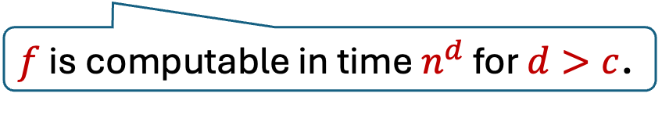
Hard to Sample Functions (HTS)
Def [SS24]: $f:{\left\{0,1\right\}}^{n}→{\left\{0,1\right\}}^{n^{′}}$ is an $h$-HTS for ${size(n}^{c})$ if $∀$ $A$ $∈{size(n}^{c})$ that samples $(X,Y)$ over ${\left\{0,1\right\}}^{n}⨉{\left\{0,1\right\}}^{n^{′}}$, $∃$ a set $H⊂{\left\{0,1\right\}}^{n},$ of size at most $h$, such that:
$$\underset{\left(X,Y\right)←A}{Pr}\left[X∉H and Y=f(X)\right]≤\frac{1}{n^{c}}$$
A ${size(n}^{c})$ circuit can be hardwired with $t≈n^{c}$pairs, $\left(x_{1},f\left(x_{1}\right)\right),…,\left(x_{t},f\left(x_{t}\right)\right).$
This has a similar flavor to the definition of keyless multi-collision-resistant hash functions. (Bitansky, Kalai, Paneth [BKP18]).
$f$ is computable in time $n^{d}$ for $d>c$.
Notes:
(we have space $O(logn)$and are allowed to read the input in one pass).

Slide 15
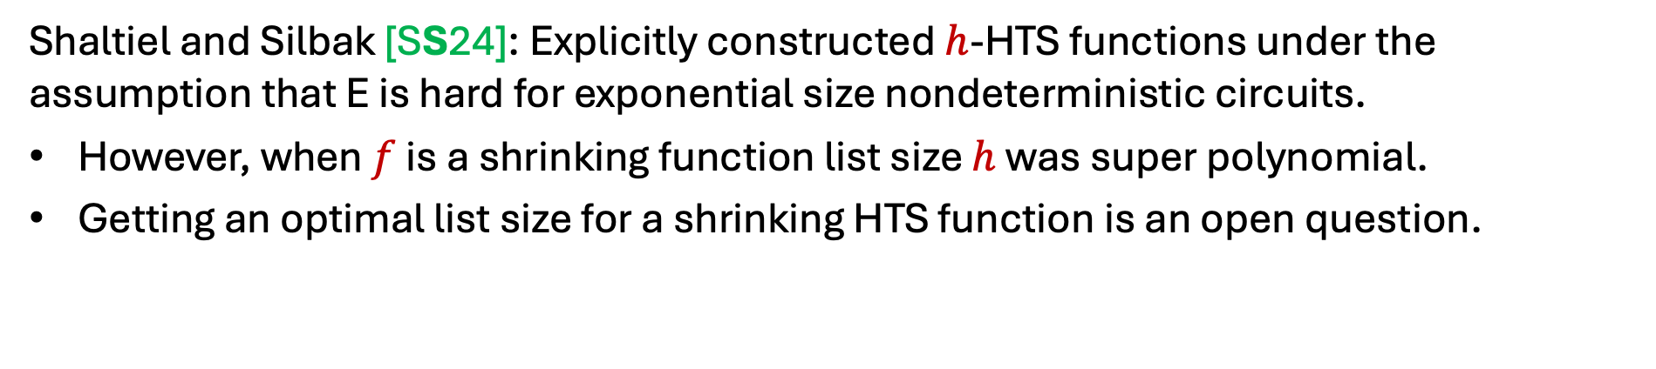
Hard to Sample Functions (HTS)
Def [SS24]: $f:{\left\{0,1\right\}}^{n}→{\left\{0,1\right\}}^{n^{′}}$ is an $h$-HTS for ${size(n}^{c})$ if $∀$ $A$ $∈{size(n}^{c})$ that samples $(X,Y)$ over ${\left\{0,1\right\}}^{n}⨉{\left\{0,1\right\}}^{n^{′}}$, $∃$ a set $H⊂{\left\{0,1\right\}}^{n},$ of size at most $h$, such that:
$$\underset{\left(X,Y\right)←A}{Pr}\left[X∉H and Y=f(X)\right]≤\frac{1}{n^{c}}$$
Shaltiel and Silbak [SS24]: Explicitly constructed $h$-HTS functions under the assumption that E is hard for exponential size nondeterministic circuits.
However, when $f$ is a shrinking function list size $h$ was super polynomial.
Getting an optimal list size for a shrinking HTS function is an open question.
Notes:
(we have space $O(logn)$and are allowed to read the input in one pass).

Slide 16
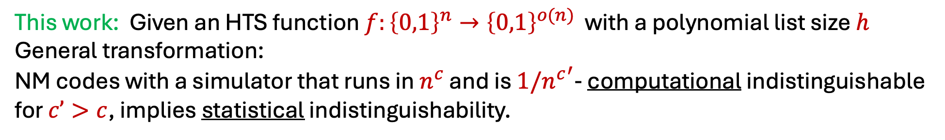
Overview of the technique
[SS24]: Constructed “small set non-malleable” (SSNM) codes:
SSNM codes = NM codes + HTS functions
This work: Using SSNM codes + new ideas, we can “compile” SSNM codes into NM codes with rate $R=1−o\left(1\right)$ and computational security.
This work: Given an HTS function $f:{\left\{0,1\right\}}^{n}→{\left\{0,1\right\}}^{o(n)}$ with a polynomial list size $h$
General transformation:
NM codes with a simulator that runs in $n^{c}$ and is ${1/n^{c}}^{′}$- computational indistinguishable for $c’>c$, implies statistical indistinguishability.

Slide 17
Overview of the technique
This work: Given an HTS function $f:{\left\{0,1\right\}}^{n}→{\left\{0,1\right\}}^{o(n)}$ with a polynomial list size $h$
General transformation:

Slide 18
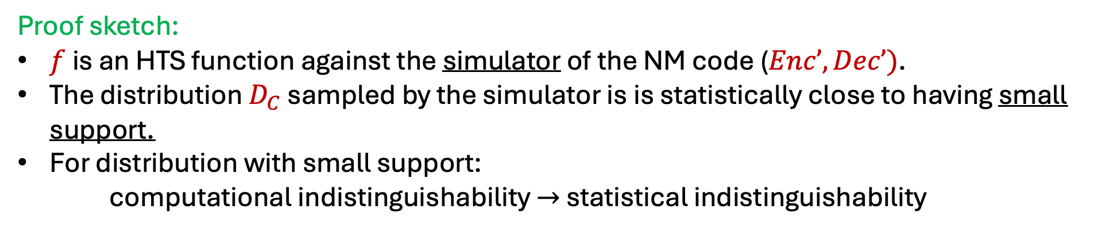

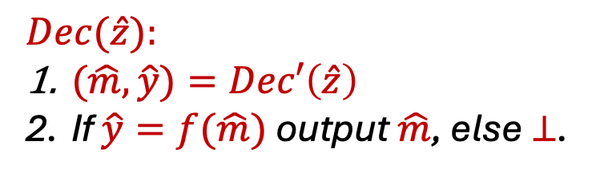
Overview of the technique
This work: Given an HTS function $f:{\left\{0,1\right\}}^{n}→{\left\{0,1\right\}}^{o(n)}$ with a polynomial list size $h$
General transformation:
Construction:
$$Enc(m)=Enc’(m,f(m))$$
$$Dec(\hat{z}):$$
$(\hat{m},\hat{y})=Dec′\left(\hat{z}\right)$
If $\hat{y}=f(\hat{m})$ output $\hat{m}$, else $⊥$.
Proof sketch:
$f$ is an HTS function against the simulator of the NM code ($Enc’,Dec’)$.
The distribution $D_{C}$ sampled by the simulator is is statistically close to having small support.
For distribution with small support:
computational indistinguishability $→$ statistical indistinguishability

Slide 19
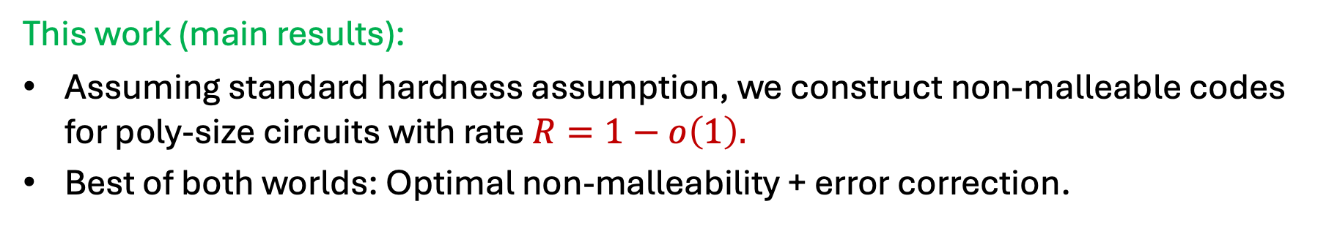
Conclusions and open problems
This work (main results):
Assuming standard hardness assumption, we construct non-malleable codes for poly-size circuits with rate $R=1−o\left(1\right).$
Best of both worlds: Optimal non-malleability + error correction.
Open problems:
Statistical Security?
  Improving the parameters for hard to sample functions implies statistical security for the non-malleable codes.
Apply a similar key encapsulation approach to other non-malleable primitives.

