Slide 1
Software with Certified Deletion
By James Bartusek, Vipul Goyal, Dakshita Khurana, Giulio Malavolta, Justin Raizes, and Bhaskar Roberts

Slide 2
Private Cloud Storage
Server
User

Slide 3
Private Cloud Storage
Server
User
classical ciphertext
b

Slide 4
Private Cloud Storage
Server
User
b
Data b is recoverable if:
Secret key is leaked
Encryption scheme is broken

Slide 5
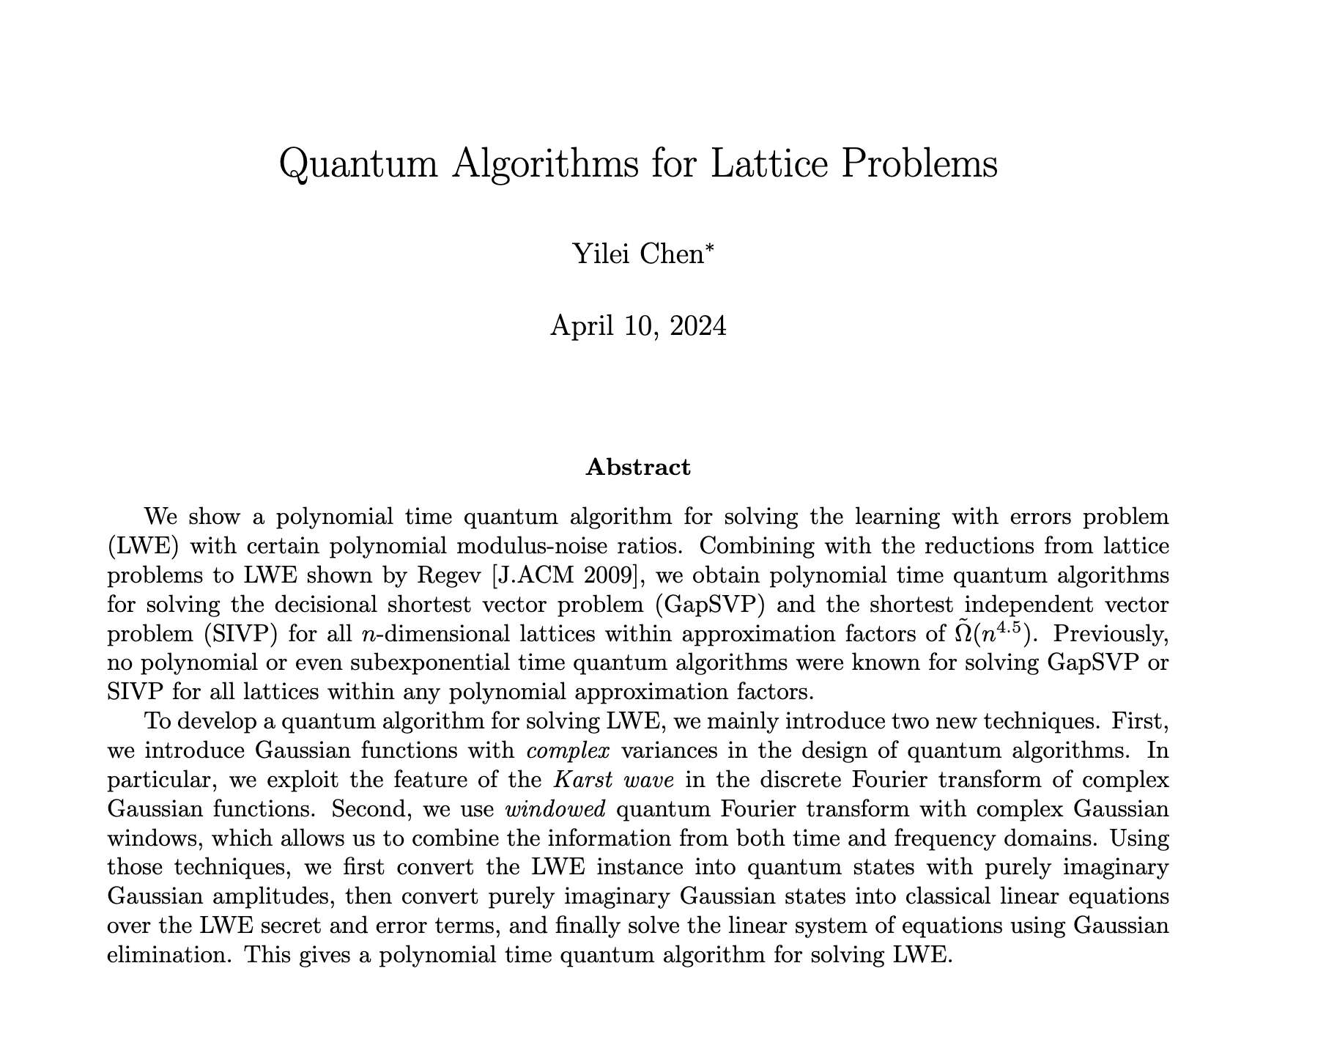
Private Cloud Storage
Server
User
Data b is recoverable if:
Secret key is leaked
Encryption scheme is broken

Slide 6
Private Cloud Storage with Certified Deletion
Server
Quantum ciphertext
User
“please delete my data”
b
Data b is recoverable if:
Secret key is leaked
Encryption scheme is broken
Notes:
There is no hope to protect the information if the ciphertext is classical, but there are interesting options if it is quantum instead.

Slide 7
Private Cloud Storage with Certified Deletion
User
“please delete my data”
Destructive measurement
Data b is recoverable if:
Secret key is leaked
Encryption scheme is broken
b is statistically hidden, even given the key
Notes:
The server can perform a destructive measurement which prevents it from ever recovering the data, even if it is given the key. Furthermore, it can convince the user that it has actually done this measurement, or at least one that is close enough.

Slide 8
Before This Work
[BI20], [HMNY21], [BK23]: encryption with certified deletion
The server can:
Store data
Delete data
Nothing else
Notes:
[BI20] (Broadbent-Islam) OTP with CD
[HMNY21] PKE with CD. Their notion of certified deletion was weaker. After deletion, the ciphertext is secure against key leakage but not against unbounded adversaries.

Slide 9
This Work
We show how to compute on encrypted data and then provably delete it.
Generic compiler allows repeated partial access to data
Can be applied to a wide variety of primitives
Before deletion: Computational hiding
After deletion: Statistical hiding
Notes:
Note: FHE allows you to compute on encrypted data, but not get the result. Doing homomorphic computation also prevents deletion, unless you add additional interaction.

Slide 10
Motivating Applications
Interactive setting: Blind Delegation with Certified Deletion
First construction with security against a malicious server
Assumes LWE
Non-interactive setting: Obfuscation with Certified Deletion
Assumes indistinguishability obfuscation and OWFs

Slide 11
Blind Delegation with Certified Deletion
The client asks the server to compute a function f on encrypted data and then asks them to delete the data.
f
f(b)
f
f
f(b)
“Please delete my data”
QPT
Construction uses post-quantum FHE and SNARGs for P
Notes:
Prior work: Quantum Proofs of Deletion for Learning with Errors: Only prove semi-honest security.
Assuming post-quantum iO, we get a 2-message protocol.

Slide 12
Motivation for Obfuscation with Certified Deletion: Subscription Software
Subscription Software, Inc.
User
January
February
March
Notes:
This setting was previously studied under the name “secure software leasing”. However, that work has significant downsides, including not giving any guarantees for user who follows their own evaluation procedure.

Slide 13
Differing Inputs Obfuscation (diO)
Given 𝚷₀ and 𝚷₁, it is hard to find a y* such that 𝚷₀(y*) ≠ 𝚷₁(y*)
𝚷_{b}
Subscription Software, Inc.
Adversary
Is it b’?

Slide 14
diO with Certified Deletion
Given 𝚷₀ and 𝚷₁, it is hard to find a y* such that 𝚷₀(y*) ≠ 𝚷₁(y*)
𝚷_{b}
Subscription Software, Inc.
Adversary
“They differ at y*”
Is it b’?

Slide 15
Other Applications
Strong Secure Software Leasing
If an adversary returns an authenticated copy of the program, they cannot continue to evaluate a local pirated copy.
Regular definition [AL21]: the pirated copy cannot be honestly evaluated.
Cryptosystems with Revocable Keys
Adversary gets a temporary decryption key.
After deleting it, new ciphertexts have semantic security.
Can be applied to PKE, Functional Encryption, more.

Slide 16
Other Applications
Publicly Verifiable Certified Deletion
Anyone can check the certificate of deletion
Follow-up work has reduced the assumptions from iO to OWFs [KNY23, BKMPW23]

Slide 17
Quantum Techniques

Slide 18
Two Bases
Computational Basis (C)
Hadamard Basis (H)
QFT
QFT

Slide 19
Destructive Measurements
Measuring in one basis destroys information about the other basis.
with prob. (1/2)
Measure in H Basis
with prob. (1/2)
with prob. (1/2)
Measure in H Basis
with prob. (1/2)

Slide 20
Certified Deletion from Prior Work
Encode data in the computational basis
Add checks in the Hadamard basis
Verification key vk tracks where and what the checks are
data = 0 1 1 1
vk = * + * + * * $−$ +
|𝜓⟩ = |0⟩ |+⟩ |1⟩ |+⟩ |1⟩ |1⟩ $|− 〉$ |+⟩

Slide 21
Certified Deletion from Prior Work
To delete, the server measures |𝜓⟩ in the Hadamard basis
H
|𝜓⟩ “$−$ + $−$ + + $−$ $−$ +”
cert: “$−$ + $−$ + + $−$ $−$ +”
vk = * + * + * * $−$ +
|𝜓⟩ = |0⟩ |+⟩ |1⟩ |+⟩ |1⟩ |1⟩ $|− 〉$ |+⟩

Slide 22
Issue: Malleability
Adversary can guess a single data index and flip it
|𝜓⟩ = |0⟩ |+⟩ |1⟩ |+⟩ |1⟩ |1⟩ |-⟩ |+⟩
|𝜓’⟩ = |1⟩ |+⟩ |1⟩ |+⟩ |1⟩ |1⟩ |-⟩ |+⟩
f(1111)
f(0111)
Now it can evaluate instead of
If the result is revealed, this leaks information
Need a method to verify that the ciphertext is original
Giving an oracle that checks the data positions is insecure [L10]

Slide 23
Second Attempt
co(S) is a group of unique coset representatives
[VZ21, CLLZ21]

Slide 24
Subspace Coset States [VZ21, CLLZ21]

Slide 25
Subspace Coset States
We can publish oracles to check membership in the subspace cosets
Secure because the oracles hide some information about the subspace

Slide 26
Subspace Hiding
$$Z\left(S\right)$$
$$≈$$
$\{Z\left(R\right):$random superspace $R⊃S\}$
Example: a membership oracle for S
Even using iO [Zha19]

Slide 27
Certified Deletion with Coset States (Simplified)
|S_{v,w}⟩
Random super-coset T+u ⊃ S+v
Subspace-hiding(S)
Enc(b ⊕Parity(v))
cert
𝜌_{b}
Adversary
Security: If cert ∊ S⊥+w, then 𝜌₀ and 𝜌₁ are statistically close

Slide 28
How to Use It for Obfuscation with Certified Deletion (Simplified)
Obfuscated Program
Hardcoded:
S
Random superspace $T+u⊃S+v$
$Π$ ⊕Parity(v)
Correct v if $y∈S+v$.
Hard to find $y∈T+u\backslash S+v$
Input: input $x$, vector $y$
If $y∈T+u$:
Compute v using S and y
Use v to decode $Π$
Output $Π$(x)
Correct $Π$ if $v$ is correct.

Slide 29
Thank you for listening!
For more details, see our paper on eprint or ask us.

