Slide 1
Best-of-Both-Worlds MPQC with Publicly Verifiable Identifiable Abort
BOBW-MPQC-PVIA
Kai-Min Chung, Miryam Huang, Er-Cheng Tang, and Jiapeng Zhang

Slide 2
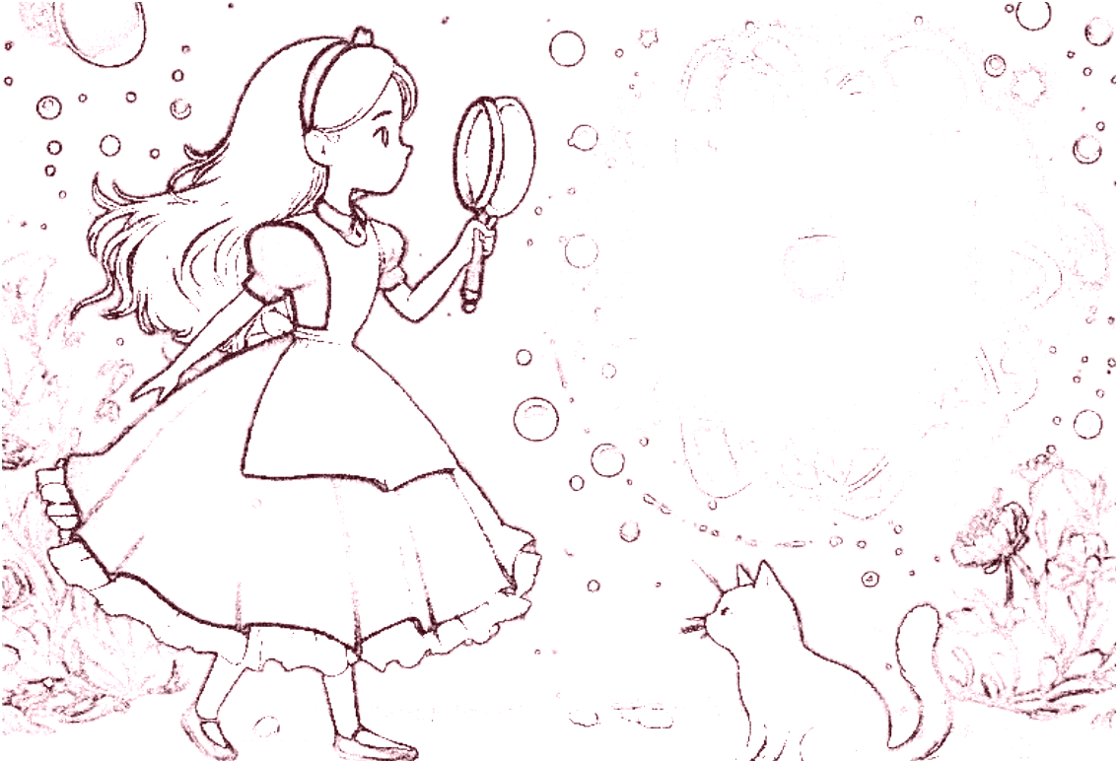
A Journey Through Wonderland​​
Alice in the crypto wonderland:
Counting carrots: Multiparty Computation (MPC)
In the quantum hole: Multiparty Quantum Computation
Consult Cheshire cat for securities.
Bob comes to the play: Explain the idea of how MPQC-PVIA works
Open questions and future works

Slide 3
Multiparty Computation (MPC)
Alice meets bunnies in a forest and
they want to know who has most carrots.......
𝑃 𝑖 holds private input 𝑥𝑖
They want to evaluate a function 𝑓 on (𝑥𝟣, …, 𝑥𝑁), producing (𝑦𝟣, …, 𝑦𝑁)
𝑃 𝑖 receives private output 𝑦𝑖
without revealing their individual counts!
They want to know the correct output without revealing their private inputs!

Slide 4
In Quantum Hole: Multiparty Quantum Computation
Suddenly, Alice falls into a quantum hole.
Everything turn to quantum.... the power, the circuit, even the carrots.....
𝑃 𝑖 holds private quantum input ⍴𝑖
They want to evaluate a quantum circuit Q on (⍴𝟣, …, ⍴𝑁), producing (σ𝟣, …, σ𝑁) ← Q(⍴𝟣, …, ⍴𝑁)
𝑃 𝑖 receives private quantum output σ𝑖
The players engage in a protocol to perform this task securely

Slide 5
Looking for Security
To understand the different security guarantees of various protocols,
Alice and the bunnies consult Cheshire Cat.
Basic securities:
Correctness: If the protocol succeeds, everyone’s final output is indeed the output of the circuit.
Privacy: Honest players' private inputs and outputs cannot be known by malicious players.
Output Delivery: The players can always get their final outputs.
Adversary will control malicious players to attack the protocol, and tries to learn honest players' secrets.
Securities are captured in simulation paradigm.
Queen of Hearts who rules over Wonderland, has control of some of the bunnies. She is always looking for ways to disrupt the protocol and learn honest bunnies and Alice's secrets.

Slide 6
Security Types
Cheshire Cat Explains Security Guarantees
Full security when < 50% players are malicious [BOCG+06]
Security with abort (SA) [DGJ+20, BCKM21]
Security with identifiable abort (SWIA) [ACCH+21]
Security with publicly verifiable identifiable abort (PVIA) [This work]
Best of both worlds security (BoBW) [This work] (e.g.)
< 10% malicious → Full security
< 90% malicious → PVIA
BoBW makes protocol more flexible!
Alice and bunnies decides to use the protocol presented in this work and find the minions of the Queen of Hearts

Slide 7
Alice is so happy that they have successfully finished the task.
They order Boba to celebrate!
Cheshire Cat wants to teach Alice and bunnies the core idea of the PVIA, Auditable Quantum Authentication (AQA), so it sends Bob the builder to deliver Boba for them as a demonstration.
|
|
〉
〉
|
〉
Alice Bob

Slide 8
Alice goes to the court to sue Bob for malicious sending, but Bob refutes this and says Alice does not want to pay, so she is maliciously accusing him.
Cheshire Cat says "As a judge, a third party, I don't know who is telling the lie.
I cannot convict the defendant without proof".
|
〉
Alice Bob
Accuse Bob
Proof ?
Cat

Slide 9
Challenges
Alice says "But it is hard in the quantum settings! Everything here is quantum!"
"Classical techniques involves duplication and broadcast messages for verification which violates the no-cloning theorem in the quantum world."
Cheshire Cat says "Right, how about existing quantum techniques?"

Slide 10
Attempt: Quantum Authentication Code
Trusted Party
Boba shop
|
〉
|
〉
sk ← KeyGen
← Encsk( )
sk
|
〉
|
〉
Alice Bob
|
〉
|
〉
( , validity) ← Decsk( )
Failed!
Quantum Authentication Code
is not enough!
validity
Proof ? Why should I trust you?
Cat

Slide 11
Cheshire Cat says
"So we know that quantum authentication code is not enough.
What should we do? We can rely on Auditable Quantum Authentication (AQA)!"

Slide 12
Our Solution: Auditable Quantum Authentication (AQA)
Audit(sk,m) is classical
Trusted Party
Boba shop
|
〉
|
〉
Setup →
(sk , φL , φR)
← Encsk( )
φL
Audit( sk , pf )
φR
|
〉
dk /⊥
pf
Alice Bob
|
〉
|
〉
← Recv( φL , dk )
pf ← Send( φR , )
validity
Cat

Slide 13
Simulation Security of AQA: Real Execution
Trusted Party
Boba shop
|
〉
|
〉
Setup →
(sk , φL , φR)
← Encsk( )
φL
Audit( sk , pf )
φR
|
〉
dk /⊥
pf
Alice Bob
|
〉
|
〉
← Recv( φL , dk )
pf ← Send( φR , )
validity
Cat

Slide 14
Simulation Security of AQA: Ideal Execution
Boba shop
Trusted Party
-1
|
| )
(φL , dk)
〉
(sk , φR ,
〉
← Setup
← Recv ( )
φL
Audit( sk , pf )
|
〉
φR ,
dk /⊥
pf
Alice Bob
|
〉
|
〉
← Recv( φL , dk )
pf ← Send( φR , )
validity
Cat

Slide 15
What does this have to do with MPQC-PVIA?
order of execution
Quantum
Setup
Classical MPC-PVIA
Input Encoding
Evaluation
Output Delivery
Bob
Attack
Alice
...
𝑃 n

Slide 16
Obtaining MPQC-PVIA with AQA
order of execution
Quantum
Setup
Repetition of MPQC with (plain) identifiable abort
Classical MPC-PVIA
Input Encoding
Evaluation
AQA
Bob
Alice
...
𝑃 n

Slide 17
Obtaining BoBW-MPQC with Quantum Secret Sharing
order of execution
Quantum
Setup
Repetition of MPQC with (plain) identifiable abort
Classical BoBW-MPC-PVIA
Input Encoding
Evaluation
AQA
𝑃 1
Input
Out
𝑃 2
...
Input
Out
Input Encoding
Evaluation
AQA
𝑃 n

Slide 18
Future Directions
Applications of AQA
Publicly Verifiable Quantum Fully Homomorphic Encryption
It takes all the running you can do, to keep in the same place.
The Queen of Hearts blustered out a threat.

Slide 19
Thank You

