Slide 1
Tight Indistinguishability Bounds for the XOR of Independent Random Permutations by
Fourier Analysis
Itai Dinur
Ben-Gurion University
Eurocrypt 2024

Slide 2
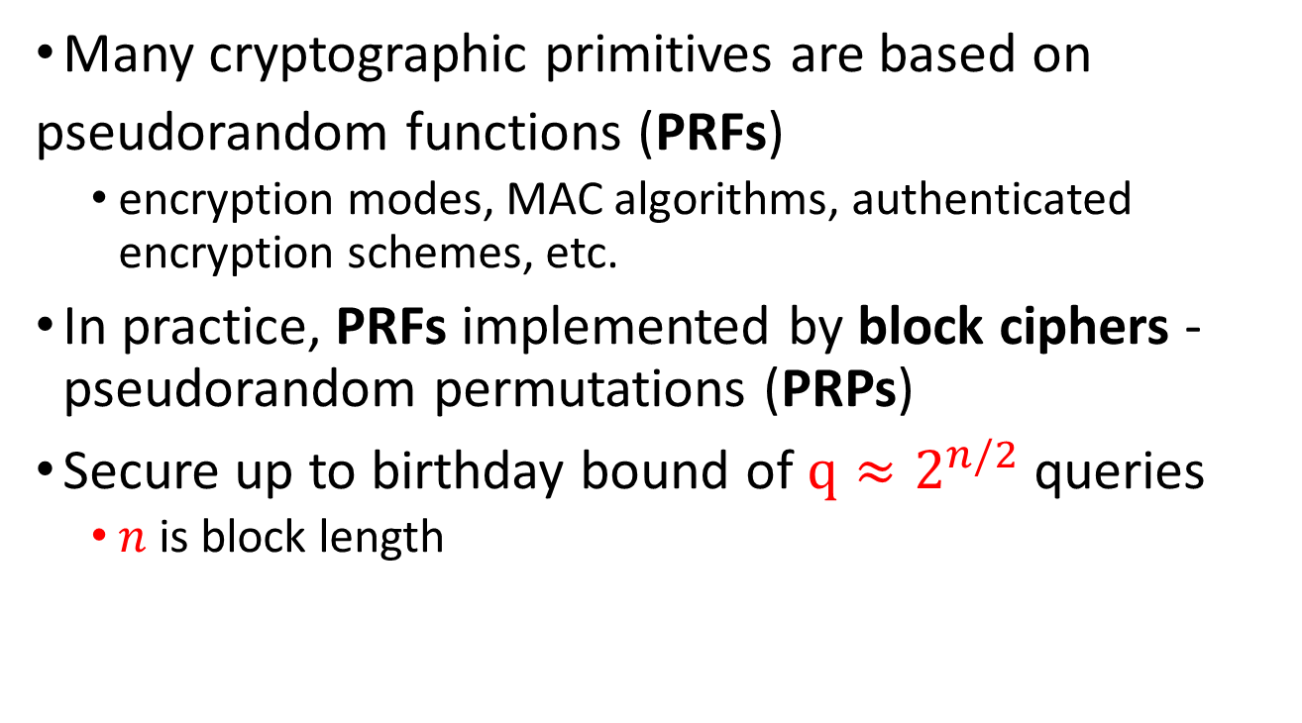
Birthday Bound Security
Many cryptographic primitives are based on
pseudorandom functions (PRFs)
  encryption modes, MAC algorithms, authenticated encryption schemes, etc.
In practice, PRFs implemented by block ciphers - pseudorandom permutations (PRPs)
Secure up to birthday bound of $q≈2^{n/2}$ queries
  $n$ is block length

Slide 3

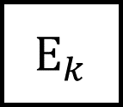
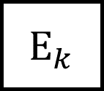
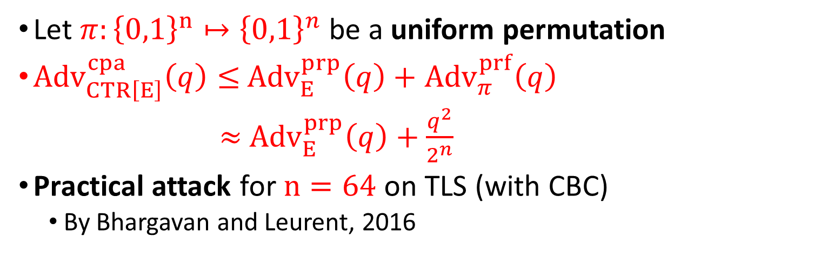






Example – Counter Mode
$ctr$
$ctr+1$
$E_{k}$
$E_{k}$
$$…$$
$$m_{1}$$
⊕
$$m_{2}$$
⊕
$c_{1}$
$c_{2}$
Let $π:{\left\{0,1\right\}}^{n}↦{\left\{0,1\right\}}^{n}$ be a uniform permutation
${Adv}_{CTR\left[E\right]}^{cpa}\left(q\right)≤$ ${Adv}_{E}^{prp}\left(q\right)+$ ${Adv}_{π}^{prf}\left(q\right)$
$≈$ ${Adv}_{E}^{prp}\left(q\right)+\frac{q^{2}}{2^{n}}$
Practical attack for $n=64$ on TLS (with CBC)
  By Bhargavan and Leurent, 2016

Slide 4

Beyond Birthday Bound Security
Goal of beyond birthday bound security:
Design efficient PRF secure for $q≫2^{n/2}$using PRPs
  “Luby-Rackoff backwards”

Slide 5
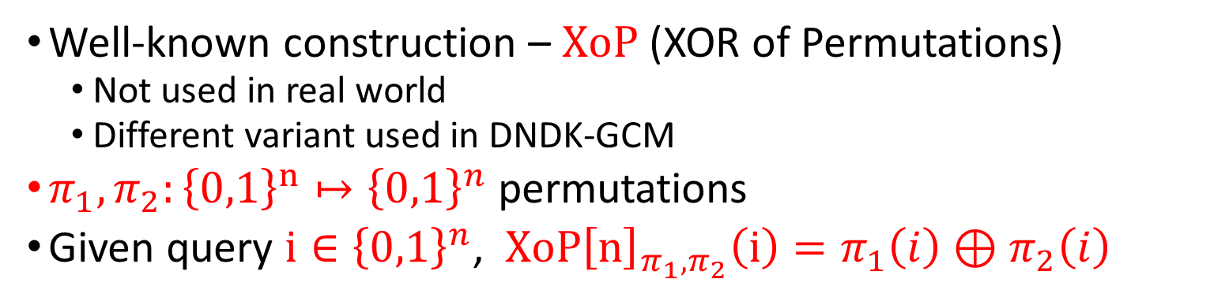




XoP (XOR of Permutations)
Well-known construction – $XoP$ (XOR of Permutations)
  Not used in real world
  Different variant used in DNDK-GCM
$π_{1},π_{2}:{\left\{0,1\right\}}^{n}↦{\left\{0,1\right\}}^{n}$ permutations
Given query $i∈{\left\{0,1\right\}}^{n}$, $XoP{\left[n\right]}_{π_{1},π_{2}}\left(i\right)=π_{1}\left(i\right)⊕π_{2}\left(i\right)$
$i$
$$π_{1}(i)$$
$π_{2}(i)$
⊕
$$XoP{\left[n\right]}_{π_{1},π_{2}}\left(i\right)$$

Slide 6
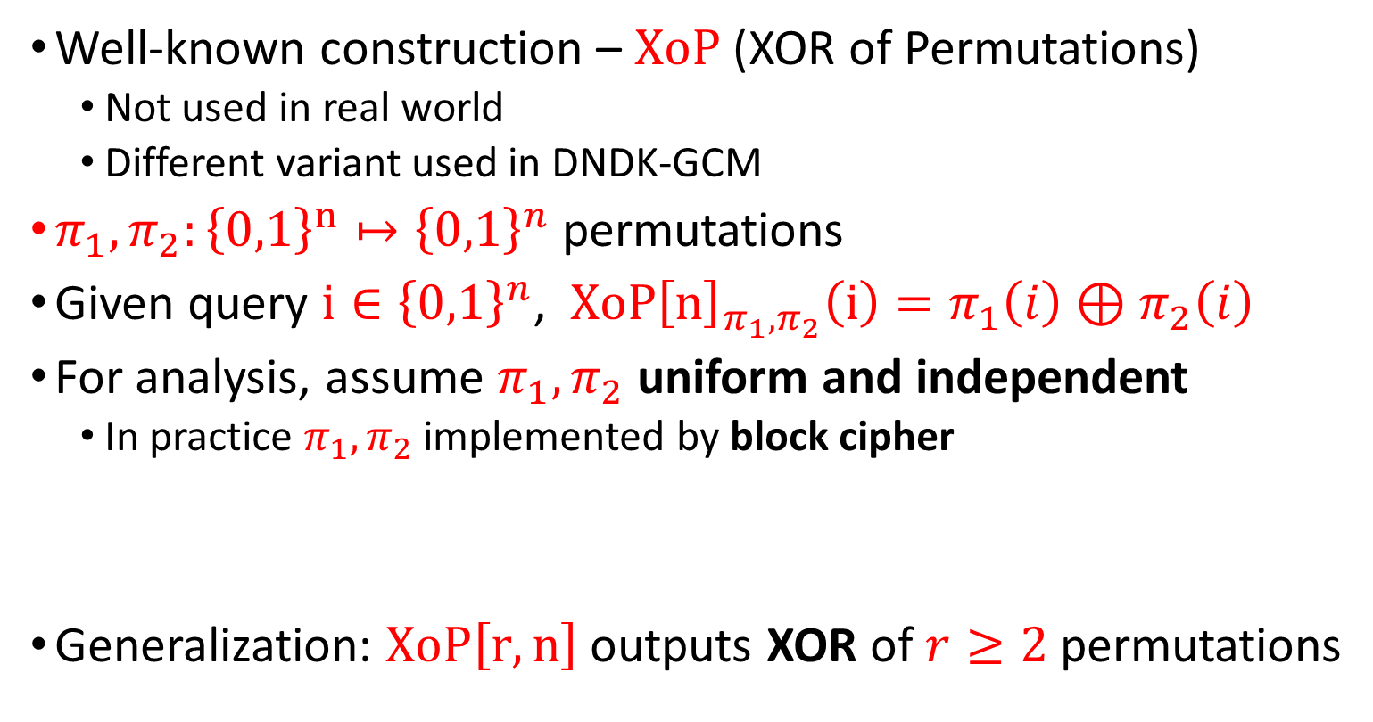
XoP (XOR of Permutations)
Well-known construction – $XoP$ (XOR of Permutations)
  Not used in real world
  Different variant used in DNDK-GCM
$π_{1},π_{2}:{\left\{0,1\right\}}^{n}↦{\left\{0,1\right\}}^{n}$ permutations
Given query $i∈{\left\{0,1\right\}}^{n}$, $XoP{\left[n\right]}_{π_{1},π_{2}}\left(i\right)=π_{1}\left(i\right)⊕π_{2}\left(i\right)$
For analysis, assume $π_{1},π_{2}$uniform and independent
  In practice $π_{1},π_{2}$ implemented by block cipher
Generalization: $XoP{\left[r,n\right]}_{ }$outputs XOR of $r≥2$ permutations

Slide 7
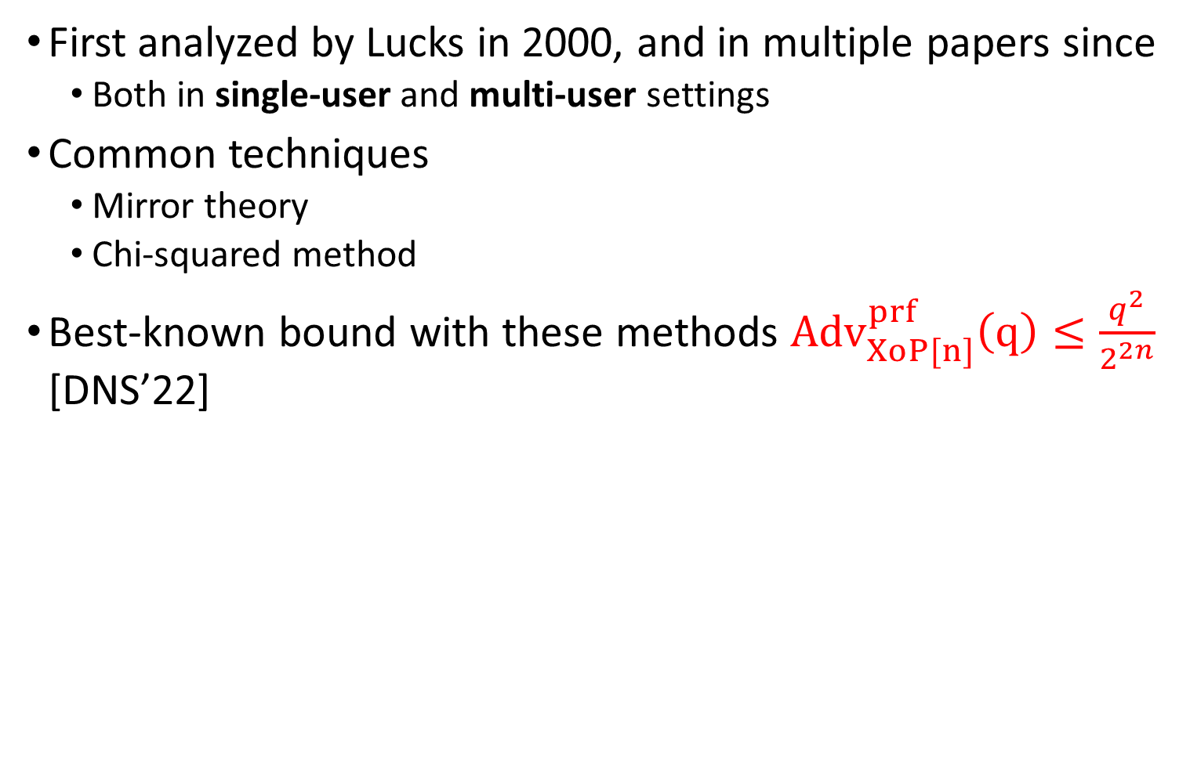
XoP – Previous Results
First analyzed by Lucks in 2000, and in multiple papers since
  Both in single-user and multi-user settings
Common techniques
  Mirror theory
  Chi-squared method
Best-known bound with these methods ${Adv}_{XoP[n]}^{prf}\left(q\right)≤\frac{q^{2}}{2^{2n}}$ [DNS’22]

Slide 8
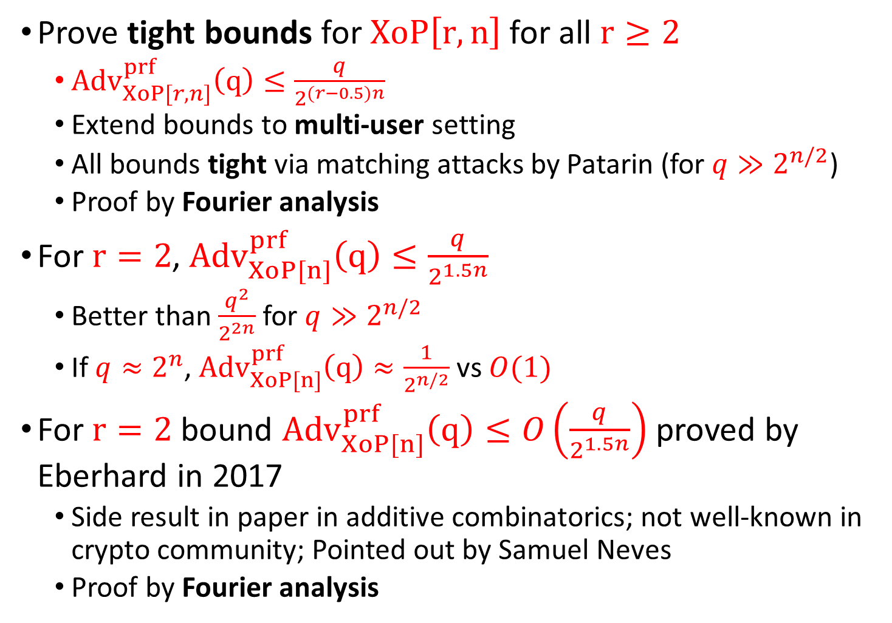
Our Results
Prove tight bounds for $XoP{\left[r,n\right]}_{ }$for all $r≥2$
  ${Adv}_{XoP[r,n]}^{prf}\left(q\right)≤\frac{q}{2^{(r−0.5)n}}$
  Extend bounds to multi-user setting
  All bounds tight via matching attacks by Patarin (for $q≫2^{n/2}$)
  Proof by Fourier analysis
For $r=2$, ${Adv}_{XoP[n]}^{prf}\left(q\right)≤\frac{q}{2^{1.5n}}$
  Better than $\frac{q^{2}}{2^{2n}}$ for $q≫2^{n/2}$
  If $q≈2^{n}$, ${Adv}_{XoP[n]}^{prf}\left(q\right)≈\frac{1}{2^{n/2}}$ vs $O(1)$
For $r=2$ bound ${Adv}_{XoP[n]}^{prf}\left(q\right)≤O\left(\frac{q}{2^{1.5n}}\right)$ proved by Eberhard in 2017
  Side result in paper in additive combinatorics; not well-known in crypto community; Pointed out by Samuel Neves
  Proof by Fourier analysis

Slide 9
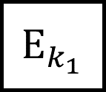
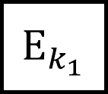



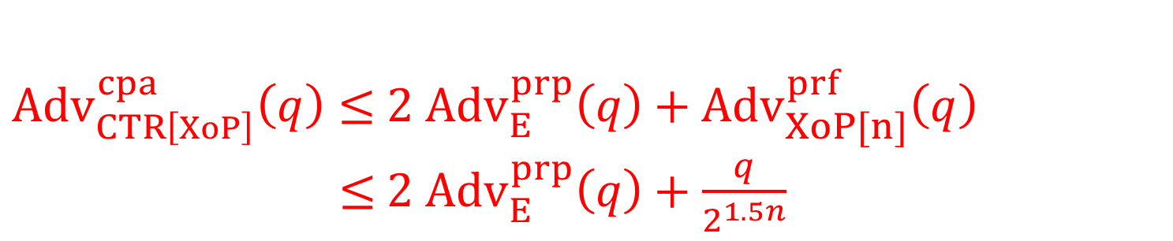




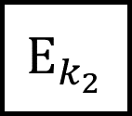

Example – XoP-Based Counter Mode
$ctr$
$ctr+1$
$E_{k_{1}}$
$E_{k_{2}}$
$E_{k_{1}}$
$E_{k_{2}}$
$$…$$
⊕
⊕
$$m_{1}$$
⊕
$$m_{2}$$
⊕
$c_{1}$
$c_{2}$
${Adv}_{CTR\left[XoP\right]}^{cpa}\left(q\right)≤$ ${2 Adv}_{E}^{prp}\left(q\right)+$ ${Adv}_{XoP[n]}^{prf}\left(q\right)$
$≤$ ${2 Adv}_{E}^{prp}\left(q\right)+\frac{q}{2^{1.5n}}$

Slide 10
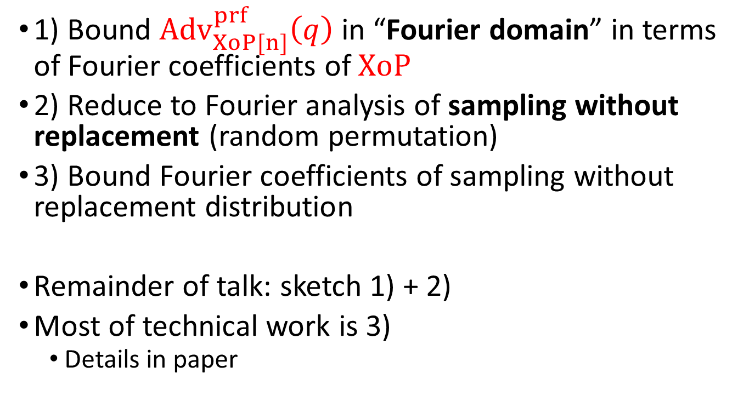

Proof Overview for $r=2$
1) Bound ${Adv}_{XoP[n]}^{prf}\left(q\right)$ in “Fourier domain” in terms of Fourier coefficients of $XoP$
2) Reduce to Fourier analysis of sampling without replacement (random permutation)
3) Bound Fourier coefficients of sampling without replacement distribution
Remainder of talk: sketch 1) + 2)
Most of technical work is 3)
  Details in paper

Slide 11

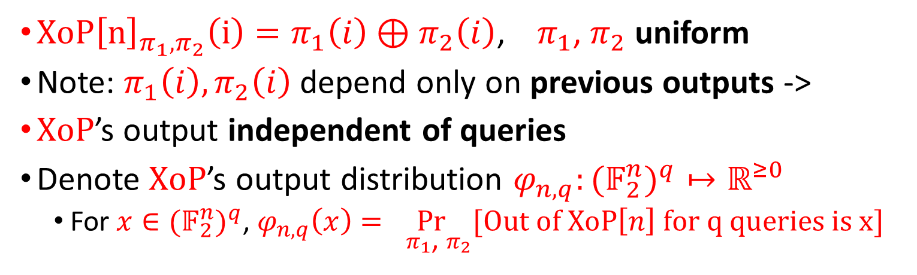



Bound by Statistical Distance
$XoP{\left[n\right]}_{π_{1},π_{2}}\left(i\right)=π_{1}\left(i\right)⊕π_{2}\left(i\right)$, ${ π}_{1}$, $π_{2}$ uniform
Note: $π_{1}\left(i\right),π_{2}\left(i\right)$ depend only on previous outputs ->
$XoP$’s output independent of queries
Denote $XoP$’s output distribution $φ_{n,q}:{{(𝔽}_{2}^{n})}^{q}↦ℝ^{≥0}$
  For $x∈{{(𝔽}_{2}^{n})}^{q}$, $φ_{n,q}\left(x\right)=\underset{{ π}_{1}\text{, }π_{2}}{Pr}[Out of XoP\left[n\right] for q queries is x]$
$${ π}_{1}$$
$$π_{1}\left(i_{1}\right)$$ | $$π_{1}\left(i_{2}\right)$$ | … |  |  |  |  | $$π_{1}\left(i_{q}\right)$$
$$⊕$$
$${ π}_{2}$$
$$π_{2}\left(i_{1}\right)$$ | $$π_{2}\left(i_{2}\right)$$ | … |  |  |  |  | $$π_{2}\left(i_{q}\right)$$
$$x$$
$$x_{1}$$ | $$x_{2}$$ | … |  |  |  |  | $$x_{q}$$

Slide 12
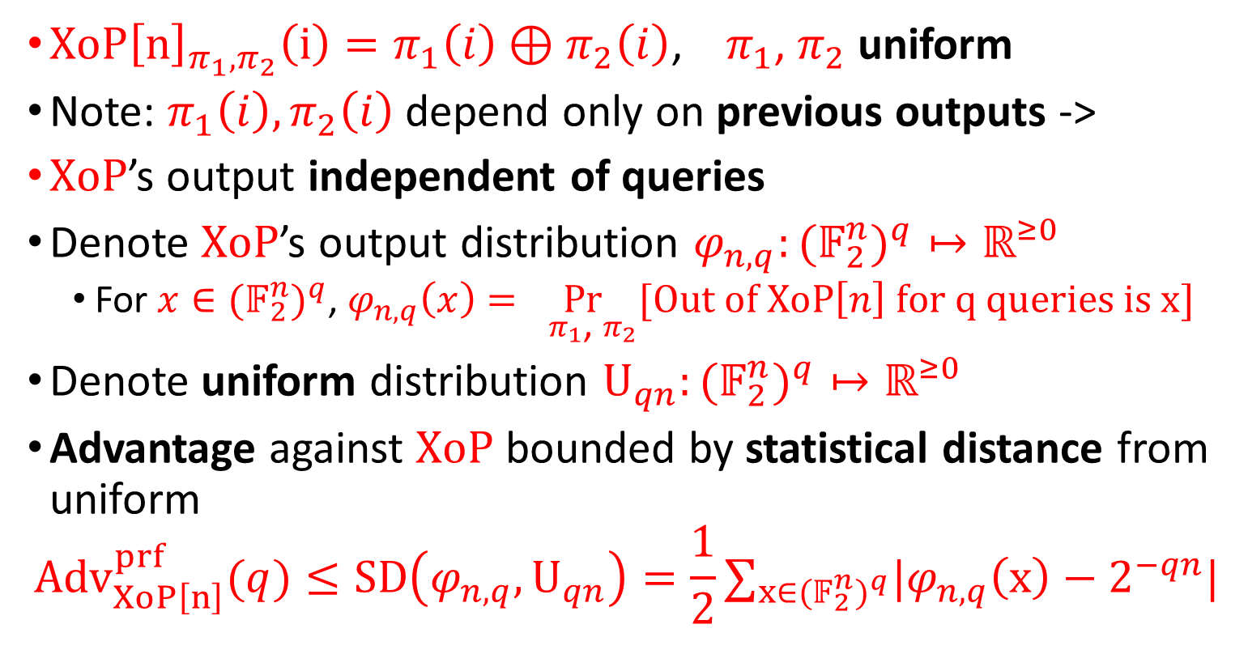
Bound by Statistical Distance
$XoP{\left[n\right]}_{π_{1},π_{2}}\left(i\right)=π_{1}\left(i\right)⊕π_{2}\left(i\right)$, ${ π}_{1}$, $π_{2}$ uniform
Note: $π_{1}\left(i\right),π_{2}\left(i\right)$ depend only on previous outputs ->
$XoP$’s output independent of queries
Denote $XoP$’s output distribution $φ_{n,q}:{{(𝔽}_{2}^{n})}^{q}↦ℝ^{≥0}$
  For $x∈{{(𝔽}_{2}^{n})}^{q}$, $φ_{n,q}\left(x\right)=\underset{{ π}_{1}\text{, }π_{2}}{Pr}[Out of XoP\left[n\right] for q queries is x]$
Denote uniform distribution $U_{qn}:{{(𝔽}_{2}^{n})}^{q}↦ℝ^{≥0}$
Advantage against $XoP$ bounded by statistical distance from uniform
$${Adv}_{XoP\left[n\right]}^{prf}(q)≤SD\left(φ_{n,q},U_{qn}\right)=\frac{1}{2}∑_{x∈{{(𝔽}_{2}^{n})}^{q}}|φ_{n,q}\left(x\right)−2^{−qn}|$$

Slide 13
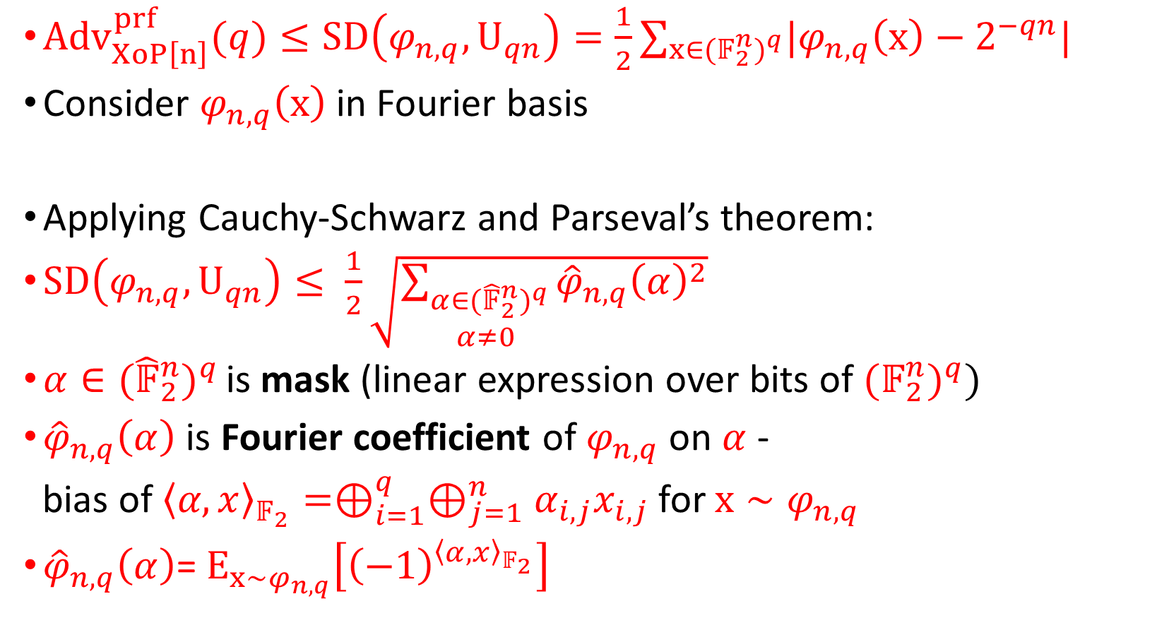
Fourier Analysis
${Adv}_{XoP\left[n\right]}^{prf}(q)≤SD\left(φ_{n,q},U_{qn}\right)=\frac{1}{2}∑_{x∈{{(𝔽}_{2}^{n})}^{q}}|φ_{n,q}\left(x\right)−2^{−qn}|$
Consider $φ_{n,q}\left(x\right)$ in Fourier basis
Applying Cauchy-Schwarz and Parseval’s theorem:
$SD\left(φ_{n,q},U_{qn}\right)≤ \frac{1}{2}\sqrt{\sum_{\begin{aligned}α∈{{(\hat{𝔽}}_{2}^{n})}^{q} \\ α≠0 \end{aligned}}{{\hat{φ}}_{n,q}{\left(α\right)}^{2}}}$
$α∈{{(\hat{𝔽}}_{2}^{n})}^{q }$is mask (linear expression over bits of ${{(𝔽}_{2}^{n})}^{q}$)
${\hat{φ}}_{n,q}\left(α\right)$ is Fourier coefficient of $φ_{n,q}$ on $α$ -
$\text{bias} \text{of}{ \left\langle α,x\right\rangle }_{𝔽_{2}}=⊕_{i=1}^{q}⊕_{j=1}^{n}α_{i,j}x_{i,j}$for $x∼φ_{n,q}$
${\hat{φ}}_{n,q}\left(α\right)$= $E_{x∼φ_{n,q}}\left[{\left(−1\right)}^{{\left\langle α,x\right\rangle }_{𝔽_{2}}}\right]$

Slide 14
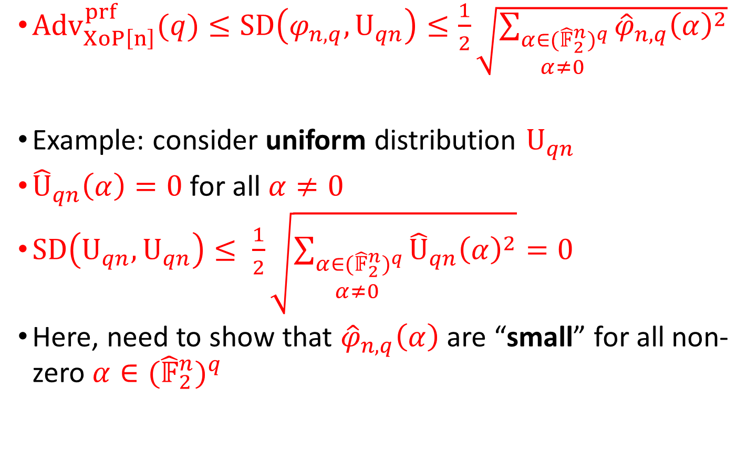
Fourier Analysis
${Adv}_{XoP\left[n\right]}^{prf}(q)≤SD\left(φ_{n,q},U_{qn}\right)≤\frac{1}{2}\sqrt{\sum_{\begin{aligned}α∈{{(\hat{𝔽}}_{2}^{n})}^{q} \\ α≠0 \end{aligned}}{{\hat{φ}}_{n,q}{\left(α\right)}^{2}}}$
Example: consider uniform distribution $U_{qn}$
${\hat{U}}_{qn}\left(α\right)=0$ for all $α≠0$
$SD\left(U_{qn},U_{qn}\right)≤ \frac{1}{2}\sqrt{\sum_{\begin{aligned}α∈{{(\hat{𝔽}}_{2}^{n})}^{q} \\ α≠0 \end{aligned}}{{\hat{U}}_{qn}{\left(α\right)}^{2}}}=0$
Here, need to show that ${\hat{φ}}_{n,q}\left(α\right)$ are “small” for all non-zero $α∈{{(\hat{𝔽}}_{2}^{n})}^{q}$

Slide 15

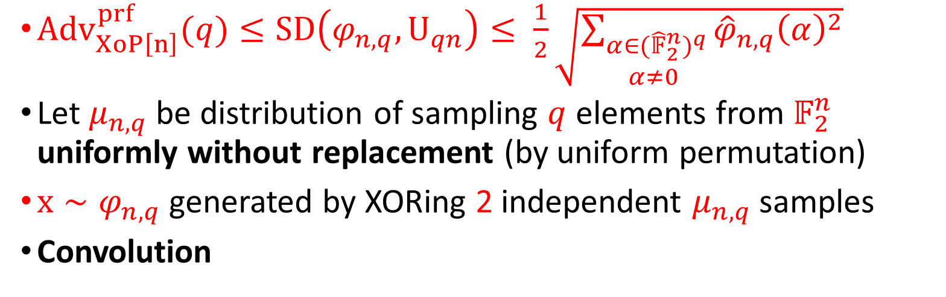


Reducing to Analysis of Sampling Without Replacement
${Adv}_{XoP\left[n\right]}^{prf}(q)≤SD\left(φ_{n,q},U_{qn}\right)≤ \frac{1}{2}\sqrt{\sum_{\begin{aligned}α∈{{(\hat{𝔽}}_{2}^{n})}^{q} \\ α≠0 \end{aligned}}{{\hat{φ}}_{n,q}{\left(α\right)}^{2}}}$
Let $μ_{n,q}$ be distribution of sampling $q$ elements from $𝔽_{2}^{n}$ uniformly without replacement (by uniform permutation)
$x∼φ_{n,q}$ generated by XORing 2 independent $μ_{n,q}$samples
Convolution
$$y∼μ_{n,q}$$
$$y_{1}$$ | $$y_{2}$$ | … |  |  |  |  | $$y_{q}$$
$$⊕$$
$$z∼μ_{n,q}$$
$$z_{1}$$ | $$z_{2}$$ | … |  |  |  |  | $$z_{q}$$
$$x∼φ_{n,q}$$
$$x_{1}$$ | $$x_{2}$$ | … |  |  |  |  | $$x_{q}$$

Slide 16
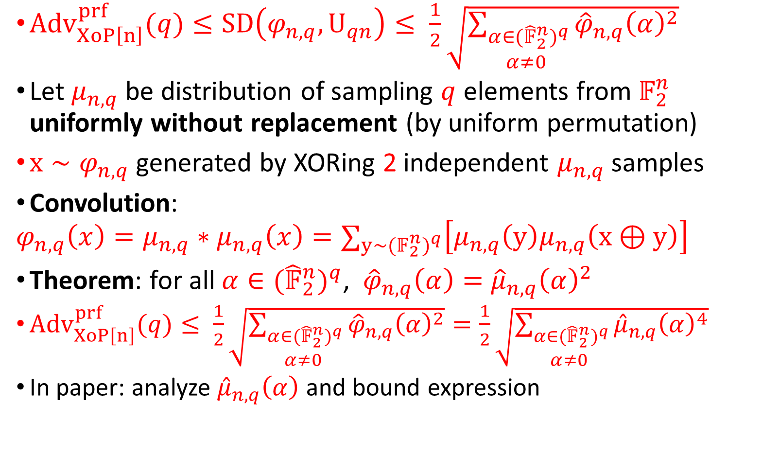
Reducing to Analysis of Sampling Without Replacement
${Adv}_{XoP\left[n\right]}^{prf}(q)≤SD\left(φ_{n,q},U_{qn}\right)≤ \frac{1}{2}\sqrt{\sum_{\begin{aligned}α∈{{(\hat{𝔽}}_{2}^{n})}^{q} \\ α≠0 \end{aligned}}{{\hat{φ}}_{n,q}{\left(α\right)}^{2}}}$
Let $μ_{n,q}$ be distribution of sampling $q$ elements from $𝔽_{2}^{n}$ uniformly without replacement (by uniform permutation)
$x∼φ_{n,q}$ generated by XORing 2 independent $μ_{n,q}$samples
Convolution:
$$φ_{n,q}\left(x\right)=μ_{n,q}∗μ_{n,q}\left(x\right)=∑_{y∼{{(𝔽}_{2}^{n})}^{q}}\left[μ_{n,q}\left(y\right)μ_{n,q}\left(x⊕y\right)\right]$$
Theorem: for all $α∈{{(\hat{𝔽}}_{2}^{n})}^{q}$, ${\hat{φ}}_{n,q}\left(α\right)=$ ${\hat{μ}}_{n,q}{\left(α\right)}^{2}$
${Adv}_{XoP\left[n\right]}^{prf}(q)≤ \frac{1}{2}\sqrt{\sum_{\begin{aligned}α∈{{(\hat{𝔽}}_{2}^{n})}^{q} \\ α≠0 \end{aligned}}{{\hat{φ}}_{n,q}{\left(α\right)}^{2}}}=\frac{1}{2}\sqrt{\sum_{\begin{aligned}α∈{{(\hat{𝔽}}_{2}^{n})}^{q} \\ α≠0 \end{aligned}}{{\hat{μ}}_{n,q}{\left(α\right)}^{4}}}$
In paper: analyze ${\hat{μ}}_{n,q}\left(α\right)$ and bound expression

Slide 17
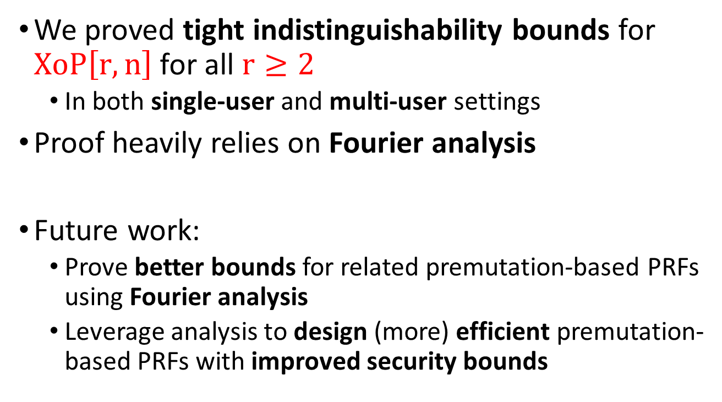
Conclusions and Future Work
We proved tight indistinguishability bounds for $XoP{\left[r,n\right]}_{ }$for all $r≥2$
  In both single-user and multi-user settings
Proof heavily relies on Fourier analysis
Future work:
  Prove better bounds for related premutation-based PRFs using Fourier analysis
  Leverage analysis to design (more) efficient premutation-based PRFs with improved security bounds

Slide 18
Thanks for your attention!
Notes:
18

