Slide 1
Leakage-Tolerant Circuits
Yuval Ishai
Technion
Yifan Song
Tsinghua University

Slide 2
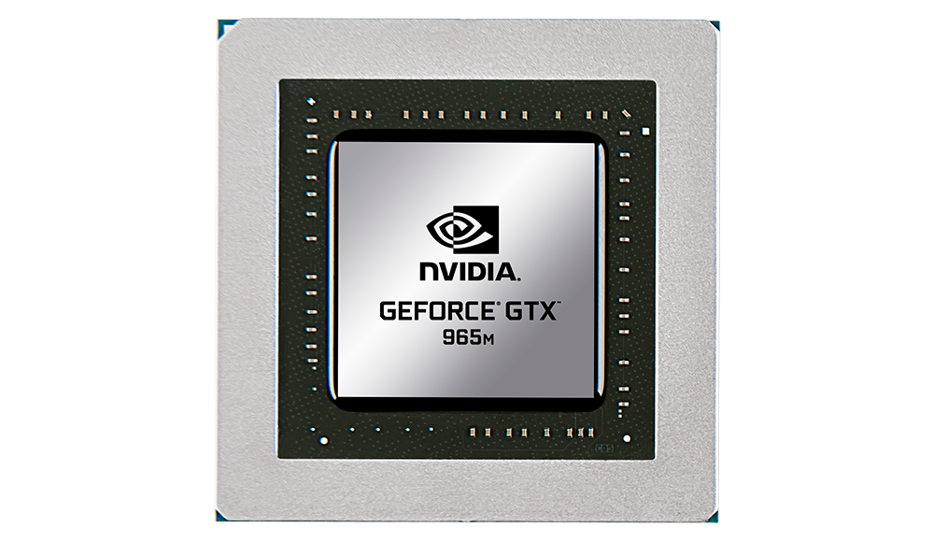
Dream Goal
Make
as secure as
$$x$$
$$y$$
$$x$$
$$y$$
Notes:
A dream goal in cryptography is to make a software or hardware implementation as secure as an ideal black-box implementation even in the presence of partial information leakage about the internal state.

Slide 3
Stateful Leakage-Resilient Circuits
[I.-Sahai-Wagner’03,Faust-Rabin-Reyzin-Tromer-Vaikuntanathan’10,…]
CIRCUIT
INPUT
OUTPUT
MEMORY
In each cycle:
Adv chooses input
Adv chooses a leakage function Leak$∈$L with t output bits
Adv observes output + leakage
Memory state is updated
Notes:
This has been referred to as “continuous leakage”

Slide 4
Stateful LRC Compiler
CIRCUIT
CIRCUIT
$$\hat{C}$$
$$C$$
INPUT
OUTPUT
INPUT
OUTPUT
Sim
Leak$∈$L
T
Adv
$$s_{0}$$
$${\hat{s}}_{0}$$
MEMORY
MEMORY
Correctness: $C[s_{0}]≈\hat{C}[\hat{s}0$]
Security: ∀Adv ∃Sim ∀C ∀s₀ View of Adv attacking $\hat{C}[\hat{s}0$] ≈ Output of Sim on $C[s_{0}]$

Slide 5
Stateful LRC Compiler
CIRCUIT
CIRCUIT
$$\hat{C}$$
$$C$$
INPUT
OUTPUT
INPUT
OUTPUT
T
$$s_{0}$$
$${\hat{s}}_{0}$$
MEMORY
MEMORY
Security: which leakage classes L?
Information-Theoretic vs. Computational security
Circuit model: with or without leak-free hardware?
Notes:
Deterministically transform C into a public Chat and randomly transform
Ideally, we want the size of the new circuit to be close to the original one, while allowing constant fractional leakage
It’s good to have some dreams

Slide 6
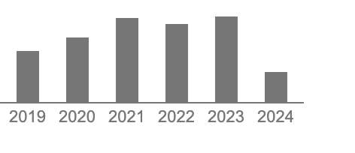
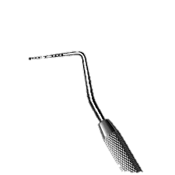
Stateful LRC Compiler
CIRCUIT
CIRCUIT
$$\hat{C}$$
$$C$$
INPUT
OUTPUT
INPUT
OUTPUT
T
$$s_{0}$$
CHES
$${\hat{s}}_{0}$$
nobody
TCC
MEMORY
Mostly: L = t-probing leakage
MEMORY
Security: which leakage classes L?
Information-Theoretic vs. Computational security
Circuit model: with or without leak-free hardware?
Notes:
We’ll hear more later in the session

Slide 7
Stateful LRC Compiler
CIRCUIT
CIRCUIT
$$\hat{C}$$
$$C$$
INPUT
OUTPUT
INPUT
OUTPUT
T
$$s_{0}$$
CHES
$${\hat{s}}_{0}$$
nobody
TCC
MEMORY
Mostly: L = t-probing leakage
MEMORY
Much less known about global leakage
AC⁰ leakage [Rothblum’12, Bogdanov-I.-Srinivasan’19]
“Only computation leaks” [Micali-Reyzin’04, Goldwasser-Rothblum’12]
Worse efficiency ($\left|\hat{C}\right|≫t^{2}|C|$), specialized constructions
Challenging even for OR, XOR leakage
Notes:
Whereas in the probing case we have a generic reduction to certain kinds of MPC< here analysis is very tailored to the specifics of the construction

Slide 8
Stateless LRC
$$\hat{C}$$
$$x$$
Enc
$$\hat{x}$$
$$\hat{y}$$
$$y$$
Dec
Reveals (essentially)
Nothing about $x$
Want Enc, Dec to be:
Universal
Small
Leak$∈$L
Notes:
Typically want Enc, Dec to be universal, typically small

Slide 9
Stateless LRC
$$\hat{C}$$
$$x$$
Enc
$$\hat{x}$$
$$\hat{y}$$
$$y$$
Dec
Simpler and better constructions!
Miles-Viola’13, Miles’14
Goyal-I.-Maji-Sahai-Sherstov’16 Bogdanov-I.-Srinivasan’19
Bogdanov-Dinesh-Filmus-I.-Kaplan-Srinivasan’22
Leak$∈$L
Notes:
Let’s take a step back

Slide 10
Stateless ➔ Stateful?
$$\hat{C}$$
$$x$$
Enc
$$\hat{x}$$
$$\hat{y}$$
$$y$$
Dec
How can we realize Enc, Dec?
Need strong composition guarantees
Much work on composable notions for probing leakage, e.g.
Rivain-Prouff’10, Coron-Prouff-Rivain-Roche’13, Barthe-Belaïd-Dupressoir-Fouque-Grégoire-Strub-Zucchini’16, Belaïd-Cassiers-Rivain-Taleb’23, ...
Notes:
Let’s take a step back

Slide 11
Leakage-Tolerant Circuit
[Garg-Jain-Sahai’11, Bitansky-Canetti-Halevi’12, Ananth-I.-Sahai’08]
$$\hat{C}$$
$$x$$
$$y$$
Leak$∈$L
Adv
Input and output are unprotected
“Best-possible” security guarantee:
$∀$Leak$∈$L $∃$Leak’$\sim$L and Sim such that $∀x$ Leak(wires of $\hat{C}(x)$)$≈$Sim(Leak’$(x,y)$)
$\hat{C}$ is as good as an ideal implementation of $C$ w.r.t. L
Notes:
Let’s take a step back

Slide 12
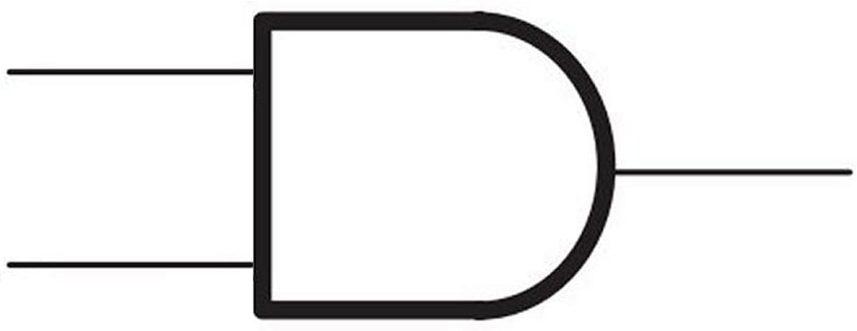
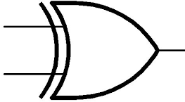
Examples: LTC for parity leakage
$$x_{1}x_{2}=y⊕x_{3}$$
$$x_{1}$$
$$f\left(x_{1},x_{2},x_{3}\right)=x_{1}x_{2}⊕x_{3}$$
$$x_{2}$$
$$y$$
$$x_{3}$$
$x_{1}x_{2}$ cannot be
Simulated with parity
$$x_{1}$$
$$f\left(x_{1},x_{2},x_{3},x_{4}\right)=x_{1}x_{2}⊕x_{3}x_{4}$$
$$x_{2}$$
$$y$$
$$x_{3}$$
Need randomness...
$$x_{4}$$
Notes:
Let’s take a step back

Slide 13
LTC ➔ Stateless LRC
Let (Enc,Dec) be any L-resilient encoding
LTC for this circuit:
$$C$$
$$x$$
Enc
$$\hat{x}$$
$$\hat{y}$$
$$y$$
Dec
Enc
Dec
Most existing stateless LRC for probing are also LTC
No LTCs known for global leakage classes L
Notes:
Let’s take a step back

Slide 14
Our Contributions
Initiate a study of LTCs for global leakage classes
LTC compilers for “depth-1” leakage
Depth-1 AC⁰, with efficient simulation
Parities, with $2^{O(t)}$-time simulation
Application: LTC ➔ Stateful LRC
Efficient simulation even when LTC simulation is inefficient!
First stateful LRCs for global leakage with $o\left(t^{2}\right)$ overhead
Notes:
LTC results strictly strengthen previous results for probing leakage

Slide 15
LTC ➔ Stateful LRC
LTC for this circuit:
LTC for this circuit:
$$C$$
$$C$$
$$\hat{s_{0}}$$
Dec
Enc
$$\hat{s_{1}}$$
Enc
$$\hat{s_{2}}$$
Dec
$$x_{1}$$
$$y_{1}$$
$$x_{2}$$
$$y_{2}$$
As long as (Enc,Dec) are L-resilient with 2 adaptive queries
Similar condition used in [FRRTV’10]
Easy to realize for simple L
Efficient simulation even with unbounded LTC simulator
Via an information-theoretic “FLS-style” trick
Notes:
Using a control bit to switch between the real functionality and a dummy one that is easy to simulate

Slide 16
LTC for OR leakage?
Natural starting point: ISW construction (LTC for probing)
Split each input $x_{i}$ into shares $x_{i}=x_{i,1}⊕x_{i,2}⊕…⊕x_{i,λ}$
Compute XOR of shares locally
Compute AND of shares by adding cross-terms and masking
Compute output $y_{i}$ by adding the shares $y_{i,j}$
Intuition why this works:
OR of many wires can be simulated by 1
OR of few wires can be simulated by OR of few inputs

Slide 17
LTC for OR leakage?
Natural starting point: ISW construction (LTC for probing)
Split each input $x_{i}$ into shares $x_{i}=x_{i,1}⊕x_{i,2}⊕…⊕x_{i,λ}$
Compute XOR of shares locally
Compute AND of shares by adding cross-terms and masking
Compute output $y_{i}$ by adding the shares $y_{i,j}$
But this actually doesn’t quite work...
- In fact, even when computing XOR of 3 input bits
- Problem: input sharing is not atomic

Slide 18
LTC for depth-1 AC⁰ leakage
Each output is OR/AND of wires or their negations
Natural starting point: ISW construction (LTC for probing)
Split each input $x_{i}$ into shares $x_{i}=x_{i,1}⊕x_{i,2}⊕…⊕x_{i,λ}$
Compute XOR of shares locally
Compute AND of shares by adding cross-terms and masking
Compute output $y_{i}$ by adding the shares $y_{i,j}$
ISW construction actually works!
- Also more efficient variants

Slide 19
LTC for parity leakage
Quite involved, see paper for details...
Modifies earlier LRC for parities [Goyal-I.-Maji-Sahai-Sherstov’16]
Original GIMSS construction yields LTC for single parity (t=1)
Proof builds on “parity-simulation lemma”
Simulator needs to find low-weight vectors spanned by parities
Provide (weak) evidence that this may be inherent
Unlike LRC, LTC with t=1 may be totally broken by t=2 parities!

Slide 20
Summary
Initiated systematic study of leakage-tolerant circuits
Positive results for depth-1 leakage
Applications to stateful leakage-resilient circuits

Slide 21
Open Questions
LTC for richer leakage classes?
Hamming weight leakage
Bounded-communication leakage
LTC for t parities with poly(t)-time simulation?
Open even for mod-2 inner product

