Slide 1
Connecting Leakage-Resilient Secret Sharing to Practice: Scaling Trends and Physical Dependencies of Prime Field Masking
EUROCRYPT 2024
Sebastian Faust¹ Loïc Masure² Elena Micheli¹ Maximilian Orlt¹ François-Xavier Standaert³
¹
²
³

Slide 2
Leakage-Resilient Cryptography
The black box model
Side-channel attacks
$$x$$
$$x$$
$$?$$
$$?$$
L
$$F$$
$$F$$
$$F_{sk}\left(x\right)$$
$$F_{sk}\left(x\right)$$
L in practice: power consumption, electromagnetic radiation
L in theory: deterministic leakage (HW, LSB,…) + independent noise (Gaussian)
Goal: design $F$ so that L is the least informative

Slide 3
Secret Sharing/Encoding Schemes
Main technique: avoid storing the secret directly, store secret shares instead
No direct leakage on the secret, only individual leakage on the shares
In this work
Additive encoding: $sk=sk_{1}+…+sk_{d}$
Prime fields: $sk,sk_{1},…,sk_{d}∈ℤ_{p}, +=+_{mod p}$
$m$-bounded leakage, no noise: ${\text{L}}_{1}\left(sk_{1}\right),…,{\text{L}}_{d}\left(sk_{d}\right)∈{\left\{0,1\right\}}^{m}$
$$sk_{1}$$
$$sk_{2}$$
$$…$$
$$sk_{d}$$
$${\text{L}}_{1}(sk_{1})$$
$${\text{L}}_{2}(sk_{2})$$
$${\text{L}}_{d}(sk_{d})$$
Increasing the number of shares improves leakage resilience [DFS16, BDIR18]
What is the impact of increasing the field size?
[DFS16]: Dziembowski, Faust, Skorski, TCC ‘16 [BDIR18]: Benhamouda, Degwar, Ishai, Rabin, CRYPTO ’18

Slide 4
Impact of the Field Size, Related work
[DFS16, BDIR18]: upper bound for generic $m$-bounded leakage
If $m$ constant, increasing the field size does not significantly improve security
If $m$ increasing with $p$, increasing the field size has negative impact on security
[MNPSWYY22]: Least significant bit (LSB) leakage
The upper bound for $m$ constant is tight
Only worst case analysis of the secrets
What about average case secrets?
What happens for other practical leakage models?
[DFS16]: Dziembowski, Faust, Skorski, TCC ‘16 [BDIR18]: Benhamouda, Degwar, Ishai, Rabin, CRYPTO ’18
[MNPSWYY22]: Maji, Nguyen, Paskin-Cherniavsky, Suad, Wang, Ye, Yu, ITC ’22

Slide 5
Impact the Field Size, Our Contribution
LSB leakage: lower bound for average-case secrets
Confirm the tightness of [BDIR18, MNPSWYY22]
Increasing the field size does not significantly improve security
Hamming weight (HW) leakage: upper bound for worst-case secrets
In contrast with [BDIR18]
Increasing the field size does improves security
More leakage models
Simulated experiments
Intermediate functions between LSB and HW: smooth degradation
Random linear functions: increasing the field size helps, but high variability
[BDIR18]: Benhamouda, Degwar, Ishai, Rabin, CRYPTO ’18 [MNPSWYY22]: Maji, Nguyen, Paskin-Cherniavsky, Suad, Wang, Ye, Yu, ITC ’22

Slide 6
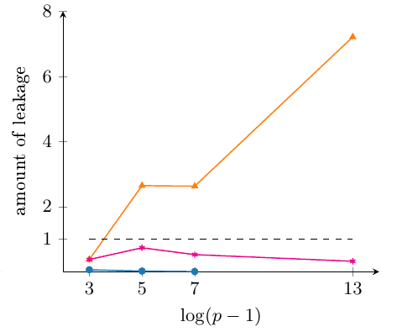
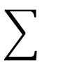
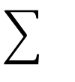
Impact of the Field Size, Hamming Weight
$$sk_{1}$$
$$…$$
$$sk_{d}$$
$m$-bounded with $m=O(log log p)$
HW correlated with power consumption
Amount of leakage vs $\log\left(p−1\right),$ worst-case secrets ($d=6$)
Upper bound of [BDIR18] for $m=\log{\log{p}}$
Increasing trend
Only informative for small $p$, or larger $d$
Numerical computation
Our upper bound
Decreasing trend $∼O({(log{p)}}^{1 − \frac{d}{4} }$)
Increasing the field size improves leakage resilience for $d≥5$
[BDIR18]: Benhamouda, Degwar, Ishai, Rabin, CRYPTO ’18

Slide 7
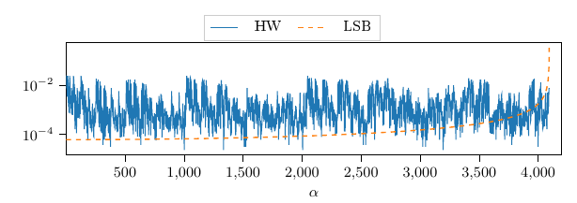
A Taste of Techniques
We study leakage-resilient secret sharing in the Fourier domain
The secret is a sum of random variables
Convolution of the distributions of the shares
Multiplication of their Fourier transforms
$$∼$$
Fourier
[BDIR18]: It’s enough to upper bound the maximum amplitude of the Fourier Spectrum
Hard to identify dominant terms for HW
[BDIR18]: Benhamouda, Degwar, Ishai, Rabin, CRYPTO ’18

Slide 8
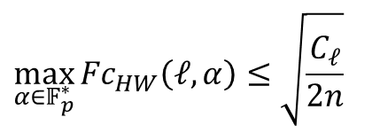
A Taste of Techniques
Goal: upper bound $\max_{α∈𝔽_{p}^{∗}}{{Fc}_{HW}\left(ℓ,α\right)}$ for every possible leakage $ℓ.$
1. Normalizing condition for Fourier coefficients (Parseval)
$$\sum_{α∈𝔽_{p}^{∗}}{{\left|Fc_{HW}\left(ℓ,α\right)\right|}^{2}=C_{ℓ}}$$
$$\max_{α∈𝔽_{p}^{∗}}{{Fc}_{HW}\left(ℓ,α\right)}≤\sqrt{C_{ℓ}}$$
2. Every Fourier coefficient has at least $2n$ copies (assumption: $p=2^{n}−1$)
1
0
1
1
0
$$α$$
1
0
1
1
0
$$α$$
Bitwise flip
Left shift
0
1
0
0
1
$$p− α$$
0
1
1
0
1
$$2α$$
3. This improves the upper bound by a factor $\sqrt{2n}$
$$\max_{α∈𝔽_{p}^{∗}}{{Fc}_{HW}\left(ℓ,α\right)}≤\sqrt{\frac{C_{ℓ}}{2n}}$$
$$2n\sum_{α∈I}{{\left|Fc_{HW}\left(ℓ,α\right)\right|}^{2}=C_{ℓ}}$$

Slide 9
Conclusions & Open Problems
Our contribution
Extend the LSB analysis of [MNPSWYY22] to average-case secrets
Larger fields do not improve leakage resilience
Hamming weight analysis
Larger fields improve leakage resilience
Simulated experiments on more general leakage models
Intermediate leakage show smooth degradation from Hamming weight to LSB
Random linear shows a positive impact of larger fields, but high variability
Open problems
Formal analysis of linear leakage functions
Impact of noise
Consider more complex gadgets
Thank you!
[MNPSWYY22]: Maji, Nguyen, Paskin-Cherniavsky, Suad, Wang, Ye, Yu, ITC ’22

Slide 10
Appendix

Slide 11
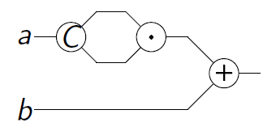
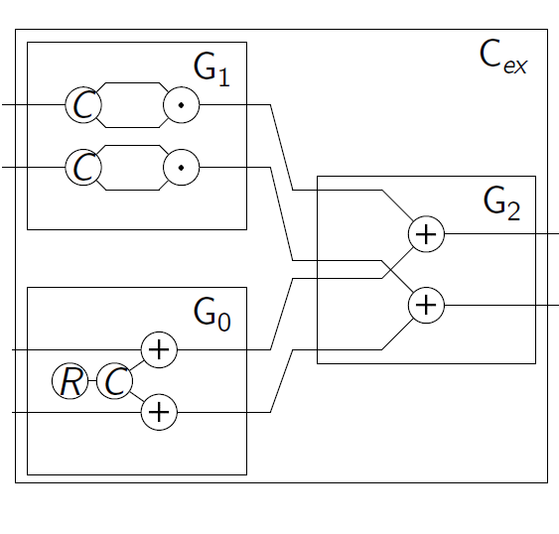
Masking
$$sk=\left(a,b\right), F=a^{2}+b$$
We model $F$ as an arithmetic circuit $C$
Operations described by gates
Values carried by wires
Masking
We use randomness to share the secret
Secret sharing/encoding schemes
We design the computation on shares
Gates become gadgets

Slide 12
On the Choice of the Field
Example: LSB leakage on additive encoding, but different fields
$$𝔽_{2^{n}}=\left({\left\{0,1\right\}}^{n},⊕\right)$$
$$𝔽_{p}=\left(ℤ_{p},+_{mod p}\right)$$
Leaking the LSB of the shares yields the LSB of the secret
No deterministic relation between LSB of the shares and LSB of the secret
$$($$
$$?$$
$$b_{1}$$
$$)$$
$$⊕$$
$$($$
$$1 0 1$$
$$)$$
$$+_{mod 7}$$
$$($$
$$1 0 1$$
$$)$$
$$+_{mod 7}$$
$$($$
$$?$$
$$b_{2}$$
$$)$$
$$=$$
$$($$
$$0 1 1$$
$$)$$
$$=$$
$$($$
$$0 0 1$$
$$)$$
$$=$$
$$($$
$$?$$
$$b_{1}⊕b_{2}$$
$$)$$
$$($$
$$0 0 1$$
$$)$$
$$($$
$$1 1 0$$
$$)$$

Slide 13
On the Choice of the Field
$$𝔽_{p}=\left(ℤ_{p},+_{mod p}\right)$$
Reason: prime fields have no non-trivial additive subgroup
No deterministic relation between L of the shares and L of the secret

Slide 14
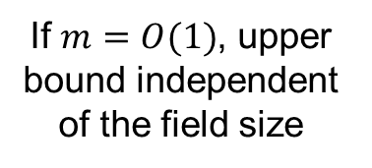
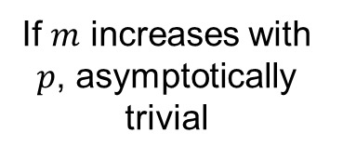
State of the Art & Our Contribution
[BDIR18]: m-bounded leakage in $𝔽_{p}$, worst case secrets, upper bound
The more the
shares, the less informative L
If $m=O(1)$, upper bound independent of the field size
If $m$ increases with $p$, asymptotically trivial
[MNPSWYY22]:
LSB gives tightness up to a constant
[MMMS23]: loose for HW (simulation, random secrets)
Formal analysis of HW for worst-case and random secrets
Simulations on intermediate models
Extend it to random secrets
This work
[BDIR18]: Benhamouda, Degwar, Ishai, Rabin, CRYPTO ’18
[MNPSWYY22]: Maji, Nguyen, Paskin-Cherniavsky, Suad, Wang, Ye, Yu, ITC ’22
[MMMS23]: Masure, Méaux, Moos, Standaert, EUROCRYPT ‘23

Slide 15
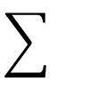
Least Significant Bit and Hamming Weight
Least significant bit (LSB) leakage
$m$-bounded with $m=O(1)$
$$sk_{1}$$
$$…$$
$$sk_{d}$$
$$≈$$
$$≈$$
[MNPSWYY22]:
LSB gives tightness
Hamming weight (HW) leakage
$m$-bounded with $m=O(log log p)$
$$sk_{1}$$
$$…$$
$$sk_{d}$$
$$≈$$
$$≈$$
HW leakage closer to practice
[MNPSWYY22]: Maji, Nguyen, Paskin-Cherniavsky, Suad, Wang, Ye, Yu, ITC ’22

Slide 16
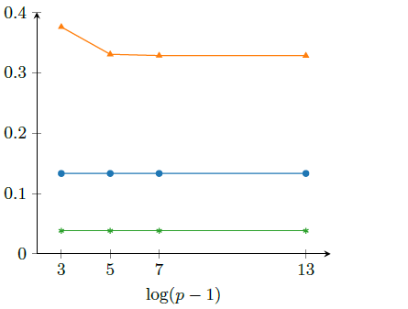
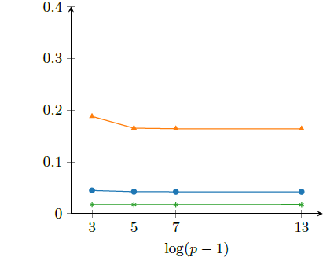
Impact of the Field Size for LSB Leakage
Worst case secrets
Random secrets
Upper bound of [BDIR18] for $m=1$
Numerical computation
Lower bound of [MNPSWYY22]
Upper bound of [BDIR18] for $m=1$
Numerical computation
Our lower bound
Increasing the field size does not improve leakage resilience!
[BDIR18]: Benhamouda, Degwar, Ishai, Rabin, CRYPTO ’18
[MNPSWYY22]: Maji, Nguyen, Paskin-Cherniavsky, Suad, Wang, Ye, Yu, ITC ’22

Slide 17
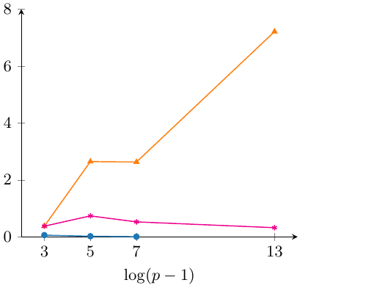
Impact of the Field Size for HW Leakage
Worst case secrets
Upper bound of [BDIR18] for $m=\log{\log{p}}$
Numerical computation
Our upper bound
Increasing the field size improves leakage resilience!
[BDIR18]: Benhamouda, Degwar, Ishai, Rabin, CRYPTO ’18

Slide 18
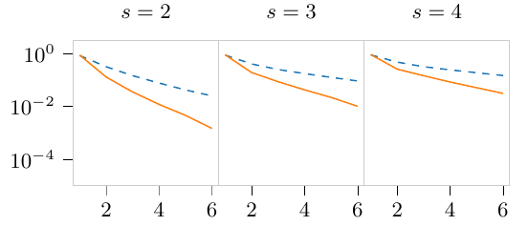
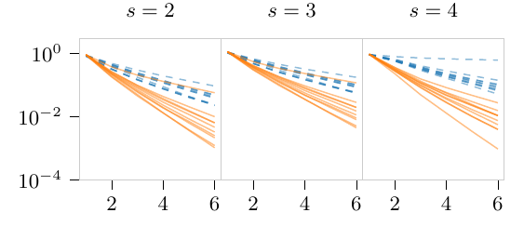
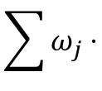
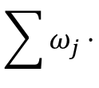
What Happens in Between: Simulations
$$sk_{1}$$
$$…$$
$$sk_{d}$$
HW
if $ω_{j}=1 ∀j$
LSB
if $ω_{1}=1, ω_{j}=0 ∀j>1$
$$≈$$
$$≈$$
$s$-Skewed HW
if $ω_{1}=s, ω_{j}=1 ∀j>1$
$$\sum{ω_{j}⋅}$$
$$\sum{ω_{j}⋅}$$
$s$-Random Linear
if $ω_{i}$ all random in $[s]$
$s$-Skewed HW
$s$-Random Linear

