Slide 1
How to Garble Mixed Circuits that Combine Boolean and Arithmetic Computations
Hanjun Li
University of Washington
Tianren Liu
Peking University
Notes:
Hello everyone!
Today I’m presenting our paper on how to garble mixed circuits.
It’s a joint work with Tianren at Peking University.

Slide 2
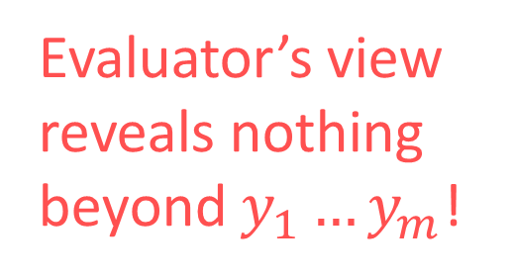







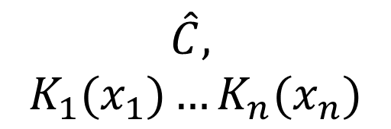



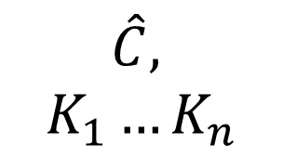





Boolean Garbling [Yao82]
Evaluator’s view
reveals nothing beyond $y_{1}…y_{m}$!
$$y_{1}$$
$$y_{m}$$
$$⋯$$
$$y_{1}…y_{m}$$
$$C$$
$$∧$$
$$⋯$$
Garb
$$\hat{C},$$
$$K_{1}…K_{n}$$
Eval
$$∧$$
$$⊕$$
$$\hat{C},$$
$$K_{1}(x_{1})…K_{n}(x_{n})$$
$$⋯$$
$$∧$$
$$⊕$$
$$⋯$$
$$x_{1}$$
$$x_{n}$$
Notes:
First, let’s recall the notion of a garbling scheme, which is the subject of talk.
Originally, proposed by [Yao82], the scheme mainly consists of two algorithms.
First, Garb takes in a Boolean circuit C, and produces a garbled circuit C-hat, together with n key functions.
The key functions are supposed to provide n keys depending on a set of inputs.
Later when Eval is given the garbled circuit C-hat and n keys, it recovers the correct results.
Security of the scheme requires that evaluator’s view, shown in the box, reveals nothing beyond the final results.

Slide 3








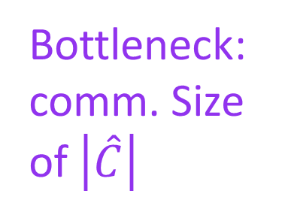









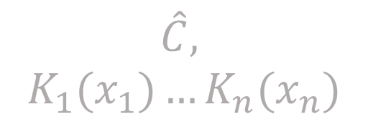




Boolean Garbling [Yao82]
$$y_{1}$$
$$y_{m}$$
$$⋯$$
$$y_{1}…y_{m}$$
$$C$$
$$∧$$
$$⋯$$
Garb
$$\hat{C},$$
$$K_{1}…K_{n}$$
Eval
$$∧$$
$$⊕$$
$$\hat{C},$$
$$K_{1}(x_{1})…K_{n}(x_{n})$$
$$⋯$$
$$∧$$
$$⊕$$
$$⋯$$
$$x_{1}$$
$$x_{n}$$
Natural Application to 2PC:
Alice
$$(C)$$
Bob
$$(x_{1}…x_{n})$$
Bottleneck: comm. Size of $\left|\hat{C}\right|$
$$K_{1}(0)…K_{n}(0)$$
$$x_{1}…x_{n}$$
OT
$$K_{1}(1)…K_{n}(1)$$
$$K_{1}(x_{1})…K_{n}(x_{n})$$
$$\hat{C}$$
Notes:
Such a garbling scheme naturally gives rise to the following two party computation protocol.
Suppose Alice and Bob each holds a circuit C and inputs x1 to xn, and wish to jointly evaluate C over x, without leaking anything beyond the final results.
In this case, Alice can run Garb and directly send the garbled circuit to Bob.
They can then run an oblivious transfer to transmit the correct keys.
In the end, Bob locally run Eval to obtain the final results.
It turns out a main bottleneck in this protocol is the communication size of the garbled circuit.
Optimizing the size of the garbled circuit has since been the subject of extensive research.

Slide 4
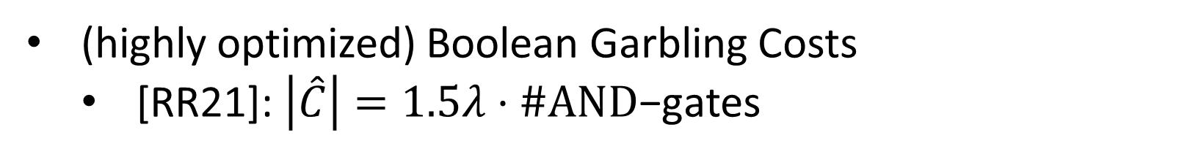

Boolean Garbling [Yao82]
$$y_{1}$$
$$y_{m}$$
$$⋯$$
$$y_{1}…y_{m}$$
$$C$$
$$∧$$
$$⋯$$
Garb
$$\hat{C},$$
$$K_{1}…K_{n}$$
Eval
$$∧$$
$$⊕$$
$$\hat{C},$$
$$K_{1}(x_{1})…K_{n}(x_{n})$$
$$⋯$$
$$∧$$
$$⊕$$
$$⋯$$
$$x_{1}$$
$$x_{n}$$
(highly optimized) Boolean Garbling Costs
  [RR21]: $\left|\hat{C}\right|=1.5λ⋅\#\text{AND}\text{−}\text{gates}$
($⊕$ gates free)
Bottleneck: comm. Size of $\left|\hat{C}\right|$
Q: Beyond Boolean Circuits?
Notes:
Through a long line of work, Boolean garbling is now highly optimized.
The state-of-the-art by [RR21] can garble XOR gates for free, and costs only 1.5 lambda bits per AND gate.
Where lambda is a security parameter usually set to 128.
Besides further optimizing the per-gate cost of Boolean garbling, one may also ask whether there are other directions of optimization.
For example, can we go beyond Boolean circuit to support other models of computation?

Slide 5

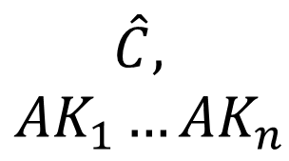


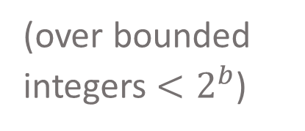

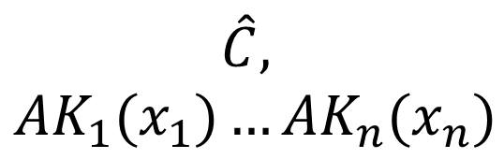

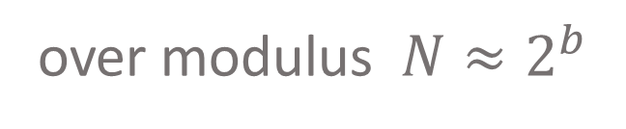



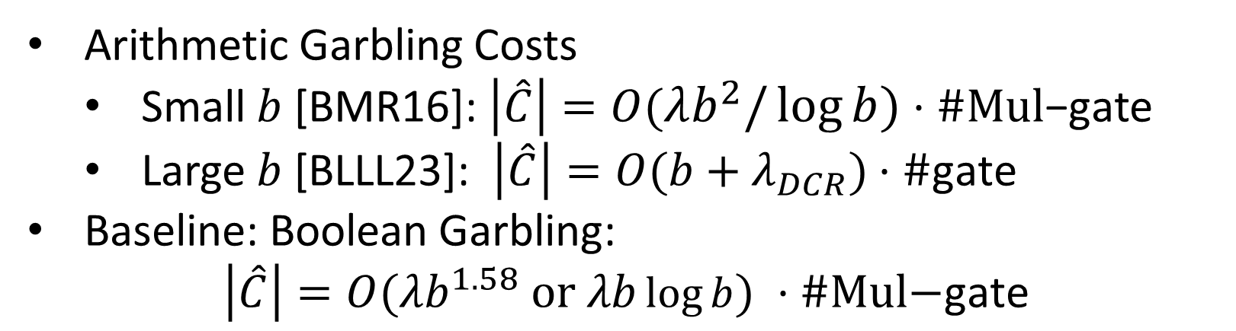
Arithmetic Garbling [AIK11]
over modulus $N≈2^{b}$
$$y_{1}$$
$$y_{m}$$
$$⋯$$
$$y_{1}…y_{m}$$
$$C$$
Add
$$⋯$$
Garb
$$\hat{C},$$
$${AK}_{1}…{AK}_{n}$$
Eval
Mul
Add
$$\hat{C},$$
$${AK}_{1}(x_{1})…{AK}_{n}(x_{n})$$
$$⋯$$
Mul
Mul
$$⋯$$
$$x_{n}$$
$$x_{n}$$
Arithmetic Garbling Costs
  Small $b$ [BMR16]: $\left|\hat{C}\right|=O(λb^{2}/\log{b})⋅\#Mul\text{−}\text{gate}$
  Large $b$ [BLLL23]: $\left|\hat{C}\right|=O(b+λ_{DCR})⋅\#\text{gate}$
Baseline: Boolean Garbling:
$$\left|\hat{C}\right|=O(λb^{1.58} or λb\log{b}) ⋅\#\text{Mul}\text{−}\text{gate}$$
(Add gates free)
(over bounded integers $<2^{b}$)
Notes:
The work of AIK11 is the first to consider garbling Arithmetic circuit, where the gates are addition and multiplication over some ring.
As illustrated, the syntax is analogous to the Boolean scheme.
In this setting, the state-of-the-art scheme for handling small domain is by BMR16, which garbles Additions for free, and costs lambda b-square over log-b bits per mult gate.
For large domain, the scheme from BLLL23 costs b plus lambda_DCR bits per gate.
Here lambda_DCR is a security parameter often set to around 4000.
And this scheme works over bounded integers rather than over a fixed modulus.
I should also mention that the less efficient baseline is garbling a Boolean circuit implementing the arithmetic operations.
For realistic domain sizes, the Karatusba algorithm for integer multiplication costs times b-to-the-1.58 bits.
Asymptotically, the best algorithm costs lambda b log b, but has huge hidden constants.
Given the progress on Arithmetic garbling, a natural question question is whether we can combine those results with the optimized Boolean garbling to get the best of both worlds.

Slide 6














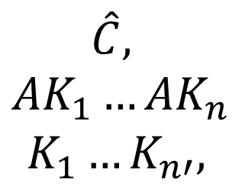



Mixed Garbling
over modulus $N≈2^{b}$
$$y_{1}^{A}$$
$$y_{1}^{B}$$
$$y_{m}^{B}$$
$$⋯$$
$$y_{1}^{A}…y_{m}^{A},y_{1}^{B}…y_{m′}^{B}$$
$$C$$
Mul
$$C_{2}^{Bool}$$
$$⋯$$
Garb
$$\hat{C},$$
$$AK_{1}…AK_{n}$$
$$K_{1}…K_{n′},$$
Eval
BC
Add
BD
$$⋯$$
$$\hat{C},$$
$$AK_{1}\left(x_{1}^{A}\right)…{AK}_{n}\left(x_{n}^{A}\right)$$
$$K_{1}\left(x_{1}^{B}\right)…K_{n}\left(x_{n′}^{B}\right),$$
$$C_{1}^{Bool}$$
Mul
Add
$$⋯$$
$$x_{1}^{B}$$
$$x_{n}^{B}$$
$$x_{1}^{A}$$
$$x_{2}^{A}$$
$$x_{3}^{A}$$
$$x_{4}^{A}$$
Notes:
More specifically, this work focus on garbling circuits containing both Arithmetic gates and arbitrary Boolean-sub-circuits.

Slide 7


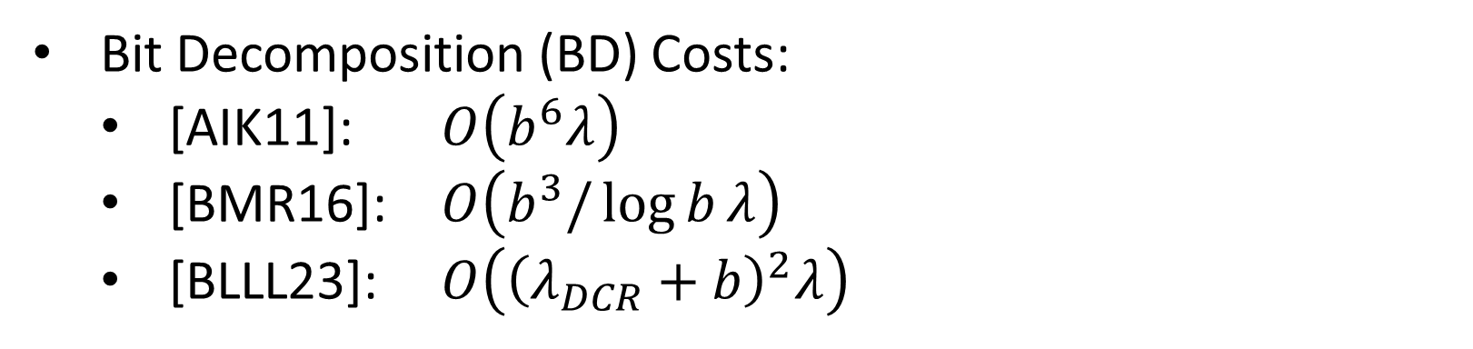
Mixed Garbling
over modulus $N≈2^{b}$
$$y_{1}^{A}$$
$$y_{1}^{B}$$
$$y_{m}^{B}$$
$$⋯$$
$$y_{1}^{A}…y_{m}^{A},y_{1}^{B}…y_{m′}^{B}$$
$$C$$
Mul
$$C_{2}^{Bool}$$
$$⋯$$
Garb
$$\hat{C},$$
$$AK_{1}…AK_{n}$$
$$K_{1}…K_{n′},$$
Eval
BC
Add
BD
$$⋯$$
$$\hat{C},$$
$$AK_{1}\left(x_{1}^{A}\right)…{AK}_{n}\left(x_{n}^{A}\right)$$
$$K_{1}\left(x_{1}^{B}\right)…K_{n}\left(x_{n′}^{B}\right),$$
$$C_{1}^{Bool}$$
Mul
Add
$$⋯$$
$$x_{1}^{B}$$
$$x_{n}^{B}$$
$$x_{1}^{A}$$
$$x_{2}^{A}$$
$$x_{3}^{A}$$
$$x_{4}^{A}$$
Bit Decomposition (BD) Costs:
  [AIK11]: $O\left(b^{6}λ\right)$
  [BMR16]: $O\left(b^{3}/\log{b}λ\right)$
  [BLLL23]: $O\left({\left(λ_{DCR}+b\right)}^{2}λ\right)$
Bottleneck: “interfacing” Boolean and Arithmetic
Notes:
As an interface between the Boolean gates and Arithmetic gates, we formulate two more gates Bit-Decomposition and Bit-Composition gates.
Naturally, a Bit Decomposition gate takes in an arithmetic wire value, and outputs the bit representation as Boolean wire values.
A Bit Composition gate is basically the invers of Bit Decomposition.
It turns out realizing Bit Decomposition is expensive in existing Arithmetic schemes.
A BD gate costs significantly more than other gates, at least by another factor of b.
This work aims to build efficient mixed garbling scheme, in particular, with more efficient BD and BC gates.

Slide 8
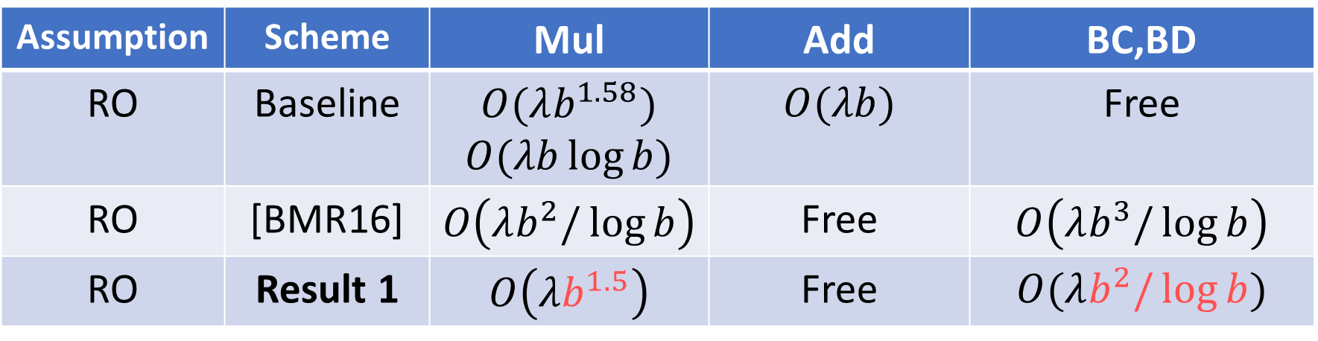
Our Results: Mixed Garbling
over modulus $N≈2^{b}$
Assumption | Scheme | Mul | Add | BC,BD
RO | Baseline | $$O(λb^{1.58})$$ $$O(λb\log{b})$$ | $$O(λb)$$ | Free
RO | [BMR16] | $$O\left(λb^{2}/\log{b}\right)$$ | Free | $$O\left(λb^{3}/\log{b}\right)$$
RO | Result 1 | $$O\left(λb^{1.5}\right)$$ | Free | $$O(λb^{2}/\log{b})$$
Notes:
Our first result assumes only a random oracle. Technically, a circular correlation robust hash function will also suffice.
Compared with the state-of-the-art in this setting, we improves the cost of both Multiplication and BD gates, and preserves free addition.

Slide 9
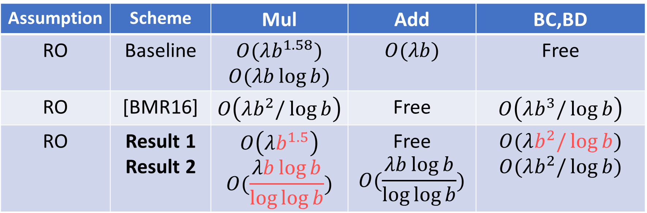
Our Results: Mixed Garbling
over modulus $N≈2^{b}$
Assumption | Scheme | Mul | Add | BC,BD
RO | Baseline | $$O(λb^{1.58})$$ $$O(λb\log{b})$$ | $$O(λb)$$ | Free
RO | [BMR16] | $$O\left(λb^{2}/\log{b}\right)$$ | Free | $$O\left(λb^{3}/\log{b}\right)$$
RO | Result 1 Result 2 | $$O\left(λb^{1.5}\right)$$ $$O(\frac{λb\log{b}}{\log{\log{b}}})$$ | Free $$O(\frac{λb\log{b}}{\log{\log{b}}})$$ | $$O(λb^{2}/\log{b})$$ $$O(λb^{2}/\log{b})$$
Notes:
Our second result further improves the cost of Multiplication, but as a trade-off, addition is no longer free.

Slide 10
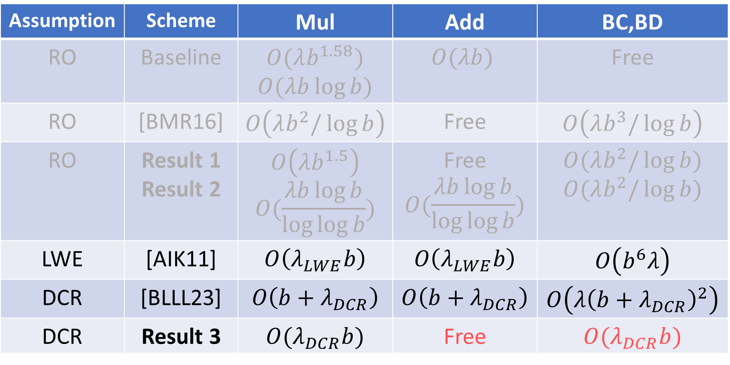
Our Results: Mixed Garbling
over modulus $N≈2^{b}$
Assumption | Scheme | Mul | Add | BC,BD
RO | Baseline | $$O(λb^{1.58})$$ $$O(λb\log{b})$$ | $$O(λb)$$ | Free
RO | [BMR16] | $$O\left(λb^{2}/\log{b}\right)$$ | Free | $$O\left(λb^{3}/\log{b}\right)$$
RO | Result 1 Result 2 | $$O\left(λb^{1.5}\right)$$ $$O(\frac{λb\log{b}}{\log{\log{b}}})$$ | Free $$O(\frac{λb\log{b}}{\log{\log{b}}})$$ | $$O(λb^{2}/\log{b})$$ $$O(λb^{2}/\log{b})$$
LWE | [AIK11] | $$O\left(λ_{LWE}b\right)$$ | $$O\left(λ_{LWE}b\right)$$ | $$O\left(b^{6}λ\right)$$
DCR | [BLLL23] | $$O\left(b+λ_{DCR}\right)$$ | $$O\left(b+λ_{DCR}\right)$$ | $$O\left(λ{\left(b+λ_{DCR}\right)}^{2}\right)$$
DCR | Result 3 | $$O(λ_{DCR}b)$$ | Free | $$O(λ_{DCR}b)$$
Notes:
Next, making public key assumptions, we construct a scheme with more efficient Bit Decomposition than BLLL23, and we support free addition.
But as a trade-off, our multiplication gates are more expensive.
(Here DCR* means a stronger variant of DCR assumed by BLLL23. )

Slide 11


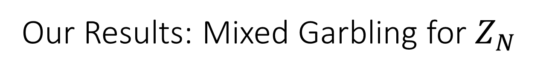






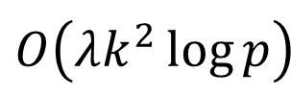


Our Results: Mixed Garbling for $Z_{N}$
$(b=\log{N})$
For $N=p^{k}$,
Add:
Mult:
BD,BC:
For $N=p_{1}^{k_{1}} p_{2}^{k_{2}}…$
Add:
Mult:
BD,BC:
Result 1
Free
CRT
Free
$$O(λb^{1.5})$$
$$O(λb^{2}/\log{b})$$
(assuming $p<k$)
$$O\left(λk^{2}\log{p}\right)$$
Emulation
For any $N$,
Add:
Mult:
BD,BC:
Result 2
For $N=p_{1}^{k_{1}} p_{2}^{k_{2}}…$
Add:
Mult:
BD,BC:
CRT
$$O(\frac{λb\log{b}}{\log{\log{b}}})$$
$$O(λb^{2}/\log{b})$$
$$O(λb^{2}/\log{b})$$
Notes:
Here is a more detailed overview of our results.
Our starting point is a scheme for prime-power modulus p-to-the-k, where additions are free.
Mult, BD, and BC gates cost lambda times k square times log p.
While this basic scheme is not yet very efficient, we will combine multiple copies of it over different prime powers through Chinese remainder theorem, to obtain our first result.
Applying a rather standard trick, we can also use the basic scheme to emulate Add and Mult over an arbitrary modulus.
Choosing an appropriate prime power results in a scheme where each gate costs lambda b square divided log b.
Note that Additions are no longer free, because each add is followed by a mod-N operation.
Finally, applying Chinese remainder theorem again, we can combine multiple copies of the new scheme into one with improved multiplication cost.
But it inherits the fact that addition are no longer free.
We also note that later in this session, David Heath’s work shows how to apply emulation to a CRT scheme, so that arbitrary modulus can be supported.
His method should also apply to our work.

Slide 12



Our Results: Mixed Garbling for $Z_{N}$
$(b=\log{N})$
Result 3
For $N=2^{b}$,
Add:
Mult:
BD,BC:
assuming DCR
Free
$$O(λ_{DCR}b)$$
Emulation
For any $N$,
Add:
Mult:
BD,BC:
$$O(λ_{DCR}b)$$
Notes:
Our third result is built upon the basic scheme, in the case when the modulus is a power of 2.
The cost per Mult , BD, and BC gate is now linear in b under the decisional composite residuosity assumption.
We can also apply the same emulation trick to support an arbitrary modulus.
Next, I’ll give more details of the transformations assuming we already have the basic scheme over prime powers.

Slide 13

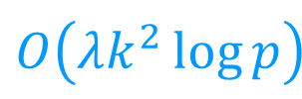

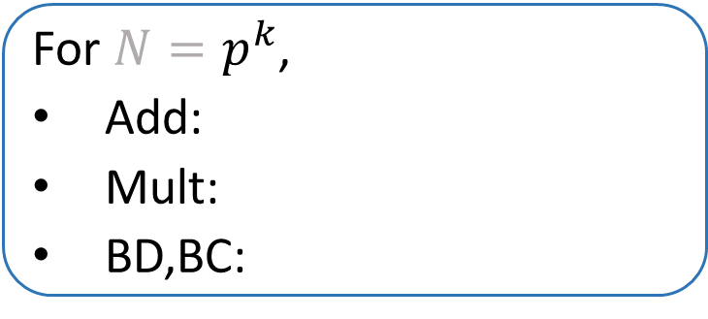

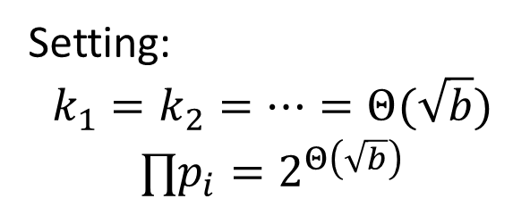

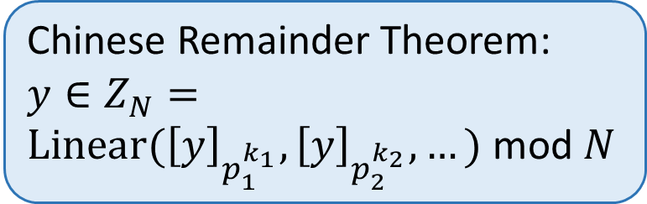
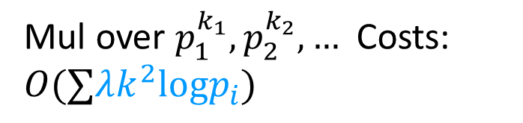


Arithmetic Gates w/ CRT
$(b=\log{N})$
For $N=p^{k}$,
Add:
Mult:
BD,BC:
For $N=p_{1}^{k_{1}} p_{2}^{k_{2}}…$
Add:
Mult:
BD,BC:
Result 1
Free
CRT
Free
$$O(λb^{1.5})$$
$$O(λb^{2}/\log{b})$$
(assuming $p<k$)
$$O\left(λk^{2}\log{p}\right)$$
$$y^{\left(1\right)},y^{\left(2\right)}, …$$
Setting:
$$k_{1}=k_{2}=⋯=Θ(\sqrt{b})$$
$$∏p_{i}=2^{Θ\left(\sqrt{b}\right)}$$
Chinese Remainder Theorem:
$$y∈Z_{N}=$$
$Linear({\left[y\right]}_{p_{1}^{k_{1}}}, {\left[y\right]}_{p_{2}^{k_{2}}},…)$ mod $N$
Add
Mul
Mul
Mul over $p_{1}^{k_{1}},p_{2}^{k_{2}},…$ Costs:
$$O(∑λk^{2}logp_{i})$$
$$…$$
$$=O\left(λb^{1.5}\right)$$
$$y^{\left(1\right)}$$
$$y^{\left(2\right)}$$
$$x^{\left(1\right)},x^{\left(2\right)}, …$$
Notes:
Our first result relies on the Chinese remainder theorem, which says values in Z_N can be uniquely determined by its remainders modulo the prime power factors, i.e., p_1^k_1, p_2^k_2, and so on.
Therefore, to compute some y mod N, we can run the circuit mod p_1^k_1 to compute the first remainder y_1, and then another copy of the circuit mod p_2^k_2 to recover y_2 and so on.
The cost of one Mult gate over N is the sum of the individual copies, as shown in blue.
If we want to support a b-bit modulus N, it suffices to set all the powers to sqare-root of b, and choose enough primes with product equals 2-to-the-square-root-of-b.
The total cost of a Mult over N under this setting is shown in red.
To achieve BD and BC in the CRT framework is a bit more complicated, and we defer the details to our paper.

Slide 14




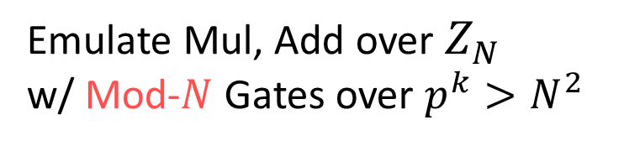





Emulating Arithmetic Gates
$(b=\log{N})$
For $N=p^{k}$,
Add:
Mult:
BD,BC:
Emulate Mul, Add over $Z_{N}$
w/ Mod-$N$ Gates over $p^{k}>N^{2}$
Free
(assuming $p<k$)
$$O\left(λk^{2}\log{p}\right)$$
$${\left[x_{3}\right]}_{N}<N$$
$${\left[x_{3}\right]}_{N}<N$$
Mod-$N$
Mod-$N$
Emulation
$$x_{3}<N^{2}$$
$$x_{3}<2N$$
For any $N$,
Add:
Mult:
BD,BC:
Mul
Add
$$x_{1},x_{2}<N$$
$$x_{1},x_{2}<N$$
$$O(λb^{2}/\log{b})$$
In paper, we show
Mod-$N⇐$ Trunc-by-p $⇐$ BD
Notes:
Next, to emulate an arbitrary modulus N, we chose an underlying prime power p^k greater than N^2 so that intermediate addition and multiplication results don’t overflow.
We then append a Mod-N gate after every Add and Mult.
In the paper, we show that mod-N can be reduced to truncation by p, which in the underlying basic scheme over p^k can be implemented easily by a bit-decomposition gate.

Slide 15


Mixed Garbling w/ CRT
$(b=\log{N})$
$$=p_{i}^{k_{i}}$$
Result 2
For any $N$
Add:
Mult:
BD,BC:
For $N=p_{1}^{k_{1}} p_{2}^{k_{2}}…$
Add:
Mult:
BD,BC:
CRT
$$O(\frac{λb\log{b}}{\log{\log{b}}})$$
$$O(λb^{2}/\log{b})$$
$$O(λb^{2}/\log{b})$$
Notes:
Lastly, applying the CRT method again on the newly obtained scheme gives our second result.
Roughly, compared to our first result, we are now able to set the prime power factors of N in a more balanced way to obtain asymptotically more efficient Add and Mult gates.

Slide 16







Summary:
$(b=\log{N})$
For $N=p^{k}$,
Add:
Mult:
BD,BC:
For $N=p_{1}^{k_{1}} p_{2}^{k_{2}}…$
Add:
Mult:
BD,BC:
Result 1
Free
CRT
Free
$$O(λb^{1.5})$$
$$O(λb^{2}/\log{b})$$
(assuming $p<k$)
$$O\left(λk^{2}\log{p}\right)$$
Emulation
For any $N$,
Add:
Mult:
BD,BC:
Result 2
For $N=p_{1}^{k_{1}} p_{2}^{k_{2}}…$
Add:
Mult:
BD,BC:
CRT
$$O(\frac{λb\log{b}}{\log{\log{b}}})$$
$$O(λb^{2}/\log{b})$$
$$O(λb^{2}/\log{b})$$
Notes:
In summary, our results assuming only a random oracle are derived from a core, basic scheme over prime powers, which I will explain next.

Slide 17

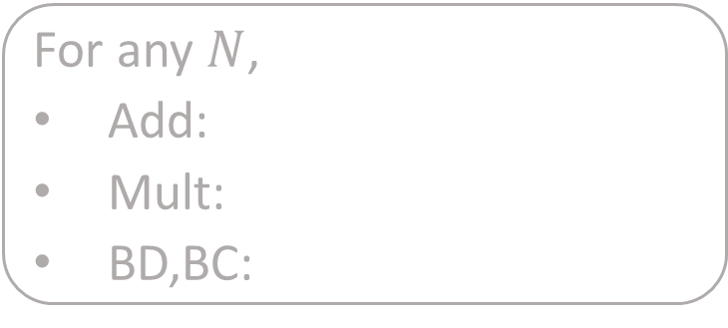
Summary:
$(b=\log{N})$
Result 3
For $N=2^{b}$,
Add:
Mult:
BD,BC:
assuming DCR
Free
$$O(λ_{DCR}b)$$
Emulation
For any $N$,
Add:
Mult:
BD,BC:
$$O(λ_{DCR}b)$$
Notes:
I’ll only comment briefly on how we modify the basic scheme under the DCR assumption to obtain the third result.

Slide 18









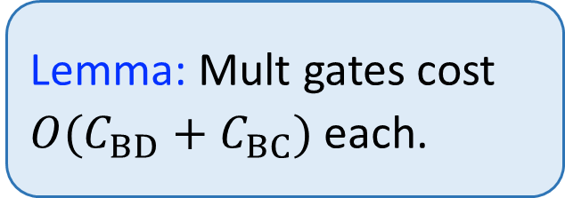












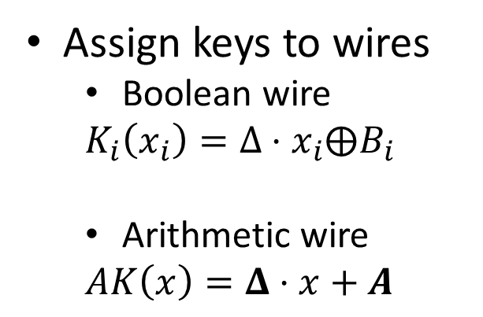








Mixed Garbling for $Z_{2^{b}}$, from BC, BD Gadgets
Bits($x$) $=\left(x_{1}, …,x_{b}\right)$
$$y_{1}^{A}$$
$$y_{1}^{B}$$
$$y_{n}^{B}$$
$$⋯$$
$$K_{1}^{out}$$
$$K_{b}^{out}$$
$$K_{1}^{out}(x_{1}), …,K_{1}^{out}(x_{b})$$
$$C_{2}^{Bool}$$
$$⋯$$
$$\text{BD}\text{.}\text{Eval}$$
Mul
BD
$$\text{BD}\text{.}\text{Garb}$$
$$⋯$$
Table
Table
BC
Add
BD
$${AK}^{in}$$
$$AK^{in} (x)$$
$$⋯$$
$$C_{1}^{Bool}$$
Mul
Add
$$⋯$$
Assign keys to wires
  Boolean wire
  $$K_{i}\left(x_{i}\right)=Δ⋅x_{i}⨁B_{i}$$
  Arithmetic wire
  $$AK\left(x\right)=Δ⋅x+A$$
$$x_{1}^{B}$$
$$x_{n}^{B}$$
$$x_{1}^{A}$$
$$x_{2}^{A}$$
$$x_{3}^{A}$$
$$x_{4}^{A}$$
$$∈\{0,1\}^{λ}$$
Lemma: Mult gates cost $O(C_{BD}+C_{BC})$each.
$$\text{BC}$$
$$\text{BD}$$
$$∈Z_{2^{b}}^{λ}$$
Notes:
At high level, our scheme garbles a mixed circuit gate-by-gate.
We first assign a key function to every wire in the circuit, with the following format, and then invoke different gadgets to garble different gates.
Note that the Boolean key functions has the Free-XOR format with a global Delta string.
Our Arithmetic key function has an analogous format, supporting free additions.
In our paper, we further show that Mult gates can be garbled through a composition of BD and BC gates.
Hence our task reduces to constructing the BD and BC gadgets.
For this talk, I’ll only have time to show the more interesting BD gadget.
The garbling algorithm BD.Garb takes in an airhtmetic key function, and b Boolean key functions, and produces a garbled table.
The BD.Eval takes in the garbled table and an arithmetic input key, and recovers the b Boolean output keys.

Slide 19



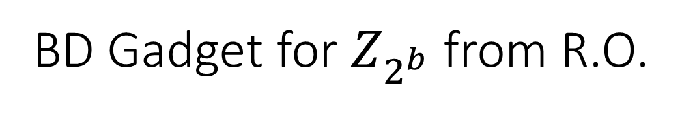
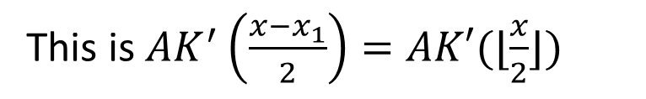

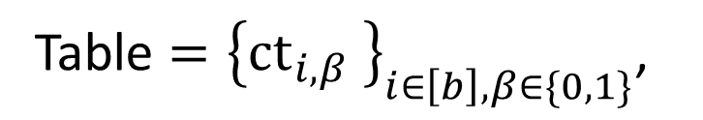
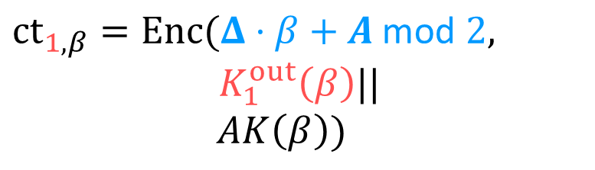
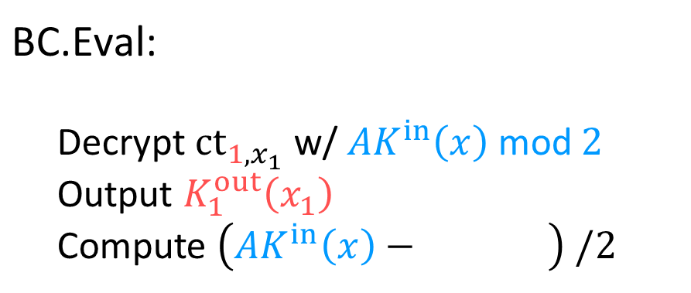
BD Gadget for $Z_{2^{b}}$ from R.O.
Bits($x$) $=\left(x_{1}, …,x_{b}\right)$
$$K_{1}^{out}$$
$$K_{b}^{out}$$
$$K_{1}^{out}(x_{1}), …,K_{1}^{out}(x_{b})$$
$$⋯$$
$$\text{BD}\text{.}\text{Eval}$$
$${AK}^{in}\left(x\right)=Δ⋅x+A$$
BD
$$\text{BD}\text{.}\text{Garb}$$
$$≡Δ⋅x_{1}+A \text{mod} 2$$
Table
Table
$${AK}^{in}$$
$$AK^{in} (x)$$
Table $={\left\{{ct}_{i,β} \right\}}_{i∈\left[b\right], β∈\{0,1\}}$,
$\text{BC}\text{.}\text{Eval}$:
Decrypt ${ct}_{1,x_{1}}$ w/ ${AK}^{in}\left(x\right) \text{mod} 2$
Output $K_{1}^{out}\left(x_{1}\right)$
Compute $\left({AK}^{in}\left(x\right)− \right) /2$
$${ct}_{1,β}=Enc(Δ⋅β+A \text{mod} 2,$$
$K_{1}^{out}\left(β\right)||$
$AK\left(β\right))$
// sk
$$AK\left(x_{1}\right)$$
This is $AK^{′}\left(\frac{x−x_{1}}{2}\right)=AK′(⌊\frac{x}{2}⌋)$
Notes:
Our starting point is the observation that an arithmetic key of x is already a Boolean key of the least significant bit x1, when taken mod 2.
Therefore, we can already setup the garbled table to contain two ciphertexts respectively containing the two possible output labels for x1.
The evaluator given AK(x), can take mod 2, and decrypt one of the ciphertext to recover the first output label k_1.
In order to repeat this process, we want an arithmetic key which taken mod 2 is a Boolean key of x_2.
For this, we further include a fresh Arithmetic key in the ciphertext, corresponding to the two cases of x_1.
The evaluator recovers AK(x1), and subtract it from AK(x), and divide it by 2.
The result is another arithmetic key for x truncated by 2.
And this is exactly what we want, because taken mod 2, this is a Boolean key of the second least significant bit of x.
Then we can repeat this construction to recover a Boolean key of x2, and so on.

Slide 20
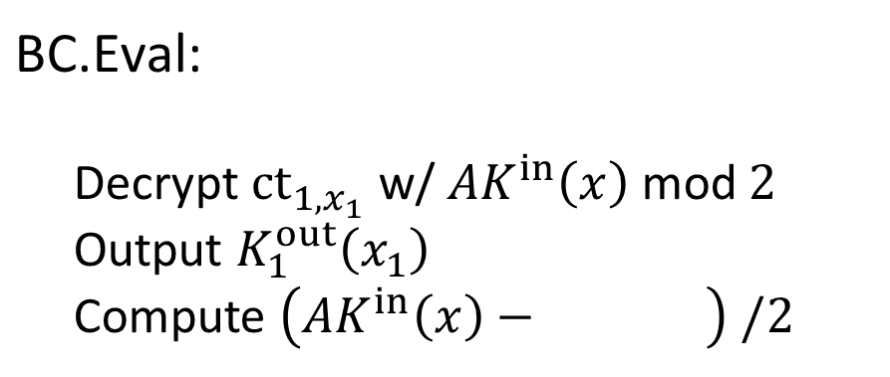

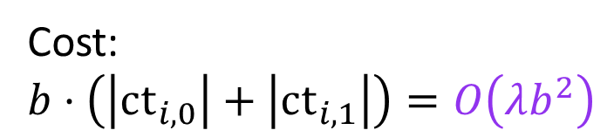
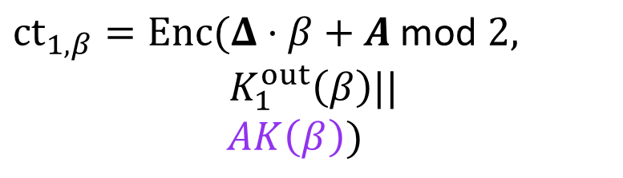
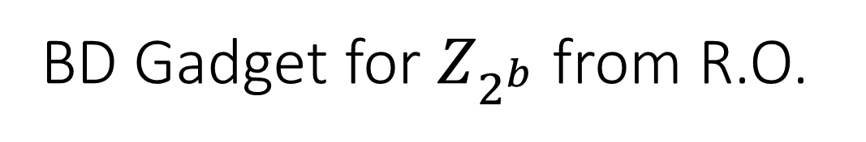
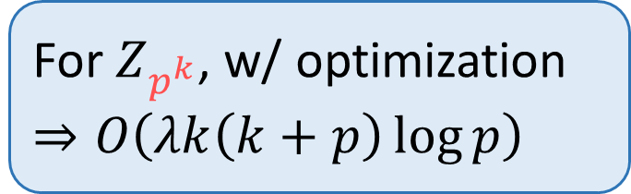
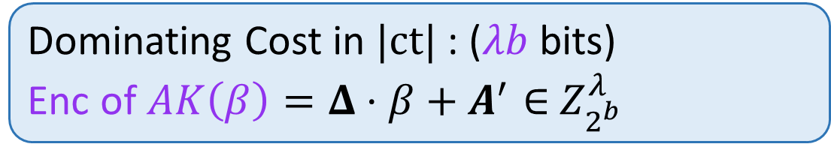
BD Gadget for $Z_{2^{b}}$ from R.O.
Bits($x$) $=\left(x_{1}, …,x_{b}\right)$
Cost:
$$b⋅\left(\left|ct_{i,0}\right|+\left|ct_{i,1}\right|\right)=O\left(λb^{2}\right)$$
$$K_{1}^{out}$$
$$K_{b}^{out}$$
$$K_{1}^{out}(x_{1}), …,K_{1}^{out}(x_{b})$$
$$⋯$$
$$\text{BD}\text{.}\text{Eval}$$
BD
$$\text{BD}\text{.}\text{Garb}$$
Table
Table
For $Z_{p^{k}}$, w/ optimization
$$⇒O\left(λk\left(k+p\right)\log{p}\right)$$
$${AK}^{in}$$
$$AK^{in} (x)$$
Table $={\left\{{ct}_{i,β} \right\}}_{i∈\left[b\right], β∈\{0,1\}}$,
$\text{BC}\text{.}\text{Eval}$:
Decrypt ${ct}_{1,x_{1}}$ w/ ${AK}^{in}\left(x\right) \text{mod} 2$
Output $K_{1}^{out}\left(x_{1}\right)$
Compute $\left({AK}^{in}\left(x\right)− \right) /2$
$${ct}_{1,β}=Enc(Δ⋅β+A \text{mod} 2,$$
$K_{1}^{out}\left(β\right)||$
$AK\left(β\right))$
// sk
$$AK\left(x_{1}\right)$$
Dominating Cost in $|ct|$: ($λb$ bits)
Enc of $AK\left(β\right)=Δ⋅β+A^{′}∈$ $Z_{2^{b}}^{λ}$
This is $AK\left(\frac{x−x_{1}}{2}\right)$, then recurse!
Notes:
Note that in this construction, the dominating cost in the garbled table is encrypting the Arithmetic key AK(beta), which is a lambda-dimension vector in Z_2^b.
In total, the table contains 2b such ciphertexts, which costs lambda b^2 bits.
In our paper, we show how to generalize this construction to modulus p^k.
To obtain our claimed efficiency will require a further optimization described in the paper.

Slide 21




BD Gadget for $Z_{2^{b}}$ from R.O. and DCR
Bits($x$) $=\left(x_{1}, …,x_{b}\right)$
High Level Idea:
Enc of $AK\left(β\right)$from additive hom. Enc of $Δ$ and $A$
Sample Enc of random $A$ implicitly from R.O.
$$K_{1}^{out}$$
$$K_{b}^{out}$$
$$K_{1}^{out}(x_{1}), …,K_{1}^{out}(x_{b})$$
$$⋯$$
$$\text{BD}\text{.}\text{Eval}$$
BD
$$\text{BD}\text{.}\text{Garb}$$
Table
Table
$${AK}^{in}$$
$$AK^{in} (x)$$
Table $={\left\{{ct}_{i,β} \right\}}_{i∈\left[b\right], β∈\{0,1\}}$,
$\text{BC}\text{.}\text{Eval}$:
Decrypt ${ct}_{1,x_{1}}$ w/ ${AK}^{in}\left(x\right) \text{mod} 2$
Output $K_{1}^{out}\left(x_{1}\right)$
Compute $\left({AK}^{in}\left(x\right)−AK\left(x_{1}\right)\right)/2$
$${ct}_{1,β}=Enc(Δ⋅β+A \text{mod} 2,$$
$K_{1}^{out}\left(β\right)||$
$AK\left(β\right))$
// sk
Dominating Cost in $|ct|$: ($λb$ bits)
Enc of $AK\left(β\right)=Δ⋅β+A∈$ $Z_{2^{b}}^{λ}$
This is $AK\left(\frac{x−x_{1}}{2}\right)$, then recurse!
Notes:
I’ll just briefly mention the high level idea behind our scheme assuming DCR.
Basically, we use an additive homomorphic encryption under DCR to reduce the cost of encrypting the arithmetic label AK.
We instead encrypt the terms Delta and A individually, where the encryption of Delta is reused through the scheme.
We can further avoid providing encryptions of the random A explicitly.
Instead, we only provide a random oracle seed in the garbled table, and use RO samples as the encryptions.

Slide 22


Summary: New Mixed Garbling Schemes
Assumption | Scheme | Mul | Add | BC,BD
RO | Result 1 Result 2 | $$O\left(λb^{1.5}\right)$$ $$O(\frac{λb\log{b}}{\log{\log{b}}})$$ | Free $$O(\frac{λb\log{b}}{\log{\log{b}}})$$ | $$O(λb^{2}/\log{b})$$ $$O(λb^{2}/\log{b})$$
DCR | Result 3 | $$O(λ_{DCR}b)$$ | Free | $$O(λ_{DCR}b)$$
Concurrent Work [Heath24] assuming RO
Lower Mult, Add, BC, BD sizes: $O(λb)$
Higher computation costs: $Ω(b^{2}/\log{b})$
Thank you!
Notes:
Here is a summary of our results.
We note that in a concurrent work by David heath, who will present later in this session, he obtains a scheme assuming only RO, and achieves a cost of lambda time b per gate, which is strictly cheaper than our result 2, communication wise.
As a trade off, this scheme will have higher computation costs, scaling with b-squared over log b.

Slide 23
Thank you!

Slide 24



Our Results: Mixed Garbling
over bounded integers $(<2^{b})$
Assumption | Scheme | Mul | Add | BC,BD
RO* | [BMR16] | $$O\left(λb^{2}/\log{b}\right)$$ | Free | $$O\left(λb^{3}/\log{b}\right)$$
RO* | Result 1 Result 2 | $$O\left(λb^{1.5}\right)$$ $$O(λb\log{b})$$ | Free $$O(λb\log{b})$$ | $$O(λb^{2}/\log{b})$$ $$O(λb^{2}/\log{b})$$
LWE | [AIK11] | $$O\left(λ_{LWE}b\right)$$ | $$O\left(λ_{LWE}b\right)$$ | $$O\left(b^{6}λ\right)$$
DCR* | [BLLL23] | $$O\left(b+λ_{DCR}\right)$$ | $$O\left(b+λ_{DCR}\right)$$ | $$O\left(λ{\left(b+λ_{DCR}\right)}^{2}\right)$$
DCR | Result 3 | $$O(λ_{DCR}b)$$ | Free | $$O(λ_{DCR}b)$$
Concurrent Work [Heath24] assuming RO*
Mult, Add, BC, BD costs $O(λb)$
Computation costs: $O({λb}^{2}/\log{b})$
Notes:
Our first result assumes only a random oracle. Technically, a circular secure correlation robust hash function will also suffice.
Compared with the state-of-the-art BMR16 scheme, also assuming RO, we improves the cost of both Multiplication and BD gates, and preserves free addition.
Our second result improves the cost of Multiplication further, but as a trade-off, addition is no longer free.
Next, making public key assumptions, we construct a scheme with more efficient Bit Decomposition, and free addition than BLLL23.
But as a trade-off, our multiplication gates are heavier.
Finally, in a concurrent work by David Heath, which will be presented later, they achieve an even better cost for Mult gates assuming only RO, but with heavier computation cost than our result.

Slide 25











Bit Decomposition w/ CRT
$(b=\log{N})$
For $N=p^{k}$,
Add:
Mult:
BD,BC:
Free
Bits($x$)
(assuming $p<k$)
$$⋯$$
Emulate over $p^{k}>N^{2}$ Costs:
$$O\left(λb^{2}/\log{b}\right)$$
$$O\left(λk^{2}\log{p}\right)$$
BD
$$x∈Z_{N}$$
Linear Comb mod $N$
Emulate over $p^{k}>N^{2}$ Costs:
$$O\left(λb^{2}/\log{b}\right)$$
Chinese Remainder Theorem:
$$y∈Z_{N}=$$
$Linear({\left[y\right]}_{p_{1}^{k_{1}}}, {\left[y\right]}_{p_{2}^{k_{2}}},…)$ mod $N$
$$⋯$$
Bits($x^{\left(1\right)}$), Bits($x^{\left(2\right)}$), $…$
$$⋯$$
BD over $p_{1}^{k_{1}},p_{2}^{k_{2}},…$ Costs:
$$O\left(λb^{1.5}\right)$$
BD
$$y^{\left(1\right)}$$
$$y^{\left(2\right)}$$
$$…$$
$$x^{\left(1\right)},x^{\left(2\right)}, …$$

Slide 26



Mixed Garbling w/ CRT
$(b=\log{N})$
For $N=p^{k}$,
Add:
Mult:
BD,BC:
For $N=p_{1}^{k_{1}} p_{2}^{k_{2}}…$
Add:
Mult:
BD,BC:
Free
CRT
Free
$$O(λb^{1.5})$$
$$O(λb^{2}/\log{b})$$
(assuming $p<k$)
$$O\left(λk^{2}\log{p}\right)$$
Chinese Remainder Theorem:
$$y∈Z_{N}=$$
$Linear({\left[y\right]}_{p_{1}^{k_{1}}}, {\left[y\right]}_{p_{2}^{k_{2}}},…)$ mod $N$
$$y^{\left(1\right)}$$
$$y^{\left(2\right)}$$
$$…$$

Slide 27




Trunc-by-N from Trunc-by-p
$(b=\log{N})$
For $N=p^{k}$,
Add:
Mult:
BD,BC:
Observation: Trunc-by-p $≡$
Bit Decompose (BD) +throw away last digit.
Free
(assuming $p<k$)
$$O\left(λk^{2}\log{p}\right)$$
Idea: find $m$ s.t. $∀x<N^{2}$,
$$\left\lfloor \frac{x}{N}\right\rfloor =\left\lfloor \frac{xm}{p^{k/2}}\right\rfloor$$
Emulation
For any $N$,
Add:
Mult:
BD,BC:
Claim: setting $m=\left\lceil \frac{p^{k/2}}{N}\right\rceil$ and $p^{k}>N^{4}$ suffices.
$$O(λb^{2}/\log{b})$$
Notes:
The observation is that we although we don’t immediately know how to truncate-by-N, we do know how to truncate-by-p, or a power of p.
This can be done by first bit-decompose to obtain labels of the mod-p digits, and then throw away the last digits.
Therefore, the idea is to find a fixed factor m such that for values x bounded by N^2, truncation of x by N equals first multiplying x by the factor m, and then truncate by a power of p.
We show in the paper that setting m as follows suffices.

Slide 28




Mixed Garbling w/ CRT
$(b=\log{N})$
Setting:
$$p_{i}^{k_{i}}=O(b)$$
$\#\text{Primes}$ $=O(b/\log{b})$
Mul over $p_{1}^{k_{1}},p_{2}^{k_{2}},…$ Costs:
$$O\left(λ\sum_{\#\text{Primes}}{\frac{{\left(\log{b}\right)}^{2}}{\log{\log{b}}}}\right)=O(λb\log{b})$$
$$=p_{i}^{k_{i}}$$
Result 2
For any $N$
Add:
Mult:
BD,BC:
For $N=p_{1}^{k_{1}} p_{2}^{k_{2}}…$
Add:
Mult:
BD,BC:
CRT
$$O\left(\frac{λ{\left(\log{b}\right)}^{2}}{\log{\log{b}}}\right)$$
$$O(λb\log{b})$$
$$O(λb^{2}/\log{b})$$
Notes:
Lastly, applying the CRT method again on the newly obtained scheme gives our second result.
Here we are able to set the prime power factors of N in a more balanced way to obtain asymptotically more efficient Add and Mult gates.

Slide 29


Summary: Remains to Construct
$(b=\log{N})$
For $N=p^{k}$,
Add:
Mult:
BD,BC:
Free
(assuming $p<k$)
$$O\left(λk^{2}\log{p}\right)$$
and
For $N=2^{b}$,
Add:
Mult:
BD,BC:
assuming DCR
Free
$$O(λ_{DCR}b)$$
Notes:
I will then go into more details of constructing the core basic scheme, and how we modify it under the DCR assumption.

Slide 30














Mixed Garbling for $Z_{p^{k}}$, from Gadgets
$$y_{1}^{A}$$
$$y_{1}^{B}$$
$$y_{n}^{B}$$
$$⋯$$
$${AK}^{out}$$
$${AK}^{out}(x_{1}⋅x_{2})$$
Mul
$$C_{2}^{Bool}$$
$$\text{Mult}\text{.}\text{Eval}$$
Mul
$$\text{Mult}\text{.}\text{Garb}$$
$$⋯$$
Table
Table
BC
Add
BD
$$AK_{1}^{in}$$
$$AK_{2}^{in}$$
$$AK_{1}^{in}(x_{1})$$
$$AK_{2}^{in}(x_{2})$$
$$⋯$$
$$C_{1}^{Bool}$$
Mul
Add
$$⋯$$
$$x_{1}^{B}$$
$$x_{n}^{B}$$
$$x_{1}^{A}$$
$$x_{2}^{A}$$
$$x_{3}^{A}$$
$$x_{4}^{A}$$
1. Assign keys to wires
  Boolean wire
  $$K\left(x\right)=Δ⋅x⨁B$$
  Arithmetic wire
  $$AK\left(x\right)=Δ⋅x+A$$
2. Garble each gate by gadget
  $\text{Mult}\text{.}\text{Garb}$, $\text{Mult}\text{.}\text{Eval}$
  $\text{BC}\text{.}\text{Garb}$, $\text{BC}\text{.}\text{Eval}$
  $\text{BD}\text{.}\text{Garb}$, $\text{BD}\text{.}\text{Eval}$
  $\text{Yao}\text{.}\text{Garb}$, $\text{Yao}\text{.}\text{Eval}$
$$∈\{0,1\}^{λ}$$
$⊕$, Add are Free!
$$∈Z_{p^{k}}^{ℓ}$$
Notes:
The basic scheme garbles the circuit gate-by-gate.
First, each wire in the circuit is assigned a key function, depending on its wire type.
A Boolean wire key function has the form Delta times x XOR with a one-time-pad B.
Here Delta is a global string of lambda bits, used for all Boolean wires.
An arithmetic wire key function has a similar form, where Delta in bold represents a global vector in Z_p^k, and A is again a one-time-pad.
Then, the Garbler runs the following garbling gadgets to produce a garbled table for each gate.
The gadgets all have a similar syntax as illustrated above.
The evaluator, after obtaining all garbled tables, and an initial set of input keys, runs the evaluation gadgets in a topological order to recover a key for every wire.
We will set the output wire keys to reveal output results in the clear.

Slide 31




Mixed Garbling for $Z_{p^{k}}$, from BC, BD Gadgets
Bits($x$) $=\left(x_{1}, …,x_{b}\right)$
$$y_{1}^{A}$$
$$y_{1}^{B}$$
$$y_{n}^{B}$$
$$⋯$$
$$K_{1}^{out}$$
$$K_{b}^{out}$$
$$K_{1}^{out}(x_{1}), …,K_{1}^{out}(x_{b})$$
$$C_{2}^{Bool}$$
$$⋯$$
$$\text{BD}\text{.}\text{Eval}$$
Mul
BD
$$\text{BD}\text{.}\text{Garb}$$
$$⋯$$
Table
Table
BC
Add
BD
$${AK}^{in}$$
$$AK^{in} (x)$$
$$⋯$$
$$C_{1}^{Bool}$$
Mul
Add
$$⋯$$
Lemma: Assuming
BD, BC gadgets with table sizes $C_{BD}, C_{BC}$,
There is a mixed GC, where
Add gates are free;
Mult gates cost $O(C_{BD}+C_{BC})$each.
$$x_{1}^{B}$$
$$x_{n}^{B}$$
$$x_{1}^{A}$$
$$x_{2}^{A}$$
$$x_{3}^{A}$$
$$x_{4}^{A}$$
Assign keys to wires
  Boolean wire
  $$K\left(x\right)=Δ⋅x⨁B$$
  Arithmetic wire
  $$AK\left(x\right)=Δ⋅x+A$$
2. Garble each gate by gadget
  $\text{Mult}\text{.}\text{Garb}$, $\text{Mult}\text{.}\text{Eval}$
  $\text{BC}\text{.}\text{Garb}$, $\text{BC}\text{.}\text{Eval}$
  $\text{BD}\text{.}\text{Garb}$, $\text{BD}\text{.}\text{Eval}$
  $\text{Yao}\text{.}\text{Garb}$, $\text{Yao}\text{.}\text{Eval}$
Notes:
We further show in our paper that the Mult gadget can be constructed as a composition of BC and BD gadgets, while Add is free.
The Yao gadget for handling Boolean sub-circuits can be instantiated with any existing Boolean scheme.
Therefore, our task reduces to constructing the bit composition and bit decomposition gadgets.
Due to time constraint, I will focus on the more interesting BD gadget, and only in the special case of N = 2^b for the remainder of the talk.
The syntax is illustrated above.
The Garb gadget takes in an input key function AK, and b output key functions and produces a garbled table.
The Eval gadget takes in the garbled table and an arithmetic input key, and recovers b Boolean output keys.

Slide 32


















BC Gadget for $Z_{2^{b}}$ from R.O
$$x=∑x_{i}⋅2^{i}$$
$${AK}^{out}$$
$$AK^{out} (x)$$
$$\text{BC}\text{.}\text{Eval}$$
BC
$$\text{BC}\text{.}\text{Garb}$$
$$⋯$$
Table
Table
$$K_{1}^{in}$$
$$K_{b}^{in}$$
$$K_{1}^{in}\left(x_{1}\right), …,K_{1}^{in}(x_{b})$$
Table $={\left\{{ct}_{i,0},{ct}_{i,1}\right\}}_{i∈[b]}$,
$\text{BC}\text{.}\text{Eval}$:
Decrypt $∀i∈[b]$
Compute $∑\left(AK^{out}\left(x_{i}⋅2^{i}\right)+R_{i}\right)$
$${ct}_{i,0}=Enc(K_{i}^{in}\left(0\right),$$
$AK^{out}\left(0⋅2^{i}\right)+R_{i})$
$${ct}_{i,1}=Enc(K_{i}^{in}\left(1\right),$$
$AK^{out}\left(1⋅2^{i}\right)+R_{i})$
$$Dec\left({ct}_{i,x_{i}},K_{i}^{in}\left(x_{i}\right)\right)→$$
$AK^{out}\left(x_{i}⋅2^{i}\right)+R_{i}$
$R_{i}$ random s.t.
$$∑R_{i}=0 \text{m}\text{od} 2^{b}$$
$=AK^{out}\left(∑x_{i}⋅2^{i}\right)+{∑R}_{i}$
$$x$$
$$0$$

Slide 33






BD Gadget for $Z_{2^{b}}$ from R.O.
Bits($x$) $=\left(x_{1}, …,x_{b}\right)$
$$K_{1}^{out}$$
$$K_{b}^{out}$$
$$K_{1}^{out}(x_{1}), …,K_{1}^{out}(x_{b})$$
$${AK}^{in}\left(x\right)=Δ⋅x+A=L_{x}^{(1)}$$
$$⋯$$
$$\text{BD}\text{.}\text{Eval}$$
BD
$$\text{BD}\text{.}\text{Garb}$$
Table
Table
$${AK}^{in}$$
$$AK^{in} (x)$$
Table $={\left\{{ct}_{i,0},{ct}_{i,1}\right\}}_{i∈[b]}$,
$\text{BC}\text{.}\text{Eval}$:
Decrypt
Derive $L_{x}^{(2)}←\left({L_{x}^{(1)}−D}_{1{,x}_{1}}\right)/2$
$${ct}_{1,0}=Enc(Δ⋅0+A \text{mod} 2,$$
$K_{1}^{out}\left(0\right)||D_{1,0})$
$${ct}_{1,1}=Enc(Δ⋅1+A \text{mod} 2,$$
$K_{1}^{out}\left(1\right)||D_{1,1})$
$$Dec\left({ct}_{1,x_{1}},L_{x}^{(1)}\text{mod} 2\right)$$
$→K_{1}^{out}\left(x_{1}\right)||D_{1,x_{1}}$
Set s.t
$$D_{1,x_{1}}=$$
$$Δ⋅x_{1}+A−2A′$$
$$L_{x}^{(2)}≡$$
$Δ⋅x_{2}+A′$ $\text{mod} 2$
Notes:
The idea to derive such an L2 is to include appropriate helper information D1 and D0 in the ciphertexts to allow exactly this.

Slide 34



BD Gadget for $Z_{2^{b}}$ from R.O.
Bits($x$) $=\left(x_{1}, …,x_{b}\right)$
$$K_{1}^{out}$$
$$K_{b}^{out}$$
$$K_{1}^{out}(x_{1}), …,K_{1}^{out}(x_{b})$$
$${AK}^{in}\left(x\right)=Δ⋅x+A=L_{x}^{(1)}$$
$$⋯$$
$$\text{BD}\text{.}\text{Eval}$$
BD
$$\text{BD}\text{.}\text{Garb}$$
Table
Table
$${AK}^{in}$$
$$AK^{in} (x)$$
Table $={\left\{{ct}_{i,0},{ct}_{i,1}\right\}}_{i∈[b]}$,
$\text{BC}\text{.}\text{Eval}$:
Decrypt
Derive $L_{x}^{(2)}←\left({L_{x}^{(1)}−D}_{1{,x}_{1}}\right)/2$
$${ct}_{2,0}=Enc(Δ⋅0+A^{′}\text{mod} 2,$$
$K_{2}^{out}\left(0\right)||D_{2,0})$
$${ct}_{2,1}=Enc(Δ⋅1+A^{′}\text{mod} 2,$$
$K_{2}^{out}\left(1\right)||D_{2,1})$
$$Dec\left({ct}_{1,x_{1}},L_{x}^{(1)}\text{mod} 2\right)$$
$→K_{1}^{out}\left(x_{1}\right)||D_{1,x_{1}}$
Set s.t
$$D_{1,x_{1}}=$$
$$Δ⋅x_{1}+A−2A′$$
$$L_{x}^{(2)}≡$$
$Δ⋅x_{2}+A′$ $\text{mod} 2$
Notes:
Then, we repeat the construction to include two more ciphertexts in the table containing the two possible output labels for x2, under the appropriate secret keys shown in blue.
Continuing the construction for the rest of the bits in x completes our bit decomposition gadget.

Slide 35



BD Gadget for $Z_{2^{b}}$ from R.O.
Bits($x$) $=\left(x_{1}, …,x_{b}\right)$
$$K_{1}^{out}$$
$$K_{b}^{out}$$
$$K_{1}^{out}(x_{1}), …,K_{1}^{out}(x_{b})$$
$${AK}^{in}\left(x\right)=Δ⋅x+A=L_{x}^{(1)}$$
$$⋯$$
$$\text{BD}\text{.}\text{Eval}$$
BD
$$\text{BD}\text{.}\text{Garb}$$
Table
Table
$${AK}^{in}$$
$$AK^{in} (x)$$
Table $={\left\{{ct}_{i,0},{ct}_{i,1}\right\}}_{i∈[b]}$,
$\text{BC}\text{.}\text{Eval}$:
Decrypt
Compute $L_{x}^{(2)}←\left({L_{x}−D}_{1{,x}_{1}}\right)/2$
$${ct}_{2,0}=Enc(Δ⋅0+A^{′}\text{mod} 2,$$
$K_{2}^{out}\left(0\right)||D_{2,0})$
$${ct}_{2,1}=Enc(Δ⋅1+A^{′}\text{mod} 2,$$
$K_{2}^{out}\left(1\right)||D_{2,1})$
$$Dec\left({ct}_{1,x_{1}},L_{x}^{(2)}\text{mod} 2\right)$$
$→K_{1}^{out}\left(x_{1}\right)||D_{1,x_{1}}$
Set s.t
$$D_{1,x_{1}}=$$
$$Δ⋅x_{1}+A−2A′$$
$$L_{x}^{(2)}≡$$
$Δ⋅x_{2}+A′$ $\text{mod} 2$
Notes:
The idea is to also include a term D

Slide 36




BD Gadget for $Z_{2^{b}}$ from R.O.
Bits($x$) $=\left(x_{1}, …,x_{b}\right)$
$$K_{1}^{out}$$
$$K_{b}^{out}$$
$$K_{1}^{out}(x_{1}), …,K_{1}^{out}(x_{b})$$
$$⋯$$
$$\text{BD}\text{.}\text{Eval}$$
BD
$$\text{BD}\text{.}\text{Garb}$$
Table
Table
$${AK}^{in}$$
$$AK^{in} (x)$$
Table $={\left\{{ct}_{i,0},{ct}_{i,1}\right\}}_{i∈[b]}$,
$\text{BC}\text{.}\text{Eval}$:
Decrypt $∀i∈[b]$
Compute $L_{x}^{(i+1)}←\left(L_{x}^{(i)}−D_{i,x_{i}}\right)/2$
$${ct}_{i,0}=Enc(Δ⋅0+R_{i−1}\text{mod} 2,$$
$K_{i}^{out}\left(0\right)||D_{i,0})$
$${ct}_{i,1}=Enc(Δ⋅1+R_{i−1}\text{mod} 2,$$
$K_{i}^{out}\left(1\right)||D_{i,1})$
$$Dec\left({ct}_{i,x_{i}},L_{x}^{(i)} \text{mod} 2 \right)$$
$→K_{i}^{out}\left(x_{i}\right)||D_{i,x_{i}}$

Slide 37


BD Gadget for $Z_{2^{b}}$ from R.O.
Bits($x$) $=\left(x_{1}, …,x_{b}\right)$
Cost:
$$b⋅\left(\left|ct_{i,0}\right|+\left|ct_{i,1}\right|\right)=O\left(λb^{2}\right)$$
$$K_{1}^{out}$$
$$K_{b}^{out}$$
$$K_{1}^{out}(x_{1}), …,K_{1}^{out}(x_{b})$$
$$⋯$$
$$\text{BD}\text{.}\text{Eval}$$
BD
$$\text{BD}\text{.}\text{Garb}$$
Table
Table
For $Z_{p^{k}}$, w/ optimization
$$⇒O\left(λk\left(k+p\right)\log{p}\right)$$
$${AK}^{in}$$
$$AK^{in} (x)$$
Table $={\left\{{ct}_{i,0},{ct}_{i,1}\right\}}_{i∈[b]}$,
$\text{BC}\text{.}\text{Eval}$:
Decrypt
Derive $L_{x}^{(2)}←\left({L_{x}^{(1)}−D}_{1{,x}_{1}}\right)/2$
$${ct}_{2,0}=Enc(Δ⋅0+A^{′}\text{mod} 2,$$
$K_{2}^{out}\left(0\right)||D_{2,0})$
$${ct}_{2,1}=Enc(Δ⋅1+A^{′}\text{mod} 2,$$
$K_{2}^{out}\left(1\right)||D_{2,1})$
$$Dec\left({ct}_{1,x_{1}},L_{x}^{(1)}\text{mod} 2\right)$$
$→K_{1}^{out}\left(x_{1}\right)||D_{1,x_{1}}$
Dominating Cost in $|ct|$: ($λb$ bits)
Enc of $\left(D_{i,x_{i}}=Δ⋅x_{i}+A^{\left(i−1\right)}−2A^{(i)}\right)$
Notes:
Note that in this construction, the dominating cost in the garbled table is encrypting the helper terms D, which is a lambda-dimension vector in Z_2^b.
In total, the table contains 2b such ciphertexts, which costs lambda b^2 bits.

Slide 38

BD Gadget for $Z_{2^{b}}$ from R.O. and DCR
Bits($x$) $=\left(x_{1}, …,x_{b}\right)$
High Level Idea:
Enc of $D_{i,0}$ from additive hom. Enc of $Δ$ and $\left\{R_{i}\right\}$
Sample Enc of random $R_{i}$ implicitly from R.O.
$$K_{1}^{out}$$
$$K_{b}^{out}$$
$$K_{1}^{out}(x_{1}), …,K_{1}^{out}(x_{b})$$
$$⋯$$
$$\text{BD}\text{.}\text{Eval}$$
BD
$$\text{BD}\text{.}\text{Garb}$$
Table
Table
$${AK}^{in}$$
$$AK^{in} (x)$$
Table $={\left\{{ct}_{i,0},{ct}_{i,1}\right\}}_{i∈[b]}$,
$\text{BC}\text{.}\text{Eval}$:
Decrypt
Derive $L_{x}^{(2)}←\left({L_{x}^{(1)}−D}_{1{,x}_{1}}\right)/2$
$${ct}_{2,0}=Enc(Δ⋅0+A^{′}\text{mod} 2,$$
$K_{2}^{out}\left(0\right)||D_{2,0})$
$${ct}_{2,1}=Enc(Δ⋅1+A^{′}\text{mod} 2,$$
$K_{2}^{out}\left(1\right)||D_{2,1})$
$$Dec\left({ct}_{1,x_{1}},L_{x}^{(1)}\text{mod} 2\right)$$
$→K_{1}^{out}\left(x_{1}\right)||D_{1,x_{1}}$
Dominating Cost in $|ct|$: ($λb$ bits)
Enc of $\left(D_{i,x_{i}}=Δ⋅x_{i}+A^{\left(i−1\right)}−2A^{(i)}\right)$

Slide 39

























Gate-by-Gate Garbling
$$y_{1}^{A}$$
$$y_{1}^{B}$$
$$y_{n}^{B}$$
$$⋯$$
Mul
$$C_{2}^{Bool}$$
$$\hat{\text{Mul}}$$
$$\hat{C_{2}^{Bool}}$$
$$⋯$$
BC
Add
BD
$$\hat{\text{BC}}$$
$$\hat{\text{ADD}}$$
$$\hat{\text{BD}}$$
$$⋯$$
$$C_{1}^{Bool}$$
Mul
Add
$$\hat{C_{1}^{Bool}}$$
$$\hat{\text{Mul}}$$
$$\hat{\text{ADD}}$$
$$⋯$$
$$x_{1}^{B}$$
$$x_{n}^{B}$$
$$x_{1}^{A}$$
$$x_{2}^{A}$$
$$x_{3}^{A}$$
$$x_{4}^{A}$$
$$K_{1}$$
$$⋯$$
$$K_{n}$$
$${AK}_{1}$$
$${AK}_{2}$$
$${AK}_{3}$$
$${AK}_{4}$$
$${AK}^{out}$$
$${AK}^{out}$$
$$K_{1}^{out}$$
$$K_{b}^{out}$$
$$⋯$$
Mul
BC
BD
$$⋯$$
$$AK_{1}^{in}$$
$$AK_{2}^{in}$$
$$K_{1}^{in}$$
$$K_{b}^{in}$$
$${AK}^{in}$$

