Slide 1
A General Framework for Lattice-Based ABE Using Evasive Inner-Product Functional Encryption
Yao-Ching Hsieh
Huijia (Rachel) Lin
Ji Luo

Slide 2
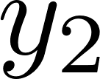
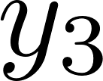
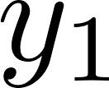
Attribute Based Encryption / ABE ([SW05])
Restricted keys
Public string

Slide 3
Modalities
Key-Policy ABE
Ciphertext-Policy ABE
$y$ : Policy / Function
$x$ : Attribute / Input
$P\left(x,y\right)=y(x)$
$y$ : Attribute / Input
$x$ : Policy / Function
$P\left(x,y\right)=x(y)$
Non-uniform Policy
Uniform Policy
Policy: Fixed input function (e.g. circuit)
Attribute: Fixed length
Policy: Variable input function (e.g. TM)
Attribute: Arbitrary length (unknown for system setup)

Slide 4
ABE constructions
Lattice Based ABE | Pairing Based ABE
Post-Quantum secure | Not Quantum Safe
Supports all poly-sized circuits | Support low-depth circuit
Succinct constructions | Non-succinct
Less is known about CP | KP/CP construction roughly transferable
Restricted security for uniform model | Supports uniform computation
Combine advantage from both?
Pairing + LWE
Evasive LWE

Slide 5
Evasive LWE assumptions ([Wee22],…)
Rationale :
Trapdoor can only be used “as supposed.”
Structural errors are “fine” as long as samples are pseudorandom with fresh errors.
New constructions: CPABE, MAABE, MIABE, WE,…

Slide 6
Vanilla ABE from Evasive assumptions
[Wee22] – Evasive LWE + LWE
Succinct CP-ABE for NC1 circuits
Succinct CP-ABE for all circuits (with additional assumption)
Remaining Challenges
CP-ABE for circuits with only LWE + evasive assumption?
Lattice-based ABE for uniform policy?
Modular Usage of Evasive LWE?

Slide 7
Contribution
Modularized Framework of constructing ABE from Evasive LWE!
Evasive LWE
Evasive IPFE
KP/CP-ABE for $ℱ$
Succinct CP-ABE for circuits
KP/CP-ABE for DFA
Noisy LSSS for $ℱ$

Slide 8
Results – CP-ABE for circuits
 | Security | Function | Ciphertext Size | Assumptions
[AY 20] | Secret key | Circuits | Non-succinct | LWE
[AY 20] | Public key | Bounded sized Circuit | Non-succinct | LWE
[Wee 22] | Public key | NC1 | Succinct | LWE + evLWE
[Wee 22] | Public key | Circuits | Succinct | LWE + evLWE + tensor LWE
Ours | Public key | Circuits | Non-succinct | LWE + evLWE
Ours | Public key | Circuits | Succinct | LWE + evLWE*
* Stronger variant with identical rationale

Slide 9
Results – ABE for uniform policy
 | Security | Function | Modalities | Assumptions
[AS 17] | Bounded Collusion Public key | DFA | Key-Policy | LWE
[AMY 19] | Secret key | NFA | Key-Policy | LWE
[Wee 21] | Public key | DFA | Key-Policy | No security proof
Ours | Public key | DFA | Key-Policy | LWE + evLWE
Ours | Public key | DFA | Ciphertext-Policy | LWE + evLWE

Slide 10
Recap – Our ABE framework
Evasive LWE
Evasive IPFE
KP/CP-ABE for $ℱ$
Noisy LSSS for $ℱ$

Slide 11
Recap – Our ABE framework
Pairing
(Standard) IPFE
KP/CP-ABE for $ℱ$
(Noiseless) LSSS for $ℱ$

Slide 12
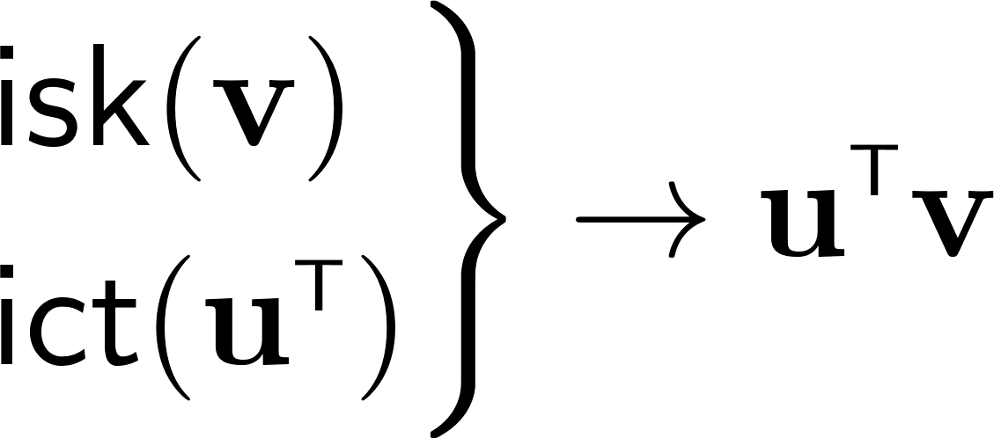
Framework for pairing-based ABE
Pairing
(Standard) IPFE
KP/CP-ABE for $ℱ$
(Noiseless) LSSS for $ℱ$
Inner Product Functional Encryption:
Linear secret sharing scheme:
Hides u.

Slide 13
Framework for pairing-based ABE
Issue: Not many-key secure.
Randomness s reused.
Inner Product Functional Encryption:
Linear secret sharing scheme:
Hides u.

Slide 14
Framework for pairing-based ABE
Relies on DDH-type rerandomization.
Limitation:
LSSS for $ℱ⊆NC$
Inner Product Functional Encryption:
Linear secret sharing scheme:
Hides u.

Slide 15
Relax to Noisy LSSS
LSSS | Noisy LSSS
Only support low-depth functions. | Supports poly-sized circuits! ([BGG+14])

Slide 16
Noisy LSSS + Lattice-based IPFE?
No fresh noise for share and secret.
${\text{r}}^{T}S$ is not random.
Want from IPFE:
Fresh noise for NLSSS.
Fresh noise for LWE rerandomization

Slide 17
Evasive IPFE
Correctness:
Security:
Fresh Noise
Evasive LWE $⇒$ restricted Evasive IPFE
$u$ is required to be the form $s^{T}A$ for some secret $s$, which is sufficient for our NLSSS formulation.

Slide 18
Evasive IPFE + NLSSS
Want from IPFE:
Fresh noise for NLSSS.
Fresh noise for LWE rerandomization

Slide 19
Evasive IPFE + NLSSS
Approach 1: Flooding
Require NLSSS to be low-norm.
Low norm (non-succinct) NLSSS for circuits $⇒$ CP-ABE for circuits.
Low norm NLSSS for DFA $⇒$ KP-ABE/CP-ABE for DFA.
Need extra tweaks leveraging local structures

Slide 20
Evasive IPFE + NLSSS
Approach 2: Structured error
IPFE directly provides
Sufficient if Evasive IPFE can give
Gives succinct CP-ABE for circuits
Relies on a modified version of evasive LWE
The rationale of the assumption is the same!

Slide 21
Open problems
Unbounded depth CP-ABE?
Our NLSSS for DFA comes from known LSSS
More NLSSS beyond NC?
NLSSS for NFA?
More applications for Evasive IPFE?

Slide 22
Thank you!
Full paper: eprint.iacr.org/2024/821

