Slide 1
Ring/Module Learning with Errors under Linear Leakage — Hardness and Applications
Zhedong Wang, Qiqi Lai, Feng-Hao Liu
Shanghai Jiao Tong University
Shaanxi Normal University
Washington State University
Apr 17 2024
Notes:
Ok, thanks for introduction. I’m zhedong, today I will talk about Ring/Module LWE under linear leakage-hardness and applications. This is a joint work with Qiqi Lai and feng-Hao Liu.

Slide 2
Lattice-based ZKP
Commit and prove paradigm
KeyGen$(1^{λ})$: inputs security parameter $λ$, outputs the public parameters $PP∈\{0,1\}^{poly(λ)}$, containing description of message space $ℳ$
Commit$(PP,x∈ℳ)$: inputs $PP, x∈ℳ$, outputs values $c, r∈\{0,1\}^{poly(λ)}$
Prove$(PP,st,\left(x_{1},r_{1}\right),⋯,(x_{n},r_{n}))$: inputs $PP$, statement $st$ and commitment message $x_{i}$ and randomness $r_{n}$ and $\left(PP,st,x_{1},⋯,x_{n}\right)∈R_{L}$ returns a proof $π$
Verify$(PP,st,c_{1},⋯,c_{n})$: input $PP$, statement $st$ , a proof $π$ and commitments $c_{1},⋯,c_{n}$, outputs 1 (accept) or 0 (reject).
Notes:
So, let me start with the lattice-based zero-knowledge proof. We first recall the commit and prove paradigm. It combines the commitment scheme and the zero-knowledge proof, and enables to prove certain relation about the committed messages. This paradigm contains four algorithms, the first one is keygen algorithm, which inputs the security parameter and outputs the public parameters pp. Second one is commit algorithm, that takes pp and a message, outputs the commitment and the corresponding randomness. During the prove phase, it takes the pp, a statement and some message and randomness pairs as input, and generates a proof \pi. The verify algorithm with input pp, statement and some commitments, outputs accept or reject.

Slide 3
Lattice-based ZKP
Commit and prove paradigm
Notes:
The correctness straightforwardly follows the compactness of commitment scheme and ZKP. There are two security properties of the paradigm. The first one is the knowledge soundness, with intuition that it’s hard to pass the verification if the messages do not belong to the language or the commitments are invalid. And the second property we mainly focused on is called simulatability. It states that the commitments and proof \pi can be simulated without the messages and randomness. In a sense, this property combines the hiding security of commitment scheme and the zero-knowledge security of ZKP.

Slide 4
Lattice-based ZKP
BDLOP Commitment Scheme
Notes:
So, let’s move to the lattice-based instantiation of this paradigm. For the commitment scheme, one can use the BDLOP scheme proposed by Baum et al in SCN 18. The keygen algorithm outputs the pp as a ring matrix with the special structure, where the blue parts are uniformly at random. For commit, it chooses random small ring vector r as the randomness, and computes c equals A times r plus the ring vector formed by concatenating 0 and x.

Slide 5
Lattice-based ZKP
BDLOP Commitment Scheme
Notes:
The BDLOP commitment scheme itself also contains another algorithm called open algorithm. It is a validation algorithm, which checks if the triple (x,r,f) satisfies the equation and r is small or not. If it’s true, we call this triple is a valid opening, and invalid opening otherwise.

Slide 6
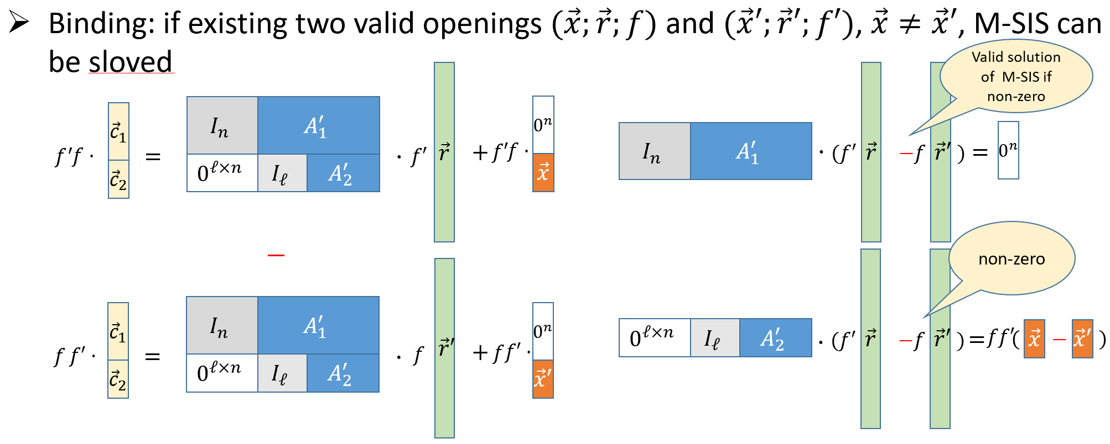
Lattice-based ZKP
BDLOP Commitment Scheme
Notes:
The binding security of BDLOP comes from the Molule-SIS assumption. This means that, if there exist two valid openings (x,r,f) and (x’,r’,f’), where x does not equal to x’, then we can obtain a solution for the MSIS problem. In other word, if the MSIS assumption holds, then the binding security holds too.

Slide 7
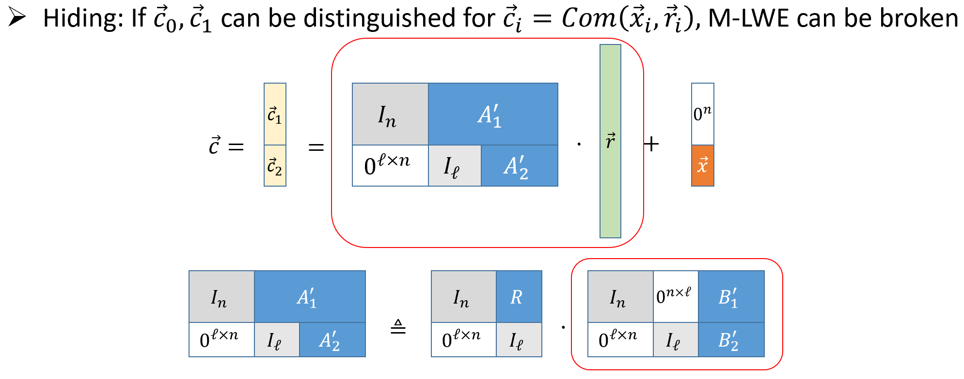
Lattice-based ZKP
BDLOP Commitment Scheme
Notes:
The hiding security of the scheme is based on the MLWE assumption. Specifically, the matrix vector product in the red frame can be convert into a MLWE instance according to the transformation below. Then we can argue that the message x can be hided as the red frame part is indistinguishable from random vector.

Slide 8
Lattice-based ZKP
ZKP of Valid Opening
Prover: $(A, \vec{r})$
Verifier: $(A, \vec{c})$
$$\vec{y}←D_{σ}^{k}$$
$$\vec{w}=A_{1}⋅\vec{y}$$
$$\vec{w}$$
$$d$$
$$d\underset{←}{\$}𝒞$$
$$\vec{z}=\vec{y}+d⋅\vec{r}$$
Rejection sampling
$$\vec{z}$$
Check if :
${\left\|z_{i}\right\|}_{2}$ are “small”, $i∈[k]$
$A_{1}⋅\vec{z}=\vec{w}+d⋅{\vec{c}}_{1}$
Zero-Knowledge:
Remove the dependency of $\vec{z}$ on $\vec{r}$, $\vec{z}$ does not reveal information of $\vec{r}$
Completeness:
$\vec{y}, d$ and $\vec{r}$ are all “small”$⇒$ ${\left\|z_{i}\right\|}_{2}$ small
$$A_{1}⋅\vec{z}=A_{1}⋅\vec{y}+d⋅A_{1}⋅\vec{r}=\vec{w}+d⋅{\vec{c}}_{1}$$
Notes:
All right, we can further go into the lattice-based ZKP. For example, considering the simple ZKP for the valid open relation, the protocol is like this. The prover has the witness r, we omit the message m here as it can be directly recovered from r. It’s a Shnorr-like protocol. during the first round, the prover samples a gaussian vector y and commits y by vector w, then sends w to the verifier. The verifier responds it with a challenge d sampled from a special space C. The prover finally computes the vector z by summing y and d times r, and runs rejection sampling algorithms, and forwards the output vector z to the verifier. The verifier checks if z is small, and the equation A_1 times z equals to w plus d times c_i or not. The completeness comes from the fact that y,d and r are all small, and the equation that the verifier needs to check implies the opening equation mentioned previously. For the zero-knowledge security, we need remove the dependency of z on the witness r. One may consider the smudding technique that adds a vector y far greater than d times r, this yet leads to very large proof size. So the intuition of the rejection sampling is making the distribution of z independent of r by adding a small y and outputting z with a certain independent probability.

Slide 9
Rejection Sampling
Rejection Sampling [Lyu12]
Have access to distribution $g(x)$ ($\vec{y}+d⋅\vec{r}$), but would like to sample from $f(x)$ ($D_{σ}^{k}$)
Define $M=max⁡(\frac{f(x)}{g(x)})$ over all $x$ in the domain of $g$
Then the solution is : 1. sample x from distribution $g$
2. output it with probability $f(x)$/$Mg(x)$, and repeat otherwise
Easy to see that at each try, Pr[x]=g(x).f(x)/Mg(x)=f(x)/M.
Notes:
Concretely, the idea of rejection sampling is that we have access to distribution g(x), for example y plus d times r in our case, and would like to sample from another independent distribution f(x) such as discrete gaussian. We can define a constant M that equals to the maximal of f(x) divided by g(x) over all x in the domain of g. Then the solution is that sample x from distribution g in the first step, output it with probability f(x) divided by Mg(x), and repeat it until outputting a vector in the second step. Now one can easy to see that the distribution of x equals to f(x) divided by M, which is independent to the original distribution g(x).

Slide 10
Rejection Sampling
Rejection Sampling [Lyu12]
$$M=\max\left(\frac{D_{σ}^{k}\left(\vec{z}\right)}{D_{d⋅ \vec{r},σ}^{k}\left(\vec{z}\right)}\right)=max\left(\exp\left(\frac{−2\left\langle \vec{z},d⋅\vec{r}\right\rangle +{\left\|d⋅\vec{r}\right\|}^{2}}{2σ^{2}}\right)\right)$$
The smaller of M, the better
The smaller of $\frac{−2\left\langle \vec{z},d⋅\vec{r}\right\rangle +{\left\|d⋅\vec{r}\right\|}^{2}}{2σ^{2}}$, the better
Make $−2\left\langle \vec{z},d⋅\vec{r}\right\rangle +{\left\|d⋅\vec{r}\right\|}^{2}$ smaller √
Make $σ$ larger
Notes:
As mentioned earlier, the motivation of rejection sampling is to reduce the proof size. So what should we concern about the concrete algorithm? We can see from the previous page, the expected number of repetitions is the big M, which equals to the maximal of D… divided by … , and further equals to e to the minus two times… plus the square of the norm of … over 2 times the square of gaussian parameter sigma. To minimize the repetition time, the big M should be as small as possible. This is equivalent to make the exponent part as small as possible. It can be achieved by making numerator smaller or denominator lager. However, as the final output follows the gaussian with parameter sigma. The later strategy will also enlarge the output size. So this is not a reasonable strategy. Alternatively, making numerator smaller does not directly affect the size of the output.

Slide 11
Subset Rejection Sampling
Subset Rejection Sampling [LNS21]
How to make $−2\left\langle \vec{z},d⋅\vec{r}\right\rangle +{\left\|d⋅\vec{r}\right\|}^{2}$ smaller ?
Add additional rejection conditions
$\left\langle \vec{z},d⋅\vec{r}\right\rangle >0$
What's the impact on the review of adversary?
Adversary always knows $\left\langle \vec{z},d⋅\vec{r}\right\rangle >0$
Same as $\vec{r}$ leak one bit information
Notes:
Based on this idea, Lybashevsky Nguyen and Seiler proposed the subset rejection sampling. The main technological improvement compared with the original rejection sampling is adding additional rejection conditions, which requires the inner product of z and d time r is positive. This requirement however, also let the adversary always knows the signs of the inner product. In other words, as z is a public vector, it is equivalent to leak one bit information of r.

Slide 12
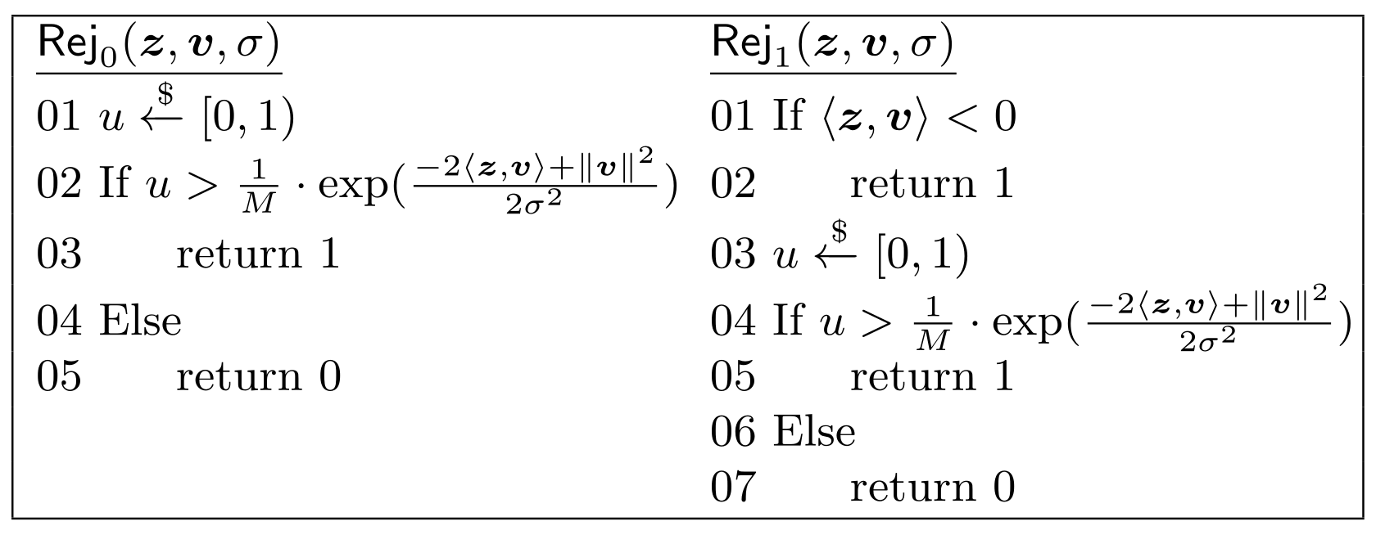
Subset Rejection Sampling
Subset Rejection Sampling [LNS21]
* $Rej_{0}$ denotes the original rejection sampling algorithm in [Lyu12], and $Rej_{1}$ denotes the subset rejection sampling in [LNS21]
Notes:
These are the concrete algorithms, where rej_0 is the original one, and rej_1 is the subsect rejection sampling in [LNS21].

Slide 13
Generalized Subset Rejection Sampling
Generalized Subset Rejection Sampling
How to make $−2\left\langle \vec{z},d⋅\vec{r}\right\rangle +{\left\|d⋅\vec{r}\right\|}^{2}$ smaller ?
Add additional rejection conditions
$\left\langle \vec{z},d⋅\vec{r}\right\rangle >P$
$\left\langle \vec{z},d⋅\vec{r}\right\rangle ∈[α,β]$
What's the impact on the review of adversary?
Adversary always knows $\left\langle \vec{z},d⋅\vec{r}\right\rangle >P$
Or adversary always knows $\left\langle \vec{z},d⋅\vec{r}\right\rangle ∈[α,β]$
Same as $\vec{r}$ leak $\log\left(\frac{1}{Pr⁡[\left\langle \vec{z},d⋅\vec{r}\right\rangle >P]}\right)$ bits information
Same as $\vec{r}$ leak $\log\left(\frac{1}{Pr⁡[\left\langle \vec{z},d⋅\vec{r}\right\rangle ∈[α,β]]}\right)$ bits information
The most extreme case: leak the total value $\left\langle \vec{z},d⋅\vec{r}\right\rangle$
Notes:
In order to achieve better efficiency, we can further set stricter requirements as the inner product greater than a positive integer P, or even within a positive interval [alpha, beta]. Similarly, these are equivalent to leak log 1 over the probabilities of the two conditions happening. In the most extreme case, one can even consider to leak the total value of the inner product.

Slide 14
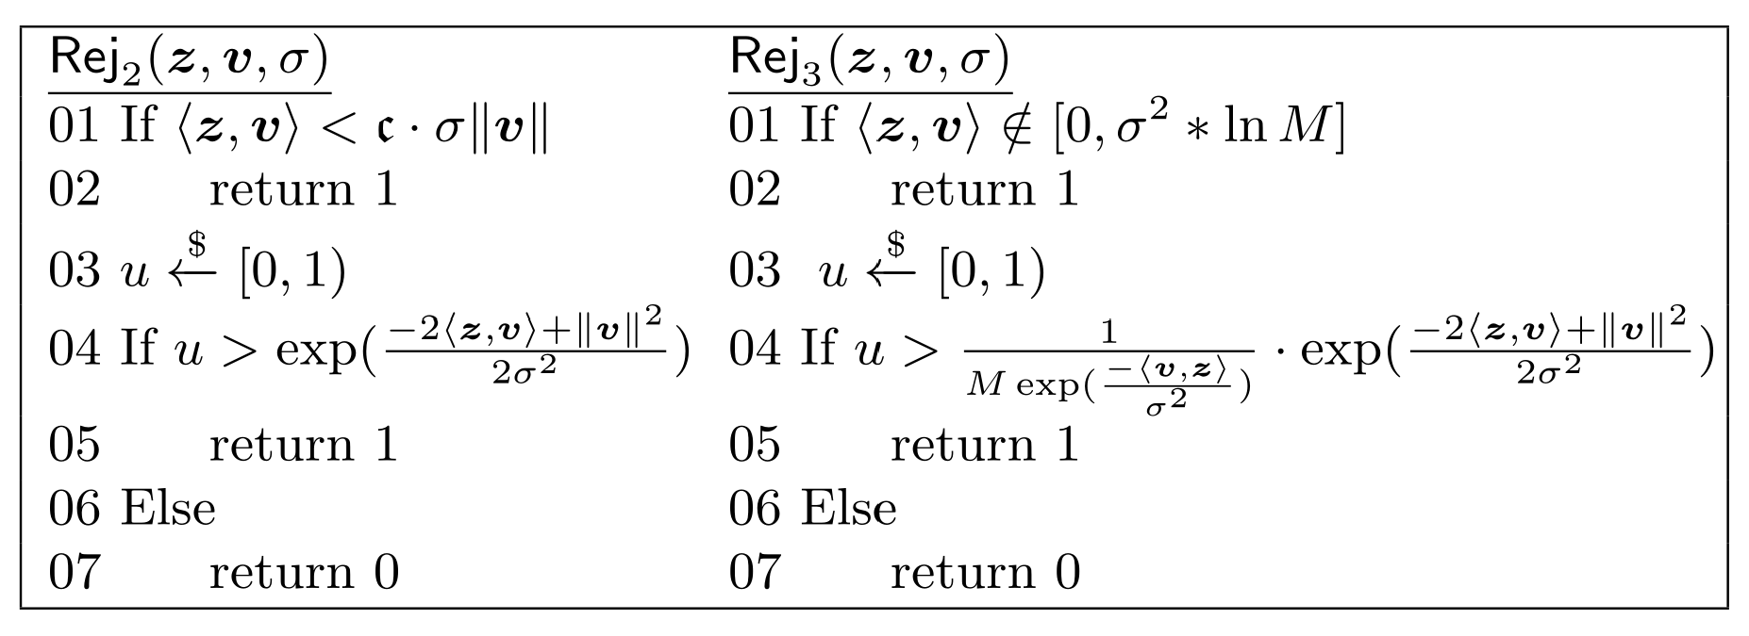
Generalized Subset Rejection Sampling
Generalized Subset Rejection Sampling
* $Rej_{2}$ denotes the generalized subset rejection sampling algorithm for the case $\left\langle \vec{z},d⋅\vec{r}\right\rangle >P$, and $Rej_{3}$ denotes the generalized subset rejection sampling algorithm for the case $\left\langle \vec{z},d⋅\vec{r}\right\rangle ∈[α,β]$
Notes:
Based on the idea, we obtain the generalized subset rejection algorithms rej_2 and rej_3.

Slide 15
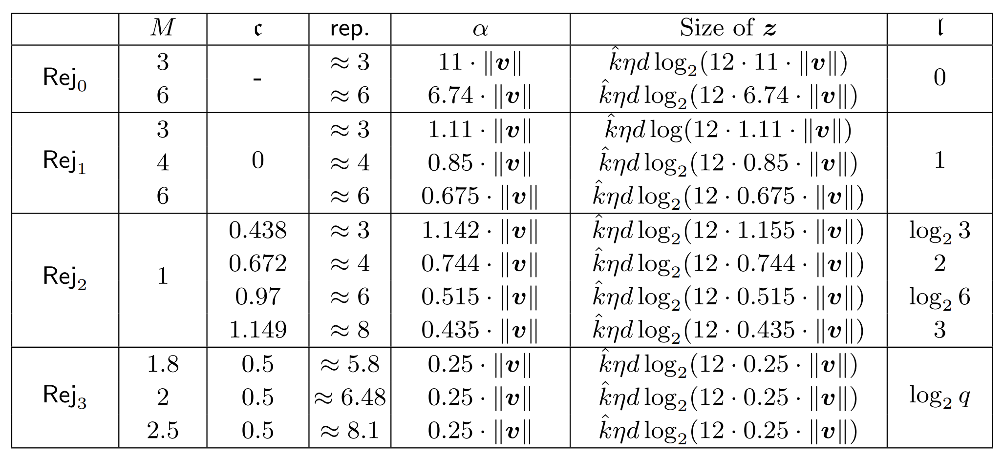
Generalized Subset Rejection Sampling
Generalized Subset Rejection Sampling
* Comparison of the efficiency of the four rejection sampling algorithms in asymptotic sense
Notes:
For concrete efficiency, the table in this page provides the parameters M, c, repeat numbers, alpha, size of z and leakage bits based on the norm of v.

Slide 16
Generalized Subset Rejection Sampling
Generalized Subset Rejection Sampling
* Comparison of the efficiency of the four rejection sampling algorithms in concrete sense
Compared with original sampling algorithm, GSRS improves the communication efficiency by 32%; GSRS improves the communication efficiency by 10% compared with [LNS21]
Notes:
And further calculate the concrete values by instantiating the norm of v, we obtain this table. we can see, compared with the …

Slide 17
Generalized Subset Rejection Sampling
Security for Generalized Subset Rejection Sampling
Is MLWE with linear leakage hard?
$$\left(\vec{a}, \left\langle \vec{a},\vec{r}\right\rangle +e,\vec{z}, \left\langle \vec{z},\vec{r}\right\rangle \right)≈?\left(\vec{a}, \vec{u},\vec{z}, \left\langle \vec{z},\vec{r}\right\rangle \right)$$
For plain LWE case, it’s true [AP12]
For ring case, previous results have limitations
Apply [AP12] ‘s reduction to the ring case occurs exponential large reduction loss, or dimension mismatch
Apply the “lossy model” in [LW20] results large module rank, not sufficient to analyze the small module rank required in [LNS21]
[BGRW22,DKLL+23,KLSS23] et.al also insufficient to analyze [LNS21]
Notes:
Ok, so this improvement seems good. What's left for us to do is showing the security of the generalized subset rejection sampling. From the previous discussion, we know that adversary obtain the information of the inner product value. So to establish the zero-knowledge security, we need to show the pseudorandomness of MLWE with linear leakage. For plain LWE case, [AP12] shows a reduction from LWE to the so-called extended-LWE. However, for the ring case, things become complicated. The existing results are insufficient for our applications. For example, when applying [AP12]’s reduction to the ring case, it occurs either ex…., or…. One may wanna apply The Technology of Information Theory such as the lossy model in [LW20], which yet results large module rank, and is not compatible to the parameters in [LNS21]. The other concurrent works like [BGRW22, DKLL+23,KLSS23] are also ….

Slide 18
Hardness of MLWE with linear leakage
MLWE with linear leakage
Theorem (Informal): Under the hardness of search MLWE (for appropriate parameters), the decision MLWE under leakage of linear functions (required as [LNS21]) is hard.
With no restriction on the module rank, compatible with low rank case (considered in [LNS21]) or even rank 1 (RLWE case)
Hint ($\vec{z}$) can be specified by the adversary, less restricted than prior Extended MLWE assumptions
Number of leakage terms is bounded, sufficient for applications (one-time commitment)
Notes:
To deal with this issue, we show a reduction from the search MLWE to the decision MLWE with linear leakage required in LNS21, as the former is the standard hardness assumption. We can thus establish the hardness of the later based on the hardness of standard lattice problem over ideal lattice. Our reduction is with no restriction on the module rank, and is compatible with the low rank case in our application, and the adversary is less restricted as the hint can be specified by the adversary. We remark that the number of leakage terms in our reduction is bounded, but this is still sufficient for our applications, as we consider the one-time (or bounded) commitment case.

Slide 19
Hardness of MLWE with linear leakage
MLWE with linear leakage
Target: Show Search-MLWE $≤$ decision-MLWELS (MLWE with linear leakage)
Given MLWE samples and decision-MLWLS oracle $𝒟$, output $\vec{s}$
Oracle $𝒟$: distinguish
Leakage function $L_{\vec{z}}\left(\vec{s}\right)=\left\langle φ\left(\vec{z}\right),φ\left(\vec{s}\right)\right\rangle ∈ℤ_{q}$
For a ring elmement $a=a_{0}+a_{1}X+⋯+a_{d−1}X^{d−1}∈ℛ$, we define
$$φ:a→\left(a_{0},a_{1},⋯a_{d−1}\right)$$
$$L_{\vec{z}}\left(\vec{s}\right)=\left\langle φ\left(\vec{z}\right),φ\left(\vec{s}\right)\right\rangle =\sum_{i,j}{z_{i,j}⋅s_{i,j}}$$
$(A,\vec{b}=A⋅\vec{s},\vec{z},L_{\vec{z}}\left(\vec{s}\right))$ and
$$(A,\vec{u},\vec{z},L_{\vec{z}}\left(\vec{s}\right))$$
Notes:
Concretely, our target is to show a reduction from search-MLWE to the decision-MLWE with linear leakage. This means that given …, one can output s, and the oracle D is to distinguish the Quadruple (A, A.s, hint z, and the linear function of s defined by z) and the Quadruple (A,u,z, and Lz(s)). The linear fuction Lz(s) denotes the inner product of the vectors \phi(z) and \phi(s), where \phi is the coefficient embedding of a ring element.

Slide 20
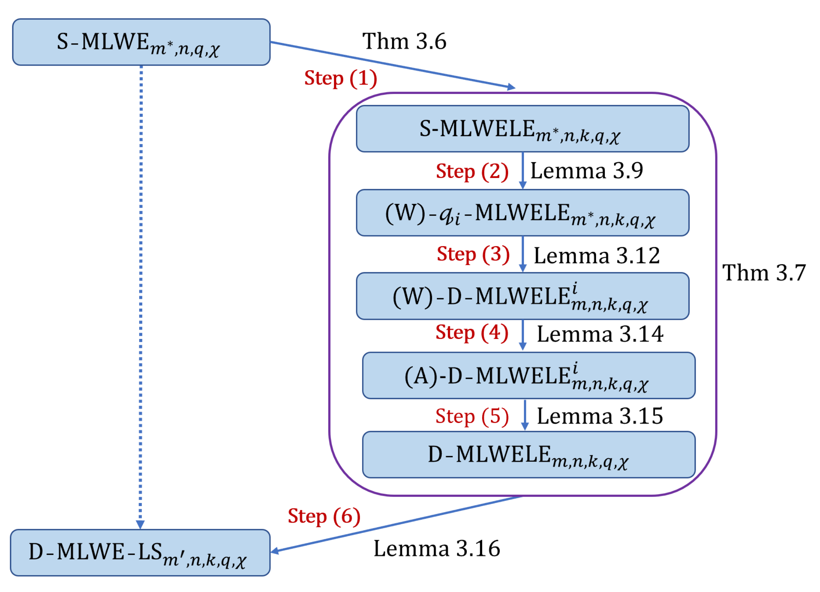
Hardness of MLWE with linear leakage
MLWE with linear leakage
Target: Show Search-MLWE $≤$ decision-MLWELS (MLWE with linear leakage)
S-MLWELE: given sample
$$\left(A,\vec{b}=A⋅\vec{s},\vec{z},L_{\vec{z}}\left(\vec{e}\right)\right),find \vec{s}$$
D-MLWELE: distinguish
$\left(A,\vec{b}=A⋅\vec{s},\vec{z},L_{\vec{z}}\left(\vec{e}\right)\right)$ and $\left(A,\vec{u},\vec{z},L_{\vec{z}}\left(\vec{e}\right)\right)$
Notes:
The reduction route is as follow. The Intermidiate problem q_i-MLWE is defined according to the ideal factor q_i of the ideal qR. And the MLWELE is defined as the MLWE with the linear leakage of error.

Slide 21
Hardness of MLWE with linear leakage
MLWE with linear leakage
Target: Show Search-MLWE $≤$ decision-MLWELS (MLWE with linear leakage)
Step (1): random guess of leakage, with reduction loss $1/q$
Step (2) – (5): similar to [LPR10, LS15], additionally simulate the leakage
Step (6): transform MLWELE sample to MLWELS sample
Notes:
At a high level, the idea of step (1) in the reduction route is a random guess of the leakage, which is with reduction loss 1/q. The step (2) to (5) are similar to the search to decision reductions of RLWE and MLWE in [LPR10, LS15], the only difference is that we should additionally simulate the leakage. Step (6) is a transformation from MLWE with linear leakage of error sample to the MLWE with linear leakage of secret sample.

Slide 22
Summary and Questions
Summary
There exists a reduction from S-MLWE to D-MLWELS.
Providing a hardness lower bound of D-MLWELS
Building hardness from hardness of worst-case (ideal) lattice problem (SIVP)
Show a generalized subset rejection sampling algorithm
Achieve better efficiency than previous algorithms
Improve the efficiency of one-time commitment based ZKP over lattice
Questions
Hardness of MLWE with leakage beyond linear function? (compact parameters)
MLWELS with other applications?
Notes:
Ok, Let's summarize this talk. We show that there exists… which provides….and further builds the hardness ….. As an application, we propose a generalized subset rejection sampling algorithm that achieves better….and thus improves … Beyond this, We would like to further understand the hardness of MLWE with …, and if the MLWE with linear leakage has other applications.

Slide 23
References
[BDLOP18] C. Baum, I. Damg˚ard, V. Lyubashevsky, S. Oechsner, and C. Peikert. More efficient commitments from structured lattice assumptions.
In D. Catalano and R. De Prisco, editors, SCN 18, volume 11035 of LNCS, pages 368{385. Springer, Heidelberg, Sept. 2018.
[LNS21] V. Lyubashevsky, N. K. Nguyen, and G. Seiler. Shorter lattice-based zeroknowledge proofs via one-time commitments. In J. Garay, editor,
PKC 2021, Part I, volume 12710 of LNCS, pages 215{241. Springer, Heidelberg, May 2021.
[Lyu12] V. Lyubashevsky. Lattice signatures without trapdoors. In D. Pointcheval and T. Johansson, editors, EUROCRYPT 2012, volume 7237 of LNCS,
pages 738-755.Springer, Heidelberg, Apr. 2012.
[AP12] J. Alperin-Sheriff and C. Peikert. Circular and KDM security for identity-based encryption. In M. Fischlin, J. Buchmann, and M. Manulis,
editors, PKC 2012, volume 7293 of LNCS, pages 334{352. Springer, Heidelberg, May 2012.
[LW20] F.-H. Liu and Z. Wang. Rounding in the rings. In Micciancio and Ristenpart [40], pages 296-326.
[BJRW23] K. Boudgoust, C. Jeudy, A. Roux-Langlois, and W. Wen. On the hardness of module learning with errors with short distributions.
Cryptology ePrint Archive, Paper 2022/472, 2022. https://eprint.iacr.org/2022/472.
[DKLL+23] N. D¨ottling, D. Kolonelos, R. W. F. Lai, C. Lin, G. Malavolta, and A. Rahimi. Efficient laconic cryptography from learning with errors.
Cryptology ePrint Archive, Paper 2023/404, 2023. https://eprint.iacr.org/2023/404.
[KLLS23] D. Kim, D. Lee, J. Seo, and Y. Song. Toward practical lattice-based proof of knowledge from hint-mlwe. Cryptology ePrint Archive, Paper
2023/623, 2023. https://eprint.iacr.org/2023/623.
[LPR10] V. Lyubashevsky, C. Peikert, and O. Regev. On ideal lattices and learning with errors over rings. In Gilbert [26], pages 1-23.
[LS15] A. Langlois and D. Stehle. Worst-case to average-case reductions for module lattices. Designs, Codes and Cryptography, 2015.

Slide 24
Thanks for your attention！
If you have any questions, please contact:
Zhedong Wang (wzdstill@sjtu.edu.cn)
Notes:
So Thanks for your attention.

