Slide 1
Tagged Chameleon Hash from Lattices and Application to Redactable Blockchain
Yiming Li and Shengli Liu
Shanghai Jiao Tong University
April 16th, 2024
Notes:
Thanks for the introduction.
Good afternoon. I am the proxy speaker Shuai Han.
I will make the presentation on behalf of the authors, Yiming Li and Shengli Liu,
who regret not being able to attend the conference in person.
The title is "Tagged Chameleon Hash from Lattices and Application to Redactable Blockchain".

Slide 2
1
1
INTRODUCTION & CONTRIBUTION
2
TECHNIQUE OVERVIEW
CONTENTS
3
OUR TCH FROM LATTICES
Notes:
Let’s come to the introduction first.

Slide 3
INTRODUCTION & CONTRIBUTION
Redactable Blockchain ^{[AMV+17]}
LEGALITY & SECURITY
“ The illegal/malicious messages should be REMOVED! ”
RIGHT TO BE FORGOTTEN
“ I want my personal data DELETED. ”
[AMV+17]
ATENIESE G, MAGRI B, VENTURI D, et al. Redactable Blockchain - or Rewriting History in Bitcoin and Friends. EuroS&P, 2017.
Notes:
Blockchains are originally designed to satisfy the immutability, that is, messages stored in blocks cannot be tampered.
However, this might not be friendly for healthy developments of blockchains.
For example, once some illegal or malicious messages are stored in blockchain, then we cannot remove them.
Besides, once some personal information is uploaded to the chain, it is hard to erase them.

Slide 4
INTRODUCTION & CONTRIBUTION
Redactable Blockchain ^{[AMV+17]}
X
LEGALITY & SECURITY
“ The illegal/malicious messages should be REMOVED! ”
RIGHT TO BE FORGOTTEN
“ I want my personal data DELETED. ”
Redactable Blockchain
Allowing SECURE and CONTROLLED after-the-fact modifications of their content.
[AMV+17]
ATENIESE G, MAGRI B, VENTURI D, et al. Redactable Blockchain - or Rewriting History in Bitcoin and Friends. EuroS&P, 2017.
Notes:
These concerns draw an increasing interest in redactable blockchains, which allow secure and controlled after-the-fact modifications of the content.

Slide 5
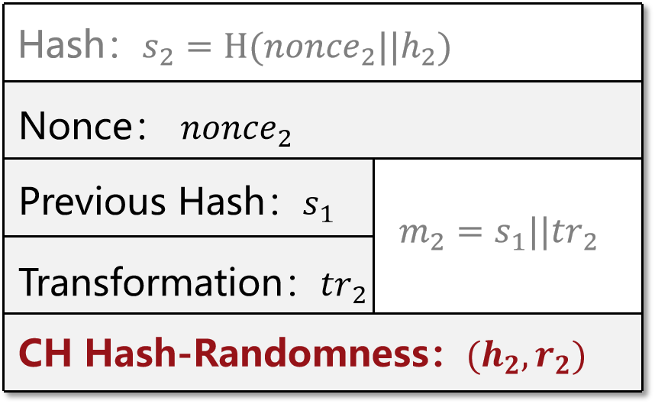
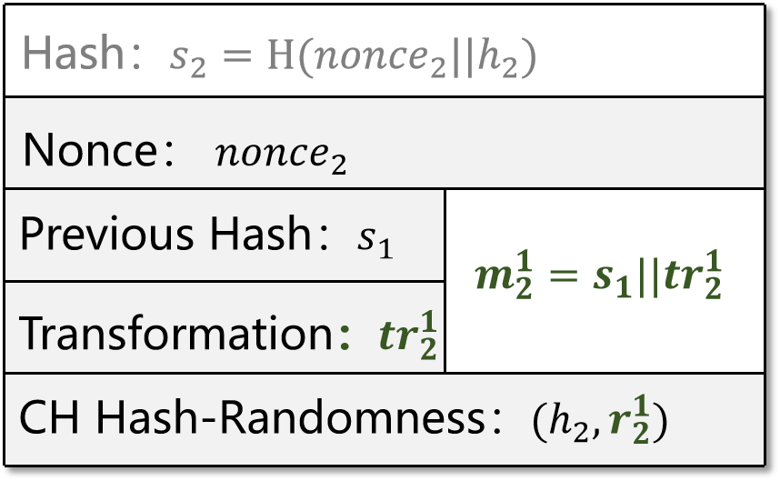
INTRODUCTION & CONTRIBUTION
CH-Based Redactable Blockchain ^{[AMV+17]}
X
Header
Modified message
Adaptation
Same hash
[AMV+17]
ATENIESE G, MAGRI B, VENTURI D, et al. Redactable Blockchain - or Rewriting History in Bitcoin and Friends. EuroS&P, 2017.
Notes:
According to existing results, blockchain can be upgraded to redactable one, by using chameleon hash functions in place of traditional hash functions.
More precisely, one can use the trapdoor of chameleon hash functions to find collisions, so that the content in blockchain can be modified without changing its hash values.

Slide 6
INTRODUCTION & CONTRIBUTION
Chameleon Hash Function ^{[KR00]}
$$\left(pp,td\right)←Setup\left(1^{κ}\right)$$
$$(h,r)←Hash(pp,m)$$
$$r^{′}←Adapt\left(pp,td,h,m,r,m^{′}\right) s.t.,$$
$$Hash$$
$$Hash$$
$$Hash$$
$$h$$
$$m$$
$$r$$
$$m$$
$$r$$
$$h$$
$$m^{′}$$
$$r^{′}$$
Correctness :
Indistinguishability :
Collision Resistance :
With $td$, $Adapt$ can efficiently find collisions for any target hash value $h$.
The $(h,r)$ tuple generated by $Hash$ algorithm is indistinguishable from that generated by $Adapt$ algorithm.
Without $td$, any adversary cannot find collisions.
[KR00]
KRAWCZYK H, RABIN T. Chameleon Signatures. DNSS, 2000.
Notes:
Generally, a chameleon hash function consists of three algorithms.
The setup algorithm generates a public parameter and a trapdoor.
The hash algorithm computes the hash value of a message m with the help of a randomness r.
The adaptation algorithm uses the trapdoor to adapt a hash value of m to a hash value of m', by outputting the corresponding r'.
Roughly speaking, with trapdoor, one can efficiently find collisions by invoking the Adapt algorithm.
But without the trapdoor, it is collision-resistant.

Slide 7
INTRODUCTION & CONTRIBUTION
Full collision resistance (fCR) is more desirable for secure redactable blockchain ^{[DSS20]}
$$\left(pp,td\right)←Setup\left(1^{κ}\right)$$
$$pp$$
Adaptation Oracle Query Phase
$r^{′}←Adapt\left(td,h,m,r,m^{′}\right) s.t.,$
$$(h,m,r,m^{′},?)$$
$$Hash$$
$$Hash$$
$$m$$
$$r$$
$$h$$
$$m$$
$$r$$
Multiple queries
$$\left(h,m,r\right), (h,m^{′},r′)$$
Challenge Phase
$$Hash$$
$$Hash$$
$$(h^{∗}, m^{∗},r^{∗},m^{′∗},r^{′∗})$$
$m^{∗}≠m^{′∗}$
${(h^{∗},m}^{∗})$ never queried to Adaptation Oracle
$$m^{′∗}$$
$$r^{′∗}$$
$$h$$
$$m^{∗}$$
$$r^{∗}$$
Find Collision
[DSS20]
DERLER D, SAMELIN K, SLAMANIG D. Bringing Order to Chaos: The Case of Collision-Resistant Chameleon-Hashes. PKC, 2020.
Notes:
There are several kinds of collision resistance defined for chameleon hash,
and the full collision resistance, or full-CR for short, is the strongest one.
Chameleon hash with full-CR is turned out to be more desirable for redactable blockchains.

Slide 8
INTRODUCTION & CONTRIBUTION
Chameleon hash functions that serve for secure redactable blockchains
[DSS20]：Generic construction from CH with weak-CR + IND-CPA PKE + SSE NIZK
Instantiations based on DDH in ROM or Symmetric DDH in standard model
[DKSS20] : Generic construction from CH with Weak-CR + Non-Interactive Commitment + SSE NIZK
Instantiations based on DLOG in standard model or LPN in (Q)ROM
Insecure against quantum adversaries
Build in the RO model
[DSS20]
DERLER D, SAMELIN K, SLAMANIG D. Bringing Order to Chaos: The Case of Collision-Resistant Chameleon-Hashes. PKC, 2020.
DERLER D, KRENN S, SAMELIN K, SLAMANIG D. Fully Collision-Resistant Chameleon-Hashes from Simpler and Post-Quantum Assumptions. SCN, 2020.
[DKSS20]
Notes:
Recently, there are several chameleon hash achieving full-CR,
however, they are either based on DDH or DLOG assumptions, and thus not quantum-safe,
or rely on the random oracle model.

Slide 9
INTRODUCTION & CONTRIBUTION
Chameleon hash functions that serve for secure redactable blockchains
[DSS20]：Generic construction from CH with weak-CR + IND-CPA PKE + SSE NIZK
Instantiations based on DDH in ROM or Symmetric DDH in standard model
[DKSS20] : Generic construction from CH with Weak-CR + Non-Interactive Commitment + SSE NIZK
Instantiations based on DLOG in standard model or LPN in (Q)ROM
Generic constructions that rely on heavy building blocks,
e.g., the simulation-sound extractable NIZK (SSE NIZK)
[DSS20]
DERLER D, SAMELIN K, SLAMANIG D. Bringing Order to Chaos: The Case of Collision-Resistant Chameleon-Hashes. PKC, 2020.
DERLER D, KRENN S, SAMELIN K, SLAMANIG D. Fully Collision-Resistant Chameleon-Hashes from Simpler and Post-Quantum Assumptions. SCN, 2020.
[DKSS20]
Notes:
Besides, these chameleon hash all use heavy tools like extractable NIZK in their constructions.

Slide 10
INTRODUCTION & CONTRIBUTION
Chameleon hash functions that serve for secure redactable blockchains
[DSS20]：Generic construction from CH with weak-CR + IND-CPA PKE + SSE NIZK
Instantiations based on DDH in ROM or Symmetric DDH in standard model
[DKSS20] : Generic construction from CH with Weak-CR + Non-Interactive Commitment + SSE NIZK
Instantiations based on DLOG in standard model or LPN in (Q)ROM
Q
Can we design a post-quantum CH serving for a redactable blockchain in the standard model (especially without relying on a NIZK proof) ?
[DSS20]
DERLER D, SAMELIN K, SLAMANIG D. Bringing Order to Chaos: The Case of Collision-Resistant Chameleon-Hashes. PKC, 2020.
DERLER D, KRENN S, SAMELIN K, SLAMANIG D. Fully Collision-Resistant Chameleon-Hashes from Simpler and Post-Quantum Assumptions. SCN, 2020.
[DKSS20]
Notes:
It is natural to ask: can we design a post-quantum chameleon hash serving for redactable blockchain in the standard model, especially without relying on NIZK proof ?

Slide 11
INTRODUCTION & CONTRIBUTION
Chameleon hash functions that serve for secure redactable blockchains
[DSS20]：Generic construction from CH with weak-CR + IND-CPA PKE + SSE NIZK
Instantiations based on DDH in ROM or Symmetric DDH in standard model
[DKSS20] : Generic construction from CH with Weak-CR + Non-Interactive Commitment + SSE NIZK
Instantiations based on DLOG in standard model or LPN in (Q)ROM
We design a specialized CH scheme from lattices in the standard model, and it provides the first post-quantum and NIZK-free solution for secure redactable blockchains in the standard model
A
[DSS20]
DERLER D, SAMELIN K, SLAMANIG D. Bringing Order to Chaos: The Case of Collision-Resistant Chameleon-Hashes. PKC, 2020.
DERLER D, KRENN S, SAMELIN K, SLAMANIG D. Fully Collision-Resistant Chameleon-Hashes from Simpler and Post-Quantum Assumptions. SCN, 2020.
[DKSS20]
Notes:
In this work, we answer the question in the affirmative by designing a chameleon hash from lattices in the standard model.

Slide 12
1
1
INTRODUCTION & CONTRIBUTION
2
TECHNIQUE OVERVIEW
CONTENTS
3
OUR TCH FROM LATTICES
Notes:
We provide a new approach to the afore-mentioned question. Let’s show its high-level ideas.

Slide 13
TECHNIQUE OVERVIEW
Take into considerations some nice properties of CH-based (redactable) blockchains
Those nice properties help to weaken the security requirements for CHs from secure redactable blockchains
Simpler constructions of CHs that serve for secure redactable blockchains
“Three Observations”
Notes:
We find that, redactable blockchains actually satisfy some nice properties.
When taking them into considerations, the security requirements for chameleon hash can be weakened.
And this makes possible simpler constructions of chameleon hash.
======
Firstly, we have three observations about Chameleon Hash-based redactable blockchain.

Slide 14
TECHNIQUE OVERVIEW
Observation 1：Each settled block can be uniquely indexed by a unique identifier $τ$ (e.g., timestamp, hash value of its previous block, its position in the chain).
Consider the unique identifier $τ$ in the description of blocks, i.e., $B=<τ,h,m,r>$
Additionally take $τ$ as input for chameleon hash evaluations $Hash$ and adaptations $Adapt$.
New Primitive ：Tagged Chameleon Hash (tCH)
NEW!
$$\left(pp,td\right)←Setup\left(1^{κ}\right)$$
$$(h,r)←Hash(pp,τ,m)$$
$$r^{′}←Adapt\left(pp,td,τ,h,m,r,m^{′}\right) s.t.,$$
$$Hash$$
$$Hash$$
$$Hash$$
$$h$$
$$m$$
$$r$$
$$m$$
$$r$$
$$h$$
$$m^{′}$$
$$r^{′}$$
Notes:
Our first observation is that, each block is in fact indexed by a unique identifier, like the timestamp or the hash value of its previous block.
Consequently, we add the unique identifier, or tag \tau, in the description of blocks,
and additionally take \tau as input for the evaluations and adaptations of chameleon hash.
This gives us a new variant of chameleon hash, called tagged chameleon hash.

Slide 15
TECHNIQUE OVERVIEW
Observation 1：Each settled block can be uniquely indexed by a unique identifier $τ$ (e.g., timestamp, hash value of its previous block, its position in the chain).
Full Collision Resistance (fCR) of tCH
NEW!
$$pp$$
$$\left(pp,td\right)←Setup\left(1^{κ}\right)$$
Adaptation Oracle Query Phase
$r^{′}←Adapt\left(td,h,m,r,m^{′}\right) s.t.,$
Record $(τ,h,m)$ & $(τ,h,m′)$ in the set $Q$
$$(τ,h,m,r,m^{′},?)$$
$$τ$$
$$m$$
$$r$$
$$h$$
$$τ$$
$$m^{′}$$
$$r′$$
$$\left(τ,h,m,r\right), (τ,h,m^{′},r′)$$
Multiple Queries
Challenge Phase
$m^{′∗}≠m^{∗}$
${({τ^{∗},h}^{∗},m}^{∗})$ $∉Q$
$$τ^{∗}$$
$$m^{∗}$$
$$r^{∗}$$
$$h^{∗}$$
$$τ^{∗}$$
$$m^{′∗}$$
$$r^{′∗}$$
$$(τ^{∗},h^{∗}, m^{∗},r^{∗},m^{′∗},r^{′∗})$$
Find Collision
Notes:
We define full-CR for tagged chameleon hash.
In the security experiment, the adversary can make multiple adaptation queries,
to ask the challenger to adapt a hash value of m to a hash value of m' w.r.t. tag \tau,
and get the corresponding r'.
We use a set Q to record the tag-hash-message tuples.
Finally, the adversary outputs a collision, and it wins if m* is different from m'*, their hash values are both h* w.r.t. tag \tau*,
And (\tau*, h*, m*) is not in set Q.
Namely, this tuple is fresh and never appears in the adaptation query phase.

Slide 16
TECHNIQUE OVERVIEW
Observation 1：Each settled block can be uniquely indexed by a unique identifier $τ$ (e.g., timestamp, hash value of its previous block, its position in the chain).
Full Collision Resistance (fCR) of tCH
NEW!
$$pp$$
$$\left(pp,td\right)←Setup\left(1^{κ}\right)$$
Adaptation Oracle Query Phase
$r^{′}←Adapt\left(td,h,m,r,m^{′}\right) s.t.,$
Record $(τ,h,m)$ & $(τ,h,m′)$ in the set $Q$
$$(τ,h,m,r,m^{′},?)$$
$$τ$$
$$m$$
$$r$$
$$h$$
$$τ$$
$$m^{′}$$
$$r′$$
$$\left(τ,h,m,r\right), (τ,h,m^{′},r′)$$
Multiple Queries
Challenge Phase
$m^{′∗}≠m^{∗}$
${({τ^{∗},h}^{∗},m}^{∗})$ $∉Q$
a tCH with fCR serves for a secure redactable blockchain
$$τ^{∗}$$
$$m^{∗}$$
$$r^{∗}$$
$$h^{∗}$$
$$τ^{∗}$$
$$m^{′∗}$$
$$r^{′∗}$$
Notes:
Such tagged chameleon hash with full-CR serves well for redactable blockchain.

Slide 17
TECHNIQUE OVERVIEW
Observation 2：Each block has a chameleon hash value $h$ and identifier $τ$, and adaptations towards that block keep $h$ and $τ$ unchanged. Then each tag $τ$ is uniquely bound with one block, and hence uniquely bound with the block’s chameleon hash value $h.$
In tCH’s fCR security experiment，the adversary wins if:
$h^{∗}=Hash\left(τ^{∗}{,m}^{∗};r^{∗}\right)$= $Hash\left({τ^{∗},m}^{′∗};r^{′∗}\right) ∧ m^{∗}≠m^{′∗}∧{ (τ^{∗},h}^{∗},m^{∗})∉Q$
Notes:
Our second observation is that, each block in the chain has a chameleon hash value and a tag \tau.
And Adaptations towards that block keep h and \tau unchanged.
Consequently, each tag is uniquely bound with one block, and hence uniquely bound with the block’s chameleon hash value.
Let’s show how to change the full-CR security based on this observation.
This is the winning condition of full-CR.

Slide 18
TECHNIQUE OVERVIEW
Observation 2：Each block has a chameleon hash value $h$ and identifier $τ$, and adaptations towards that block keep $h$ and $τ$ unchanged. Then each tag $τ$ is uniquely bound with one block, and hence uniquely bound with the block’s chameleon hash value $h.$
Split ${(τ^{∗},h}^{∗},m^{∗})∉Q$ into two cases acording to whether $(τ^{∗},⋅,m^{′∗})∈Q$
$h^{∗}=Hash\left(τ^{∗}{,m}^{∗};r^{∗}\right)$= $Hash\left({τ^{∗},m}^{′∗};r^{′∗}\right) ∧ m^{∗}≠m^{′∗}∧{ (τ^{∗},h}^{∗},m^{∗})∉Q$
$$({(τ^{∗},h}^{∗},m^{∗})∉Q ∧(τ^{∗},⋅,m^{′∗})∉Q) ∨ ({(τ^{∗},h}^{∗},m^{∗})∉Q∧(τ^{∗},⋅ ,m^{′∗})∈Q)$$
Notes:
Firstly, we split the condition that “(\tau*,h*,m*) not in Q” into two cases according to whether “(\tau*, m'*) is in Q”.

Slide 19
TECHNIQUE OVERVIEW
Observation 2：Each block has a chameleon hash value $h$ and identifier $τ$, and adaptations towards that block keep $h$ and $τ$ unchanged. Then each tag $τ$ is uniquely bound with one block, and hence uniquely bound with the block’s chameleon hash value $h.$
“Equivalent transofrmation”based on observation 2
$h^{∗}=Hash\left(τ^{∗}{,m}^{∗};r^{∗}\right)$= $Hash\left({τ^{∗},m}^{′∗};r^{′∗}\right) ∧ m^{∗}≠m^{′∗}∧{ (τ^{∗},h}^{∗},m^{∗})∉Q$
$$({(τ^{∗},h}^{∗},m^{∗})∉Q ∧(τ^{∗},⋅,m^{′∗})∉Q) ∨ ({(τ^{∗},h}^{∗},m^{∗})∉Q∧(τ^{∗},⋅ ,m^{′∗})∈Q)$$
$\left(\left(τ^{∗}, ⋅ ,m^{∗}\right)∉Q∧\left(τ^{∗},⋅,m^{′∗}\right)∉Q\right) ∨((τ^{∗},⋅ ,m^{∗})∉Q∧(τ^{∗},h^{∗},m^{′∗})∈Q)$
+
Observation 2：$τ^{∗}$ is always uniquely bound with one block / hash $h^{∗}$
Notes:
Then we change the conditions further based on the second observation, since \tau* is uniquely bound with h*.
Note that, we can make this transformation only when the second observation holds.

Slide 20
TECHNIQUE OVERVIEW
Observation 2：Each block has a chameleon hash value $h$ and identifier $τ$, and adaptations towards that block keep $h$ and $τ$ unchanged. Then each tag $τ$ is uniquely bound with one block, and hence uniquely bound with the block’s chameleon hash value $h.$
There do not exist $(τ, h_{1}, ·)$ and $(τ, h_{2}, ·)$ in $Q$ (among those tuples queried during the adaptation oracle query phase) with $h_{1}≠h_{2}$ .
$$τ_{1}$$
$$h_{1}$$
$$τ_{2}$$
$$h_{2}$$
$$τ_{3}$$
$$h_{3}$$
Notes:
Besides, we add a restriction for the adversary's adaptation queries.
Namely, there should not exist (\tau,h_1) and (\tau,h_2) in Q with distinct h_1 and h_2.
We can add this restriction due to the second observation, since \tau is uniquely bound with the hash value h.

Slide 21
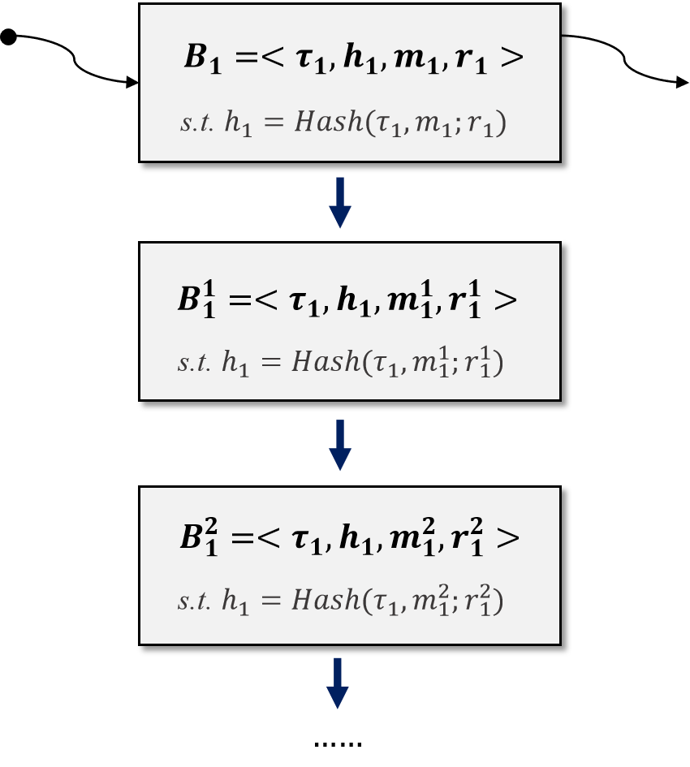
TECHNIQUE OVERVIEW
Observation 3：All adaptations towards a specific block are made with fresh messages (this can be accomplished by appending a counter to the adapted message).
According to observation 3, each adaptation query $(τ,h,m,r,m^{′})$ satisfies that $\left(τ,⋅,m^{′}\right)∉Q$.
Fresh Adapted Message
$$m_{1}^{1}≠m_{1}$$
Fresh Adapted Message
$m_{1}^{2}≠m_{1}^{1}$, $m_{1}^{2}≠m_{1}$
Notes:
Our third observation is that, all adaptations towards a specific block are typically made with different messages, and this can be ensured by appending a counter to the message.
Consequently, we can assume that all messages m' w.r.t. a same tag in adaptation queries are different.

Slide 22
TECHNIQUE OVERVIEW
New Security Requirement ：Restricted Collision Resistance (rCR) of tCH
NEW!
$$\left(pp,td\right)←Setup\left(1^{κ}\right)$$
Adaptation Oracle Query Phase
+
Add restrictions:
each $τ$ bound with a unique $h$
$m′$ is a fresh adapted message w.r.t. $τ$
$r^{′}←Adapt\left(td,τ,h,m,r,m^{′}\right) s.t.,$
Record $(τ,h,m)$ & $(τ,h,m′)$ in the set $Q$
Observation 2
$$τ$$
$$m$$
$$r$$
$$h$$
$$τ$$
$$m^{′}$$
$$r′$$
Observation 3
Challenge Phase
Modified restrictions:
Satisfies one of the following restrictions:
$\left(τ^{∗},⋅,m^{∗}\right)∉Q$ and $\left(τ^{∗},⋅,m^{′∗}\right)∉Q$；
$\left(τ^{∗},⋅,m^{∗}\right)∉Q and \left(τ^{∗},h^{∗},m^{′∗}\right)∈Q$
$m^{′∗}≠m^{∗}$
${({τ^{∗},h}^{∗},m}^{∗})$ $∉Q$
$$τ^{∗}$$
$$m^{∗}$$
$$r^{∗}$$
$$h^{∗}$$
$$τ^{∗}$$
$$m^{′∗}$$
$$r^{′∗}$$
Observation 2
Notes:
Based on the three observations, we finally arrive at a new security notion for tagged chameleon hash, called restricted collision resistance, or restricted-CR for short.

Slide 23
TECHNIQUE OVERVIEW
Imply
Restricted Collision Resistance (rCR)
tCH
Full Collision Resistance (fCR)
Works in RB
Imply
Consider a tCH working in a redactable blockchain
(3 observations)
According to our definitions, the rCR security of a tCH is strictly weaker than fCR
We proved that : tCH with rCR security provides the same security guarantee as tCH with f-CR
Fact 1 : A tCH with rCR is easier to construct
Fact 2 : A tCH with rCR serves for constructing secure redactable blockchains
Notes:
Note that, the restricted-CR is strictly weaker than full-CR, since it makes more restrictions on the adversary.
Consequently, a tagged chameleon hash with restricted-CR should be easier to construct.
On the other hand, in the application of redactable blockchain, the three observations hold, and we can prove that, restricted-CR provides the same security guarantee as full-CR.
In this case, tagged chameleon hash with restricted-CR also serves for secure redactable blockchains.

Slide 24
TECHNIQUE OVERVIEW
Imply
Restricted Collision Resistance (rCR)
tCH
Full Collision Resistance (fCR)
Works in RB
Imply
Q
Can we design a post-quantum CH serving for a redactable blockchain in the standard model (especially without relying on a NIZK proof) ?
Can we design a post-quantum tCH with rCR security in the standard model (especially without relying on a NIZK proof) ?
NEW!
Q’
Notes:
Now, the question we considered can be changed to
“Can we design a post-quantum tagged chameleon hash with restricted-CR in the standard model?”

Slide 25
1
1
INTRODUCTION & CONTRIBUTION
2
TECHNIQUE OVERVIEW
CONTENTS
3
OUR TCH FROM LATTICES
Notes:
We now present our tagged chamelen hash construction from lattices.

Slide 26
TCH FROM LATTICES : STANDARD MODEL
$\left(pp,td\right)←Setup\left(1^{κ}\right)$ / Setup algorithm
Public parameter ($pp$):
Master trapdoor:
$$A$$
$$A_{1},A_{2},…,A_{k}←Z_{q}^{n×w}$$
Random Lattice + Lattice Trapdoor
$$T_{A}$$
$$k=(k_{1},k_{2},....,k_{k})$$
PRF key (used only for security proof)
Notes:
Our tagged chameleon hash is constructed as follows.
Its public parameter consists of random matrices A, A_1 to A_k.
The trapdoor consists of a lattice trapdoor T_A for A, and a PRF key k, which is used only for security proof.

Slide 27
TCH FROM LATTICES : STANDARD MODEL
$\left(pp,td\right)←Setup\left(1^{κ}\right)$ / Setup algorithm
Public parameter ($pp$):
Master trapdoor:
$$A$$
$$A_{1},A_{2},…,A_{k}←Z_{q}^{n×w}$$
$$T_{A}$$
$$k=(k_{1},k_{2},....,k_{k})$$
$(h,r)←Hash(τ, m)$ / Hash evaluation algorithm
sample $y←{\left\{0,1\right\}}^{y}$ and other randomness
define circuit $𝒞\left[τ||m,y\right]\left(k\right)=\left\{\begin{matrix} 1 if PRF\left(k,τ||m\right)=y \\ 0 otherwise\end{matrix}\right.$
$A_{prf}←HomEval(𝒞\left[τ||m,y\right](⋅),pp)$
$e←χ, h≔\left[A|A_{prf}\right]⋅e, r=(y,e,...)$
Sample $e$ and $h≔\left[A|A_{prf}\right]⋅e$
Notes:
To hash a message m.
It first samples a string y.
Then it defines a circuit C, which equals one if and only if the PRF value on (\tau,m) equals y.
Next it computes matrix A_prf by homomorphic evaluations on circuit C.
The hash value h is computed as the concatenation of [A and A_prf], times a short vector e.
The randomness r includes y and e.

Slide 28
TCH FROM LATTICES : STANDARD MODEL
$\left(pp,td\right)←Setup\left(1^{κ}\right)$ / Setup algorithm
Public parameter ($pp$):
Master trapdoor:
$$A$$
$$A_{1},A_{2},…,A_{k}←Z_{q}^{n×w}$$
$$T_{A}$$
$$k=(k_{1},k_{2},....,k_{k})$$
$(h,r)←Hash(τ, m)$ / Hash evaluation algorithm
sample $y←{\left\{0,1\right\}}^{y}$ and other randomness
define circuit $𝒞\left[τ||m,y\right]\left(k\right)=\left\{\begin{matrix} 1 if PRF\left(k,τ||m\right)=y \\ 0 otherwise\end{matrix}\right.$
$A_{prf}←HomEval(𝒞\left[τ||m,y\right](⋅),pp)$
$e←χ, h≔\left[A|A_{prf}\right]⋅e, r=(y,e,...)$
$r′←Adapt(T_{A},τ,h,m,r,m′)$ / Adaptation algorithm
sample $y′←{\left\{0,1\right\}}^{y}$ and other randomness define circuit $𝒞\left[τ||m′,y′\right]\left(k\right)=\left\{\begin{matrix} 1 if PRF\left(k,τ||m′\right)=y′ \\ 0 otherwise\end{matrix}\right.$ $A_{prf}^{′}←HomEval(𝒞\left[τ||m′,y′\right](⋅),pp)$ $e^{′}←SamplePre\left([A|A_{prf}^{′}],T_{A},h,s\right) \text{s}\text{.}\text{t}\text{.}, h\text{=}\left[A|A_{prf}^{′}\right]⋅e^{′}$
Goal : given $h$, find $e^{′}$ s.t., $h\text{=}\left[A|A_{prf}^{′}\right]⋅e^{′}$
This can be done by preimage sampling algorithm with the help of $T_{A}$
Notes:
To adapt a hash value h to m' w.r.t tag \tau,
It first samples a string y'.
Then it defines the circuit C using \tau, m' and y', and computes A_prf' by homomorphic evaluations.
Our goal is to find a short vector e', such that the concatenation of [A and A_prf'] times e' equals the given hash value h.
This can be done by preimage sampling with the lattice trapdoor T_A.

Slide 29
rCR SECURITY EXPERIMENT
Setup Phase
Public parameter ($pp$):
Master trapdoor:
$$A$$
$$A_{1},A_{2},…,A_{k}←Z_{q}^{n×w}$$
$$T_{A}$$
$$k=(k_{1},k_{2},....,k_{k})$$
Adaptation Oracle Query Phase : $(τ,h,m,r,m′)$
sample $y′←{\left\{0,1\right\}}^{y}$ and other randomness define circuit $𝒞\left[τ||m′,y′\right]\left(k\right)=\left\{\begin{matrix} 1 if PRF\left(k,τ||m′\right)=y′ \\ 0 otherwise\end{matrix}\right.$ $A_{prf}^{′}←HomEval(𝒞\left[τ||m′,y′\right](⋅),pp)$ $e^{′}←SamplePre\left([A|A_{prf}^{′}],T_{A},h,s\right) \text{s}\text{.}\text{t}\text{.}, h\text{=}\left[A|A_{prf}^{′}\right]⋅e^{′}$
Challenge Phase : $({τ^{∗},h}^{∗}, m^{∗},r^{∗},m^{′∗},r^{′∗})$
$A_{prf}^{∗}←HomEval(𝒞\left[τ^{∗}||m^{∗},y^{∗}\right],pp)$ where $r^{∗}=(y^{∗},e^{∗},...)$
$A_{prf}^{′∗}←HomEval(𝒞\left[τ^{∗}||m^{′∗},y^{′∗}\right],pp)$ where $r^{′∗}=(y^{′∗},e^{′∗},...)$
Wins if $\left[A | A_{prf}^{′∗}\right]⋅e^{′∗}=h^{∗}=[A|A_{prf}^{∗}]{⋅e}^{∗}$ and other wining conditions required by rCR is satisfied
Notes:
We can prove the restricted-CR of our tagged chameleon hash based on the SIS assumption.
Here we give a high-level overview of the security proof.
Recall that the adversary can make multiple adaptation queries and receive the corresponding r'.
And the adversary aims to provide a valid collision to satisfy the winning conditions.

Slide 30
rCR SECURITY EXPERIMENT
Setup Phase
Reduction
Public parameter ($pp$):
Master trapdoor:
$$A$$
$$A_{1},A_{2},…,A_{k}←Z_{q}^{n×w}$$
Embed an SIS instance into A
Adaptation Oracle Query Phase : $(τ,h,m,r,m′)$
sample $y′←{\left\{0,1\right\}}^{y}$ and other randomness define circuit $𝒞\left[τ||m′,y′\right]\left(k\right)=\left\{\begin{matrix} 1 if PRF\left(k,τ||m′\right)=y′ \\ 0 otherwise\end{matrix}\right.$ $A_{prf}^{′}←HomEval(𝒞\left[τ||m′,y′\right](⋅),pp)$ $e^{′}←SamplePre\left([A|A_{prf}^{′}],T_{A},h,s\right) \text{s}\text{.}\text{t}\text{.}, h\text{=}\left[A|A_{prf}^{′}\right]⋅e^{′}$
Challenge Phase : $({τ^{∗},h}^{∗}, m^{∗},r^{∗},m^{′∗},r^{′∗})$
$A_{prf}^{∗}←HomEval(𝒞\left[τ^{∗}||m^{∗},y^{∗}\right],pp)$ where $r^{∗}=(y^{∗},e^{∗},...)$
$A_{prf}^{′∗}←HomEval(𝒞\left[τ^{∗}||m^{′∗},y^{′∗}\right],pp)$ where $r^{′∗}=(y^{′∗},e^{′∗},...)$
Wins if $\left[A | A_{prf}^{′∗}\right]⋅e^{′∗}=h^{∗}=[A|A_{prf}^{∗}]{⋅e}^{∗}$ and other wining conditions required by rCR is satisfied
Notes:
During the reduction,
We will embed an instance of the SIS assumption into the matrix A, but there are two problems to be solved.

Slide 31
rCR SECURITY EXPERIMENT
Setup Phase
Public parameter ($pp$):
Master trapdoor:
$$A$$
$$A_{1},A_{2},…,A_{k}←Z_{q}^{n×w}$$
$$T_{A}$$
$$k=(k_{1},k_{2},....,k_{k})$$
Problem 1
Adaptation Oracle Query Phase : $(τ,h,m,r,m′)$
How to find $e^{′}$ without $T_{A}$ during the adaptation oracle query phase ?
sample $y′←{\left\{0,1\right\}}^{y}$ and other randomness define circuit $𝒞\left[τ||m′,y′\right]\left(k\right)=\left\{\begin{matrix} 1 if PRF\left(k,τ||m′\right)=y′ \\ 0 otherwise\end{matrix}\right.$ $A_{prf}^{′}←HomEval(𝒞\left[τ||m′,y′\right](⋅),pp)$ $e^{′}←SamplePre\left([A|A_{prf}^{′}],T_{A},h,s\right) \text{s}\text{.}\text{t}\text{.}, h\text{=}\left[A|A_{prf}^{′}\right]⋅e^{′}$
Challenge Phase : $({τ^{∗},h}^{∗}, m^{∗},r^{∗},m^{′∗},r^{′∗})$
$A_{prf}^{∗}←HomEval(𝒞\left[τ^{∗}||m^{∗},y^{∗}\right],pp)$ where $r^{∗}=(y^{∗},e^{∗},...)$
$A_{prf}^{′∗}←HomEval(𝒞\left[τ^{∗}||m^{′∗},y^{′∗}\right],pp)$ where $r^{′∗}=(y^{′∗},e^{′∗},...)$
Wins if $\left[A | A_{prf}^{′∗}\right]⋅e^{′∗}=h^{∗}=[A|A_{prf}^{∗}]{⋅e}^{∗}$ and other wining conditions required by rCR is satisfied
Notes:
Since A is embedded as an SIS instance, the trapdoor of A is unknown.
The first problem is,
how to compute the short vector e' without the trapdoor of A?

Slide 32
rCR SECURITY EXPERIMENT
Setup Phase
Public parameter ($pp$):
Master trapdoor:
$$A$$
$$A_{1},A_{2},…,A_{k}←Z_{q}^{n×w}$$
$$T_{A}$$
$$k=(k_{1},k_{2},....,k_{k})$$
Adaptation Oracle Query Phase : $(τ,h,m,r,m′)$
sample $y′←{\left\{0,1\right\}}^{y}$ and other randomness define circuit $𝒞\left[τ||m′,y′\right]\left(k\right)=\left\{\begin{matrix} 1 if PRF\left(k,τ||m′\right)=y′ \\ 0 otherwise\end{matrix}\right.$ $A_{prf}^{′}←HomEval(𝒞\left[τ||m′,y′\right](⋅),pp)$ $e^{′}←SamplePre\left([A|A_{prf}^{′}],T_{A},h,s\right) \text{s}\text{.}\text{t}\text{.}, h\text{=}\left[A|A_{prf}^{′}\right]⋅e^{′}$
Challenge Phase : $({τ^{∗},h}^{∗}, m^{∗},r^{∗},m^{′∗},r^{′∗})$
Problem 2
$A_{prf}^{∗}←HomEval(𝒞\left[τ^{∗}||m^{∗},y^{∗}\right],pp)$ where $r^{∗}=(y^{∗},e^{∗},...)$
$A_{prf}^{′∗}←HomEval(𝒞\left[τ^{∗}||m^{′∗},y^{′∗}\right],pp)$ where $r^{′∗}=(y^{′∗},e^{′∗},...)$
Wins if $\left[A | A_{prf}^{′∗}\right]⋅e^{′∗}=h^{∗}=[A|A_{prf}^{∗}]{⋅e}^{∗}$ and other wining conditions required by rCR is satisfied
How does the reduction algorithm derive a valid solution to SIS when the adversary wins during the challenge phase ?
Collision
Notes:
The second problem is,
how to derive a valid solution to SIS when the adversary wins?

Slide 33
PARTITIONING PROOF STRATAGY
Setup Phase
Solution
Public parameter ($pp$):
Master trapdoor:
$$A$$
$$A_{i}=AR_{i}+k_{i}⋅G$$
Partition : Homomorphic evaluation + PRF
$$T_{A}$$
$$k=(k_{1},k_{2},....,k_{k})$$
Adaptation Oracle Query Phase : $(τ,h,m,r,m′)$
compute $y′←PRF(k,τ||m′)$ and other randomness define circuit $𝒞\left[τ||m′,y′\right]\left(k\right)=\left\{\begin{matrix} 1 if PRF\left(k,τ||m′\right)=y′ \\ 0 otherwise\end{matrix}\right.$ $A_{prf}^{′}←HomEval(𝒞\left[τ||m′,y′\right](⋅),pp)$ $e^{′}←SamplePre\left([A|A_{prf}^{′}],T_{A},h,s\right) \text{s}\text{.}\text{t}\text{.}, h\text{=}\left[A|A_{prf}^{′}\right]⋅e^{′}$
Challenge Phase : $({τ^{∗},h}^{∗}, m^{∗},r^{∗},m^{′∗},r^{′∗})$
$A_{prf}^{∗}←HomEval(𝒞\left[τ^{∗}||m^{∗},y^{∗}\right],pp)$ where $r^{∗}=(y^{∗},e^{∗},...)$
$A_{prf}^{′∗}←HomEval(𝒞\left[τ^{∗}||m^{′∗},y^{′∗}\right],pp)$ where $r^{′∗}=(y^{′∗},e^{′∗},...)$
Wins if $\left[A | A_{prf}^{′∗}\right]⋅e^{′∗}=h^{∗}=[A|A_{prf}^{∗}]{⋅e}^{∗}$ and other wining conditions required by rCR is satisfied
Notes:
To solve these two problems, we resort to a partitioning strategy implemented by homomorphic evaluations and PRF.
We will embed the PRF key k in matrix A_i, by computing A_i as A R_i + k_i G,
Here R_i is randomly chosen short matrix and G is the gadget matrix.
Besides, for each adaptation query, we compute y' as the PRF value of (\tau, m').

Slide 34
PARTITIONING PROOF STRATAGY
Setup Phase
Public parameter ($pp$):
Master trapdoor:
$$A$$
$$A_{i}=AR_{i}+k_{i}⋅G$$
Problem 1
$$T_{A}$$
$$k=(k_{1},k_{2},....,k_{k})$$
How to find $e^{′}$ without $T_{A}$ during the adaptation oracle query phase ?
Adaptation Oracle Query Phase : $(τ,h,m,r,m′)$
For each adaptation oracle query, we have:
$PRF(k,τ||m′)=y′$
$$𝒞[τ||m′,y^{′}](k)=$$
$$R_{prf}^{′}←HomEval(𝒞[τ||m′,y′](⋅),k,\{R_{i}\})$$
[$A|{A′}_{prf}$]=[$A|A{R′}_{prf}+G$]
Sample $e^{′}$ using the gadget trapdoor
compute $y′←PRF(k,τ||m′)$ and other randomness define circuit $𝒞\left[τ||m′,y′\right]\left(k\right)=\left\{\begin{matrix} 1 if PRF\left(k,τ||m′\right)=y′ \\ 0 otherwise\end{matrix}\right.$ $A_{prf}^{′}←HomEval(𝒞\left[τ||m′,y′\right](⋅),pp)$ $e^{′}←SamplePre\left([A|A_{prf}^{′}],T_{A},h,s\right) \text{s}\text{.}\text{t}\text{.}, h\text{=}\left[A|A_{prf}^{′}\right]⋅e^{′}$
Adapted tuple
1
Challenge Phase : $({τ^{∗},h}^{∗}, m^{∗},r^{∗},m^{′∗},r^{′∗})$
$A_{prf}^{∗}←HomEval(𝒞\left[τ^{∗}||m^{∗},y^{∗}\right],pp)$ where $r^{∗}=(y^{∗},e^{∗},...)$
$A_{prf}^{′∗}←HomEval(𝒞\left[τ^{∗}||m^{′∗},y^{′∗}\right],pp)$ where $r^{′∗}=(y^{′∗},e^{′∗},...)$
Wins if $\left[A | A_{prf}^{′∗}\right]⋅e^{′∗}=h^{∗}=[A|A_{prf}^{∗}]{⋅e}^{∗}$ and other wining conditions required by rCR is satisfied
Gadget trapdoor
Notes:
Then for adaptation query, the circuit C evaluates to one.
=======
In this case, the homomorphic evaluation on C gives us a gadget trapdoor.
=======
And we can use it to compute e' without T_A.
This solves the first problem.

Slide 35
PARTITIONING PROOF STRATAGY
Setup Phase
Public parameter ($pp$):
Master trapdoor:
$$A$$
Problem 2
$$A_{i}=AR_{i}+k_{i}⋅G$$
How does the reduction algorithm derive a valid solution to SIS when the adversary wins during the challenge phase ?
$$T_{A}$$
$$k=(k_{1},k_{2},....,k_{k})$$
Adaptation Oracle Query Phase : $(τ,h,m,r,m′)$
compute $y′←PRF(k,τ||m′)$ and other randomness define circuit $𝒞\left[τ||m′,y′\right]\left(k\right)=\left\{\begin{matrix} 1 if PRF\left(k,τ||m′\right)=y′ \\ 0 otherwise\end{matrix}\right.$ $A_{prf}^{′}←HomEval(𝒞\left[τ||m′,y′\right](⋅),pp)$ $e^{′}←SamplePre\left([A|A_{prf}^{′}],T_{A},h,s\right) \text{s}\text{.}\text{t}\text{.}, h\text{=}\left[A|A_{prf}^{′}\right]⋅e^{′}$
We can always find collision tuples from the adversary’s challenge or set Q, s.t.,
$PRF\left(k,τ^{∗}||m^{∗}\right)≠y^{∗} PRF\left(k,τ^{∗}||\overline{m}\right)≠\overline{y}$
$𝒞\left[τ^{∗}||m^{∗},y^{∗}\right]\left(k\right)=$ $𝒞\left[τ^{∗}||\overline{m},\overline{y}\right]\left(k\right)=$
[$A|A_{prf}^{∗}$]=[$A|{AR}_{prf}^{∗}$]$[A|{\overline{A}}_{prf}]$=[$A|A{\overline{R}}_{prf}$]
Derive a valid solution to SIS from
$$[A|AR_{prf}^{∗}]⋅e^{∗}=h^{∗}=[A|A{\overline{R}}_{prf}]⋅\overline{e}$$
Tuple from challenge
Tuple from challenge or Q
Challenge Phase : $({τ^{∗},h}^{∗}, m^{∗},r^{∗},m^{′∗},r^{′∗})$
0
0
$A_{prf}^{∗}←HomEval(𝒞\left[τ^{∗}||m^{∗},y^{∗}\right],pp)$ where $r^{∗}=(y^{∗},e^{∗},...)$
$A_{prf}^{′∗}←HomEval(𝒞\left[τ^{∗}||m^{′∗},y^{′∗}\right],pp)$ where $r^{′∗}=(y^{′∗},e^{′∗},...)$
Wins if $\left[A | A_{prf}^{′∗}\right]⋅e^{′∗}=h^{∗}=[A|A_{prf}^{∗}]{⋅e}^{∗}$ and other wining conditions required by rCR is satisfied
Notes:
As for the second problem, the winning conditions makes sure that,
we can always find collision tuples from the adversary’s challenge or the set Q,
such that their circuit C evaluate to zero.
=======
Consequently, we can derive a valid SIS solution from these tuples.
And solve the second problem.

Slide 36
TCH FROM LATTICES : STANDARD MODEL
$\left(pp,td\right)←Setup\left(1^{κ}\right)$ / Setup algorithm
Public parameter ($pp$):
Master trapdoor:
$$A_{1},A_{2},…,A_{k}←Z_{q}^{n×w}$$
Construction 1
$$A$$
A tCH with rCR security in the standard model, which is tightly reduced to SIS and the pseudorandomness of PRF
Instantiated based on SIS and LWE
$$T_{A}$$
$(h,r)←Hash(τ, m)$ / Hash evaluation algorithm
sample $y←{\left\{0,1\right\}}^{y}$ and other randomness
define circuit $𝒞\left[τ||m,y\right]\left(k\right)=\left\{\begin{matrix} 1 if PRF\left(k,τ||m\right)=y \\ 0 otherwise\end{matrix}\right.$
$A_{prf}←HomEval(𝒞\left[τ||m,y\right](⋅),pp)$
$e←χ, h≔\left[A|A_{prf}\right]⋅e, r=(y,e,...)$
$r′←Adapt(T_{A},τ,h,m,r,m′)$ / Adaptation algorithm
sample $y′←{\left\{0,1\right\}}^{y}$ and other randomness define circuit $𝒞\left[τ||m′,y′\right]\left(k\right)=\left\{\begin{matrix} 1 if PRF\left(k,τ||m′\right)=y′ \\ 0 otherwise\end{matrix}\right.$ $A_{prf}^{′}←HomEval(𝒞\left[τ||m′,y′\right](⋅),pp)$ $e^{′}←SamplePre\left([A|A_{prf}^{′}],T_{A},h,s\right) \text{s}\text{.}\text{t}\text{.}, h\text{=}\left[A|A_{prf}^{′}\right]⋅e^{′}$
Notes:
When instantiating PRF with LWE-based one, we obtain a concrete tagged chameleon hash from SIS and LWE in the standard model, solving the question we raised.

Slide 37
OUR TCH FROM LATTICES : ROM
$\left(pp,td\right)←Setup\left(1^{κ}\right)$ / Setup algorithm
Public parameter ($pp$):
Master trapdoor:
Construction 2
$$A$$
Replace the “homomorphic evaluation + PRF” related algorithms with ROs
Re-programmable properties of RO play the role of implementing the partition strategy
$$T_{A}$$
Better efficiency
$(h,r)←Hash(τ, m)$ / Hash evaluation algorithm
$A_{h}←H(A,τ|m)$
$e←χ, h≔\left[A|A_{h}\right]⋅e, r=(y,e,...)$
Tight reduction
$r′←Adapt(T_{A},τ,h,m,r,m′)$ / Adaptation algorithm
A tCH with rCR in ROM, which is tightly reduced to SIS
$A_{h}^{′}←H(A,τ|m′)$ $e^{′}←SamplePre\left(\left[A|A_{h}^{′}\right],T_{A},h,s\right) \text{s}\text{.}\text{t}\text{.,} h\text{=}\left[A|A_{h}^{′}\right]⋅e^{′}$
Notes:
Finally, we note that,
by replacing the homomorphic evaluations and PRF with random oracle,
we can also obtain a tagged chameleon hash in the random oracle model.
This instantiation is very efficient and enjoys tight security based on SIS, which may be of independent interest.

Slide 38
CONCLUSION
tCH with rCR security
Secure Redactable Blockchain
Construction 1
Tightly reduced to SIS and the pseudorandomness of PRF; instantiated from SIS and LWE
Bult in the standard model
Free of NIZK
First post-quantum and NIZK-Free solution to secure redactable blockchains in the standard model
Construction 2
Tightly reduced to SIS
Bult in the RO model
Free of NIZK
Comparably more efficient and NIZK-Free solution to secure redactable blockchains in ROM
THANKS FOR LISTENING
Notes:
This is the end of this talk.
If you have any question, please feel free to contact the authors!
Thanks for your listening!
=====
Let me conclude this talk.
We propose the concept of tagged chameleon hash, and show that a tagged chameleon hash with restricted-CR serves for secure redactable blockchains.
We construct a tagged chameleon hash with restricted-CR from SIS and LWE, without resorting to random oracles or NIZK proofs.
We also construct a more efficient tagged chameleon hash with restricted-CR tightly reduced to SIS in the random oracle model.
That’s it. Thank you for listening.
If you have any question, please feel free to contact the authors!

