Slide 1
Fast and Simple Point Operations on Edwards448 and E448
Luying Li, Wei Yu, Peng Xu

Slide 2
Background

Slide 3
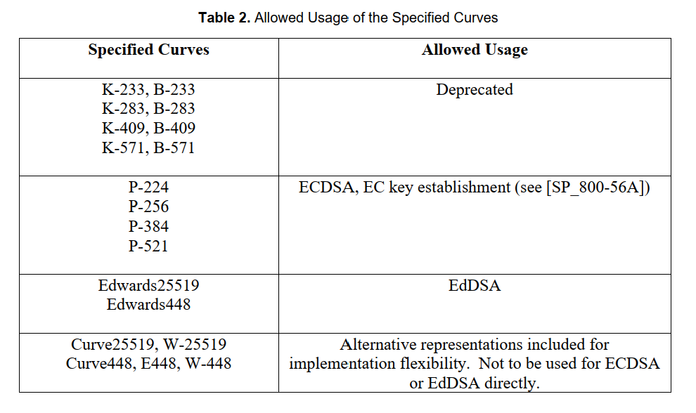
Background

Slide 4
Background

Slide 7
The case of subgroup with prime order q

Slide 9
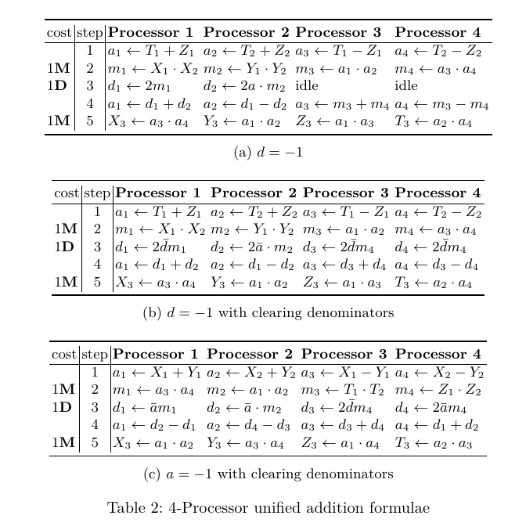

Slide 10
The case of subgroups with order 2q and 4q

Slide 15
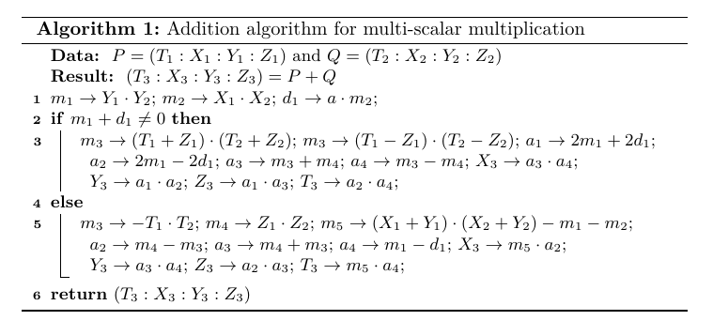

Slide 16
Thank you!
Q&A

