Slide 1

Dynamic Collusion FE and Multi-Authority ABE
PKC – Apr 2024
Rachit Garg Rishab Goyal
George Lu

Slide 2



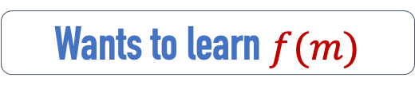
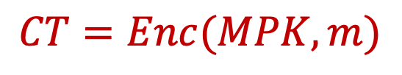



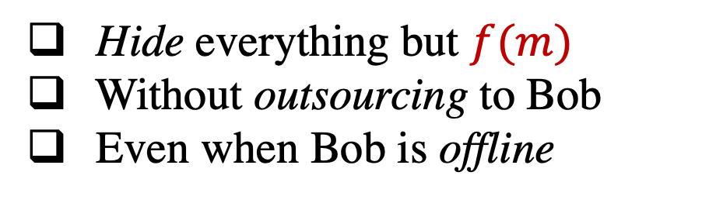
Functional Encryption [Sahai-Waters05 ……]
Hide everything but $f(m)$
Without outsourcing to Bob
Even when Bob is offline
$$MSK$$
Wants to learn $f(m)$
$$MPK$$
$$CT=Enc(MPK, m)$$
$$m$$

Slide 3

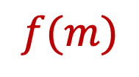
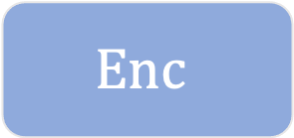
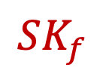

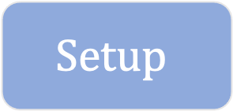


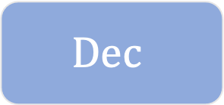

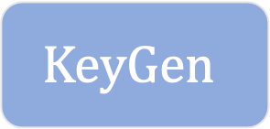

Functional Encryption [Sahai-Waters05 ……]
$$f$$
$$Setup$$
$$KeyGen$$
$$λ$$
$$MSK$$
$$MPK$$
$$SK_{f}$$
$$Enc$$
$$Dec$$
$$m$$
$$CT$$
$$f(m)$$

Slide 4
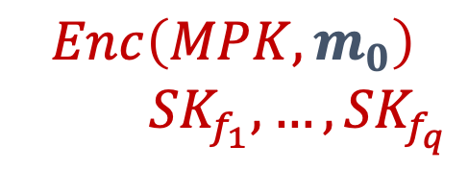
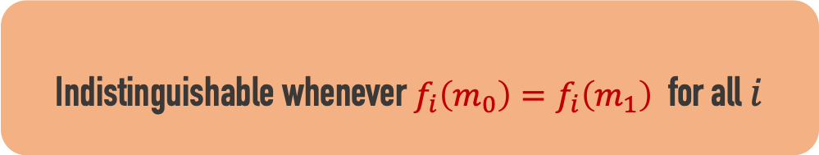
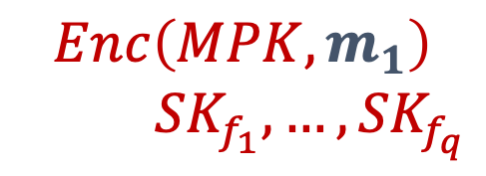
FE: Indistinguishability
IND-Based Security
vs
$$Enc\left(MPK, m_{0}\right)$$
${SK}_{f_{1}},…,{SK}_{f_{q}}$
$$Enc\left(MPK, m_{1}\right)$$
${SK}_{f_{1}},…,{SK}_{f_{q}}$
Indistinguishable whenever $f_{i}\left(m_{0}\right)=f_{i}\left(m_{1}\right)$ for all $i$

Slide 5
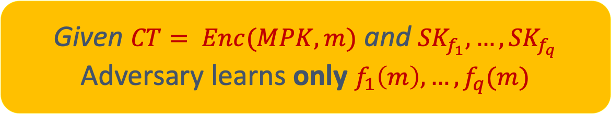
FE: Indistinguishability
IND-Based Security
IDEALLY
vs
Given $CT= Enc(MPK, m)$ and ${SK}_{f_{1}},…,{SK}_{f_{q}}$
Adversary learns only $f_{1}\left(m\right), …,f_{q}(m)$
$$Enc\left(MPK, m_{0}\right)$$
${SK}_{f_{1}},…,{SK}_{f_{q}}$
$$Enc\left(MPK, m_{1}\right)$$
${SK}_{f_{1}},…,{SK}_{f_{q}}$
Very successful
FE for NC1 → Obfuscation → A lot of Crypto
But, it might not completely capture what we want.

Slide 6
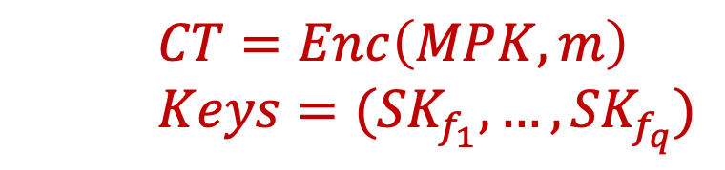
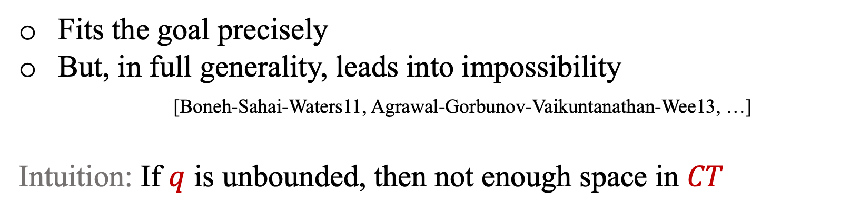
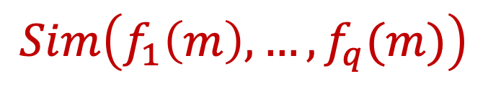
FE: Simulatability
SIM-Based Security
vs
$CT=Enc\left(MPK, m\right)$
$Keys=({SK}_{f_{1}},…,{SK}_{f_{q}})$
$$Sim\left(f_{1}\left(m\right), …, f_{q}(m)\right)$$
Fits the goal precisely
But, in full generality, leads into impossibility
[Boneh-Sahai-Waters11, Agrawal-Gorbunov-Vaikuntanathan-Wee13, …]
Intuition: If $q$ is unbounded, then not enough space in $CT$

Slide 7

Bounded Collusion FE
$$Q$$
$$f$$
$$Setup$$
$$KeyGen$$
$$λ$$
$$MSK$$
$$MPK$$
$$SK_{f}$$
$$Enc$$
$$Dec$$
$$m$$
$$CT$$
$$f(m)$$

Slide 8
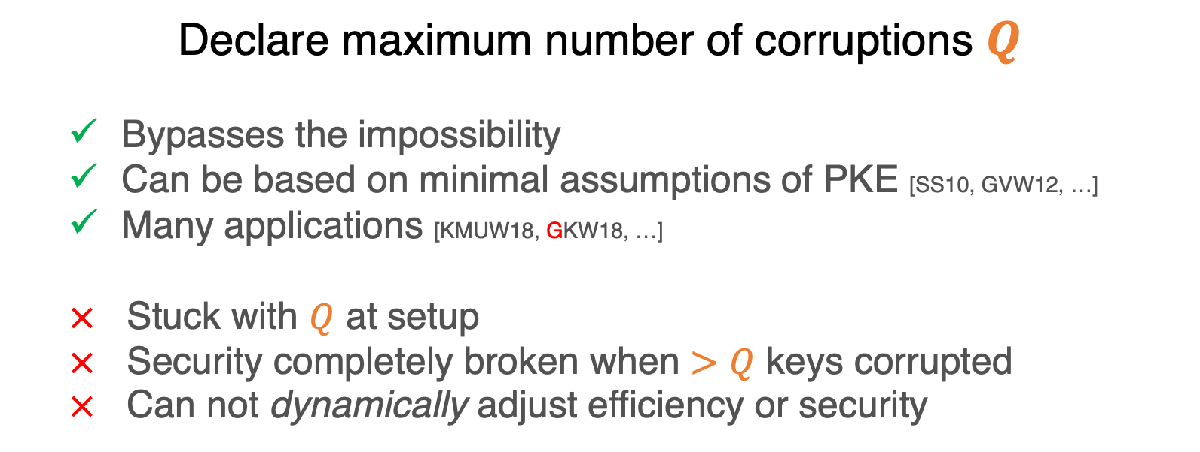
Bounded Collusion FE
$$Q$$
$$f$$
Declare maximum number of corruptions $Q$
  Bypasses the impossibility
  Can be based on minimal assumptions of PKE [SS10, GVW12, …]
  Many applications [KMUW18, GKW18, …]
  $×$ Stuck with $Q$ at setup
  $×$ Security completely broken when $>Q$ keys corrupted
  $×$ Can not dynamically adjust efficiency or security
$$Setup$$
$$KeyGen$$
$$λ$$
$$MSK$$
$$MPK$$
$$SK_{f}$$
To mitigate this, [AMVY, GGLW] proposed a dynamic collusion model
$$Enc$$
$$Dec$$
$$m$$
$$CT$$
$$f(m)$$

Slide 9
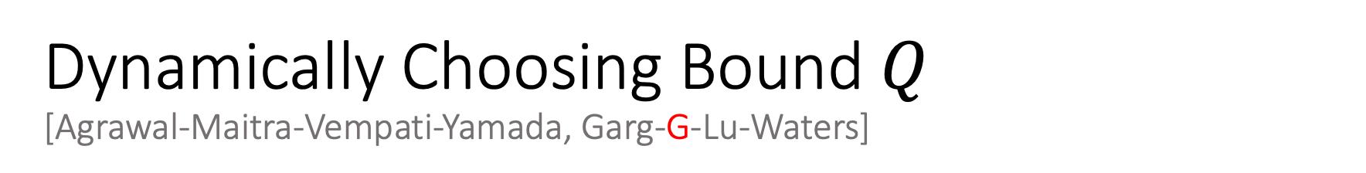
Dynamically Choosing Bound $Q$
[Agrawal-Maitra-Vempati-Yamada, Garg-G-Lu-Waters]
$$Q$$
$$f$$
$$Setup$$
$$KeyGen$$
$$λ$$
$$MSK$$
$$MPK$$
$$SK_{f}$$
$$Enc$$
$$Dec$$
$$m$$
$$CT$$
$$f(m)$$

Slide 10
Bounded Collusion FE
Dynamic
$$Q$$
$$f$$
Declare maximum number of corruptions $Q$
  Bypasses the impossibility
  Can be based on minimal assumptions of PKE [SS10, GVW12, …]
  Many applications [KMUW18, GKW18, …]
  $×$ Stuck with $Q$ at setup
  $×$ Security completely broken when $>Q$ keys corrupted
  $×$ Can not dynamically adjust efficiency or security
$$Setup$$
$$KeyGen$$
$$λ$$
$$MSK$$
$$MPK$$
$$SK_{f}$$
$$Enc$$
$$Dec$$
$$m$$
$$CT$$
$$f(m)$$

Slide 11
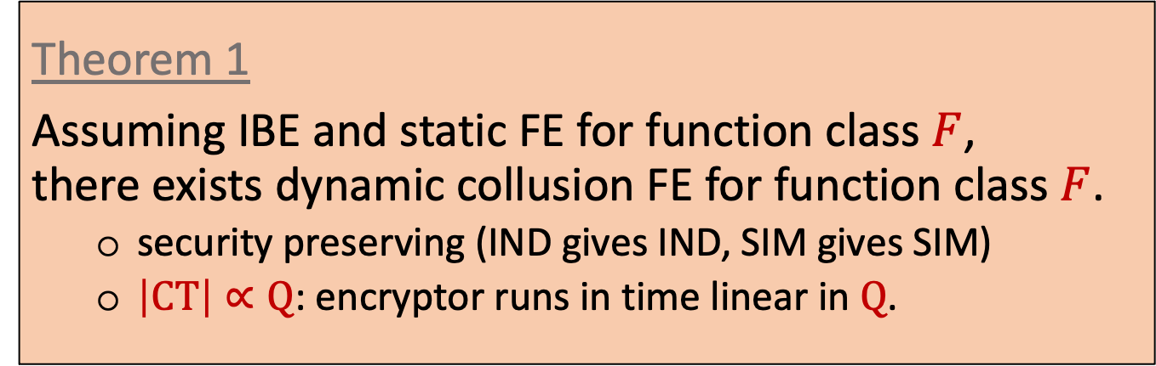
This Work: Our Results (Part 1)
Generic Bootstrapping Compiler for Dynamic Model FE
  Under minimal assumptions, static model can be upgraded to dynamic model
Theorem 1
Assuming IBE and static FE for function class $F$,
there exists dynamic collusion FE for function class $F$.
  security preserving (IND gives IND, SIM gives SIM)
  $\left|CT\right|∝Q$: encryptor runs in time linear in $Q$.

Slide 12

Roadmap from [Garg-G-Lu-Waters: Eurocrypt’22]
IBE
“Tagged” FE
Dynamic FE

Slide 13
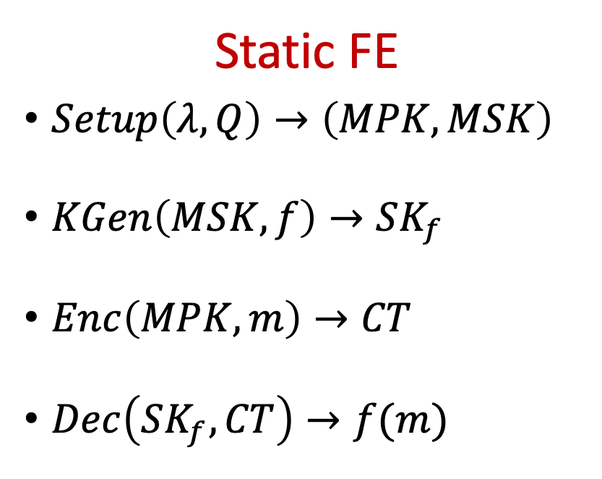
Adding Tags to CTs and SKs: “Tagged” FE
[Garg-G-Lu-Waters: Eurocrypt’22]
Static FE
$Setup\left(λ, Q\right)→\left(MPK, MSK\right)$
$KGen\left(MSK, f\right)→SK_{f}$
$Enc\left(MPK, m\right)→CT$
$Dec\left(SK_{f}, CT\right)→f(m)$

Slide 14

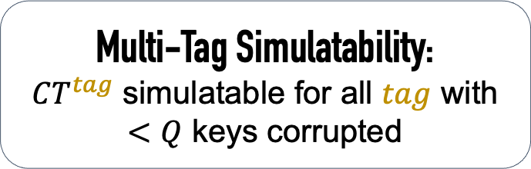
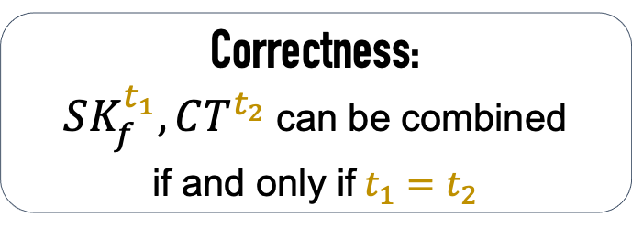

Adding Tags to CTs and SKs: “Tagged” FE
[Garg-G-Lu-Waters: Eurocrypt’22]
$tag$ is a $λ$-bit string
Static FE
$Setup\left(λ, Q\right)→\left(MPK, MSK\right)$
$KGen\left(MSK, f\right)→SK_{f}$
$Enc\left(MPK, m\right)→CT$
$Dec\left(SK_{f}, CT\right)→f(m)$
Tagged FE
$Setup\left(λ, Q\right)→\left(MPK, MSK\right)$
$KGen\left(MSK, f, tag\right)→SK_{f}^{tag}$
$Enc\left(MPK, m, tag\right)→CT^{tag}$
$Dec\left(SK_{f}^{tag}, CT^{tag}\right)→f(m)$
Correctness:
$SK_{f}^{t_{1}}, CT^{t_{2}}$ can be combined
if and only if $t_{1}=t_{2}$
Multi-Tag Simulatability:
$CT^{tag}$ simulatable for all $tag$ with $<Q$ keys corrupted

Slide 15
“Tagged” FE is enough for Dynamic FE
[Garg-G-Lu-Waters: Eurocrypt’22]
Tagged FE
$Setup\left(λ, Q\right)→\left(MPK, MSK\right)$
$KGen\left(MSK, f, tag\right)→SK_{f}^{tag}$
$Enc\left(MPK, m, tag\right)→CT^{tag}$
$Dec\left(SK_{f}^{tag}, CT^{tag}\right)→f(m)$
Intuition
Use tag space for MPK, MSK compression
Linearization trick to reduce SK size

Slide 16
Roadmap
We show this can be done generically too!
Easy!
IBE
“Tagged” FE
Dynamic FE
Very complex!
[AMVY21,GGLW22]
Developed new constructions from scratch.

Slide 17


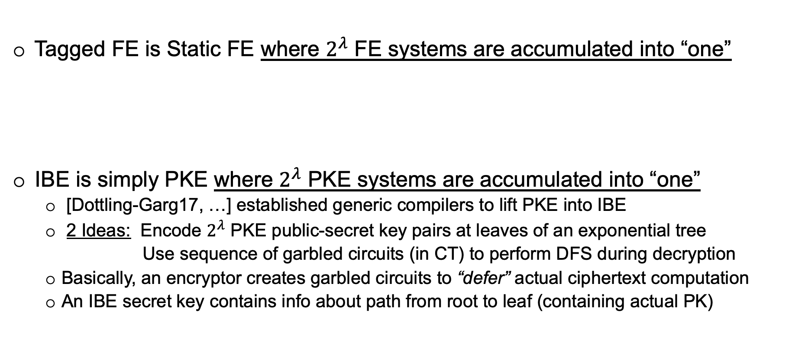
Tagged FE from IBE
Tagged FE is Static FE where $2^{λ}$ FE systems are accumulated into “one”
IBE is simply PKE where $2^{λ}$ PKE systems are accumulated into “one”
  [Dottling-Garg17, …] established generic compilers to lift PKE into IBE
  2 Ideas: Encode $2^{λ}$ PKE public-secret key pairs at leaves of an exponential tree
  Use sequence of garbled circuits (in CT) to perform DFS during decryption
  Basically, an encryptor creates garbled circuits to “defer” actual ciphertext computation
  An IBE secret key contains info about path from root to leaf (containing actual PK)
IDEA → Replace each call to PKE algorithm with appropriate FE algorithm
→ Use “tag” as IBE identity

Slide 18


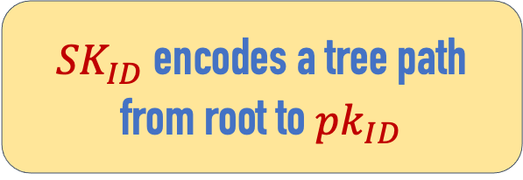
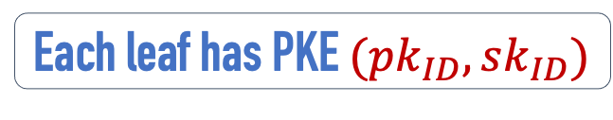
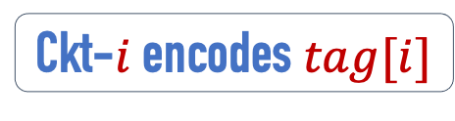


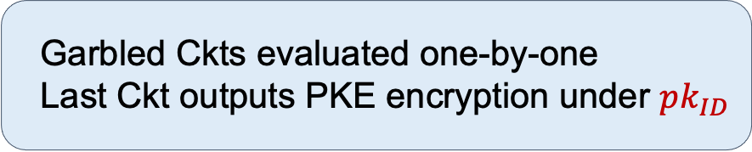
Pictorially
Missing details
one-time signatures with encryption
iterated simulation of garbled ckts
efficiently generating tree during setup
…
Root serves as $MPK$
Ckt-$i$ encodes $tag[i]$
Let us replace PKE with FE appropriately!
Garbled Ckt-1
${SK}_{ID}$ encodes a tree path from root to ${pk}_{ID}$
Garbled Ckt-2
$MSK$encodes tree efficiently
……
$$CT$$
……
……
………
………
……
Garbled Ckt-$λ$
Garbled Ckts evaluated one-by-one
Last Ckt outputs PKE encryption under $pk_{ID}$
Each leaf has PKE $(pk_{ID},sk_{ID})$

Slide 19
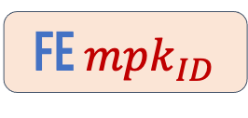
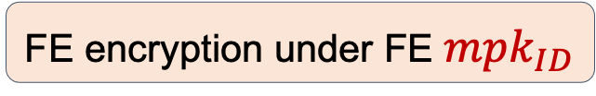
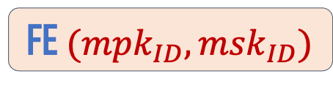
Pictorially
Rest of the design choices are natural extensions
Proof also a natural generalization
Root serves as $MPK$
Ckt-$i$ encodes $tag[i]$
FE Keygen used here.
Garbled Ckt-1
${SK}_{ID}$ encodes a tree path from root to ${pk}_{ID}$
Garbled Ckt-2
$MSK$encodes tree efficiently
……
FE ${mpk}_{ID}$
$$CT$$
……
……
………
………
……
Garbled Ckt-$λ$
Garbled Ckts evaluated one-by-one
Last Ckt outputs PKE encryption under $pk_{ID}$
FE $({mpk}_{ID},{msk}_{ID})$
Each leaf has PKE $(pk_{ID},sk_{ID})$
FE encryption under FE ${mpk}_{ID}$

Slide 20
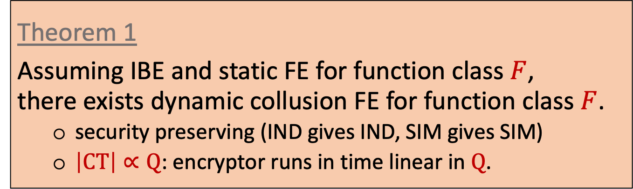
This Work: Our Results (Part 1)
Generic Bootstrapping Compiler for Dynamic Model FE
  Under minimal assumptions, static model can be upgraded to dynamic model
Theorem 1
Assuming IBE and static FE for function class $F$,
there exists dynamic collusion FE for function class $F$.
  security preserving (IND gives IND, SIM gives SIM)
  $\left|CT\right|∝Q$: encryptor runs in time linear in $Q$.
We also sketch a simpler generic construction using just a single garbled circuit by using [GKW16] deferred encryption idea

Slide 21
This Work: Our Results (Part 2)
Generic Bootstrapping Compiler for Dynamic Model FE
  Under minimal assumptions, static model can be upgraded to dynamic model
Multi-Authority Attribute-Based Encryption with Bounded Collusions
  Under PKE, MA-ABE in static collusion model for poly-size monotone ckts
  Under IBE, MA-ABE in dynamic collusion model for poly-size monotone ckts
  Full adaptive security in ROM
  Poly-size monotone ckts cover log-depth general circuits.
Theorems 2 to 5
Assuming PKE (or IBE), there exists static (or dynamic) collusion MA-ABE for computational secret sharing schemes.
  Adaptive in ROM, super-selective in standard model

Slide 22



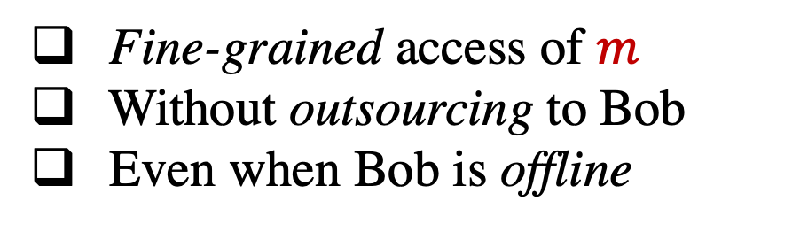
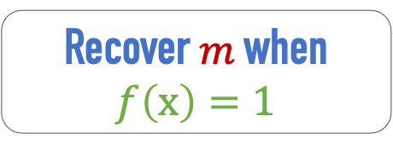
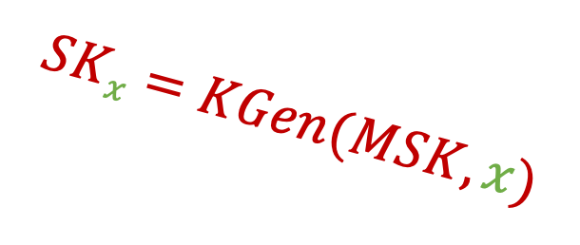
Attribute-Based Encryption [Sahai-Waters05 ……]
Fine-grained access of $m$
Without outsourcing to Bob
Even when Bob is offline
$$MSK$$
$$SKx=KGen(MSK, x)$$
Recover $m$ when $f\left(x\right)=1$
$$MPK$$
$$CT=Enc(MPK, m, f)$$
$$m$$
Attributes $x$
$$f$$

Slide 23


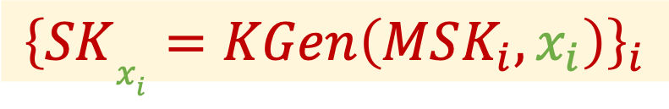




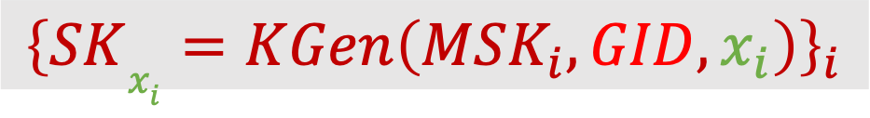
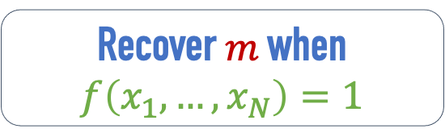

Multi-Authority ABE [Chase07 ……]
Multiple key authorities
To prevent mix-match attacks, each partial key tied to public global identifier GID
……
$$MSK_{1}$$
$$MSK_{2}$$
$$MSK_{N}$$
Recover $m$ when $f\left(x_{1},…, x_{N}\right)=1$
$${\left\{SKx_{i}=KGen\left(MSK_{i}, x_{i}\right)\right\}}_{i}$$
$${\left\{SKx_{i}=KGen\left(MSK_{i}, GID, x_{i}\right)\right\}}_{i}$$
$$MPK_{1}$$
$$MPK_{2}$$
……
$$MPK_{N}$$
$$CT=Enc({\left\{MPK_{i}\right\}}_{i}, m, f)$$
$$m$$
Attributes $x$
Each authority sets up independently and each authority creates a partial secret key on its own (with no interaction)
$$f$$

Slide 24
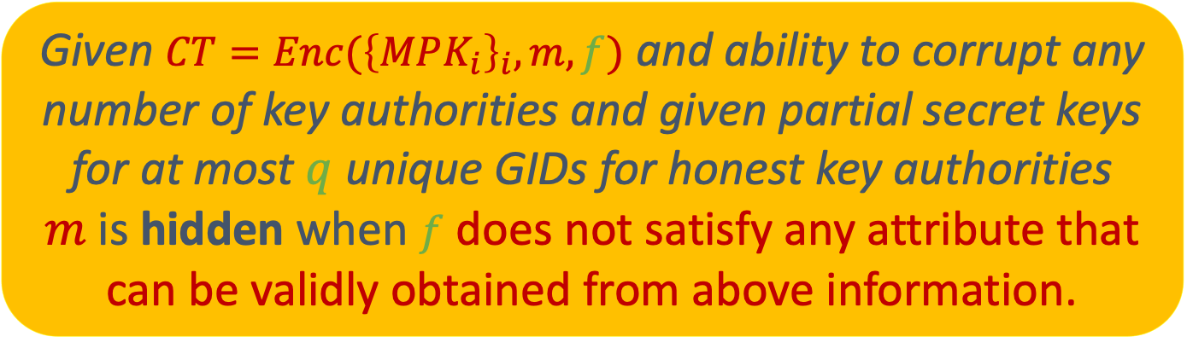
MA-ABE: Security
INTUITION
Given $CT=Enc({\left\{MPK_{i}\right\}}_{i}, m, f)$ and ability to corrupt any number of key authorities and given partial secret keys for at most $q$ unique GIDs for honest key authorities
$m$is hidden when $f$ does not satisfy any attribute that can be validly obtained from above information.

Slide 25
Summary of approach and key ideas
Classic Sahai-Seyalioglu10 construction gives 1-bounded ABE
  Cannot be extended to MA-ABE directly.
  Why? It uses garbled circuits whose security is toast if both label keys for a single wire get corrupted. This happens in MA-ABE as authorities corruptible.
Our approach
  Step 1: Replace garbled circuits with CSS (computational secret sharing) schemes in SS10 construction.
    Intuition: This would give 1-bounded MA-ABE for CSS access structures.
  Step 2: Amplify 1-bounded to q-bounded via combinatorics
    Intuition: Such amplification is common in single authority setting
    Barrier: Standard probabilistic argument fails since each authority has to agree on a random set that they sample for encrypting to a given GID
    Approach: Use Random Oracle to de-randomize while reproving via a worst-case probabilistic argument
There are many more technical details–
ROM-based non-committing encryption for post-challenge queries
Making MA-ABE tagged and generalizing to dynamic model
Super-selective security without ROM
CSS for all poly-size monotone ckts [Yao89, Bei11]

Slide 26

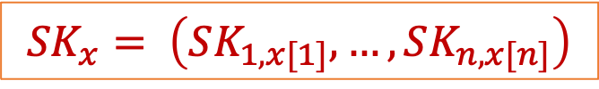
1-Bounded ABE from PKE
[Sahai-Seyalioglu10]
$Setup→$ Run PKE Setup for every bit of f
$KGen(x)$ $→$ Give out keys corresponding to bits of f
$Enc(m, f)$ $→$ Garble $f$ encoding $m$ and hide wire labels
$Dec$ $→$ Decrypt labels using $SK_{x}$ and evaluate $G$
$$\left(PK_{i, b}, SK_{i, b}\right)←PKE.Setup$$
KGen already working independently for each bit.
$${SK}_{x}= \left(SK_{1, x[1]}, …,SK_{n, x[n]}\right)$$
$\left(G, lab_{i,b}\right)←Gbl\left(f_{m}\right)$ ${CT}_{i, b} ←PKE.Enc(PK_{i, b},lab_{i,b})$
Replace Garbling with CSS

Slide 27
Summarizing: Our Results
Generic Bootstrapping Compiler for Dynamic Model FE
  Under minimal assumptions, static model can be upgraded to dynamic model
Multi-Authority Attribute-Based Encryption with Bounded Collusions
  Under PKE, MA-ABE in static collusion model for poly-size monotone ckts
  Under IBE, MA-ABE in dynamic collusion model for poly-size monotone ckts
  Full adaptive security in ROM
  Poly-size monotone ckts cover log-depth general circuits.

Slide 28

<\Thanks!>

