Slide 1
Network-Agnostic Multi-Party Computation Revisited
Nidhish Bhimrajka Ashish Choudhury Supreeth Varadarajan
IIIT Bangalore
IIIT Bangalore
IIIT Bangalore
Public Key Cryptography (PKC) 2024
Conference Registration and Travel Supported by PKC 2024, ACM IARCS, Silence Laboratories

Slide 2
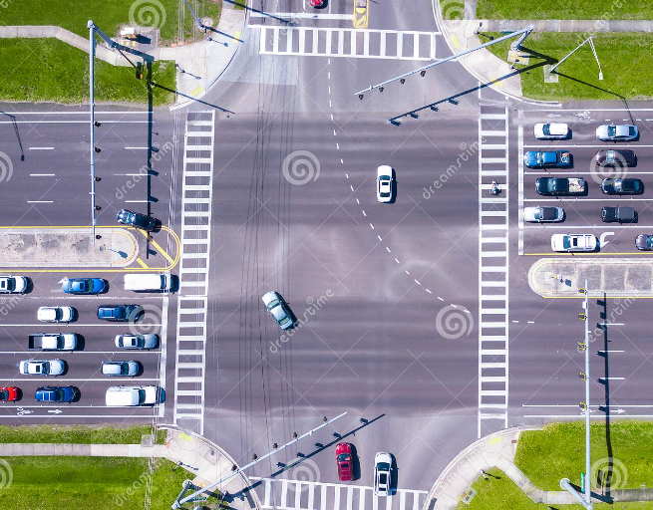
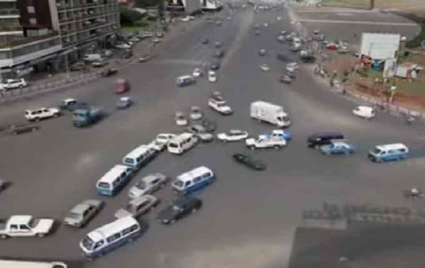
Secure Multi-Party Computation
[Yao86, GMW87, BGW88, RB89]
$$P1$$
….
$$Pt$$
$$P_{t+1}$$
….
$$P_{n}$$
$$y = f(x_{1}, …, x_{n})$$
$$x_{1}$$
$$x_{t}$$
$$x_{t+1}$$
$$x_{n}$$
$$t_{s}<\frac{n}{2}$$
Synchronous Network
Asynchronous Network
$$t_{a}<\frac{n}{3}$$
Adv
$$t_{s}$$
$$t_{a}$$
Does there exist an efficient MPC protocol that tolerates up to $t_{s}$ corrupt parties when the network is synchronous and up to $t_{a}$corrupt parties when the network is asynchronous?
$t_{a}+2t_{s}< n$
Blum et al. (CRYPTO 2020)
Deligios et al. (TCC 2021)
Bacho et al. (CRYPTO 2020)
CRS, ZK Proofs, Threshold Encryption
Without computationally heavy cryptographic primitives
Notes:
Sync vertical boxes alignment
Condition for bobw

Slide 3
Shared Circuit Evaluation
$$f\left(X\right)=s+a_{1}x+…+a_{t}x^{t}$$
$$s_{1}$$
$$s_{i}$$
$$y=x_{1}x_{2}x_{3}+x_{4}$$
$$s_{n}$$
$$s$$
$$s_{2}$$
$$f\left(X\right)$$
$$x_{1}$$
$$x_{2}$$
$$x_{3}$$
$$x_{4}$$
$$[x_{1}]$$
$$[x_{2}]$$
$$[x_{3}]$$
$$[x_{4}]$$
$$1$$
$$2$$
$$i$$
$$n$$
$$×$$
$$P_{1}$$
$$P_{2}$$
$$P_{i}$$
$$P_{n}$$
$$[s]$$
$$[x_{1}x_{2}]$$
$$×$$
Framework of [CP17]
$$[x_{1}x_{2}x_{3}]$$
Perfect [ACC22]
Statistical [AC23]
Computational
$$+$$
Network-Agnostic VSS
$$[y]$$
Multiplication Gates
Robust Reconstruction
$$y$$
Network-Agnostic
BA
[BKL19]
Notes:
Reduce framework size and increase graph size

Slide 4
Verifiable Secret Sharing (VSS)
$$Π_{\text{S}\text{h}}$$
Polynomial based SS
Verification
$$Π_{\text{Rec}}$$
$$s^{′}$$
$$s^{′}$$
$$s$$
$$s_{1}$$
$$s_{2}$$
$$s_{1}$$
$$𝒟$$
$$s_{2}$$
$$s^{′}$$
$$s^{′}$$
$$s_{t}$$
$$s_{t}$$
$$s_{n}$$
$$s_{i}$$
$$s$$
$$s_{n}$$
$$s^{′}$$
$$s_{1}$$
$$s_{i}$$
$$s$$
$$s_{n}$$
$$s_{i}$$
$$s_{2}$$
$t$-deg
$$f\left(X\right)$$
$$s^{′}=s^{∗}$$
$$s^{′}=s$$
$$1$$
$$2$$
$$i$$
$$n$$
Goal: Allow $𝒟$ to verifiably secret-share $s$
Privacy
Correctness
Termination
Commitment

Slide 5
Commitment Scheme
$$Commit$$
$$Open$$
$$m$$
$$m$$
$$m$$
$$1$$
$$m′$$
$$m$$
$m$, Opening information
$$0$$
$$C$$
Commitment $Com$
$$Com$$
$$V$$
$$C$$
$$V$$
Hiding Property
Binding Property
Pedersen’s Commitment Scheme
Homomorphic Property
$${Com_{m}}_{2}$$
$${Com_{m}}_{1}$$
$$Com_{{g(m_{1},m}_{2}) }$$
Discrete Logarithm problem
$$m_{1}$$
$$m_{2}$$
$${g(m_{1},m}_{2})$$

Slide 6
Synchronous VSS (SVSS)
Pedersen, CRYPTO 1991
$$Check\left(s_{i}, 𝓒\right)=0$$
$$t<\frac{n}{2}$$
$$s_{1}$$
$$F\left(X\right)=s+a_{1}X+…+a_{t}X^{t}$$
$$𝒟$$
$$s_{2}$$
$$s_{t}$$
$$Check\left(s_{i}, 𝓒\right)=0$$
$$s_{i}$$
$>t$ parties, then
$$s_{1}$$
$$s_{i}$$
$$s$$
$$s_{n}$$
$$s$$
$$s_{n}$$
$$(NOK,i)$$
$$s_{2}$$
$t$-deg
$$F\left(X\right)$$
$$(NOK,n)$$
$$s_{i}$$
$$1$$
$$2$$
$$i$$
$$n$$
$$𝓒$$
$$C_{0}←Commit(s)$$
$$C_{1}←Commit(a_{1})$$
$$⋮$$
$$⋮$$
$$C_{t}←Commit(a_{t})$$

Slide 7
Asynchronous VSS (AVSS)
[BKP11]
$$Check\left(f_{i}, 𝓒\right)=1$$
$$f_{1}$$
$$Check\left(f_{i}(j), 𝓒\right)=Check\left(f_{j}(i), 𝓒\right)$$
$$t<\frac{n}{3}$$
$$𝒟$$
$$f_{2}$$
$$\left|CORE\right|≥n−t$$
$$F(x, y)$$
$$f_{i}$$
$$(OK,i)$$
$$f_{j}$$
$$CORE$$
$$f_{1}= F\left(x, 1\right)$$
$$f_{n}(0)$$
$$f_{i}(0)$$
$$f_{n}\left(2\right)$$
$$f_{i}\left(2\right)$$
$$⋮$$
$$s$$
$$f_{n}$$
$$f_{i}= F\left(x, i\right)$$
$$f_{j}\left(2\right)$$
$$f_{1}\left(2\right)$$
$$f_{j}(0)$$
$$⋮$$
$$CORE$$
$$(OK,n)$$
$$f_{1}(0)$$
$$f_{n}= F\left(x,n\right)$$
$$𝓒$$
$$𝓒_{1}=C_{10},C_{11},…,C_{1t}$$
$$F(1,1)$$
$$…$$
$$F(j,1)$$
$$…$$
$$F(n,1)$$
$$𝓒_{1}$$
$${𝓒_{2}=C}_{20},C_{21},…,C_{2t}$$
$$NON−CORE$$
$$f_{1}$$
$$⋮$$
$$⋮$$
$$⋮$$
$$⋮$$
$$⋮$$
$$F(1,i)$$
$$…$$
$$F(j,i)$$
$$…$$
$$F(n,i)$$
$$f_{i}$$
$$𝓒_{i}$$
$${𝓒_{n}=C}_{n0},C_{n1}…,C_{nt}$$
$$f_{2}(0)$$
$$⋮$$
$$⋮$$
$$⋮$$
$$Check\left(f_{i}(2), 𝓒\right)=1$$
$$F(1,n)$$
$$…$$
$$F(j,n)$$
$$…$$
$$F(n,n)$$
$$f_{n}$$
$$𝓒_{n}$$

Slide 8
Network-Agnostic VSS (naVSS)
$$T_{BC}$$
$${2T}_{BC}$$
$${3T}_{BC}$$
$${3T}_{BC}+T_{BA}$$
0
$$f_{1}$$
$$Check\left(f_{i}, 𝓒\right)=1$$
$$t_{a}+2t_{s}<n$$
$$Check\left(f_{i}(j), 𝓒\right)=Check\left(f_{j}(i), 𝓒\right)$$
$$𝒟$$
$$f_{2}$$
$$CORE$$
1
$$F(x, y)$$
$$f_{i}$$
$$Π_{BA}$$
$$CORE$$
0
$$(OK,i)$$
$$f_{1}= F\left(x, 1\right)$$
$$f_{j}$$
$$⋮$$
$$s$$
$$f_{n}$$
0
$$f_{i}= F\left(x, i\right)$$
$$CORE$$
$$(OK,n)$$
0
$$⋮$$
$$CORE$$
1
1
$$f_{n}= F\left(x,n\right)$$
$$𝓒$$
$$\left|CORE\right|≥n−t_{s}$$
CORE Not Found
CORE Found
$$𝓒_{1}=C_{10},C_{11},…,C_{1t_{s}}$$
$${𝓒_{2}=C}_{20},C_{21},…,C_{2t_{s}}$$
$$⋮$$
$$⋮$$
$${𝓒_{n}=C}_{n0},C_{n1}…,C_{nt_{s}}$$

Slide 9
Network-Agnostic VSS (naVSS)
$$T_{BC}$$
$${2T}_{BC}$$
$${3T}_{BC}$$
$${3T}_{BC}+T_{BA}$$
$${4T}_{BC}+T_{BA}$$
$${5T}_{BC}+T_{BA}$$
$${6T}_{BC}+T_{BA}$$
$${6T}_{BC}+T_{BA}+Δ$$
$$\left|CORE\right|≥n−t_{s}$$
$$t_{a}+2t_{s}<n$$
$$CORE$$
$$Π_{BA}$$
1
$$f_{n}\left(⋅\right)$$
CORE Found
$$f_{n}\left(0\right)$$
$$f_{i}\left(0\right)$$
$$f_{i}\left(⋅\right)$$
$$m_{2}\left(x\right) m_{2}\left(0\right)=f_{2}(0)$$
$$m_{j}\left(x\right) m_{j}\left(0\right)=f_{j}(0)$$
$$f_{1}\left(⋅\right)$$
$$m_{21}$$
$$𝒟$$
$$m_{22}$$
$$Check\left(m_{2i}, 𝓢𝓒\right)=1$$
$$f_{1}\left(0\right)$$
$$m_{21}$$
$$m_{2i}$$
$$f_{2}(0)$$
$$m_{2n}$$
$$m_{22}$$
$t_{a}$-deg
$$m_{2i}$$
$$m_{2}(x)$$
$$(OK_{2},i)$$
 | Synchronous Network | Asynchronous Network
Honest parties
$$Check\left(m_{2i}, 𝓢𝓒\right)=1$$
$$1$$
$$2$$
$$i$$
$$n$$
$$m_{2j}$$
$$\left|QUALIFIED\right|≥n−t_{s}$$
$$t_{a}+1$$
$$t_{s}+1$$
$$𝓢𝓒$$
$$m_{2n}$$
$$QUALIFIED$$
$$𝓢𝓒_{2}=SC_{21},…,SC_{2t_{a}}$$
$$𝓢𝓒_{j}=SC_{j1},…,SC_{jt_{a}}$$
$$(OK_{2},n)$$
$$NON−CORE$$
$$QUALIFIED$$
$$f_{2}(0)$$
$$f_{j}\left(0\right)$$

Slide 10
Network-Agnostic VSS (naVSS)
$$T_{BC}$$
$${2T}_{BC}$$
$${3T}_{BC}$$
$${3T}_{BC}+T_{BA}$$
$${4T}_{BC}+T_{BA}$$
$${5T}_{BC}+T_{BA}$$
$${6T}_{BC}+T_{BA}$$
$${6T}_{BC}+T_{BA}+Δ$$
$$t_{a}+2t_{s}<n$$
$$Π_{BA}$$
0
CORE Not Found
Synchronous
Asynchronous
$$\left|NEW−CORE\right|≥n−t_{a}$$
$$𝒟$$
$$NEW−CORE$$
$$Check\left(f_{i}(2), 𝓒\right)=1$$
$$f_{j}\left(0\right)$$
$$f_{j}\left(2\right)$$
$$f_{n}\left(2\right)$$
$$f_{n}\left(0\right)$$
$$NON−CORE$$
$$s$$
$$f_{i}\left(2\right)$$
$$f_{i}\left(0\right)$$
$$NEW−CORE$$
$$f_{1}\left(2\right)$$
$$f_{2}\left(0\right)$$
$$f_{1}\left(0\right)$$

Slide 11
Open Problems
Packed Network-Agnostic VSS
Utilizing
Trusted Setup
Improving the communication complexity

Slide 12
Thank you!

