Slide 1
Quantum CCA-Secure PKE, Revisited
Varun Maram
Quantum Security Group
SandboxAQ
Joint work with Navid Alamati
: https://varun-maram.github.io/
: varun-maram-pqc
Notes:
Hi everyone! Welcome to my talk on revisiting quantum CCA secure public key encryption. I’m Varun, a fresh postdoc at SandboxAQ. This talk is based on joint work with Navid Alamati, (who’s) a scientist at Visa Research. This work was done while I was a PhD student at ETH Zurich.

Slide 2
Quantum CCA-Secure PKE, Revisited
Notes:
I’ll begin my talk by first deconstructing the title.

Slide 3
Quantum CCA-Secure PKE, Revisited
Notes:
Starting with CCA-Secure PKE,…

Slide 4
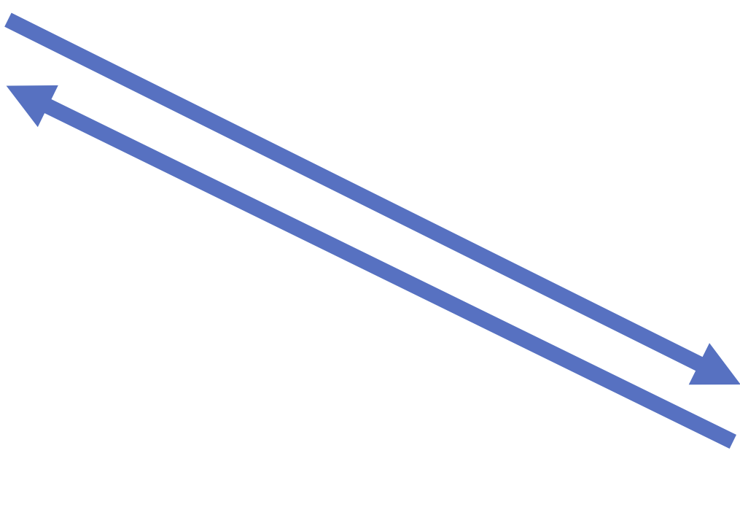
IND-CCA Security
$$PKE=(KGen, Enc, Dec)$$
Alice
Bob
$$c$$
$$m$$
$$c←Enc({pk}_{Bob}, m)$$
$$m←Dec({sk}_{Bob}, c)$$
$$c$$
$$m= ?$$
Eve
$$c′$$
$$Dec({sk}_{Bob}, .)$$
$$m′$$
Notes:
Here’s a quick 1-slide recap of what we mean by that. IND-CCA security, roughly speaking, guarantees that if Alice encrypts a message under Bob’s public-key, then the resulting ciphertext does not leak anything about the message to third-parties such as Eve. This holds true even when Eve has black-box access to Bob’s “decryption oracle” which allows her to decrypt any ciphertext of her choice, except of course the Alice’s / target ciphertext c.

Slide 5
Quantum CCA-Secure PKE, Revisited
Notes:
Great,…

Slide 6
Quantum CCA-Secure PKE, Revisited
Notes:
Now what do we mean by *quantum* CCA-secure PKE?

Slide 7
IND-CCA Security
$$PKE=(KGen, Enc, Dec)$$
Alice
Bob
$$c$$
$$m$$
$$c←Enc({pk}_{Bob}, m)$$
$$m←Dec({sk}_{Bob}, c)$$
$$c$$
$$m= ?$$
Eve
$$c′$$
$$Dec({sk}_{Bob}, .)$$
$$m′$$
Notes:
Note that in the earlier IND-CCA security definition, Eve has *classical* access to Bob’s decryption oracle. Namely, the ciphertexts c’ and the corresponding decryptions m’ are *classical* bit strings.

Slide 8
IND-qCCA Security
Introduced by [Boneh-Zhandry’13].
$$PKE=(KGen, Enc, Dec)$$
Alice
Bob
$$c$$
$$m$$
$$c←Enc({pk}_{Bob}, m)$$
$$m←Dec({sk}_{Bob}, c)$$
$$c$$
Relevance in (far) future when quantum computing becomes ubiquitous.
Also in not-so-far future when adversaries can trick classical devices to behave “quantumly” (e.g., “frozen smart-card attacks”).
$$m= ?$$
Eve
$$\left.\left.α\left|c′\right.\right\rangle +β\left|c′′\right.\right\rangle$$
$$Dec({sk}_{Bob}, .)$$
$$α\left.\left.\left|m′\right.\right\rangle +β\left|m′′\right.\right\rangle$$
Notes:
In the so-called IND- quantum CCA security definition (or IND-qCCA security for short) – as introduced by Boneh and Zhandry – Eve now has *quantum* access to the decryption oracle. That is, Eve can ask for decryption of ciphertexts in superposition and get back the corresponding decryptions again in superposition.

Slide 9
IND-qCCA Security
Introduced by [Boneh-Zhandry’13].
$$PKE=(KGen, Enc, Dec)$$
Alice
Bob
$$c$$
$$m$$
$$c←Enc({pk}_{Bob}, m)$$
$$m←Dec({sk}_{Bob}, c)$$
$$c$$
Relevance in future when quantum computing becomes ubiquitous.
Also in not-so-far future when adversaries can trick classical devices to behave “quantumly” (e.g., “frozen smart-card attacks”).
$$m= ?$$
Eve
$$\left.\left.α\left|c′\right.\right\rangle +β\left|c′′\right.\right\rangle$$
$$Dec({sk}_{Bob}, .)$$
$$α\left.\left.\left|m′\right.\right\rangle +β\left|m′′\right.\right\rangle$$
Notes:
This notion is quite relevant in scenarios where end-users like Bob start using quantum devices in the future that can handle quantum data. Then this IND-qCCA definition models the fact that Eve can get quantum (decryption) access to such a device.
(E.g., let’s say “Bob” is a “quantum cloud computing center (FHE?)” (however it may look like) that receives quantum data. )

Slide 10
IND-qCCA Security
Introduced by [Boneh-Zhandry’13].
$$PKE=(KGen, Enc, Dec)$$
Alice
Bob
$$c$$
$$m$$
$$c←Enc({pk}_{Bob}, m)$$
$$m←Dec({sk}_{Bob}, c)$$
$$c$$
Relevance in future when quantum computing becomes ubiquitous.
Also, in not-so-far future when adversaries can trick classical devices to behave “quantumly” (e.g., “frozen smart-card attacks”).
$$m= ?$$
Eve
$$\left.\left.α\left|c′\right.\right\rangle +β\left|c′′\right.\right\rangle$$
$$Dec({sk}_{Bob}, .)$$
$$α\left.\left.\left|m′\right.\right\rangle +β\left|m′′\right.\right\rangle$$
Notes:
But turns out that there are also some scenarios in the not-so-far future where this qCCA security notion becomes relevant. Namely, there are cases where an adversary can trick classical devices (say, devices owned by Bob such as smart-cards) to behave “quantumly”– e.g., by keeping the device at super low temperatures and shielding it from any electromagnetic interference. Hence, even in such scenarios, (IND-)qCCA security guarantees that Eve cannot obtain any extra advantage in extracting Alice’s message when having this clever quantum access to Bob’s device.

Slide 11
Quantum CCA-Secure PKE, Revisited
Notes:
Cool,…

Slide 12
Quantum CCA-Secure PKE, Revisited
Notes:
Now what do we mean by revisiting such qCCA secure public key encryption?

Slide 13
Motivation
IND-CCA PKE
Notes:
If we consider the plain CCA secure PKE in the post-quantum setting,…

Slide 14
Motivation
[Agrawal-Boneh-Boyen’10]
[Kitagawa-Matsuda-Tanaka’19]
Lattices
IND-CCA PKE
Codes
[Alamati-De Feo-Montgomery-Patranabis’20]
Group Actions
(E.g., Isogenies)
Notes:
…there are numerous/tons of instantiations of such schemes in the literature from different post-quantum hardness assumptions – e.g., from lattice-based problems (like LWE), code-based problems (like LPN), and isogeny-based group actions (like CSIDH).

Slide 15
Motivation
IND-qCCA PKE
Notes:
However, when it comes to qCCA secure PKE,…

Slide 16
Motivation
Lattices
[Boneh-Zhandry’13]
IND-qCCA PKE
Only prior construction in the standard model.*
Notes:
Turns out there is only one instantiation of such a scheme in the literature, namely from lattices, in the standard model – thanks to Boneh and Zhandry. And I stress “standard model” because…

Slide 17
Motivation
Lattices
[Boneh-Zhandry’13]
IND-qCCA PKE
Only prior construction in the standard model.*
*There exist richer constructions
of qCCA-secure PKE in the
idealized quantum ROM – e.g.,
by [Xagawa-Yamakawa’19].
Notes:
…if we consider idealized models instead, such as the quantum ROM, then there exists a rich set of generic constructions of qCCA secure PKE schemes – e.g., using variants of the Fujisaki-Okamoto transforms as shown by Xagawa and Yamakawa.

Slide 18
Motivation
?
Lattices
[Boneh-Zhandry’13]
IND-qCCA PKE
Codes
?
Only prior construction in the standard model.*
Group Actions
(E.g., Isogenies)
Notes:
However in our work, we only consider the non-idealized standard model. So in this model, what about instantiations of qCCA secure PKE schemes from non-lattice-based assumptions, such as code-based or (isogeny-)group-action based?

Slide 19
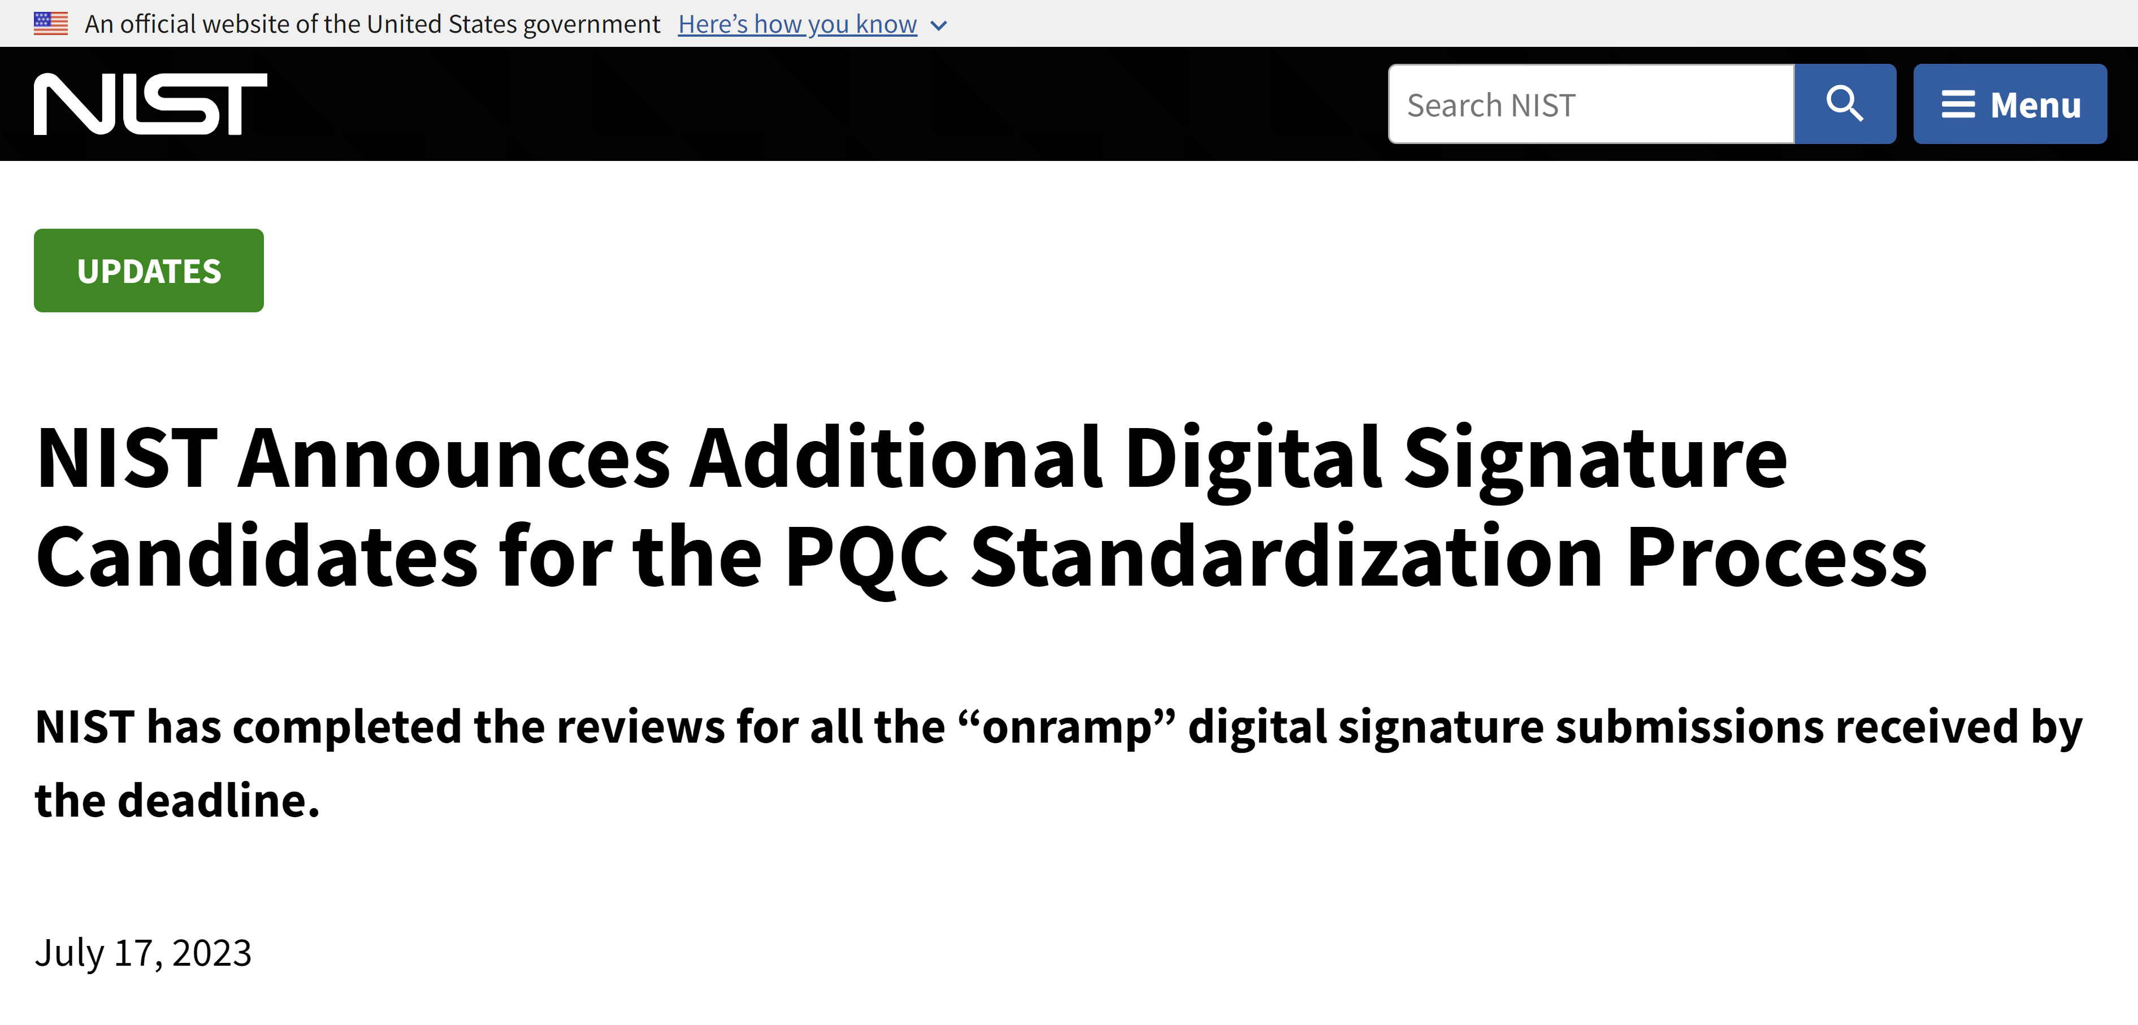
Motivation
?
Lattices
[Boneh-Zhandry’13]
IND-qCCA PKE
Codes
?
Only prior construction in the standard model.*
Group Actions
(E.g., Isogenies)
Notes:
This is quite similar to NIST’s main motivation to standardize additional digital signatures that are based on post-quantum assumptions that are not based on structured lattices.

Slide 20
Motivation
?
Lattices
[Boneh-Zhandry’13]
IND-qCCA PKE
Codes
?
Only prior construction in the standard model.*
Group Actions
(E.g., Isogenies)
Notes:
Furthermore, in light of the recent claimed cryptanalysis of LWE by Yilei Chen, it makes more sense to focus our attention on instantiations from objects beyond /other than lattices.

Slide 21
Motivation
Lattices
[Boneh-Zhandry’13]
IND-qCCA PKE
Notes:
Now going back to Boneh and Zhandry’s construction of qCCA secure PKE from LWE,…

Slide 22
Motivation
Lattices
[Boneh-Zhandry’13]
IND-qCCA PKE
[Agrawal-Boneh-Boyen’10]
Lattices
IND-CCA PKE
Notes:
…at a high-level, they follow the blue-print of a prior LWE-based construction of plain CCA secure PKE scheme by Agrawal et al.

Slide 23
Motivation
Lattices
[Boneh-Zhandry’13]
IND-qCCA PKE
[Agrawal-Boneh-Boyen’10]
Lattices
IND-CCA PKE
Notes:
Technically, Agrawal et al. don’t construct a CCA-secure PKE scheme from lattices directly, but instead…

Slide 24
Motivation
Lattices
[Boneh-Zhandry’13]
IND-qCCA PKE
[Agrawal-Boneh-Boyen’10]
Lattices
Selective-IBE
IND-CCA PKE
Identity-Based Encryption.
Notes:
…they construct a different primitive called selective secure identity based encryption (or IBE). BTW in the rest of my talk, I’ll be throwing different primitives at you. So be prepared!

Slide 25
Motivation
Lattices
[Boneh-Zhandry’13]
IND-qCCA PKE
[Agrawal-Boneh-Boyen’10]
[Boneh-Canetti-Halevi-Katz’04]
Lattices
Selective-IBE
IND-CCA PKE
Identity-Based Encryption.
Notes:
And then Boneh et al. showed in the early 2000’s how to generically construct a (plain) CCA-secure PKE scheme from such an IBE. This is also known as the BCHK transform/construction in the literature.

Slide 26
Motivation
Lattices
[Boneh-Zhandry’13]
IND-qCCA PKE
[Agrawal-Boneh-Boyen’10]
[Boneh-Canetti-Halevi-Katz’04]
Lattices
Selective-IBE
IND-CCA PKE
Identity-Based Encryption.
Notes:
So Boneh and Zhandry did something similar. Namely, …

Slide 27
Motivation
Secure against quantum secret key queries.
Lattices
[Boneh-Zhandry’13]
qSelective-IBE
IND-qCCA PKE
[Agrawal-Boneh-Boyen’10]
[Boneh-Canetti-Halevi-Katz’04]
Lattices
Selective-IBE
IND-CCA PKE
Identity-Based Encryption.
Notes:
… they constructed a different primitive from lattices, namely, a so-called quantum selective secure IBE. In the corresponding security notion for IBE, the adversary can corrupt users in a “quantum fashion” – i.e., it can obtain secret keys of users from the challenger in superposition.

Slide 28
Motivation
Using the same IBE → PKE construction of [Boneh-Canetti-Halevi-Katz’04].
Secure against quantum secret key queries.
Lattices
[Boneh-Zhandry’13]
qSelective-IBE
[Boneh-Zhandry’13]
IND-qCCA PKE
[Agrawal-Boneh-Boyen’10]
[Boneh-Canetti-Halevi-Katz’04]
Lattices
Selective-IBE
IND-CCA PKE
Identity-Based Encryption.
Notes:
And then they used the same BCHK IBE -> PKE transform to construct a qCCA secure PKE scheme from such a qSelective IBE. In other words, Boneh and Zhandry extended the analysis of the BCHK transform to quantum CCA setting.

Slide 29
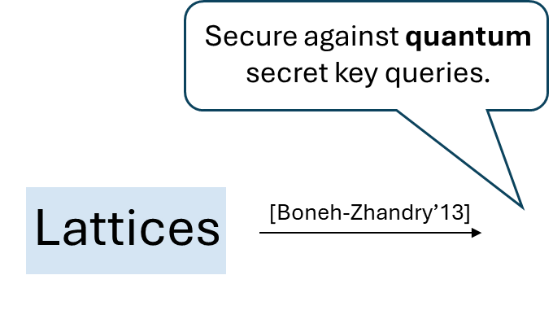
Motivation
Using the same IBE → PKE construction of [Boneh-Canetti-Halevi-Katz’04].
qSelective-IBE
[Boneh-Zhandry’13]
IND-qCCA PKE
Notes:
But if we focus on the BCHK transform,…

Slide 30
Motivation
Selective-IBE
[Boneh-Canetti-Halevi-Katz’04]
IND-CCA PKE
Notes:
…, note that in the plain IND-CCA setting, this is not the only generic construction of such PKE schemes.

Slide 31
Motivation
Key-Dependent Message.
Selective-IBE
KDM-secure PKE
[Boneh-Canetti-Halevi-Katz’04]
[Kitagawa-Matsuda-Tanaka’19]
IND-CCA PKE
[Kiltz-Mohassel-O’Neill’10]
[Cramer-Shoup’02]
Adaptive TDF
Hash Proof System
Notes:
In fact, there are a myriad of generic constructions of CCA secure PKE schemes in the literature. Here I show some of them. Namely, we have constructions from so-called KDM (or Key-Dependent Message secure) PKE schemes, hash proof systems, adaptive trapdoor functions, and so on.

Slide 32
Motivation
Selective-IBE
KDM-secure PKE
?
?
IND-qCCA PKE
?
?
Adaptive TDF
Hash Proof System
Notes:
But coming back to our qCCA setting, can we show similar generic constructions?

Slide 33
Motivation
Secure against post-quantum adversaries with quantum access to secret oracles.
qSelective-IBE
KDM-secure PKE
?
[Boneh-Zhandry’13]
IND-qCCA PKE
?
?
Adaptive TDF
Hash Proof System
Notes:
Now Boneh and Zhandry showed a quantum secure construction from IBE. However, they had to rely on a stronger and non-standard quantum security notion for their IBE in the first place as well. So in some sense, their result does not seem surprising.

Slide 34
Overview: Results
Secure against post-quantum adversaries with quantum access to secret oracles.
qSelective-IBE
KDM-secure PKE
[Boneh-Zhandry’13]
[Our Work]
IND-qCCA PKE
?
[Our Work]
Adaptive TDF
Hash Proof System
Notes:
But surprisingly in our work, we show that generic constructions of qCCA secure PKE schemes from hash proof systems and KDM(-secure) PKE are possible without any extra assumption on their (post-)quantum security!

Slide 35
Overview: Results
Secure against post-quantum adversaries with quantum access to secret oracles.
qSelective-IBE
KDM-secure PKE
[Boneh-Zhandry’13]
[Our Work]
IND-qCCA PKE
?
[Our Work]
Secure against post-quantum adversaries with no special quantum access!
Adaptive TDF
Hash Proof System
Notes:
Namely, we just require that these building blocks are secure against post-quantum adversaries with no special quantum access in their corresponding standard security games/notions. In other words, we are not modifying the security games/notions of KDM PKE and hash proof systems in our analysis, in contrast to what Boneh and Zhandry did for IBE.

Slide 36
Overview: Results
qSelective-IBE
KDM-secure PKE
[Boneh-Zhandry’13]
[Our Work]
IND-qCCA PKE
?
[Our Work]
Adaptive TDF
Hash Proof System
Notes:
Now in terms of constructions from concrete post-quantum hardness assumptions,…

Slide 37
Overview: Results
Lattices
[Boneh-Zhandry’13]
qSelective-IBE
KDM-secure PKE
[Boneh-Zhandry’13]
[Our Work]
IND-qCCA PKE
?
[Our Work]
Adaptive TDF
Hash Proof System
Notes:
…, as mentioned earlier, Boneh and Zhandry used the LWE assumption.

Slide 38
Overview: Results
Lattices
Codes
[Boneh-Zhandry’13]
[Applebaum-Cash-Peikert-Sahai’09]
qSelective-IBE
KDM-secure PKE
[Boneh-Zhandry’13]
[Our Work]
IND-qCCA PKE
Group Actions
?
[Our Work]
[Alamati-De Feo-Montgomery-Patranabis’20]
Adaptive TDF
Hash Proof System
Notes:
Whereas a nice part about our new generic constructions is that, in the literature, there exist instantiations of KDM-secure PKE from code-based problems such as LPN, and instantiations of hash proof systems from isogeny-based group actions such as CSIDH. This in-turn implies new instantiations of qCCA secure PKE from non-lattice-based assumptions.

Slide 39
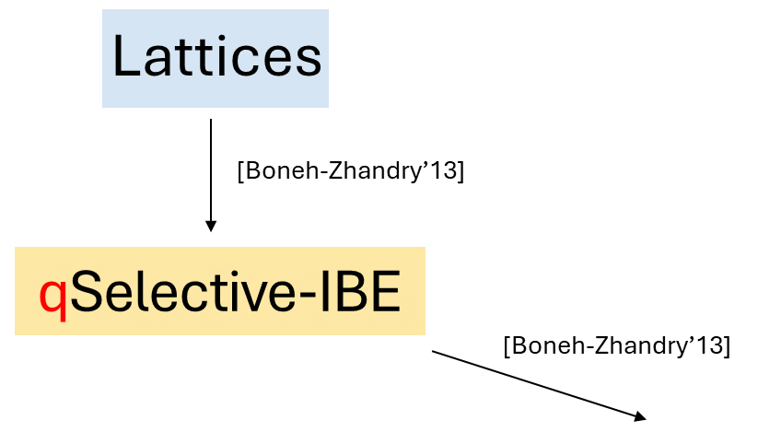
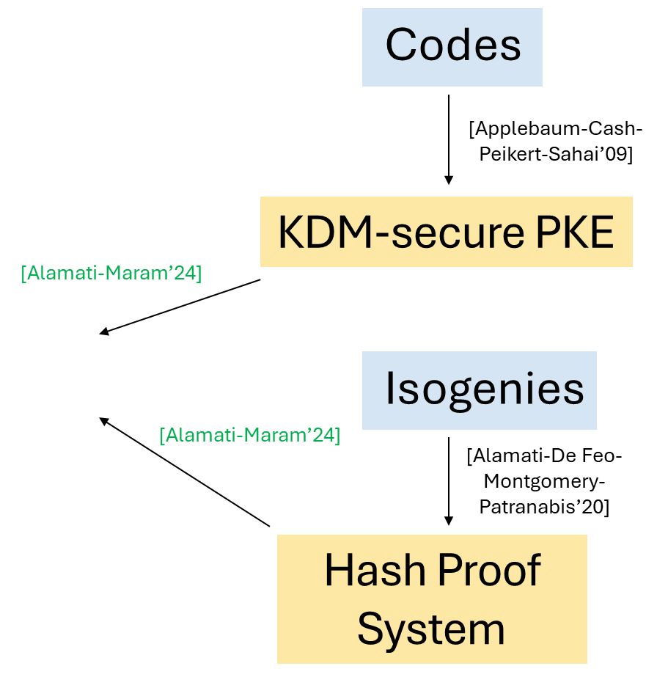
Overview: Results
[Our Work]
IND-qCCA PKE
?
[Our Work]
Adaptive TDF
Notes:
Notice that all this time, I was not really touching / talking about adaptive TDFs.

Slide 40
Overview: Results
[Our Work]
Secure against quantum TDF inversion queries.
IND-qCCA PKE
[Our Work]
[Our Work]
qAdaptive TDF
Notes:
Because we also show a construction of qCCA secure PKE from adaptive TDFs but wherein we require a stronger quantum security property from such TDFs. We introduce/call these primitives as “quantum adaptive TDFs” wherein one-wayness of TDFs holds even when an adversary can make inversion queries in superposition. Now this is quite similar to Boneh and Zhandry’s result from IBEs and whatever criticism we had for their construction should also apply to us.

Slide 41
Overview: Results
[Our Work]
Secure against quantum TDF inversion queries.
IND-qCCA PKE
[Our Work]
[Our Work]
Only need post-quantum security.
qAdaptive TDF
[Our Work]
Correlated-product TDF
Notes:
But we also go on to show that such quantum adaptive TDF’s can be generically constructed from yet another primitive in the literature called correlated-product TDF; I believe this should be the last “new” primitive I talk about in this presentation. And in this construction, the correlated-product TDFs need not satisfy any new quantum security property and just need to be secure against post-quantum adversaries with no special quantum access.

Slide 42
Overview: Results
[Our Work]
Secure against quantum TDF inversion queries.
IND-qCCA PKE
[Our Work]
[Our Work]
Only need post-quantum security.
qAdaptive TDF
[Our Work]
Correlated-product TDF
Lattices
[Micciancio-Peikert’13]
Notes:
Finally, Micciancio and Peikert provide a construction of such correlated product TDFs from LWE. This means that our results imply yet another lattice-based construction of qCCA secure PKE scheme. However because of the recent claimed quantum attack on LWE by Yilei Chen, this instantiation might be moot. Regardless of this, we hope that the primitive of “quantum ATDFs” (that we introduce in our work) finds other applications beyond the construction of qCCA secure PKE..

Slide 43
Overview: Results
Lattices
Codes
[Boneh-Zhandry’13]
[Applebaum-Cash-Peikert-Sahai’09]
qSelective-IBE
KDM-secure PKE
[Boneh-Zhandry’13]
[Our Work]
IND-qCCA PKE
Group Actions
[Our Work]
[Our Work]
[Alamati-De Feo-Montgomery-Patranabis’20]
qAdaptive TDF
Hash Proof System
[Our Work]
Correlated-product TDF
Lattices
[Micciancio-Peikert’13]
Notes:
Putting things together, this is sort-of a bird’s eye view of our results. But we are not done yet.

Slide 44
Overview: Results
qSelective-IBE
KDM-secure PKE
[Boneh-Zhandry’13]
[Our Work]
IND-qCCA PKE
[Our Work]
[Our Work]
qAdaptive TDF
Hash Proof System
[Our Work]
Correlated-product TDF
Notes:
If we only consider the “generic (constructions) part” of this overview (– and forget the concrete post-quantum assumptions for a moment –), then during our analysis, we came up with some more interesting (generic) results.

Slide 45
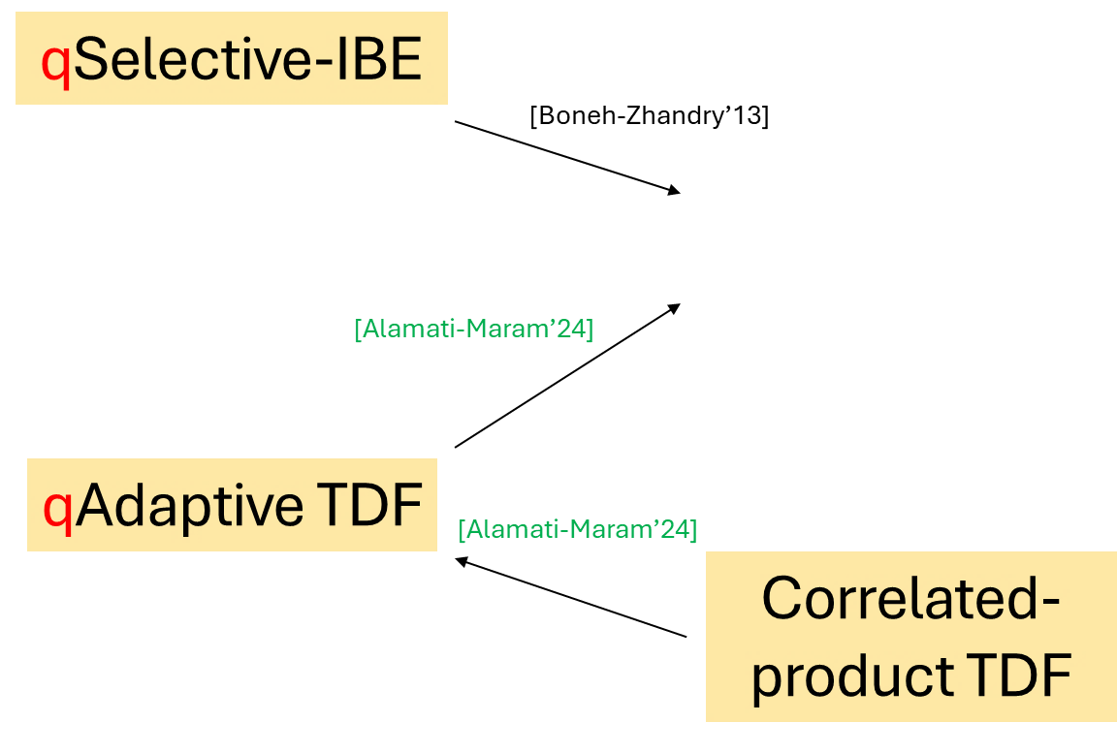
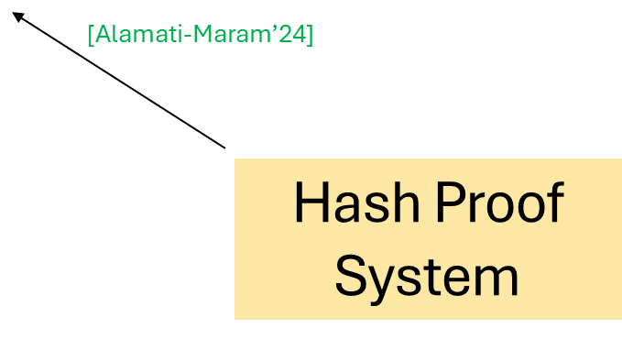
Overview: Results
KDM-secure PKE
[Our Work]
IND-qCCA PKE
[Our Work]
[Our Work]
[Our Work]
Notes:
For example, starting with the construction from KDM-secure PKE,…

Slide 46
Overview: Results
IND-qCCA KEM
[Our Work]
KDM-secure PKE
IND-qCCA PKE
[Our Work]
[Our Work]
[Our Work]
Notes:
…, we technically show that such PKE schemes result in qCCA secure Key Encapsulation Mechanism (KEM).

Slide 47
Overview: Results
Using the KEM-DEM paradigm of [Cramer-Shoup’03], with only a post-quantum secure DEM!
IND-qCCA KEM
[Our Work]
KDM-secure PKE
[Our Work]
IND-qCCA PKE
[Our Work]
[Our Work]
[Our Work]
Notes:
Then, we showed that qCCA secure KEMs result in qCCA secure PKE schemes as well via the well-known KEM-DEM paradigm of Cramer and Shoup. And an interesting part of our result is that in such a composition we don’t require a strong quantum secure DEM – i.e., for the DEM component, we only require security against post-quantum adversaries who have classical access to the encryption and decryption oracles.

Slide 48
Overview: Results
[Our Work]
[Our Work]
IND-qCCA PKE
[Our Work]
[Our Work]
qAdaptive TDF
[Our Work]
Notes:
And when it comes to the generic construction from quantum adaptive TDFs,…

Slide 49
Overview: Results
[Our Work]
[Our Work]
1-bit IND-qCCA PKE
IND-qCCA PKE
[Our Work]
[Our Work]
qAdaptive TDF
[Our Work]
Notes:
…., we first show that such TDFs result in qCCA secure PKE schemes that can only encrypt single-bit messages.

Slide 50
Overview: Results
Extending bit completeness of CCA-secure PKE by [Hohenberger-Lewko-Waters’12] to the quantum setting.
[Our Work]
[Our Work]
1-bit IND-qCCA PKE
IND-qCCA PKE
[Our Work]
[Our Work]
[Our Work]
qAdaptive TDF
[Our Work]
Notes:
Then we show how to bootstrap any single-bit qCCA secure PKE scheme to a multi-bit one. In essence, here we extend the so-called completeness of bit encryption in the classical CCA setting showed by Hohenberger et al. to the quantum CCA setting.

Slide 51
Overview: Results
IND-qCCA KEM
[Our Work]
qSelective-IBE
KDM-secure PKE
[Boneh-Zhandry’13]
[Our Work]
1-bit IND-qCCA PKE
IND-qCCA PKE
[Our Work]
[Our Work]
[Our Work]
qAdaptive TDF
Hash Proof System
[Our Work]
Correlated-product TDF
Notes:
So this is a more fine-grained overview of our results.

Slide 52
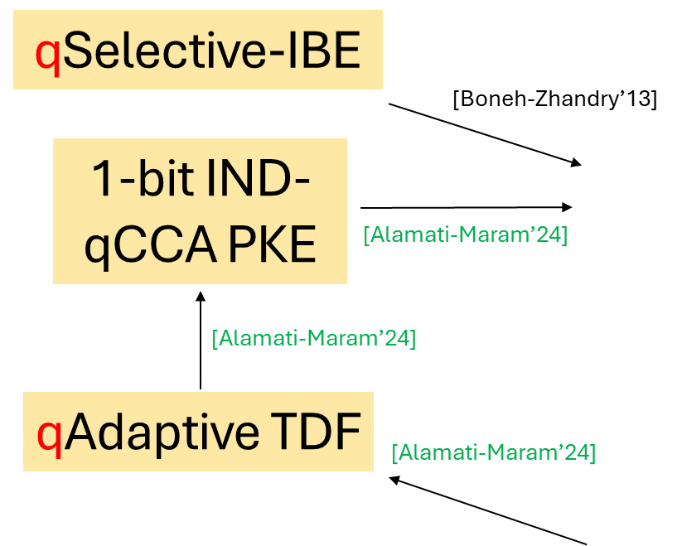
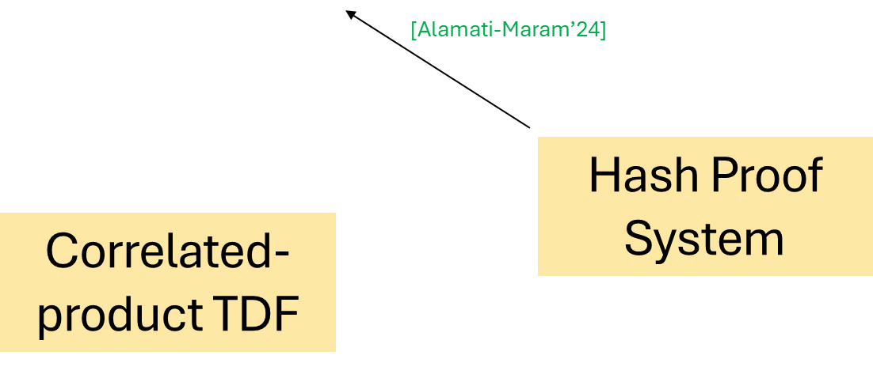
Overview: Results
[Our Work]
[Our Work]
IND-qCCA PKE
[Our Work]
[Our Work]
[Our Work]
[Our Work]
[Our Work]
[Our Work]
Notes:
And finally, if we take a step back and revisit the qCCA security notion ….

Slide 53
IND-qCCA Security
Introduced by [Boneh-Zhandry’13].
$$PKE=(KGen, Enc, Dec)$$
Alice
Bob
$$c$$
$$m$$
$$c←Enc({pk}_{Bob}, m)$$
$$m←Dec({sk}_{Bob}, c)$$
$$c$$
Relevance in (far) future when quantum computing becomes ubiquitous.
Also in not-so-far future when adversaries can trick classical devices to behave “quantumly” (e.g., “frozen smart-card attacks”).
$$m= ?$$
Eve
$$\left.\left.α\left|c′\right.\right\rangle +β\left|c′′\right.\right\rangle$$
$$Dec({sk}_{Bob}, .)$$
$$α\left.\left.\left|m′\right.\right\rangle +β\left|m′′\right.\right\rangle$$
Notes:
…. of Boneh and Zhandry in more detail…

Slide 54
IND-qCCA Security
Introduced by [Boneh-Zhandry’13].
$$PKE=(KGen, Enc, Dec)$$
Alice
Bob
$$c$$
$$m$$
$$c←Enc({pk}_{Bob}, m)$$
$$m←Dec({sk}_{Bob}, c)$$
$$c$$
Relevance in (far) future when quantum computing becomes ubiquitous.
Also in not-so-far future when adversaries can trick classical devices to behave “quantumly” (e.g., “frozen smart-card attacks”).
$$m= ?$$
Notion restricted to classical challenge messages.
Eve
$$\left.\left.α\left|c′\right.\right\rangle +β\left|c′′\right.\right\rangle$$
$$Dec({sk}_{Bob}, .)$$
$$α\left.\left.\left|m′\right.\right\rangle +β\left|m′′\right.\right\rangle$$
Notes:
… then in the left-or-right type security game/notion, the challenge phase is “classical” – i.e., Eve can only pick classical messages of Alice to distinguish. Whereas the rest/other pre- and post-challenge phases of the security game are “quantum” – i.e., Eve can query the decryption oracle in superposition. Because of this inconsistency/asymmetry across phases, the community thought this qCCA security notion was a bit “artificial” and proposed their own ”realistic” quantum security notions as alternatives (by “realistic”, I don’t mean in terms of applications, but just the formal security notion itself – on how it’s defined).

Slide 55
qIND-qCCA Security
Introduced by [Chevalier-Ebrahimi-Vu’22].
$$PKE=(KGen, Enc, Dec)$$
Alice
Bob
$$c$$
$$m$$
$$c←Enc({pk}_{Bob}, m)$$
$$m←Dec({sk}_{Bob}, c)$$
$$c$$
Relevance in (far) future when quantum computing becomes ubiquitous.
Also in not-so-far future when adversaries can trick classical devices to behave “quantumly” (e.g., “frozen smart-card attacks”).
$$m= ?$$
Notion allows quantum challenge messages.
Eve
$$\left.\left.α\left|c′\right.\right\rangle +β\left|c′′\right.\right\rangle$$
$$Dec({sk}_{Bob}, .)$$
$$α\left.\left.\left|m′\right.\right\rangle +β\left|m′′\right.\right\rangle$$
Notes:
On such notion that was proposed was the so-called qIND-qCCA security by Chevalier et al. In such a notion, all phases are “quantum”. At a very high-level, this notion follows a “real-or-random” style instead of “left-or-right”.

Slide 56
Overview: Results
[Our Work]
[Our Work]
IND-qCCA PKE
[Our Work]
[Our Work]
[Our Work]
[Our Work]
[Our Work]
[Our Work]
Notes:
But a nice result shown by Chevalier et al. is that, …

Slide 57
Overview: Results
[Our Work]
[Our Work]
IND-qCCA PKE
[Our Work]
[Chevalier-Ebrahimi-Vu’22]
[Our Work]
[Our Work]
[Our Work]
qIND-qCCA PKE
[Our Work]
Notes:
…, one can generically construct such a “truly” quantum secure PKE – i.e., qIND-qCCA-secure PKE – from *any* (plain) qCCA secure PKE scheme.

Slide 58
Overview: Results
IND-qCCA KEM
[Our Work]
qSelective-IBE
KDM-secure PKE
[Boneh-Zhandry’13]
[Our Work]
1-bit IND-qCCA PKE
IND-qCCA PKE
[Our Work]
[Chevalier-Ebrahimi-Vu’22]
[Our Work]
[Our Work]
qIND-qCCA PKE
qAdaptive TDF
Hash Proof System
[Our Work]
Correlated-product TDF
Notes:
In other words, if we plug in this lifting theorem to our results, then we not only obtain new constructions of qIND-qCCA secure PKE schemes from a variety of generic primitives shown here,…

Slide 59
Overview: Results
Lattices
Codes
[Boneh-Zhandry’13]
IND-qCCA KEM
[Applebaum-Cash-Peikert-Sahai’09]
[Our Work]
qSelective-IBE
KDM-secure PKE
[Boneh-Zhandry’13]
[Our Work]
1-bit IND-qCCA PKE
IND-qCCA PKE
Group Actions
[Our Work]
[Chevalier-Ebrahimi-Vu’22]
[Our Work]
[Alamati-De Feo-Montgomery-Patranabis’20]
[Our Work]
qIND-qCCA PKE
qAdaptive TDF
Hash Proof System
[Our Work]
Correlated-product TDF
Lattices
[Micciancio-Peikert’13]
Notes:
…, but we also obtain constructions from diverse post-quantum assumptions such as LPN and CSIDH.

Slide 60
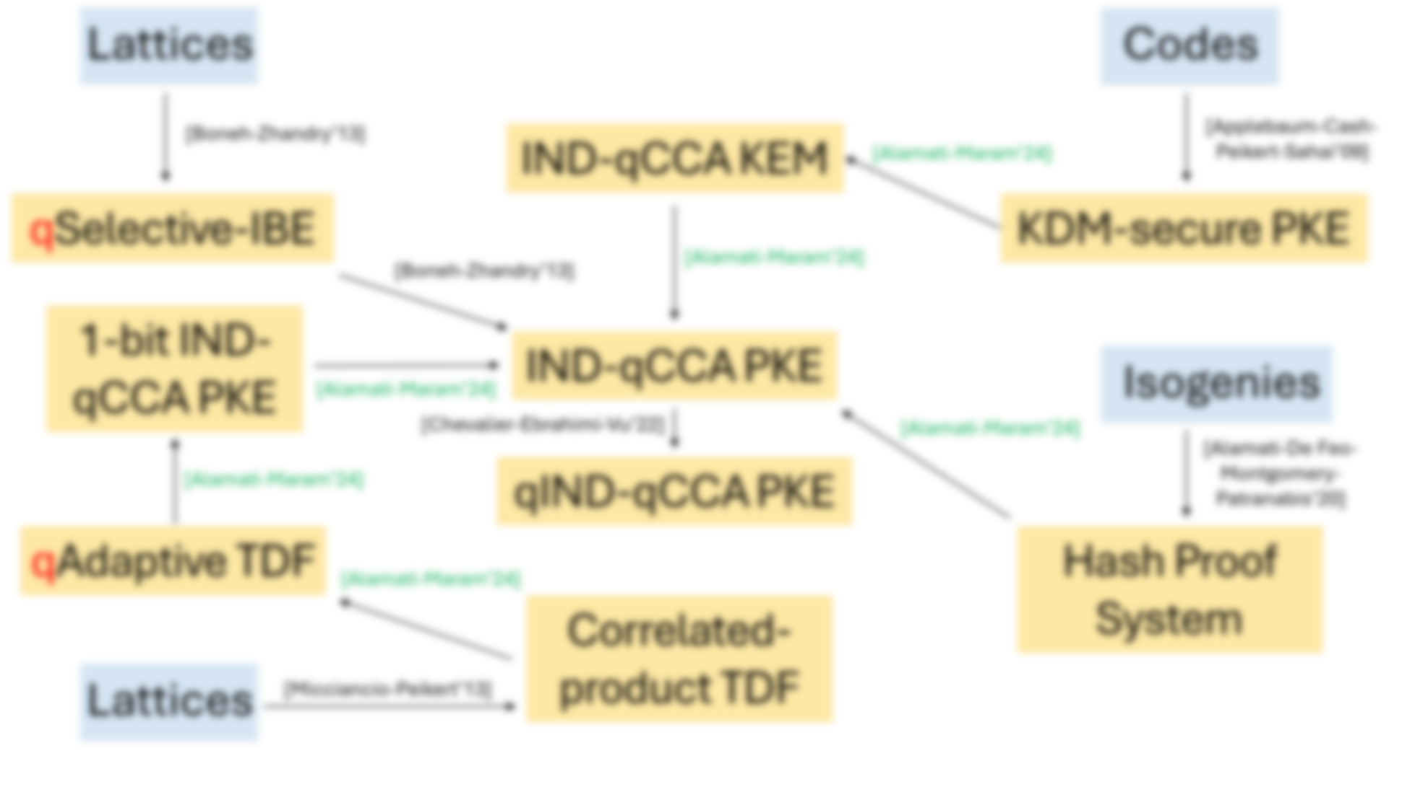
Overview: Results
All our analyzed PKE constructions are classical.
They can be implemented on classical computers.
As opposed to quantum PKE schemes (e.g., in [Barooti-Grilo-Huguenin(-)Dumittan-Malavolta-Sattath-Vu-Walter’23]) which need inherent quantum components, such as quantum public keys.
Notes:
But one very important thing that I’d like to stress here is that, even though we are considering different quantum security notions, all our analyzed constructions shown in the overview are *classical*.

Slide 61
Overview: Results
All our analyzed PKE constructions are classical.
They can be implemented on classical computers.
As opposed to quantum PKE schemes (e.g., in [Barooti-Grilo-Huguenin(-)Dumittan-Malavolta-Sattath-Vu-Walter’23]) which need inherent quantum components, such as quantum public keys.
Notes:
By that, I mean that all these constructions can implemented on classical devices, even now. The motivation here is that when (large scale) quantum computing becomes reality/mainstream, and when these classical PKE constructions are eventually ported to a quantum device, then we can still be sure of their confidentiality guarantees even when Eve gets quantum decryption access to such devices.

Slide 62
Overview: Results
All our analyzed PKE constructions are classical.
They can be implemented on classical computers.
As opposed to quantum PKE schemes (e.g., in [Barooti-Grilo-Huguenin(-)Dumittan-Malavolta-Sattath-Vu-Walter’23]) which need inherent quantum components, such as quantum public keys.
Notes:
And these classical PKE constructions need to be contrasted with some recent quantum PKE constructions introduced in the literature which inherently require quantum machinery. E.g., a recent construction of Barooti et al. require quantum public keys which is (just) not feasible with our current technology.

Slide 63
Overview: Techniques
[Kitagawa-Matsuda-Tanaka’19]
KDM-secure PKE
IND-CCA PKE
$$\overline{Dec}(.)$$
$$Dec({sk}_{Bob}, .)$$
$$≈$$
$$≈$$
$$c′$$
$$m′$$
$$c′$$
$$m′$$
$$c′$$
$$m′$$
Breaks
IND-CCA!
Breaks
IND-CCA!
Breaks
IND-CCA!
Notes:
Finally, in the last part of my talk, I’ll give an overview of the techniques we used in our qCCA security analysis. I’ll take the example of our KDM-based result. Let’s first focus on the *plain* CCA-security analysis of Kitagawa et al.’s PKE construction from a KDM-secure PKE scheme.

Slide 64
Overview: Techniques
[Kitagawa-Matsuda-Tanaka’19]
KDM-secure PKE
IND-CCA PKE
Breaks KDM-security!
$$\overline{Dec}(.)$$
$$Dec({sk}_{Bob}, .)$$
$$≈$$
$$≈$$
$$c′$$
$$m′$$
$$c′$$
$$m′$$
$$c′$$
$$m′$$
Breaks
IND-CCA!
Breaks
IND-CCA!
Breaks
IND-CCA!
Notes:
In such an analysis, we want to show that if there exists an adversary, say Eve, who can break IND-CCA security of the constructed PKE scheme, then there also exists an adversary, say Charlie shown in red, who breaks KDM security of the underlying / starting PKE – this is essentially what we call a reduction. So in a formal proof, we start with Eve interacting with the decryption oracle classically in the IND-CCA security game w.r.t. the final / constructed PKE.

Slide 65
Overview: Techniques
[Kitagawa-Matsuda-Tanaka’19]
KDM-secure PKE
IND-CCA PKE
Breaks KDM-security!
$$\overline{Dec}(.)$$
$$Dec({sk}_{Bob}, .)$$
$$≈$$
$$≈$$
$$c′$$
$$m′$$
$$c′$$
$$m′$$
$$c′$$
$$m′$$
Breaks
IND-CCA!
Breaks
IND-CCA!
Breaks
IND-CCA!
Notes:
Then in the IND-CCA game, we replace the original decryption oracle with an indistinguishable oracle, Dec hat, (from the point of view of Eve) wherein the modified oracle no longer uses the secret key to respond to Eve’s decryption queries.

Slide 66
Overview: Techniques
[Kitagawa-Matsuda-Tanaka’19]
KDM-secure PKE
IND-CCA PKE
Breaks KDM-security!
$$\overline{Dec}(.)$$
$$Dec({sk}_{Bob}, .)$$
$$≈$$
$$≈$$
$$c′$$
$$m′$$
$$c′$$
$$m′$$
$$c′$$
$$m′$$
Breaks
IND-CCA!
Breaks
IND-CCA!
Breaks
IND-CCA!
Notes:
Finally, we show how Charlie can break KDM security of the starting / underlying PKE scheme by simulating the Dec hat oracle towards Eve. Note that Charlie can simulate the Dec hat oracle because the oracle no longer uses the secret key for Eve’s decryption queries. And this replacement step is important because Charlie doesn’t have access to related secret key information in the KDM security game.

Slide 67
Overview: Techniques
KDM-secure PKE
[Our Work]
IND-qCCA PKE
Breaks KDM-security!
$$\overline{Dec}(.)$$
$$Dec({sk}_{Bob}, .)$$
$$≈$$
$$≈$$
$$\left.\left.α\left|c′\right.\right\rangle +β\left|c′′\right.\right\rangle$$
$$α\left.\left.\left|m′\right.\right\rangle +β\left|m′′\right.\right\rangle$$
$$\left.\left.α\left|c′\right.\right\rangle +β\left|c′′\right.\right\rangle$$
$$α\left.\left.\left|m′\right.\right\rangle +β\left|m′′\right.\right\rangle$$
$$\left.\left.α\left|c′\right.\right\rangle +β\left|c′′\right.\right\rangle$$
$$α\left.\left.\left|m′\right.\right\rangle +β\left|m′′\right.\right\rangle$$
Breaks
IND-qCCA!
Breaks
IND-qCCA!
Breaks
IND-qCCA!
Notes:
When it comes to our work, we show how to extend this (plain) CCA security reduction to the quantum qCCA setting. At a high-level, the reduction strategy stays the same as before. But now, Eve has quantum access to the decryption oracles in each “(game-)hybrid”. And this brings about its own / some challenges. For example, when we replace the original decryption oracle to a new oracle Dec hat which doesn’t use the secret key – so that it can be simulated by Charlie – in the end, how can we now argue about indistinguishability from the PoV of Eve when Eve now has quantum access to the oracles?

Slide 68
Overview: Techniques
Showed using the generalized OW2H lemma of [Ambainis-Hamburg-Unruh’19].
KDM-secure PKE
[Our Work]
IND-qCCA PKE
Breaks KDM-security!
$$\overline{Dec}(.)$$
$$Dec({sk}_{Bob}, .)$$
$$≈$$
$$≈$$
$$\left.\left.α\left|c′\right.\right\rangle +β\left|c′′\right.\right\rangle$$
$$α\left.\left.\left|m′\right.\right\rangle +β\left|m′′\right.\right\rangle$$
$$\left.\left.α\left|c′\right.\right\rangle +β\left|c′′\right.\right\rangle$$
$$α\left.\left.\left|m′\right.\right\rangle +β\left|m′′\right.\right\rangle$$
$$\left.\left.α\left|c′\right.\right\rangle +β\left|c′′\right.\right\rangle$$
$$α\left.\left.\left|m′\right.\right\rangle +β\left|m′′\right.\right\rangle$$
Breaks
IND-qCCA!
Breaks
IND-qCCA!
Breaks
IND-qCCA!
Notes:
To show indistinguishability of these quantum oracles, when use the so-called generalized OW2H lemma of Ambainis et al. - a popular QROM proof technique – in a (completely) new setting.

Slide 69
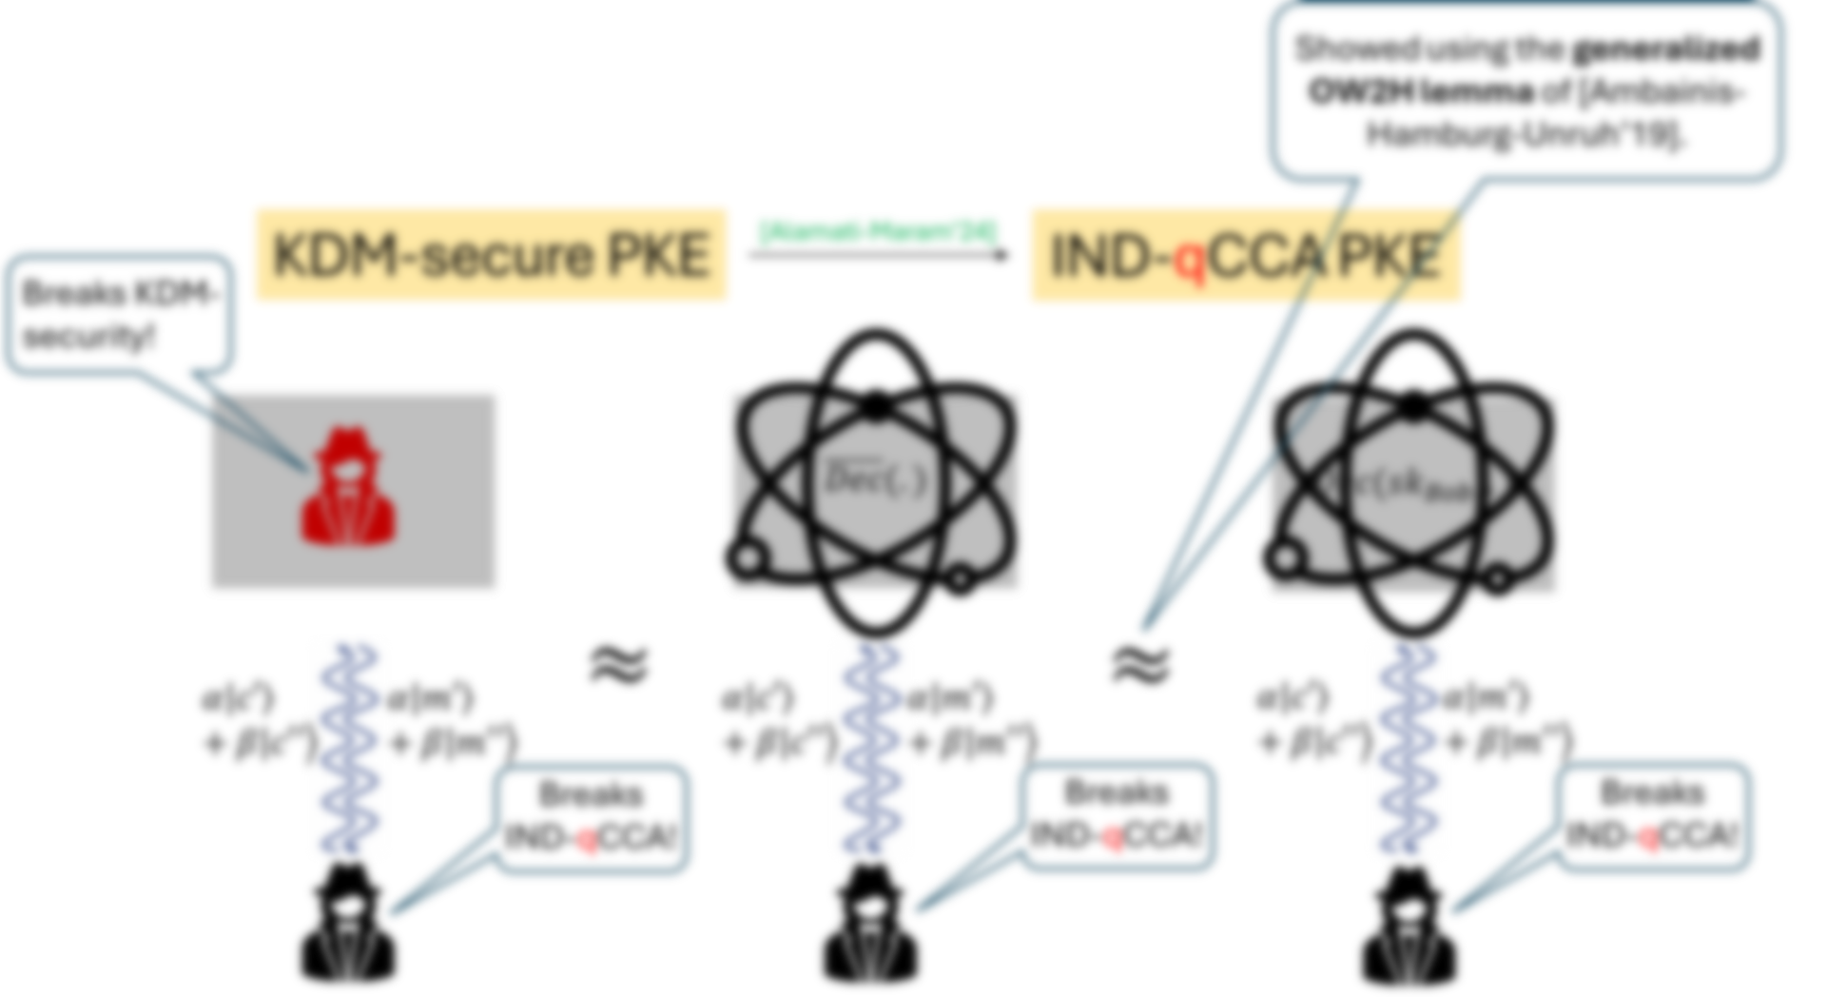
Overview: Techniques
The original “One-Way To Hiding” (OW2H) lemma of [Unruh’14] was used to argue indistinguishability of quantum (uniformly) random oracles.
The lemma was later generalized by [Ambainis-Hamburg-Unruh’19] to handle quantum oracles with arbitrary output distributions.
Our work involves the first application of the (generalized) OW2H lemma w.r.t. qCCA decryption oracles in the standard model – as opposed to the QROM.
Notes:
To give a brief history of the OW2H lemma, the original version of the lemma was introduced by Unruh to argue about indistinguishability of random oracles – which model hash functions – in a quantum setting. Specifically in such a setting, the random oracles in question have a uniform output distribution.

Slide 70
Overview: Techniques
The original “One-Way To Hiding” (OW2H) lemma of [Unruh’14] was used to argue indistinguishability of quantum (uniformly) random oracles.
The lemma was later generalized by [Ambainis-Hamburg-Unruh’19] to handle quantum oracles with arbitrary output distributions.
Our work involves the first application of the (generalized) OW2H lemma w.r.t. qCCA decryption oracles in the standard model – as opposed to the QROM.
Notes:
Later on, the lemma was generalized by Ambainis et al. to handle quantum oracles with arbitrary output distributions. However in their work and in subsequent works, to the best of our knowledge, the lemma was still mostly restricted to the QROM setting.

Slide 71
Overview: Techniques
The original “One-Way To Hiding” (OW2H) lemma of [Unruh’14] was used to argue indistinguishability of quantum (uniformly) random oracles.
The lemma was later generalized by [Ambainis-Hamburg-Unruh’19] to handle quantum oracles with arbitrary output distributions.
Our work involves the first application of the generalized OW2H lemma w.r.t. qCCA decryption oracles in the standard model – as opposed to the QROM.
Notes:
So another technical contribution of our work is finding a novel application for the OW2H lemma in the standard model (and not the QROM) – the application being to establish quantum CCA security of different (standard model) PKE constructions. In this setting, we applied OW2H lemma w.r.t. quantum oracles with more advanced functionalities (beyond simple hashing) – namely, decryption oracles.

Slide 72
Overview: Techniques
Showed using the generalized OW2H lemma of [Ambainis-Hamburg-Unruh’19].
KDM-secure PKE
[Our Work]
IND-qCCA PKE
Breaks KDM-security!
$$\overline{Dec}(.)$$
$$Dec({sk}_{Bob}, .)$$
$$≈$$
$$≈$$
$$\left.\left.α\left|c′\right.\right\rangle +β\left|c′′\right.\right\rangle$$
$$α\left.\left.\left|m′\right.\right\rangle +β\left|m′′\right.\right\rangle$$
$$\left.\left.α\left|c′\right.\right\rangle +β\left|c′′\right.\right\rangle$$
$$α\left.\left.\left|m′\right.\right\rangle +β\left|m′′\right.\right\rangle$$
$$\left.\left.α\left|c′\right.\right\rangle +β\left|c′′\right.\right\rangle$$
$$α\left.\left.\left|m′\right.\right\rangle +β\left|m′′\right.\right\rangle$$
Breaks
IND-qCCA!
Breaks
IND-qCCA!
Breaks
IND-qCCA!
Notes:
However, this doesn’t mean that we can simply use the generalized OW2H lemma when showing oracle indistinguishability in the plain CCA security reduction to obtain a new security proof in the quantum qCCA setting.

Slide 73
Overview: Techniques
IND-qCCA KEM
[Our Work]
qSelective-IBE
KDM-secure PKE
[Boneh-Zhandry’13]
[Our Work]
1-bit IND-qCCA PKE
IND-qCCA PKE
[Our Work]
[Chevalier-Ebrahimi-Vu’22]
[Our Work]
[Our Work]
qIND-qCCA PKE
qAdaptive TDF
Hash Proof System
[Our Work]
Correlated-product TDF
Notes:
For example,…

Slide 74
Overview: Techniques
Required a “nested” application of the generalized OW2H lemma.
[Our Work]
[Our Work]
1-bit IND-qCCA PKE
IND-qCCA PKE
[Our Work]
[Our Work]
[Our Work]
[Our Work]
[Our Work]
Notes:
,… when we showed completeness of bit encryption in the quantum qCCA setting, we had to use the generalized OW2H lemma in a “nested” manner – i.e., applying the lemma on 2 levels (– and this had to be done in a careful manner). More detail can be found in our paper.

Slide 75
Conclusion
Notes:
To conclude,…

Slide 76
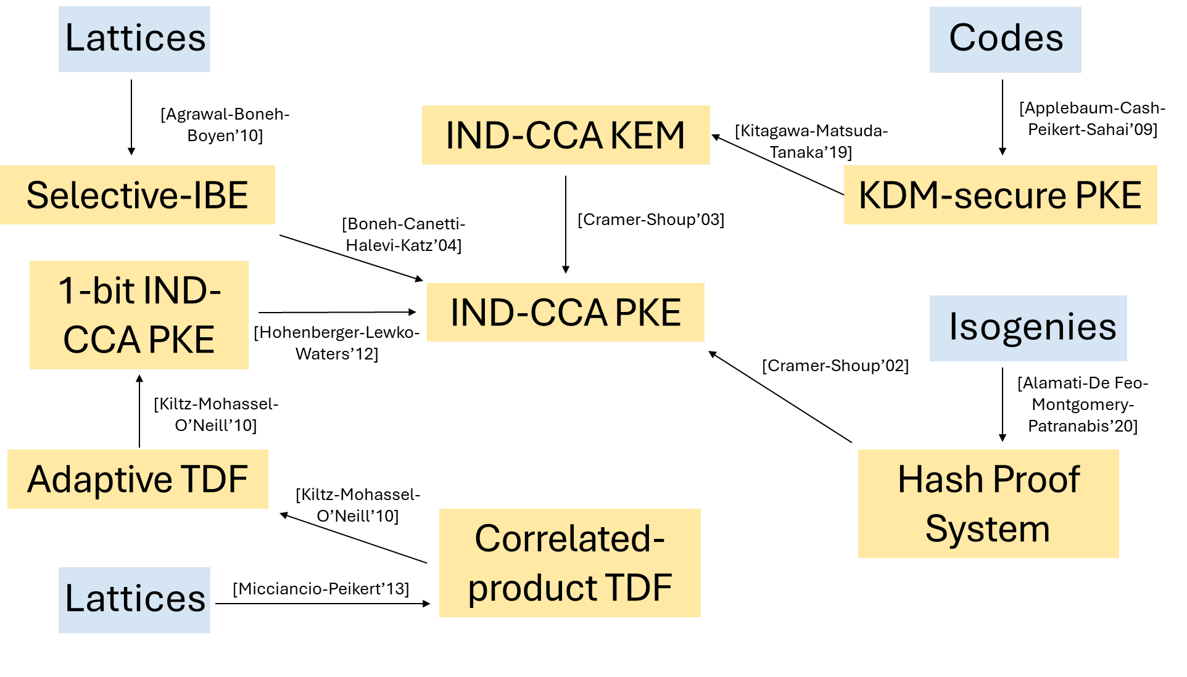
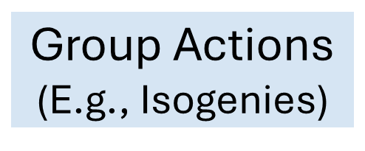
Conclusion
IND-CCA PKE
Notes:
…, as I mentioned before, plain IND-CCA secure PKE is a very well-studied primitive in the post-quantum setting. Namely, there are numerous constructions of such schemes in the literature from various generic (cryptographic) primitives and concrete post-quantum hardness assumptions. I only show some on this slide (and I didn’t show everything otherwise the slide would’ve been a mess).

Slide 77
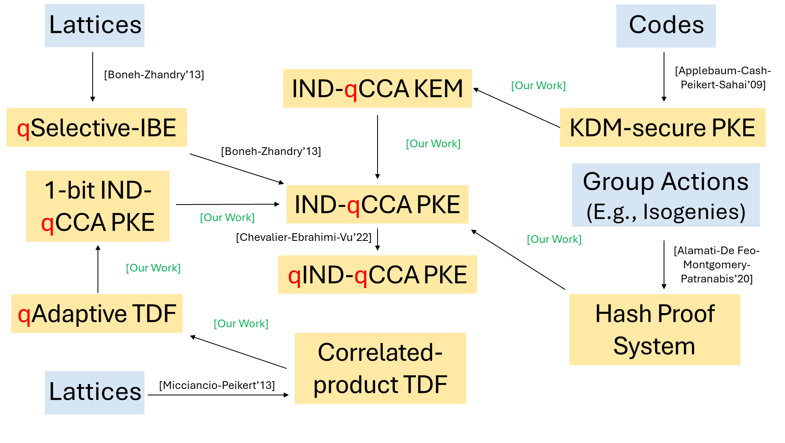
Conclusion
IND-CCA PKE
IND-qCCA PKE
Notes:
In our work, we tried to do something similar but for the quantum CCA secure PKE primitive. That is, we comprehensively studied qCCA secure PKE and in the process, obtained new constructions of this quantum secure scheme from different generic primitives and post-quantum assumptions.

Slide 78
Conclusion
IND-CCA PKE
IND-qCCA PKE
??
Notes:
I’ll end my talk with an open question. Can we construct qCCA secure PKE generically from any ”plain” CCA secure PKE? As we can see on this slide, most generic primitives which imply CCA-secure PKE like hash proof system, KDM-secure PKE, correlated product TDF etc. also imply qCCA secure PKE (as shown in our work). So it looks like maybe CCA-secure PKE primitive and qCCA-secure PKE primitive are equivalent from a foundational / theoretical perspective. Or maybe they’re not equivalent. That would probably explain why we inherently need a quantum selective IBE to build qCCA secure PKE, as shown by Boneh and Zhandry, and a plain selective IBE just wouldn’t suffice. So showing such a generic separation between the CCA secure PKE primitive and qCCA secure PKE primitive would also be a pretty cool result.
With this, I end my talk. Thanks for your attention, and I’m happy to take any questions!

