Slide 1

Strongly Multiplicative Secret Sharing Schemes with Repairing Ability
Daniel Escudero, Ivan Tjuawinata and Chaoping Xing

Slide 2
Overview
Introduction
Naïve Solution Properties and Aim of Proposed Solution
Proposed Construction and its Properties

Slide 3
Overview
Introduction
Naïve Solution Properties and Aim of Proposed Solution
Proposed Construction and its Properties

Slide 4
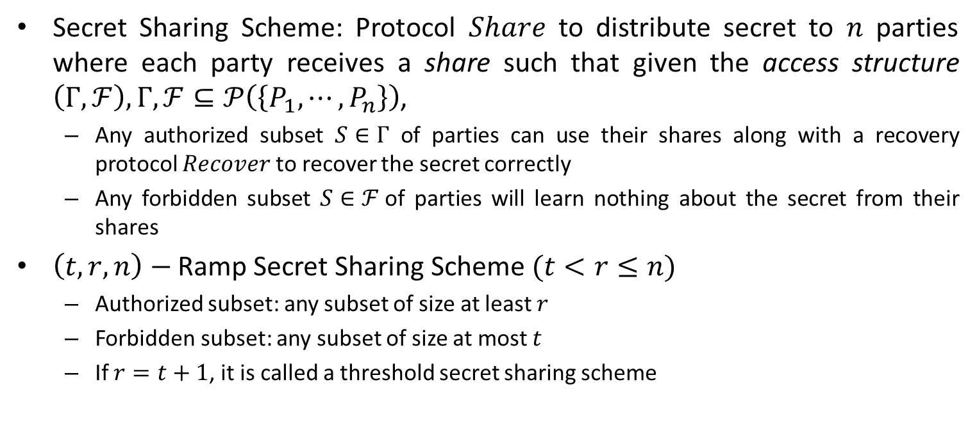
Ramp Secret Sharing Scheme
Secret Sharing Scheme: Protocol $Share$ to distribute secret to $n$ parties where each party receives a share such that given the access structure $\left(Γ,ℱ\right),Γ,ℱ⊆𝒫\left(\left\{P_{1},⋯, P_{n}\right\}\right)$,
  Any authorized subset $S∈Γ$ of parties can use their shares along with a recovery protocol $Recover$ to recover the secret correctly
  Any forbidden subset $S∈ℱ$of parties will learn nothing about the secret from their shares
$\left(t,r,n\right)−$ Ramp Secret Sharing Scheme $(t<r≤n)$
  Authorized subset: any subset of size at least $r$
  Forbidden subset: any subset of size at most $t$
  If $r=t+1$, it is called a threshold secret sharing scheme

Slide 5
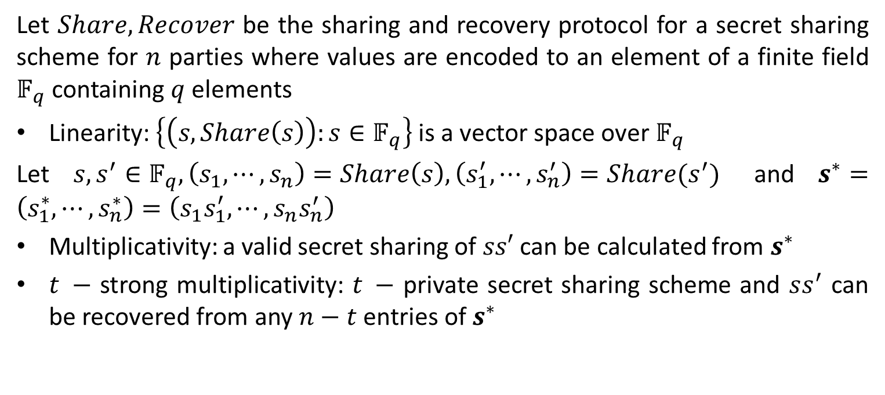
Linearity, Multiplicative, Strong Multiplicative
Let $Share,Recover$ be the sharing and recovery protocol for a secret sharing scheme for $n$ parties where values are encoded to an element of a finite field $𝔽_{q}$ containing $q$ elements
Linearity: $\left\{\left(s,Share\left(s\right)\right):s∈𝔽_{q}\right\}$ is a vector space over $𝔽_{q}$
Let $s,s^{′}∈𝔽_{q},\left(s_{1},⋯,s_{n}\right)=Share\left(s\right),\left(s_{1}^{′},⋯,s_{n}^{′}\right)=Share(s^{′})$ and $s^{∗}=\left(s_{1}^{∗},⋯, s_{n}^{∗}\right)=\left(s_{1}s_{1}^{′},⋯,s_{n}s_{n}^{′}\right)$
Multiplicativity: a valid secret sharing of $ss′$ can be calculated from $s^{∗}$
$t −$ strong multiplicativity: $t −$ private secret sharing scheme and $ss^{′}$ can be recovered from any $n−t$ entries of $s^{∗}$

Slide 6
Multiparty Computation (MPC) Scheme
Allows a set of mutually distrustful parties to securely compute a public function on private data
Common design technique is to have private data secretly shared
Computed function processed as a circuit consisting of addition and multiplication operations
  Schemes process each operation with the invariance that it has the inputs to be secretly shared and the output of the operation is also secretly shared
Properties of secret sharing scheme enable calculation of the secretly shared values
  Linearity allows addition as well as public constant multiplication to be done locally without further interaction between parties
  (Strong) Multiplicativity allows the calculation of multiplication of two shared values in different adversarial setting

Slide 7
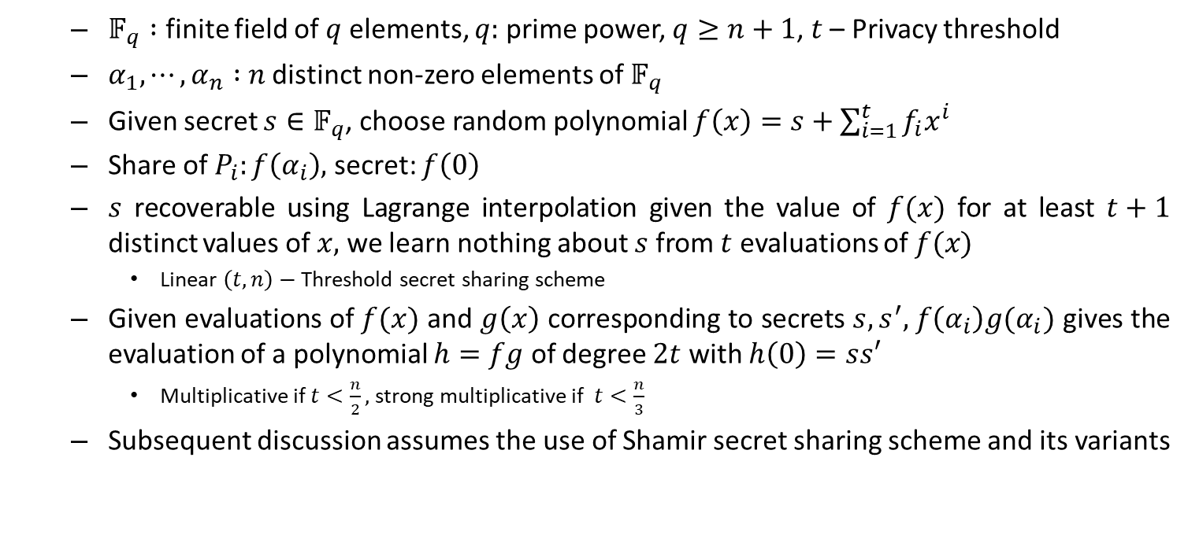
Shamir Secret Sharing Scheme
  $𝔽_{q} :$ finite field of $q$ elements, $q:$ prime power, $q≥n+1$, $t$ – Privacy threshold
  $α_{1},⋯, α_{n} :$ $n$ distinct non-zero elements of $𝔽_{q}$
  Given secret $s∈𝔽_{q}$, choose random polynomial $f\left(x\right)=s+\sum_{i=1}^{t}{f_{i}x^{i}}$
  Share of $P_{i}:f\left(α_{i}\right),$ secret: $f\left(0\right)$
  $s$ recoverable using Lagrange interpolation given the value of $f(x)$ for at least $t+1$ distinct values of $x,$ we learn nothing about $s$ from $t$ evaluations of $f(x)$
    Linear $\left(t,n\right)−$ Threshold secret sharing scheme
  Given evaluations of $f(x)$ and $g\left(x\right)$ corresponding to secrets $s,s^{′},$ $f\left(α_{i}\right)g(α_{i})$ gives the evaluation of a polynomial $h=fg$ of degree $2t$ with $h\left(0\right)=ss′$
    Multiplicative if $t<\frac{n}{2},$ strong multiplicative if $t<\frac{n}{3}$
  Subsequent discussion assumes the use of Shamir secret sharing scheme and its variants

Slide 8
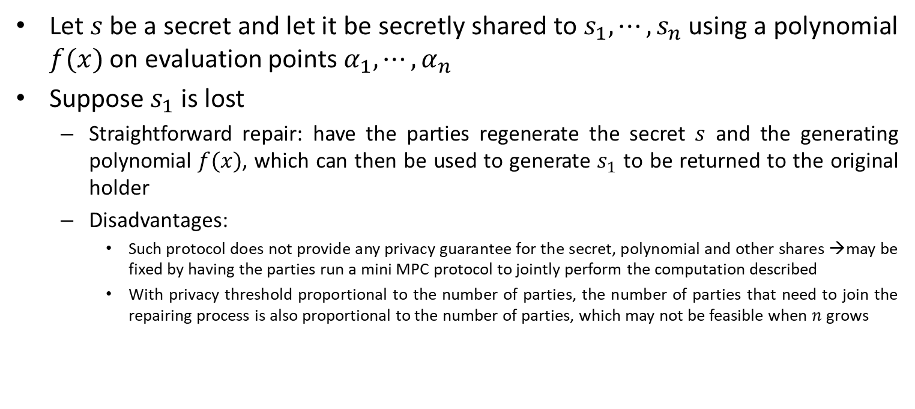
Repairing Shares
Let $s$ be a secret and let it be secretly shared to $s_{1},⋯,s_{n}$ using a polynomial $f(x)$ on evaluation points $α_{1},⋯, α_{n}$
Suppose $s_{1}$ is lost
  Straightforward repair: have the parties regenerate the secret $s$ and the generating polynomial $f(x)$, which can then be used to generate $s_{1}$ to be returned to the original holder
  Disadvantages:
    Such protocol does not provide any privacy guarantee for the secret, polynomial and other shares →may be fixed by having the parties run a mini MPC protocol to jointly perform the computation described
    With privacy threshold proportional to the number of parties, the number of parties that need to join the repairing process is also proportional to the number of parties, which may not be feasible when $n$ grows

Slide 9
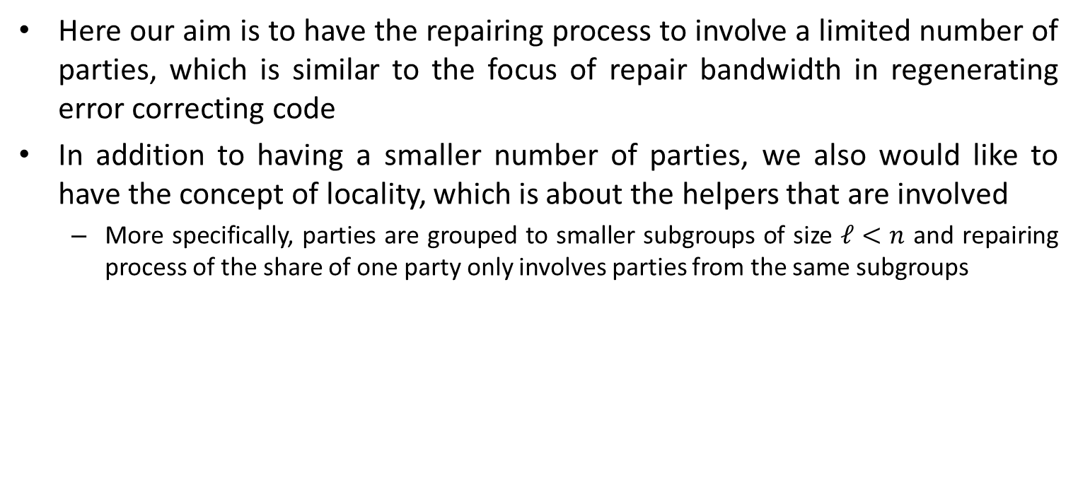
Locality
Here our aim is to have the repairing process to involve a limited number of parties, which is similar to the focus of repair bandwidth in regenerating error correcting code
In addition to having a smaller number of parties, we also would like to have the concept of locality, which is about the helpers that are involved
  More specifically, parties are grouped to smaller subgroups of size $ℓ<n$ and repairing process of the share of one party only involves parties from the same subgroups

Slide 10
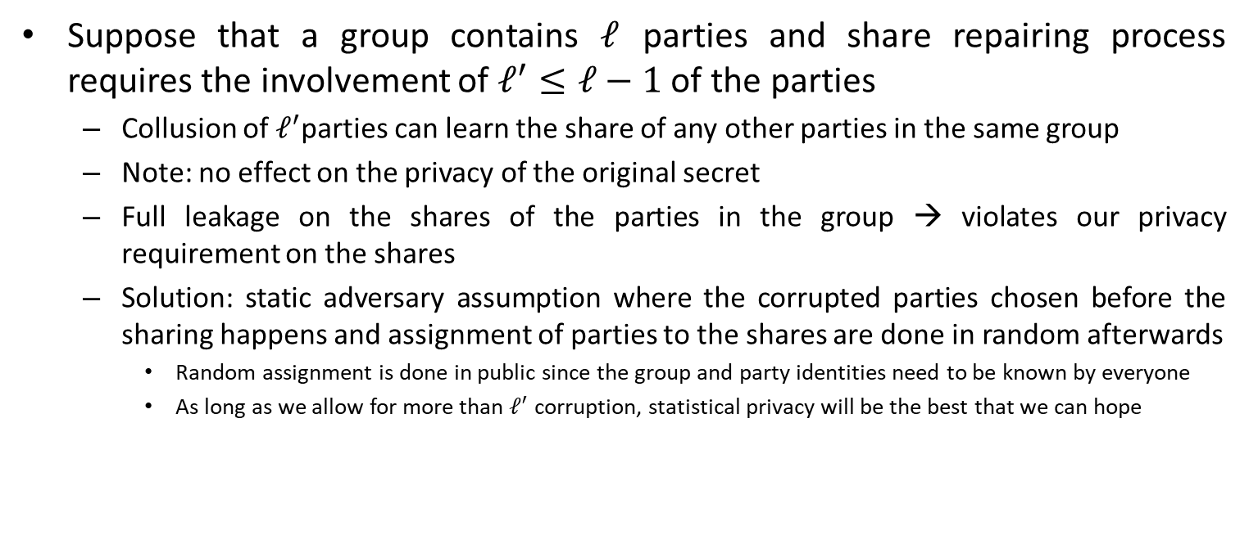
Discussions
Suppose that a group contains $ℓ$ parties and share repairing process requires the involvement of $ℓ^{′}≤ℓ−1$ of the parties
  Collusion of $ℓ^{′}$parties can learn the share of any other parties in the same group
  Note: no effect on the privacy of the original secret
  Full leakage on the shares of the parties in the group → violates our privacy requirement on the shares
  Solution: static adversary assumption where the corrupted parties chosen before the sharing happens and assignment of parties to the shares are done in random afterwards
    Random assignment is done in public since the group and party identities need to be known by everyone
    As long as we allow for more than $ℓ^{′}$ corruption, statistical privacy will be the best that we can hope

Slide 11
Natural Questions
Can we design a variant of Shamir secret sharing scheme that comes with a share repairing scheme that only involves a smaller amount of parties → locality of repair?
Can such repairing scheme be designed with security guarantee to the secret, share generating polynomial and any other shares?
To ensure that the secret sharing scheme still usable in the application of MPC, can the secret sharing scheme still have the (strong) multiplicative property?

Slide 12
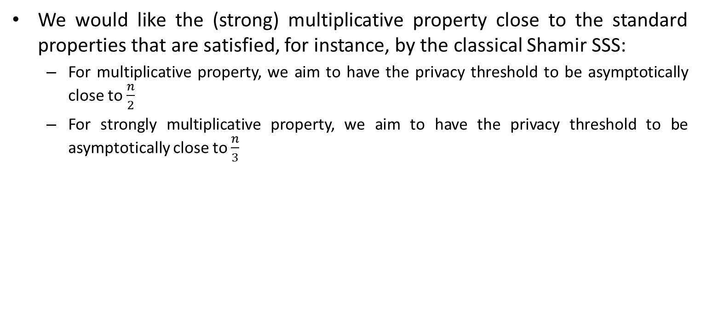
Discussions
We would like the (strong) multiplicative property close to the standard properties that are satisfied, for instance, by the classical Shamir SSS:
  For multiplicative property, we aim to have the privacy threshold to be asymptotically close to $\frac{n}{2}$
  For strongly multiplicative property, we aim to have the privacy threshold to be asymptotically close to $\frac{n}{3}$

Slide 13
Existing Results
Repairable error-correcting code
  Well explored, especially in its relationship with distributed storage system
  Works focus more on the repair bandwidth as well as the number of contacted nodes and due to its application, the problems of security and multiplicativity are not considered
Secret sharing scheme
  There have been numerous works on repairable secret sharing scheme as well as multiplicative secret sharing scheme
  However, works on multiplicative secret sharing scheme have not considered the problem of secure local repair while existing local repairable secret sharing schemes are in general not multiplicative and only provides secret privacy against passive adversary

Slide 14
Overview
Introduction
Naïve Solution Properties and Aim of Proposed Solution
Proposed Construction and its Properties

Slide 15
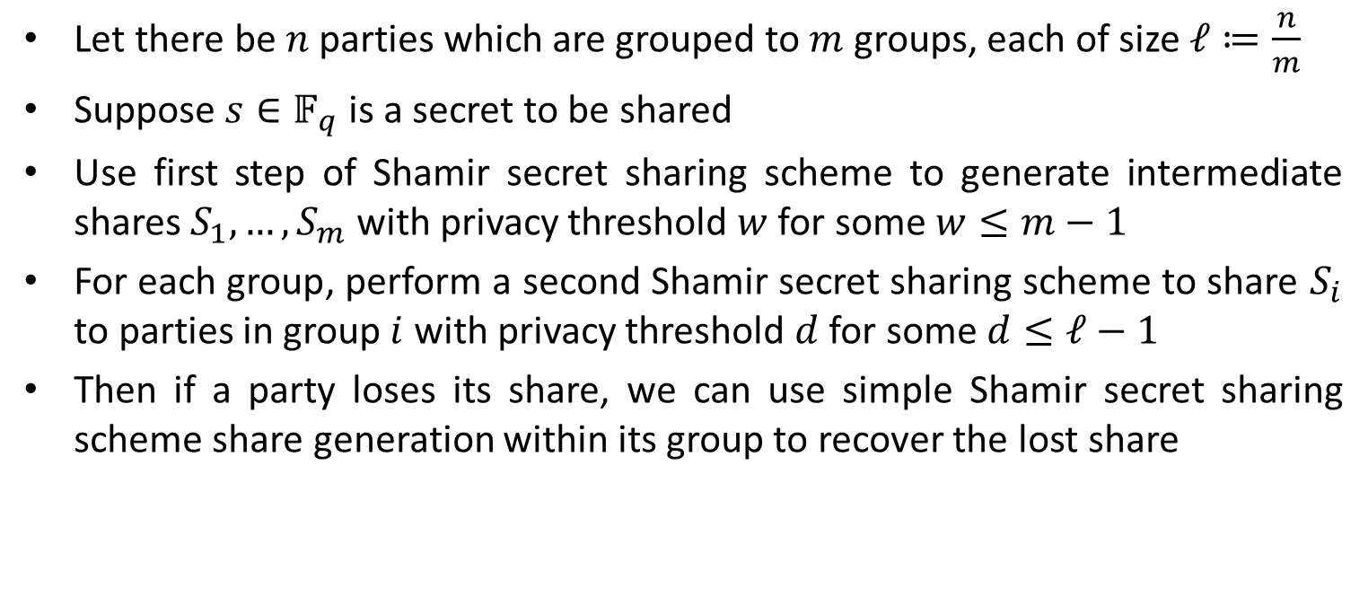
Naïve Solution through Two-Steps Shamir SSS
Let there be $n$ parties which are grouped to $m$ groups, each of size $ℓ≔\frac{n}{m}$
Suppose $s∈𝔽_{q}$ is a secret to be shared
Use first step of Shamir secret sharing scheme to generate intermediate shares $S_{1},…,S_{m}$ with privacy threshold $w$ for some $w≤m−1$
For each group, perform a second Shamir secret sharing scheme to share $S_{i}$ to parties in group $i$ with privacy threshold $d$ for some $d≤ℓ−1$
Then if a party loses its share, we can use simple Shamir secret sharing scheme share generation within its group to recover the lost share

Slide 16
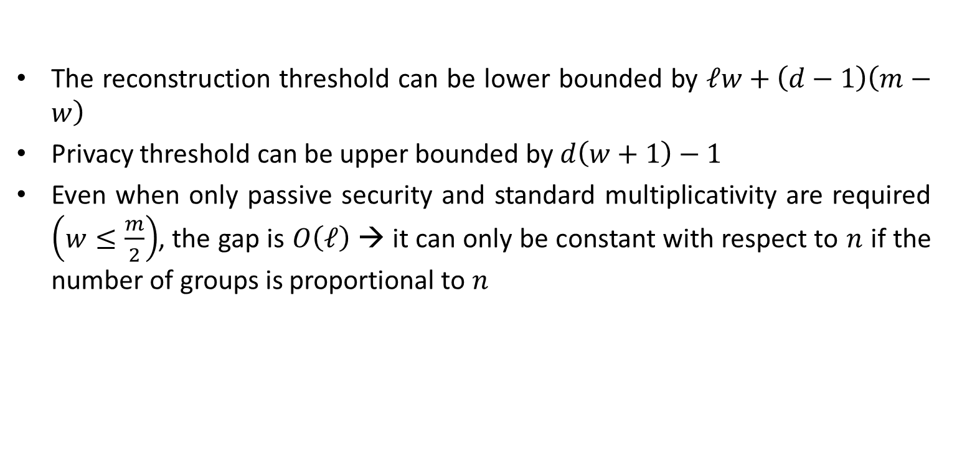
Naïve Solution Property
The reconstruction threshold can be lower bounded by $ℓw+\left(d−1\right)\left(m−w\right)$
Privacy threshold can be upper bounded by $d\left(w+1\right)−1$
Even when only passive security and standard multiplicativity are required $\left(w≤\frac{m}{2}\right)$, the gap is $O\left(ℓ\right)$ → it can only be constant with respect to $n$ if the number of groups is proportional to $n$

Slide 17
Property of Naïve Solution
Relation between parties either inside and outside the group is not well established, making the guarantee to be weaker to accommodate the scenario with weak relations between them
This leads to the gap between reconstruction and privacy threshold to be relatively bigger
  This implies that we may have less choice in setting the parameters and threshold since a wrongly set of parameters may cause the reconstruction threshold to be prohibitively high or the privacy threshold to be prohibitively low
With more careful choice of evaluation points, we hope that we may reduce the gap between reconstruction and privacy threshold

Slide 18
Overview
Introduction
Naïve Solution Properties and Aim of Proposed Solution
Proposed Construction and its Properties

Slide 19
Reference Paper in Consideration
I. Tamo and A. Barg. A Family of Optimal Locally Recoverable Codes. In IEEE Transactions on Information Theory, 60(8):4661-4676, 2014.

Slide 20
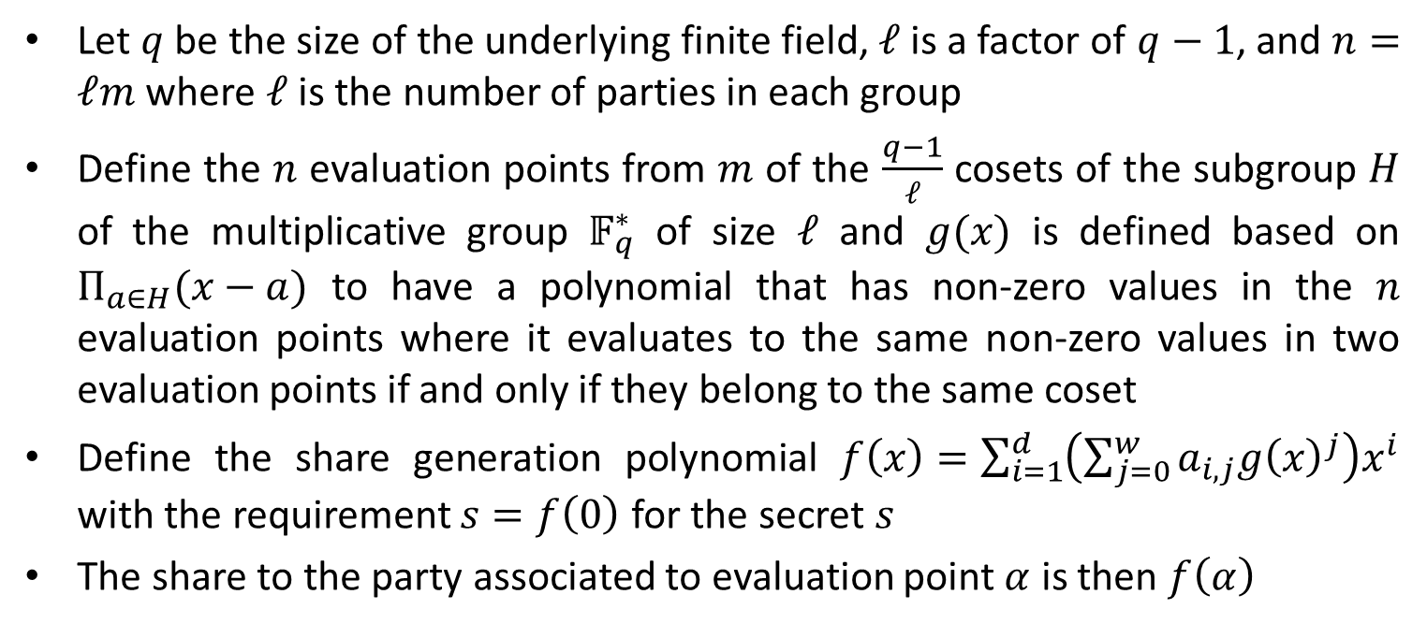
Proposed Construction
Let $q$ be the size of the underlying finite field, $ℓ$ is a factor of $q−1$, and $n=ℓm$ where $ℓ$ is the number of parties in each group
Define the $n$ evaluation points from $m$ of the $\frac{q−1}{ℓ}$ cosets of the subgroup $H$ of the multiplicative group $𝔽_{q}^{∗}$ of size $ℓ$ and $g(x)$ is defined based on $Π_{a∈H}(x−a)$ to have a polynomial that has non-zero values in the $n$ evaluation points where it evaluates to the same non-zero values in two evaluation points if and only if they belong to the same coset
Define the share generation polynomial $f\left(x\right)=\sum_{i=1}^{d}{\left(\sum_{j=0}^{w}{a_{i,j}g{\left(x\right)}^{j}}\right)x^{i}}$ with the requirement $s=f\left(0\right)$ for the secret $s$
The share to the party associated to evaluation point $α$ is then $f\left(α\right)$

Slide 21

Proposed Construction – General Discussion
Can be seen as a special case of the naïve two-step Shamir SSS with carefully chosen evaluation points
With a more general choice of evaluation points, the degree of $g$, a polynomial that stays constant in each group, can be very high, causing the weaker guarantee for the reconstruction and privacy threshold

Slide 22
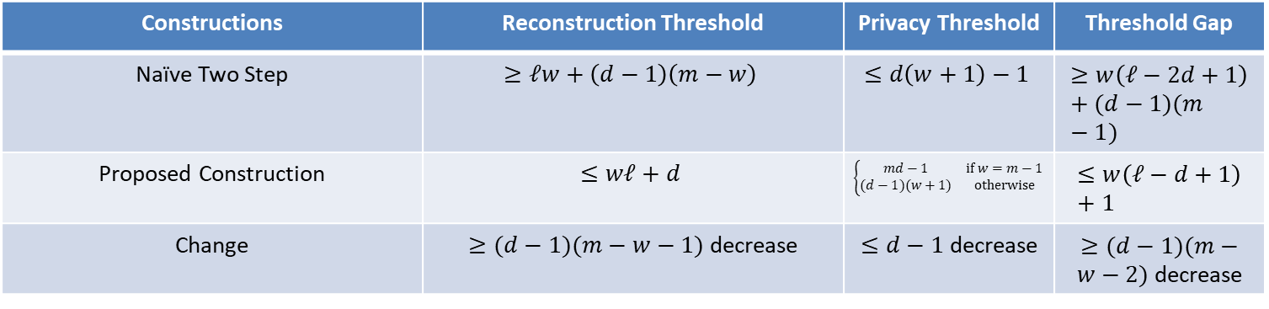
Proposed Construction – Thresholds
Constructions | Reconstruction Threshold | Privacy Threshold | Threshold Gap
Naïve Two Step | $$≥ℓw+\left(d−1\right)\left(m−w\right)$$ | $$≤d\left(w+1\right)−1$$ | $$≥w\left(ℓ−2d+1\right)+(d−1)(m−1)$$
Proposed Construction | $$≤wℓ+d$$ | $$\left\{\begin{matrix}md−1 & if w=m−1 \\ (d−1)(w+1) & otherwise\end{matrix}\right.$$ | $$≤w\left(ℓ−d+1\right)+1$$
Change | $≥(d−1)(m−w−1)$ decrease | $≤d−1$ decrease | $≥(d−1)(m−w−2)$ decrease
The change can be observed in any choice of parameters
The gap between the two thresholds are much smaller in the proposed construction
Fixing the reconstruction threshold, the proposed construction allows for a larger privacy threshold

Slide 23
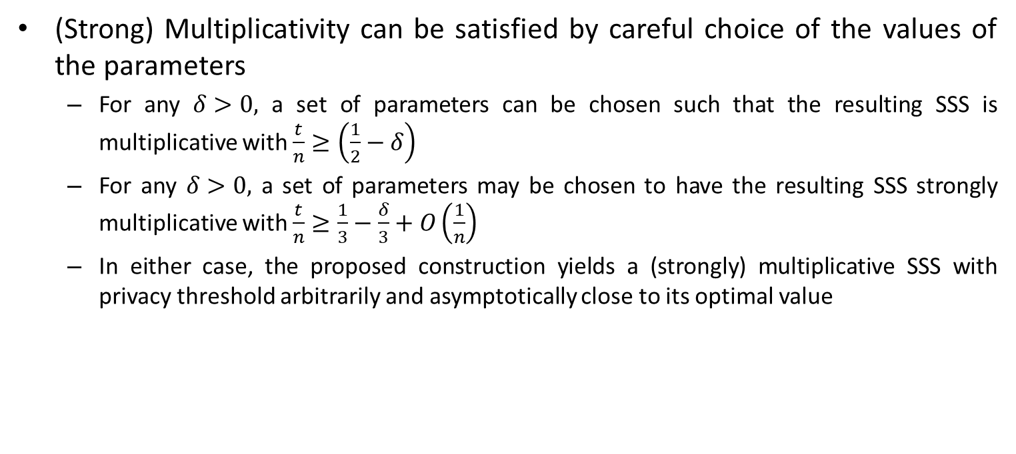
Proposed Construction – Multiplicativity
(Strong) Multiplicativity can be satisfied by careful choice of the values of the parameters
  For any $δ>0,$ a set of parameters can be chosen such that the resulting SSS is multiplicative with $\frac{t}{n}≥\left(\frac{1}{2}−δ\right)$
  For any $δ>0,$ a set of parameters may be chosen to have the resulting SSS strongly multiplicative with $\frac{t}{n}≥\frac{1}{3}−\frac{δ}{3}+O\left(\frac{1}{n}\right)$
  In either case, the proposed construction yields a (strongly) multiplicative SSS with privacy threshold arbitrarily and asymptotically close to its optimal value

Slide 24
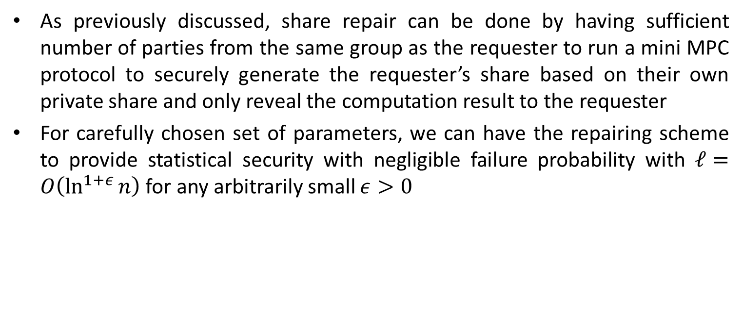
Proposed Construction – Repairing Scheme
As previously discussed, share repair can be done by having sufficient number of parties from the same group as the requester to run a mini MPC protocol to securely generate the requester’s share based on their own private share and only reveal the computation result to the requester
For carefully chosen set of parameters, we can have the repairing scheme to provide statistical security with negligible failure probability with $ℓ=O\left(\ln^{1+ε}{n}\right)$ for any arbitrarily small $ε>0$

Slide 25
Possible Future Research Direction – Application in MPC
Design of MPC protocol that allows for computing parties to be disconnected and/or lost their shares while rejoining the computation in the latter stage
Design of MPC protocols that allows new parties to join a secure computation
  Although our proposed construction may provide some initial steps in such an effort and improving its efficiency by requiring a smaller amount of shares to determine a share, a more careful analysis may be required to have an optimized design of such protocols
Removal of static-corruption assumption which is required in our work, as well as plenty different works on regenerating secret sharing scheme

Slide 26
THANK YOU

